Slide 1
Compiler Course Lab 7
CSE 440

Slide 2
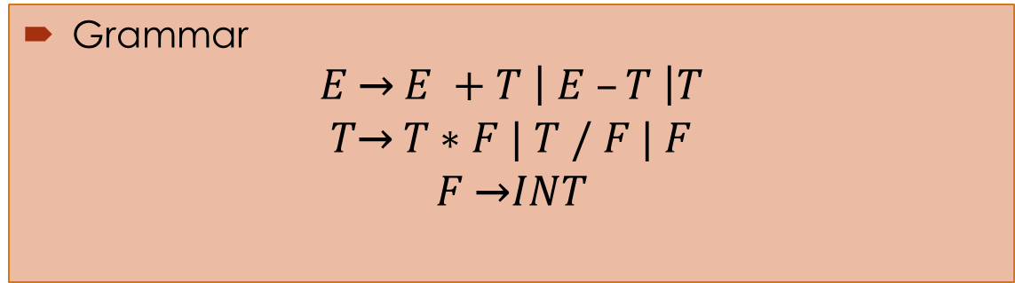
Task 1: Write a parser for the following grammar that it would print all production rules in a order that have used to parse the input.
Grammar
$$E \text{→} E +T \left| E –T \right|T$$
$$T\text{→} T∗F | T / F | F$$
$$F \text{→}INT$$
Lex Source File Name: Lex1.l
Lex Generated C File Name: Lex1.c
Yacc Source File Name: Yacc1.y
Yacc Generated C File Name: Yacc1.c
Parser Name: Parser1.exe

Slide 3
Task 2: Create a parser that will parse following grammar.
$$E \text{→} E + E | E – E | E ∗ E | E / E | INTEGER$$
Hint:
This grammar does not maintain precedence, but you have to enforce precedence using %left, %right, %nonassoc, or %precedence
INTEGER is terminal indicating all integer number as token
Use an augmented production to take multiple line input
Lex Source File Name: Lex1.l
Lex Generated C File Name: Lex1.c
Yacc Source File Name: Yacc1.y
Yacc Generated C File Name: Yacc1.c
Parser Name: Parser1.exe

Slide 4
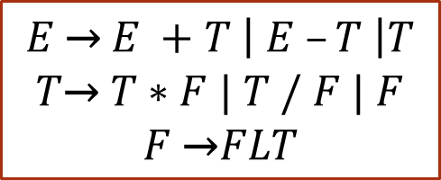
Task 3: Create a parser that will parse following grammar.
$$E \text{→} E +T \left| E –T \right|T$$
$$T\text{→} T∗F | T / F | F$$
$$F \text{→}FLT$$
Hint:
Bison normally uses the type int for semantic values if your program uses the same data type for all language constructs. To specify some other type, define YYSTYPE as a macro.
This grammar does maintain precedence, you don’t have to enforce precedence
FLT is terminal indicating all floating point number as token
Use an augmented production to take multiple line input
Lex Source File Name: Lex1.l
Lex Generated C File Name: Lex1.c
Yacc Source File Name: Yacc1.y
Yacc Generated C File Name: Yacc1.c
Parser Name: Parser1.exe

Slide 5
Task 3: Create a parser that will parse following grammar.
$$E \text{→} E +T \left| E –T \right|T$$
$$T\text{→} T∗F | T / F | F$$
$$F \text{→}FLT$$
Hint:
Use the %union declaration specifies the entire collection of possible data types for semantic values.
This grammar does maintain precedence, you don’t have to enforce precedence
FLT is terminal indicating all floating point number as token
Use an augmented production to take multiple line input
Lex Source File Name: Lex2.l
Lex Generated C File Name: Lex2.c
Yacc Source File Name: Yacc2.y
Yacc Generated C File Name: Yacc2.c
Parser Name: Parser2.exe

Slide 6
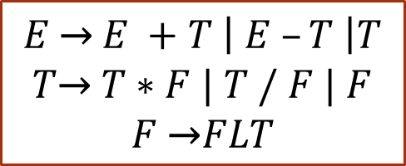
Task 3: Solution
$$E \text{→} E +T \left| E –T \right|T$$
$$T\text{→} T∗F | T / F | F$$
$$F \text{→}FLT$$
Parser:
Scanner:
%union { float flt; }
%token <flt> DOUBLE
%type <flt> E T F
yylval.flt = atof(yytext);

Slide 7
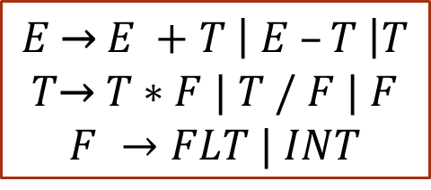
Task 3: Create a parser that will parse following grammar.
$$E \text{→} E +T \left| E –T \right|T$$
$$T\text{→} T∗F | T / F | F$$
$$F →FLT | INT$$
This grammar does maintain precedence, you don’t have to enforce precedence
FLT & INT is terminal indicating all floating point & integer number as token respectively
Use an augmented production to take multiple line input
Lex Source File Name: Lex3.l
Lex Generated C File Name: Lex3.c
Yacc Source File Name: Yacc3.y
Yacc Generated C File Name: Yacc3.c
Parser Name: Parser3.exe

Slide 8
Task 4: Create a parser that will evaluate postfix expression.
$$E \text{→} E + E | E – E | E ∗ E | E / E | FLT | INT$$
Hint:
Change this grammar so that it accepts postfix expression
FLT & INT is terminal indicating all floating point & integer number as token respectively
Use an augmented production to take multiple line input
Lex Source File Name: Lex1.l
Lex Generated C File Name: Lex1.c
Yacc Source File Name: Yacc1.y
Yacc Generated C File Name: Yacc1.c
Parser Name: Parser1.exe

