Slide 1
Compiler Course Lab 8
CSE 440

Slide 2
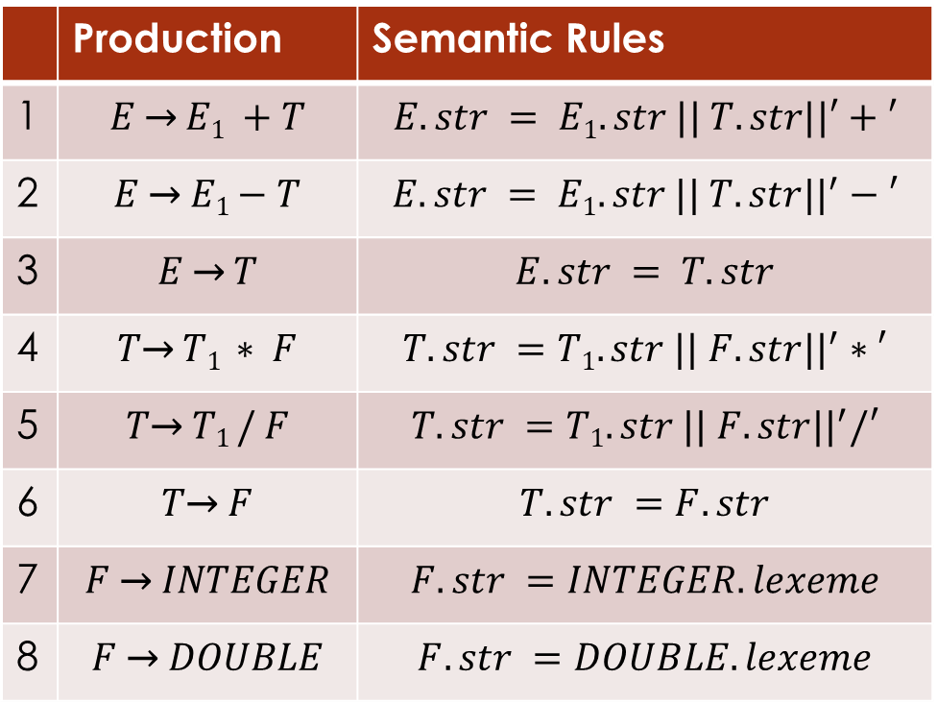
Task 1: Create a parser that will convert infix to postfix expression.
Hint: Use this following SDD
 | Production | Semantic Rules
1 | $$E \text{→} E1 +T$$ | $$E.str = E1.str || T.str||′+′$$
2 | $$E \text{→} E1−T$$ | $$E.str = E1.str || T.str||^{′}−′$$
3 | $$E \text{→} T$$ | $$E.str = T.str$$
4 | $$T\text{→} T1 ∗ F$$ | $$T.str =T1.str || F.str||^{′}∗′$$
5 | $$T\text{→} T1 / F$$ | $$T.str =T1.str || F.str||^{′}/′$$
6 | $$T\text{→} F$$ | $$T.str =F.str$$
7 | $$F \text{→} INTEGER$$ | $$F.str =INTEGER.lexeme$$
8 | $$F \text{→} DOUBLE$$ | $$F.str =DOUBLE.lexeme$$
Lex Source File Name: Lex1.l
Lex Generated C File Name: Lex1.c
Yacc Source File Name: Yacc1.y
Yacc Generated C File Name: Yacc1.c
Parser Name: Parser1.exe

Slide 3

Task 2: Create a parser that will convert infix to postfix expression using Incremental SDT
Hint: Change this following SDD so that it work as incremental SDT
 | Production | Semantic Rules
1 | $$E \text{→} E1 +T$$ | $$E.str = E1.str || T.str||′+′$$
2 | $$E \text{→} E1−T$$ | $$E.str = E1.str || T.str||^{′}−′$$
3 | $$E \text{→} T$$ | $$E.str = T.str$$
4 | $$T\text{→} T1 ∗ F$$ | $$T.str =T1.str || F.str||^{′}∗′$$
5 | $$T\text{→} T1 / F$$ | $$T.str =T1.str || F.str||^{′}/′$$
6 | $$T\text{→} F$$ | $$T.str =F.str$$
7 | $$F \text{→} INTEGER$$ | $$F.str =INTEGER.lexeme$$
8 | $$F \text{→} DOUBLE$$ | $$F.str =DOUBLE.lexeme$$
Lex Source File Name: Lex1.l
Lex Generated C File Name: Lex1.c
Yacc Source File Name: Yacc1.y
Yacc Generated C File Name: Yacc1.c
Parser Name: Parser1.exe

Slide 4
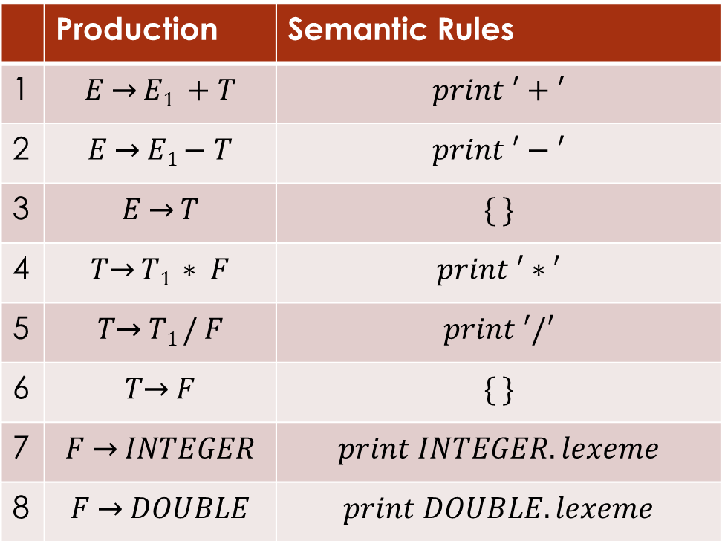
Task 2: Soulution
 | Production | Semantic Rules
1 | $$E \text{→} E1 +T$$ | $$print ′+′$$
2 | $$E \text{→} E1−T$$ | $$print ′−′$$
3 | $$E \text{→} T$$ | $$\{ \}$$
4 | $$T\text{→} T1 ∗ F$$ | $$print ′∗′$$
5 | $$T\text{→} T1 / F$$ | $$print ′/′$$
6 | $$T\text{→} F$$ | $$\{ \}$$
7 | $$F \text{→} INTEGER$$ | $$print INTEGER.lexeme$$
8 | $$F \text{→} DOUBLE$$ | $$print DOUBLE.lexeme$$

Slide 5
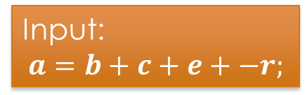
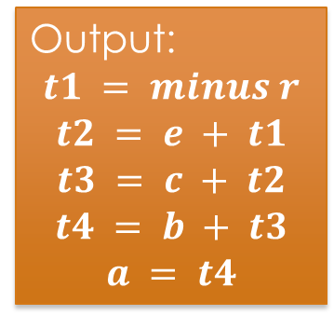
Task 3: Create a parser that will generate three address code using following SDD.
Input:
$$a=b+c+e+−r;$$
Output:
$$t1 = minus r$$
$$t2 = e + t1$$
$$t3 = c + t2$$
$$t4 = b + t3$$
$$a = t4$$
Lex Source File Name: Lex1.l
Lex Generated C File Name: Lex1.c
Yacc Source File Name: Yacc1.y
Yacc Generated C File Name: Yacc1.c
Parser Name: Parser1.exe

