Slide 1
Compiler Course Lab 9
CSE 440

Slide 2
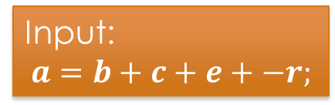
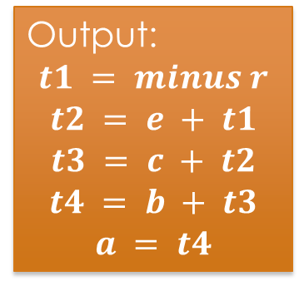
Task 1: Create a parser that will generate three address code using following SDD.
Input:
$$a=b+c+e+−r;$$
Output:
$$t1 = minus r$$
$$t2 = e + t1$$
$$t3 = c + t2$$
$$t4 = b + t3$$
$$a = t4$$
Lex Source File Name: Lex1.l
Lex Generated C File Name: Lex1.c
Yacc Source File Name: Yacc1.y
Yacc Generated C File Name: Yacc1.c
Parser Name: Parser1.exe

Slide 3
Solution
Scanner:
{ID} { yylval.a = strdup(yytext); return ID; }
[-+=();\n] return *yytext;
Parser:
%code requires { struct node { char *addr; char *code; }; }
%union { char *a; char *c; struct node e_att;}
%token <a> ID
%type <e_att> E
%type <c> S
Temp:
char * newTemp() {
char *t = (char *) malloc(sizeof(char) * 4);
tempCount++; sprintf(t,"t%d",tempCount);
return t; }

Slide 4
Solution (Continues)
Parser (Production Rules):
E: E '+' E { $$.addr = newTemp();
$$.code = strdup($1.code);
$$.code = (char *) realloc($$.code, strlen($3.code)+
strlen($$.addr)+strlen($1.addr)+strlen($3.addr)+10);
strcat($$.code,"\n");
strcat($$.code,$3.code);
strcat($$.code,"\n");
strcat($$.code,$$.addr);
strcat($$.code," = ");
strcat($$.code,$1.addr);
strcat($$.code," + ");
strcat($$.code,$3.addr); }

Slide 5
Task 1: Create a parser that will generate three address code using following SDD but change it so that it should work for ‘*’,‘/’,‘-’ also.
Lex Source File Name: Lex2.l
Lex Generated C File Name: Lex2.c
Yacc Source File Name: Yacc2.y
Yacc Generated C File Name: Yacc2.c
Parser Name: Parser2.exe

Slide 6
Task 2: Change the previous parser such that it work as incremental SDT.
Hint: Change this following SDD so that it work as incremental SDT
Lex Source File Name: Lex1.l
Lex Generated C File Name: Lex1.c
Yacc Source File Name: Yacc1.y
Yacc Generated C File Name: Yacc1.c
Parser Name: Parser1.exe

Slide 7
Task 2: Solution

Slide 8
Task 3: Create a parser for the following language
Example sentence | Corresponding action
HEAT ON | Print – “Heater on!”
HEAT OFF | Print – “Heater off!”
SET TEMP 20 | Print – “Temperature set to 20!”
SET TEMP 33 | Print – “Temperature set to 33!”
HEAT SET | Syntax Error
heat on | Invalid Character
Lex Source File Name: Lex1.l
Lex Generated C File Name: Lex1.c
Yacc Source File Name: Yacc1.y
Yacc Generated C File Name: Yacc1.c
Parser Name: Parser1.exe

Slide 9
Task 4: Create a parser for following L-attributed SDD.
Lex Source File Name: Lex1.l
Lex Generated C File Name: Lex1.c
Yacc Source File Name: Yacc1.y
Yacc Generated C File Name: Yacc1.c
Parser Name: Parser1.exe

