Slide 1
AZ-305T00A Designing Microsoft Azure Infrastructure Solutions

Slide 2
Module 02: Design a compute solution

Slide 3
Introduction
Choose a compute service
Design for Azure virtual machine solutions
Design for Azure Batch solutions
Design for Azure App Services solutions
Design for Azure Container Instances solutions
Design for Azure Kubernetes Service solutions
Design for Azure Function solutions
Design for Azure Logic App solutions
Case study
Summary and resources
AZ-305: Design Infrastructure Solutions (25-30%)
Design for compute solutions
Recommend an appropriately sized compute solution based on workload requirements.
Recommend a Container-based compute solution.
Recommend a Serverless-based compute solution
Recommend a Virtual Machine-based compute solution
Notes:
Exam page - https://docs.microsoft.com/learn/certifications/exams/az-305
Prerequisites
Conceptual knowledge of Azure compute solutions.
Working experience with virtual machines, containers, and app service.

Slide 4

Choose a compute solution

Slide 5
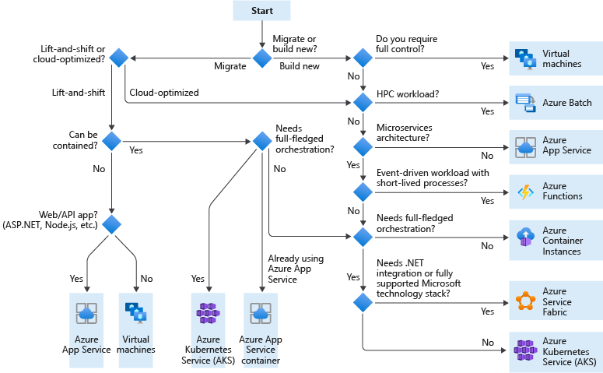
Choose a compute service for your application
Notes:
Instructor note: You might prefer to review this decision tree at the end of the lesson once all compute topics have been discussed rather than the beginning, so an additional slide is hidden in the review section of this same decision tree.
Choose an Azure compute service for your application - https://docs.microsoft.com/azure/architecture/guide/technology-choices/compute-decision-tree
On the diagram, cover the starting choices. Each area will be discussed later so keep the discussion high level. The classroom diagram is different, focusing just on the solutions covered in class.
Cloud optimized is a strategy for migrating to the cloud . Cloud optimized refactors an application to take advantage of cloud-native features and capabilities. A lift and shift strategy migrates workloads without redesigning the application or making code changes. Lift-and-shift lets organizations keep running their applications with minimal changes and disruption.
TIP: The output from this flowchart is a starting point for consideration. You’ll need to do a more detailed evaluation of the service to see if it meets your needs. The next sections will help with this analysis.
Key Concepts:
VM, VMSS, Azure Functions, Batch, Kubernetes
Questions:
Will the system run in containers and/or Kubernetes?
What are the application bottlenecks? (CPU, Memory, etc.)
What are the solution's scaling requirements? (Scale up specific microservice as part of "follow-the-sun" model)
What should trigger a scaling event? (CPU hits 70%)

Slide 6

Design for Azure virtual machine solutions

Slide 7
When to select virtual machines
Know when to use virtual machines
Quickly test and troubleshoot different configurations
Use specialty hardware such as high-performance computing
Extend your on-premises datacenter without purchasing additional hardware
Run legacy apps on modern hardware
Access third party software that requires local add-ons or plug-ins
Quickly migrate apps to the cloud
Fully control the computing environment
Notes:
Windows Virtual Machines in Azure - https://docs.microsoft.com/azure/virtual-machines/windows/overview
Discussion: Just as important as knowing when to use virtual machines is when not use virtual machines. For example, licensing restrictions, specialty hardware, and time synchronization issues.

Slide 8
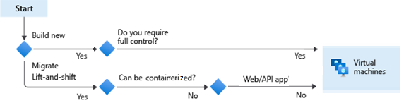
Plan the Azure virtual machine deployment
Azure virtual machines scenarios include build new or migrate patterns
Start with the network
Name the VM
Decide the VM location
Select the VM storage
Select an VM operating system
Keep the VM up to date
Monitor the VM
Notes:
This is just to highlight how large the responsibilities are when using VMs versus other more cloud native solutions
Windows virtual machines in Azure - https://docs.microsoft.com/azure/virtual-machines/windows/overview
Windows virtual machines in Azure - https://docs.microsoft.com/azure/virtual-machines/linux/overview

Slide 9


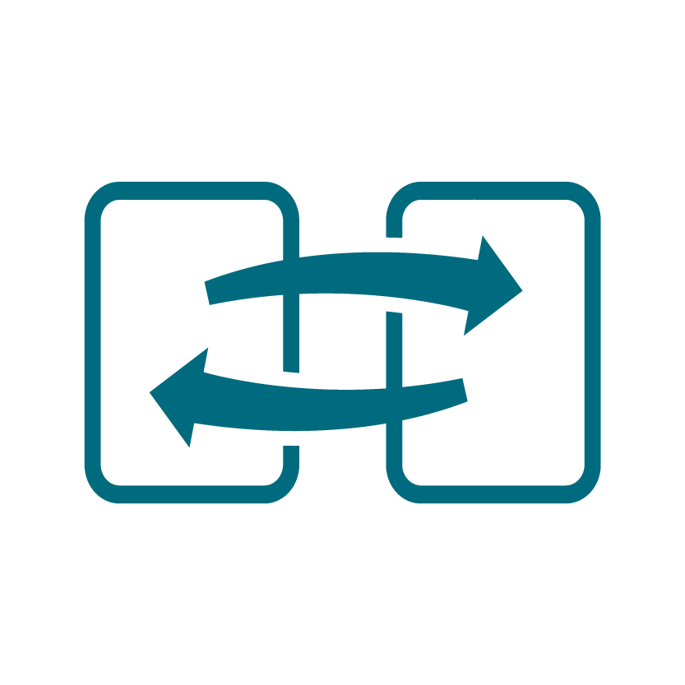
Determine the virtual machine family
The virtual machine size determines pricing
General purpose
Storage optimized
Compute optimized
GPU
Memory optimized
High performance compute
Notes:
Sizes for virtual machines in Azure - https://docs.microsoft.com/azure/virtual-machines/sizes
There is a VM selector tool - https://aka.ms/vm-selector
General purpose - Balanced CPU-to-memory ratio. Ideal for testing and development, small to medium databases, and low to medium traffic web servers.
Compute optimized - Compute optimized designed for high CPU-to-memory ratio. Suitable for medium traffic web servers, network appliances, batch processes, and application servers.
Memory optimized - Designed for high memory-to-CPU ratio. Great for relational database servers, medium to large caches, and in-memory analytics.
Storage optimized - Designed to have high disk throughput and IO. Ideal for VMs running databases.
GPU - Specialized for heavy graphics rendering and video editing. Ideal for model training and inferencing with deep learning.
High performance compute - The fastest and most powerful CPU virtual machines with optional high-throughput network interfaces.

Slide 10
When to select virtual machine scale sets
Scale sets are built from virtual machines. With scale sets, the management and automation layers are provided to run and scale your applications.
Scenario | Group of virtual machines | Virtual machine scale sets*
You need to add VM instances for changing workload | Manual process to create, configure, and ensure compliance | Automatically create from central configuration
You need to balance and distribute workloads | Manual process to create and configure Azure load balancer or Application Gateway | Can automatically create and integrate with Azure load balancer or Application Gateway
You need high availability and redundancy | Manually create Availability Set or distribute and track VMs across Availability Zones | Automatic distribution of VM instances across Availability Zone (when zones are selected) and Availability Set
You need to monitor and then scale virtual machines | Manual monitoring and Azure Automation | Autoscale based on host metrics, in-guest metrics, Application Insights, or schedule
* Ensure application supports VMSS
Notes:
The following table outlines the benefits of scale sets compared to manually managing multiple VM instances.
Add note about application compatibility with VMSS

Slide 11

Design for Azure Batch solutions

Slide 12
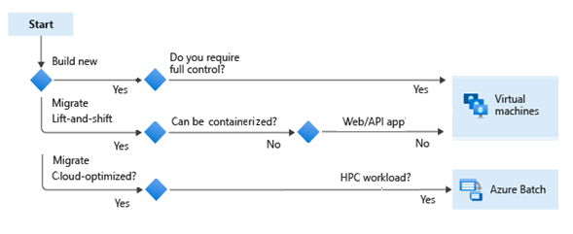
When to use Azure Batch
Azure Batch enables large-scale parallel and HPC batch jobs
Compute-intensive tasks and dynamically adjust resources for your solution without managing infrastructure
Create and manage jobs in a pool of compute nodes (virtual machines)
Azure Batch can also install the application that you want to run, and schedule jobs to run on the compute nodes
Notes:
What is Azure Batch? https://docs.microsoft.com/azure/batch/batch-technical-overview
Review use cases in documentation

Slide 13
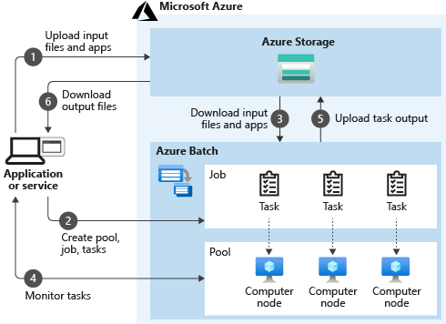
How Azure Batch works
Think of the diagram in two parts:
Your service that uses Azure as the platform
Batch as the compute platform behind your service. Batch uses Azure Storage to fetch applications or data needed to complete a task.
Considerations
Pools – dynamically allocate jobs, right size the pools
Nodes – use multiple nodes in the pool, right size the machines
Jobs – uniquely name the jobs, monitor and log activity
Notes:
Best practices - Azure Batch | Microsoft Docs.- https://docs.microsoft.com/azure/batch/best-practices

Slide 14

Design for Azure App Services solutions

Slide 15
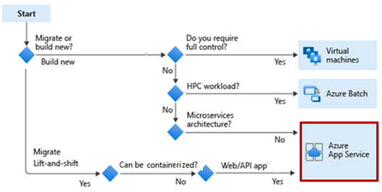
When to use Azure App Services Web Apps
Azure App Service is an HTTP-based service that lets you build and host apps
Web apps, background jobs, mobile backends, and RESTful APIs.
Use the programming language of your choice
Automatic scaling and high availability
App Service enables automated deployments from GitHub, Azure DevOps, or other source control services
Notes:
Important: Azure App Service is platform as a service (PaaS) environment. You focus on the website development and API logic. Azure handles the infrastructure to run and scale your web applications.

Slide 16


Considerations for App Service Web Apps
Determine the appropriate app service plan – determines cost and scaling
Use built-in authentication and authorization capabilities
Use App Services deployment slots for continuous deployment
Build REST-based web apps with the API
Use WebJobs to run a program or script
Use the Mobile Apps to build a back end for iOS and Android apps.

Slide 17
Compare containers to virtual machines
App Services can also run containers
Feature | Containers | Virtual Machines
Isolation | Lightweight isolation from the host and other container. | Complete isolation, strong security boundary, from the host and other VMs.
Operating system | Runs the user mode portion of an operating system | Runs a complete operating system
Deployment | Deploy using Docker – orchestration with Azure Kubernetes Service | Deploy in the cloud or on-premises – portal, PowerShell, CLI, templates, automation ..
Persistent storage | Azure disks or file share | Virtual hard disk (VHD)or a file share
Fault tolerance | If a cluster node fails, any containers running on it are rapidly recreated by the orchestrator on another cluster node. | VMs can fail over to another server in a cluster, with the VM’s operating system restarting on the new server.
Notes:
Containers vs. virtual machines - https://docs.microsoft.com/virtualization/windowscontainers/about/containers-vs-vm
Navigate back to decision tree to show how the student would end up choosing App Services with containers

Slide 18

Design for Azure Container Instances solutions

Slide 19
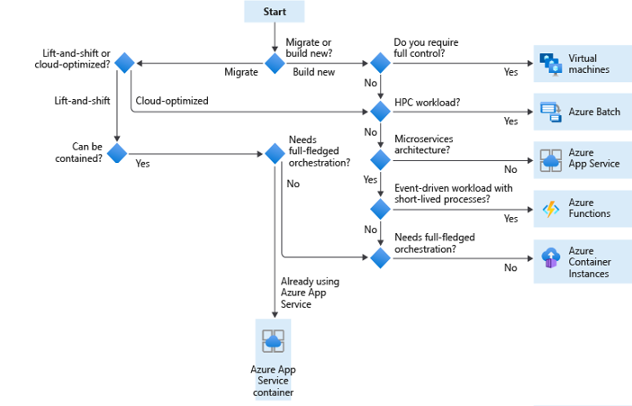
What is Azure Container Instance
Azure Container Instances offers the fastest and simplest way to run a container in Azure, without having to manage any virtual machines and without having to adopt a higher-level service.
Ensure the integrity of images throughout the lifecycle
Monitor container resource activity
Consider container groups

Slide 20
When to use Azure Container Instances
Azure Container Instances are a fast and simple way to run a container on Azure.
Pros:
Fast and Easy
Used for testing and development.
Used for short-lived processes.
Can be used for AKS overflow
Cons:
Doesn’t scale
Not designed for microservices
Notes:
Azure Container Instances - https://docs.microsoft.com/azure/container-instances/container-instances-overview
Security considerations for container instances - https://docs.microsoft.com/azure/container-instances/container-instances-image-security
Return to the first flow chart and discuss how to get to the container instances decision.

Slide 21

Design for Azure Kubernetes Service solutions

Slide 22

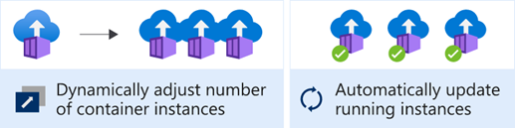
Considerations for Azure Kubernetes Services
Azure Kubernetes Service (AKS) orchestrates your containerized applications
Enterprise scalability
Automatic cluster node and pod scaling
Granular network control
Cluster node upgrades
Storage volume support
Ingress with HTTP application routing support
Private container registry support
Notes:
Introduction to Azure Kubernetes Service - https://docs.microsoft.com/learn/modules/intro-to-kubernetes/2-what-is-kubernetes
What is AKS - https://docs.microsoft.com/azure/aks/intro-kubernetes
Customer story - Mercedes-Benz R&D creates 'container-driven cars' powered by Microsoft Azure - https://customers.microsoft.com/story/784791-mercedes-benz-r-and-d-creates-container-driven-cars-powered-by-microsoft-azure
Cluster operator and developer best practices to build and manage applications on Azure Kubernetes Service (AKS) - https://docs.microsoft.com/azure/aks/best-practices

Slide 23
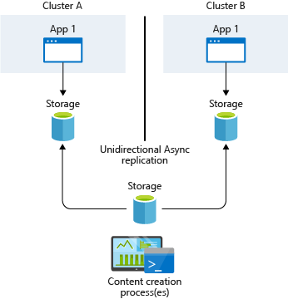
Design a highly available container solution
AKS provides high availability using multiple nodes in a virtual machine scale set.
When planning to implement AKS clusters across multiple region deployments, consider the following:
AKS region availability
Azure paired regions
Service availability
Two ways to synchronize storage.
Infrastructure-based asynchronous replication
Application-based asynchronous replication
Notes:
NOTE: Persistent volumes follow pods even if the pods are moved to a different node inside the same cluster.
https://docs.microsoft.com/azure/aks/operator-best-practices-multi-region#infrastructure-based-asynchronous-replication
Typically, you provide a common storage point where apps write their data. This data is then replicated across regions and accessed locally, as displayed in the graphic.
TIP: When you deploy multiple AKS clusters, choose regions where AKS is available. Always use paired regions.
Consider multiple region availability
When planning to implement AKS clusters across multiple region deployments, consider the following:
AKS region availability. Choose regions that are close to your users. Keep in mind that AKS is continually expanding into new regions.
Azure paired regions. For your geographic area, choose two regions paired together. Also consider that:
AKS platform updates (planned maintenance) are serialized with a delay of at least 24 hours between paired regions.
Recovery efforts for paired regions are prioritized where needed.
Service availability. Decide whether your paired regions should be hot/hot, hot/warm, or hot/cold. In other words, do you want to run both regions at the same time, with one region ready to start serving traffic? Or do you want to give one region time to get ready to serve traffic?

Slide 24

Design for Azure Functions

Slide 25
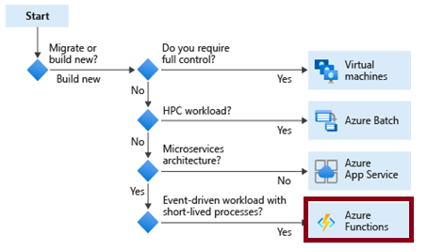
When to use Azure Functions
Azure Functions is a serverless application platform for compute-on-demand
Implement your system's logic into readily available blocks of code
Supports a microservice design
Promotes code reuse
Scales easily
Event-driven
Notes:
Azure Functions - https://docs.microsoft.com/azure/azure-functions/functions-overview
Azure Functions code samples - https://docs.microsoft.com/samples/browse/?expanded=azure&languages=csharp&products=azure-functions
Durable functions - https://docs.microsoft.com/azure/azure-functions/durable/durable-functions-overview?tabs=csharp

Slide 26
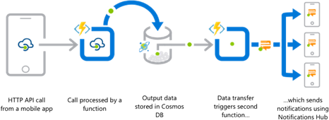
Considerations for Azure Functions
Azure Functions are best when handling specific definable actions triggered by an event.
Avoid long running functions
Know when to use durable functions
Organize functions for performance and scaling
Write defensive functions
Notes:
Best practices for reliable Azure Functions - https://docs.microsoft.com/azure/azure-functions/functions-best-practices
Relativity, an e-discovery company, is using Azure functions to identify and resolve performance issues - https://customers.microsoft.com/story/relativity-partner-professional-services-azure

Slide 27

Design for Azure Logic App solutions

Slide 28
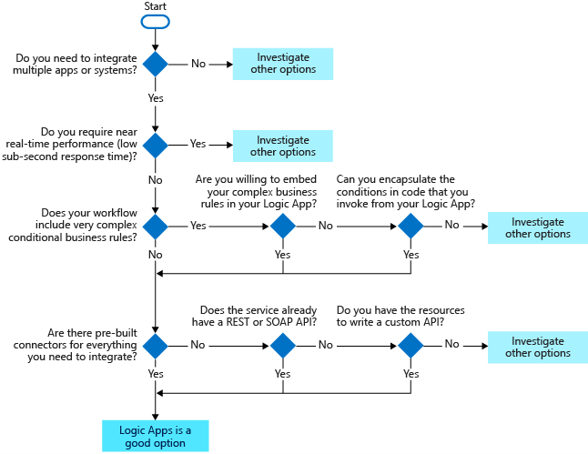
When to use Azure Logic Apps
Azure Logic Apps is a cloud-based platform creating and running workflows.
Send email notifications using Office 365 when a specific event happens
Route and process customer orders across on-premises systems and cloud services.
Move uploaded files from an FTP server to Azure Storage.
Monitor tweets, analyze the sentiment, and create alerts or tasks for items that need review.
Notes:
Azure Logic App - https://azure.microsoft.com/services/logic-apps
Azure Integration Services - https://azure.microsoft.com/product-categories/integration/
Built-in binding types - https://docs.microsoft.com/azure/azure-functions/functions-triggers-bindings
Cramo is using Logic Apps - https://customers.microsoft.com/story/cramo-professional-services-azure
You need multiple applications and systems to work together. You need to scale your apps automatically. You need to build complex and nested conditionals with business rules. You need a built-in connector for your integration.

Slide 29
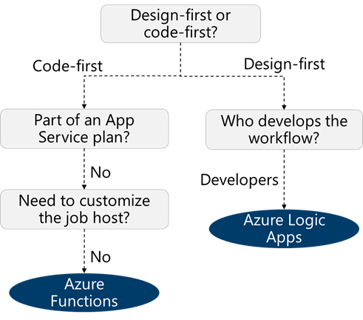
How are Logic Apps different from Functions?
Code-first vs designer-first
Comparison | Logic Apps | Durable Functions
Development | Designer-first | Code-first
Method | Create orchestrations by using a GUI or editing configuration files | Write code and use the durable functions extension
Connectivity | Large collection of connectors , B2B pack, custom connectors | Large selection of built-in binding types, write code for custom bindings
Monitoring | Azure portal, Azure Monitor logs | Azure Application Insights
Execution context | Runs only in the cloud | Can be run locally or in the cloud
Notes:
Choose the right integration and automation services in Azure - https://docs.microsoft.com/azure/azure-functions/functions-compare-logic-apps-ms-flow-webjobs
TIP: You can mix and match services when you build an orchestration. You can call functions from logic apps and call logic apps from functions. Build each orchestration based on the services' capabilities or your personal preference.

Slide 30
Review

Slide 31
Review – Choosing a compute service
Notes:
Now that you have reviewed each branch of the decision tree you can evaluate which compute solution is best for your application workload.
Choose an Azure compute service for your application - https://docs.microsoft.com/azure/architecture/guide/technology-choices/compute-decision-tree

Slide 32


Case study – Compute solutions
Which Azure compute service would you recommend for the front-end tier? Address both the workload hosting and the web application.
Which Azure compute service would you recommend for the middle tier application? Diagram what you decide and explain your solution.
IIS Web Servers
.NET Framework-based business logic
SQL Server Analysis Services with SQL Server Always On Availability Group database
Business analysts
Heavy demand
Servers reach their performance limits during the day
Servers sit idle during off hours
Rest API call from the front-end tier
Request demand changes from day to day
Uses all-flash enterprise SAN storage
Notes:
There is no separate Instructor slide to discuss this case study. Use the Instructor solution.

Slide 33
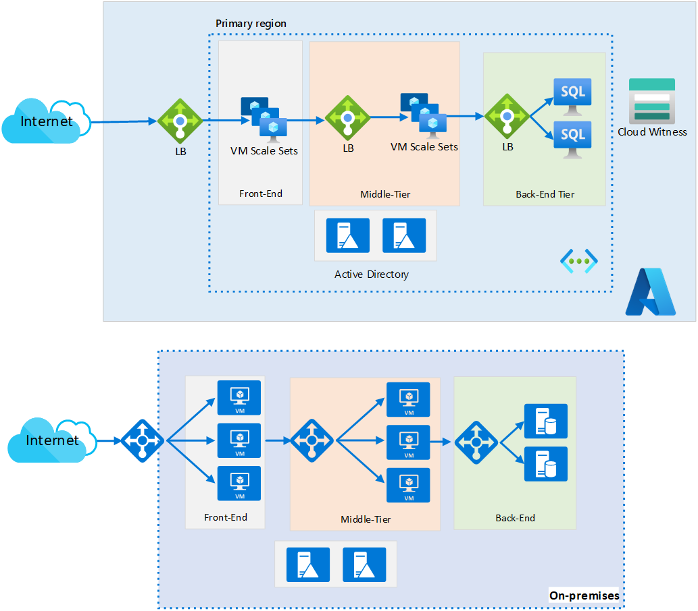
Instructor Solution – IaaS Version

Slide 34
Instructor Solution – PaaS Solution

Slide 35
Summary and resources
Check your knowledge
Microsoft Learn Modules (docs.microsoft.com/Learn)
Choose the best Azure service to automate your business processes
Introduction to Azure virtual machines
Create an Azure Batch account
Create serverless logic with Azure Functions
Introduction to Azure Logic Apps
Host a web application with Azure App Service
Introduction to Azure Kubernetes Service
Optional hands-on exercises:
Create a web app in the Azure portal
Create a Windows virtual machine
Create the social media tracker Logic App
Notes:
Learn - https://docs.microsoft.com/learn/browse/
Exercise - Create a web app in the Azure portal - Learn | Microsoft Docs
Exercise - Create a Windows virtual machine - Learn | Microsoft Docs
Exercise - Create the social media tracker Logic App - Learn | Microsoft Docs
Choose the best Azure service to automate your business processes - Learn | Microsoft Docs - https://docs.microsoft.com/learn/modules/choose-azure-service-to-integrate-and-automate-business-processes/
Align requirements with cloud types and service models in Azure - Learn | Microsoft Docs - https://docs.microsoft.com/learn/modules/align-requirements-in-azure/
Introduction to Azure virtual machines - Learn | Microsoft Docs - https://docs.microsoft.com/learn/modules/intro-to-azure-virtual-machines/
Create an Azure Batch account by using the Azure portal - Learn | Microsoft Docs - https://docs.microsoft.com/learn/modules/create-batch-account-using-azure-portal/
Create serverless logic with Azure Functions - Learn | Microsoft Docs - https://docs.microsoft.com/learn/modules/create-serverless-logic-with-azure-functions/
Introduction to Azure Logic Apps - Learn | Microsoft Docs - https://docs.microsoft.com/learn/modules/intro-to-logic-apps/
Host a web application with Azure App Service - Learn | Microsoft Docs - https://docs.microsoft.com/learn/modules/host-a-web-app-with-azure-app-service/
Introduction to Azure Kubernetes Service - Learn | Microsoft Docs - https://docs.microsoft.com/learn/modules/intro-to-azure-kubernetes-service/

Slide 36

End of presentation

Slide 37
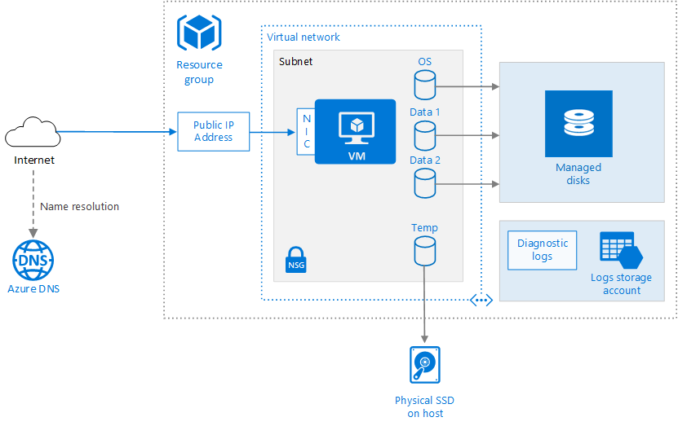
Optional – Whiteboard discussion #1
Run a Linux or Windows virtual machine on Azure
Notes:
There is a simple Linux and VM architecture.
Run a Windows VM on Azure - https://docs.microsoft.com/azure/architecture/reference-architectures/n-tier/windows-vm
Run a Linux VM on Azure - https://docs.microsoft.com/azure/architecture/reference-architectures/n-tier/linux-vm

Slide 38
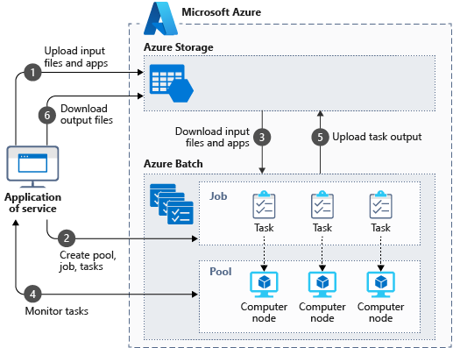
Optional – Whiteboard discussion #2
3d image rendering with Azure Batch
Notes:
This scenario shows a workflow that uses Azure Batch.
A computer-aided engineering service - https://docs.microsoft.com/azure/architecture/example-scenario/infrastructure/video-rendering

Slide 39
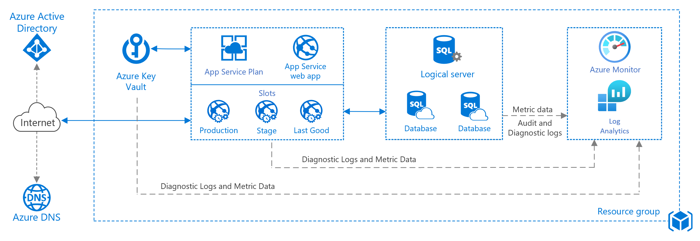
Optional – Whiteboard discussion #3
Basic web application
Notes:
This scenario shows a basic App Service plan and App Service web app. Focus on the components in this module.
Basic web application - https://docs.microsoft.com/azure/architecture/reference-architectures/app-service-web-app/basic-web-app

Slide 40
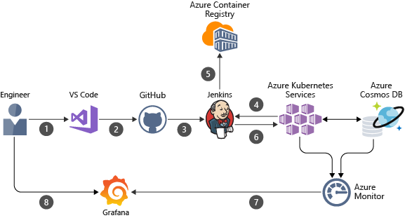
Optional – Whiteboard discussion #4
Pipeline for container-based workloads
Notes:
This scenario shows a pipeline with different components. Focus on the container parts.
Pipeline for container-based workloads - https://docs.microsoft.com/azure/architecture/example-scenario/apps/devops-with-aks

Slide 41
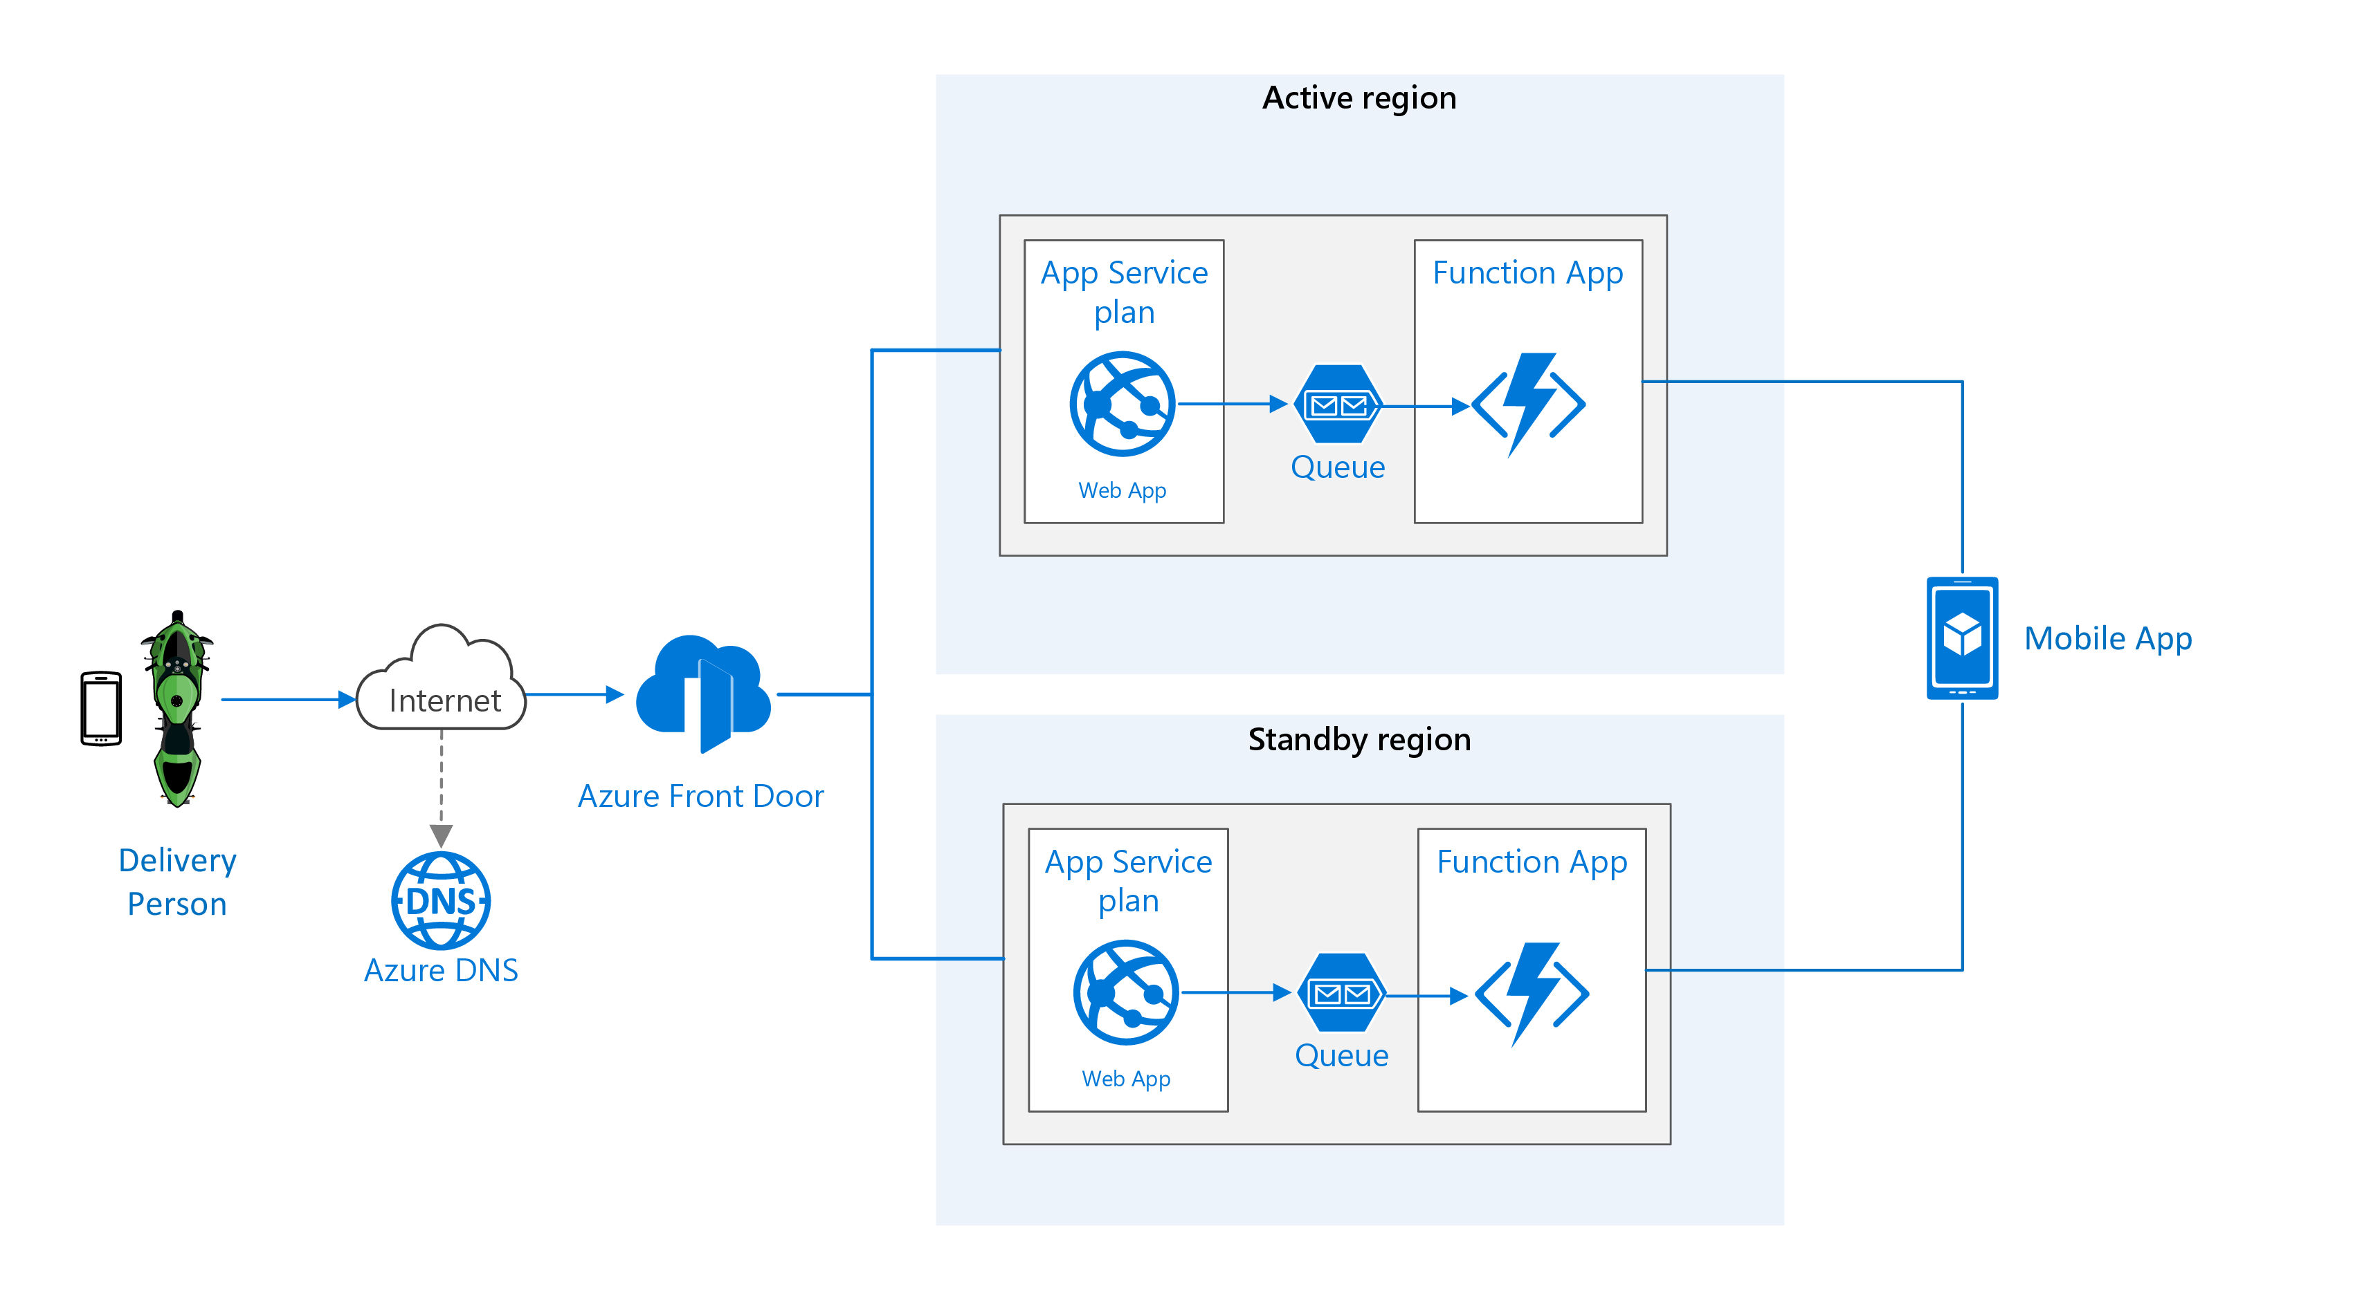
Optional – Whiteboard discussion #5
Sharing location in real time using low-cost serverless Azure services
Notes:
This scenario combines App Service Plan with Function App. It also address high availability. Front Door will be covered in Networking.
Sharing location in real time using low-cost serverless Azure services - https://docs.microsoft.com/azure/architecture/example-scenario/signalr/

