Slide 1
AZ-305T00A Designing Microsoft Azure Infrastructure Solutions

Slide 2

Module 08: Design a solution to log and monitor Azure resources

Slide 3
Introduction
Design for Azure Monitor data sources
Design for Log Analytics
Design for Azure workbooks and Azure Insights
Design for Azure Data Explorer
AZ-305: Design Identity, Governance, and Monitoring Solutions (25-30%)
Design a Solution for Logging and Monitoring
Design a log routing solution
Recommend an appropriate level of logging
Recommend a monitoring tool(s) for a solution
Notes:
Exam page - https://docs.microsoft.com/learn/certifications/exams/az-305
Prerequisites
Working experience with monitoring and logging cloud environments
Conceptual knowledge of monitoring and logging

Slide 4

Design for Azure Monitor data sources

Slide 5
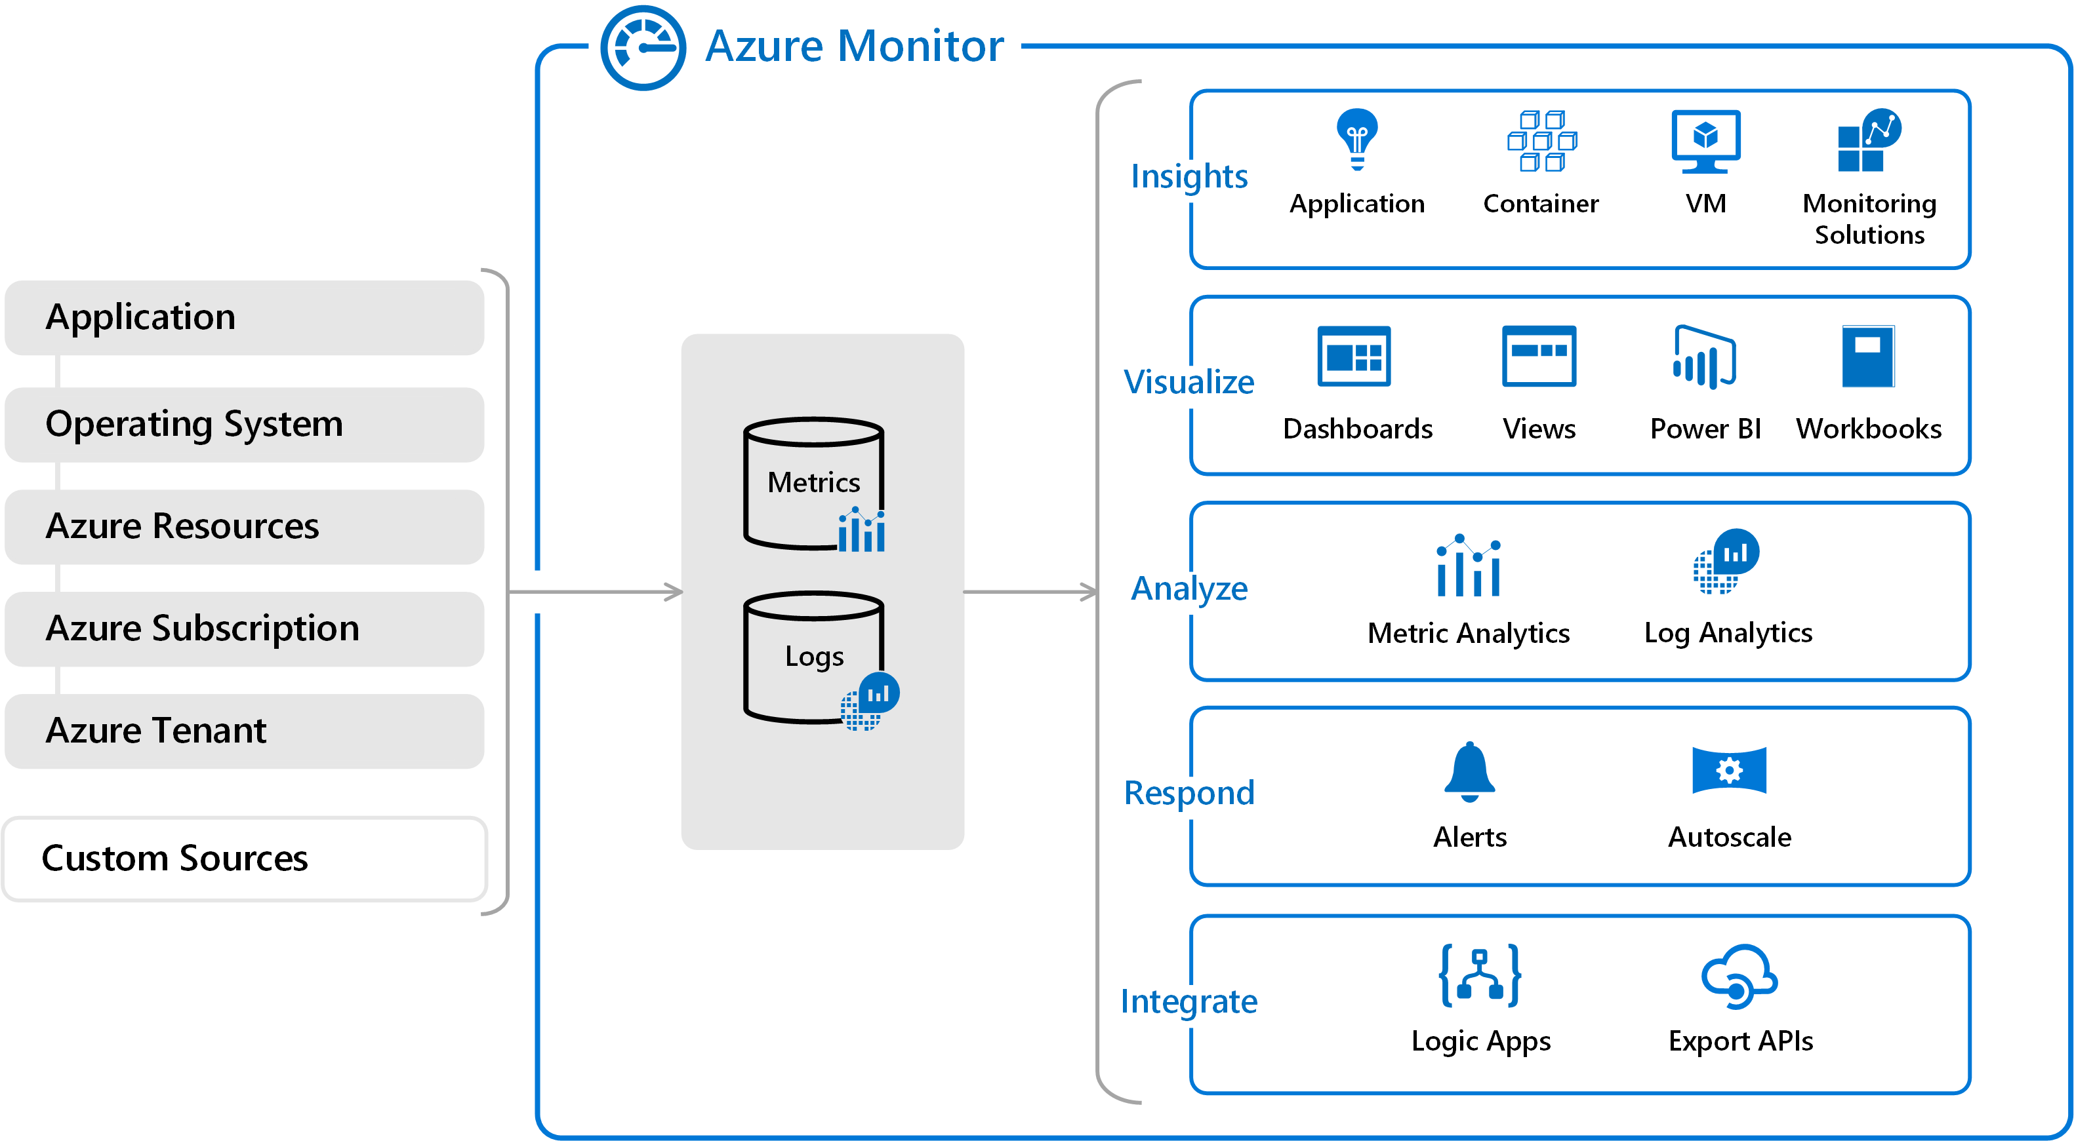
Review Azure Monitor capabilities
Data sources
Data stores
Analysis, alerting, and streaming to external systems
Notes:
Azure Monitor features - https://docs.microsoft.com/learn/modules/analyze-infrastructure-with-azure-monitor-logs/2-features-azure-monitor-log
Best practices for monitoring cloud applications - https://docs.microsoft.com/azure/architecture/best-practices/monitoring
Best practices for costing and sizing resources hosted in Azure - https://docs.microsoft.com/azure/cloud-adoption-framework/govern/cost-management/best-practices#best-practice-use-azure-cost-management--billing
Use this as a high-level review – data sources, data stores, and insights. The next page focuses on data sources.

Slide 6
Identify data sources and access method
Azure Monitor collects data automatically from a range of components.
Examples
Application data
Data tiers go from Azure applications (highest tier) to Azure platform components (lowest tier)
The method of accessing data from each tier varies – for example, installing an agent
Each data tier can stream to different external systems
Prioritize and be deliberate on what data sources you need
Operating System data
Azure Monitor Metrics, Azure Event Hubs, and Azure Storage
Diagnostic extension
Log Analytics agent
Log Analytics workspace
Dependency agent
VM Insights
Azure resources data
Azure subscription data
Azure tenant data
Azure Monitor logs, Azure storage (archiving), and Event Hubs
Azure Active Directory
Notes:
This slide only shows a sampling of external uses . Use the link to review other possibilities.
Azure Active Directory reporting - https://docs.microsoft.com/azure/active-directory/reports-monitoring/overview-reports
Sources of monitoring data - https://docs.microsoft.com/en-us/azure/azure-monitor/agents/data-sources
Telemetry related to your Azure tenant is collected from tenant-wide services such as Azure Active Directory.
Discussion: What data sources do you need?

Slide 7

Design for Log Analytics

Slide 8
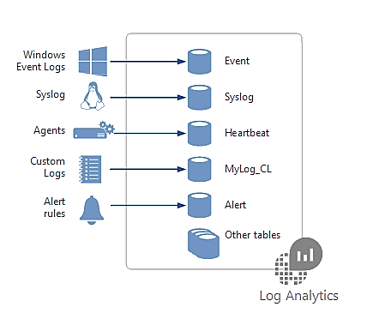
What is Log Analytics?
Log Analytics is a service in that helps you collect and analyze data.
Azure Monitor stores log data in the workspace
Data in a workspace is organized into tables with properties you can query
A Log Analytics workspace provides:
A geographic location for data storage.
Data isolation by granting different users access rights following one of our recommended design strategies.
Scope for configuration of settings like pricing tier, retention, and data capping.
Notes:
Overview of Log Analytics in Azure Monitor - https://docs.microsoft.com/azure/azure-monitor/logs/log-analytics-overview
Discussion: What is the difference between Azure monitor and log analytics? Azure Monitor builds on top of Log Analytics, the platform service that gathers log and metrics data from all your resources. The easiest way to think about it is that Azure Monitor is the marketing name, whereas Log Analytics is the technology that powers it.
Example 1 - Assessing updates: An important part of the daily routine for any IT administrator is assessing systems update requirements and planning patches. Accurate scheduling is critical, as it directly relates to SLAs to the business and can seriously impact business functions. In the past, you had to schedule an update with only limited knowledge of how long the patching would take. Operations Management Suite collects data from all customers performing patches and uses that data to provide an average patching time for specific missing updates. This use of “crowd-sourced” data is unique to cloud systems and is a great example of how Log Analytics can help meet strict SLAs.
Example 2 - Change tracking: Troubleshooting an operational incident is a complex process, requiring access to multiple data streams. With Operations Management Suite, you can easily perform analysis from multiple angles, using data from a wide variety of sources through a single interface for correlation of information. By tracking changes throughout the environment, Log Analytics helps to easily identify things like abnormal behavior from a specific account, users installing unapproved software, unexpected system reboots or shutdowns, evidence of security breaches, or specific problems in loosely coupled applications.

Slide 9

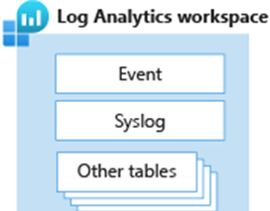
Considerations for workspace access control
Workspace deployment models include centralized, decentralized, and hybrid.
Centralized
Centralized: All logs are stored in a central workspace and administered by a single team, with Azure Monitor providing differentiated access per-team.
Decentralized: Each team has their own workspace created in a resource group they own and manage, and log data is segregated per resource.
Decentralized
Hybrid: Security audit compliance requirements further complicate this scenario because many organizations implement both deployment models in parallel.
Notes:
What are Azure Monitor Logs and Azure Monitor VM Insights?– https://docs.microsoft.com/learn/modules/monitor-performance-using-azure-monitor-for-vms/2-what-are-azure-monitor-logs-vms
Designing your Azure Monitor Logs deployment - https://docs.microsoft.com/azure/azure-monitor/platform/design-logs-deployment
Overview of Azure Monitor agents - https://docs.microsoft.com/azure/azure-monitor/platform/agents-overview
Centralized – All logs stored in a central workspace. Administered by a single team. Easy to manage, search across resources, and cross-correlate logs. Can grow significantly in size. Additional administrative overhead to maintain access control to different users. Centralized logging can help you uncover hidden issues that might be difficult to track down. With Log Analytics, you can query and aggregate data across logs. This cross-source correlation can help you identify issues or performance problems that might not be evident when you look at logs or metrics individually.
Decentralized - Each team has their own workspace created in a resource group they own and manage. Log data segregated per resource Workspace can be kept secure with resource access, but it's difficult to cross-correlate logs. Users who need a broad view of many resources cannot analyze the data in a meaningful way.
Hybrid - Both centralized and decentralized workspace. Complex, expensive, and hard-to-maintain. Possible gaps in the log coverage.

Slide 10
Considerations for access mode
The access mode is how a user accesses the workspace and what data they can access.
Issue | Workspace-context | Resource-context
How does the access mode work? | You can view all logs in the workspace you have permission to. Queries in this mode are scoped to all data in all tables in the workspace. This is the access mode used when logs are accessed with the workspace as the scope. | When you access the workspace for a particular resource, resource group, or subscription. You can view logs for only resources in all tables that you have access to. Queries in this mode are scoped to only data associated with that resource.
Who is each model intended for? | Central administration | Application teams
What does a user require to view logs? | Permissions to the workspace | Read access to the resource
What is the scope of permissions? | Workspace | Azure resource

Slide 11

Design for Azure workbooks and Azure Insights

Slide 12
Design for Azure Workbooks
Workbooks provide a flexible canvas for data analysis and the creation of rich visual reports within the Azure portal. They allow you to tap into multiple data sources from across Azure and combine them into unified interactive experiences.
Authors of workbooks can transform this data to provide insights into the availability, performance, usage, and overall health of the underlying components.
But the real power of workbooks is the ability to combine data from disparate sources within a single report. This allows for the creation of composite resource views or joins across resources enabling richer data and insights that would otherwise be impossible.
Notes:
Azure Monitor Workbooks - https://docs.microsoft.com/azure/azure-monitor/visualize/workbooks-overview

Slide 13
Design for Azure Insights
It's critical to monitor your systems closely to identify any performance problems or attacks before they can affect users. Designing insights as a part of your overall architecture will help identify performance issues.
Use Application Insights to:
Analyze and address issues and problems that affect your application's health and performance.
Improve your application's development lifecycle.
Measure your user experience and analyze users' behavior.
Use Azure Monitor VM insights to:
View the health and performance of your VMs.
Monitor your VMs at-scale across multiple subscriptions and resource groups.
Want a topology view that shows the processes, and network connection details of your VMs and scale sets.
Use Azure Monitor container insights to:
View the health and performance of your Kubernetes workloads at-scale across multiple subscriptions and resource groups.
Want visibility into memory and processor performance metrics from controllers, nodes, and containers.
Want view and store container logs for real time and historical analysis.
Notes:
What is Application Insights? https://docs.microsoft.com/azure/azure-monitor/app/app-insights-overview

Slide 14
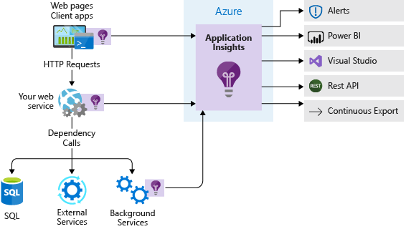
Select Application Insights
You want to understand how your app is performing and how it's being used.
You need usage information on request rates, response times, and failure rates.
You need transaction diagnostics and performance statistics (client and server).
You want to automatically collect a snapshot of a live application to analyze it at a later stage.
Notes:
Enable Application Insights on an Azure web app - https://docs.microsoft.com/learn/modules/capture-page-load-times-application-insights/2-enable-application-insights
Scenario:
Imagine that you work for a company that makes digital video cameras. You have an App Service web app that enables users of your products to upload and share their videos with the community.
The app was first deployed to Azure a few months ago. No application performance management (APM) system was set up. Performance was initially good, with no errors reported to clients. But a few months after the app went live, user feedback indicated that pages in the app were loading slowly. Because there was no telemetry in place, your team wasn't even aware that the app was slow until users started to complain.
Admins and developers have no way to diagnose the problem because the sparse trace output generated by the application isn't comprehensive enough to be helpful. You need to quickly instrument the app so you can diagnose and fix the performance problems.

Slide 15

Design for Azure Data Explorer
Notes:
Optional

Slide 16
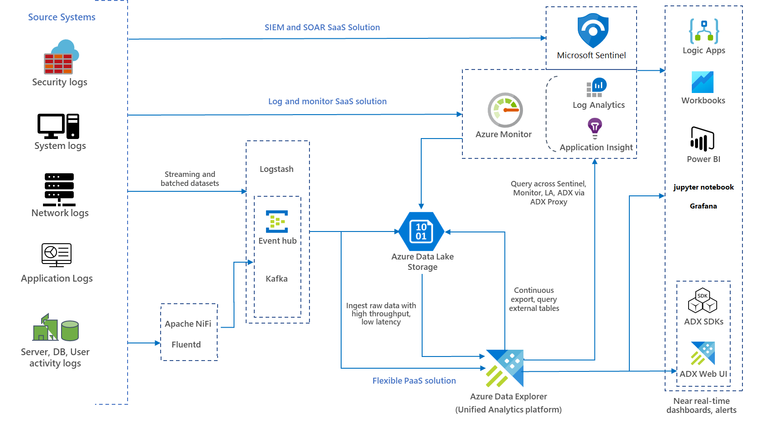
When to use Azure Data Explorer
Azure Data Explorer is a fast and highly scalable data exploration service for log and telemetry data.
Helps you handle the many data streams emitted by modern software, so you can collect, store, and analyze data.
Azure Data Explorer is ideal for analyzing large volumes of diverse data from any data source, such as websites, applications, IoT devices, and more.
This data is used for diagnostics, monitoring, reporting, machine learning, and additional analytics capabilities.
Can combine with Azure Sentinel and Azure Monitor.
Notes:
Data Explorer - https://azure.microsoft.com/services/data-explorer/
The diagram is an example of a hybrid end-to-end monitoring solution integrated with Azure Sentinel and Azure Monitor for ingesting streamed and batched logs from diverse sources, on-premises, or any cloud within an
enterprise ecosystem. This could be a solution used in Tailwind Traders architecture to monitor various logs.

Slide 17
Review

Slide 18

Use Case Scenarios (matching)
Azure Monitor
Measure user experience and analyze users' behavior for all external facing applications
Solution for collecting, analyzing, and acting on telemetry from your cloud and on-premises environments
Application Insights
You need to edit and run log queries
You need transaction diagnostics and performance statistics (client and server).
Azure workbooks
You need data analysis and the creation of rich visual reports
You need usage information on request rates, response times, and failure rates of an application
Log Analytics
Notes:
Azure Monitor - Solution for collecting, analyzing, and acting on telemetry from your cloud and on-premises environments
App Insights - measure user experience and analyze users' behavior for all external facing applications
App insights - need usage information on request rates, response times, and failure rates of an application
App insights -You need transaction diagnostics and performance statistics (client and server).
Azure workbooks - data analysis and the creation of rich visual reports
Log analytics -Edit and run log queries

Slide 19

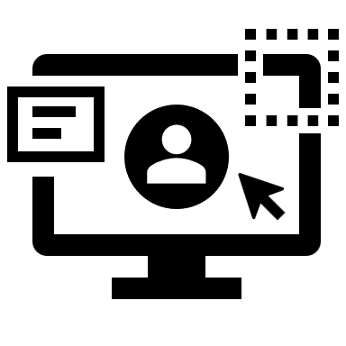
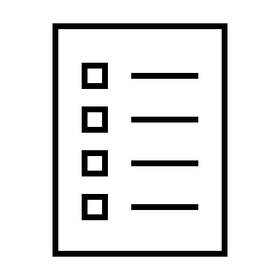
Fabrikam Residences case study – PM software
Third party Windows application
2 node cluster with SQL backend
Images and documents stored on NAS device
Corporate provides data on schedules and orders
Superintendents record daily progress
NAS
(mapped drive)
Corporate Users
Project Management Software
Microsoft SQL Server
Superintendents
FTP Server
Notes:
The PM software uses a third-party Windows application. The application runs on a 2-node Network Load Balancing (NLB) cluster with a single Microsoft SQL Server backend.
Images and documents are stored on a mapped drive of the server, which resides on a dedicated NAS appliance.
Corporate users, office staff, use a web front end to enter data such as supply delivery schedules and change orders.
Field superintendents use Windows laptops and tablets offline to continuously record building progress and other details. These changes, such as new work orders, are stored in a local change file. At the end of each day, superintendents return to the office to connect to the wireless network and run a small script to upload the change file to an FTP server. A second script is scheduled to run each night to processes all the change files and enter their contents into the Project Management database (Microsoft SQL Server).

Slide 20









Instructor solution - Fabrikam Residences PM software
Corporate Users
Azure storage?
Project Management Software
Azure storage?
Superintendents
Copy to storage?
Azure storage?
Trigger updates and write to storage?
Function
Azure blob
Event Grid
Azure Files
Data Factory
SQL
Cosmos DB
Event Hub
AzCopy
Notes:
Use your instructor solution. Drag the icons to the appropriate box or use a whiteboard.

Slide 21
Summary and resources
Module Review Questions
Microsoft Learn Modules (docs.microsoft.com/Learn)
Design a holistic monitoring strategy on Azure
Analyze your Azure infrastructure by using Azure Monitor logs
Monitor performance of virtual machines by using Azure Monitor VM Insights
Choose the best monitoring service for visibility, insight, and outage mitigation
Capture and view page load times in your Azure web app with Application Insights
Optional hands-on lab - Monitor, diagnose, and troubleshoot your Azure storage
Notes:
Learn - https://docs.microsoft.com/learn/
Design a holistic monitoring strategy on Azure - https://docs.microsoft.com/learn/modules/design-monitoring-strategy-on-azure/
Analyze your Azure infrastructure by using Azure Monitor logs - https://docs.microsoft.com/learn/modules/analyze-infrastructure-with-azure-monitor-logs/
Choose the best monitoring service for visibility, insight, and outage mitigation - https://docs.microsoft.com/learn/modules/monitoring-fundamentals/
Monitor performance of virtual machines by using Azure Monitor VM Insights - https://docs.microsoft.com/learn/modules/monitor-performance-using-azure-monitor-for-vms/
Capture and view page load times in your Azure web app with Application Insights - https://docs.microsoft.com/learn/modules/capture-page-load-times-application-insights/

Slide 22

End of presentation

