Slide 1
AZ-305T00A Designing Microsoft Azure Infrastructure Solutions

Slide 2
Module 11: Design a migration solution

Slide 3
Introduction
Evaluate migration with the Cloud Adoption Framework
Describe the Azure Migration Framework
Assess your workloads
Compare migration tools
Migrate your databases
Select an online storage migration tool
Select an offline storage migration tool
Summary and resources
AZ-305: Design Infrastructure Solutions (25-30%)
Design migrations
Evaluate migration solution that leverages the Cloud Adoption Framework
Assess and interpret on-premises servers, data, and applications for migration
Recommend a solution for migrating applications and Virtual Machines
Recommend a solution for migrating databases
Recommend a solution for migrating unstructured data
Notes:
Exam page - https://docs.microsoft.com/learn/certifications/exams/az-305
Prerequisites
Conceptual knowledge of migrating compute, database, and storage workloads.
Working experience with planning migrations, assessing workloads, determining migration requirements, and deploying workloads.

Slide 4

Evaluate migration with the Cloud Adoption Framework

Slide 5
Review the Cloud Adoption Framework
Adopt
Define Strategy
Understand motivations
Business outcomes
Business justification
Prioritize project
Plan
Digital estate
Initial organization alignment
Skills readiness plan
Cloud adoption plan
Ready
Azure readiness guide
First landing zone
Expand the blueprint
Best practice Validation
Migrate
• First workload migration
• Expanded scenarios
• Best practice validation
• Process improvements
Innovate
• Innovation guide
• Expanded scenarios
• Best practice validation
• Process improvements
Govern
Methodology • Benchmark
initial best practice • Governance maturity
Manage
Business commitments
operations baseline • Ops maturity
Notes:
The cloud adoption journey - https://azure.microsoft.com/cloud-adoption-framework/#cloud-adoption-journey
Azure migration guide overview - https://docs.microsoft.com/azure/cloud-adoption-framework/migrate/azure-migration-guide
Azure cloud migration best practices checklist - https://docs.microsoft.com/azure/cloud-adoption-framework/migrate/azure-best-practices
Microsoft Cloud Adoption Framework for Azure - https://docs.microsoft.com/learn/modules/microsoft-cloud-adoption-framework-for-azure/

Slide 6
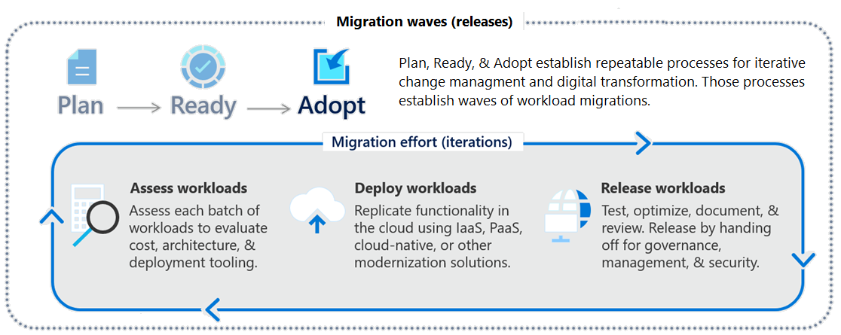
Focus on migration efforts
Notes:
Cloud Adoption Framework migration model - https://docs.microsoft.com/azure/cloud-adoption-framework/migrate/migration-considerations/
The One Migrate approach to migrating the IT portfolio - https://docs.microsoft.com/azure/cloud-adoption-framework/scenarios
Questions:
Why are we moving the solution to Azure?
What are the business objectives or quantifiable business goals?
What outcomes will you achieve?
Is there a timeline for building the solution Azure?
Is there a targeted event or date for an announcement about the solution's availability on Azure?

Slide 7

Describe the Azure Migration Framework

Slide 8




Determine your migration strategy
Select a strategy that meets your goals – you may need several strategies
Pattern | When to use
Rehost | Move workloads quickly to the cloud Don't need immediate changes to app capabilities
Refactor | Apply Azure DevOps practices or using a container strategy for workloads. Consider the portability of your existing code base and available development skills.
Rearchitect | Use existing application investments, Apps need major revisions for new features and to work effectively on a cloud platform.
Rebuild (new) | Rapid development and existing apps have limited functionality and lifespan. Expedite business innovation by using Azure DevOps practices. Legacy apps as no code or low apps in the cloud.
Notes:
Overview of application migration examples for Azure - https://docs.microsoft.com/azure/cloud-adoption-framework/migrate/azure-best-practices/contoso-migration-overview
The options Replace and Retire would not be considered migration strategies for the purposes of our discussion.

Slide 9

Assess your workloads

Slide 10
Determine what to migrate
Migrate and modernize all your mission-critical workloads to Azure.
Scenario | Description
Windows Server workloads | On-premises Windows virtual machines (not databases)
SQL Server workloads | Databases and other functionality running on SQL Server virtual machines
Linux workloads | RedHat or SUSE VMs, and Hadoop and Linux containers
ASP.NET-PHP-Java apps | Customer-facing and internal-facing apps at the SaaS level
SAP HANA | Enterprise resource planning with a centralized database
Specialized compute | High-performance computing (HPC)

Slide 11

Compare migration tools

Slide 12
Identify migration tools
Tool | Usage
Azure Migrate: Server Assessment | Physical servers and on-premises VMs running in Hyper-V and VMware environments as preparation for migrating to Azure.
Azure Migrate: Server Migration | Physical servers and on-premises VMs running in Hyper-V, VMware environments, and other public cloud VMs.
Azure Migrate: Database Assessment | Performs an assessment of on-premises Microsoft SQL Server databases as preparation for migration to Azure SQL Database, an Azure SQL Managed Instance, or Azure VMs running Microsoft SQL Server.
Azure Migrate: Database Migration | Migrates data from your existing on-premises databases to databases running in Azure.
Azure Migrate: Web App Assessment | Assessment of on-premises web apps and migrates them to Azure.
Azure Migrate: Data Box | Move of large amounts of offline data to Azure by using Azure Data Box.
Notes:
Plan your Azure migration - https://docs.microsoft.com/learn/modules/design-your-migration-to-azure/2-plan-your-azure-migration
There are also optimization tools like Azure Cost Management and Azure Advisor. And other tools like TCO calculator and Service Map.
And more Integration Tools - https://docs.microsoft.com/en-us/azure/migrate/migrate-services-overview#integrated-tools.

Slide 13

Migrate your databases

Slide 14
Select a database migration type
Database migrations can be performed offline and online
Migration type | Migration scenario
Offline | Requires shutting down the server at the start of the migration. Application downtime begins when the migration starts.
Online | To limit downtime to the time required to cut over to the new environment when the migration completes, use an online migration. Uses a continuous synchronization of live data, allowing a cutover to the Azure replica database at any time.
Each migration type supports different source and target database pairs
Check for support of your migration scenario as migration tools are updated frequently

Slide 15

Select an online migration tool

Slide 16
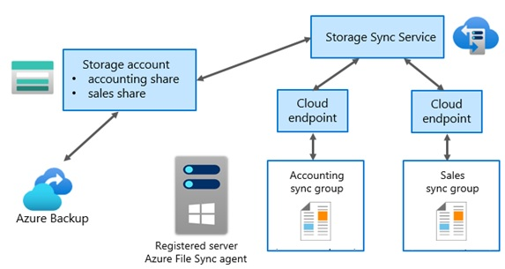
Consider using Azure File Sync
Azure File Sync can be used specifically for migration
Works in both hybrid and cloud migrations
Transfers both the data stream and file metadata
Combines with other products like Azure Data Box
Supports tiering options
Notes:
Planning for an Azure File Sync deployment - https://docs.microsoft.com/azure/storage/file-sync/file-sync-planning
Migrate to Azure File Shares - https://docs.microsoft.com/azure/storage/files/storage-files-migration-overview
Requires a Windows Server on premises.

Slide 17
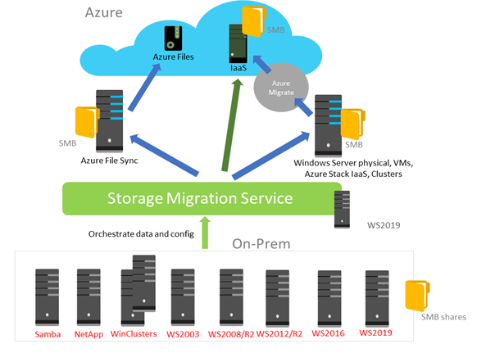
Consider the Storage Migration Service
Storage Migration Service migrates storage to Windows Server or to Azure.
Inventory multiple servers and their data
Rapidly transfer files, file shares, and security configuration from the source servers
Optionally, cut over to the new servers.
Notes:
Storage Migration Service overview - https://docs.microsoft.com/windows-server/storage/storage-migration-service/overview

Slide 18

Select an offline migration tool

Slide 19
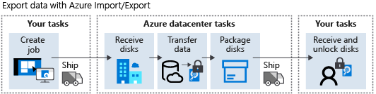
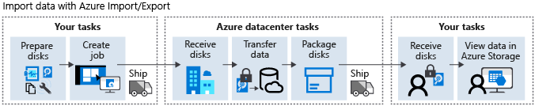
Consider the import/export service
Import/Export migrates on-premises locations and Azure Storage accounts.
Migrate large amounts of data from on-premises to Azure, as a one-time task
Back up your data on-premises in Azure Storage
Recover large amounts of data that you previously stored in Azure Storage
Distribute data from Azure Storage to customer site
Notes:
What is Azure Import/Export service? - https://docs.microsoft.com/azure/import-export/storage-import-export-service
Export large amounts of data from Azure by using Azure Import/Export - https://docs.microsoft.com/learn/modules/export-data-with-azure-import-export/
When should you use AzCopy instead of the Azure Import/Export service? Use AzCopy to transfer small to moderate amounts of data online across the network.

Slide 20
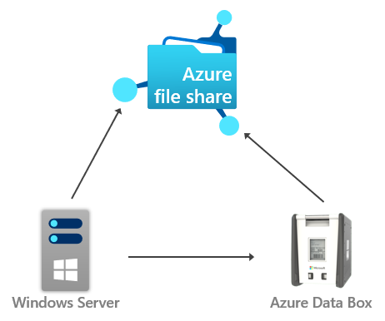
Consider the Data Box family of products
Data Box provides offline and online data transfer.
Scenarios to import data to Azure
One time migration
Initial bulk transfer
Periodic uploads
Scenarios to export data from Azure
Disaster recovery
Security requirements
Migrate back to on-premises or to another cloud service provider
Notes:
What is Azure Data Box? - https://docs.microsoft.com/azure/databox/data-box-overview
Migrate data offline to Azure File Sync with Azure Data Box - https://docs.microsoft.com/azure/storage/files/storage-files-migration-server-hybrid-databox
Move large amounts of data to the cloud by using Azure Data Box family - https://docs.microsoft.com/learn/modules/move-data-with-azure-data-box/
When should you use Azure Import/Export service instead of Data Box Family? Data Box family is the recommended solution for handling very large import or export jobs when the organization is in a region where it's supported.
Here are the various scenarios where Data Box devices can be used to import data to Azure.
One time migration - when large amount of on-premises data is moved to Azure.
Moving a media library from offline tapes into Azure to create an online media library.
Migrating your VM farm, SQL server, and applications to Azure
Moving historical data to Azure for in-depth analysis and reporting using HDInsight
Initial bulk transfer - when an initial bulk transfer is done using Data Box (seed) followed by incremental transfers over the network.
Periodic uploads - when large amount of data is generated periodically and needs to be moved to Azure. For example in energy exploration, where video content is generated on oil rigs and windmill farms.
Here are the various scenarios where Data Box can be used to export data from Azure. Data Box Disk and Data Box Heavy don't support exporting data from Azure.
Disaster recovery - when a copy of the data from Azure is restored to an on-premises network. In a typical disaster recovery scenario, a large amount of Azure data is exported to a Data Box. Microsoft then ships this Data Box, and the data is restored on your premises in a short time.
Security requirements - when you need to be able to export data out of Azure due to government or security requirements. For example, Azure Storage is available in US Secret and Top Secret clouds, and you can use Data Box to export data out of Azure.
Migrate back to on-premises or to another cloud service provider - when you want to move all the data back to on-premises, or to another cloud service provider, export data via Data Box to migrate the workloads.

Slide 21
Compare data migration solutions
Dataset | Network bandwidth | Solution to use
Large dataset | Low-bandwidth network or direct connectivity to on-premises storage is limited by organization policies | Azure Import/Export or Data Box for export; Data Box Disk or Data Box for import where supported; otherwise use Azure Import/Export
Large dataset | High-bandwidth network: 1 gigabit per second (Gbps) - 100 Gbps | AZCopy for online transfers; or to import data, Azure Data Factory, Azure Stack Edge, or Azure Data Box Gateway
Large dataset | Moderate-bandwidth network: 100 megabits per second (Mbps) - 1 Gbps | Azure Import/Export or Azure Data Box family where it is supported
Small dataset: a few GBs to a few TBs | Low to moderate-bandwidth network: up to 1 Gbps | If transferring only a few files, use Azure Storage Explorer, Azure portal, AZCopy, or AZ CLI
Notes:
Use this slide to broaden the discussion. Not every tool or scenario is covered in class.

Slide 22

Review

Slide 23

Discussion (matching)
What strategies or tooling would you suggest for these situations?
Media and corporate files
Product catalog that uses a database
On-premises virtual machines
On-premises NAS server
Cloud based blob storage
Notes:
This module does not have a case study. Use this slide to review different areas and what BCDR strategy they would use. There is more than one solution. Add to the slide other areas you want to emphasize. Talk thorough considerations and suggested solutions. There are no wrong answers, just better answers depending on the specific situation.
Media and corporate files – Import/export, blob upload, file sync, virtual machine migration.
Product catalog and marketing literature (database) – DMA, SSMA
On-premises virtual machines – Azure Migrate
On-premises NAS server – File Sync, Data Box
Cloud-based blob storage – automated

Slide 24
Summary and resources
Check your knowledge
Microsoft Learn Modules (docs.microsoft.com/Learn)
Design your migrations to Azure
Accelerate your migration journey to Azure
Applications and infrastructure migration and modernization
Migrate your relational data stored in SQL Server to Azure SQL Database
Prepare on-premises workloads for migration to Azure
Migrate on-premises workloads to Azure
Export large amounts of data from Azure by using Azure Import/Export
Move large amounts of data to the cloud by using Azure Data Box family
Notes:
Learn - https://docs.microsoft.com/learn/browse/
Design your migration to Azure - Learn | Microsoft Docs - https://docs.microsoft.com/learn/modules/design-your-migration-to-azure/
Accelerate your migration journey to Azure - Learn | Microsoft Docs - https://docs.microsoft.com/learn/modules/accelerate-azure-migration-journey/
Applications and infrastructure migration and modernization - Learn | Microsoft Docs - https://docs.microsoft.com/learn/modules/app-and-infra-migration-and-modernization/
Migrate your relational data stored in SQL Server to Azure SQL Database - Learn | Microsoft Docs - https://docs.microsoft.com/learn/modules/migrate-sql-server-relational-data/
Prepare on-premises workloads for migration to Azure - Learn | Microsoft Docs - https://docs.microsoft.com/learn/modules/prepare-onpremises-workloads-migration-azure/
Migrate on-premises workloads to Azure - Learn | Microsoft Docs - https://docs.microsoft.com/learn/modules/migrate-on-premises-workloads-azure/
Set up Azure Migrate for server migration - Learn | Microsoft Docs - https://docs.microsoft.com/learn/modules/m365-azure-migrate-set-up/
Export large amounts of data from Azure by using Azure Import/Export - - https://docs.microsoft.com/learn/modules/export-data-with-azure-import-export/
Export large amounts of data from Azure by using Data Box - https://docs.microsoft.com/learn/modules/move-data-with-azure-data-box/

Slide 25

End of presentation

Slide 26
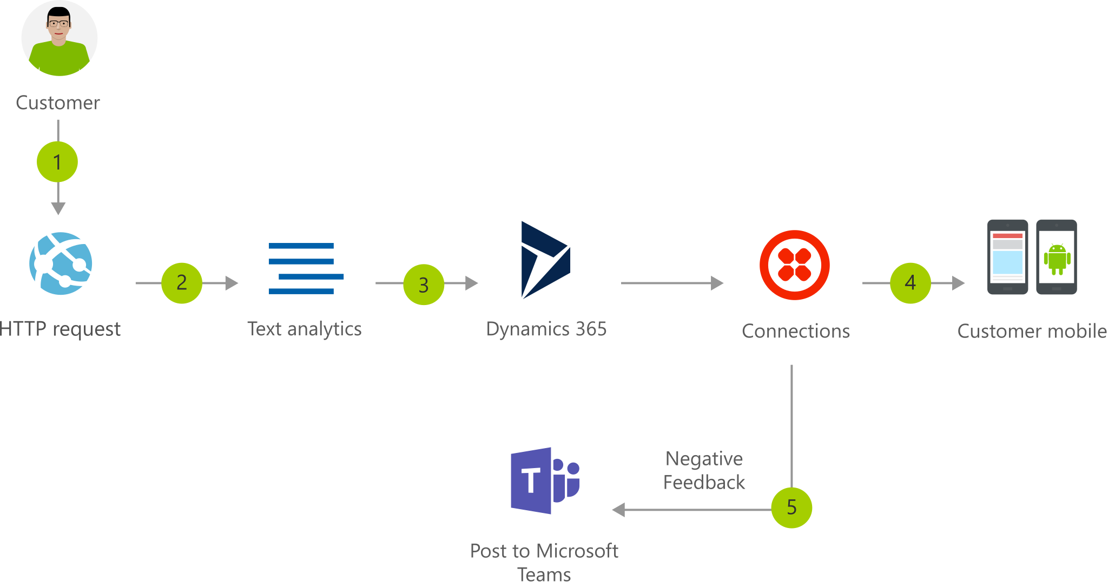
Optional – Whiteboard discussion #1
Lift and shift – customer support portal
Notes:
This line-of-business application solution provides a mechanism for monitoring and responding to customer feedback.
Modern customer support portal - https://docs.microsoft.com/azure/architecture/solution-ideas/articles/modern-customer-support-portal-powered-by-an-agile-business-process

Slide 27
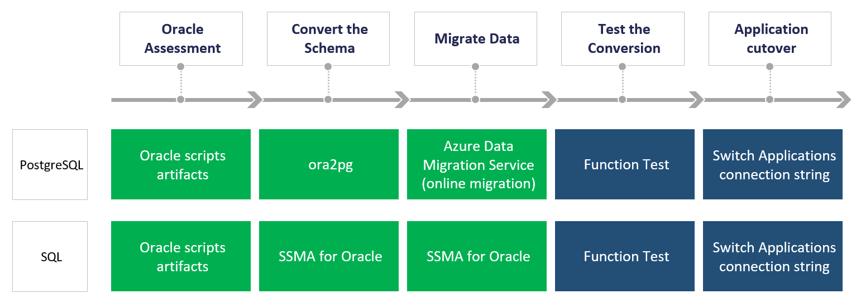
Optional – Whiteboard discussion #2
Oracle database migration
Notes:
This flow chart shows you the steps to move an Oracle database to either a PostgreSQL or a SQL database in Azure. The steps and the details are similar for both migration paths.
Oracle database migration - https://docs.microsoft.com/azure/architecture/example-scenario/oracle-migrate/oracle-migration-overview

