Slide 1


CCAWT Project
ST Dashboard
Eng. Ahmad Al-Sheikho
NANS-ISCEIT
Monday, May 16, 2022

Slide 2

Contents
ST Vision and Mission
Requirements Analysis
Use Case Design(HLD)
Coding Design (LLD)
Ambitions

Slide 3
ST Vision and Mission
To be the Leading Provider of Telecom Services
Customer Loyalty
Revenue Growth

Slide 4
Requirements Analysis
User Registration

Slide 5

Requirements Analysis
User Services

Slide 6
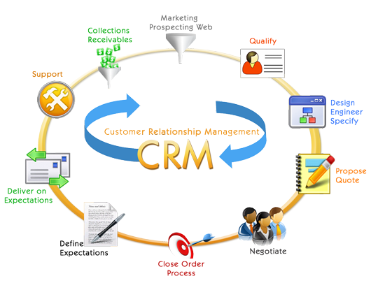
Requirements Analysis
Bill Inquiry

Slide 7

Requirements Analysis
User Usage (Voice & Data)

Slide 8
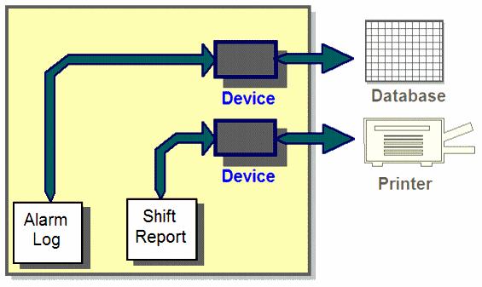
Requirements Analysis
User Compliance & Experience

Slide 9
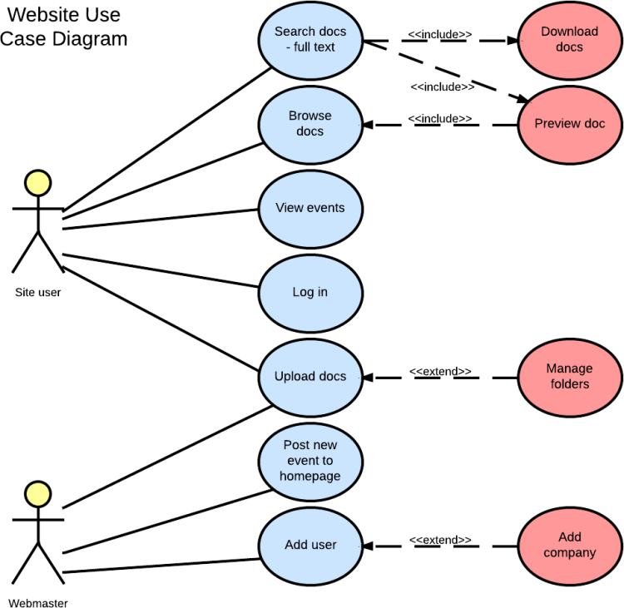
Use Case Design(HLD)

Slide 10
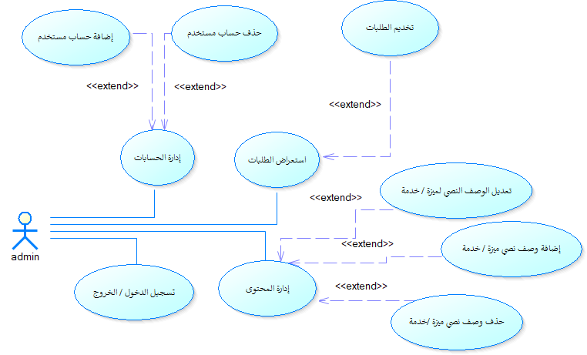
Use Case Design(HLD)

Slide 11
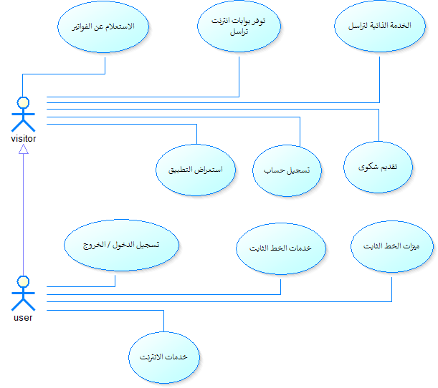
Use Case Design(HLD)

Slide 12
Use Case Design(HLD)

Slide 13
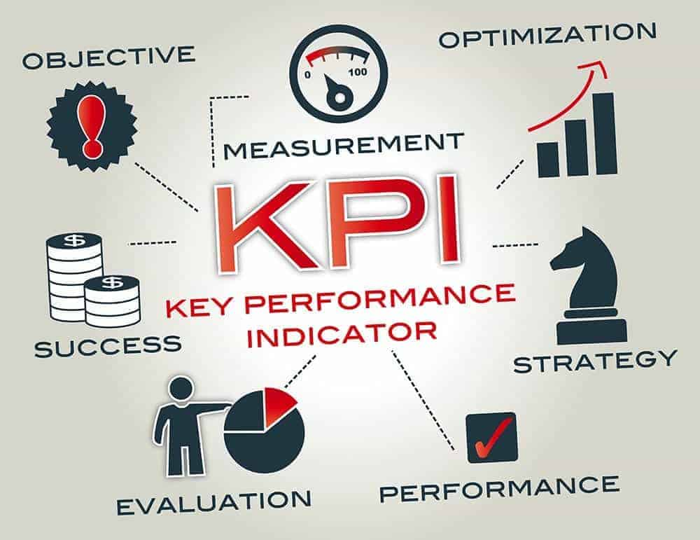
Coding Design (LLD)
PHP Laravel

Slide 14
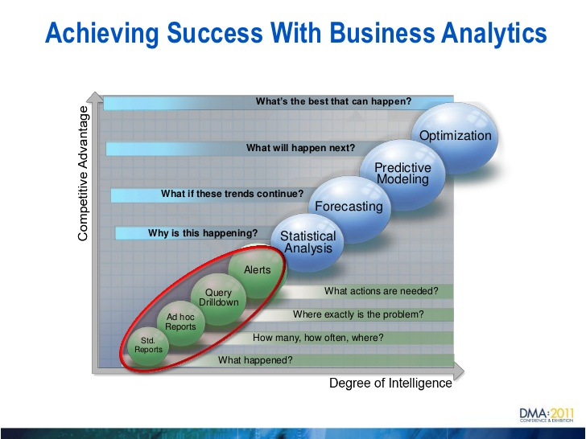
Coding Design (LLD)
CI\CD
Git Repository
Auto Build Test Deploy

Slide 15

Ambitions
Developer Team

Slide 16
Finalize
إذاً لدينا بيانات (معطيات) متعددة المصادر تمتاز بالتنوع من حيث:
الحجم (Volume)...
سرعة التغير(Velocity) ...
الشكل (Variety)...
ولجمعها وعرضها وتحليلها للاستفادة منها في دعم صناعة القرار نحتاج إلى:
المعطيات الكبيرة Big Data

Slide 17
Thank You
Eng. Ahmad Al-Sheikho
NANS-ISCEIT
Monday, May 16, 2022

