Slide 1


CCAWT Project
ST Dashboard
Eng. Ahmad Al-Sheikho
NANS-ISCEIT
Monday, May 16, 2022

Slide 2

Contents
ST Vision and Mission
Requirements Analysis
Use Case Design(HLD)
Coding Design (LLD)
Ambitions

Slide 3
ST Vision and Mission
To be the Leading Provider of Telecom Services
Customer Loyalty
Revenue Growth

Slide 4
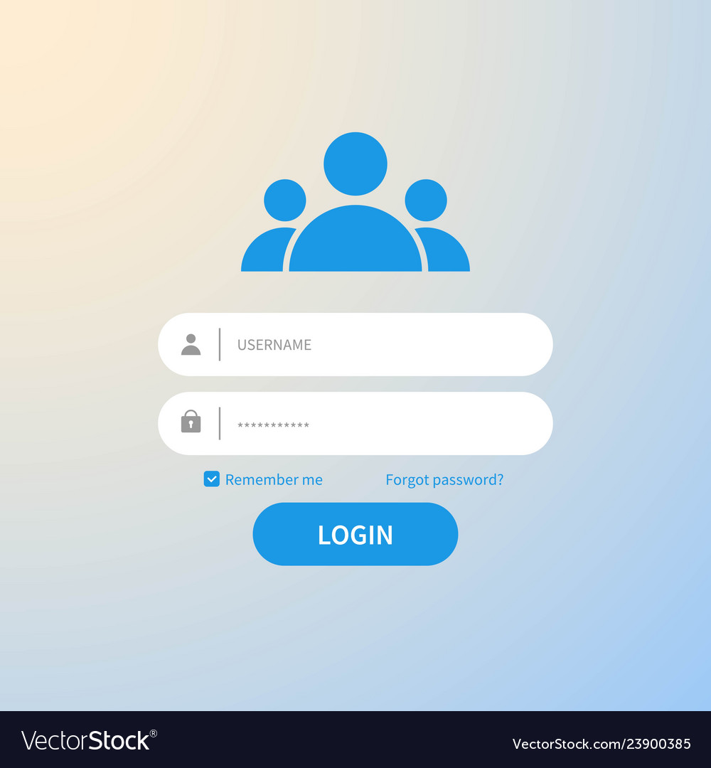
Requirements Analysis
User Registration

Slide 5

Requirements Analysis
User Services

Slide 6
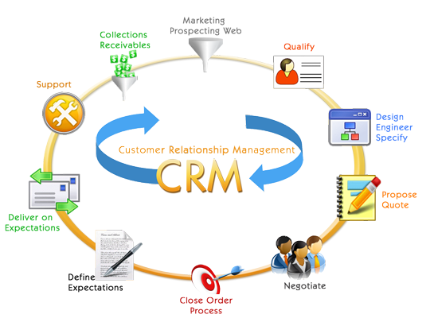
Requirements Analysis
Bill Inquiry

Slide 7
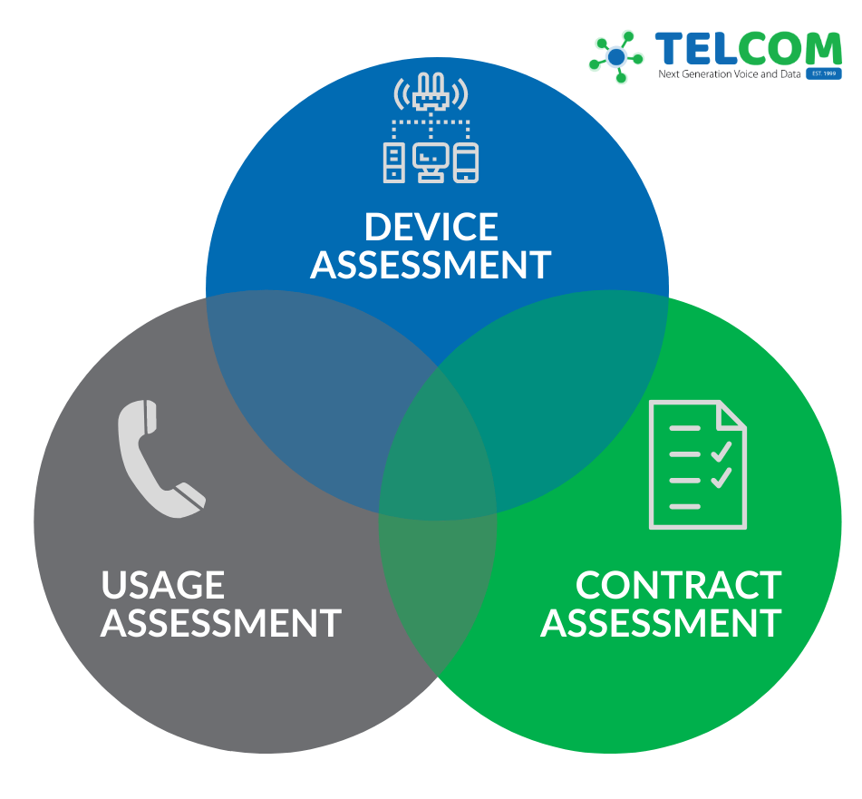
Requirements Analysis
User Usage (Voice & Data)

Slide 8

Requirements Analysis
User Compliance & Experience

Slide 9
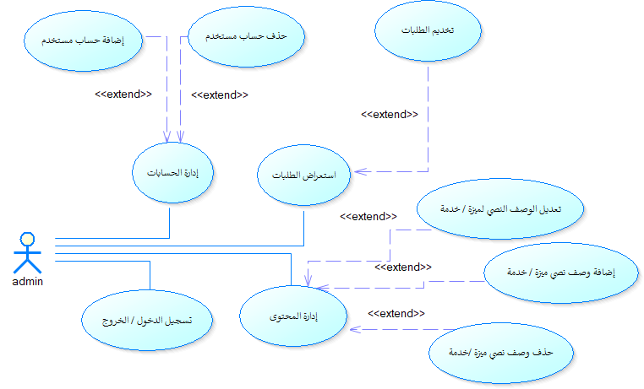
Use Case Design(HLD)

Slide 10
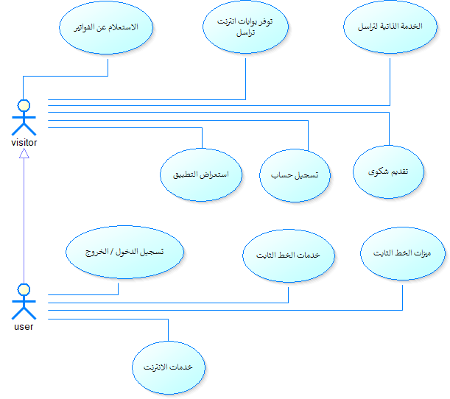
Use Case Design(HLD)

Slide 11
Use Case Design(HLD)

Slide 12
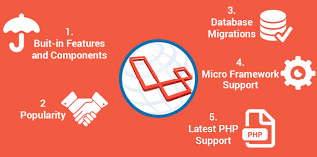
Coding Design (LLD)
PHP Laravel

Slide 13
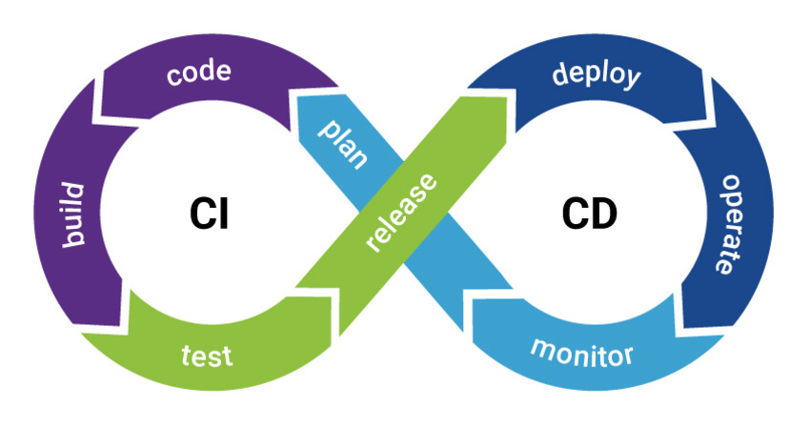
Coding Design (LLD)
Continuous Integration & Continuous Delivery
Git Repository
Auto Build Test Deploy

Slide 14
Ambitions
Build a Developer Team
Apply Methodology of Software Engineering

Slide 15
Thank You
Eng. Ahmad Al-Sheikho
NANS-ISCEIT
Monday, May 16, 2022

