Slide 1
A Centralized Data Validation Approach For Distributed Healthcare Systems In Dew-Fog Computing Environment Using Blockchain
Grace Simpson and Kester Quist-Aphetsi.
Sheikh Sadi Emon
ID: 20301349
CSE449
1

Slide 2
Introduction
Healthcare data security and accessibility
Highlight the need for reliable and available patient healthcare data
Challenges associated with conflicting treatments and unauthorized access
Objective of the paper: proposing a framework for centralized patient data validation in a dew-fog computing environment using blockchain
2

Slide 3
Literature Review
Cloud computing and its benefits in healthcare
Features and advantages of fog computing
Dew computing and its key features
Blockchain and its potential applications in healthcare
3

Slide 4
Methodology
System architecture for the proposed framework
Use of tiger hash function for data validation
Initialization, computation, and feedforward stages of the tiger hash function
Synchronization of data with the centralized data center
4

Slide 5
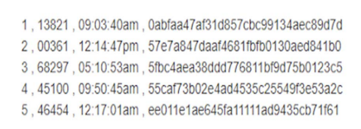
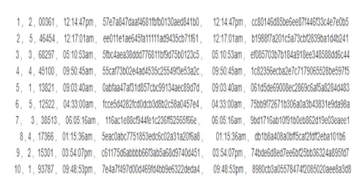
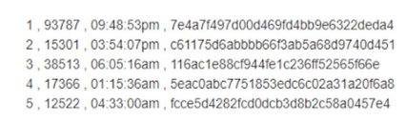
Results
Hash Values from Hospital 1
Hash Values from Hospital 1 and Hospital 2
Hash Values from Hospital 2
5

Slide 6
Conclusions
Secure and efficient approach to healthcare data validation and accessibility
Dew-fog computing and blockchain technology ensure availability and integrity of patient healthcare data
Validation and protection of data through hash functions
Enhanced patient care and reduced risks of conflicting treatments
6

Slide 7
References
G. Simpson and K. Quist-Aphetsi, "A Centralized Data Validation Approach for Distributed Healthcare Systems in Dew-Fog Computing Environment Using Blockchain," 2019 International Conference on Cyber Security and Internet of Things (ICSIoT), Accra, Ghana, 2019, pp. 1-4,
doi: 10.1109/ICSIoT47925.2019.00006.
7

Slide 8
Thanks You!
8

