Slide 1
Authorship Attribution in English Literature Using Machine learning
Presented by:
SK Saif Al Islam(16151012)
Md. Jahidul Kabir(16151037)
Sungida Shuchi(16151054)
Maruf Alam(17151097)
Supervised by- Dr. Supratip Ghose (PHD)

Slide 2
Outline
Introduction
Background Study and present state of the problem
Motivation
Problem Statement
Methodology
Algorithm
Experimentation
Improvement
Conclusion
References
Acknowledgement

Slide 3
Introduction
Authorship Attribution is the process of finding an author from anonymous text. This is a problem that can readily be framed as a text classification task, “where author represents a class (label) of a given text,” and as a result, recent research into author attribution analysis has focused almost exclusively on the use of machine learning techniques.

Slide 4
Background Study and present state of the problem
The aim of this analysis is to develop a machine learning-based model capable of successfully identifying the authorship of several stories from English Literature.
In doing this, we consider two approaches: a CNN-based approach, similar to that proposed by Shrestha et al. (2017) and a bag-of-words SVM-based approach, similar to that used by Green and Sheppard (2013).

Slide 5
Related Works (Cont.)
Authorship Attribution in Bengali Literature using Convolutional Neural Networks with fastText’s word embedding model [https://ieeexplore.ieee.org/document/8934492]
Authorship Attribution using Support Vector Machine ://ieeexplore.ieee.org/document/8929859]
Multi-Task Learning for Authorship Attribution via Topic Approximation and Competitive Attention [https://ieeexplore.ieee.org/document/8930008]
A Multiview Clustering Approach for Mining Authorial Affinities in Literary Texts[https://ieeexplore.ieee.org/document/8923628]
Authorship Analysis of Online Predatory Conversations using Character Level Convolution Neural Networks[https://ieeexplore.ieee.org/document/8914323]

Slide 6
Problem statement
The aim of this analysis is to develop a machine learning-based model capable of success-fully identifying the author of a text from English Literature.
In doing this, we consider two approaches: a CNN-based approach, similar to that proposed by Shrestha et al. (2017) and a bag-of-words SVM-based approach, similar to that used by Green and Sheppard (2013).

Slide 7
Contribution
Features of Authorship Attribution we extracted in Stylometric feature.
Character count/Word count is considered as stylometric feature.
We have compared CNN model with SVM model with required feature selection model.
Since we applying and Embeddings we also find the context of word.

Slide 8

Methodology
Raw Text
Preprocess
(Lemitization)
Feature Extract
Feature Enginerring
Feature Selection
Classifier
Word Preprocess Lemitization
Feature Extraction Stylometric Features
Feature Selection Word Embedding with bag of words
Classification CNN and SVM

Slide 9
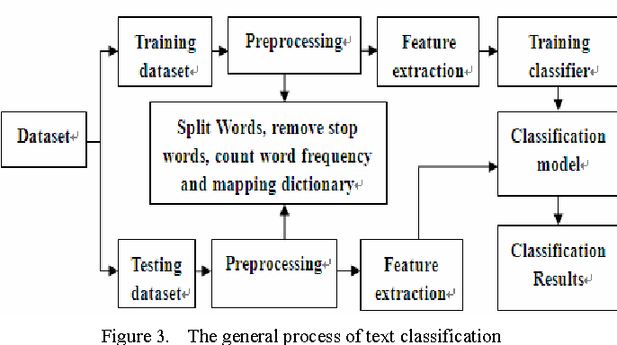
Workflow of Text Classification Process

Slide 10
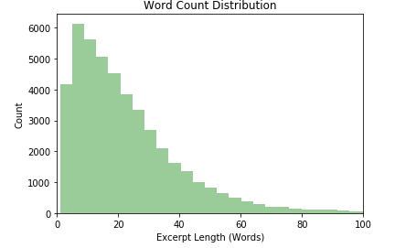
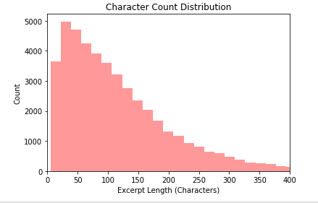
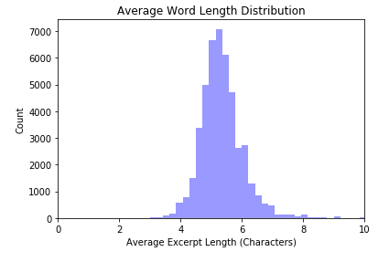
Stylometric Features Extraction
Word Count Distribution
Character Count Distribution
Average Word length Distribution

Slide 11
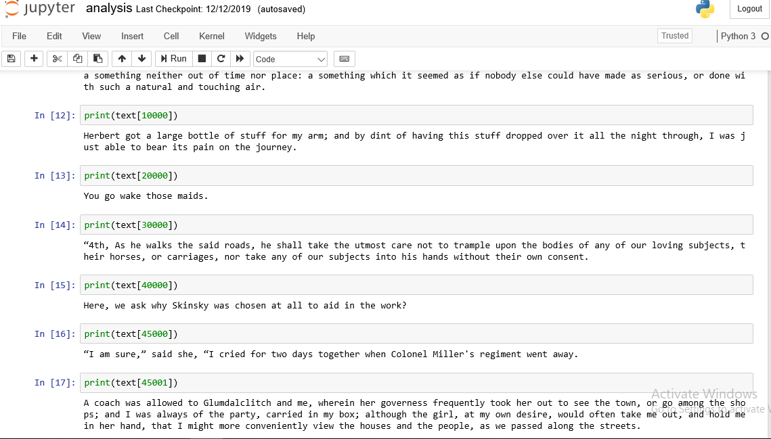
Data Exploration and Exploratory Visualization

Slide 12
Feature Selection
Traditional Approach
Data Pre Processing
Creating of n grams sequences
Creation of bag of words feature vectors (SVM)
One hot encoding of levels
Implementation
Refinement
Model-1 (Word Embedding : n gram model)
Proposed Approach

Slide 13
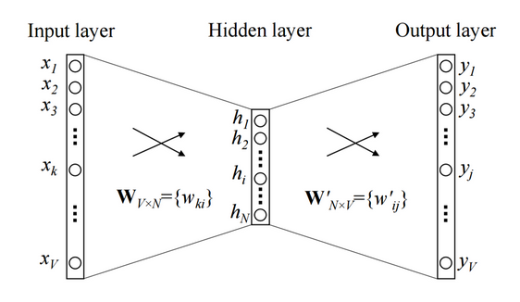
Word Embedding
Word Embedding is is capable of capturing context of a word in a document, semantic and syntactic similarity, relation with other words,
Figure : Word Embedding

Slide 14
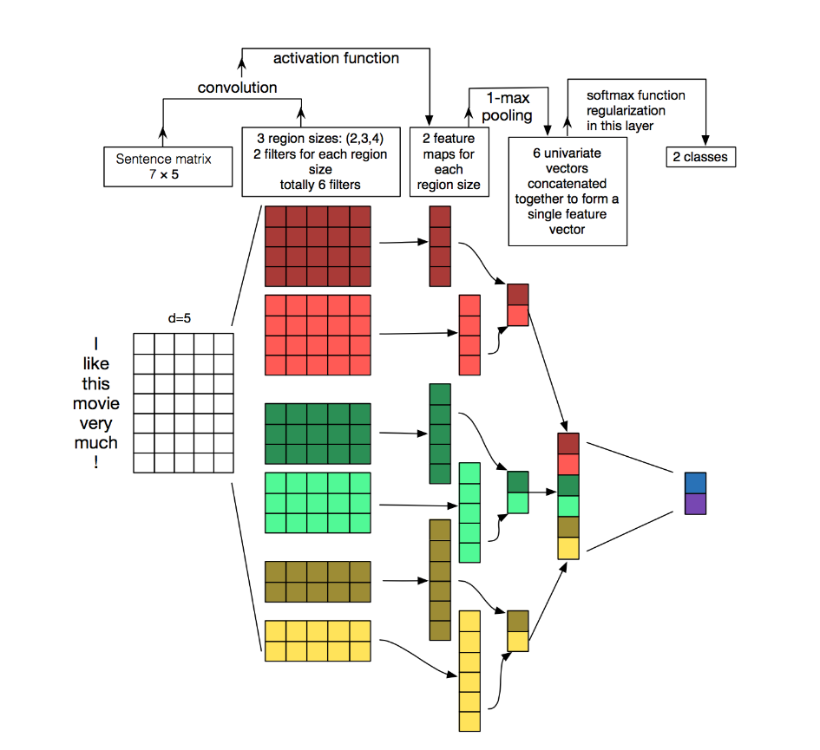
How CNN works for Text Classification
Figure: CNN Architecture for Text processing

Slide 15
Implementation
The CNN was implemented using Keras, while the SVM was implemented using sklearn’s SVC function.
• An embedding layer of dimension 26, in the 1-gram case; 300, in the 2-gram case and 600, in the 3-gram case.
• A 25% drop-out layer;
• A convolutional layer with 500 filters, kernels of size 3, 4 and 5 for each of the three channels respectively, and a ReLU activation function;
• A max pooling layer with pool size 2.

Slide 16
Classifier Used
The two main algorithms used in this analysis are
convolutional neural networks (CNNs)
Support vector machines (SVMs).

Slide 17
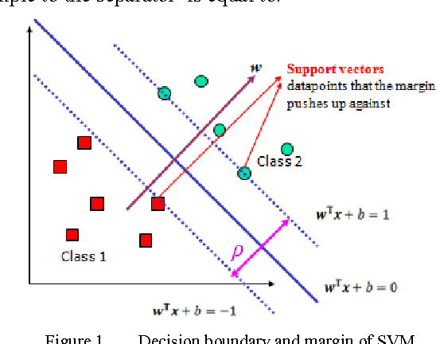
Support Vector Machine
In machine learning, support-vector machines are supervised learning models with associated learning algorithms that analyze data used for classification and regression analysis.

Slide 18
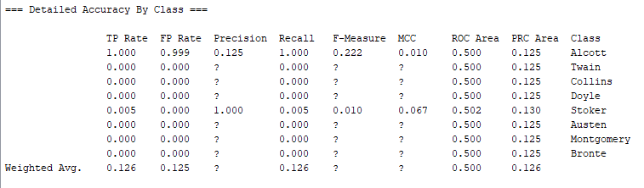
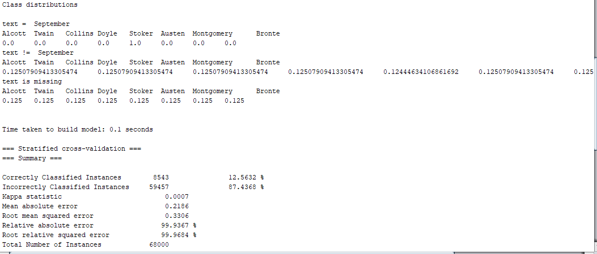
Data Description and Model Evaluation

Slide 19
Average Precision, Recall, F1 Score
Average precision is a measure that combines recall and precision for ranked retrieval results.
Recall refers to the percentage of total relevant results correctly classified by a particular algorithm.
F1 score is a measure of a test's accuracy. The F1 score can be interpreted as a weighted average of the precision and recall, where an F1 score reaches its best value at 1 and worst at 0.

Slide 20
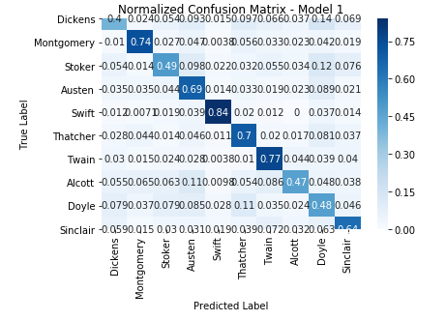
Confusion Matrix
Model -1
Figure : Confusion Matrix

Slide 21
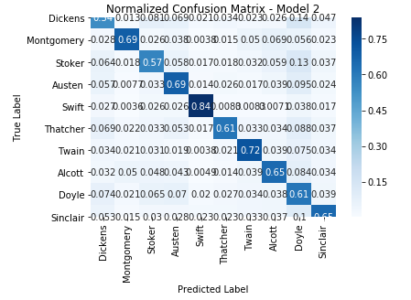
Confusion Matrix
Model -2
Figure: Confusion Matrix

Slide 22
Comparison Between CNN and SVM
CNN
SVM
Accuracy: .58
Average Precession: .59
Average Recall: .58
Average F1 Score: .57
Accuracy: .64
Average Precession: .66
Average Recall: .64
Average F1 Score: .65

Slide 23
Discussion
As CNN works with context therefore the relevancy of (Recall, Precision) if result for CNN word embedding combination will give us better result than the SVM with bag of words.
We have shown Stylometric feature as Words.
We have gained 58% accuracy because of we have worked on longer text.

Slide 24
Improvement
Some changes that could be made to the CNN, which may potentially result in improvements include:
• Using n-gram sequences, for n values greater than 3, as inputs;
• Using n-gram word sequences, instead of character sequences;
• Incorporating additional convolutional layers into each of the CNN model channels;
• Changing the number of filters used in the convolutional layers of the model and
• Incorporating some aspects of Recurrent Neural Network (RNN) architecture into the model, for example, long short-term memory (LSTM) units, which have previously been successfully applied to natural language problems.

Slide 25
Conclusion
Overall, both models considered in this analysis fit my expectations for a solution to this problem and I believe both could be used in a more general setting to solve similar problems to the author attribution problem presented in this analysis.

Slide 26
References:
[1] Brownlee, J. (2017). What are Word Embeddings for Text? https://machinelearningmastery.com/what-are-word-embeddings/.
[2]Diederich, J., J. Kindermann, E. Leopold, and G. Paass (2003). Authorship attribution with support vector machines. Applied Intelligence 19, 109–123.
[3]Forsyth, R. and D. Holmes (1996). Feature finding for text classification. Literary and Linguistic Computing 11 (4), 163–174.
[4]Green, R. and J. Sheppard (2013). Comparing frequency- and style-based features for Twitter author identification. Proceedings of the Twenty-Sixth International Florida Artificial Intelligence Research Society Conference, 64–69.

Slide 27
References (Cont.)
[5] Mohsen, A., N. El-Makky, and N. Ghanem (2016). Author identification using deep learning. Proceedings of the 15th IEEE International Conference on Machine Learning and Applications, 898–903.
[6] Schwartz, R., O. Tsur, A. Rappoport, and M. Koppel (2013). Authorship attribution of micro-messages. Proceedings of the 2013 Conference on Empirical Methods in Natural Language Processing. Seattle, Washington, USA, 1880–1891.
Shrestha, P., S. Sierra, F. Gonz´alez, P. Rosso, M. Montes-y G´omez, and T. Solorio (2017). Convolutional neural networks for authorship attribution of short texts. Proceedings of the 15th Conference of the European Chapter of the Association for Computational Linguistics: Volume 2, Short Papers. Valencia, Spain, 669–674. Udacity (2017). Deep Learning Nanodegree [Online Course]. https://

Slide 28
Acknowledgement
We would like to convey our Heart felt to our supervisor DR. Supratip Ghose who always gave valuable suggestion and guidelines for the completion of the project.

Slide 29

Any Question

Slide 30
Thank You

