Slide 1

The Chronicle – Vintage Blog Platform (MERN)
A full-stack blogging platform built with the MERN stack, offering a unique blend of vintage aesthetics and modern functionality.
Role-Based Access Control
Vintage UI Theme
Responsive Design
A charming, nostalgic user experience.
Seamless experience across all devices.
Secure and managed user permissions.
Secure JWT Auth
Full CRUD Capabilities
Protected routes and user data.
Complete control over blog content.

Slide 2

Features & User Roles
Key Features
User Roles
Vintage UI Styling
Tailwind CSS v4 for a classic look.
Reader
View published posts, leave comments.
JWT Authentication
Secure user sessions and protected routes.
Author
CRUD Post Management
Create, edit, and publish their own posts.
Create, Read, Update, Delete blog posts easily.
Admin Dashboard
Admin
Centralized control for administrators.
Full control over users, posts, and settings.
Responsive Design
Optimized for all screen sizes.

Slide 3
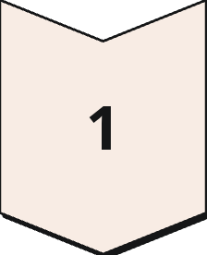
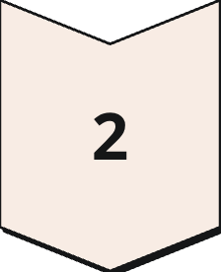
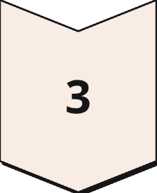
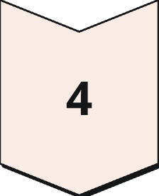
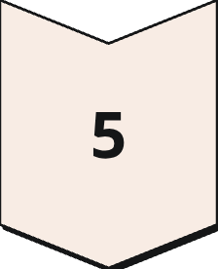
Tech Stack
Frontend
Backend
React 19
Node.js
Dynamic UI components.
Server-side runtime environment.
Vite 7
Express 4
Fast build tool and dev server.
Web application framework.
Tailwind CSS 4
MongoDB & Mongoose 8
Utility-first styling.
NoSQL database and ODM.
Axios
JWT
HTTP client for API calls.
JSON Web Tokens for authentication.
React Router DOM 7
bcryptjs
Declarative routing.
Password hashing library.

Slide 4
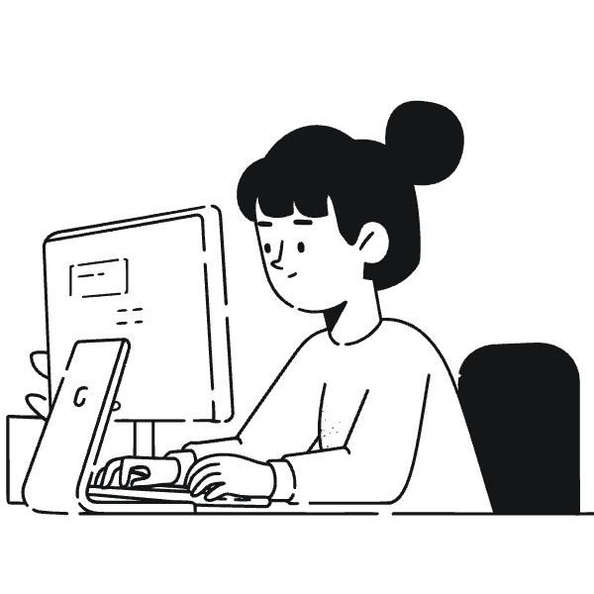
Setup & API Overview
Quick Setup Steps
Key API Endpoints
Clone Repository: git clone [repo-url]
01
Install Dependencies: npm install in both root and client directories.
Authentication
Environment Variables: Create .env files as per documentation.
/api/auth for login, register, logout.
Run Backend: npm start in root.
Run Frontend: npm run dev in client.
02
Posts
/api/posts for CRUD operations on blog posts.
03
Admin Management
/api/admin for user and content control.

Slide 5

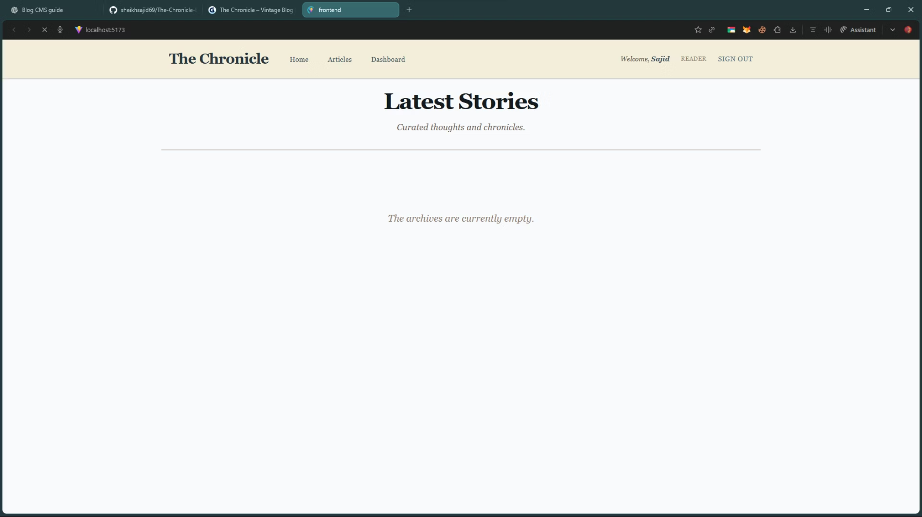
Project Structure and UI

Slide 6
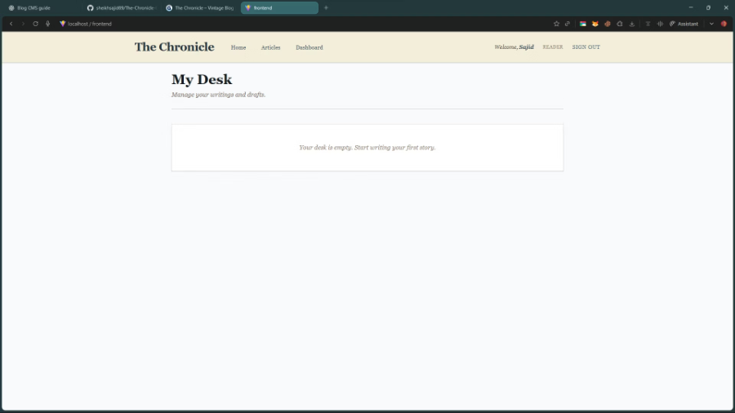
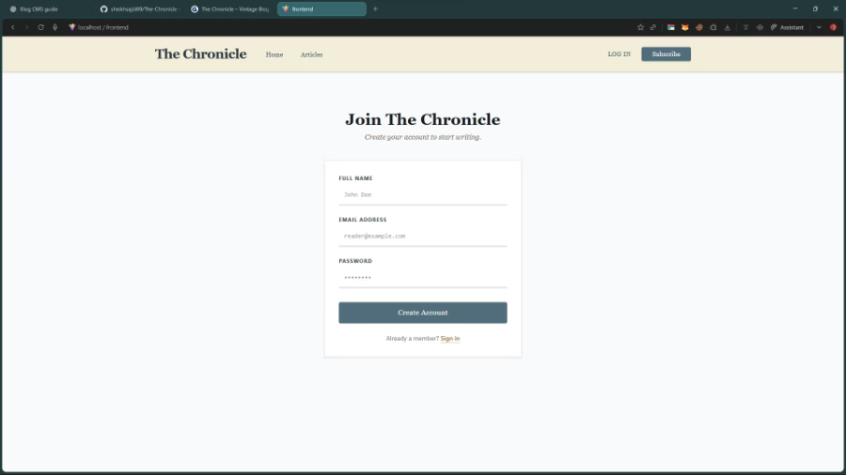
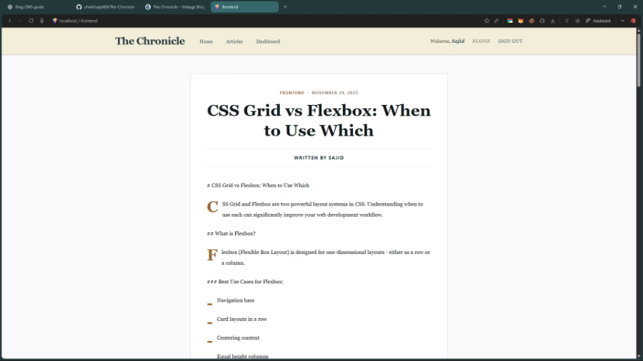
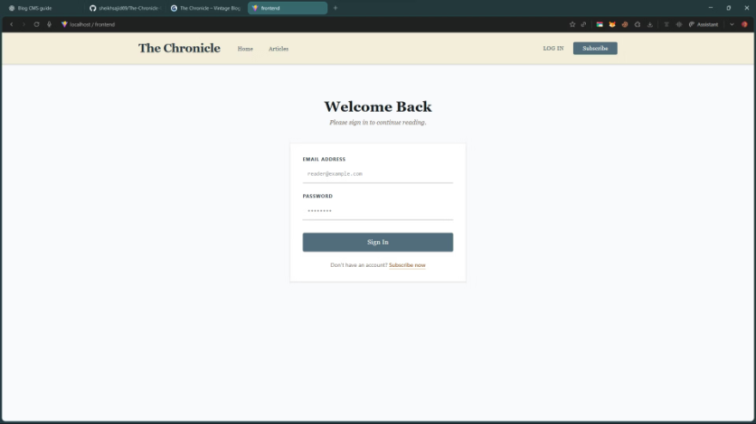
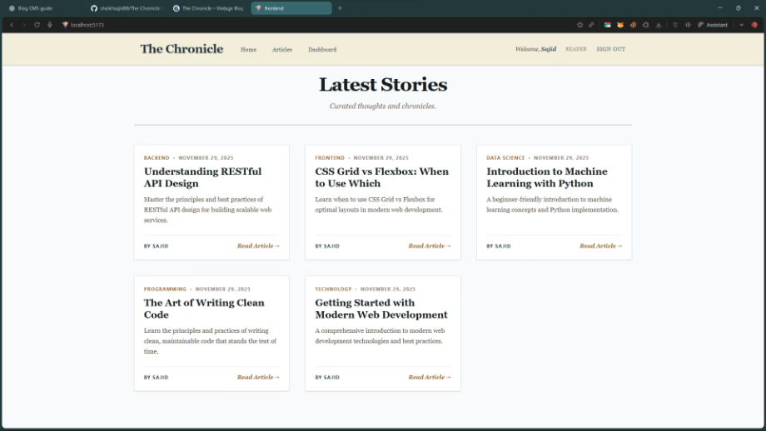
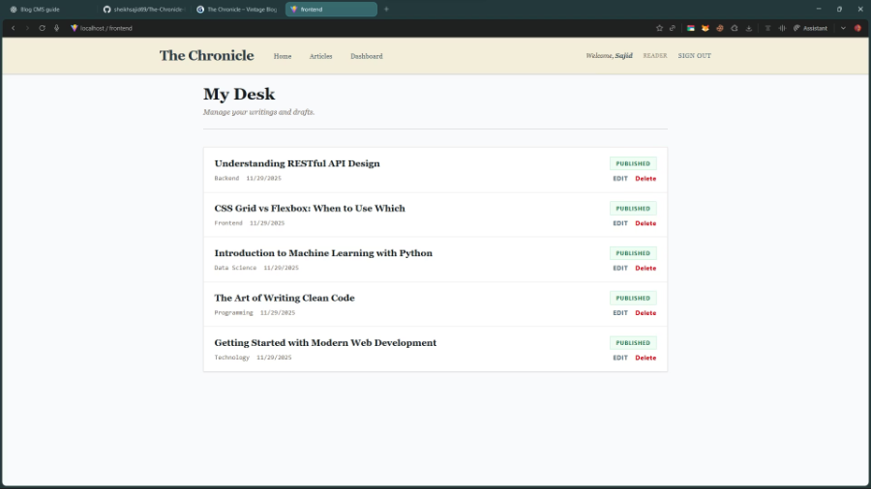
Pages

