Slide 1
LangNation Cloud Platform
PROGRESS PRESENTATION · MONDAY 19 OCTOBER 2026
6 milestones
implemented and validated
Milestones 1–6 · implemented and validated
2 AZs
AWS Cloud Computing with AI Bootcamp
multi-AZ application + data layer
What I built, why I designed it this way, and how I validated it.
Auto recovery
Route 53
CloudFront
WAF
ALB
ECS
Cognito
morning rebuild after nightly cleanup + DNS sync
Request path · secure · highly available · automated · containerized · cloud-native
Live endpoint
Presented by SERAJ AHMAD SIDDIQUI
cloud.langnation.com/de
Guidance: Micheal (Theory Teacher) · Rahul (Practical Teacher) · Dominic (HoD)
Notes:
Opening (20–30 sec): “My capstone is LangNation Cloud Platform. The goal is to turn a simple application into a secure, highly available and reproducible AWS platform.”
Say that today you will focus on what has been completed through Milestone 6, not future services.
Mention that the environment is a teaching sandbox that is cleaned regularly, so reproducibility and recovery became a real design requirement.

Slide 2




The challenge and the design goal
Overview
Real LangNation use case: students learn, teachers manage materials, admins operate the platform — on a repeatable, secure AWS foundation.
CHALLENGE 1
Target platform
Sandbox resets
AWS resources are cleaned regularly, so the environment must be reproducible instead of manually rebuilt.
Reproducible
Terraform / HCP Terraform owns infrastructure
Deployable
GitHub Actions builds and releases the application
CHALLENGE 2
Security
Private by default
ECS and RDS stay in private subnets
No direct access to ECS or RDS; edge traffic passes CloudFront + WAF; authentication uses Cognito JWTs.
Protected at the edge
HTTPS + CloudFront + WAF
CHALLENGE 3
Authenticated
Cognito access tokens protect API routes
Availability
Application tasks, networking and database components span two Availability Zones.
Recoverable
Morning automation rebuilds infra, app and DNS
Notes:
Explain the three real engineering constraints: disposable sandbox, security, and high availability.
Then connect them to the platform goals on the right.
Key line: “I wanted the environment to be rebuildable from code, not dependent on what I clicked yesterday.”

Slide 3




Master architecture — Milestones 1–6
M1–M6
Everything completed so far, on one map. Use it as the guide for the rest of the presentation.
PUBLIC ENTRY
Users
Route 53
personal AWS
CloudFront + WAF + ACM
HTTPS edge · sandbox
ALB
CloudFront-only
Cognito
JWT validated by the API
Sandbox AWS account · VPC 10.0.0.0/16 · us-east-1 · 2 Availability Zones
Secrets Manager
RDS credentials
Availability Zone us-east-1a
Availability Zone us-east-1b
Public 10.0.1.0/24 · NAT Gateway
Public 10.0.2.0/24 · NAT Gateway
S3
private · versioned · SSE‑S3
App 10.0.11.0/24 · ECS Task A · no public IP
App 10.0.12.0/24 · ECS Task B · no public IP
CloudWatch
logs + metrics
DB 10.0.21.0/24 · RDS Primary · local-only route
DB 10.0.22.0/24 · RDS Standby (Multi-AZ)
Security path
CF→ALB :80 · ALB→ECS :3000 · ECS→RDS :3306
AUTOMATION & DELIVERY
Terraform modules
HCP Terraform · remote state
Sandbox AWS
GitHub Actions
OIDC
ECR
ECS rolling deploy
Morning recovery: HCP Terraform rebuild → restore application → discover CloudFront → update persistent Route 53 → verify public HTTPS
Notes:
Spend about 60 seconds here. Do not read every box.
Trace the main request path: user → Route 53 → CloudFront → WAF → ALB → ECS.
Then point to private database/storage, CI/CD, Terraform and morning recovery.
Clarify account boundary: Route 53 is kept in the personal AWS account because DNS must survive sandbox cleanup; workload services remain in the sandbox.
The full reference diagram and the live interactive walkthrough follow on the next two slides.

Slide 4









Why I chose these AWS resources
Design
Every service answers one of the four design goals: secure, highly available, reproducible or recoverable.
NETWORK & EDGE
NETWORK & EDGE
NETWORK & EDGE
NETWORK & EDGE
VPC · 2 AZs
NAT Gateways ×2
Route 53
CloudFront + ACM
Isolates tiers; two AZs remove a single point of failure
Outbound-only internet for private tasks, one per AZ
Persistent DNS in personal AWS — survives sandbox cleanup
One HTTPS entry point with managed TLS certificates
NETWORK & EDGE
COMPUTE
COMPUTE
COMPUTE
AWS WAF
Amazon ECR
ECS Fargate
ALB + Auto Scaling
Blocks common web attacks and rate-limits abusive IPs
Private image registry; Git-SHA tags make deploys traceable
Runs containers privately with no EC2 servers to manage
Health checks across both AZs; scales 2 → 4 tasks on CPU
DATA
DATA
SECURITY
SECURITY
RDS MySQL Multi-AZ
Amazon S3
Secrets Manager
Amazon Cognito
Managed DB with synchronous standby, encryption, backups
Private, versioned, encrypted storage with lifecycle cleanup
Database credentials never stored in code or config
Managed sign-in; the API only verifies JWT access tokens
Also: IAM OIDC — GitHub deploys with no long-lived keys · CloudWatch — logs, metrics and Container Insights
Notes:
Spend about 60 seconds here. Do not read every box.
Trace the main request path: user → Route 53 → CloudFront → WAF → ALB → ECS.
Then point to private database/storage, CI/CD, Terraform and morning recovery.
Clarify account boundary: Route 53 is kept in the personal AWS account because DNS must survive sandbox cleanup; workload services remain in the sandbox.
The full reference diagram and the live interactive walkthrough follow on the next two slides.

Slide 5
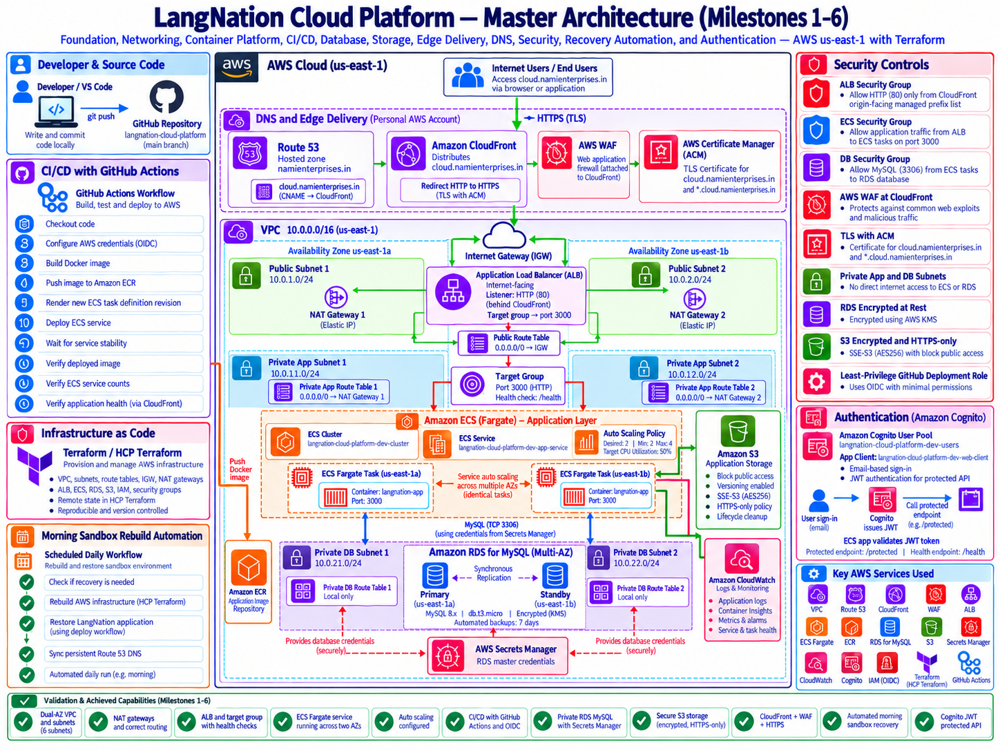
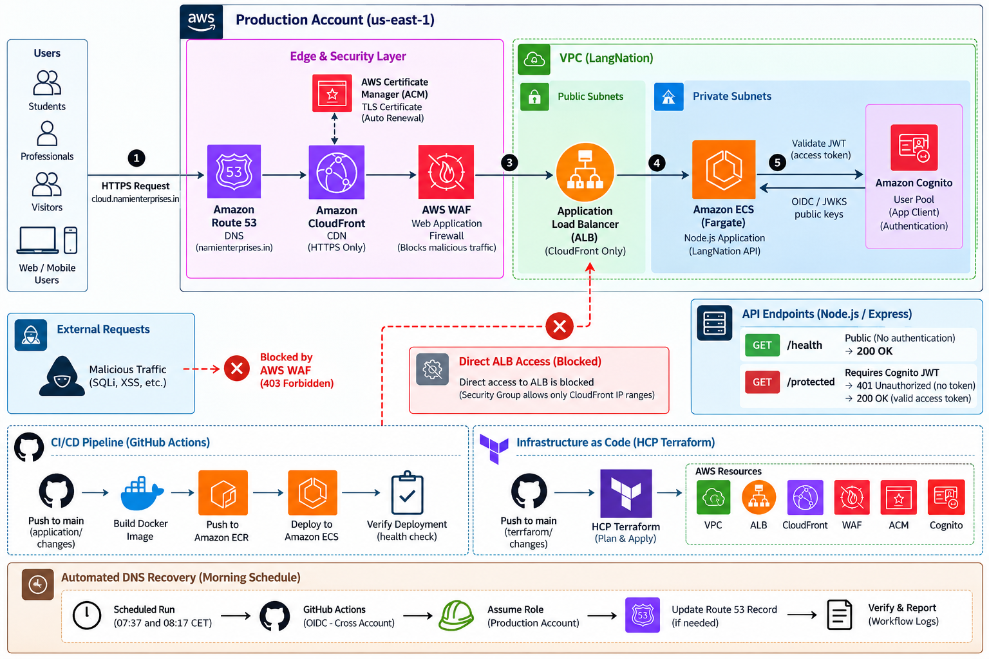
Master architecture
M1–M6
The complete Milestones 1–6 reference diagram, from source code to the private data tier.
Notes:
Optional deep-dive slide — skip if short on time.
This is the full reference diagram. Walk the audience around the zones in the order on the right rather than reading boxes.
If people want to see a flow in motion, switch to the live interactive walkthrough on the next slide.

Slide 6
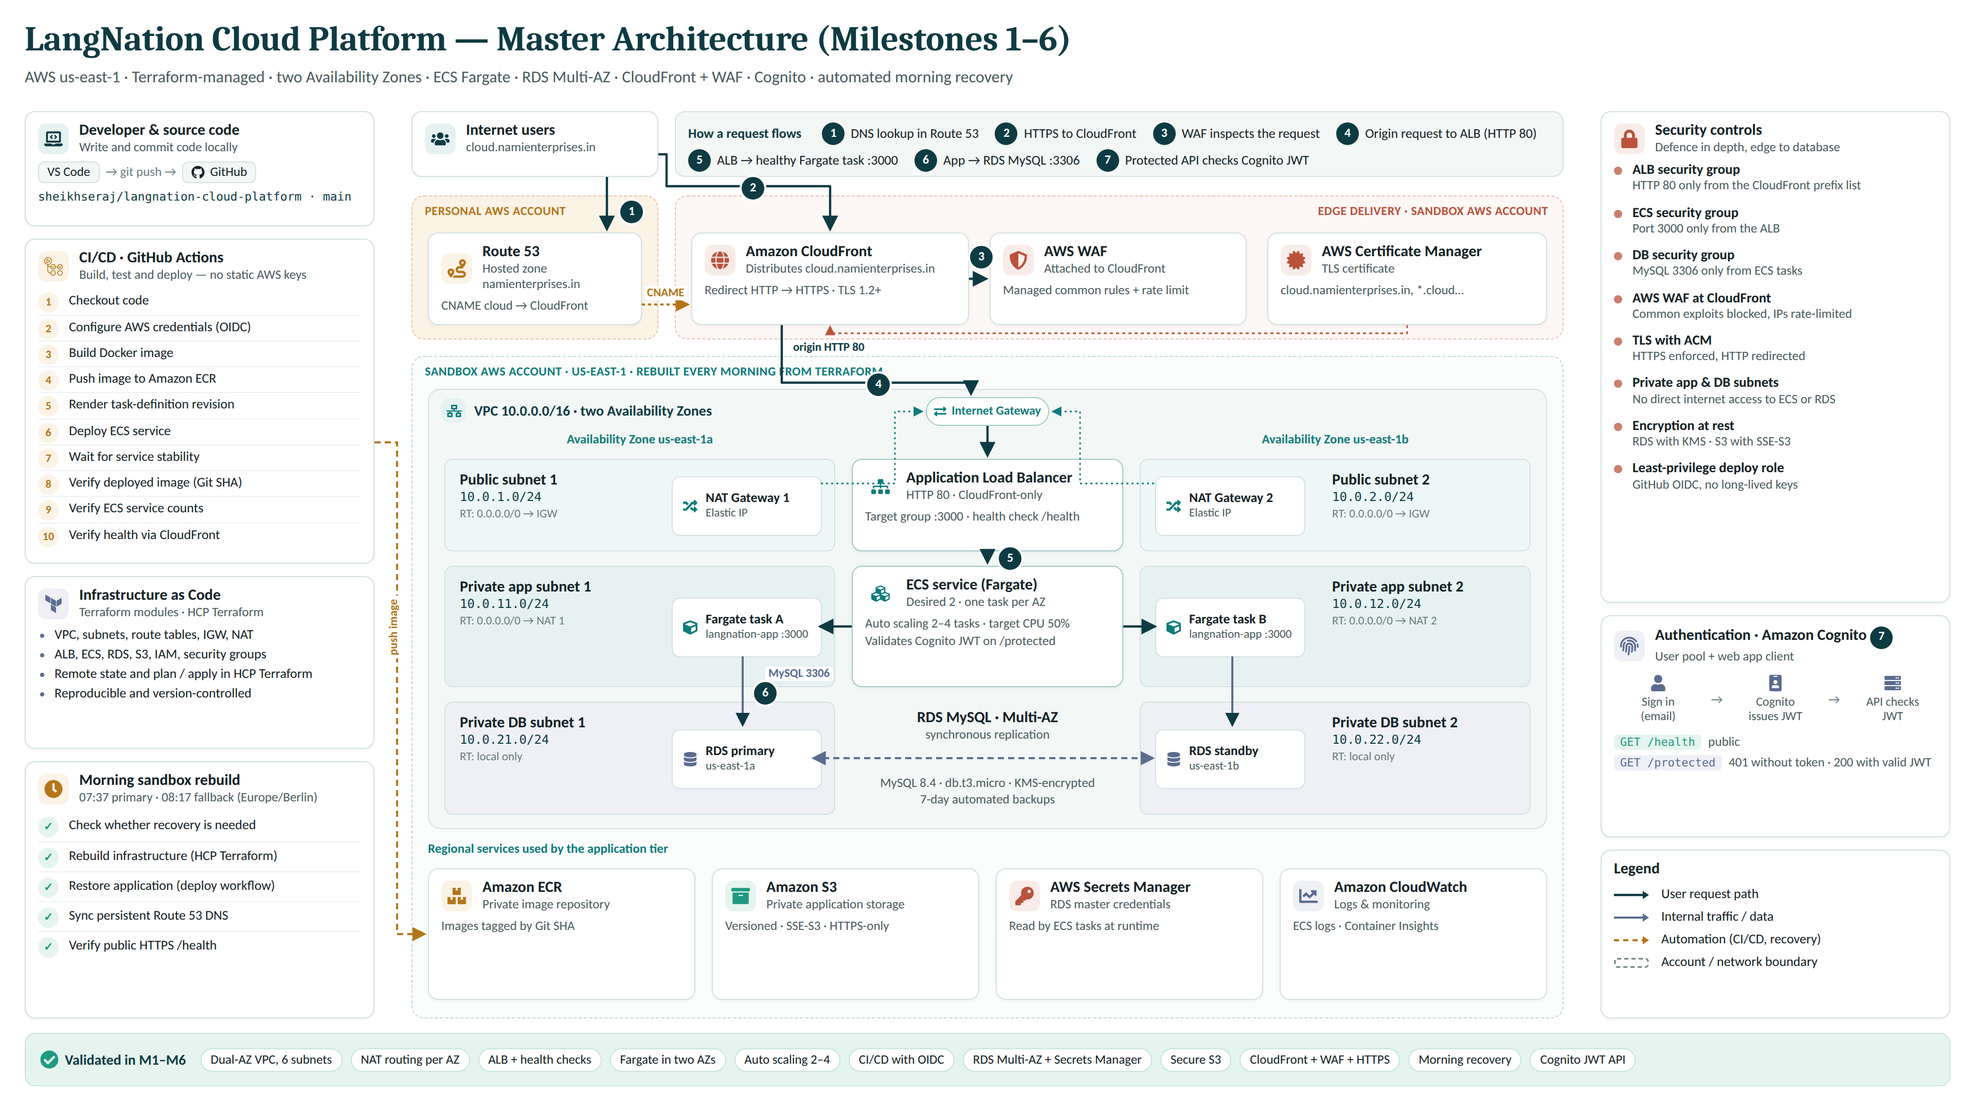
Master architecture — full detail
M1–M6
Notes:
Optional deep-dive slide — skip if short on time.
This is the full reference diagram. Walk the audience around the zones in the order on the right rather than reading boxes.
If people want to see a flow in motion, switch to the live interactive walkthrough on the next slide.

Slide 7
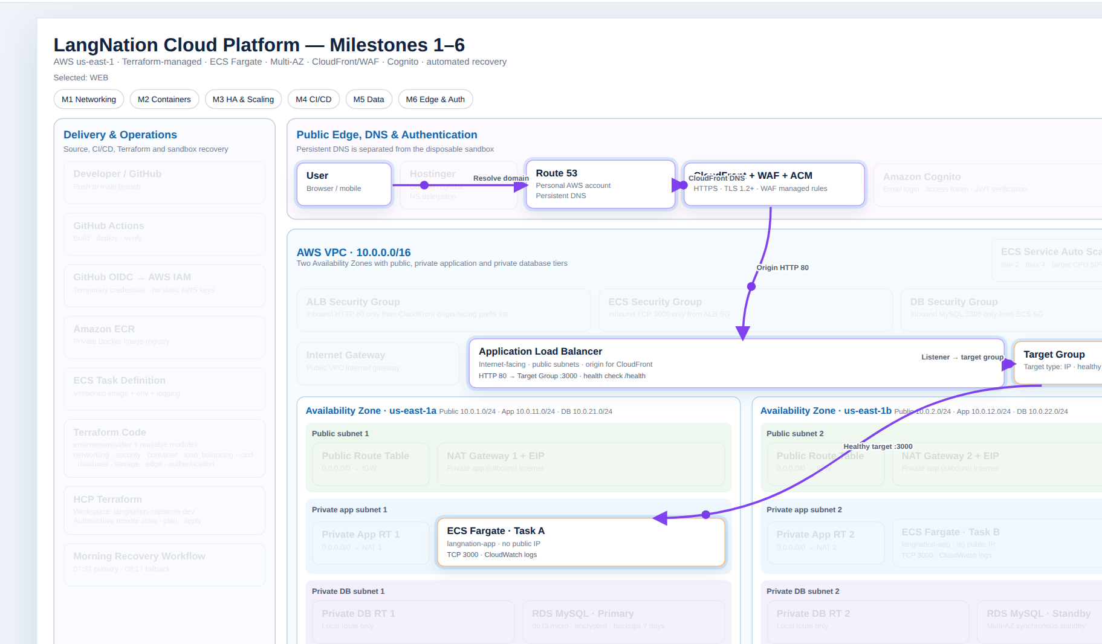

Live interactive walkthrough
Live demo
An animated version of the architecture — choose a milestone or flow and watch the request path move.
Live walkthrough
Opens the HTML file in your browser. Keep it in the same folder as this deck.
Suggested demo order
1
Milestones M1 → M6 (keys 1–6)
2
Flow · CI/CD deployment
3
Flow · Cognito authentication
4
Flow · Morning sandbox recovery
Keyboard
1–6 milestone
Space play / pause
Shown: Flow · Public web request — User → Route 53 → CloudFront + WAF → ALB → target group → ECS task.
A all flows
F fullscreen
S auto sequence
Notes:
Click the screenshot or the amber button to open the animated walkthrough (the HTML file must sit in the same folder as this PowerPoint).
Suggested order: M1 → M6 with keys 1–6, then the CI/CD, Cognito authentication and morning recovery flows.
Press F for fullscreen, Space to pause. Alt+Tab back to PowerPoint when done.
If the link does not open, open the HTML file directly from the folder.

Slide 8


Foundation & networking
M1
A two-AZ VPC separates public ingress, application compute and the database layer.
VPC 10.0.0.0/16
Availability Zone us-east-1a
Availability Zone us-east-1b
Routing design
Public
Internet Gateway
10.0.1.0/24
10.0.2.0/24
Public
ALB · NAT Gateway
ALB · NAT Gateway
Private app
same-AZ NAT
internet-facing
Private DB
local only
10.0.11.0/24
10.0.12.0/24
Private app
ECS Fargate tasks
ECS Fargate tasks
compute
No public IP on ECS
tasks are reachable only through the ALB
10.0.21.0/24
10.0.22.0/24
Private DB
RDS only · no internet route
RDS only · no internet route
RDS not public
database has no internet route
data
Notes:
Explain the subnet strategy, not every route-table ID.
Why two NAT gateways? Each private app subnet exits through its own AZ, avoiding a single-AZ dependency.
Why DB route tables are local-only? The database does not need general internet egress.
This is the foundation used by every later milestone.

Slide 9
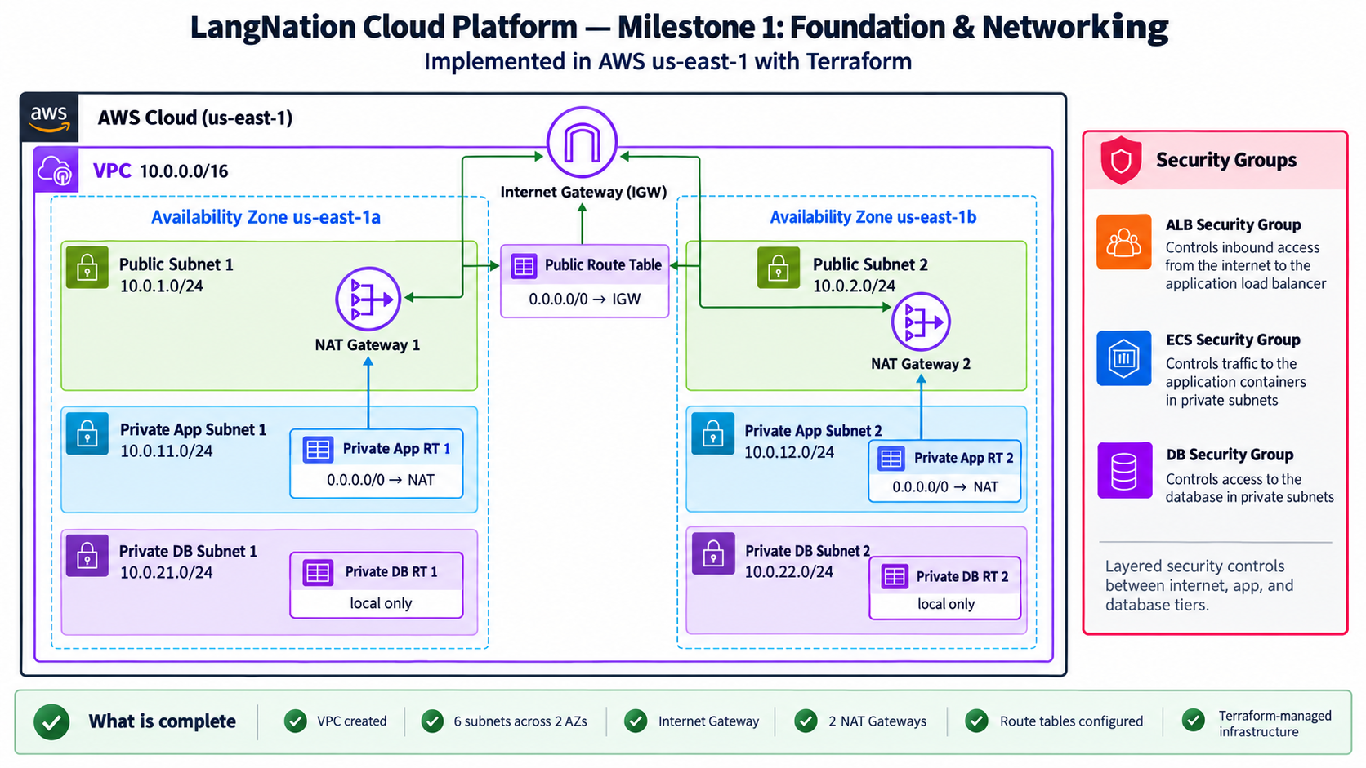
Foundation & networking — as built
M1
Milestone 1 delivered the VPC, six subnets, per-tier route tables and layered security groups — all from Terraform.
6
subnets across two Availability Zones
2
NAT gateways, one per AZ
3
security groups: ALB · ECS · DB
Milestone 1 diagram — each tier has its own route table; each AZ has its own NAT gateway.
Notes:
Optional deep-dive slide.
Point out the three tiers and that each private app subnet routes through the NAT gateway in its own AZ.
Private DB route tables are local-only. Security groups are layered: ALB → ECS → DB.

Slide 10
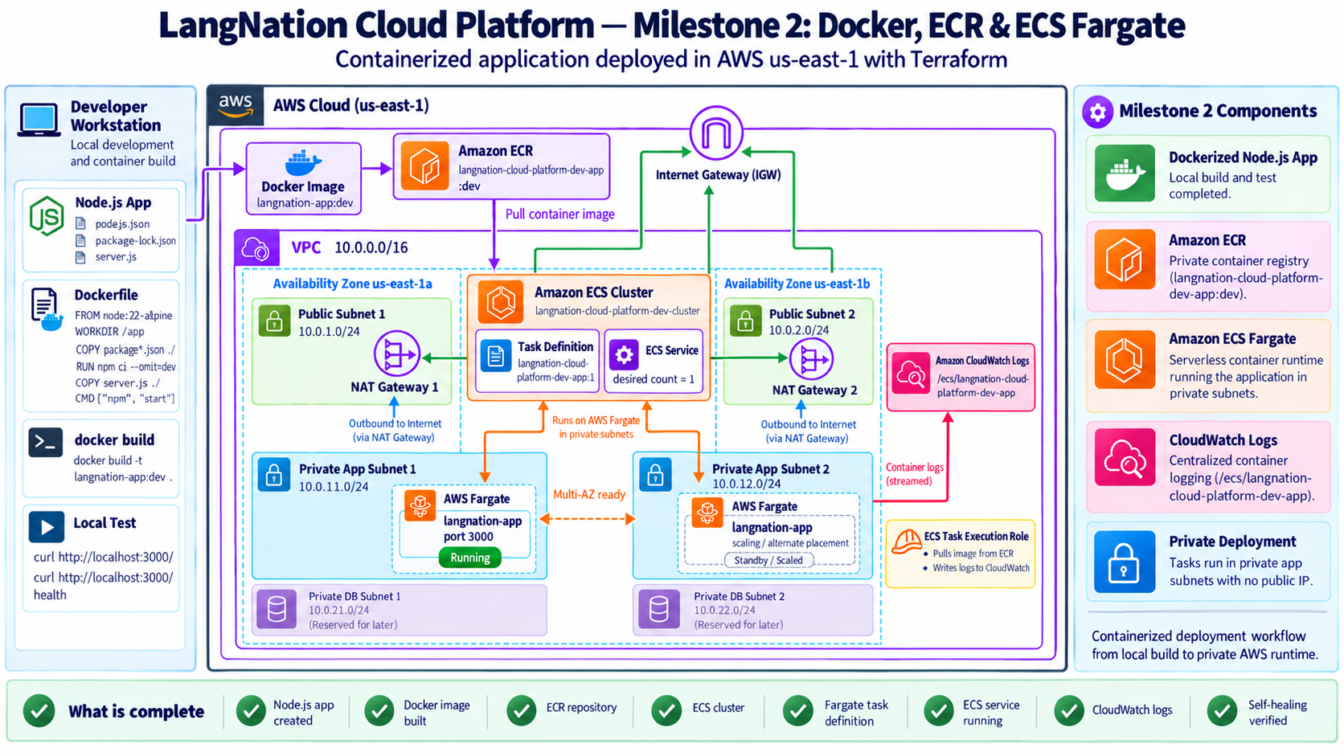


Containers, load balancing & auto scaling
M2 · M3
Docker images are stored in ECR and deployed as private ECS Fargate tasks behind an Application Load Balancer.
Baseline capacity
2 ECS tasks spread across both Availability Zones
Auto scaling
Min 2 · max 4 · CPU target 50%
Health & self-healing
ALB checks /health on port 3000; failed tasks are replaced
Milestone 2 build snapshot (one task at that stage). The service now runs two tasks with auto scaling, as summarised on the right.
Controlled validation
CPU threshold test scaled the service from 2 → 4 tasks
Notes:
Describe the runtime flow: image in ECR → task definition → ECS service → target group → ALB.
Mention Fargate removes EC2 server management.
Show that availability was tested, not only configured: the autoscaling test intentionally forced 2→4 tasks.
The diagram is the Milestone 2 snapshot (desired count 1, DB subnets reserved). Milestone 3 raised the baseline to 2 tasks and added auto scaling.

Slide 11


CI/CD and Infrastructure as Code
M4
GitHub Actions owns application releases; Terraform code + HCP Terraform own infrastructure and remote state.
Application deployment — GitHub Actions
No long-lived AWS keys · GitHub OIDC
1
2
3
4
5
6
7
8
Push to main
OIDC to AWS
Build Docker
Push to ECR
Render task definition
Deploy ECS
Verify SHA + counts
Health via CloudFront
Infrastructure as Code — Terraform + HCP Terraform
1
2
3
4
5
Commit Terraform changes
HCP Terraform plan
Review / apply
Authoritative remote state
Reproducible sandbox rebuild
Clear ownership: Terraform owns the infrastructure · GitHub Actions owns application task-definition revisions
Notes:
Explain ownership clearly: Terraform owns infrastructure; GitHub owns application task-definition revisions.
GitHub uses OIDC rather than static AWS access keys.
Mention the exact-subject trust was tightened to the repository/branch identity.
Important lesson: deployment success is validated by service stability, deployed image SHA, task counts and CloudFront health.

Slide 12
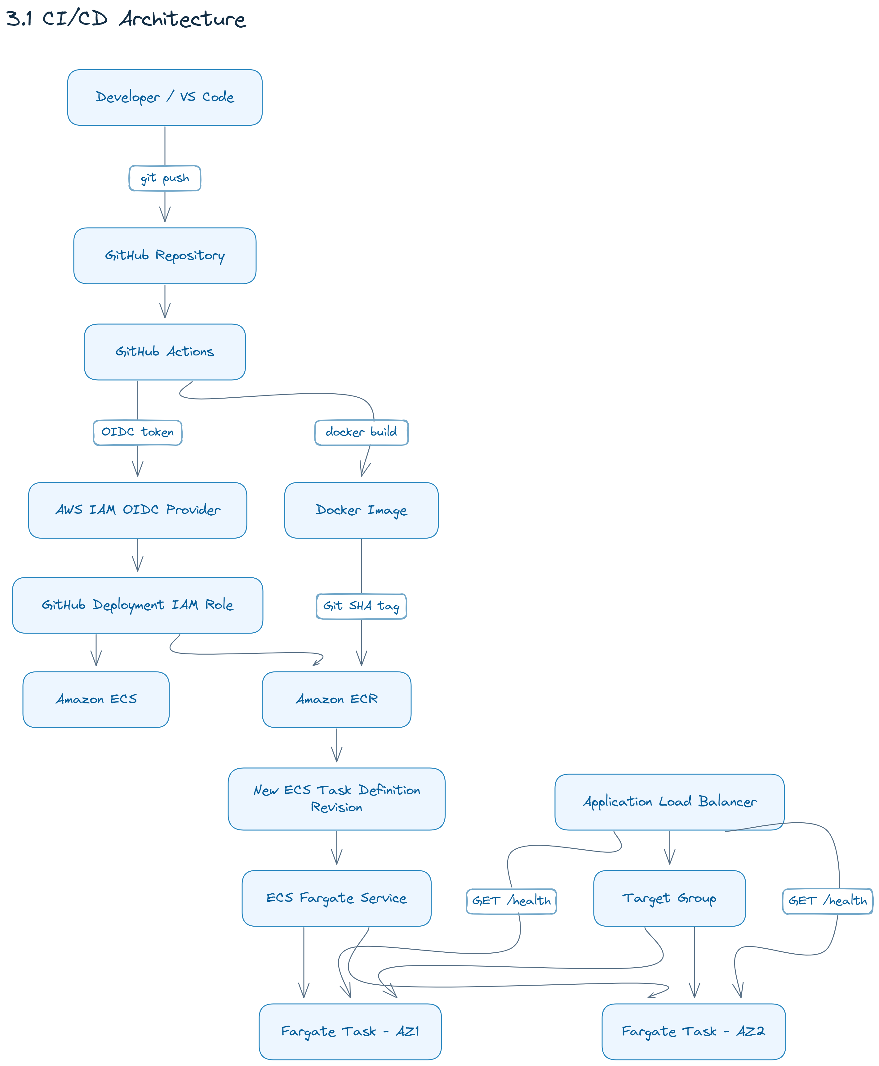
CI/CD pipeline — end to end
M4
From a git push to healthy Fargate tasks in both Availability Zones — six stages, no static AWS keys.
1
Source
2
Build & CI
Developer pushes to the main branch of the GitHub repository
GitHub Actions workflow starts automatically on every push
3
Identity
4
Build & registry
OIDC token → IAM OIDC provider → deployment role; no static keys
Docker image built, tagged with the Git SHA and pushed to ECR
5
Deployment
6
Runtime
New task-definition revision; the ECS Fargate service rolls it out
ALB → target group → healthy Fargate tasks in both AZs (desired 2)
Notes:
Optional deep-dive slide.
Walk the numbered stages: source → build → identity (OIDC) → image to ECR → new task definition → rolling deploy behind the ALB.
Key point: GitHub never holds long-lived AWS keys; it assumes a role through OIDC for each run.

Slide 13
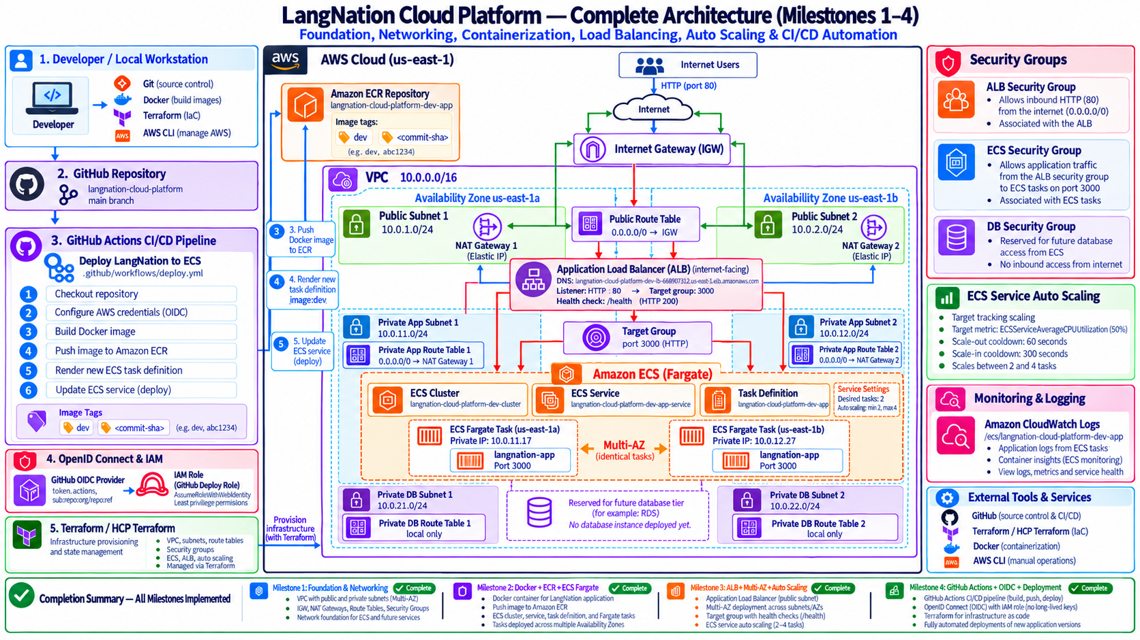
Checkpoint — Milestones 1–4 complete
M1–M4
Where the platform stood before data and edge security were added.
M1
Foundation & networking
VPC, 6 subnets in 2 AZs, IGW, NAT gateways, route tables
M2
Docker, ECR & Fargate
Containerised app, private ECR, ECS cluster and service
M3
ALB, Multi-AZ & scaling
/health checks, tasks in both AZs, auto scaling 2–4
M4
GitHub Actions + OIDC
Build, push and deploy with no long-lived AWS keys
Snapshot before M5–M6: the ALB was still internet-facing and the DB subnets were empty.
Notes:
Optional checkpoint slide — use it to bridge from the compute/delivery milestones to data and edge security.
Note honestly that at this stage the ALB accepted HTTP from the internet; M6 later locked it to CloudFront only.

Slide 14
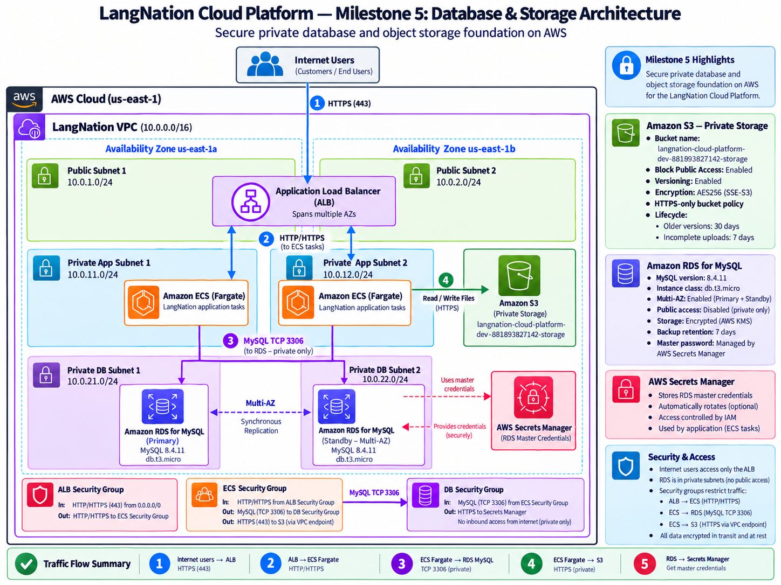

Database & storage
M5
The data layer is private, encrypted and designed for availability.
RDS MySQL Multi-AZ
db.t3.micro · encrypted · private · 7-day backups · managed master secret
Network isolation
DB security group accepts TCP 3306 only from the ECS security group
Amazon S3
Private bucket · block public access · versioning · SSE‑S3 · HTTPS-only policy
Lifecycle controls
Milestone 5 snapshot — ALB ingress was later locked to CloudFront only in M6.
Non-current versions expire after 30 days; incomplete multipart uploads abort after 7 days
Notes:
Explain that database credentials are managed by AWS Secrets Manager through RDS managed master password.
The application reaches MySQL only from ECS; the public internet cannot connect to the DB.
S3 is private and encrypted, with versioning and lifecycle cleanup.
The diagram is the Milestone 5 snapshot; in Milestone 6 the ALB was restricted to CloudFront's origin-facing prefix list.

Slide 15

Edge security, DNS & authentication
M6
Milestone 6 turned the platform into a protected public service with authenticated API access.
Users
HTTPS
Route 53
CNAME
CloudFront
+ ACM · HTTPS
AWS WAF
rules + rate limit
ALB
CloudFront-only
ECS Fargate
Express API
Cognito
user pool · JWT
Personal AWS
Sandbox AWS account · us-east-1
HTTPS edge
AWS WAF
ACM certificate; CloudFront redirects HTTP → HTTPS and reaches the ALB origin over HTTP 80.
AWS managed common rule set plus per-IP rate limiting.
ALB hardening
Cognito + JWT
Port 80 accepts only the CloudFront origin-facing managed prefix list — no bypass.
/health stays public; /protected returns 401 without a token and 200 with a valid access token.
Notes:
Trace the public request path: Route 53 → CloudFront → WAF → ALB → ECS.
Highlight that direct ALB access was deliberately blocked after CI/CD health checks were moved to CloudFront.
For authentication, explain managed Cognito user pool + app client and JWT verification in the Express application.

Slide 16
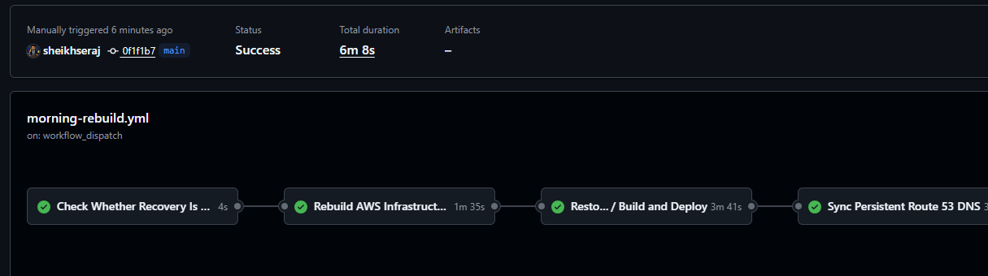

Automated morning recovery
Operations
The sandbox is cleaned overnight, so recovery is an operational workflow — validated end-to-end.
Recovery sequence
1
Check whether recovery is needed
2
HCP Terraform rebuilds infrastructure
3
Deploy current application image
Run #6 — manual end-to-end validation: all four jobs green, total duration 6 m 8 s.
4
Read new CloudFront domain
5
OIDC into personal AWS account
Primary schedule
Fallback schedule
Why personal Route 53?
6
UPSERT Route 53 CNAME
07:37
08:17
DNS must persist even when sandbox CloudFront / ACM resources are recreated.
Europe/Berlin time
Skips if the endpoint is already healthy
7
Verify public HTTPS /health
Notes:
This is a strong presentation point because it came from a real sandbox limitation.
Explain why Route 53 is in the personal account: DNS cannot be disposable.
Mention that the workflow was manually validated end-to-end; the fallback prevents duplicate rebuilds when the first run already succeeded.
If asked about scheduler reliability, say GitHub scheduled workflows are best-effort, so you added a fallback health-based run.

Slide 17

Evidence: tested, not just configured
Validation
These are the outcomes I would demonstrate if there is time for a live demo.
200
403
TIMEOUT
401 → 200
Normal HTTPS request
WAF blocks bad input
Direct ALB bypass
Protected API
GET /health
→ {"status":"healthy"}
XSS-style query
→ request blocked
Public ALB DNS
→ connection blocked
No JWT → 401
Valid Cognito JWT → 200
Additional validation completed
ECS service: desired 2 / running 2 / pending 0
CloudFront status: Deployed
Targets healthy in both private app subnets
ACM certificate: ISSUED / validation SUCCESS
Auto scaling test: 2 → 4 tasks
Morning recovery: manual end-to-end run, all jobs green
Notes:
This slide is your strongest evidence slide.
Do not run all demos live unless time allows; show one or two and use the rest as verified results.
Good live demo order: /health 200, /protected 401, then valid JWT 200. WAF 403 can be backup because typing encoded query strings is slower.

Slide 18
Engineering challenges I solved
Lessons
The capstone included real troubleshooting — not only successful “happy path” deployments.
01
Nightly sandbox cleanup
02
Route 53 must survive cleanup
FIX
Built Terraform / HCP reproducibility plus a morning recovery pipeline.
FIX
Moved authoritative DNS to personal AWS and automated cross-account CNAME sync.
03
GitHub OIDC trust initially failed
04
ECS action reported a failed deployment
FIX
Restricted trust to immutable repository / owner IDs and the main branch.
FIX
Validated by service stability + exact Git SHA + task counts + CloudFront health.
05
ALB could bypass WAF
06
PowerShell / AWS CLI parsing issues
FIX
Reworked the CI/CD health check, then restricted ALB ingress to CloudFront’s prefix list.
FIX
Used safer quoted CLI arguments and validated every step independently.
Notes:
Use this slide to show engineering maturity: problems occurred and you improved the design because of them.
Pick only 3–4 examples verbally depending on time.
A strong answer in Q&A is to describe the symptom, the root cause, and the permanent fix.

Slide 19


Where the project stands now
Roadmap
Milestones 1–6 are implemented and validated. Next: Serverless & Event-Driven, followed by the AI/RAG milestones.
M1
M2
M3
M4
M5
M6
M7
M8
M9
M10
NEXT
Foundation & Networking
Docker / ECR / ECS
ALB / Multi-AZ / Auto Scaling
Automated Deployment
Database & Storage
Edge / Security / Auth
Serverless & Event-Driven
RAG Knowledge Pipeline
Lina AI Tutor Runtime
Monitoring / Resilience / Final
● Implemented & validated ● Next ○ Planned
Next: Milestone 7 — Serverless & Event-Driven Architecture
20 Oct 2026
Then RAG → AI Tutor → monitoring, resilience, cost and final documentation
target
Notes:
Clearly separate completed work from future work.
Say: “I am not calling future services implemented yet. Tomorrow I start Milestone 7.”
This makes the presentation trustworthy and shows a clear delivery roadmap.

Slide 20
Cost estimate — running the platform
Cost
On-demand list prices, us-east-1, if every service ran 24/7 for a month (730 hours). An estimate, not a bill.
Monthly cost by service
USD / month
≈ $164
NAT Gateways ×2
hourly charge + data processing
$67
per month if running 24/7
RDS MySQL Multi-AZ
db.t3.micro + 20 GB gp3
$29
≈ $5.40 per day
Application Load Balancer
hourly charge + ~1 LCU
$22
ECS Fargate
2 tasks · 0.25 vCPU · 0.5 GB
$18
Biggest driver
Public IPv4 addresses ×4
2 NAT Elastic IPs + 2 ALB IPs
$15
NAT gateways ≈ 40% of the total — charged every hour, even with no traffic.
AWS WAF
web ACL + 2 rules
$7
CloudWatch
logs + Container Insights
$5
Keeping it low
Other
Route 53, Secrets Manager, ECR, S3
$1
The sandbox is torn down every night, so hourly services run only part of the day. To evaluate in M10: VPC endpoints, Fargate Spot.
$0 — free tier: CloudFront · Cognito · ACM certificates · HCP Terraform · GitHub Actions
Notes:
Clearly separate completed work from future work.
Say: “I am not calling future services implemented yet. Tomorrow I start Milestone 7.”
This makes the presentation trustworthy and shows a clear delivery roadmap.

Slide 21




Key takeaway
The platform is now secure, multi-AZ, reproducible and operationally recoverable.
Secure by design
Highly available
Private compute and data, WAF, CloudFront-only ALB, Cognito JWT
Two AZs, multiple ECS tasks, auto scaling, Multi-AZ RDS
Automated
Demonstrably working
Terraform + HCP Terraform + GitHub Actions + scheduled recovery
200 / 403 / timeout / 401 / authenticated 200 tests
“Built from code. Protected at the edge. Recovered automatically.”
cloud.langnation.com/de
Thank you · AWS Cloud Computing with AI Bootcamp
Notes:
Close in 20–30 seconds.
Suggested closing: “The most important result is that this is no longer a collection of AWS resources. It is a platform that can be rebuilt, deployed, secured and validated repeatedly.”
Then invite questions.

Slide 22

Source code on GitHub
Repository
Everything shown today is in a public repository — infrastructure, application, pipelines and recovery.
Terraform infrastructure
environments/dev plus reusable modules: networking, security, container, load balancing, CI/CD, database, storage, edge, authentication
GitHub Actions workflows
deploy.yml builds, pushes and deploys the app; morning-rebuild.yml restores the sandbox and syncs DNS
Application
Node.js / Express API with /health and the Cognito-protected /protected route, plus its Dockerfile
Scan to open the repository
Architecture & documentation
github.com/sheikhseraj/
langnation-cloud-platform
Milestone diagrams and the interactive M1–M6 walkthrough
Notes:
Clearly separate completed work from future work.
Say: “I am not calling future services implemented yet. Tomorrow I start Milestone 7.”
This makes the presentation trustworthy and shows a clear delivery roadmap.

Slide 23



Acknowledgements & support
Thanks
AWS Cloud Computing with AI Bootcamp · guidance, feedback and peer support behind this capstone.
Instruction & leadership
Micheal — Theory Teacher
Rahul Patel— Practical Teacher
Dominic Singaraj— Head of Department
Questions?
Supporting teachers
Shahabuddin · Charisima · Pushpajit · Siranach
and the wider teaching team
Thank you for the guidance, questions and support that helped me improve the project.
Peer & student support
All of my classmates — discussions, feedback, testing and motivation throughout the capstone
cloud.namienterprises.in
Notes:
Thank the teaching team and classmates, then open the floor for questions.
The last two backup slides hold exact configuration values and short answers to likely questions.

Slide 24
Key technical configuration
BACKUP
Keep this slide for Q&A — do not present unless asked.
VPC
10.0.0.0/16
RDS
MySQL 8.4.11 · db.t3.micro · Multi-AZ · 20 GiB gp3
Public subnets
10.0.1.0/24 · 10.0.2.0/24
Backups
7 days
Private app
10.0.11.0/24 · 10.0.12.0/24
S3
versioned · SSE‑S3 · HTTPS-only
Private DB
10.0.21.0/24 · 10.0.22.0/24
WAF
AWS Managed Common Rule Set + 1000/IP rate rule
ECS
Fargate · 256 CPU · 512 MiB · port 3000
Auth
Cognito User Pool + public app client (no secret)
Scaling
min 2 · max 4 · CPU target 50%
Domain
cloud.namienterprises.in · Route 53 in personal AWS
Notes:
Backup slide only. Use when someone asks for exact CIDRs, task size, scaling, RDS or security configuration.

Slide 25

FAQs — likely questions & short answers
BACKUP
Use this as your mental checklist during Q&A.
Why personal Route 53?
Why two NAT gateways?
The sandbox is disposable. Route 53 stays in personal AWS so DNS, mail records and ACM validation remain stable across nightly cleanup.
Each private app subnet has same-AZ egress, reducing an AZ dependency.
Why OIDC instead of AWS keys?
Why restrict the ALB?
Short-lived federated credentials; no long-lived GitHub AWS secrets.
Otherwise users could bypass CloudFront and WAF using the ALB DNS name.
Why HCP Terraform?
Why Cognito?
Remote state, controlled plan/apply, and reproducible rebuilds.
Managed identity service; the API validates signed access JWTs instead of implementing identity storage itself.
Notes:
Backup Q&A slide. Do not read it to the audience.

