Slide 1
AWS Capstone Project
Submission
LangNation Cloud Platform
23 October 2026
Secure • Highly Available • Containerized • AI/RAG-powered
My Personal Goal
Terraform
Docker
Fargate
RAG
Bedrock
Build a real, reproducible AWS platform that I can explain and demonstrate in cloud/DevOps interviews.
Challenges
Environment is cleaned at midnight → infrastructure must be recreated with Terraform every day.
Capstone proposal / project update for neue fische

Slide 2
What I am building
A cloud-native learning platform based on a real LangNation use case
Business use case
Cloud engineering goal
Portfolio value
Students access courses, homework, reading material and an AI tutor. Teachers upload content and manage learning material. Admins monitor the platform.
Show networking, containers, security, scaling, databases, serverless workflows, monitoring and infrastructure automation in one coherent system.
One project that connects my QA/Test Automation background with AWS Cloud, DevOps, Terraform, Docker, ECS Fargate and Generative AI.
Core architecture principle
Users
CloudFront + WAF
ALB
ECS Fargate
Data + Events
Bedrock RAG
web application firewall
Application Load Balancer
Everything is provisioned as code. The target is: empty sandbox → Terraform + pipeline → working environment again.

Slide 3
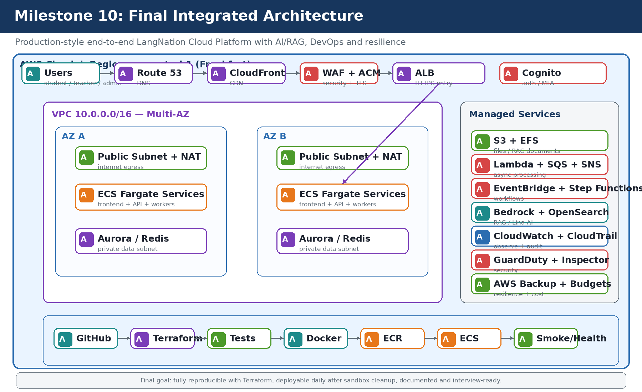
Target architecture
The full architecture is intentionally large, so I will build it milestone by milestone
Final state after all milestones

Slide 4
10 implementation milestones
Each milestone produces a working architecture increment, Terraform code and evidence
1
Foundation & Networking
2
Docker + ECR + Fargate
VPC • 2 AZ • 6 subnets • IGW/NAT
Containerize and deploy
3
ALB + Auto Scaling
4
Automated Deployment
Multi-AZ + health checks
Daily rebuild after sandbox cleanup
5
Database & Storage
6
Edge + Auth
Aurora/RDS • Redis • S3 • EFS
Route 53 • CloudFront • WAF • Cognito
7
Event-Driven
8
RAG Knowledge Pipeline
Lambda • SQS • SNS • EventBridge • SFN
S3 → processing → Bedrock KB → vector store
9
Lina AI Tutor
10
Production Readiness
Fargate API → RAG → Bedrock
Security • monitoring • testing • cost

Slide 5
Plan to 23 October
Build by 20 Oct, then keep 21–22 Oct for validation, documentation and buffer
Oct 2026
6
7
8
9
10
11
12
13
14
15
16
17
18
19
20
21
22
23
Phase 1
Cloud foundation
M1–M4
Phase 2
Application platform
M5–M7
Phase 3
AI / RAG
M8–M9
Phase 4
Production readiness
M10
Test + Docs
Buffer
Submit
Final
Target: after 20 Oct, no new services — only fix, test, document and prepare the demo.

Slide 6
Daily sandbox strategy / Challenge
The nightly cleanup becomes part of the architecture challenge
1
Sandbox starts empty
2
terraform apply
3
Docker build + push
4
Deploy ECS Fargate
5
Run tests + work
6
Midnight auto-cleanup
Success criterion
Why this matters
From an empty AWS sandbox, recreate the working platform with Terraform and the deployment pipeline — without manual console setup.
It demonstrates reproducibility, infrastructure as code, immutable deployments and recovery from a completely clean environment.

Slide 7
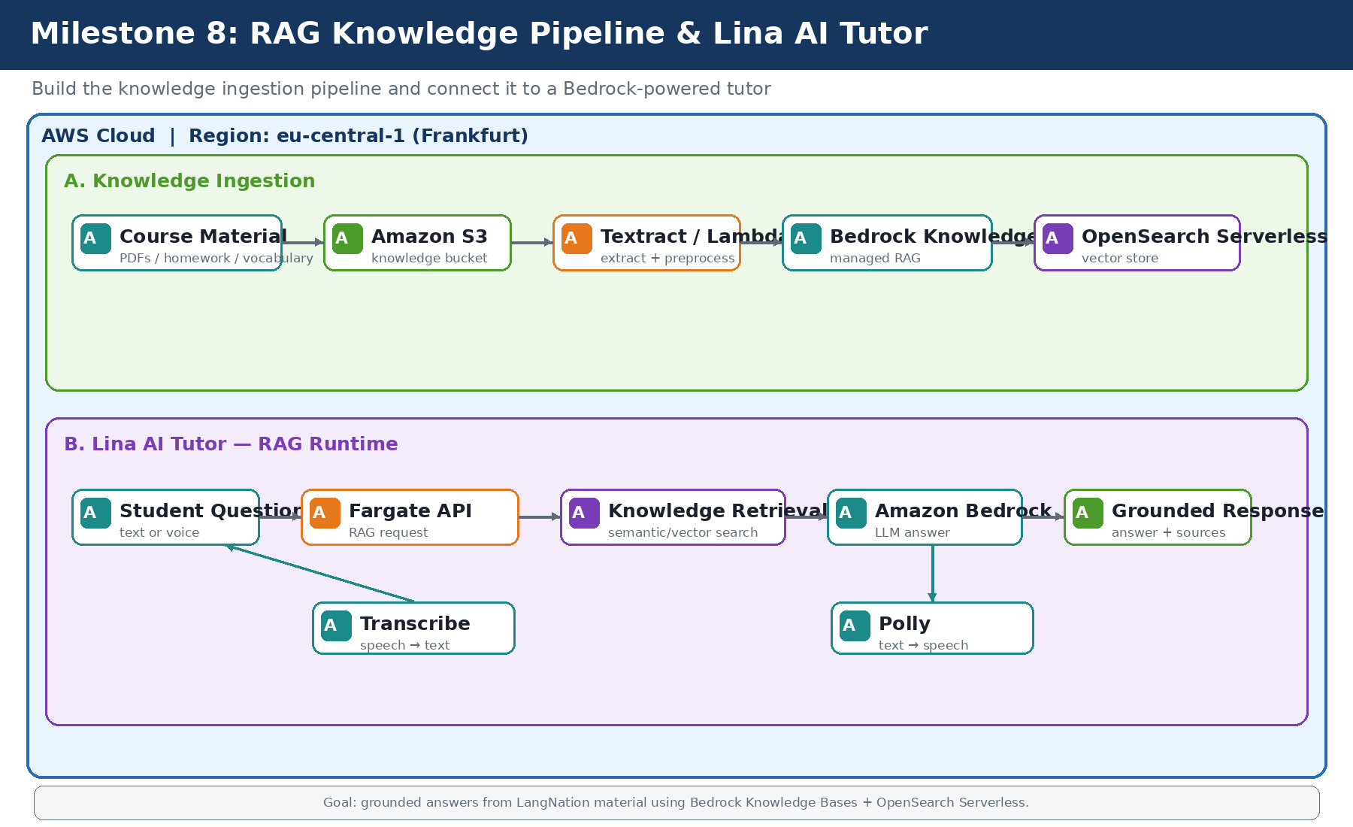
AI differentiator: RAG-based Lina Tutor
The model should answer from LangNation learning material, not only from general LLM knowledge
Knowledge ingestion
Course PDFs / homework / vocabulary → S3 → preprocessing → Bedrock Knowledge Base → OpenSearch vector store.
Runtime
Student question → Fargate API → retrieve relevant context → Amazon Bedrock → grounded answer.
Optional extension
Amazon Transcribe for speech-to-text and Polly for spoken responses if the core RAG flow is stable on time.

Slide 8
What I want to demonstrate at submission
Not just “many AWS services” — a platform I can deploy, test, explain and defend technically
Cloud Architecture
Containers & DevOps
Event-Driven AWS
Multi-AZ VPC, private subnets, ALB, RDS/Aurora, edge services
Docker, ECR, ECS Fargate, Terraform and automated CI/CD
Lambda, SQS, SNS, EventBridge and Step Functions
AI / RAG
Security & Operations
Quality Engineering
Bedrock Knowledge Base, vector search and Lina Tutor
IAM, KMS, Secrets Manager, CloudWatch, CloudTrail, security checks
Unit/API/E2E tests and deployment quality gates with Playwright
Final Goal: a strong GitHub portfolio project for AWS Cloud Engineer / DevOps / Platform Engineer roles.

