Slide 1
LangNation Cloud Platform
FINAL CAPSTONE PRESENTATION · OCTOBER 2026
12 milestones
implemented, validated and documented
Secure, highly available, containerized learning platform with AI/RAG on AWS
2 AZs
multi-AZ app tier + MariaDB database
Request path
Route 53
CloudFront
WAF
ALB
ECS Fargate
MariaDB
Grounded AI
Lina AI (RAG)
S3 docs
Titan
S3 Vectors
Claude Haiku
Lina answers from LangNation knowledge
Presented by
SERAJ AHMAD SIDDIQUI
AWS Cloud Computing with AI Bootcamp
Live endpoint
www.langnation.com
Guidance: Micheal (Theory Teacher) · Rahul Patel (Practical Teacher) · Dominic Singaraj (HoD)
Notes:
Opening (30 seconds): “My capstone is the LangNation Cloud Platform. Over twelve milestones I turned a simple container into a secure, highly available, observable and AI-enabled platform on AWS.”
The two rows show the two main paths: every user request goes Route 53 → CloudFront → WAF → ALB → ECS → MariaDB, and Lina, the AI assistant, answers from LangNation knowledge through Titan embeddings, S3 Vectors and Claude Haiku.
Tell the audience the structure: the challenge, the architecture, milestone by milestone, then proof, cost and lessons.

Slide 2






The challenge and the final design goal
Overview
The capstone grew from a simple container into a recoverable, observable and AI-enabled platform.
CHALLENGE 01
CHALLENGE 02
CHALLENGE 03
Disposable sandbox
Security
Availability
AWS resources are cleaned overnight, so reproducibility is a real requirement.
No direct ECS or RDS exposure; CloudFront + WAF + JWT authentication.
Two AZs, two baseline ECS tasks, Auto Scaling and a Multi-AZ database.
CHALLENGE 04
CHALLENGE 05
CHALLENGE 06
AI grounding
Release quality
Cost awareness
Lina must answer from LangNation knowledge, not generic model memory.
Bad code or vulnerable images must be blocked before ECS deployment.
Production-like resilience has a real fixed cost; trade-offs must be explicit.
Notes:
Explain the six real constraints that shaped the design.
The first three — disposable sandbox, security and availability — drove Milestones 1 to 6. The last three — AI grounding, release quality and cost awareness — drove Milestones 7 to 12.
Key line: “I wanted a platform that can be rebuilt from code, defended at the edge, and proven with evidence — not a collection of services I clicked together.”

Slide 3
Final master architecture — Milestones 1–12
M1–M12
One connected view of public edge, private runtime, data, event processing, RAG, automation and governance.
PUBLIC EDGE
Users
Route 53
persistent DNS
CloudFront
ACM TLS · HTTPS
WAF
filters
Cognito User Pool
issues JWT
PERSISTENT / EXTERNAL
VPC 10.0.0.0/16 · us-east-1 · 2 Availability Zones
OPERATIONS
GitHub repository
HCP Terraform state
Route 53 hosted zone
PUBLIC
NAT GW A
Application Load Balancer
NAT GW B
GitHub Actions
quality gates + deploy
CloudWatch
dashboard + 9 alarms
PRIVATE APP
ECS Service: LangNation + Lina API · Auto Scaling 2 → 4 tasks
CloudTrail
→ audit S3
AWS MANAGED SERVICES
ECS Task A
AZ-a
ECS Task B
AZ-b
ECR · app images
S3 · app storage
Secrets Manager · credentials
Morning recovery
DB + app + DNS
PRIVATE DB
RDS MariaDB Multi-AZ · TLS :3306
Cost Explorer
trade-offs
DOCUMENT PROCESSING + RAG
S3 docs
EventBridge
SQS + DLQ
Lambda
Titan Embeddings
S3 Vectors
Claude Haiku
Lina runtime: question → Titan query vector → S3 Vectors → Claude Haiku → grounded answer + source
Notes:
Spend about 60–90 seconds here. Don’t read every box — follow the flows.
Top: the public edge. Users resolve the domain in Route 53, which persists outside the sandbox, then reach CloudFront with ACM TLS and WAF. Cognito issues the JWTs.
Middle: the VPC across two Availability Zones — public subnets with two NAT gateways and the ALB, private app subnets with the ECS service and Auto Scaling, private DB subnets with Multi-AZ MariaDB over TLS.
Bottom: document processing and RAG — S3 documents flow through EventBridge, SQS and Lambda into Titan embeddings and S3 Vectors; at runtime Lina retrieves relevant knowledge and Claude Haiku writes a grounded answer.
Right: operations — quality-gated deployments, CloudWatch and CloudTrail, the morning recovery and cost analysis.

Slide 4















Why I chose these AWS resources
Design
Every service answers a design goal: secure, highly available, reproducible, grounded or observable.
NETWORK & EDGE
NETWORK & EDGE
NETWORK & EDGE
NETWORK & EDGE
VPC · 2 AZs
NAT Gateways ×2
Route 53
CloudFront + ACM
Isolates tiers; two AZs remove a single point of failure
Outbound-only internet for private tasks, one per AZ
Persistent DNS that survives sandbox cleanup
One HTTPS entry point with managed TLS
NETWORK & EDGE
COMPUTE
COMPUTE
COMPUTE
AWS WAF
Amazon ECR
ECS Fargate
ALB + Auto Scaling
Blocks common web attacks at the edge
Private images tagged by Git SHA — traceable releases
Private containers with no servers to manage
Health checks across both AZs; scales 2 → 4 tasks
DATA
DATA
SECURITY
SECURITY
RDS MariaDB Multi-AZ
Amazon S3
Secrets Manager
Amazon Cognito
Managed DB with standby, TLS, encryption, backups
Private, versioned storage for files and documents
Database credentials never stored in code
Managed sign-in; the API only verifies JWTs
EVENTS & AI
EVENTS & AI
EVENTS & AI
OPERATIONS
EventBridge · SQS
Bedrock: Titan + Haiku
S3 Vectors
CloudWatch + CloudTrail
Durable async processing into Lambda, with retries + DLQ
Managed embeddings and answers — no model hosting
Serverless vector index — no vector database to run
Alarms, dashboard and a validated audit trail
Notes:
Teachers often ask “why this service and not another?” — this slide answers it. Go row by row instead of reading all sixteen.
Row 1: network and edge. Row 2: compute and data. Row 3: data, security and the event pipeline. Row 4: AI and operations.
Good comparisons if asked: Fargate vs EC2 (no servers to patch); RDS vs MariaDB on EC2 (managed backups and Multi-AZ failover); Cognito vs building login yourself; Bedrock vs hosting a model (no GPU servers); S3 Vectors vs a vector database (nothing to run or patch).

Slide 5

Architecture evolution — 12 milestones
Journey
Each milestone added one capability while preserving the previous architecture.
M1
Network foundation
M2
Container runtime
M3
Availability
M4
Deployment
VPC · 6 subnets · 2 NAT · SG
Docker · ECR · ECS Fargate
ALB · 2 AZs · Auto Scaling
GitHub Actions · OIDC · SHA
M5
Data layer
M6
Public edge
M7
Events
M8
RAG ingestion
MariaDB · S3 · Secrets
Route 53 · CF · WAF · Cognito
EventBridge · SQS · Lambda · DLQ
Titan embeddings · S3 Vectors
M9
Real application
M10
Operations
M11
Quality gates
M12
Resilience & cost
58-table restore · Lina runtime
9 alarms · CloudTrail audit
Tests · tf validate · Trivy
Self-healing · Cost Explorer
▌ Foundation ▌ Data & edge ▌ Events & AI ▌ Operations & quality ✓ implemented and validated
Notes:
Show the journey in one view: all twelve milestones are implemented and validated.
M1–M4 built the foundation: network, containers, availability and automated deployment. M5–M6 added the private data layer and the secure public edge. M7–M9 added event processing, the RAG pipeline and the real LangNation application with Lina. M10–M12 added operations, quality gates, and resilience and cost evidence.
Key line: “Each milestone added one capability without breaking the previous architecture.”

Slide 6




Milestone 1 — Foundation & networking
M1
The network is split by trust level, Availability Zone and routing behavior.
VPC 10.0.0.0/16
Availability Zone us-east-1a
Availability Zone us-east-1b
Routing & security
Public
Internet Gateway
10.0.1.0/24
10.0.2.0/24
ALB · NAT Gateway
ALB · NAT Gateway
Private app
same-AZ NAT
Public
internet-facing
Private DB
local only
10.0.11.0/24
10.0.12.0/24
SG path
ALB → ECS → DB
Private app
ECS Fargate · no public IP
ECS Fargate · no public IP
compute
No public IP on ECS
tasks are reachable only through the ALB
10.0.21.0/24
10.0.22.0/24
Private DB
RDS only · local route table
RDS only · local route table
No public DB route
Terraform / HCP defines every route
data
Notes:
Milestone 1 is the foundation: one VPC, 10.0.0.0/16, across two Availability Zones and three tiers — six subnets.
Public subnets hold the ALB and a NAT gateway; private app subnets hold the ECS Fargate tasks with no public IP; private DB subnets hold only RDS with a local route table.
Why two NAT gateways? Each private app subnet leaves through the NAT in its own AZ, so one AZ failing doesn’t cut off the other.
Security groups form a chain: ALB → ECS → DB. Everything is defined in Terraform and applied through HCP Terraform.

Slide 7


Milestones 2–3 — Containers & scaling
M2–M3
Private Fargate tasks behind a load balancer — health-checked, spread across AZs and scaled by CPU.
ECS Service
CloudFront
current edge
Application LB
both AZs
Target Group
/health :3000
Task A
us-east-1a
Task B
us-east-1b
Amazon ECR
Git-SHA images
Docker
build
Request path: CloudFront → ALB → target group → healthy task
Image path: build → ECR → rolling deploy
2
2 AZs
2 → 4
50%
200
baseline tasks
task distribution
Auto Scaling range
CPU target
/health expected
Controlled validation
Ownership lesson
Temporarily lowered the CPU target to 1%; generated load scaled the service from 2 to 4 tasks — then restored the normal 50% target.
Terraform defines the service and scaling configuration. Application Auto Scaling owns the live desired task count.
Notes:
Milestones 2 and 3: the application runs as Docker images stored in ECR and tagged by Git SHA. ECS Fargate runs two tasks, one in each AZ, with no servers to manage.
Requests come from CloudFront to the ALB, which checks /health on port 3000 and only sends traffic to healthy tasks.
Auto Scaling keeps 2 to 4 tasks at a 50% CPU target. I proved it: I temporarily lowered the target to 1%, generated load, and the service scaled from 2 to 4 — then I restored 50%.
Ownership lesson: Terraform defines the scaling config, but Auto Scaling owns the live desired count — so Terraform must not fight it.

Slide 8



Milestone 4 — Automated deployment
M4
Application delivery is traceable, short-lived and independently validated.
Release pipeline — GitHub Actions
1
2
3
4
5
6
7
8
Push to main
GitHub Actions
OIDC → STS
Docker build
ECR · Git SHA
New task revision
ECS rolling deploy
Verify final state
No long-lived AWS keys
Immutable deployment
Final-state validation
GitHub proves its identity through OIDC; AWS STS issues temporary credentials for the restricted deployment role.
Docker image tag = Git commit SHA — a direct link from source code to ECR image to ECS task revision.
Wait for services-stable, verify the exact image SHA, desired = running, pending = 0 and public /health.
Ownership: Terraform → infrastructure · GitHub Actions → live task-definition revision · Auto Scaling → live desired count
Notes:
Milestone 4 automates delivery. A push to main starts GitHub Actions, which proves its identity with OIDC and receives temporary STS credentials — no AWS keys are stored in GitHub.
The Docker image is tagged with the Git commit SHA, pushed to ECR, a new task-definition revision is registered and ECS rolls it out.
The pipeline doesn’t trust “deploy succeeded” — it checks the final state: service stable, exact SHA running, desired equals running, nothing pending, and /health OK through the public endpoint.
Clear ownership avoids drift: Terraform owns infrastructure, GitHub Actions owns the live task definition, Auto Scaling owns the live task count.

Slide 9
Milestones 5–6 — Data, edge & authentication
M5–M6
The database stays private; the public path is HTTPS → CloudFront/WAF → ALB → ECS.
DATA LAYER · M5
PUBLIC EDGE + AUTH · M6
Private ECS
app subnets
RDS MariaDB
Multi-AZ · TLS :3306
Users
Route 53
CloudFront
WAF
ALB
Secrets Manager
managed password
ACM terminates viewer TLS at CloudFront
ALB :80 accepts only CloudFront origin-facing addresses
Amazon S3
private · versioned · AES256
Cognito User Pool
Access token
/protected · JWT verify
MariaDB 11.8.9 · db.t3.micro
200
401
200
403
20 GiB gp3 · max 100 GiB
7-day backups · public access disabled
/health
public
no token
rejected
valid token
allowed
WAF test
blocked
S3 HTTPS-only policy + lifecycle controls
Notes:
Milestone 5 adds the private data layer: RDS MariaDB 11.8.9 in Multi-AZ mode, reachable only from ECS over TLS on 3306. The master password is managed by Secrets Manager. S3 is private, versioned, AES256-encrypted and HTTPS-only.
Milestone 6 adds the secure public edge: Route 53 → CloudFront with an ACM certificate → WAF → ALB. The ALB only accepts CloudFront’s origin-facing addresses, so nobody can bypass the firewall.
Authentication: Cognito issues access tokens; /protected verifies the JWT.
The four results prove it: /health 200, no token 401, valid token 200, controlled WAF test 403.

Slide 10


Milestone 7 — Serverless & event-driven processing
M7
S3 uploads become durable asynchronous work with retries and a Dead Letter Queue.
NORMAL PATH
Validated normal path
S3 Object Created
EventBridge
SQS main queue
Lambda
Python 3.12
CloudWatch Logs
An Object Created event reached Lambda and produced CloudWatch logs.
FAILURE PATH
fail/ object
controlled error
Lambda retries
3 receives
Dead Letter Queue
14-day retention
Validated failure path
An intentional fail/ object was retried 3 times, then moved to the DLQ.
Queue settings: visibility timeout 180 s · maxReceiveCount 3 · DLQ retention 14 days
Key lesson
Why SQS before Lambda? Durable buffering, decoupling and explicit retry / DLQ behavior — nothing is lost if Lambda fails.
Serverless still needs explicit retry, queue and failure semantics.
Notes:
Milestone 7 makes processing event-driven. When a file lands in S3, EventBridge routes the Object Created event to an SQS queue, and a Python 3.12 Lambda processes it, logging to CloudWatch.
I tested both paths. Normal: the event reached Lambda and produced logs. Failure: an intentional fail/ object was retried three times and then moved to the Dead Letter Queue, which keeps messages for 14 days.
Key lesson: serverless still needs explicit retry, queue and failure semantics — that’s why SQS sits between EventBridge and Lambda.

Slide 11

Milestone 8 — RAG knowledge pipeline
M8
Documents are converted into semantic vectors that can be searched by meaning.
INGESTION
Retrieval proof
S3
knowledge file
EventBridge
SQS
Lambda
chunk 200 / 40
Titan
Embeddings V2
S3 Vectors
vector index
Relevant LangNation knowledge was ranked ahead of an unrelated document.
1024 dimensions · float32 · cosine distance · source metadata on every vector
Why Titan for both?
Documents and questions must live in the same semantic embedding space, or the search can’t compare them.
RETRIEVAL
User question
Titan
query embedding
S3 Vectors
similarity search
Relevant
source_text
Lesson: RAG starts with retrieval quality — ingest correctly → embed consistently → prove semantic ranking.
Notes:
Milestone 8 builds Lina’s knowledge base. A knowledge file in S3 goes through the same event pipeline into a Lambda that splits it into chunks of 200 words with a 40-word overlap.
Amazon Titan Embeddings V2 turns each chunk into a 1024-dimension vector, stored in S3 Vectors with cosine distance and source metadata.
At question time, the same Titan model embeds the question and S3 Vectors finds the closest chunks.
Proof: relevant LangNation knowledge ranked ahead of an unrelated document. Lesson: RAG quality starts with retrieval — ingest correctly, embed consistently, prove the ranking.

Slide 12
Milestone 9 — Real application & Lina RAG runtime
M9
The capstone moved from a demo API to sanitized real application data and grounded AI answers.
DATABASE RECOVERY
58
Restore image
dedicated · ECR
One-off task
ECS Fargate
Secrets Manager
credentials
MariaDB
sanitized data
tables restored
true
58 tables restored · /api/health → database = true over verified RDS TLS
database health over TLS
grounded
LINA RUNTIME
answers with sources
Question
Titan
query vector
S3 Vectors
top matches
Claude Haiku
Bedrock
Answer
+ source
Key fix
RDS required secure transport. I updated the application for verified TLS instead of weakening the database.
Response includes grounded = true and the retrieved LangNation source metadata.
Notes:
Milestone 9 replaced the demo API with the real LangNation application and data.
Database recovery: a dedicated restore image in ECR runs as a one-off Fargate task, reads credentials from Secrets Manager and restores sanitized MariaDB data — 58 tables, verified. /api/health reports database = true over verified TLS.
Lina runtime: the question is embedded with Titan, S3 Vectors returns the top matches, and Claude Haiku on Bedrock writes the answer — with grounded = true and the source.
Key fix: RDS required secure transport. The right fix was to make the app use verified TLS — not to weaken the database.

Slide 13



Milestone 10 — Monitoring, security & governance
M10
Operational visibility and audit evidence were added around the full platform.
Amazon CloudWatch
AWS CloudTrail & audit bucket
9
1
Multi-Region trail
Global service events
custom alarms
operations dashboard
Management events
Log-file validation
Health, performance and failure signals — including the M7 Dead Letter Queue.
Private AES256 + versioned bucket
30-day lifecycle
Alarm proof
CloudTrail governance
Audit storage
Existing DLQ test messages triggered a real ALARM state; after purging the queue the alarm returned to OK.
Management activity across all Regions is recorded, including global services.
A real .json.gz audit log was delivered to the private, encrypted, versioned bucket.
Notes:
Milestone 10 adds visibility and governance around the whole platform.
CloudWatch: one operations dashboard and nine custom alarms covering health, performance and failures — including the Dead Letter Queue from Milestone 7.
Real proof: old DLQ test messages triggered a genuine ALARM; after I purged the queue, it returned to OK.
CloudTrail: a multi-Region trail with global service events, management events and log-file validation, delivered to a private, AES256-encrypted, versioned S3 bucket with a 30-day lifecycle — a real .json.gz log arrived.

Slide 14



Milestone 11 — CI/CD quality gates
M11
Release hardening: nothing ships until application, Terraform and container checks all pass.
Push to main
code · Terraform · Dockerfile
quality-gates.yml · all three must pass
deploy.yml
Application gate
Infrastructure gate
Container gate
1. Calls quality gates first
Node.js 24
Terraform 1.16.2
docker build (node:24-alpine)
2. Build & push to ECR
npm ci (locked deps)
fmt -check -recursive
run + /health smoke test
3. Deploy ECS (Fargate)
npm run check
init -backend=false
Trivy image scan
npm audit --omit=dev
validate (environments/dev)
no CRITICAL findings
4. Serve via CloudFront
Real security outcome
Trivy blocked a CRITICAL vulnerability in the tar package of the old base image. I fixed it by upgrading the production base image to Node 24 — the gate was not weakened.
Notes:
Milestone 11 adds quality gates in front of every release. quality-gates.yml runs three gates and all must pass.
Application: Node.js 24, npm ci with locked dependencies, the app checks and a production dependency audit. Infrastructure: Terraform 1.16.2 fmt, init without backend, and validate. Container: build on node:24-alpine, run it and smoke-test /health, then a Trivy scan for CRITICAL vulnerabilities.
deploy.yml calls the gates first and only then builds, pushes and deploys.
Real outcome: Trivy blocked a CRITICAL tar vulnerability. I fixed the root cause — upgraded the base image to Node 24 — instead of weakening the gate.

Slide 15
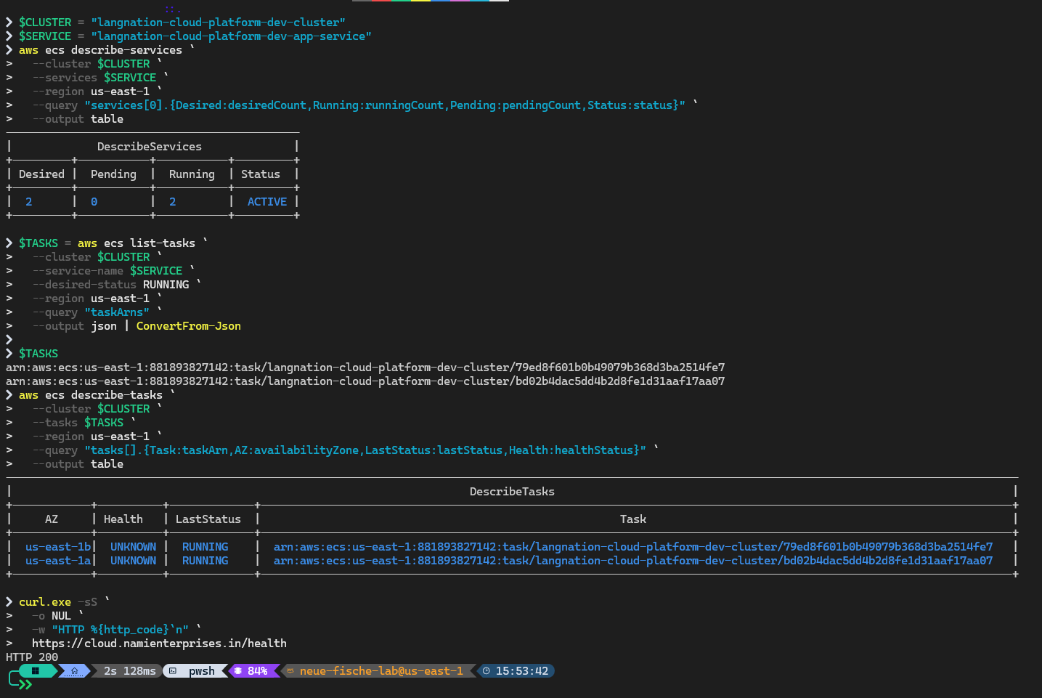
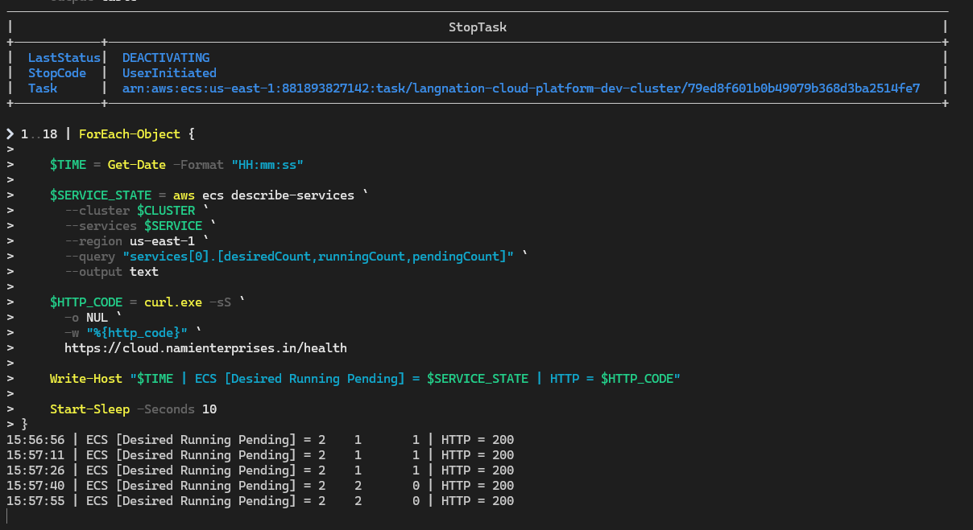
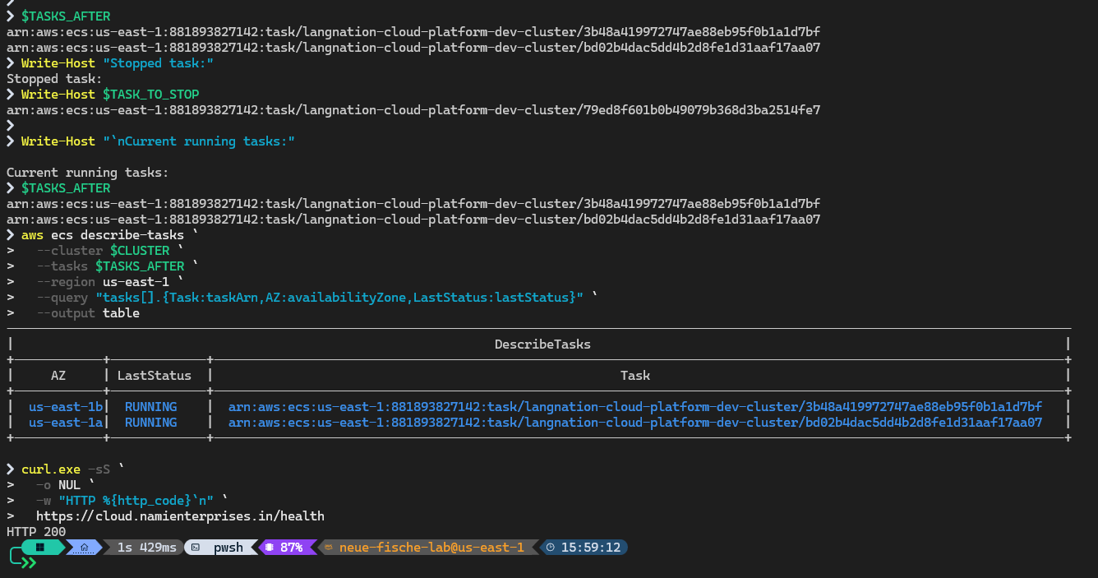
Milestone 12 — Resilience tested through failure
M12
I intentionally stopped a running ECS service task and observed the actual recovery.
1 · Baseline
2 · Controlled stop
3 · Recovery
2 desired / 2 running / 0 pending
Tasks across both AZs · HTTP 200
2 desired / 1 running / 1 pending
Public endpoint still HTTP 200
Replacement task healthy
Final state 2 / 2 / 0
≈ 44 seconds
observed recovery back to the two-task baseline — while the public endpoint kept answering HTTP 200.
Notes:
Milestone 12: resilience tested through real failure, not just configured.
Baseline: 2 desired, 2 running, 0 pending, tasks in both AZs, endpoint HTTP 200.
I stopped one running task on purpose. ECS showed 2 desired, 1 running, 1 pending — and the public endpoint still returned HTTP 200, because the other AZ’s task kept serving.
ECS started a replacement task, it became healthy, and the service was back at 2/2/0 in about 44 seconds.
The screenshots are the real terminal evidence from that test.

Slide 16
Real AWS cost analysis — October 2026
M12 Cost
Cost Explorer was used to find actual service and usage-type drivers, not theoretical list prices.
Cost by service
USD
$28.07
EC2 – Other
mainly NAT Gateway hours
$12.22
total incl. shown tax
Amazon RDS
Multi-AZ MariaDB
$3.15
$23.78 usage subtotal + $4.29 tax
Amazon ECS
2 baseline Fargate tasks
$2.32
Key finding
Elastic Load Balancing
Application Load Balancer
$2.23
The largest driver was NAT Gateway hourly runtime — not high traffic volume.
Amazon VPC
$2.16
Why I kept the architecture
AWS WAF
$0.87
Two NAT Gateways, Multi-AZ RDS and two baseline ECS tasks preserve the resilience story.
CloudWatch
$0.61
Dev-only options
Decision: document cheaper dev options — don’t weaken the final architecture.
Single NAT, Single-AZ RDS, scheduled non-production runtime, careful IPv4 reduction.
Notes:
I measured real cost in Cost Explorer instead of quoting list prices. For October 2026: $23.78 usage plus $4.29 tax, $28.07 in total.
The biggest item, “EC2 – Other”, looked confusing — drilling into the usage type showed it was mainly NAT Gateway hours. So the driver is hourly runtime, not traffic.
I deliberately kept two NAT gateways, Multi-AZ RDS and two ECS tasks, because they carry the resilience story. Cheaper options — single NAT, Single-AZ RDS, scheduled runtime — are documented as development-only choices.
Decision: document cheaper dev options; don’t weaken the final production-style architecture.

Slide 17


OP01 — Automated morning sandbox recovery
Operations
After Auto sandbox activation, recovery coordinates infrastructure, data, application and DNS.
PHASE 1 · INFRASTRUCTURE
GitHub Actions
scheduled run
HCP Terraform API
recovery run
Plan + auto-apply
langnation-capstone-dev
Infrastructure
recreated
07:37
primary · Europe/Berlin
08:17
PHASE 2 · DATA, APPLICATION & DNS
fallback · Europe/Berlin
Build image
OIDC · Git SHA → ECR
Restore DB
one-off task · 58 tables
Deploy ECS
new revision · stable
Sync DNS
CloudFront → Route 53
GET /health
→ READY
Auto sandbox activation first
Normal runs stay manual
Recovery auto-applies
No long-lived keys
Dynamic DNS
Regular Terraform changes still go through the standard approval.
Only the morning recovery uses a dedicated auto-apply run.
GitHub OIDC + AWS STS, short-lived credentials.
CloudFront domain read from Terraform outputs, synced to Route 53.
Notes:
OP01 exists because the training sandbox is cleaned every night. After I activate the sandbox, the recovery runs at 07:37 Berlin time, with a fallback at 08:17.
Phase 1: GitHub Actions calls the HCP Terraform API, which runs a dedicated plan and auto-apply on the langnation-capstone-dev workspace and recreates the infrastructure.
Phase 2: the reusable deploy workflow builds the image with OIDC credentials, restores the sanitized MariaDB with a one-off task and validates 58 tables, deploys the new task revision, reads the new CloudFront domain from Terraform outputs, updates Route 53, waits for INSYNC, and checks /health.
Design decisions: normal Terraform runs stay manually approved; only recovery auto-applies; no long-lived keys; DNS is synced dynamically.

Slide 18

Security and ownership model
Design
The platform stays maintainable because each system has a clear trust boundary and owner.
Public edge
Private runtime
Identity
Ownership
Route 53 persists outside the sandbox
ECS tasks have no public IP
GitHub OIDC → temporary STS credentials
HCP Terraform → infrastructure & state
CloudFront terminates HTTPS
DB sits in private DB subnets
No static AWS deployment keys
GitHub Actions → releases
WAF filters requests
ECS → DB only on 3306
Cognito issues access tokens
Auto Scaling → live desired count
ALB accepts CloudFront origin only
Secrets Manager supplies credentials
JWT protects application routes
Recovery workflow → rebuild, data, DNS
Core security path: Internet → CloudFront / WAF → ALB → ECS → MariaDB
Notes:
This slide summarises the trust boundaries and owners.
Public edge: Route 53 persists outside the sandbox; CloudFront terminates HTTPS; WAF filters; the ALB only accepts CloudFront.
Private runtime: no public IPs, private DB subnets, ECS to DB only on 3306, credentials from Secrets Manager.
Identity: GitHub OIDC with temporary credentials, no static keys, Cognito tokens and JWT-protected routes.
Ownership: HCP Terraform owns infrastructure, GitHub Actions owns releases, Auto Scaling owns task count, and the recovery workflow owns rebuild, data and DNS.
One sentence: Internet → CloudFront/WAF → ALB → ECS → MariaDB — nothing skips a layer.

Slide 19
Evidence — tested, not just configured
Validation
The project includes controlled success, failure and recovery validation across the stack.
HTTP 200
WAF 403
ALB blocked
Public /health through CloudFront
Controlled malicious-style request blocked
Direct origin bypass prevented
JWT 401 → 200
DLQ retry
RAG retrieval
Protected API without / with token
Controlled Lambda failure reached the DLQ
Relevant knowledge ranked first
ALARM → OK
Trivy block
2/1/1 → 2/2/0
DLQ backlog detected, then cleared
CRITICAL vulnerability prevented release
ECS self-healed while the endpoint stayed up
Notes:
This is the strongest evidence slide — nine results across the stack, each tested on purpose.
Edge: /health 200, WAF 403 for a malicious-style request, direct ALB access blocked.
App and data: JWT 401 without a token and 200 with one; a controlled Lambda failure reached the DLQ; relevant knowledge ranked first in RAG retrieval.
Operations: the DLQ alarm went ALARM → OK; Trivy blocked a CRITICAL vulnerability; ECS self-healed from 2/1/1 back to 2/2/0 while the endpoint stayed up.
If there’s time for a live demo: /health, then /protected without and with a token.

Slide 20
Engineering challenges I solved
Lessons
Real troubleshooting — each symptom traced to a root cause and fixed permanently.
01
Nightly sandbox cleanup
02
OIDC role assumption denied
CAUSE
Disposable training environment
CAUSE
Trust policy did not match the immutable GitHub identity
FIX
Terraform / HCP rebuild + OP01 recovery
FIX
Tightened owner / repo / branch / audience conditions
03
Database health false
04
DLQ alarm fired immediately
CAUSE
RDS required secure transport
CAUSE
Controlled M7 test messages were still queued
FIX
Verified RDS TLS in the real application
FIX
Explained the backlog, purged, observed ALARM → OK
05
Trivy blocked deployment
06
Cost seemed to be “EC2 – Other”
CAUSE
CRITICAL vulnerable tar package in the old base image
CAUSE
The billing category hid networking usage
FIX
Upgraded the image to Node 24; kept the gate strict
FIX
Drilled into usage type — found NAT Gateway hours
Notes:
Pick 3–4 of these depending on time. For each: symptom, root cause, permanent fix.
Strongest stories: the OIDC trust policy (tightened to the immutable identity), the database health check (fixed TLS in the app instead of weakening RDS), Trivy (fixed the image, kept the gate), and the cost investigation (“EC2 – Other” was really NAT Gateway hours).
Key message: every problem led to a better design, not a workaround.

Slide 21
Final architecture decisions & trade-offs
Decisions
I optimized for a defensible production-style design, not the lowest possible sandbox bill.
Decision | Benefit | Trade-off | Final choice
2 NAT Gateways | Same-AZ private egress, less AZ dependency | Higher fixed hourly cost | Keep; single NAT is a dev-only option
Multi-AZ MariaDB | Database failover and availability | Higher DB runtime cost | Keep; Single-AZ only for cost-controlled dev
2 baseline ECS tasks | Availability + rolling-deployment headroom | More Fargate cost | Keep; needed for a meaningful resilience proof
Persistent Route 53 | Stable public DNS across sandbox rebuilds | Cross-account recovery step | Keep; enables a disposable workload account
Strict Trivy gate | Blocks vulnerable releases | Can stop a deployment unexpectedly | Keep; fix the root cause, never bypass the scan
Notes:
These are the five decisions I would defend in front of a reviewer.
Each one costs something — NAT hours, database runtime, Fargate cost, an extra recovery step, or a blocked deployment — and each one buys availability, security or reliability.
Key line: “I optimized for a defensible production-style design. The cheaper options are documented, but only for development.”

Slide 22





Key takeaway
The final result is not a collection of AWS services. It is one platform that can be rebuilt, deployed, secured, observed, grounded with RAG, tested through failure — and explained with evidence.
Secure by design
Highly available
Grounded AI
Private compute and data · WAF · OIDC · Cognito
Multi-AZ DB · 2 AZs · 2 tasks · Auto Scaling
Titan embeddings · S3 Vectors · Claude Haiku
Operational
Quality controlled
CloudWatch · CloudTrail · OP01 recovery
Tests · Terraform validation · smoke test · Trivy
“Built from code. Protected at the edge.
Grounded by knowledge. Proven through failure.”
cloud.namienterprises.in
Notes:
Close in 30 seconds: “The final result is not a collection of AWS services. It is one platform that can be rebuilt, deployed, secured, observed, grounded with RAG, tested through failure — and explained with evidence.”
Point at the five cards briefly, then say the closing line: built from code, protected at the edge, grounded by knowledge, proven through failure.

Slide 23


Source code, infrastructure & documentation
Repository
The repository is organized so architecture, implementation, evidence and operations are easy to review.
langnation-cloud-platform/
├── application/
real Node.js app + Lina runtime
├── database/
sanitized seed / restore assets
├── knowledge/
RAG source documents
├── lambda/
document processor
├── terraform/
│ ├── environments/dev/
composition + seed objects
│ └── modules/
network, security, container, data, edge, RAG…
├── .github/workflows/
quality gates, deploy, recovery
└── docs/
Scan to open on GitHub
├── milestones/
M01 → M12
github.com/sheikhseraj/
langnation-cloud-platform
├── evidence/
proof + screenshots
├── architecture/
milestones, flows, master
└── operations/
OP01 recovery runbook
Terraform + HCP · GitHub Actions
M1–M12 docs · Evidence + OP01
Notes:
Everything is public on GitHub — invite people to scan the QR code.
The repository mirrors the architecture: the real application with Lina, database restore assets, knowledge documents, the Lambda processor, Terraform modules for every layer, the three GitHub workflows, and docs for all twelve milestones, evidence and the OP01 runbook.
The infrastructure is rebuilt from this code, so the repository is the single source of truth.

Slide 24




Acknowledgements & support
Thanks
AWS Cloud Computing with AI Bootcamp · guidance, feedback and peer support behind this capstone.
Instruction & leadership
Micheal — Theory Teacher
Rahul Patel — Practical Teacher
Dominic Singaraj — Head of Department
Questions?
Supporting teachers
Shahabuddin · Charisima · Pushpajit · Siranach
and the wider teaching team
Thank you for the questions and feedback that helped improve the architecture.
Classmates & peers
Discussions, feedback, testing, troubleshooting and motivation throughout the capstone
cloud.namienterprises.in
github.com/sheikhseraj/langnation-cloud-platform
Notes:
Thank the teaching team and classmates by name, then open the floor for questions.
The two backup slides after this hold exact configuration values and short answers to likely questions.

Slide 25
Key technical configuration
BACKUP
Exact values for Q&A — not a main presentation slide.
VPC
10.0.0.0/16
S3
private · versioned · AES256 · HTTPS-only
Public subnets
10.0.1.0/24 · 10.0.2.0/24
Event pipeline
SQS visibility 180 s · maxReceiveCount 3 · DLQ 14 days
Private app
10.0.11.0/24 · 10.0.12.0/24
Embeddings
Titan Text Embeddings V2 · 1024 dims
Private DB
10.0.21.0/24 · 10.0.22.0/24
Chunking
200 words · 40-word overlap
ECS
Fargate · 256 CPU · 512 MiB · port 3000
CloudWatch
dashboard + 9 custom alarms
Scaling
min 2 · max 4 · CPU target 50%
CloudTrail
multi-Region · management events · log validation
RDS
MariaDB 11.8.9 · db.t3.micro · Multi-AZ
Domain
cloud.namienterprises.in
RDS storage
20 GiB gp3 · max 100 GiB · 7-day backups
M12 recovery
~44 s observed back to 2/2/0
Notes:
Backup slide. Use only when someone asks for exact CIDRs, sizes, scaling, database, event, RAG or monitoring values.

Slide 26

FAQs — likely questions & short answers
BACKUP
Use as a mental checklist during Q&A.
Why two NAT Gateways?
Why persistent Route 53?
Same-AZ private egress and less AZ dependency; single NAT is a dev cost option.
The sandbox is disposable — DNS must survive CloudFront and ACM recreation.
Why OIDC instead of AWS keys?
Why block direct ALB access?
Short-lived federated credentials; no permanent AWS secrets in GitHub.
Otherwise users could bypass CloudFront and WAF using the ALB DNS name.
Why SQS before Lambda?
Why Titan for documents and queries?
Durable buffering, decoupling and explicit retry / DLQ behavior.
Both vectors must live in the same semantic embedding space.
Why MariaDB TLS?
How do you prove Lina is grounded?
RDS required secure transport; the app complies instead of weakening the DB.
The response includes grounded = true and the retrieved source metadata.
Why did Trivy stop deployment?
What happens after nightly cleanup?
A real CRITICAL vulnerability existed; the image was fixed, not the gate.
Activation → HCP rebuild → DB restore → app deploy → DNS sync → health check.
Notes:
Backup Q&A checklist — don’t read it to the audience. Two more likely questions:
Why not cut cost by removing redundancy? That would weaken the production-style resilience evidence; dev-only options are documented separately.
How was resilience proven? I stopped one ECS task; the endpoint stayed at HTTP 200 and ECS restored 2/2/0 in about 44 seconds.

Slide 27
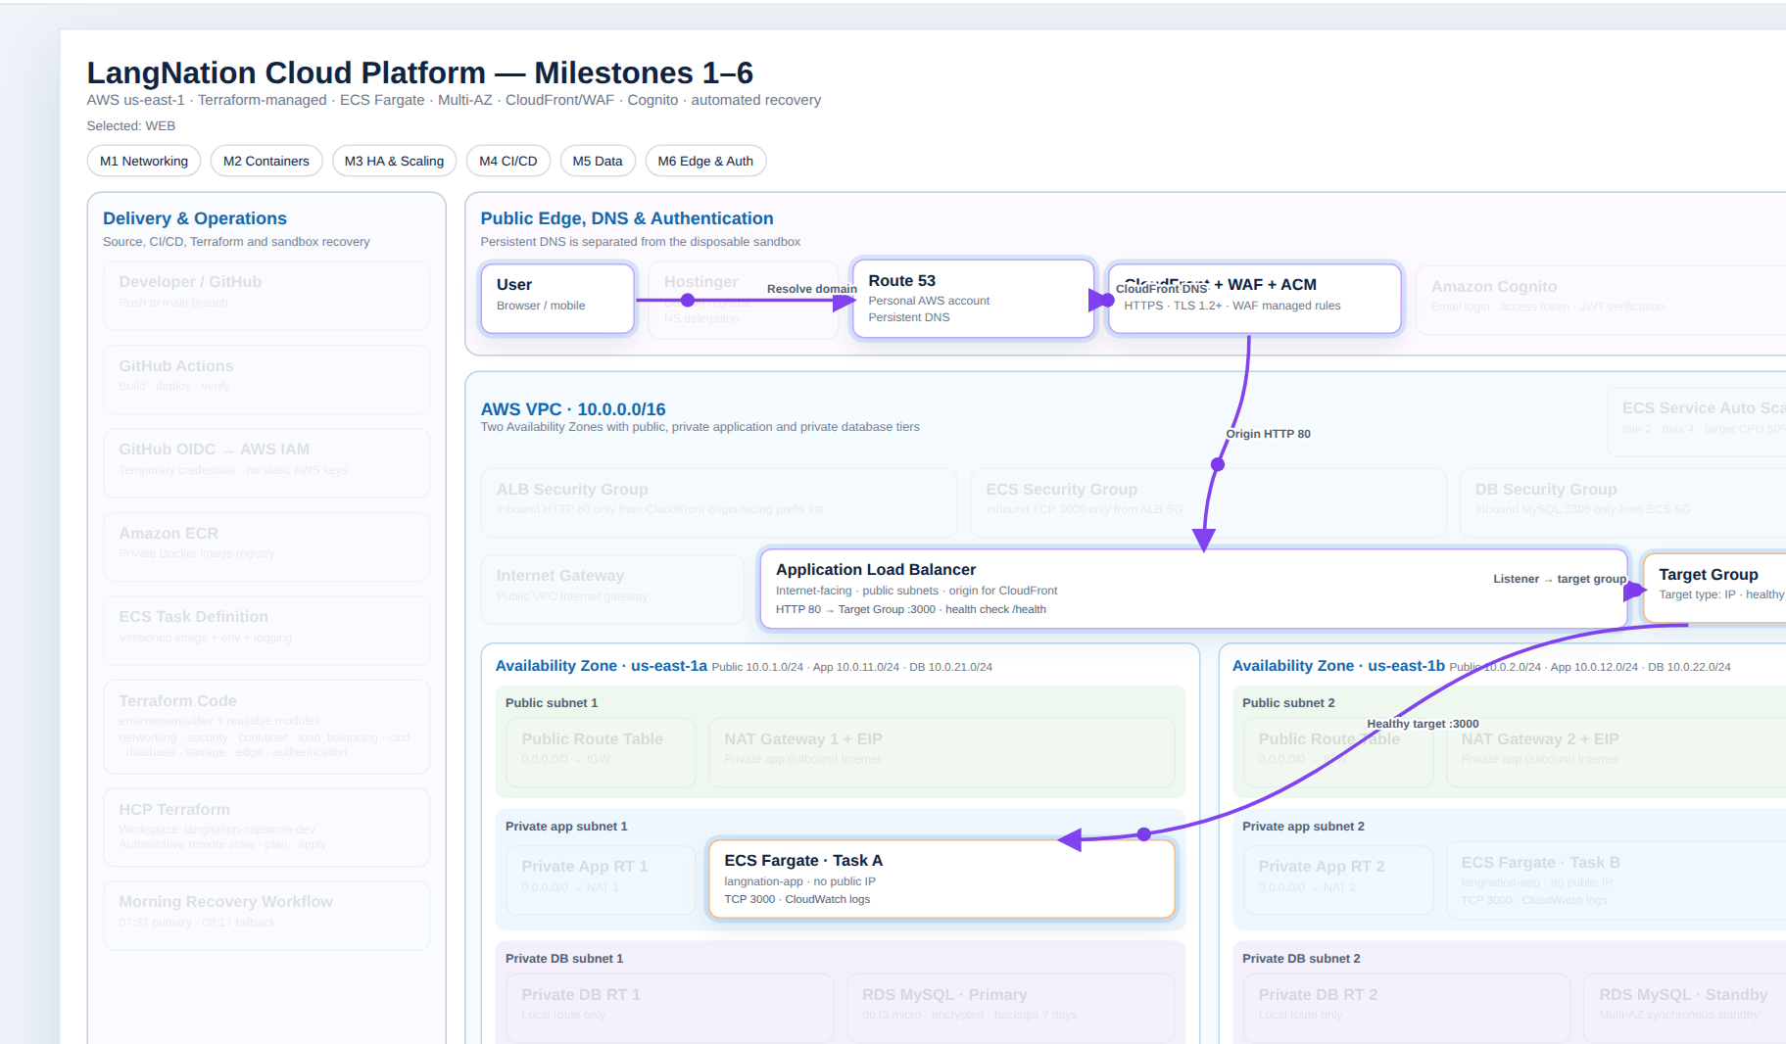

Interactive walkthrough — core platform (M1–M6)
BACKUP
An animated view of the foundation milestones — choose a milestone or flow and watch the request path move.
Open the live walkthrough
Opens the HTML file in your browser. Keep it in the same folder as this deck.
Keyboard
1–6
select a milestone
A
all flows together
S
auto sequence
Space
play / pause
F
fullscreen
Covers Milestones 1–6 (network, containers, deployment, data, edge and authentication).
Notes:
Optional backup: if someone asks to see the core platform in motion, open the animated walkthrough. It covers Milestones 1–6.
The HTML file must sit in the same folder as this PowerPoint for the link to work.

