Slide 1
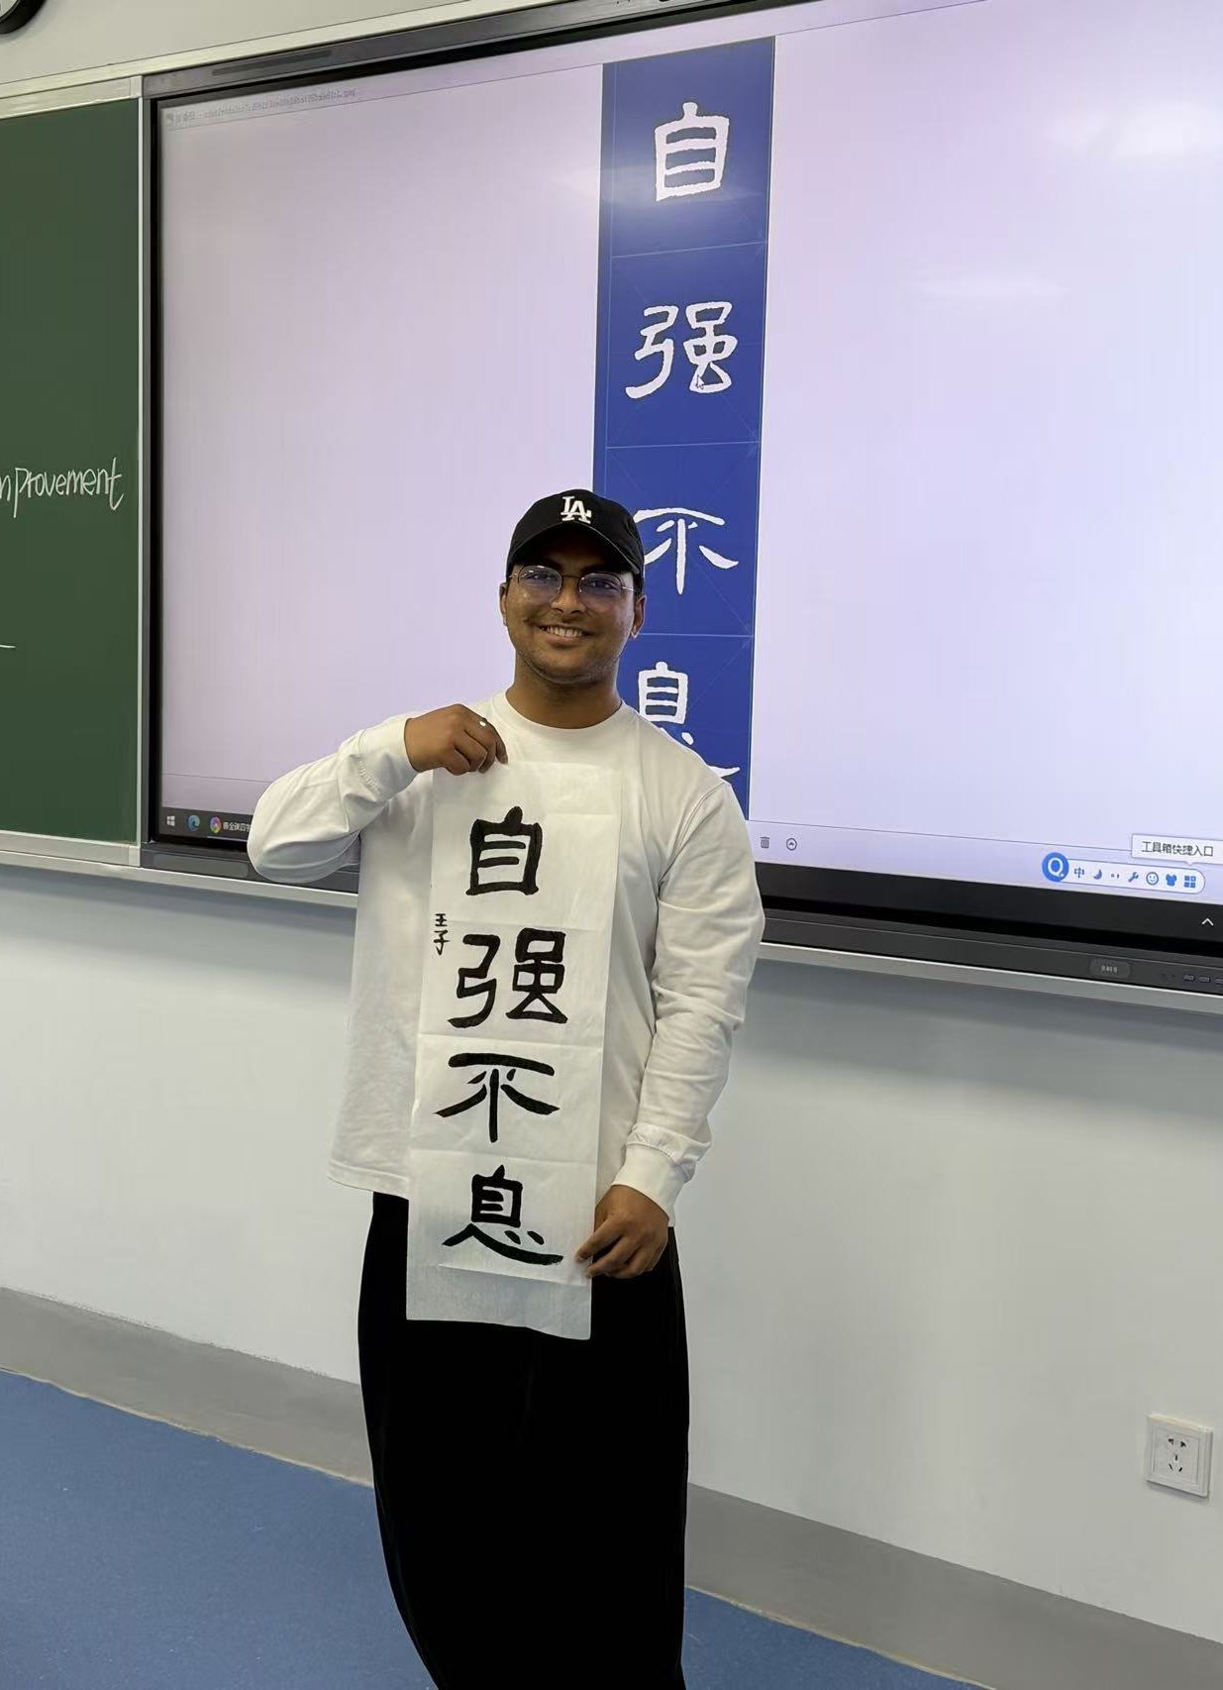
王
JIANGSU SCHOLARSHIP · CATEGORY A DEFENSE
自强不息
Strive Without Rest
Ink, voice and service: a Bangladeshi scholar's year at Huai'an University
Jubair Md Ariful Islam · 王子
Master's candidate, International Business · Class GMIB2501
School of International Education, Huai'an University
Notes:
Greet the committee. I am Jubair Md Ariful Islam, Chinese name 王子, master's candidate in International Business, class GMIB2501, from Bangladesh. The calligraphy in my hands reads 自强不息, 'strive without rest', the spirit of my year. I will cover three things: my academic achievements, my other accomplishments, and my activities.

Slide 2
年
MY YEAR AT A GLANCE
Scholar. Artist. Host and helper.
学
ACADEMIC ACHIEVEMENTS
艺
ACCOMPLISHMENTS
行
ACTIVITIES & SERVICE
B → A
Provincial
Service Award
Category B → Category A
Highest marks in my major
HSK 3 · 250 / 300
Provincial calligraphy award
Research paper under peer review
Still practising the brush
Hosted Chinese festivals
Service Award for assisting SIE
Class monitor · Student Council VP
Jubair Md Ariful Islam · 王子
02 / 11
Notes:
In one slide: academically I moved from Category B to Category A and passed HSK 3 within a year. Beyond class I earned a provincial calligraphy award and completed original research. In activities I hosted, volunteered and received a Service Award. The next slides show the evidence.

Slide 3




学
1 · ACADEMIC ACHIEVEMENTS
From Category B to Category A
YEAR 1 · AWARDED
Category B
Annual Review · 年度考核
THE UNIVERSITY AWARDED
Category A
HOW I EARNED IT
Top marks
Helped teachers
Volunteered
Hosted events
Highest marks in my major's department
Supported staff, including on 2026 admission day
Took part in university programs and events
Hosted Chinese events, incl. the Mid-Autumn Festival
Jubair Md Ariful Islam · 王子
03 / 11
Notes:
In my first year I was awarded the Category B scholarship. After the annual review, the University awarded me Category A. The reasons: the highest marks in my major in the department, helping teachers, volunteering in university programs, and hosting Chinese events.

Slide 4
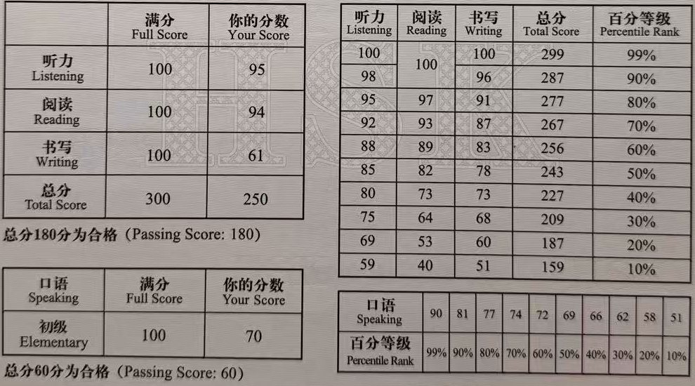

语
1 · ACADEMIC ACHIEVEMENTS
HSK 3 within a year
250 / 300
HSK Level 3 total score · pass mark 180 · tested 16 May 2026
Listening 95 and Reading 94: top-tier results
Used every day: in class, on stage and in service
Writing (61) is my next target: I keep practising
*Speaking taken at Elementary level (pass mark 60)
Jubair Md Ariful Islam · 王子
04 / 11
Notes:
I achieved HSK Level 3 within a year, scoring 250 out of 300 against a pass mark of 180. Listening 95 and Reading 94 are my strongest sections; Writing at 61 is where I am still improving. Speaking was taken at Elementary level with 70, pass mark 60. Chinese lets me host, volunteer and connect with classmates.

Slide 5




研
2 · RESEARCH & ACCOMPLISHMENTS
Research beyond the classroom
WHAT THE PAPER EXAMINES
UNDER PEER REVIEW
Commodity cycles
How price swings shape investment
Chinese Mining Foreign Direct Investment in Zambia, 2000–2024
Belt and Road effects
The influence of the BRI
Institutional determinants
Rules and governance that attract capital
中国在赞比亚采矿业的外国直接投资（2000—2024）
Submitted to International Studies of Economics · completed original research · not yet published
From state-owned to private
The shift in who invests
Jubair Md Ariful Islam · 王子
05 / 11
Notes:
Beyond coursework I contributed to a completed, original research paper on Chinese mining foreign direct investment in Zambia, 2000 to 2024. It is currently under peer review at International Studies of Economics. It is not yet published, so I describe the topic and status only.

Slide 6
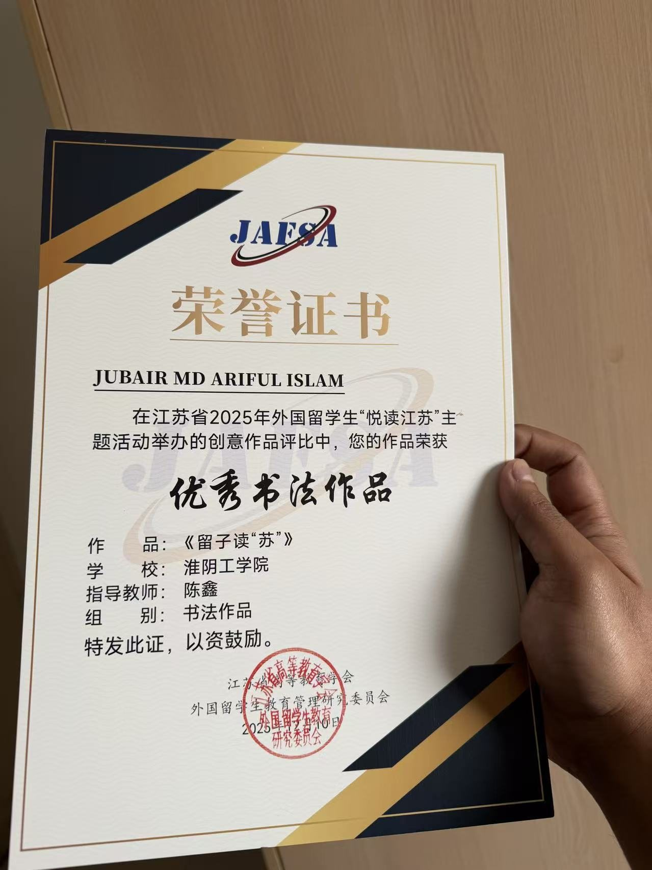
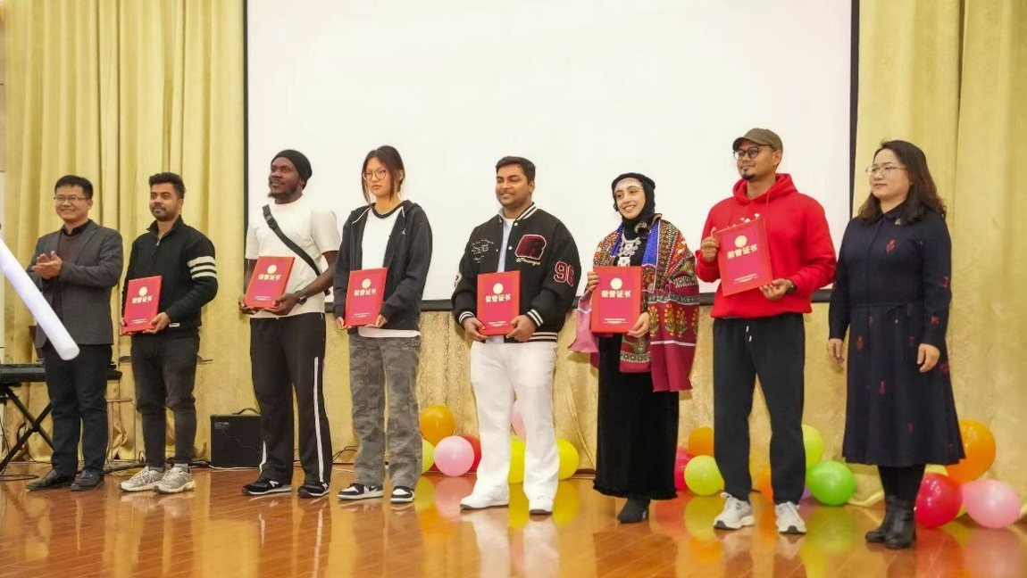
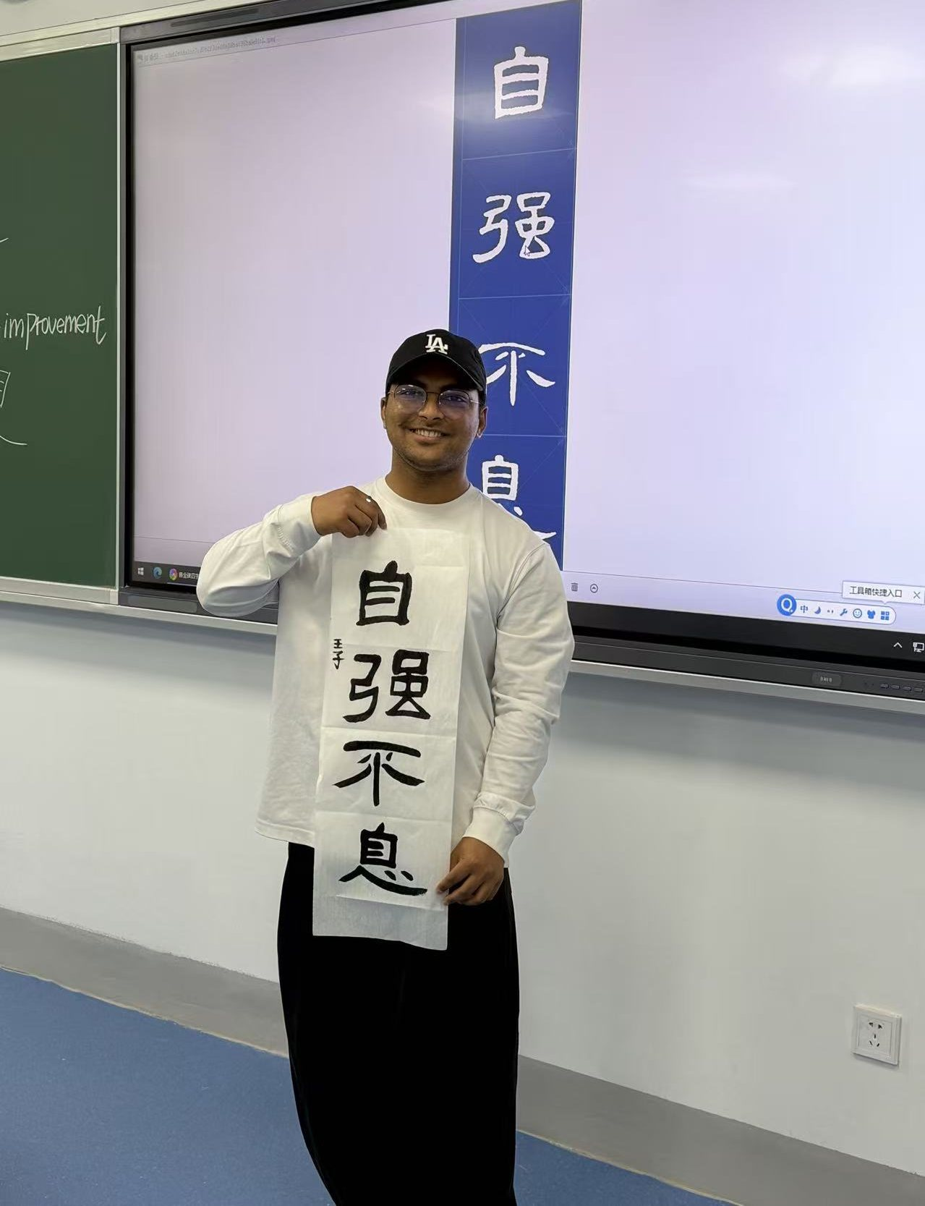
艺
2 · ACCOMPLISHMENTS · INK
Provincial calligraphy award · 书法
优秀书法作品 · Excellent Calligraphy Work
Jiangsu 2025 “Read Jiangsu” contest for international students. My piece: 《留子读“苏”》. Issued by the Jiangsu Higher Education Association.
Jubair Md Ariful Islam · 王子
06 / 11
Notes:
In Jiangsu Province's 2025 'Read Jiangsu' creative contest for international students, my calligraphy work 'Liu Zi Du Su' was honored as Excellent Calligraphy Work, issued by the Jiangsu Higher Education Association's committee on international student education. I keep practising, including the calligraphy class at SIE. The piece in my hands reads 自强不息.

Slide 7
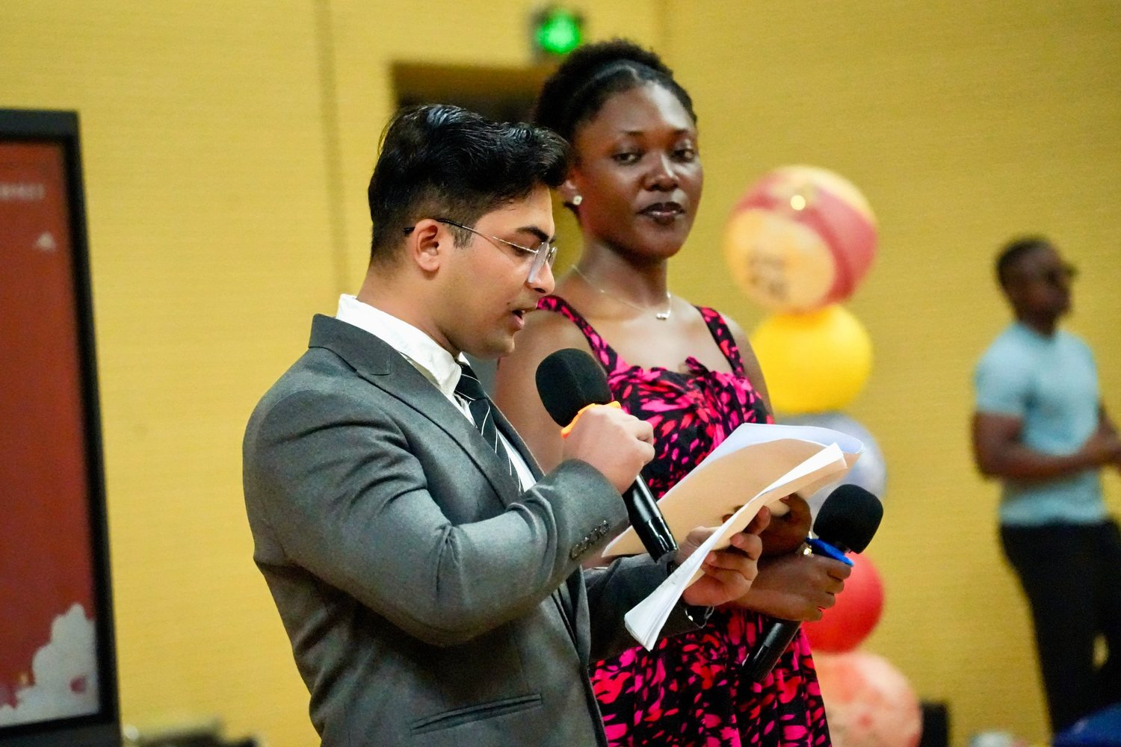
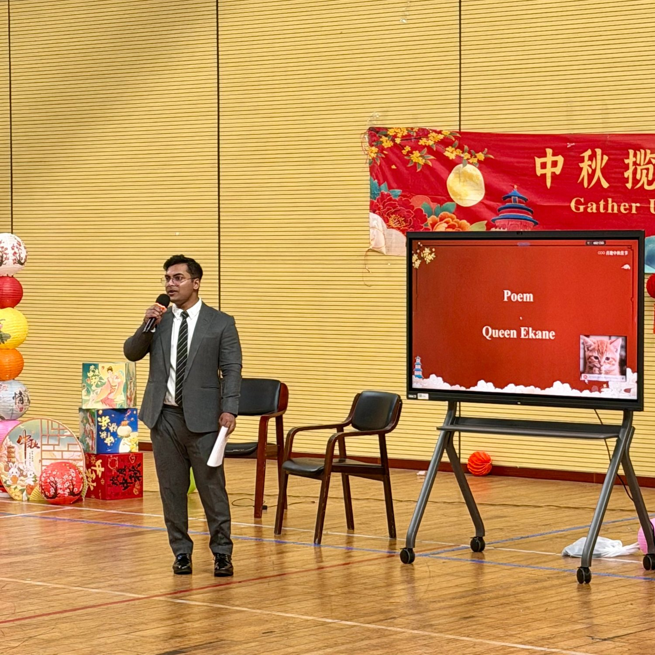
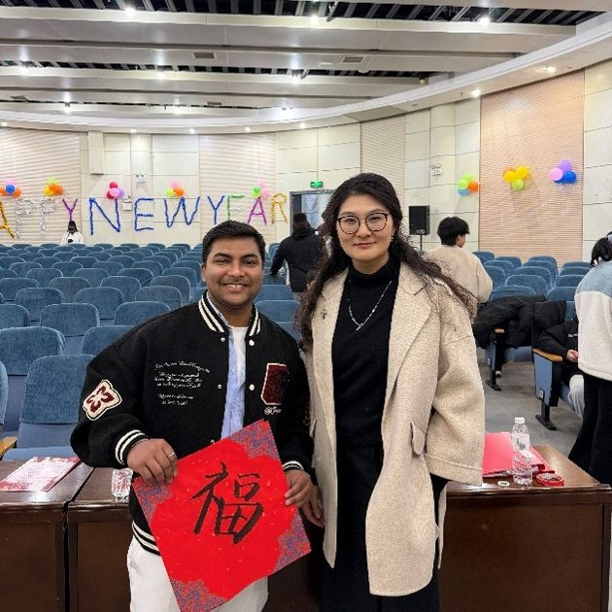
主
3 · ACTIVITIES · VOICE
A voice for Chinese celebrations
Mid-Autumn Festival host
Hosted Chinese cultural events
New Year celebration, 29 Dec 2025: my own 福
Co-hosting the Mid-Autumn Festival, 29 Sep 2025
Jubair Md Ariful Islam · 王子
07 / 11
Notes:
I hosted the Mid-Autumn Festival at Huai'an University on 29 September 2025, and other Chinese events as well. Standing on stage with a microphone helped me practise Chinese and build confidence. At the New Year celebration on 29 December I wrote my own 福, the character for fortune.

Slide 8
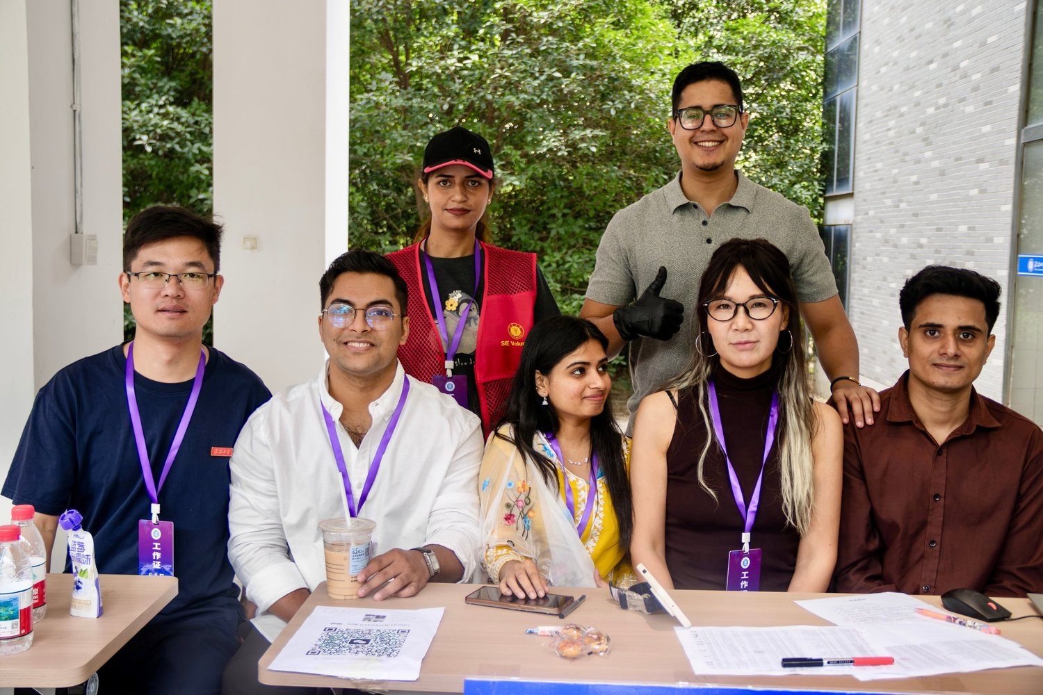

服
3 · ACTIVITIES · SERVICE
Service that earned an award
SERVICE AWARD
For assisting the School of International Education
Made check-in easier
A smoother, more comfortable day for new students
Guided every step
Walked them through the proper processes
Supported teachers
Worked with staff and the SIE volunteer team
Jubair Md Ariful Islam · 王子
08 / 11
Notes:
On the 2026 new-student admission day I assisted the School of International Education. I helped teachers, made the process easier and more comfortable for new students, and guided them through each step. For assisting SIE I received a Service Award.

Slide 9
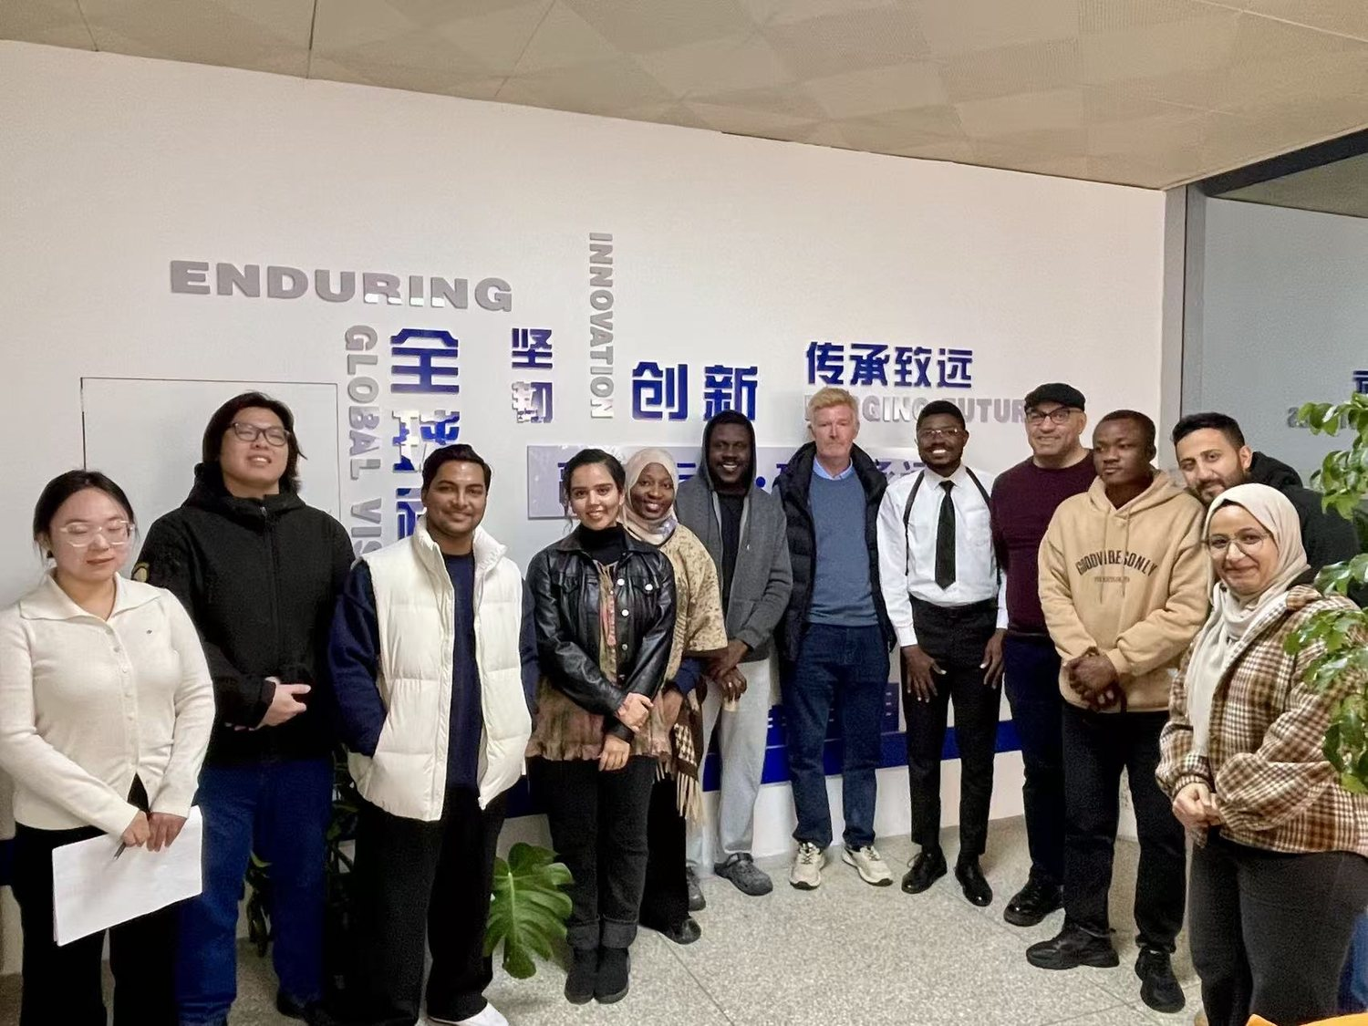
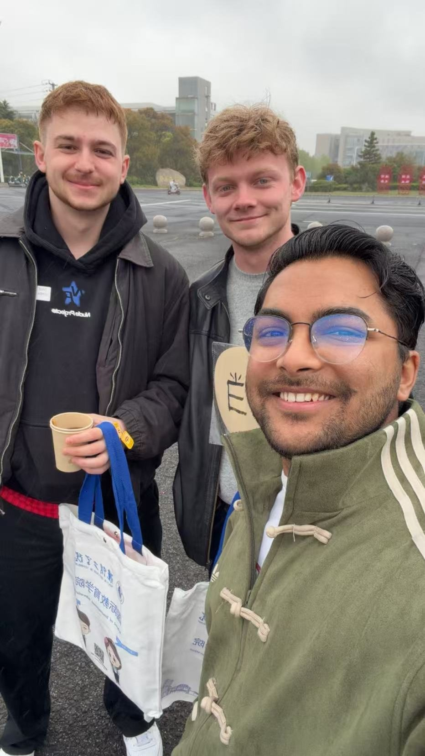

桥
3 · ACTIVITIES · BRIDGE
Bridging languages and cultures
Spoken English, made easier
Helped Chinese students improve their English speaking in a simpler way, and it worked.
Understanding China
Helped international students understand the culture of China.
Volunteer English-speaking help · Helping international students explore China
Jubair Md Ariful Islam · 王子
09 / 11
Notes:
I volunteered with the English language club and helped Chinese students improve their spoken English in an easier way, and it worked. I also helped international students understand Chinese culture. Language and culture are how I give back to the community that hosts me.

Slide 10
年
3 · ACTIVITIES · THE YEAR
One year, many stops
JUL 2025
Class monitor, International Business
29 SEP 2025
Hosted the Mid-Autumn Festival
3 NOV
Chinese chess class
8 NOV
High-speed rail seminar
13 NOV
Volunteered, English language club
NOV 2025
Elected VP, Student Council Academic Dept.
15 DEC
Study tour, Zhou Enlai Memorial Hall
29 DEC
Jiangsu calligraphy award · New Year celebration
12 APR 2026
Volunteer, Huai'an Marathon
9 MAY
Calligraphy class at SIE
16 MAY
Passed HSK 3 · 250 / 300
2026
Admission-day helper · Service Award
Jubair Md Ariful Islam · 王子
10 / 11
Notes:
A quick tour of the year, from class monitor and the Mid-Autumn Festival to the HSK 3 result and the 2026 admission day: a Chinese chess class, a high-speed rail seminar, the English language club, the Zhou Enlai Memorial Hall tour, the provincial calligraphy award, the Huai'an Marathon and the calligraphy class. I was also elected Vice President of the Student Council Academic Department in November 2025.

Slide 11
谢
WHY CATEGORY A
自强不息
I will keep striving.
学
A scholar
艺
An artist
行
A host and helper
Highest marks in my major's department · HSK 3, 250 / 300, within a year
Provincial award for Excellent Calligraphy Work · original research under review
Hosted Chinese events · Service Award for assisting SIE · class monitor and volunteer
谢谢各位老师 · Thank you
11 / 11
Notes:
Close: I am a scholar, an artist, and a host and helper. I respectfully ask the committee to consider my Category A scholarship. I will keep striving without rest. Thank you, 谢谢. Then take questions.

