Slide 1
THESIS PRE-DEFENCE
Deep Learning for Deforestation Detection in Bangladesh
A Three-District Comparison of Classification and Change Detection Methods Using Landsat Imagery
Sheikh Sulaiman Sony (ID 2002026)
Jalal Uddin Mohammad Akbar (ID 2002050)
Supervisor: Rubel Sheikh, Lecturer
Department of Educational Technology and Engineering
University of Frontier Technology, Bangladesh (UFTB)
August 2026
Notes:
REMINDER — confirm before presenting: supervisor name on this slide (Rubel Sheikh, Lecturer, Dept. of ETE, UFTB) is taken from the original proposal; the title-page draft left this field blank. Verify it is still correct before this deck is used.

Slide 2
Table of Contents
1. Research Background
2. Research Problem & Motivation
3. Literature Review
4. Research Gap
5. Research Objectives / Questions
6. Proposed Research Framework
7. Dataset / Data Collection
8. Data Preprocessing
9. Research Methodology
10. Experimental Setup
11. Experimental Results
12. Detailed Results Analysis
13. Discussion & Comparison
14. Research Contributions
15. Limitations, Future Work & Conclusion
2

Slide 3
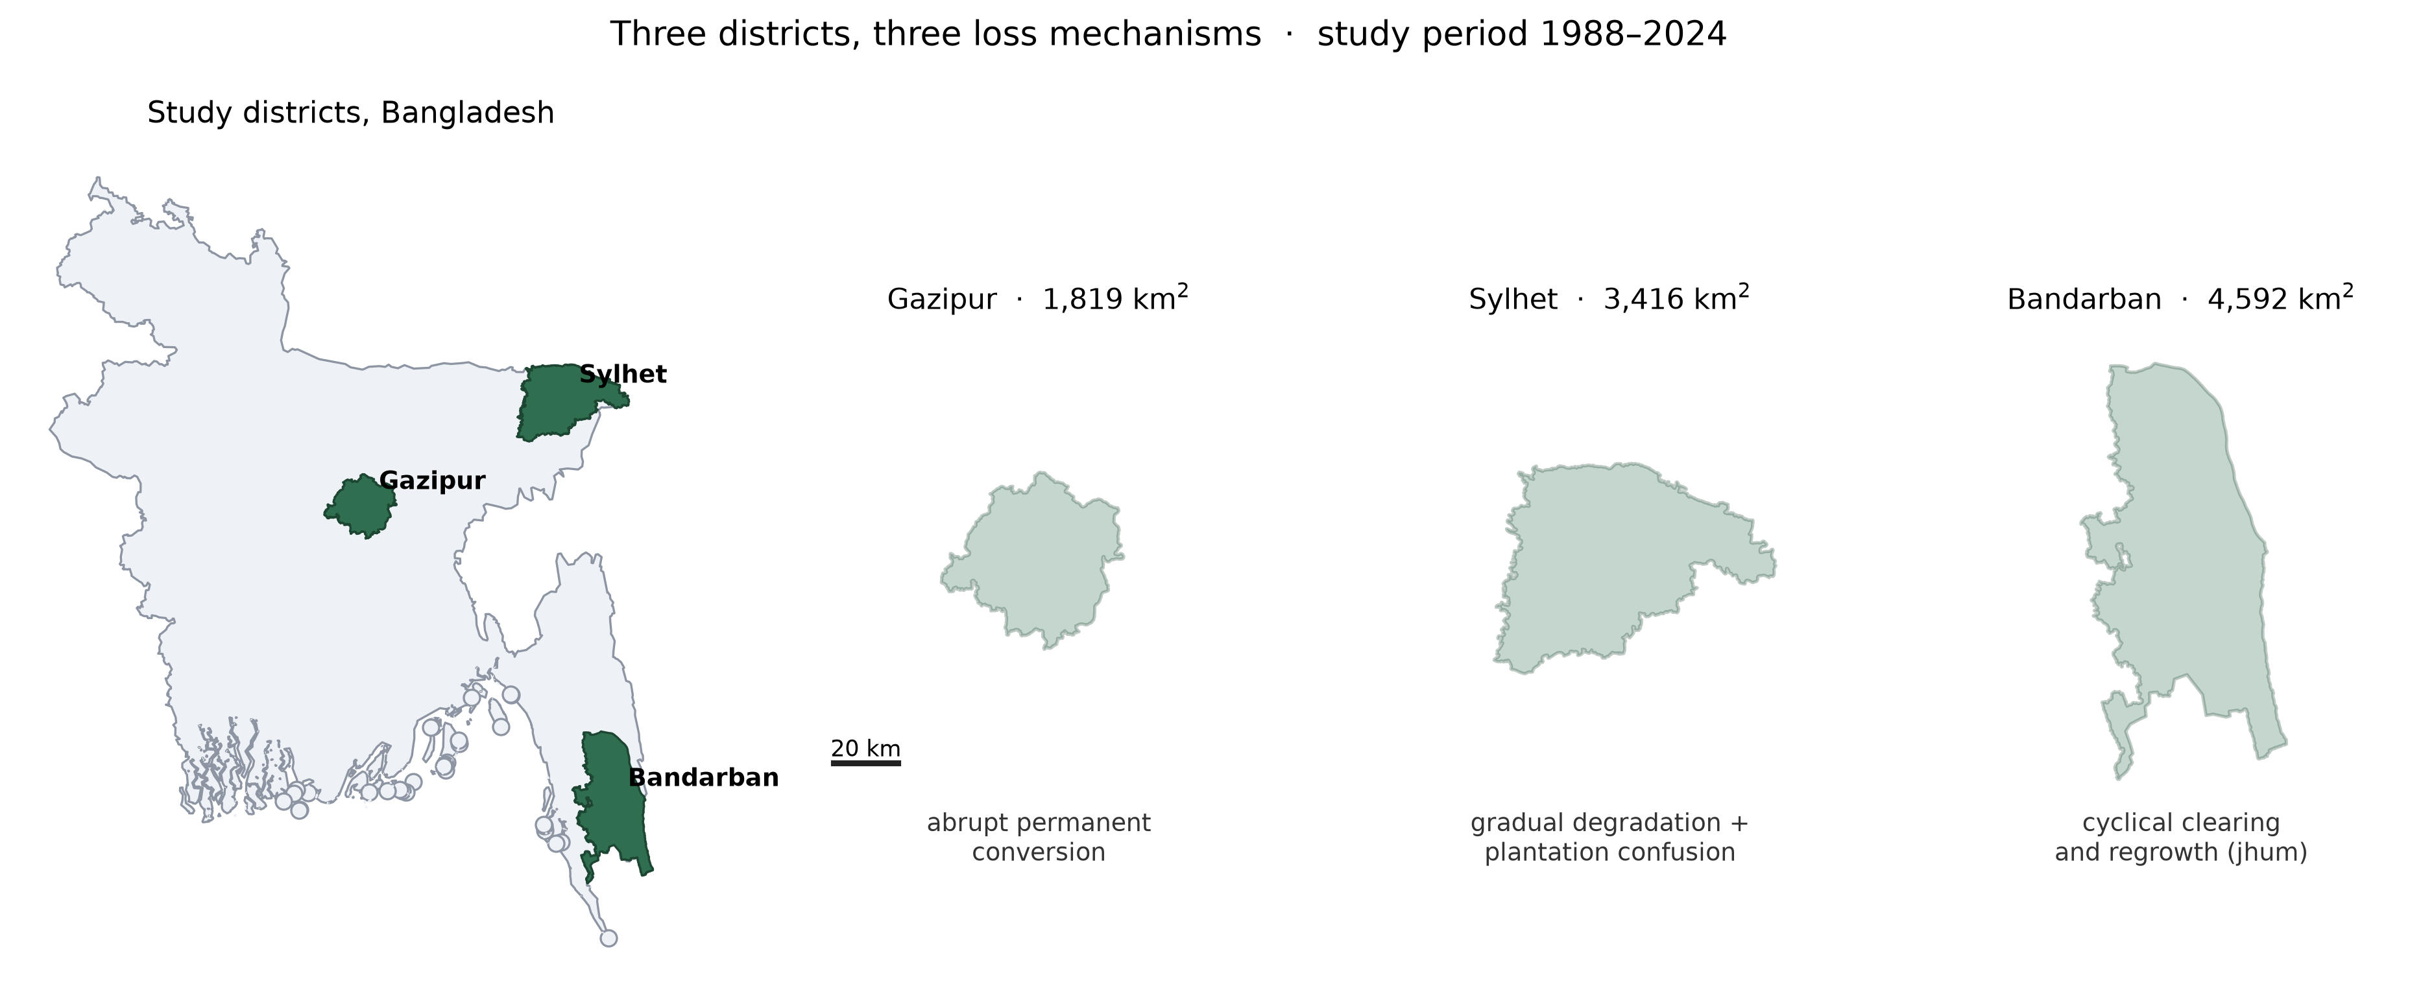
Research Background
Bangladesh has one of the lowest per-capita forest areas and highest population densities in the world. Forest pressure is not uniform — it takes three different forms in three different regions:
Region | Pressure
Around Dhaka (Gazipur) | Urban and industrial expansion
Northeast (Sylhet) | Agricultural encroachment, plantation conversion
Southeast hill tracts (Bandarban) | Shifting cultivation (jhum)
Satellite-based forest monitoring methods were developed and validated on landscapes where loss is abrupt, permanent, and spectrally unambiguous. Where that doesn't hold — plantation confusion, cyclical clearing — the failure is silent: a map and a number get produced, and nothing in the output signals that the method answered the wrong question.
Fig. 1 — Study districts and dominant loss mechanism
3

Slide 4
Research Problem & Motivation
THREE DIFFICULTIES, EACH DEFEATING A STANDARD ASSUMPTION
1
Spectral ambiguity — forest vs. plantation
Tea plantation and natural forest are both dense, evergreen, and spectrally similar at 30 m. A classifier that can't separate them reports plantation expansion as forest stability, or forest cleared for tea as no change.
2
Village tree cover that isn't forest
Homestead gardens (betel, areca, etc.) look forest-like at Landsat resolution but sit over settlement. Distinguishing needs settlement pattern, not greenness.
3
Cyclical disturbance that isn't deforestation
Shifting cultivation (jhum): cleared, cropped, regrown over 5-7 years. A two-date comparison scores the same plot as loss, gain, or no-change purely depending on where the two dates fall in the cycle — an error in temporal design, not classifier accuracy.
Motivating question: how much does choice of method matter as these three problems accumulate — and do methods that work on simple landscapes remain the right choice on complex ones?
4

Slide 5
Literature Review
Satellite forest monitoring baseline — Hansen et al. (2013) Global Forest Change: global 30 m Landsat-based loss/gain map, baseline year 2000, used here as training-label source. Pekel et al. (2016) JRC Global Surface Water is a permanence statistic, not date-specific (matters for the water-class results).
Forest definitions — FAO's definition includes a land-use criterion (temporarily unstocked land still counts as forest). This study deliberately uses a canopy-only, date-specific definition instead: a jhum plot is non-forest when cleared, forest again once regrown.
Classification methods — Random Forest (Breiman, 2001): strong baseline, no spatial context. U-Net (Ronneberger et al., 2015): standard for segmentation, needs pretraining on small datasets. Stacked ensembles combine models with different failure modes, but the literature under-discusses that a stack inherits its meta-learner's training-partition class coverage.
Change detection — Post-classification comparison (PCC) accumulates error from both dates (well-established weakness). Direct/Siamese methods (Daudt et al., 2018) compare dates within one model. Benchmark datasets (LEVIR-CD, OSCD) are urban/high-res, limiting direct transfer to 30 m forest change.
Temporal segmentation — LandTrendr (Kennedy et al., 2010) fits piecewise trajectories to a yearly series, needed because two dates can't separate cyclical from permanent change. Alternatives (BFAST, CCDC) exist; LandTrendr was chosen for explicit segment-level disturbance/recovery magnitude.
Plantation discrimination — GLCM texture (Haralick et al., 1973) is the structural signal (planted rows, geometric boundaries) tested here via ablation. SDPT v2.0 (2024) now covers 158 countries. Bangladesh Tea Board/Association reports 167 estates, ~113,100 ha nationally — area statistics, not boundaries.
Accuracy & area estimation — Olofsson et al. (2014): pixel counting is a biased area estimator; use a stratified estimator with confidence intervals instead. Cohen's κ (1960) is appropriate for interpreter agreement (as used here), explicitly not recommended by Olofsson et al. as a map-accuracy statistic.
Cross-sensor harmonisation — Roy et al. (2016): standard published ETM+ -> OLI coefficients, derived over CONUS. This study tests, rather than assumes, their transfer to Bangladesh — they do not transfer well.
5

Slide 6
Research Gap
1
Method comparison across loss mechanisms, not just landscapes
Most studies hold landscape constant and vary the model. This study varies both — three districts, three mechanisms — so the interaction between class structure and model capability becomes visible.
2
No controlled ablation isolating texture's contribution to plantation discrimination
Texture features are commonly included in stacks but rarely isolated by holding architecture and everything else constant. This study's E3/E4 comparison does exactly that.
3
Deforestation totals for shifting-cultivation landscapes routinely skip the permanent/cyclical split
This study makes that separation explicit and mandatory — no Bandarban loss figure is reported without it.
4
No spatial reference data exists for Bangladesh's tea plantations
National area statistics exist; boundaries don't. This bounds what any study of the region can currently achieve.
6

Slide 7
Research Objectives / Research Questions
Aim: measure forest cover change in Gazipur, Sylhet and Bandarban, 1988-2024, using Landsat imagery, comparing ML, DL and temporal-segmentation approaches across three landscapes chosen to differ in loss mechanism.
# | Research Question
RQ1 | How much forest cover has been lost in each district, and how do loss patterns differ?
RQ2 | Which model — U-Net or Random Forest — performs best in each district? Does the best model differ between districts?
RQ3 | Does adding GLCM texture resolve the natural-forest vs. tea-plantation confusion in Sylhet?
RQ4 | Can annual temporal segmentation separate cyclical jhum disturbance from permanent conversion in Bandarban?
RQ4 is the reason Bandarban is in the study — without it, the third district is just more area, not a distinct test.
7

Slide 8
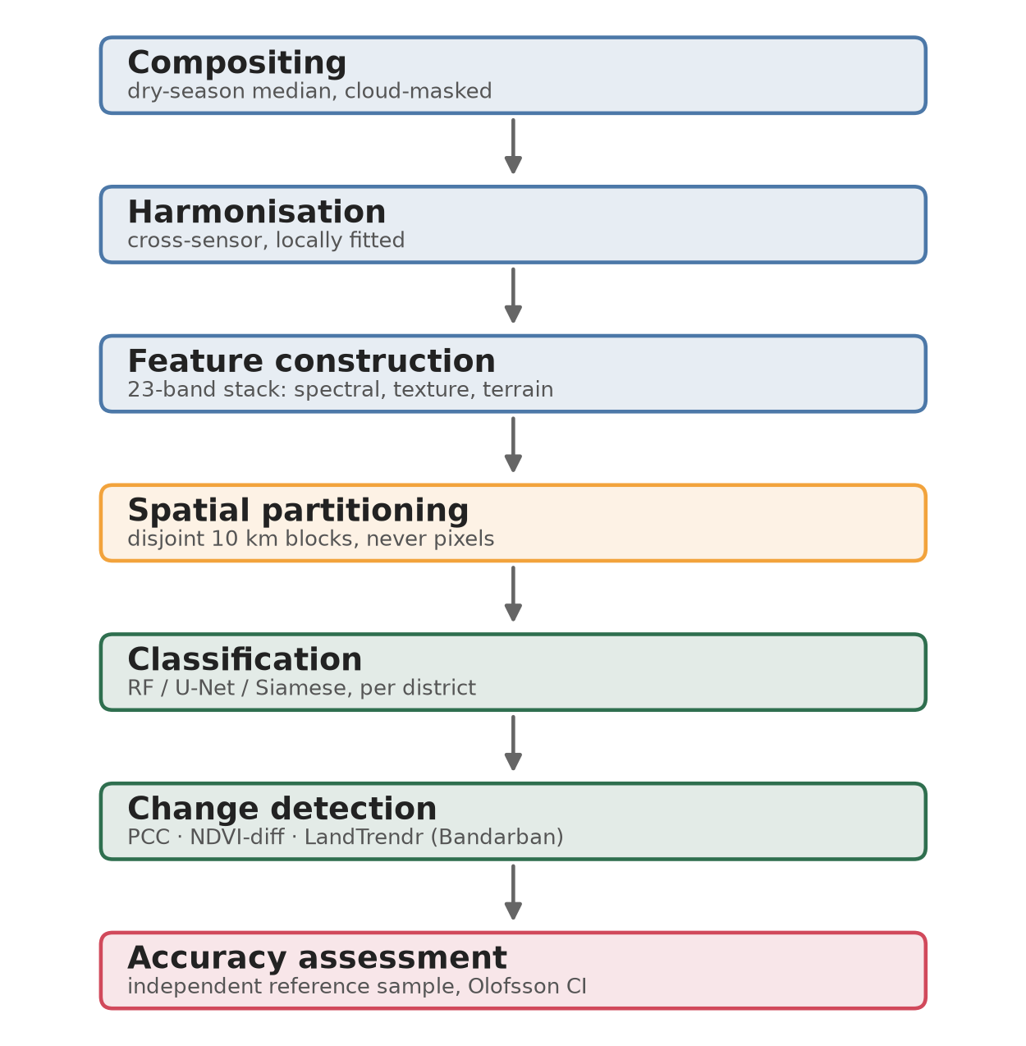
Proposed Research Framework
Compositing
→
Harmonisation
→
Feature
construction
→
Spatial
partitioning
→
Classification
→
Change
detection
→
Accuracy
assessment
District | Area | Mechanism | What it tests
Gazipur | 1,819 km² | Abrupt permanent conversion | Baseline / easy case
Sylhet | 3,416 km² | Gradual degradation, plantation confusion | RQ3
Bandarban | 4,592 km² | Cyclical clearing / regrowth (jhum) | RQ6
“A method that performs well in Gazipur and poorly in Bandarban has told us something specific about where it should — and shouldn't — be deployed.”
Fig. — Analysis pipeline overview
8

Slide 9
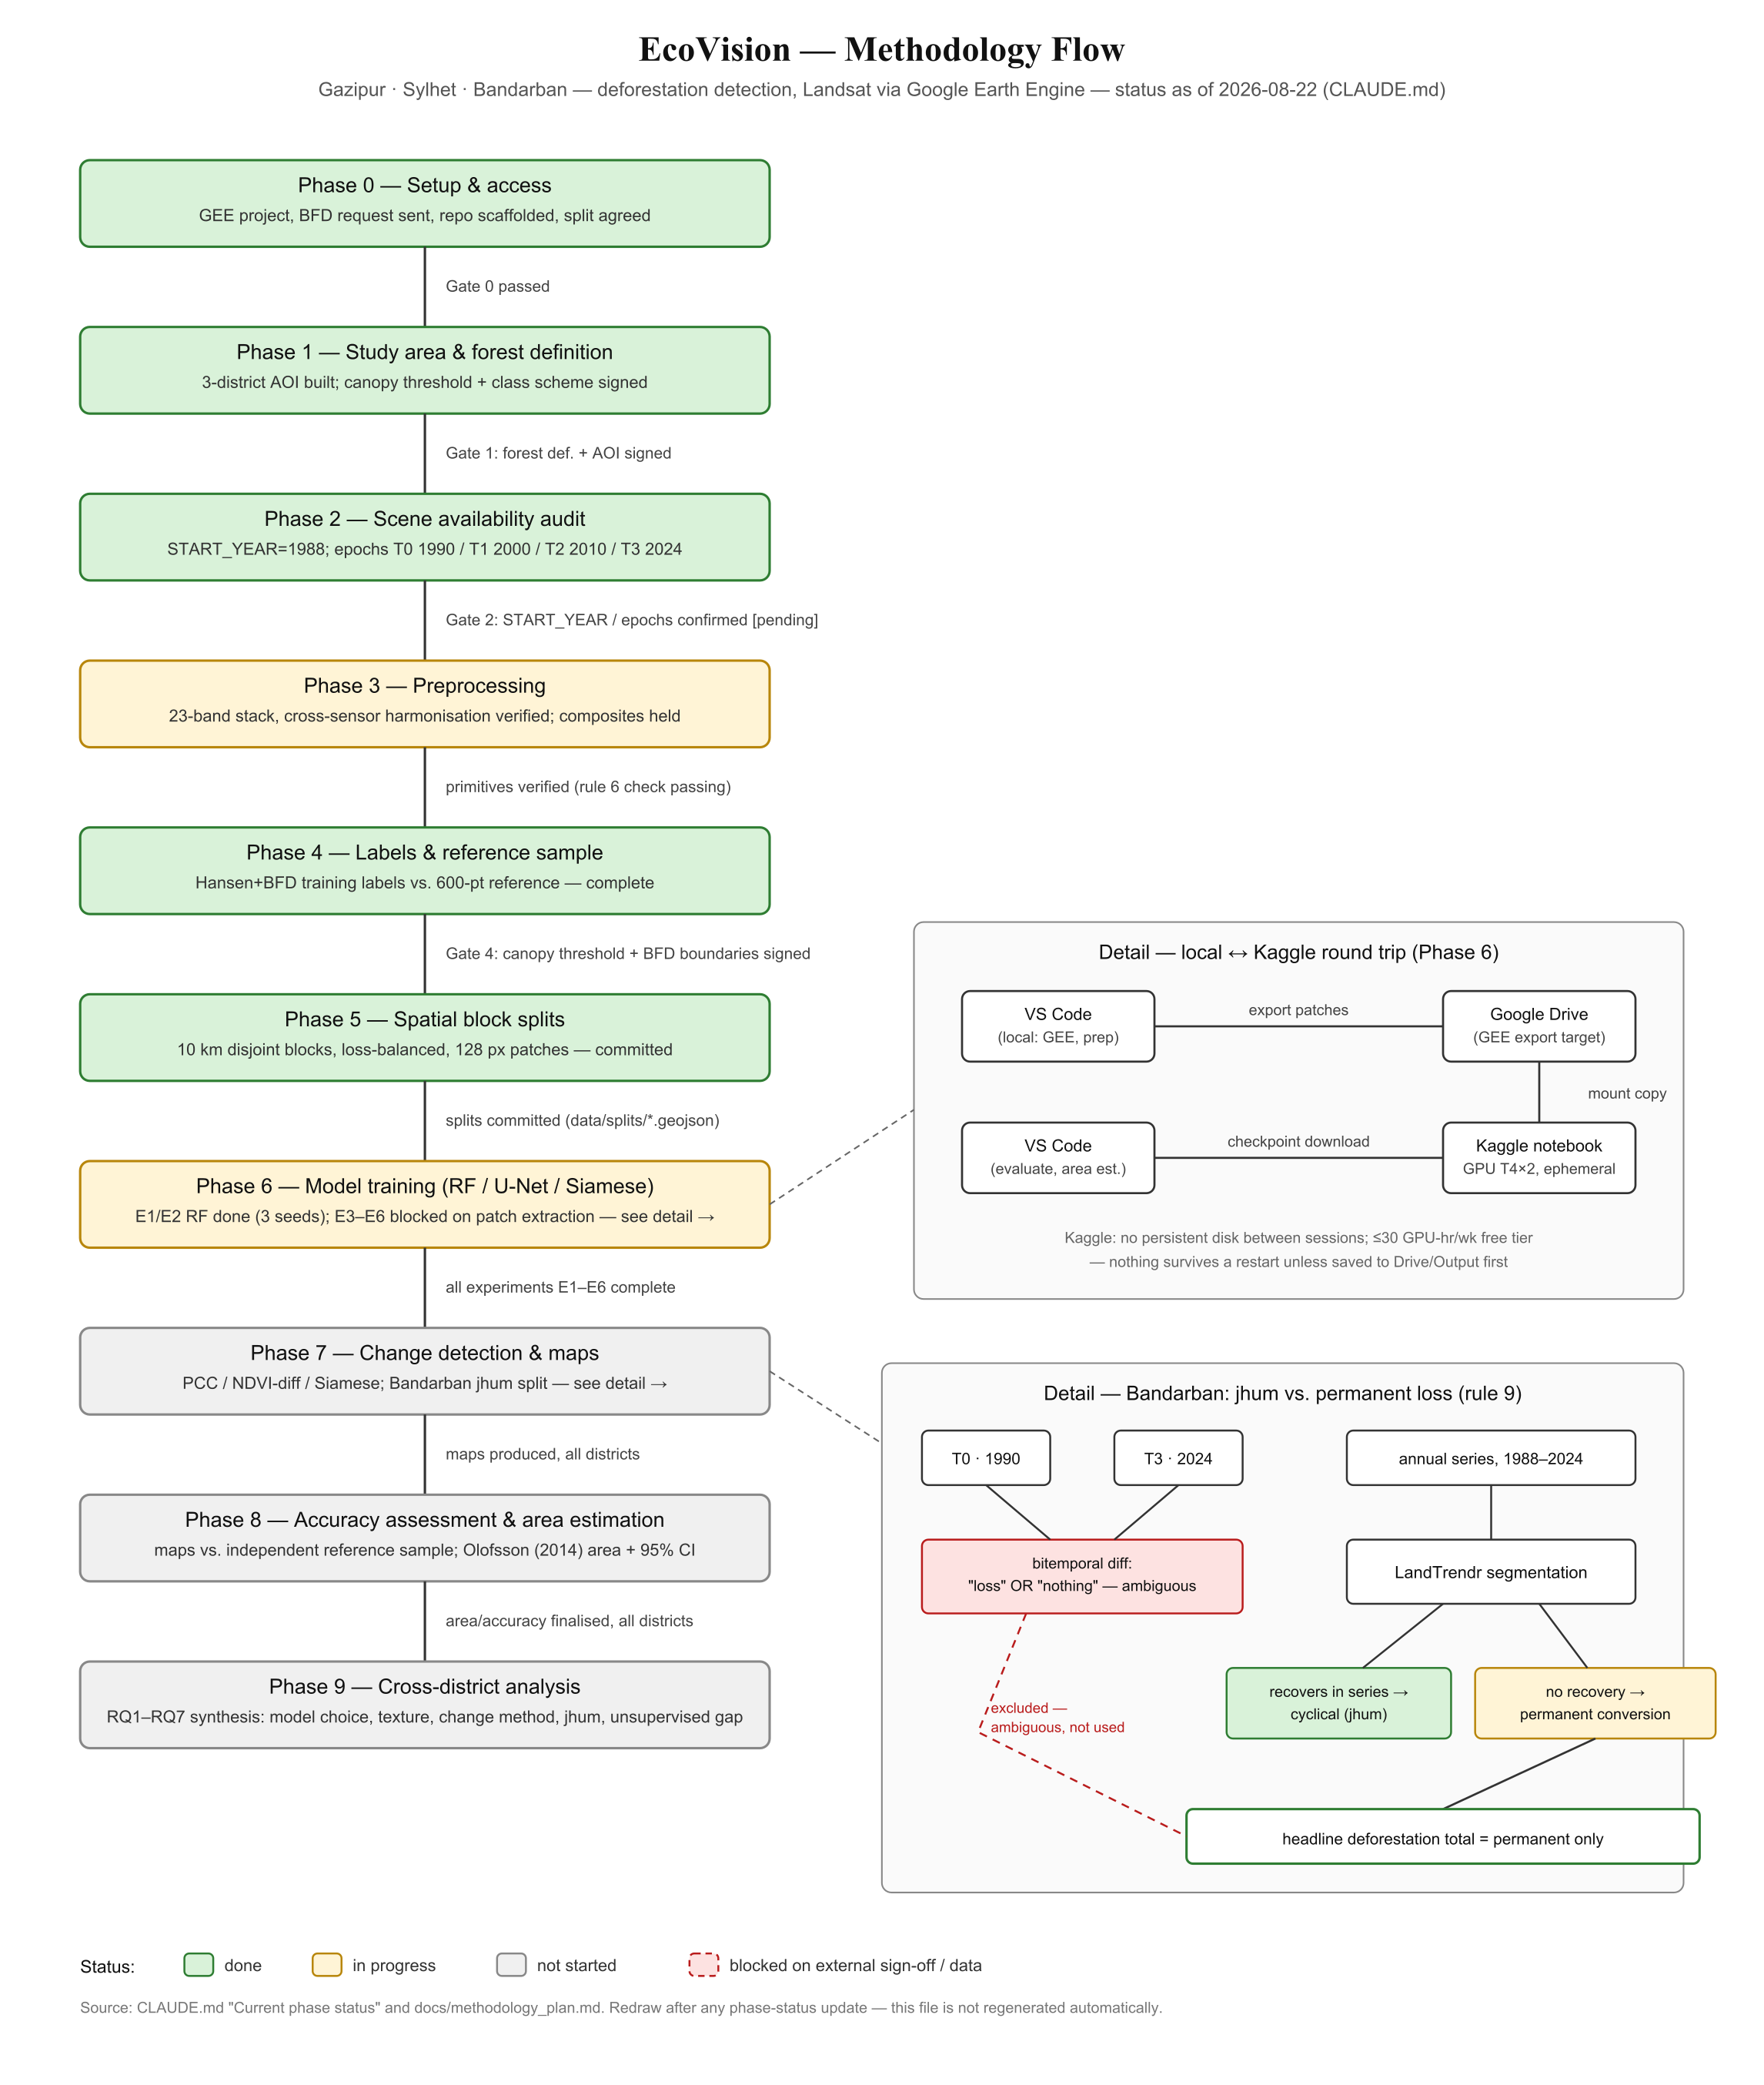
Methodology Flow — Detail
9

Slide 10
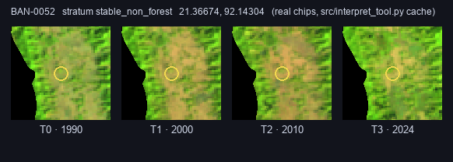
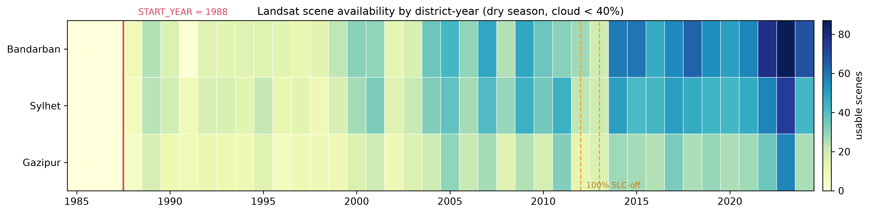
Dataset / Data Collection
IMAGERY
REFERENCE SAMPLE (ACCURACY ASSESSMENT)
Landsat Collection 2 Level-2 surface reflectance via Google Earth Engine (L4/L5 TM, L7 ETM+, L8/L9 OLI). High-resolution commercial imagery used only for visual reference interpretation — never as model input.
District | Total ha | Points
Gazipur | 179,782 | 100
Sylhet | 326,039 | 180
Bandarban | 459,409 | 120
Total |  | 400
TEMPORAL DESIGN
Study period starts 1988 — 1985-87 returned zero usable scenes in all three districts (acquisition gap, not cloud).
Epoch anchors: T0=1990, T1=2000 (aligns with Hansen baseline), T2=2010, T3=2024. T0 is 1990 not 1988 because 1988's observation depth is ~half of 1990's.
2012-2013 fully SLC-off (Landsat 7 scan-line issue) — excluded as epoch anchors.
Bandarban's longest coverage gap: 1 year (1991) — confirms LandTrendr is viable there.
Reduced from an original 1,650-point design (~80 person-hours) due to schedule constraints — a deliberate, quantified trade-off (see Slide 12).
Fig. 2 — Scene availability audit, 1985-2024
Fig. — reference-point interpretation tool, one point across all four epochs (real chip cache)
10

Slide 11
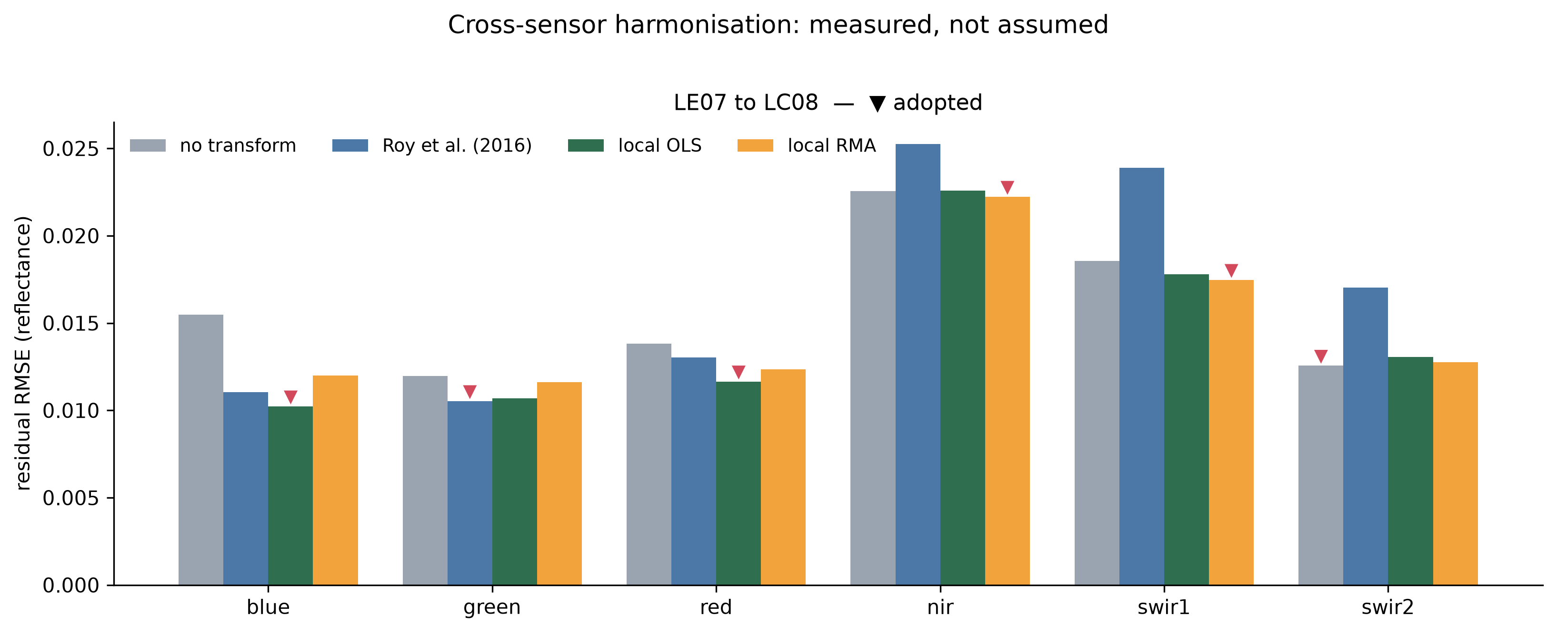
Data Preprocessing
SCALE FACTORS (COLLECTION 2 L2 -> SURFACE REFLECTANCE)
Band | Transform | Gain vs. raw
Blue | local OLS | −33.9%
Green | Roy et al. | −12.0%
Red | local OLS | −15.6%
NIR | none | −1.5% (below margin)
SWIR1 | local RMA | −5.8%
SWIR2 | none | raw was best
Optical: DN × 0.0000275 − 0.2
Thermal: DN × 0.00341802 + 149.0
Compositing: dry season only (1 Nov – 31 Mar), cloud/shadow masked (QA_PIXEL), median-reduced (robust to residual cloud/shadow).
CROSS-SENSOR HARMONISATION — TESTED, NOT ASSUMED
Published Roy et al. (2016) coefficients vs. a locally-fitted alternative (45 near-coincident scene pairs, 34,414 paired pixels, split by pair to avoid leakage). Result: published coefficients performed worse than no correction at all (held-out residual: raw 0.01582, Roy 0.01680, local OLS 0.01433).
Why NIR/SWIR2 untransformed matters: NBR (used for LandTrendr/Bandarban) is built from exactly those two bands. Roy's coefficients would have degraded them by 8.5% and 69.8% respectively.
Feature stack — 23 bands: spectral (7) + vegetation indices (NDVI/EVI/SAVI) + moisture/built-up (NDWI/NDMI/NDBI) + NBR + tasselled cap (3) + GLCM texture (3, on NIR) + terrain (elevation/slope/aspect).
[IMG-06]
Fig. 3 — Residual RMSE per band, raw vs. Roy vs. local
11

Slide 12
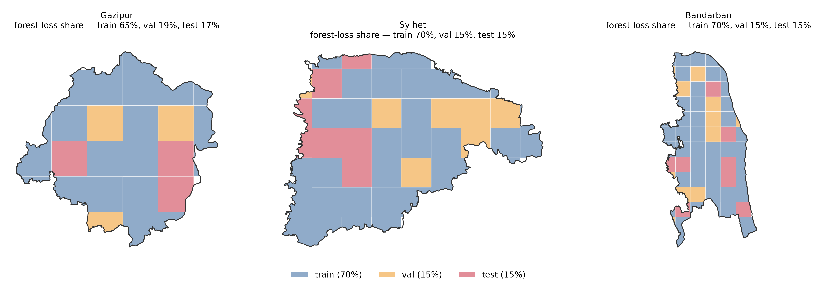
Research Methodology
Spatial partitioning: train/val/test splits are spatially disjoint whole 10 km blocks (never random pixel/patch splits — spatial autocorrelation would inflate accuracy). Targets 70/15/15, balanced on forest-loss pixel share, since loss is only 0.22% of pixels in Gazipur/Sylhet.
Sylhet plantation constraint: tea polygons fall in only 4 of 48 blocks (2 hold 99.8% of the area). Solved by pinning the two meaningful blocks (largest -> train, second -> test). Unpinned assignment gave 0.000 F1 on plantation everywhere.
Change detection: PCC (indirect, error-accumulating), NDVI differencing (2σ threshold calibrated on stable-forest pixels), Siamese (direct).
Temporal segmentation (Bandarban only): LandTrendr on annual NBR series 1988-2024 — classifies trajectories as permanent conversion, cyclical disturbance, or undetermined (disturbance within 6 years of series end).
Accuracy framework: Olofsson et al. (2014) stratified area estimator with 95% CIs (never raw pixel counts). Headline metric is F1 on the change class, not overall accuracy.
CLASSIFICATION EXPERIMENTS
ID | Model | Purpose
E1 | Random Forest, spectral+indices+texture | Baseline
E2 | E1 + terrain | Does terrain help?
E3 | U-Net, full 23-band stack | DL baseline
E4 | U-Net, 20 bands (no texture) | RQ3 ablation
E5 | Siamese network | Direct change detection
E7 | Stacked RF + U-Net (logistic meta-learner) | Does combining help?
Fig. 4 — Spatially disjoint block assignment
12

Slide 13
Experimental Setup
Patch extraction (U-Net): 128×128 px (3.84 km) — not the originally planned 256×256, which yielded only ~165 total training patches (too few to fine-tune a pretrained encoder). 128 px yields 706 patches total, zero fetch failures. Patches cut strictly inside blocks; partial edge tiles discarded.
ACHIEVED SPLIT SHARES
District | Blocks | Area share | Loss share
Gazipur | 21/3/3 | .706/.136/.159 | .650/.185/.165
Sylhet | 31/10/7 | .732/.135/.133 | .631/.224/.145
Bandarban | 45/11/8 | .697/.149/.154 | .696/.153/.151
Class imbalance: loss is 0.22% of pixels in Gazipur/Sylhet vs. 24.3% in Bandarban — a two-orders-of-magnitude difference. Patch sampling weighted toward informative content in Gazipur/Sylhet, left unweighted in Bandarban. Test splits are never weighted, in any district.
Ensemble (E7): meta-learner fit on the validation split only (not train — would just learn memorized predictions; not test — leakage). Training-patch counts: Gazipur 55, Sylhet 167, Bandarban 260 — central to the RQ5 result.
Loss function: Dice + cross-entropy; nodata pixels excluded via ignore-index (not folded into non-forest class).
Splits are (train/val/test). Sylhet deviates furthest from the 70/15/15 target (train loss-share 0.631 vs. 0.700) — the accepted cost of pinning plantation blocks to make RQ3 answerable.
13

Slide 14
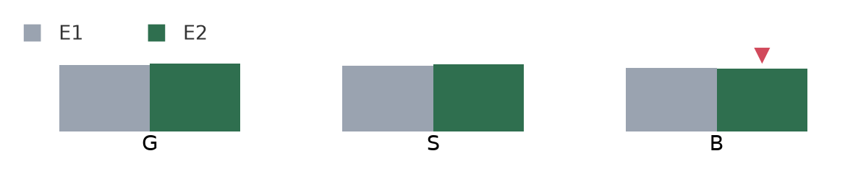
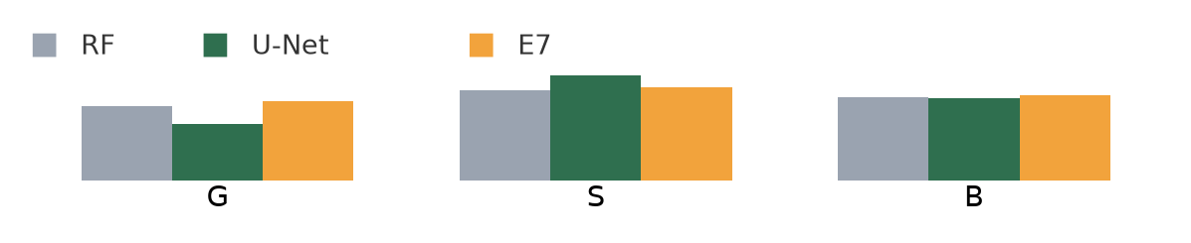
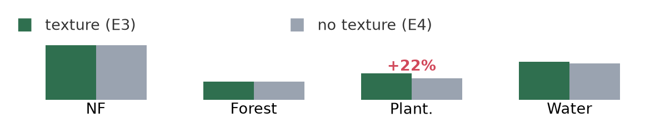
Experimental Results
RF BASELINE + TERRAIN (E1/E2) — 3 SEEDS, VS. HANSEN LABELS
DL + ENSEMBLE — SINGLE SEED, PATCH-TEST MACRO F1
District | E1 F1 | E2 F1 | Δ | Verdict
Gazipur | 0.7805 | 0.7979 | +0.0174 | Terrain helps
Sylhet | 0.7676 | 0.7883 | +0.0207 | Terrain helps
Bandarban | 0.7431 | 0.7359 | −0.0073 | Within noise
District | RF | U-Net | E7 | Patches
Gazipur | 0.4125 | 0.3157 | 0.4443 | 55
Sylhet | 0.5028 | 0.5895 | 0.5187 | 167
Bandarban | 0.4632 | 0.4607 | 0.4754 | 260
No single model wins everywhere → direct answer to RQ2. RF wins decisively at 55 patches, loses at 167, ties at 260 — a clean answer to RQ5: deep learning isn't uniformly superior, only superior above a data threshold.
TEXTURE ABLATION (RQ3) — SYLHET, PER-CLASS F1
Run | Non-forest | Nat. forest | Plantation | Water | Macro F1
E3 (texture) | 0.9389 | 0.3163 | 0.4520 | 0.6508 | 0.5895
E4 (no texture) | 0.9368 | 0.3172 | 0.3696 | 0.6244 | 0.5620
E1 vs E2 F1 by district
+0.0824 plantation F1 (22% relative gain), almost entirely isolated to the plantation class. Random Forest on the same data scores only 0.0286 on plantation — a per-pixel model literally cannot see the spatial pattern that defines tea.
Model comparison by district
Plantation F1, texture on/off
14

Slide 15
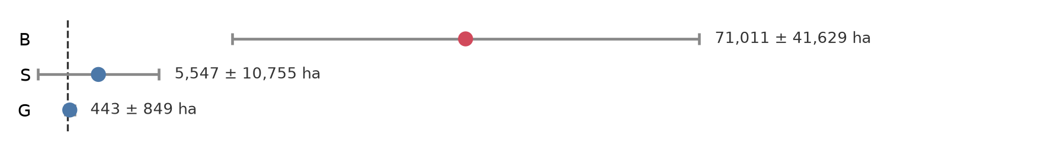
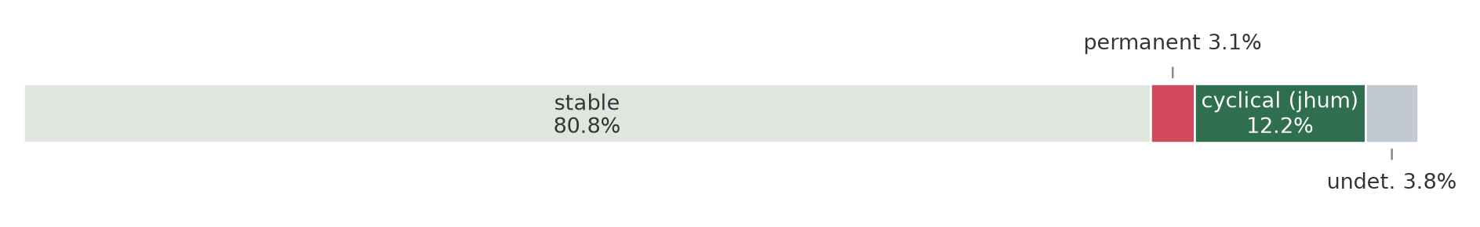
Detailed Results Analysis
CYCLICAL VS. PERMANENT DISTURBANCE, BANDARBAN (RQ6) — LANDTRENDR, 1988-2024
ADJUSTED LOSS VS. INDEPENDENT REFERENCE SAMPLE (400 PTS)
Class | Area | Share
Stable | 371,380 ha | 80.8%
Permanent conversion | 14,457 ha | 3.15%
Cyclical disturbance | 56,235 ha | 12.24%
Undetermined | 17,431 ha | 3.79%
District | Adjusted loss (1990-2024) | Ref. pts
Gazipur | 443 ± 849 ha | 2
Sylhet | 5,547 ± 10,755 ha | 7
Bandarban | 71,011 ± 41,629 ha | 18
Gazipur and Sylhet intervals include zero — no significant loss detectable there at 95% CI, a consequence of the reduced sample (400 vs. the planned 1,650). Bandarban's reconciled estimate is the exception: 71,011 ± 41,629 ha — the first interval in this thesis that excludes zero.
Of 88,122 ha disturbed, only 16.4% is permanent — a bitemporal method would have reported ~4× the actual deforestation. This is the finding the third district exists to produce.
Adjusted loss ± 95% CI, all districts
Bandarban disturbance breakdown
INTER-INTERPRETER AGREEMENT (COHEN'S Κ, TARGET ≥0.75)
District | κ
Gazipur | 0.157 ± 0.165
Sylhet | 0.038 ± 0.124 (≈ chance)
Gazipur's over-sampled loss stratum: only 2 of 40 points were genuine forest→non-forest transitions — a direct measurement of Hansen commission error.
Also flagged as findings, not errors: water F1 = 0.000 everywhere (map's water class is permanent, reference is date-specific); Sylhet's plantation stratum was never interpreted, so RQ3's model-side result has no independent validation yet.
Reference-sample accuracy figures use phase8_results.md (interim) numbers throughout.
15
Notes:
CAUTION FLAGS for Q&A: (1) A later full-thesis draft reports a much larger, statistically significant Bandarban loss figure (71,011 +/- 41,629 ha, 18 reference change points) — this deck deliberately uses the phase8_results.md interim numbers (2 reference change points, non-significant) per instruction; do not mix the two. (2) The kappa figures (0.157/0.038) come from a fuller cross-stratum double-interpretation design, not phase8_results.md's single-interpreter design — flag this to the supervisor if asked; frame as: interpretation is still in progress and both sample size and double-coverage subset are evolving. (3) In the fuller draft, the Discussion chapter is labelled Chapter 7 but its subsections are numbered 8.1-8.9, a leftover from an earlier numbering scheme — don't be caught off guard if the supervisor raises it.

Slide 16
Discussion & Comparison
MODEL CHOICE MATTERS MORE AS LANDSCAPE COMPLEXITY RISES
PLANTATION MAPPING IS GENUINELY UNSOLVED — FOUR CONVERGING LINES OF EVIDENCE
Spectrally distinct + scarce data (Gazipur) → per-pixel model (RF) wins.
Structurally (not spectrally) confusable (Sylhet plantation) → spatial context wins (U-Net beats RF by >10×, 0.4520 vs. 0.0286).
Temporally structured (Bandarban jhum) → no bitemporal model of any architecture works; only trajectory segmentation (LandTrendr) answers it.
Manual sub-metre digitisation still carried an 83% error on one polygon (1,906 ha claimed → 321 ha real, caught only by independent review).
No open dataset maps Bangladesh's tea (global databases omit the country; OSM has 1 usable polygon; gazetteers resolve 1/19 estates).
A purpose-built FFT/Hough texture detector found no separation between tea and forest (p=0.55).
Two trained human interpreters agreed at chance level (κ=0.038, Sylhet).
Ensembles inherit their meta-learner's blind spots: E7 scored 0.0000 on plantation despite the U-Net inside it scoring 0.4520 — the plantation-block-pinning that made RQ3 answerable left the validation split, where the meta-learner is fit, with zero plantation examples. General lesson: a stack can be strictly worse than its own best member on a rare, spatially clustered class.
Harmonisation coefficients don't automatically transfer — published Roy et al. coefficients, fit over CONUS, performed worse than no correction here, a general caution against adopting published remote-sensing coefficients on authority rather than testing locally. Bitemporal change detection is structurally weak here: no method exceeded F1=0.36.
16

Slide 17
Research Contributions
1
Three landscapes, not one
Lets us see how model choice changes as the terrain gets harder to read.
2
A clean texture test
Same model, texture on vs. off, nothing else changed.
3
Separated real loss from regrowth
Bandarban's number counts permanent clearing only, not the forest cycling back.
4
We report uncertainty honestly
Confidence intervals, not raw counts — and we show where things didn't work, not just where they did.
17

Slide 18
Limitations, Future Work & Conclusion
LIMITATIONS
FUTURE WORK — PRIORITY ORDER
Reference sample cut to 400 points (planned 1,650) → wide uncertainty, can't confirm loss in two of three districts.
Our two interpreters didn't agree well (κ below target) → accuracy numbers are provisional.
Tea plantation mapping is incomplete → Sylhet's confusion is reduced, not solved.
Deep-learning models ran once each, and the 1990 imagery was scored with a model trained on 2024 data — both untested assumptions, not yet confirmed.
A proper spatial reference dataset for Bangladeshi tea plantation — highest-value next step; every plantation result in this study is bounded by it.
Reconciliation and re-measurement of κ, then recomputation of all reference-based figures.
Extend LandTrendr-style trajectory separation to Sylhet's gradual degradation.
Multi-seed replication of deep-learning experiments; complete the 2000-2024 overlap comparison to quantify pre-2000 transfer.
Conclusion: No single model or method wins everywhere — the right choice depends on whether the target class's discriminating signal is spectral, spatial, or temporal. This study measured, rather than assumed, several standard remote-sensing practices and found them wanting in this setting — which is itself the thesis's central, generalizable finding.
18

Slide 19
Thank You
Questions?
“This thesis asks not which model is best, but which property of a target class — spectral, spatial, or temporal — determines which model can even see it.”
Sheikh Sulaiman Sony (ID 2002026) • Jalal Uddin Mohammad Akbar (ID 2002050)
Notes:
Anticipated pre-defence questions (prep notes):
Q: Why is your Bandarban loss figure not significant, when the abstract talks about the jhum finding so confidently?
A: Two separate results. The LandTrendr trajectory proportions (16.4% permanent / 63.8% cyclical, out of 88,122 ha disturbed) are a model-side finding, independent of the reference sample's small size. The reference-sample-based loss estimate (70+/-96 ha) is a separate, underpowered measurement limited by only 2 reference change points in Bandarban. Both are honestly reported; they answer different questions.
Q: Why report a failing kappa instead of just fixing it before presenting?
A: Reporting it, and stating what it means (definitional ambiguity in village-vegetation/forest boundary, not random error -- 75 of Sylhet's 101 disagreements run in one direction), is itself a contribution; reconciliation is explicitly next on the future-work list.
Q: Why only 400 reference points instead of the planned 1,650?
A: Schedule constraint, stated as a deliberate, one-directional trade: smaller sample = wider intervals (a weaker but honest result) vs. omitting accuracy assessment entirely (which would make every other figure circular).

