Slide 1

Self-driving vehicle demo
Name: Shiekh Zeeshan Ahmad
Professor: Dr. Harangi Balázs
Subject: Machine Learning Basics
Department: Computer Science
(using python, OpenCV & Tensorflow)

Slide 2
Introduction
An autonomous vehicle, or a driverless vehicle, is one that is able to operate itself and perform necessary functions without any human intervention, through the ability to sense its surroundings.
In this project, the lane keep assist system (LKAS) technique is used to automate steering so that the car is in the middle of the lane.
This Model uses given images, exacts information from them, and tries to predict the car’s steering angles.
This is known as a supervised machine learning program, where images (features) and steering angles (labels) are used in training. Because the steering angles are numerical values, i,e this is a regression problem, instead of a classification problem.

Slide 3

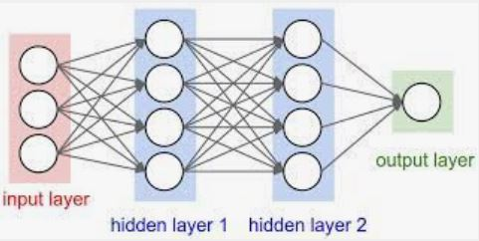

Technologies used
OpenCV
Convolutional neural network (CNN)
TensorFlow

Slide 4
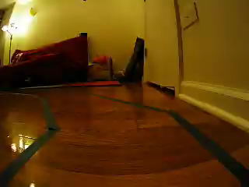

Data set
To collect training data, OpenCV implementation is done on the track a few times and saved the video files and the corresponding steering angles and then use to train our model.
Frame Number
Steering angle in degree
Sample training data set had only 200 images, So, Image Augmentation (like Zoom, Pan(rotate), Flip & Blur) operations were done to generate more data dynamically from the original.
It finally helps to improve our model training.

Slide 5
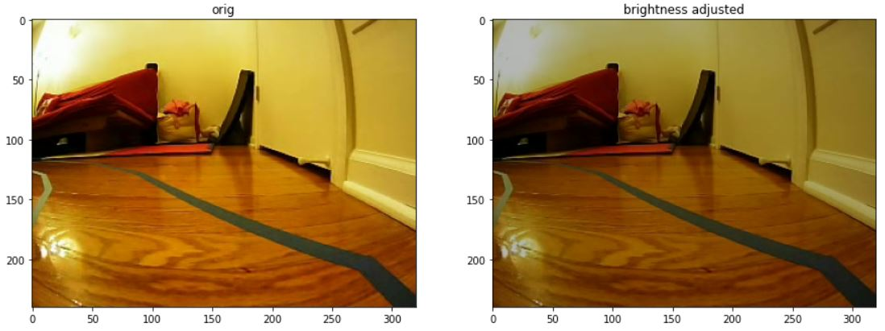
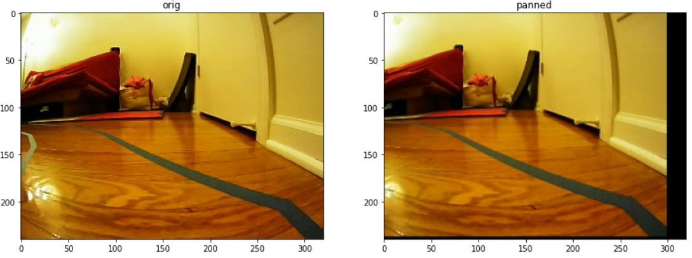
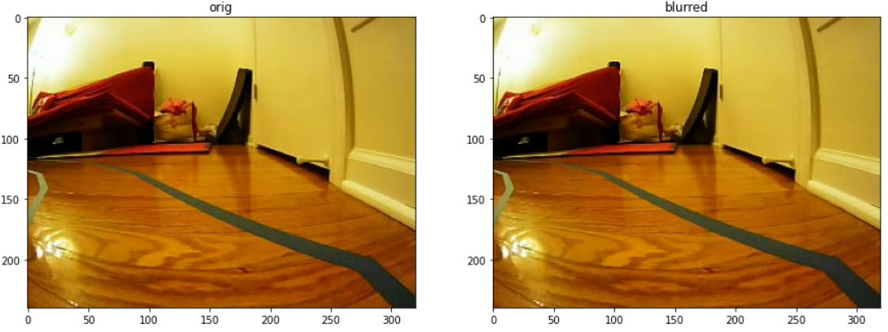
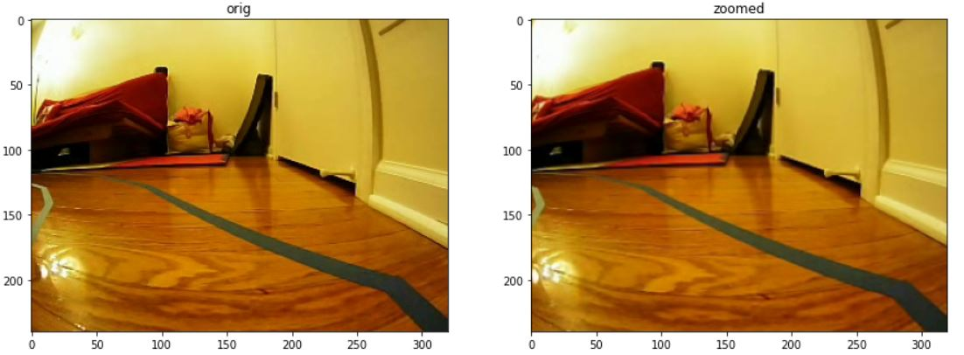
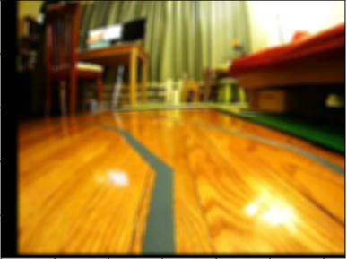
augmented operations
Brightness Adjust
Panned
Blurred
Zoomed

Slide 6
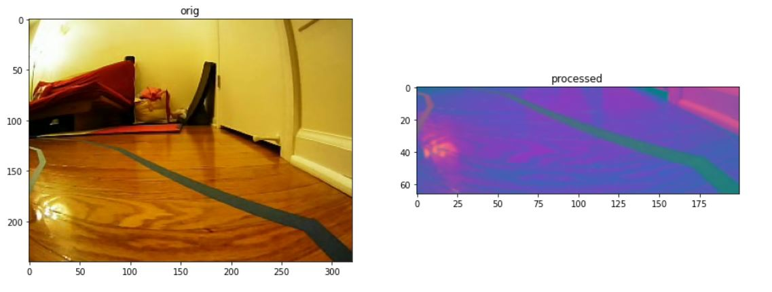
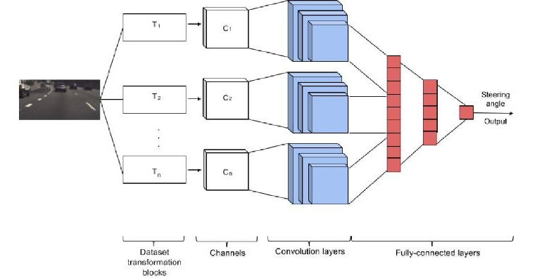
working
At the core of the model, there is a Convolutional Neural Network.
It extracts lines and edges in its early layers and complex shapes in its later layers. The fully connected layers function can be thought of as a controller for steering.

Slide 7
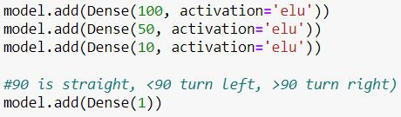
working
Number of filters used: 36
The shape of the filters used: 5 * 5
Hidden nodes: 100 => 50 => 10 => 1
No. of filters
Shape of filter
Note: Just to decrease the computational complexity
‘elu’ activation function is used.

Slide 8
working
This model contains about 30 layers in total.
The input image to the model (bottom of the diagram) is a 66x200 pixel image.
The image is first normalized, then passed through 5 groups of convolutional layers
Finally passed through 4 fully connected neural layers and arrived at a single output, which is the model-predicted steering angle of the car.
This model-predicted angle is then compared with the desired steering angle given the images, and the error is fed back into the CNN training process via backpropagation(until the loss/Mean Squared Error is low enough).

Slide 9
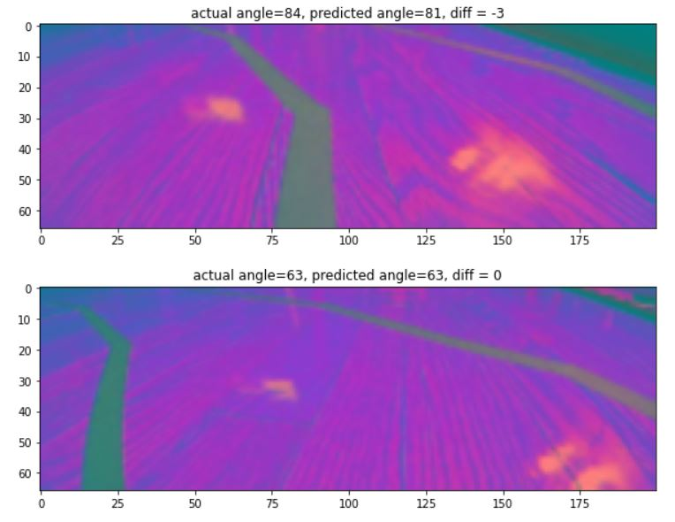
working
The loss function used is Mean Squared Error (MSE) because regression training is done.
Predicted result details:
mse = 5.0
Accuracy = = 92.59%

Slide 10
Thank you!

