Slide 1






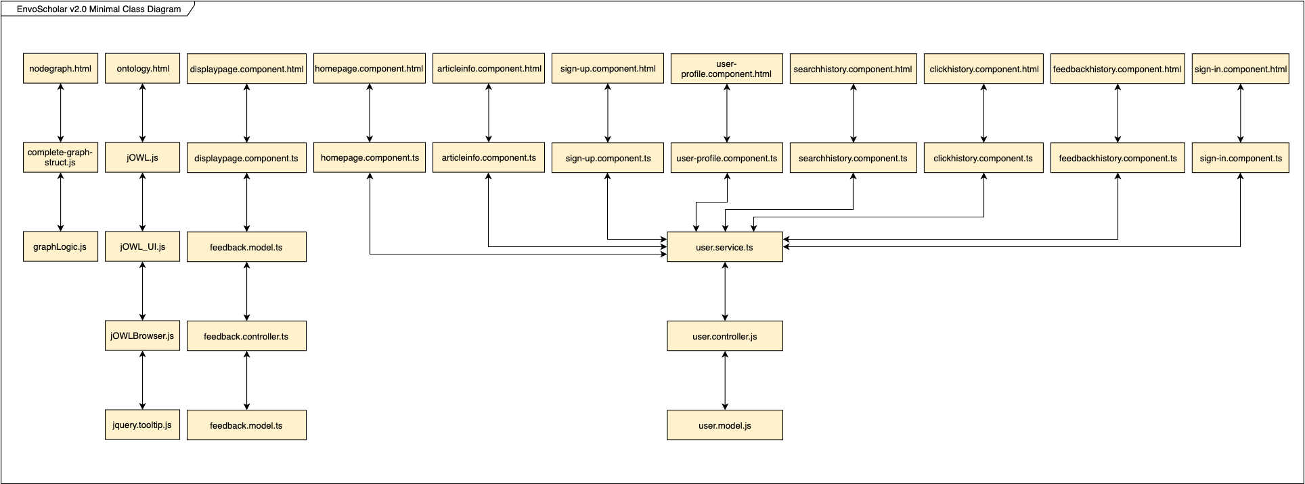
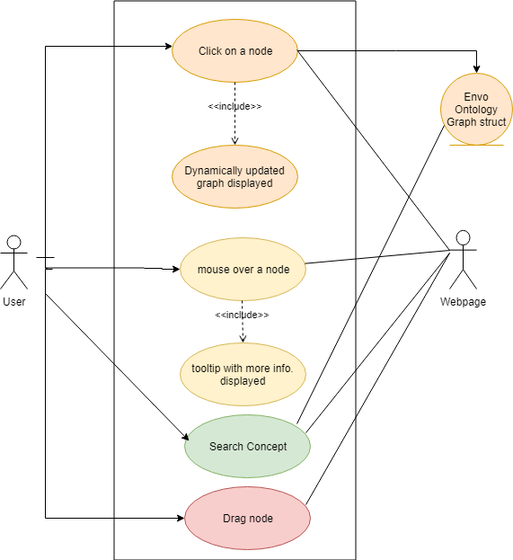
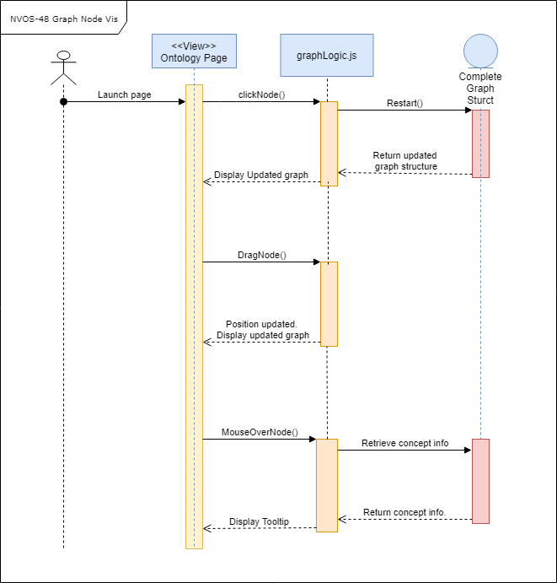


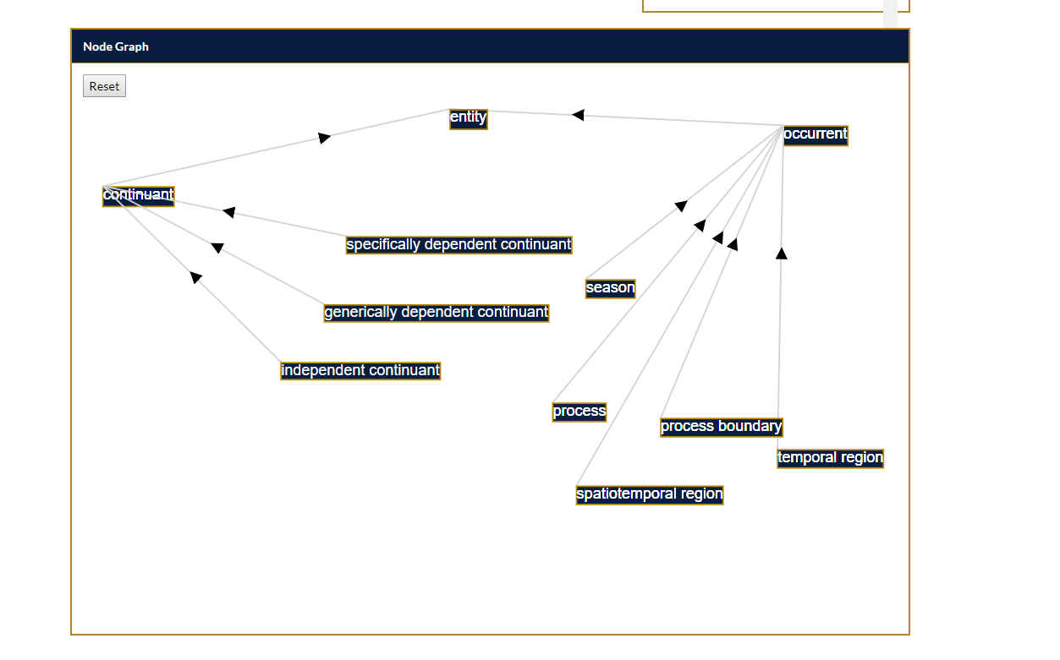
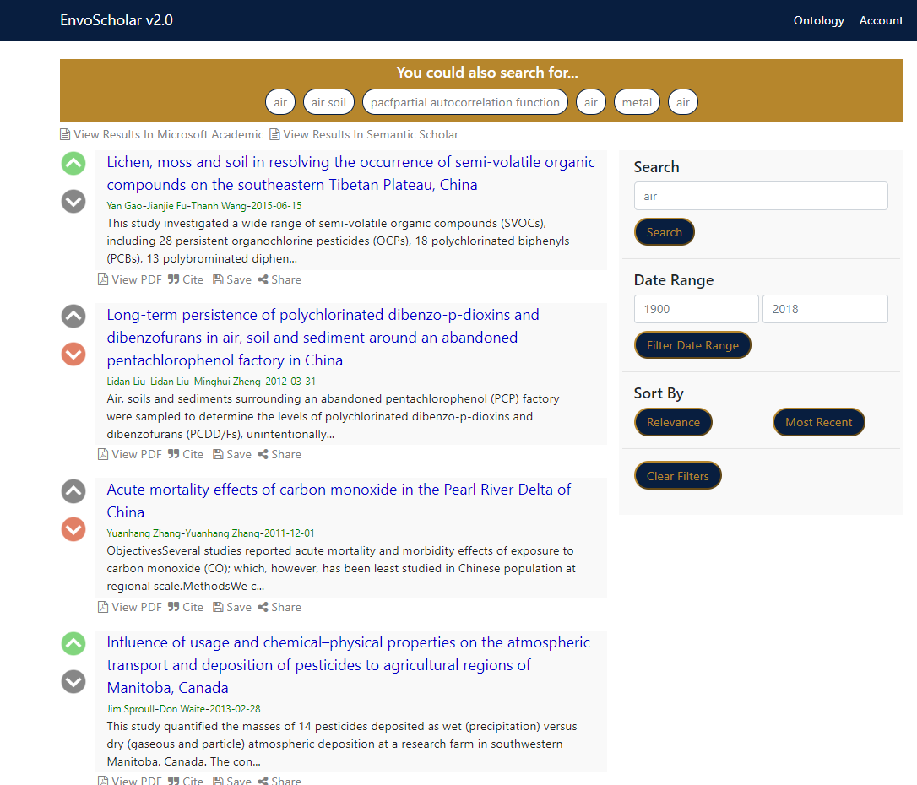


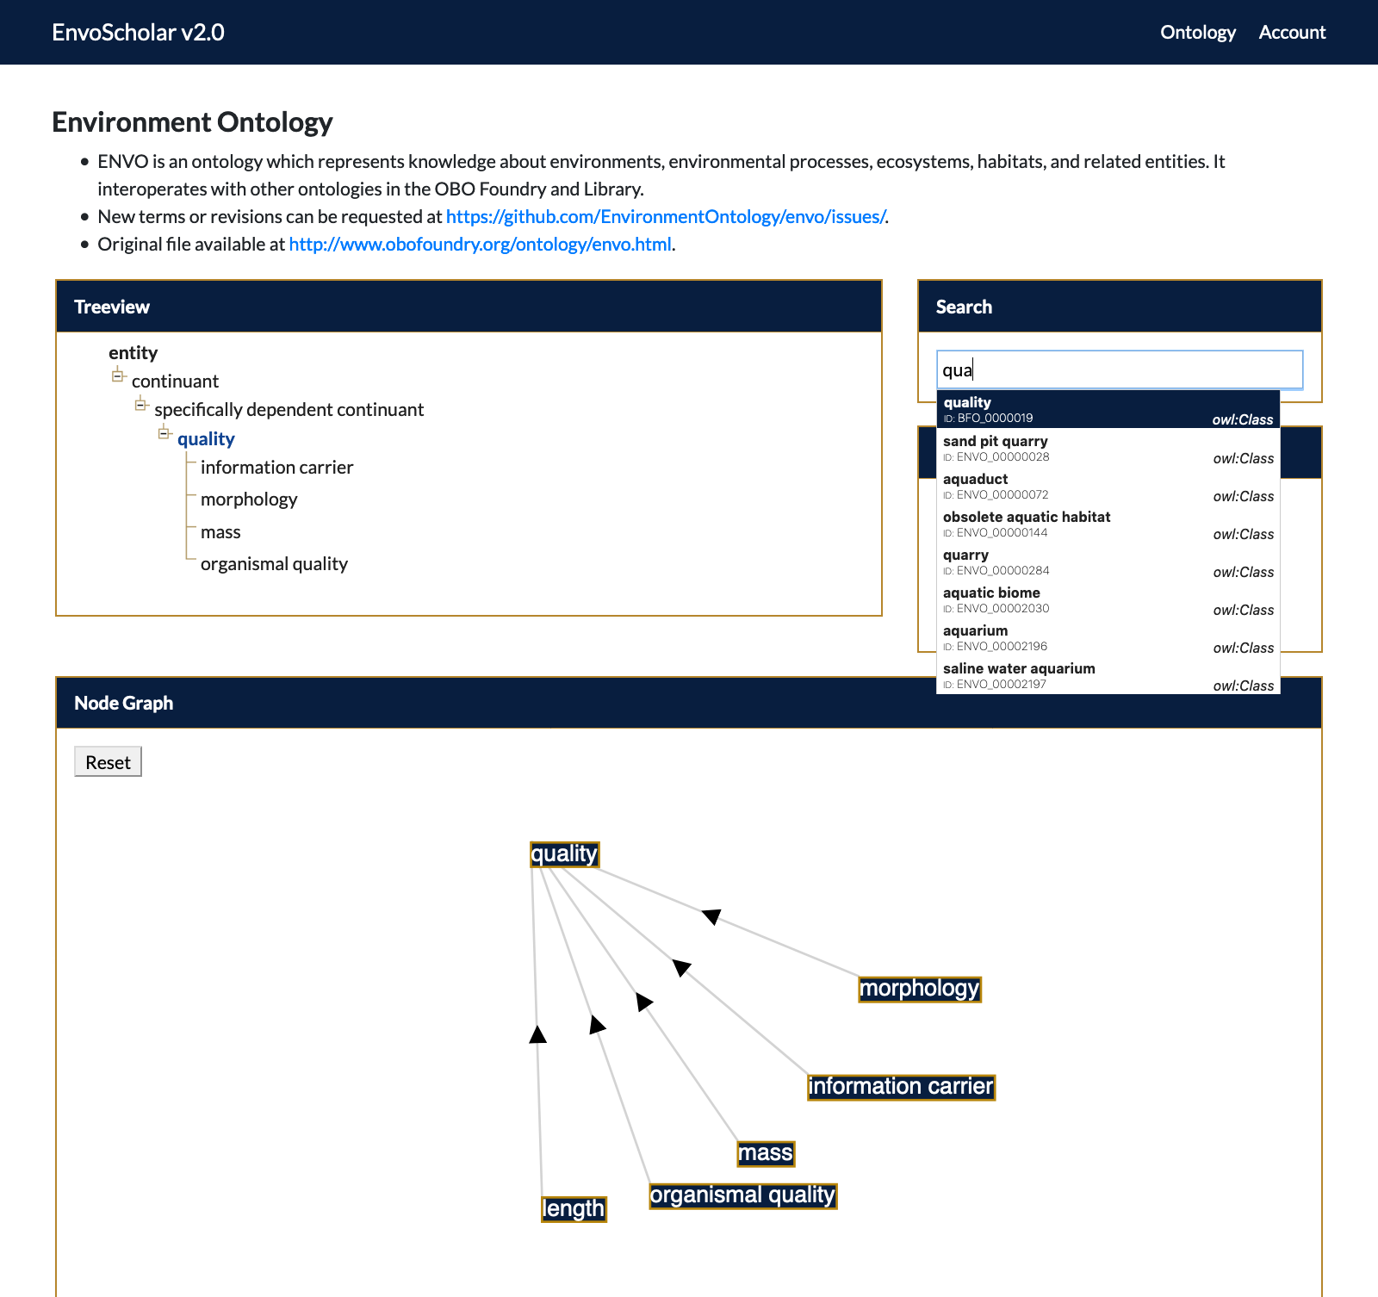
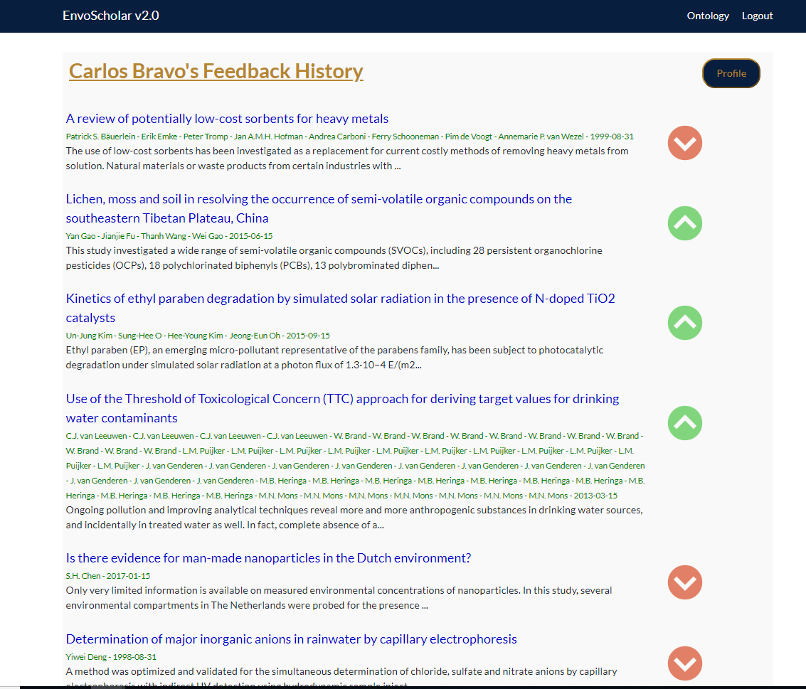
School of Computing & Information Sciences
Spring 2019 Senior Design Project
EnvoScholar v2.0
Student: Carlos Bravo
Mentor: Dr. Mark Finlayson,
Instructor: Dr. Masoud Sadjadi, Florida International University
Problem
Current System
Requirements
Center for Aquatic Chemistry and Environment(CREST): a research center at FIU is in need for a Web-based, user-friendly front-end solution to browse through the scientific articles stored on their databases and be able to find useful literature for future and ongoing research.
There isn’t a search engine dedicated to environmental science papers only.
The current system allows users to:
Enter a search query which has autocomplete feature.
Click on an article to view more information .
Highlight sentences containing key concepts on the abstract.
View the ontology in Node Graph and Tree view format.
Go to the articles Science Direct page.
Leave feedback on user experience and Rate articles.
Create an account.
Save articles.
View the history of
  Search queries they have entered.
  Articles they have rated
  Articles they have clicked on.
  Articles they have saved.
EnvoScholar v2.0 should be web-based, cross-browser and interactive.
For my contributions, a user should be:
Able browse the ontology through a Node graph visualization.
Able to rate scientific articles.
Able to see feedback history.
Search concepts and visualize them in Graph view and tree view simultaneously.
Object Design
Minimal class diagram: Entire system
Use Case Diagram: Node graph visualization
Sequence Diagram: Node graph view
System Design
Screenshots
Article Information
Elastic search
CREST DATABASE
Back-end
User Information
Front-end
Node graph expanded when clicking a node
Rate articles from display results page
Implementation
Feedback history page to keep track of rated articles.
Angular 6 was used to create the functionality of the front end.
HTML5, CSS were used for styling.
D3.js was used to create Node graph visualization of the ontology.
NodeJS and Express were used to create the server that connects to the Mongo Database containing the users and feedback information.
Elasticsearch was used to enhance the GET requests to the PostgreSQL database containing the articles.
JWT and Passport were used for user authentication
Node graph updates on hover from search bar
Acknowledgement
The material presented in this poster is based upon the work supported by Dr. Masoud Sadjadi and Dr. Mark Finlayson. I thank Sheila Alemany, Maria Presa, and Deya Banisakher for assistance, cooperation and mentorship that I received throughout this process

