Slide 1






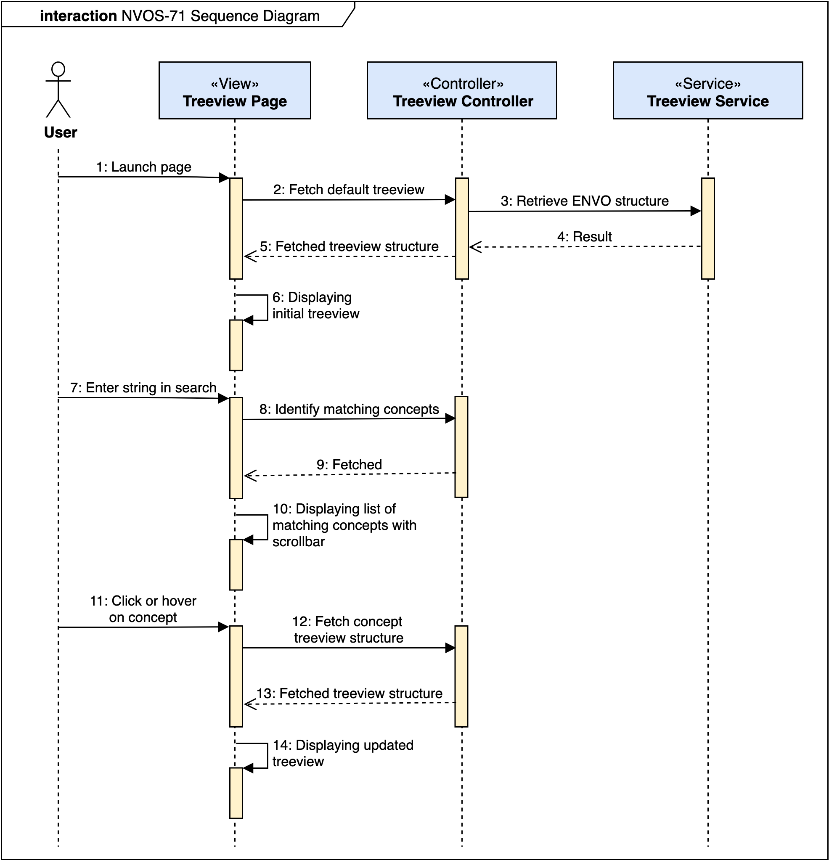
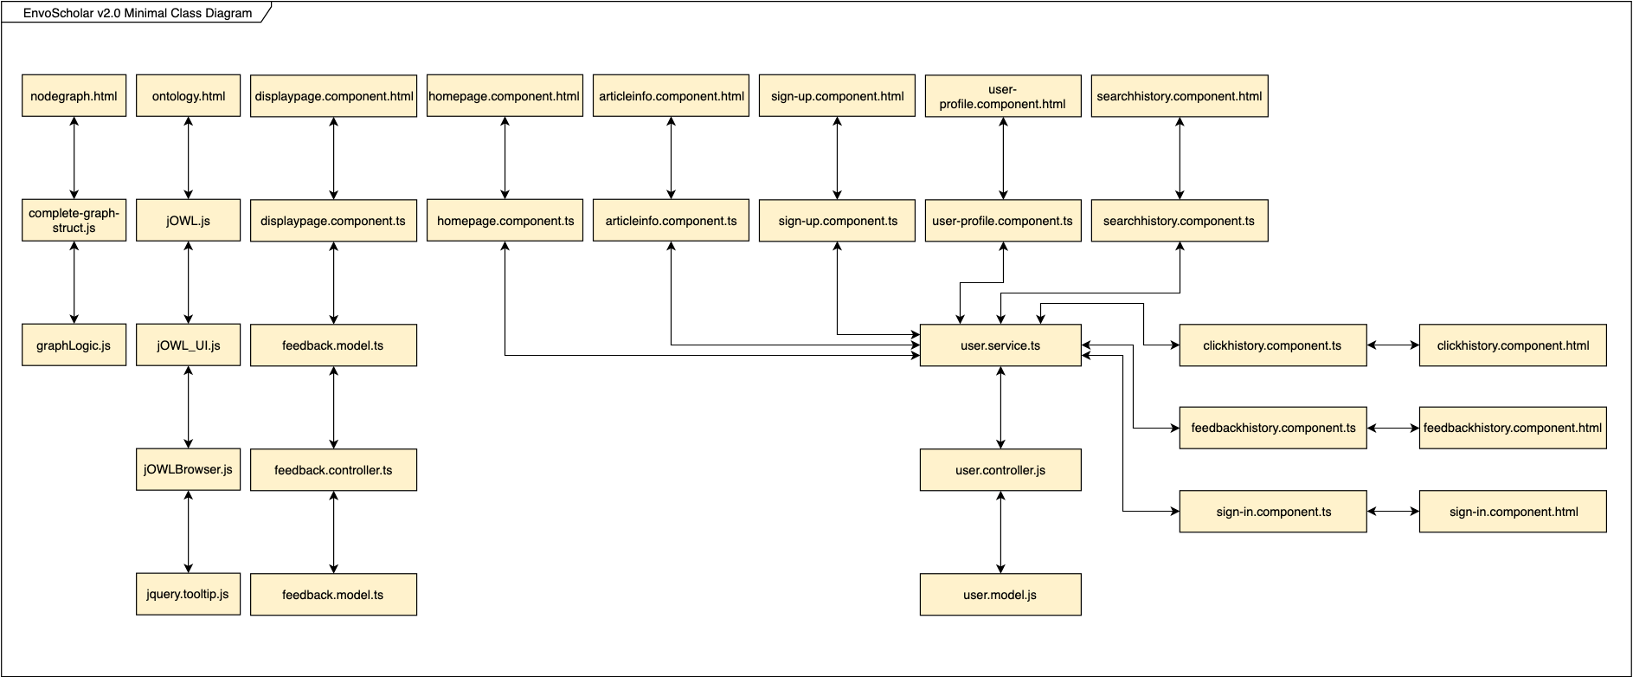
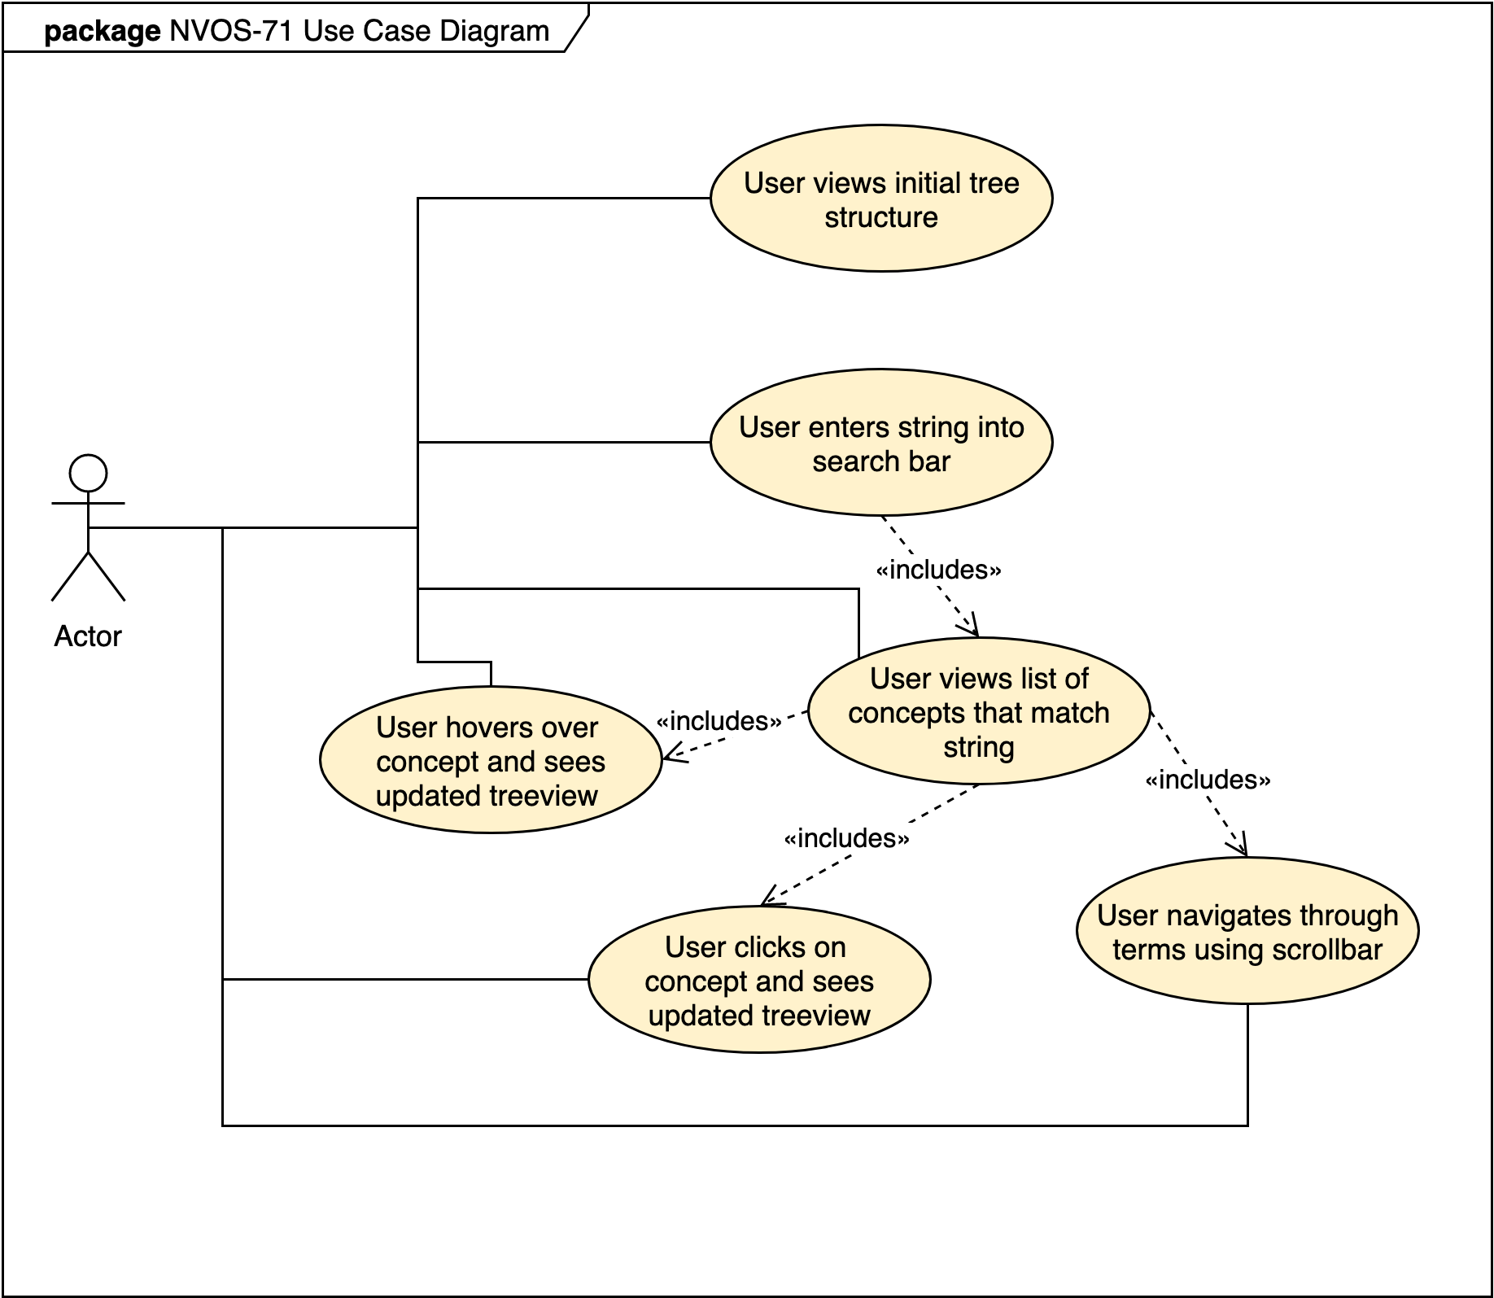
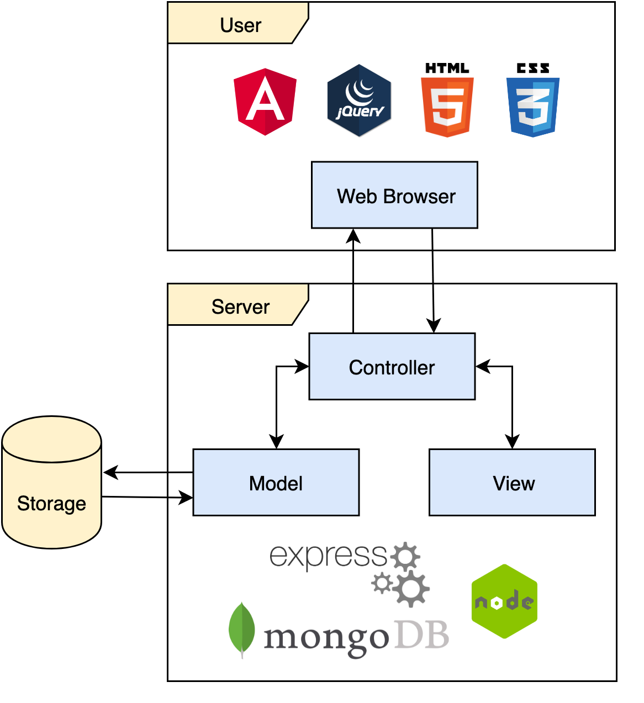
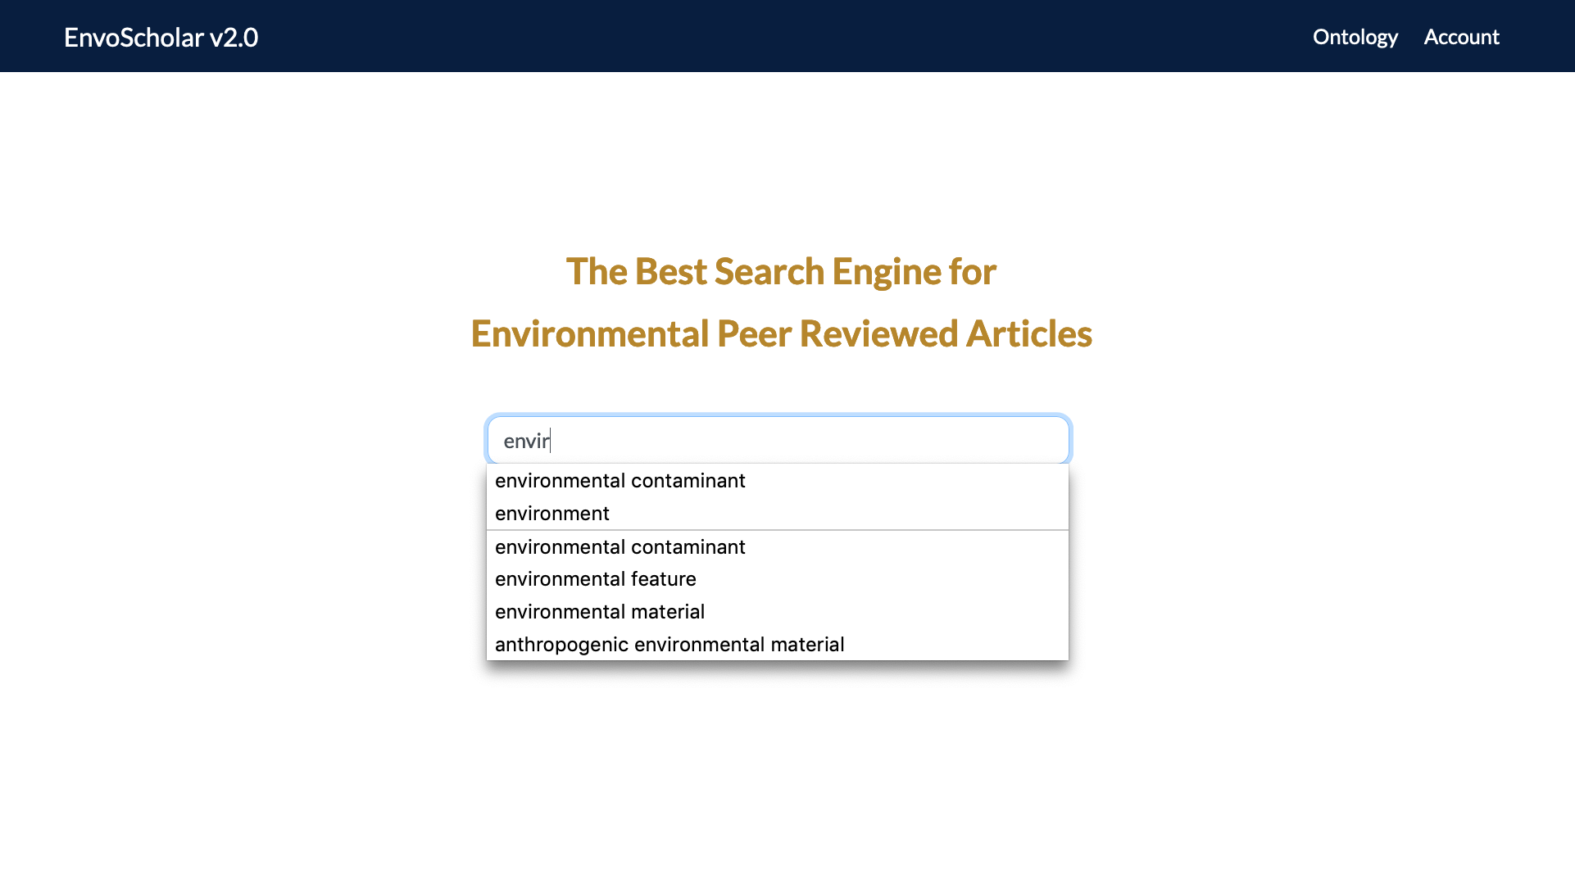
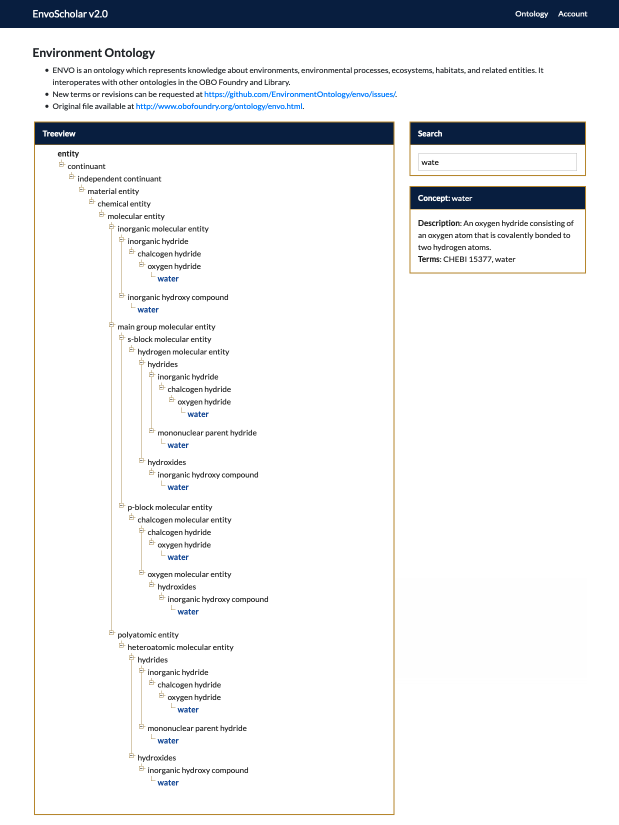
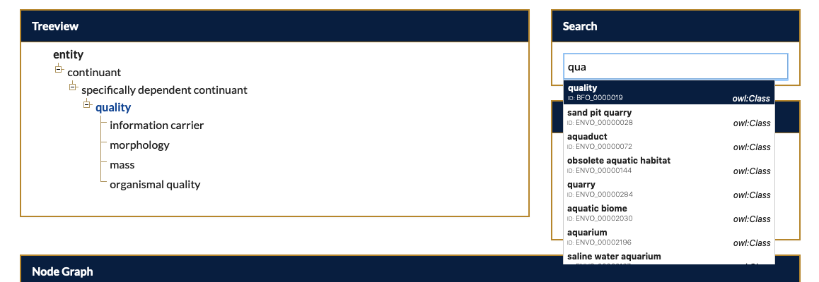
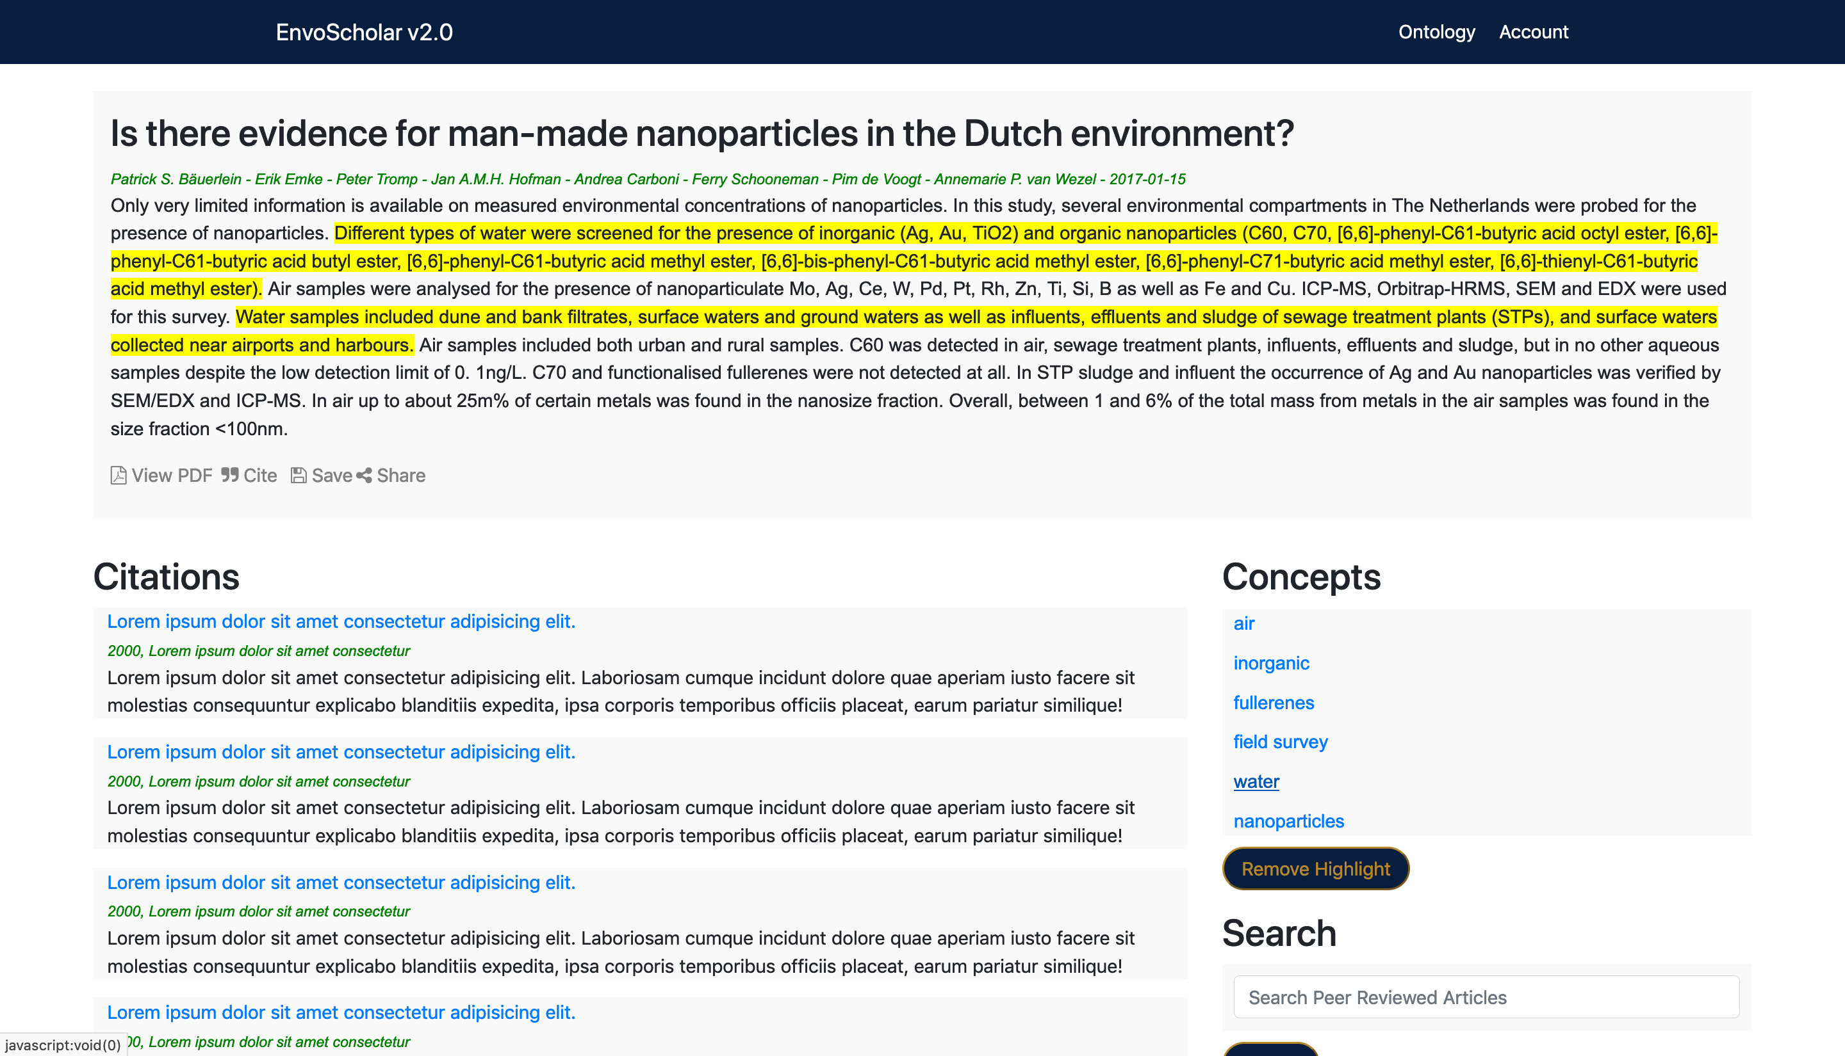
Spring 2019 Senior Design Project
EnvoScholar v2.0
Student: Sheila Alemany, Mentor: Dr. Mark Finlayson, Instructor: Dr. Masoud Sadjadi
Florida International University
Problem
Current System
Requirements
Researchers in the field of environmental science use academic search engines as tools while conducting investigations.
Examples of Academic Search Engines:
Google Scholar
Academia.edu
Springer
Limitations: These contain information in a multitude of fields and it is not field-specific. Therefore, it is difficult for young researchers in the field of environmental science to explore the current work in that specific area.
EnvoScholar v2.0 is a academic search engine in the field of environmental science which contains the following features:
Autocomplete search with concepts from the ENVO ontology
Tree structure and node graph structure visualizations of the ENVO ontology
Display results page with feedback features to rate articles in the search
Visualization of text to find key terms in article abstracts
Account login option to access feedback history, click history, and concept search history
Overall, the UI must be web-based, cross- browser, cross-platform, and interactive for researchers. My specific contributions were implementing the following:
Tree structure visualization using the most up-to-date ENVO ontology
Dynamic search capabilities to explore this ENVO ontology
Autocomplete search on the homepage
Unification of the tree structure visualization with the node graph
Visualization of text to find key terms in the article abstracts
Object Design
Example Use Case and Sequence Diagrams for NVOS-71 Search for ENVO Ontology
Minimal class diagram depicting all models, views, and
controllers in the system and their interactions
System Design
Screenshots
Client-Server and Model View Controller (MVC)
Implementation
Autocomplete search while user is typing
Search bar with terms and IDs
The front end of EnvoScholar v2.0 was created using Angular 6 and jQuery for the functionality. Additionally, HTML5 and CSS for the styling.
The back end was created using NodeJS and Express and connected to the Mongo Database which stored the user account information and feedback.
JWT and Passport were used for the user authentication at login.
Highlighted abstract given selected concept
Tree structure showing ENVO concept relationship
Acknowledgements
The material presented in this poster is based upon the work supported by Dr. Mark Finlayson and Dr. Masoud Sadjadi. I thank them along with Carlos Bravo, Maria Presa Reyes, and Deya Banisakher for their assistance, cooperation, and mentorship that I received throughout this process.

