Slide 1
Supporting the neurodiverse classroom with Universal Design for Learning
© Sheila R. Ross, Milwaukee School of Engineering 2019

Slide 2
Presentation Goals
Learn about neurodiversity
Introduce the principles of UDL
Provide examples and resources
Start an ongoing discussion
Adapted from http://enact.sonoma.edu/udl © California State University

Slide 3
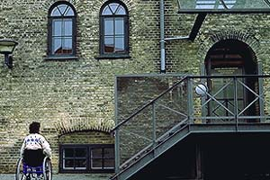
Universal Design: Is our physical environment accessible?
Architectural term coined by R. Mace at NCSU
Proactive design for universal access to physical environment
Choice of stairs and ramps
Physical Disabilities
Elderly
Children
Strollers/Carts
Retrofitting for individual issues possible but not ideal
DisWeb © 2000 Karen G. Stone
Adapted from http://enact.sonoma.edu/udl © California State University
Notes:
Universal Design, quite simply, is the design of our environment to be usable by all people, to the greatest extent possible, without the need for adaptations or specialized design. The intent of Universal Design is to simplify life for everyone by proactively designing our physical environment to be “barrier free” thus more accessible to as many people as possible at little or no extra cost.

Slide 4
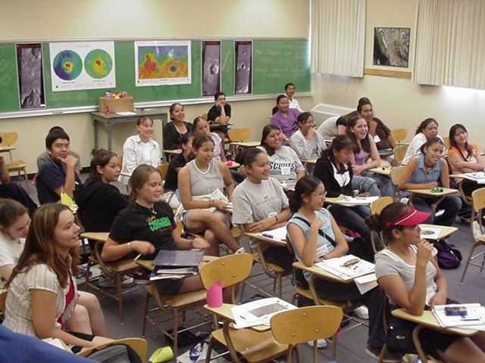
Universal Design for Learning: Is our pedagogical environment accessible?
UDL is the proactive design of our courses to ensure they are educationally accessible regardless of learning style, physical or sensory abilities.
Adapted from http://enact.sonoma.edu/udl © California State University
Notes:
eliminate unnecessary barriers without eliminating the necessary challenges

Slide 5
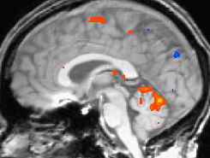
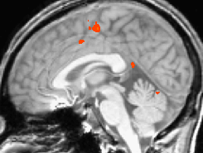
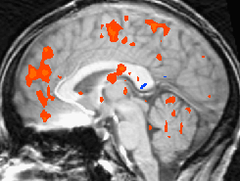
Brain Imaging Showing Individual Differences
fMRI images show brain activity patterns of three different people performing the same simple, finger tapping task.
Blue indicates a low to moderate level of activity, red indicates a high level of activity, and yellow indicates an extremely high level of activity.
CAST: Teaching Every Student © 2002-2009
Adapted from http://enact.sonoma.edu/udl © California State University
Notes:
Differences in brain activity on same task clearly demonstrate that we are not all “wired” the same.

Slide 6
What is neurodiversity?
Neurological differences exist in our student population
ADHD Depression
Dyslexia Autism Spectrum Disorder
To learn more, see http://accessproject.colostate.edu/disability/
Expect diversity in neurology and cognition
Learn general practices that allow students to access learning in a way that works best for them
Facilitate multiple paths to the learning goal
Notes:
In learning environments, such as schools and universities, individual variability is the norm, not the exception.
Students who have learning differences that are significant enough to raise serious obstacles to learning (ADHD, ASD, dyslexia, depression, stereotype threat, deficit in social capital) are present in our courses.
We as faculty cannot possibly have a separate “version” of curriculum for every situation, nor can we become experts on neuropsychology.
When curricula are designed to meet the needs of an imaginary “average”, they do not address the reality learner variability. They fail to provide all individuals with fair and equal opportunities to learn by excluding learners with different abilities, backgrounds, and motivations.

Slide 7
Universal Design for Learning
CAST Website:
http://www.cast.org/
Detailed description (slide notes):
http://udlguidelines.cast.org/binaries/content/assets/udlguidelines/udlg-v2-0/udlg_fulltext_v2-0.doc
Universal Design for Learning: Theory and Practice E-book (must register):
http://udltheorypractice.cast.org

Slide 8
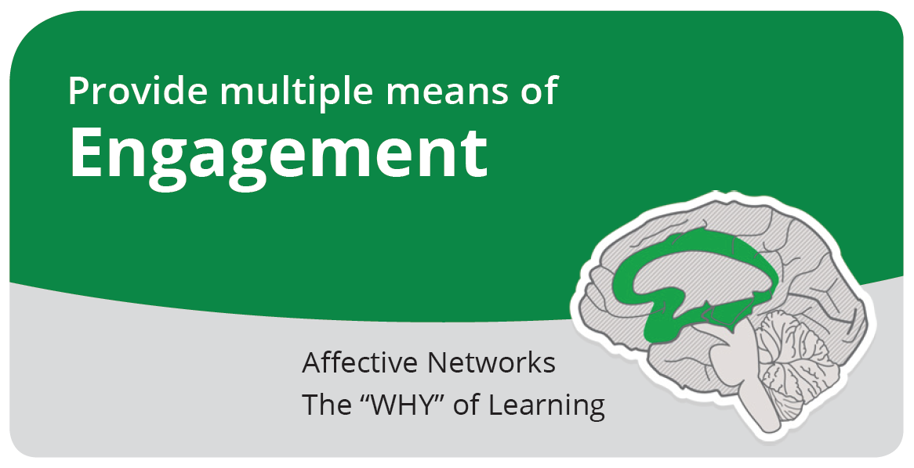

Notes:
There are a variety of sources that can influence individual variation in affect including neurology, culture, personal relevance, subjectivity, and background knowledge, along with a variety of other factors. Some learners are highly engaged by spontaneity and novelty while other are disengaged, even frightened, by those aspects, preferring strict routine. Some learners might like to work alone, while others prefer to work with their peers.

Slide 9
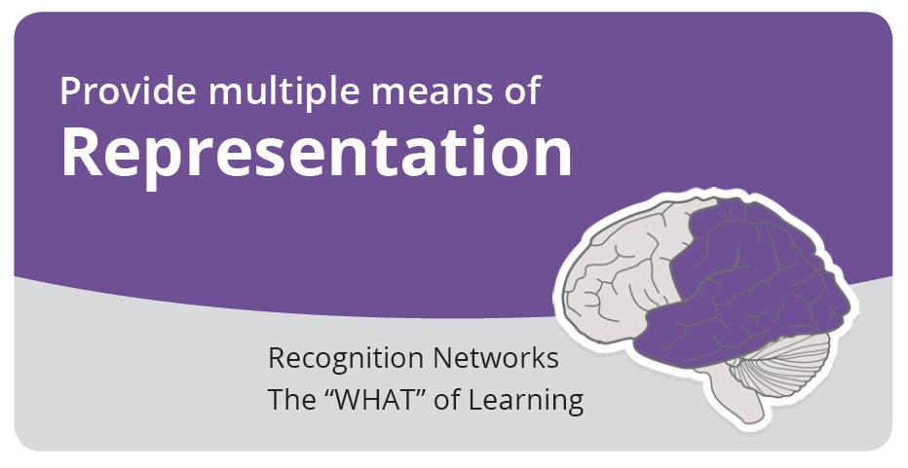

Notes:
Those with sensory disabilities (e.g., blindness or deafness); learning disabilities (e.g., dyslexia); language or cultural differences, and so forth may all require different ways of approaching content. Others may simply grasp information quicker or more efficiently through visual or auditory means rather than printed text.

Slide 10
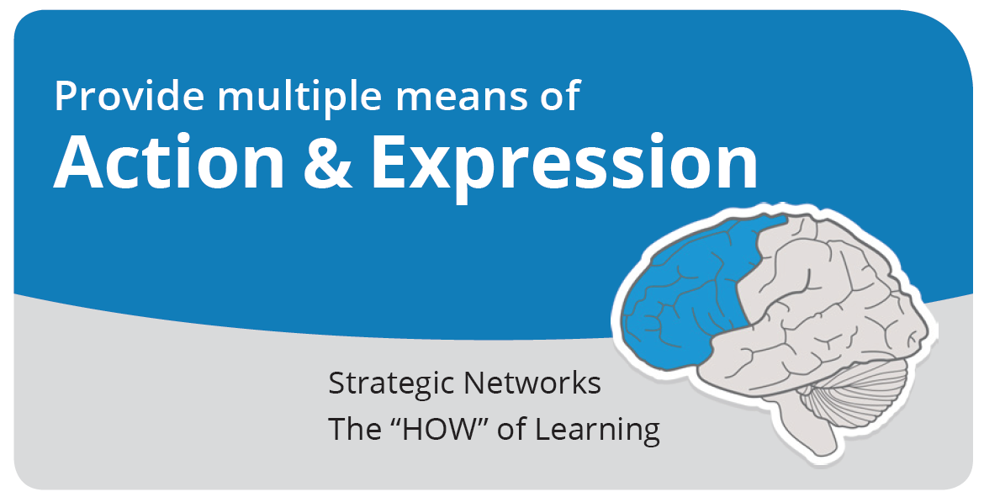

Notes:
Learners differ in the ways that they can navigate a learning environment and express what they know. For example, individuals with significant movement impairments (e.g., cerebral palsy), those who struggle with strategic and organizational abilities (executive function disorders), those who have language barriers, and so forth approach learning tasks very differently. Some may be able to express themselves well in written text but not speech, and vice versa.

Slide 11
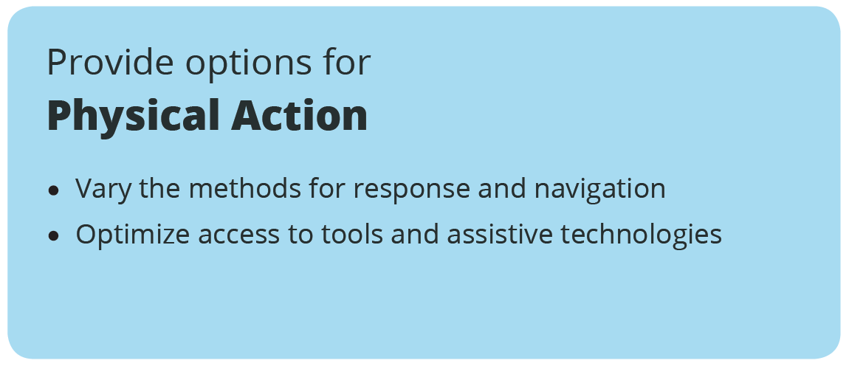
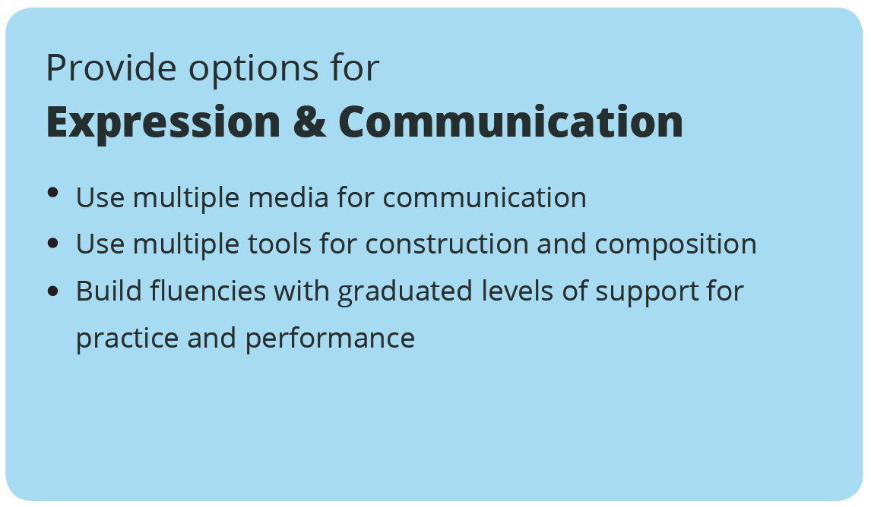
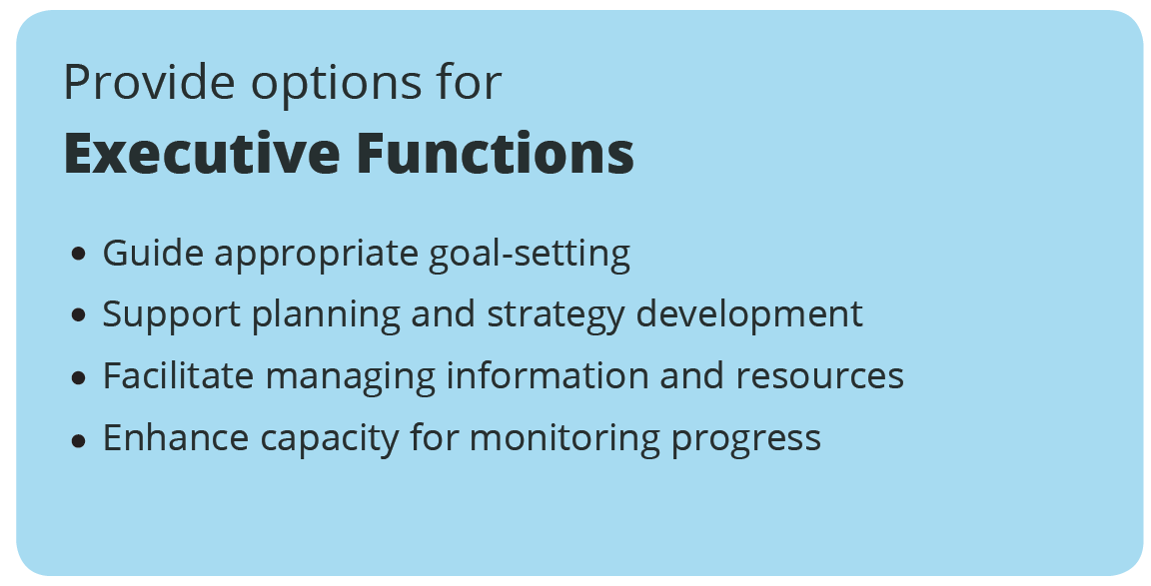
Notes:
Provide alternatives for physically responding or indicating selections (e.g., alternatives to marking with pen and pencil, alternatives to mouse control)
Electronic Labs—explicitly tell students their options for response
Select software that works seamlessly with keyboard alternatives and alt keys
OneNote TeX entry

Slide 12
Notes:
Unless specific media and materials are critical to the goal (e.g., learning to paint specifically with oils, learning to handwrite with calligraphy) it is important to provide alternative media for expression.
EE2050 Lab

Slide 13
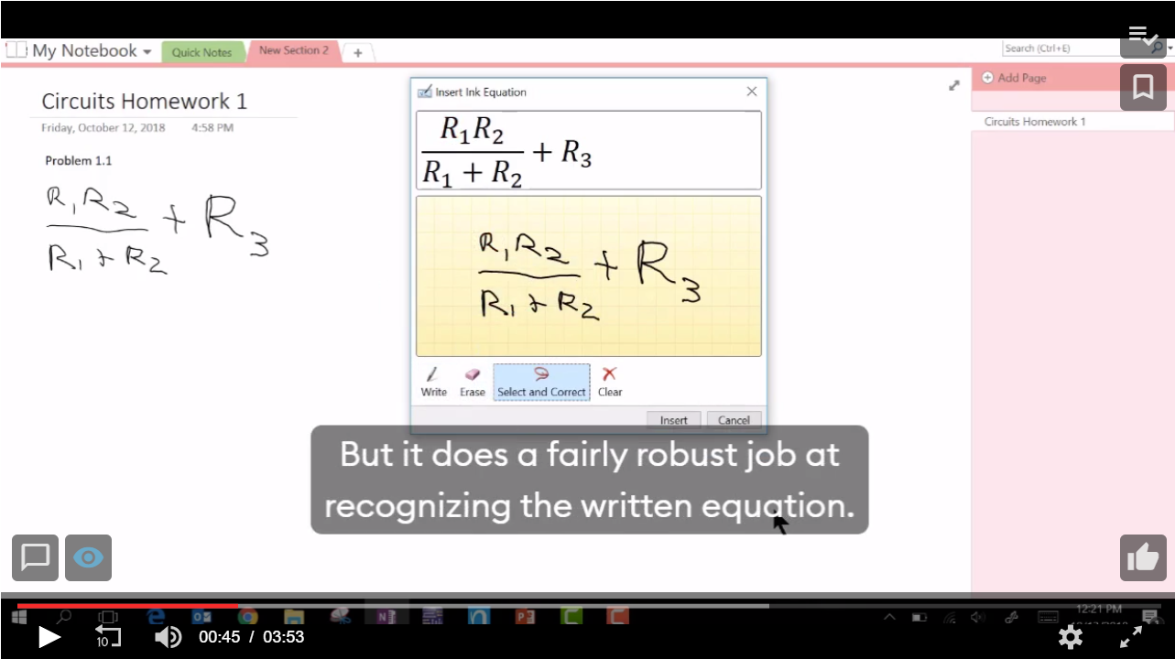
Options for writing & drawing
Notes:
2:34 has tex entry

Slide 14
More Examples
Recorded lectures (screen capture)
Use VidGrid (formerly iLOS)
Login with SSO on vidgrid.com
External mic recommended
Machine captioning is free, editable
Use electronic documents wherever possible
Students choose the representation (screen readers, reformatting)
Best practices:
https://accessibility.umn.edu/
http://accessproject.colostate.edu/udl/

Slide 15
Options for assessments
Could students “answer” using different methods or media?
Think-pair-share Question 1

Slide 16
Notes:
Executive capacity is sharply reduced when: 1) executive functioning capacity must be devoted to managing “lower level” skills and responses which are not automatic or fluent thus the capacity for “higher level” functions is taken; and 2) executive capacity itself is reduced due to some sort of higher level disability or to lack of fluency with executive strategies.
Refer to Landmark materials
Provide prompts and scaffolds to estimate effort, resources, and difficulty grade spreadsheet
Provide models or examples of the process and product of goal-setting
Provide guides and checklists for scaffolding goal-setting SMART goals
Post goals, objectives, and schedules in an obvious place
Implementation Examples:
Ask questions to guide self-monitoring and reflection
Coaching document
Use templates that guide self-reflection on quality and completeness
Exam wrapper
Provide differentiated models of self-assessment strategies (e.g., role-playing, video reviews, peer feedback)
Use of assessment checklists, scoring rubrics, and multiple examples of annotated student work/performance examples Define acceptable performance in the context of course

Slide 17
Executive function challenges
What executive function challenges are most common in your courses?
Think-pair-share Question 2

Slide 18
Notes:
Information that is not attended to, that does not engage learners’ cognition, is in fact inaccessible. It is inaccessible both in the moment and in the future, because relevant information goes unnoticed and unprocessed

Slide 19
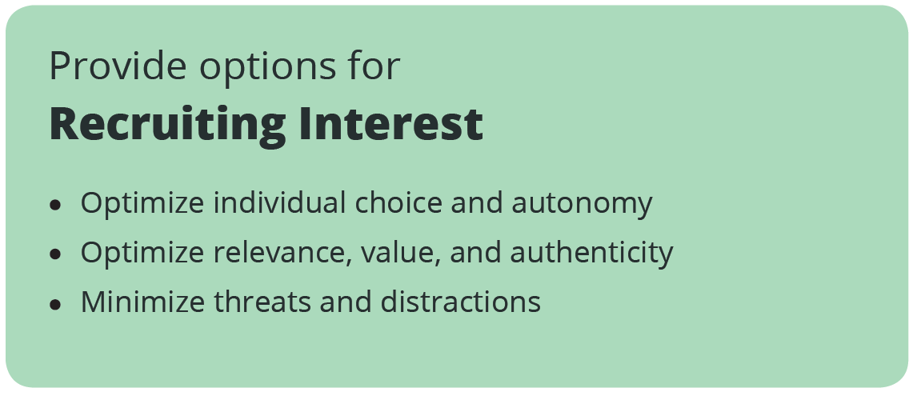
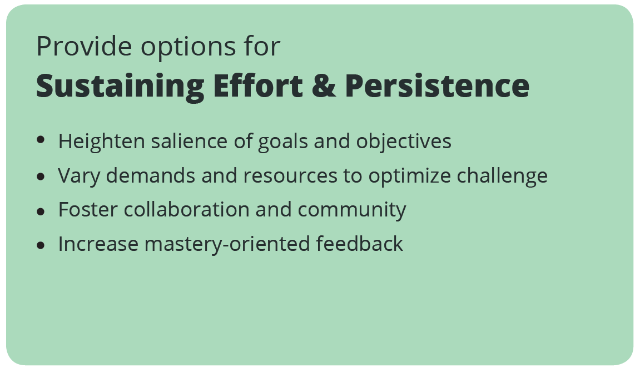
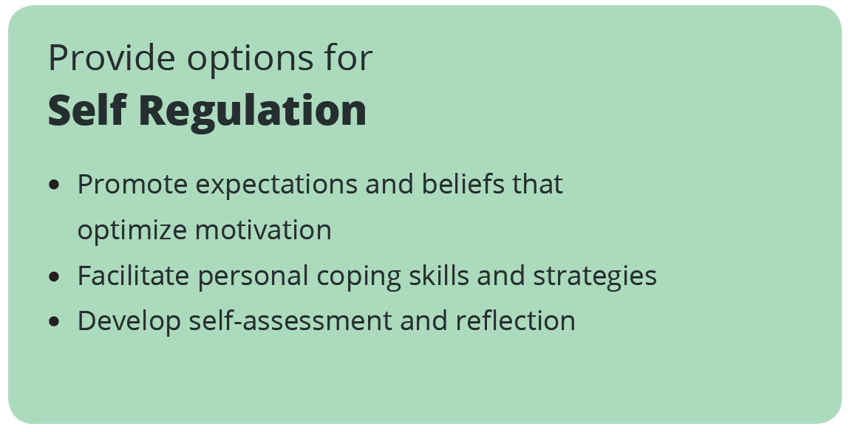
Notes:
Differences in activities students find motivating--for many students human impact is important
When learners have to focus their attention on having basic needs met or avoiding a negative experience they cannot concentrate on the learning process.
Create an accepting and supportive classroom climate SO IMPORTANT student interaction is not possible without it
Many students threatened by changes in routine
EE 1000 weekly routine established

Slide 20
Notes:
When motivated to do so, many learners can regulate their attention and affect in order to sustain the effort and concentration that such learning will require. However, learners differ considerably in their ability to self-regulate in this way
Encourage division of long-term goals into short-term objectives
Demonstrate the use of hand-held or computer-based scheduling tools
Use prompts or scaffolds for visualizing desired outcome
Engage learners in assessment discussions of what constitutes excellence and generate relevant examples that connect to their cultural background and interests

Slide 21
Notes:
The ability to self-regulate – to strategically modulate one’s emotional reactions or states in order to be more effective at coping and engaging with the environment – is a critical aspect of human development. While many individuals develop self-regulatory skills on their own, either by trial and error or by observing successful adults, many others have significant difficulties in developing these skills. Unfortunately some classrooms do not address these skills explicitly, leaving them as part of the “implicit” curriculum that is often inaccessible or invisible to many
Appropriately handling subject specific phobias and judgments of “natural” aptitude (e.g., “how can I improve on the areas I am struggling in?” rather than “I am not good at math”)
Use real life situations or simulations to demonstrate coping skills
Second chances
Lead with specific strategy for what to do if assessment did not go well

Slide 22
Examples
Assignments with human impact
How does this help people?
How to study guides and goals
What to do, how often, to what quality
Support self-assessment, metacognition
Promote growth mindset

Slide 23
Self-Regulation
What self-regulation challenges do you commonly see among students?
Think-pair-share Question 3

Slide 25
Cognitive Load
We all have limited processing capacity
All learning tasks impose cognitive load
Intrinsic – Core elements of a learning goal
Extraneous – Part of task not integral to the learning goal
The way information is represented can increase or decrease the extraneous load

Slide 26
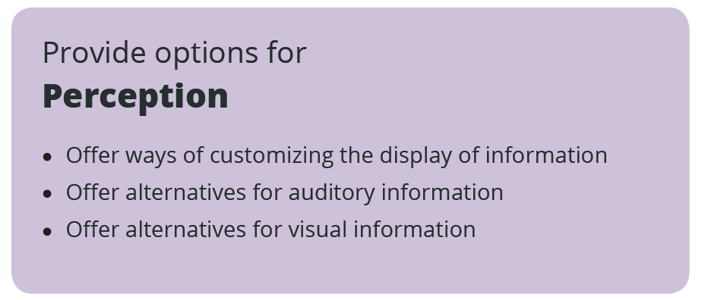
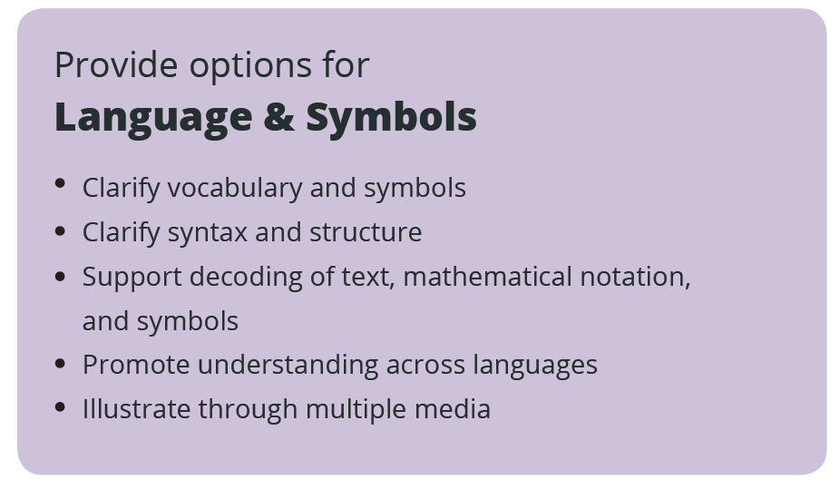
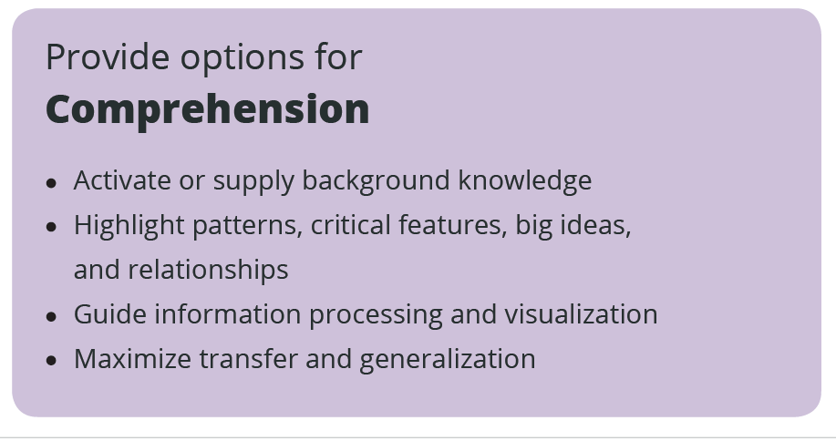
Notes:
They are commonly available automatically in digital materials, though it cannot be assumed that because it is digital it is accessible as many digital materials are equally inaccessible Use Word accessibility checker and titles. Example from EE2050 lab.
Already discussed recordings, can speed up/slow down (3x)
Use touch equivalents (tactile graphics or objects of reference) for key visuals that represent concepts
Provide physical objects and spatial models to convey perspective or interaction

Slide 27
Notes:
Embed support for vocabulary and symbols within the text (e.g., hyperlinks or footnotes to definitions, explanations, illustrations, previous coverage, translations) E-texts are getting better on this, consider when adopting text
IDEs with font changes
Just don’t take it for granted—spend time talking about what symbols look like, what their differences are, same with punctuation in programming languages
Multiple media is a known best practice

Slide 28
Notes:
One of the big differences between experts and novices in any domain is the facility with which they distinguish what is critical from what is unimportant or irrelevant.
Highlight or emphasize key elements in text, graphics, diagrams, formulas
Use outlines, graphic organizers, unit organizer routines, concept organizer routines, and concept mastery routines to emphasize key ideas and relationships
Not all students can identify what’s important—spend time on this
Remove unnecessary distractions unless they are essential to the instructional goal
Use checkboxes
Minimize required hand writing or offer multiple means of entry
Provide scaffolds that connect new information to prior knowledge (e.g., word webs, half-full concept maps)

Slide 29
Example
Circuits Lab document with accessibility best practices (Word accessibility check)
Complete with pen/paper or typing
Think-pair-share Question 4

Slide 30
UDL is not…
Specialized privileges for a few students
It is not about special accommodations
Watering down your academic expectations
It is not about making courses easier – school is supposed to be challenging if learning occurs
A “magic bullet” or “fix” for all students
It is not going to solve all your curricular or pedagogical problems
A prescriptive formula
No checklist will offer the “UDL solution”
Adapted from http://enact.sonoma.edu/udl © California State University

Slide 31
UDL Working Group
Participate in a working group at MSOE to share challenges and solutions

Slide 32
Post-Workshop
Evaluation survey
UDL websites
Reference articles

