Slide 1
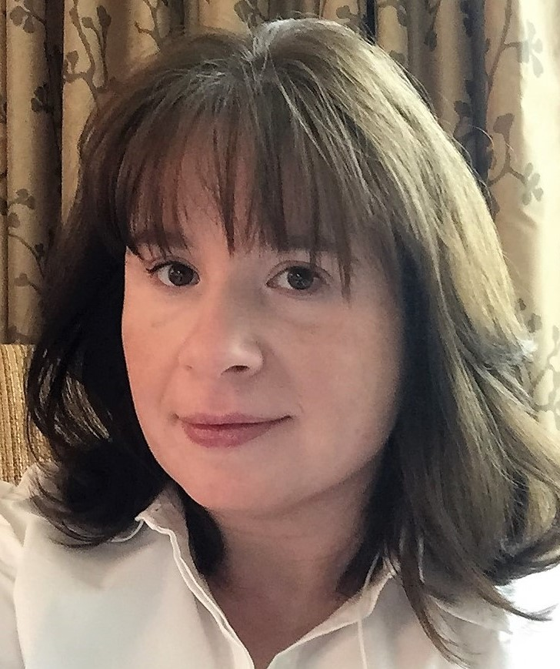
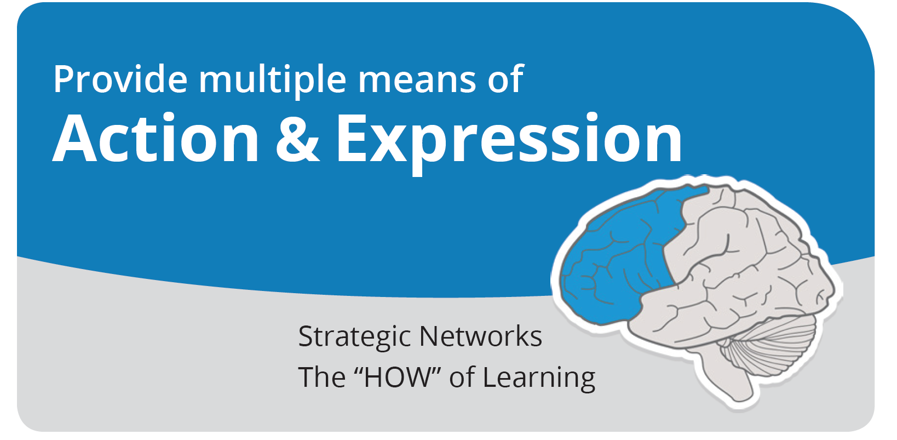
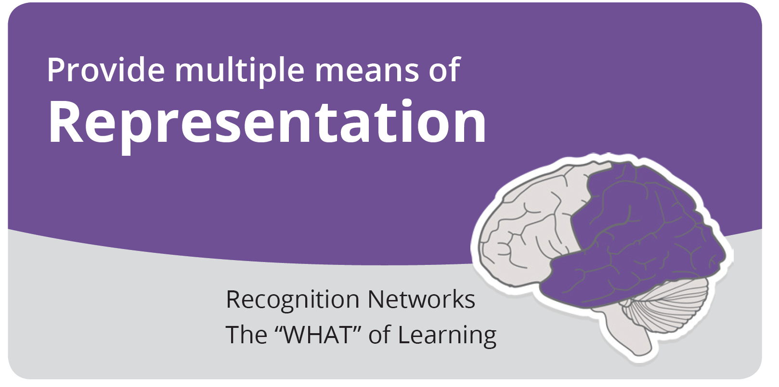
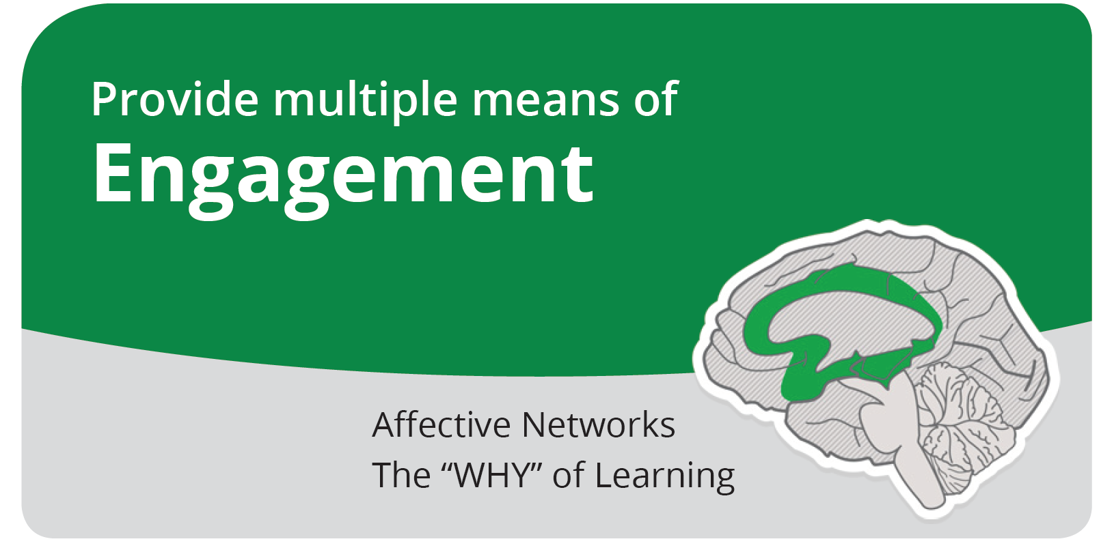
Sheila Ross, Associate Professor and EE Program Director, MSOE
Supporting your neurodiverse student population with the Universal Design for Learning (UDL) framework
Design for student diversity, including physical and neurological diversity
Give students multiple paths to learning
See how UDL can be applied in ECE courses
View the examples and let’s collaborate!

Slide 2
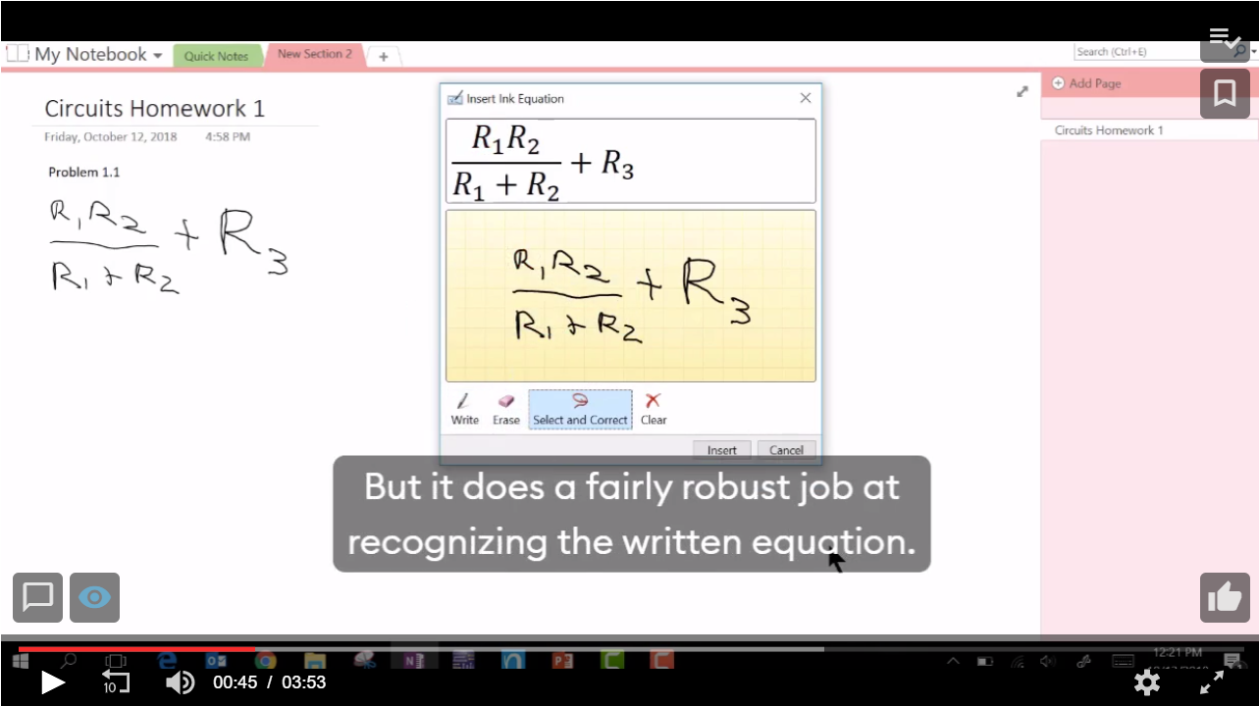
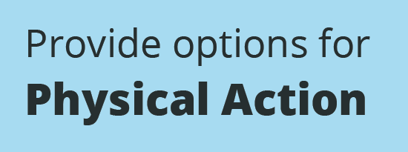
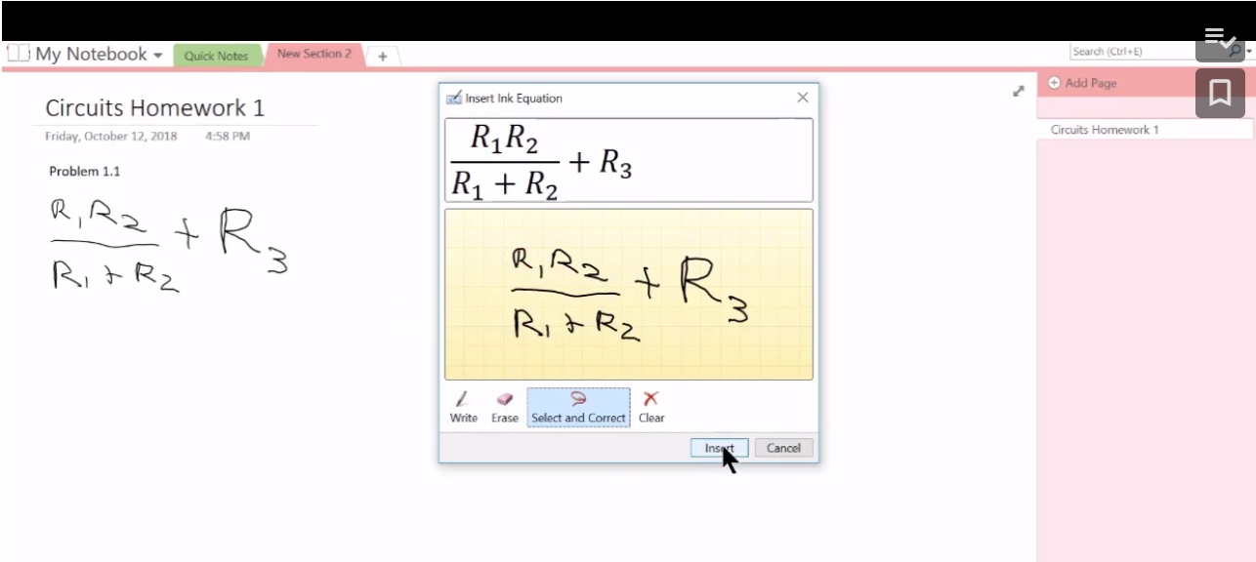
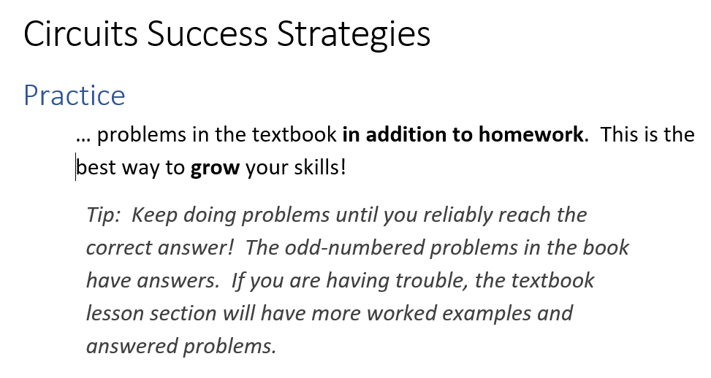
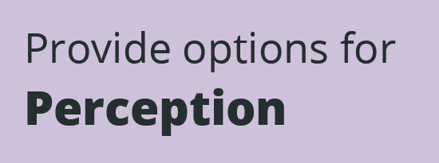
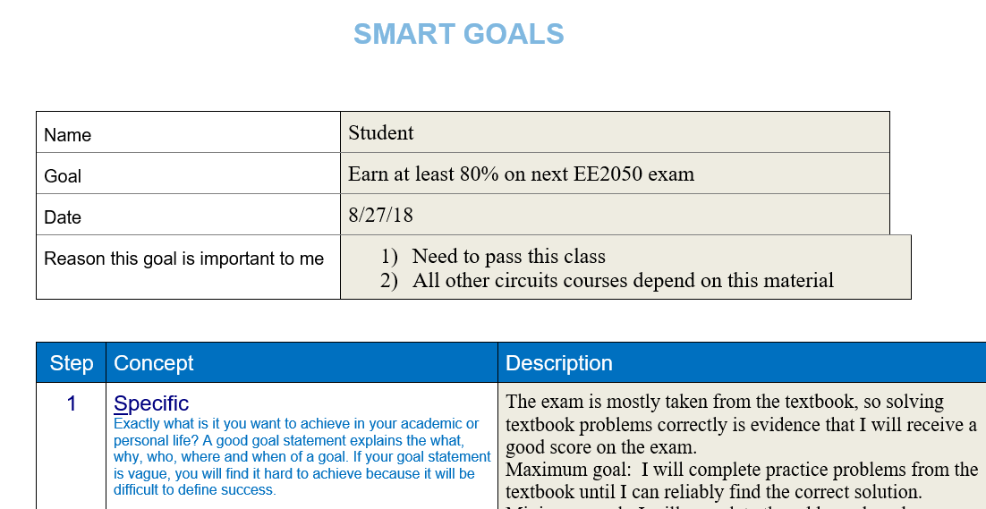
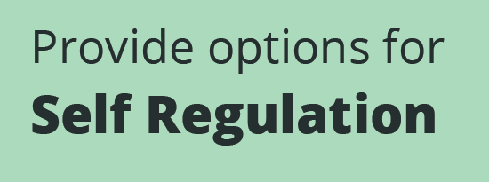
CAST (2018). Universal Design for Learning Guidelines version 2.2. Retrieved from http://udlguidelines.cast.org

