Slide 1
Anomaly Detection On a Power Grid (Critical Infrastructure Protection)
Notes:
Importance of components:
PC1 PC2 PC3 PC4 PC5 PC6 PC7
Standard deviation 1.6911 0.9992 0.9698 0.9133 0.8777 0.68606 0.35513
Proportion of Variance 0.4086 0.1426 0.1343 0.1192 0.1101 0.06724 0.01802
Cumulative Proportion 0.4086 0.5512 0.6855 0.8047 0.9147 0.98198 1.00000

Slide 2
Background
This project attempts to make use of principal component analysis (PCA) and multivariate Hidden Markov Models (HMM) in order to perform anomaly detection on electricity consumption dataset.
Our project was broken up into 3 main components:
Feature engineering [Principal Component Analysis (PCA)]
Hidden Markov Model training and testing
Anomaly detection (log-lik) by using the information above.

Slide 3
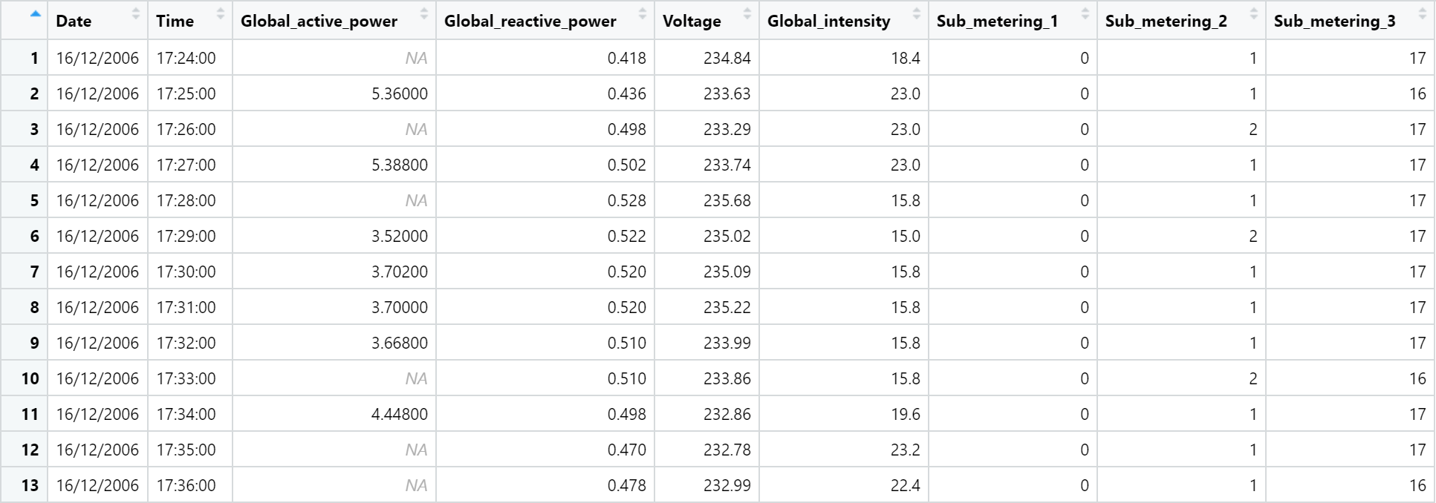
The Dataset
The normal data set that is used in this project for training and testing is the consumption of electricity from December 16th, 2006 at 5:24 PM to December 1st, 2009 at 2:07 PM.
The entries in the data set are taken every minute (a sampling frequency of one minute).

Slide 4
The Dataset
The normal data set that is used in this project for training and testing is the consumption of electricity from December 16th, 2006 at 5:24 PM to December 1st, 2009 at 2:07 PM.
The entries in the data set are taken every minute (a sampling frequency of one minute).

Slide 5
The Dataset
The data set contained 1,556,444 instances.
Due to the fact that some of the entries in the set were missing values for certain attributes that were determined to be important later on in this project (Global Active Power and Global Intensity). These were removed (NA values) from the dataset so as to get the most accurate results possible.
This was done using the na.omit() function on the database.
This left us with 1,548,072 instances after filtering them out.
Notes:
The normal data set that is used in this project for training and testing is the consumption of electricity from December 16th, 2006 at 5:24 PM to December 1st, 2009 at 2:07 PM from a single household (Source). The entries in the data set are taken every minute (a sampling frequency of one minute). Every entry (minute) in the data set contains the following 9 attributes:
Date: The date in the form of a character string and the format of DD/MM/YYYY.
Time: The time in the form of a character string and the format of HH:MM:SS.
Global Active Power: Average active power (measured in kilowatt) for that minute.
Global Reactive Power: Average global reactive power (measured in kilowatt) for that minute.
Voltage: Average voltage (measured in volts) for that minute.
Global Intensity: Average intensity (Measured in ampere) for that minute.
Sub Metering: The active energy consumption per minute in specific locations of the household. Each of the three sub metering variables represents a different section of the household with different appliances.
Sub metering 1
Sub metering 2
Sub metering 3
The data set contained 1556444 instances. Due to the fact that some of the entries in the set were missing values for certain attributes (Global Active Power and Global Intensity) that contained important characteristics they were removed (infinite values).

Slide 6
The Dataset
Every entry (minute) in the data set contains the following 9 attributes (the description of the attributes were taken from the University of California Irvine Machine Learning Repository website (Source):
Date: Date from a character string. Format of DD/MM/YYYY.
Time: Time form of a character string. Format of HH:MM:SS.
Global Active Power: Average active power (measured in kilowatt) for that minute.
Global Reactive Power: Average global reactive power (measured in kilowatt) for that minute.
Voltage: Average voltage (measured in volts) for that minute.
Global Intensity: Average intensity (Measured in ampere) for that minute.
Sub Metering: The active energy consumption per minute in specific locations of the household. Each of the three sub metering variables represents a different section of the household with different appliances.
Notes:
The normal data set that is used in this project for training and testing is the consumption of electricity from December 16th, 2006 at 5:24 PM to December 1st, 2009 at 2:07 PM from a single household (Source). The entries in the data set are taken every minute (a sampling frequency of one minute). Every entry (minute) in the data set contains the following 9 attributes:
Date: The date in the form of a character string and the format of DD/MM/YYYY.
Time: The time in the form of a character string and the format of HH:MM:SS.
Global Active Power: Average active power (measured in kilowatt) for that minute.
Global Reactive Power: Average global reactive power (measured in kilowatt) for that minute.
Voltage: Average voltage (measured in volts) for that minute.
Global Intensity: Average intensity (Measured in ampere) for that minute.
Sub Metering: The active energy consumption per minute in specific locations of the household. Each of the three sub metering variables represents a different section of the household with different appliances.
Sub metering 1
Sub metering 2
Sub metering 3
The data set contained 1556444 instances. Due to the fact that some of the entries in the set were missing values for certain attributes (Global Active Power and Global Intensity) that contained important characteristics they were removed (infinite values).

Slide 7
Part 1 - Feature Engineering (Choosing Best Variables)
The principal component analysis, or PCA is the process of taking a data set, and transforming it into just one or two of the main variables that affect the data.
We used PCA in order to choose only the most suitable variables for this project, and to narrow down to only the most important components that would affect our model the most.
PCA is also able to still maintain the integrity of the model, making it a very effective choice.
We used prcomp to retrieve the standard deviation and rotation of each variable.
Notes:
The principal component analysis, or PCA is the process of taking a data set, and transforming it into just one or two of the main variables that affect the data. This is more useful than a correlation matrix since it does not contain so many dimensions that are difficult to visualise. Principal component analysis was used to simplify the dataset and reduce the number of dimensions in the dataset. In the case of the data set provided, one of the components accounted for 40% of the variance of the entire dataset.

Slide 8
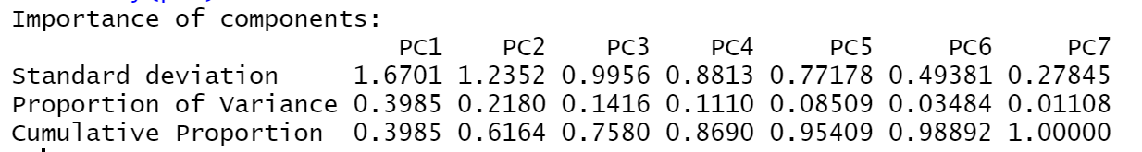
PCA
The results of our principal component analysis show that PC1 accounted for approximately 40% of the total variance of the dataset. This is an indicator that PC1 is a key variable in the creation of our model.

Slide 9
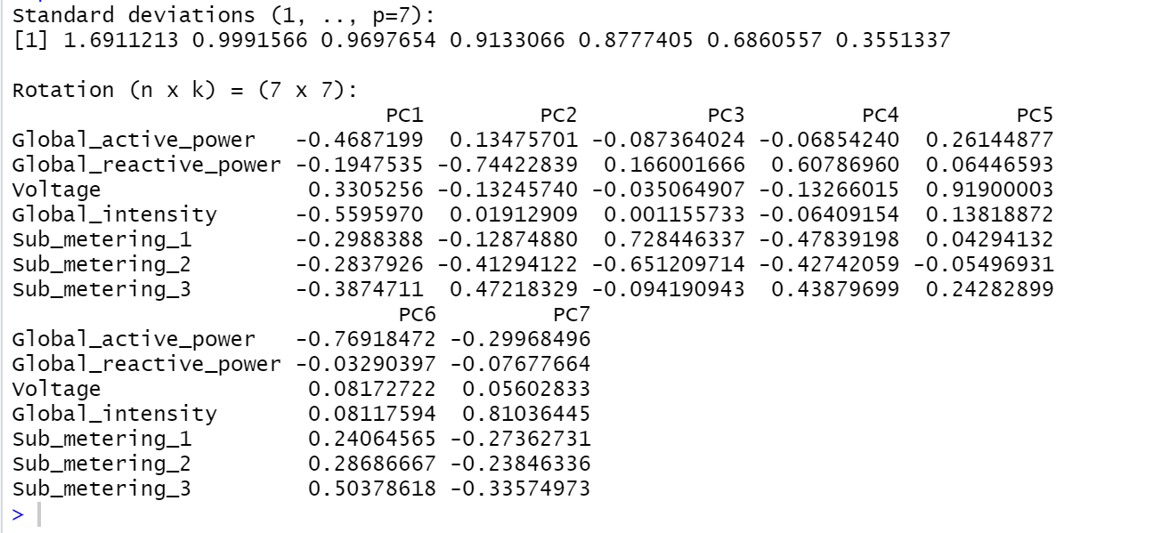
Feature Engineering
Notes:
With PCA done, we can use only 1 or two components and ignore the rest of them, reducing computing time while also preserving data integrity. After settling on two important components, the data set was partitioned into a test and training set, and the data was filtered for only a chosen time frame. The selected time frame was Tuesdays between 9 and 11am. For this time window, various multivariate hidden markov models were trained, each with different states starting from 4, up to 15. The dependent variables based on our PCA analysis were: Global_intensity and Global_active_power.
For each of the markov models with differing states, the Bayesian information criterion (BIC) and Log-likelihood was calculated. These two were criteria with which to assess the models, when fitted onto the test data.
The model with the highest absolute log-likelihood, was the 4-state model, with the value |-13941.65|. The highest BIC was also for this model, with a value of 28181.14.

Slide 10
Loading scores in descending order.
Variance on PC1 in descending order
Global_intensity | Global_active_power | Sub_metering_3 | Voltage | Sub_metering_1 | Sub_metering_2 | Global_reactive_power
0.559597 | 0.4687199 | 0.3874711 | 0.3305256 | 0.2988388 | 0.2837926 | 0.1947535

Slide 11
Feature Engineering
As shown in the data above, PC1 accounted for around 40% of the variance in the dataset, with PC2 accounting for about 22%.
In our case, the top 2 variables were ‘Global_intensity’ and ‘Global_active_power’, with them accounting for loading scores of ~0.56 and ~0.47.
This is how we reduced the dimensions to model the dataset on, and this was the rationale behind selecting ‘Global_intensity’ and ‘Global_active_power’ as our two variables.

Slide 12
Splitting the Dataset
The next thing we did, was select a timeframe for our dataset, which was between 9am and 11am on Tuesdays.
Once we decided on our timeframe, we split our dataset into a training set and a test set.
We first checked how many different days existed for this particular time frame. The results were that the data made up approximately 154.8 days. This is due to some days not having complete information for the whole 2 hour period.
We split the data set with a roughly 80:20 ratio. The data from 16/12/2006 to 28/4/2009 being the training, and the remaining days being the testing set.

Slide 13
Part 2: HMM training and testing
Now that we have our data cleaned and split into a training and testing subset, we can start to test different configurations for our model.
We used the library ‘depmix’ for this part of the project.
To end up with a suitable probabilistic model, we tried to find a balance between overfitting and underfitting the data.
We ran our model with states set from 4 through 15.
Notes:
Since depmix required us to set some level of random number generation, we set the seed to (1).

Slide 14
Using Log-likelihood and BIC
The two metrics we used to judge and compare our different models using different number of states, were Log-likelihood and BIC.
Bayesian Information Criterion or BIC for short, is a scale that helped us avoid overfitting the data, while Log-likelihood helped us to avoid underfitting the data.
Models with lower BIC and higher log-likelihoods are preferred.
By using the graphs generated by these values, we came to the conclusion that the optimum number of states would be around 14 or 15. Of course, we still had to test this hypothesis more, but with anomaly detection, there is always going to be some degree of uncertainty.

Slide 15
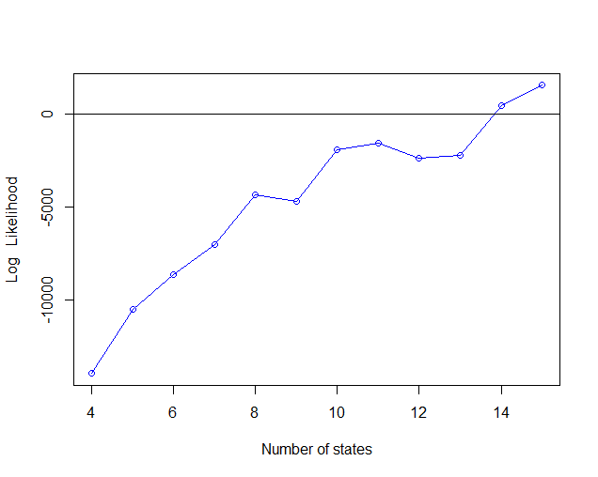
Log Likelihood

Slide 16
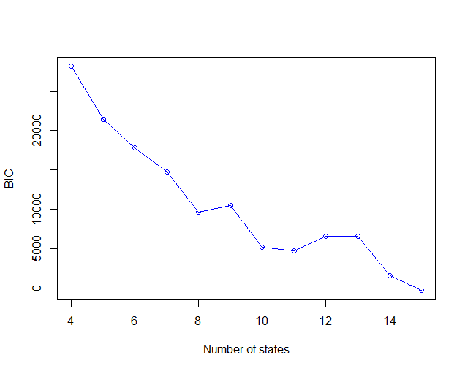
BIC

Slide 17
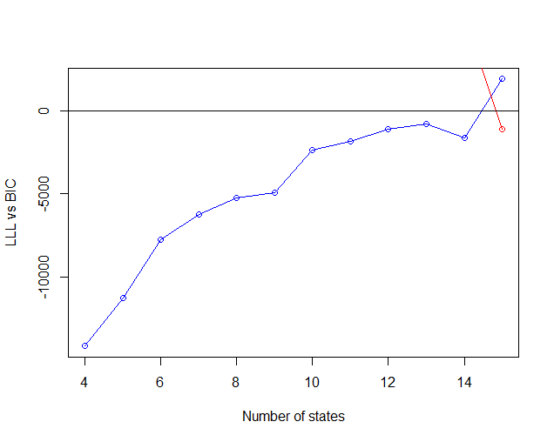
Choosing a suitable n
The graph intersected between 14 and 15 states in our dataset, and so we believed it would be fair to test both 14 and 15 as our number of states, in order to find a good compromise between over and under fitting.

Slide 18
Testing the HMM.
The training model was verified by feeding our test data set and comparing the log-likelihood.
We scaled the log-likelihoods before comparing, since the models cover different periods of data.

Slide 19

Running tests on states = 14 and 15
We ran the code for states = 14 & 15. The results are given below. It was observed that 15 was a better candidate, as it had a lower difference between the test and training log likelihood.

Slide 20
Anomaly Detection
Now with a trained model now verified, we could use it to detect any anomalies or patterns that deviate from the normal behavior in other data sets.
It was assumed that the injected datasets would behave similarly to our original test data. We used the Log-likelihood method in order to assess how similar the data set was to the original.
We fed the anomalous datasets to an instance of the trained model, and then calculated the difference in their scaled log-likelihoods.

Slide 21
Anomaly Detection
 | Train | Test | Anomaly 1 | Anomaly 2 | Anomaly 3
Log-likelihood | -1419.94347 | -2531.319528 | -50754.56147 | -50754.56177 | NaN
Above is the output from running the chosen model on the different datasets and subsets.
Both Anomaly 1 and 2 are skewed far from the original, however interestingly they produced similar outputs. On the other hand, Anomaly 3 didn’t give us any results, which could be due to the fact that this data set was very different from our original, and did not fit our model at all.

Slide 22
Final Conclusions
Anomaly detection using machine learning techniques can be a very powerful tool. However there are many compromises and there are several trade-offs to be made.
By doing this project, we learned that right from the beginning, cleaning and processing our dataset is very important. Additionally, using techniques such as PCA are imperative to realistically create a workable model.
We found that there could be room for improvement in the following areas:
We could have given more thought to choosing our time interval, by diving more into the dataset.
We could have tried more states, for the Hidden Markov Model, and maybe tested them out as well.
Our anomaly data seems to be very skewed,and could be investigated more. The NaN value for anomaly 3 could possibly have been due to another error that is not related to the data set.

Slide 23

Anuvrat Sharma - Student # 301321176
Sheil Mehta - Student # 301307105
Thank you!

