Slide 1
MEAM510 Design Review 2
Sheil Sarda
sheils@seas.upenn.edu
4/23/2021

Slide 2
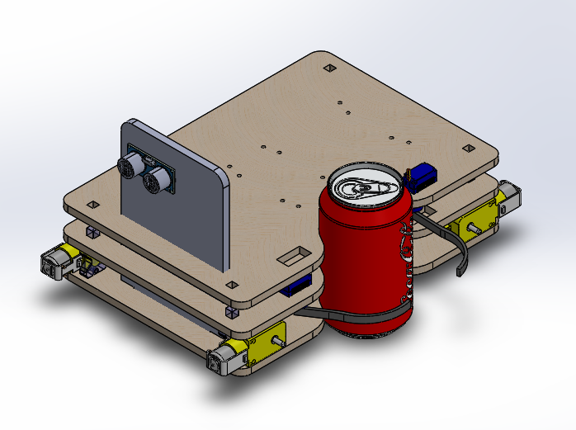
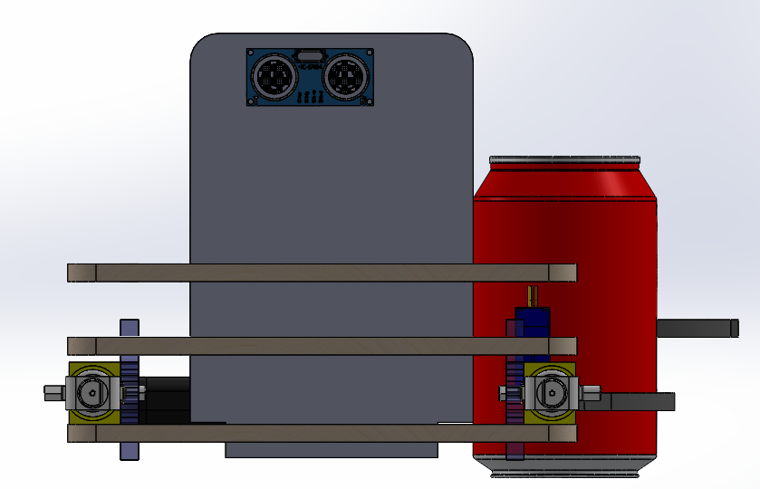
3D Model

Slide 3
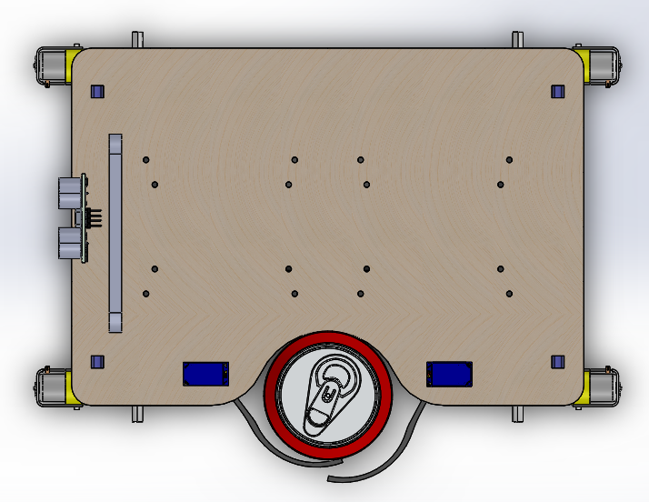
3D Model

Slide 4
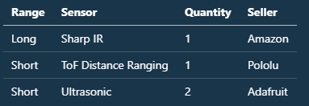
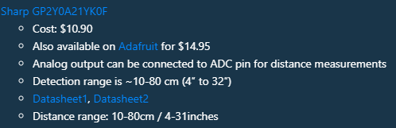
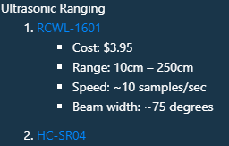
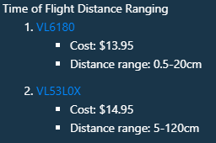
Sensor List

Slide 5
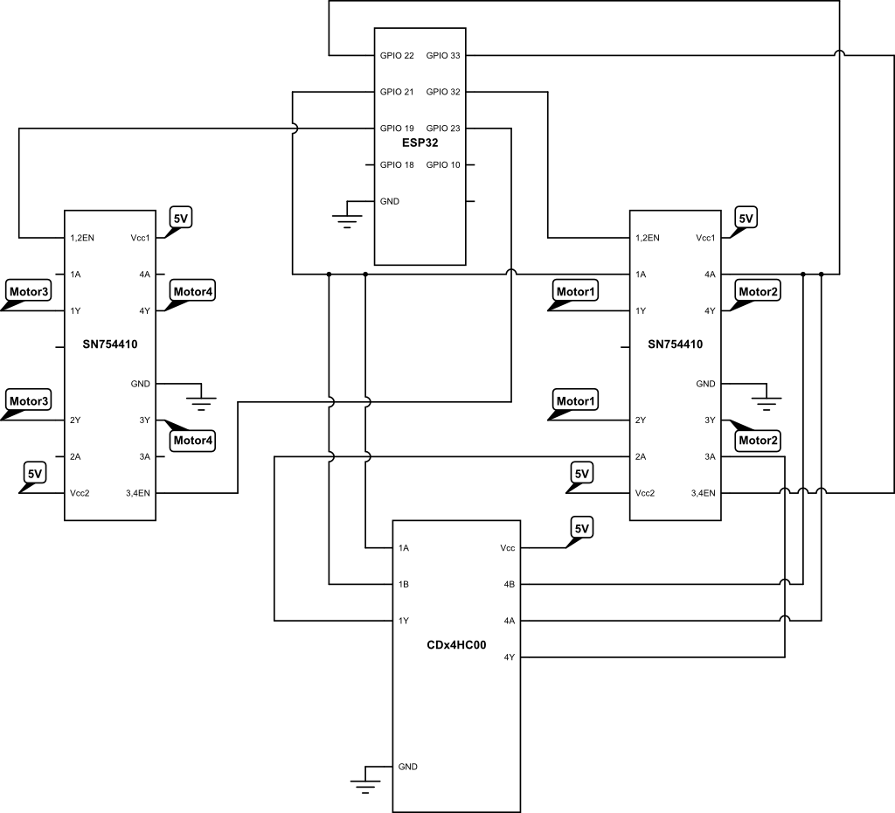
Motor Circuit Diagram

Slide 6
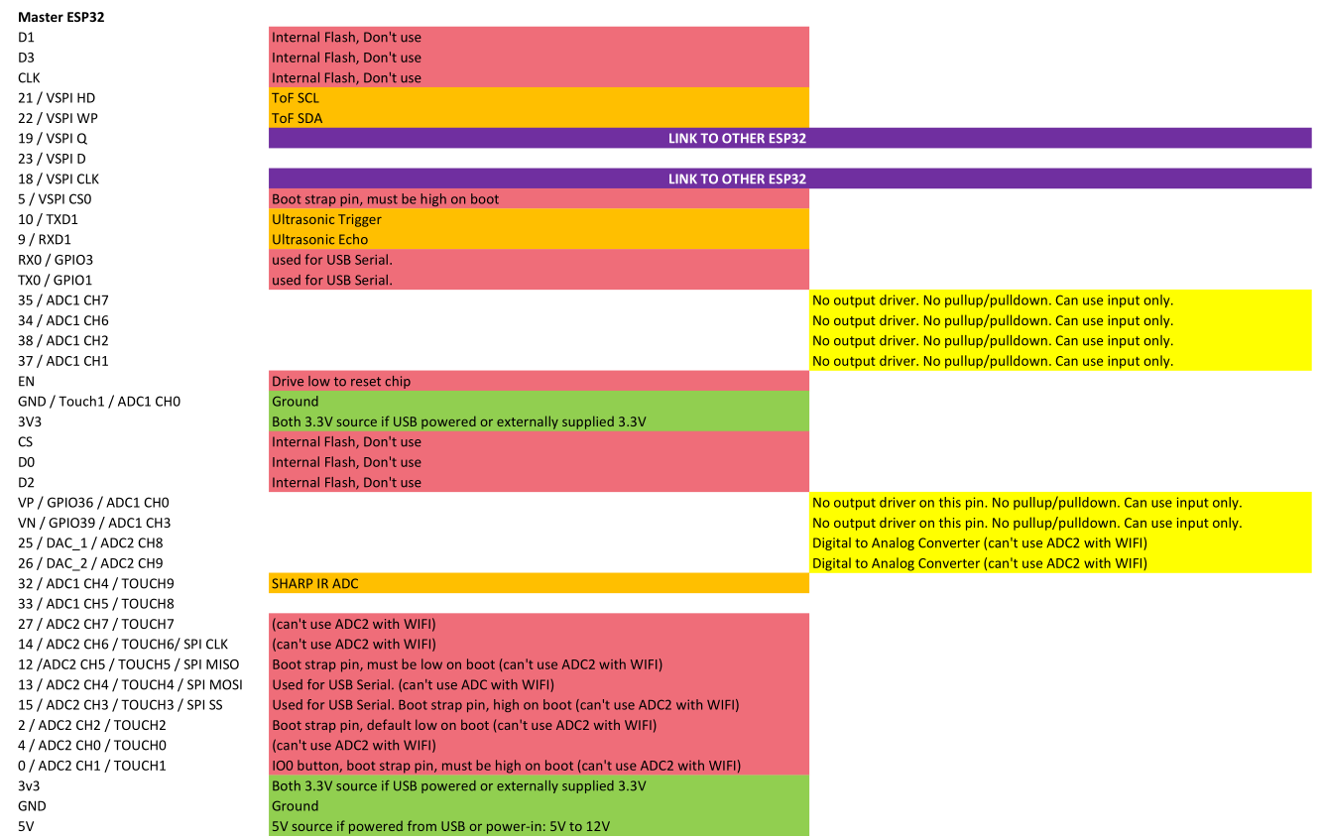
ESP32 Pinouts : Master ESP32

Slide 7
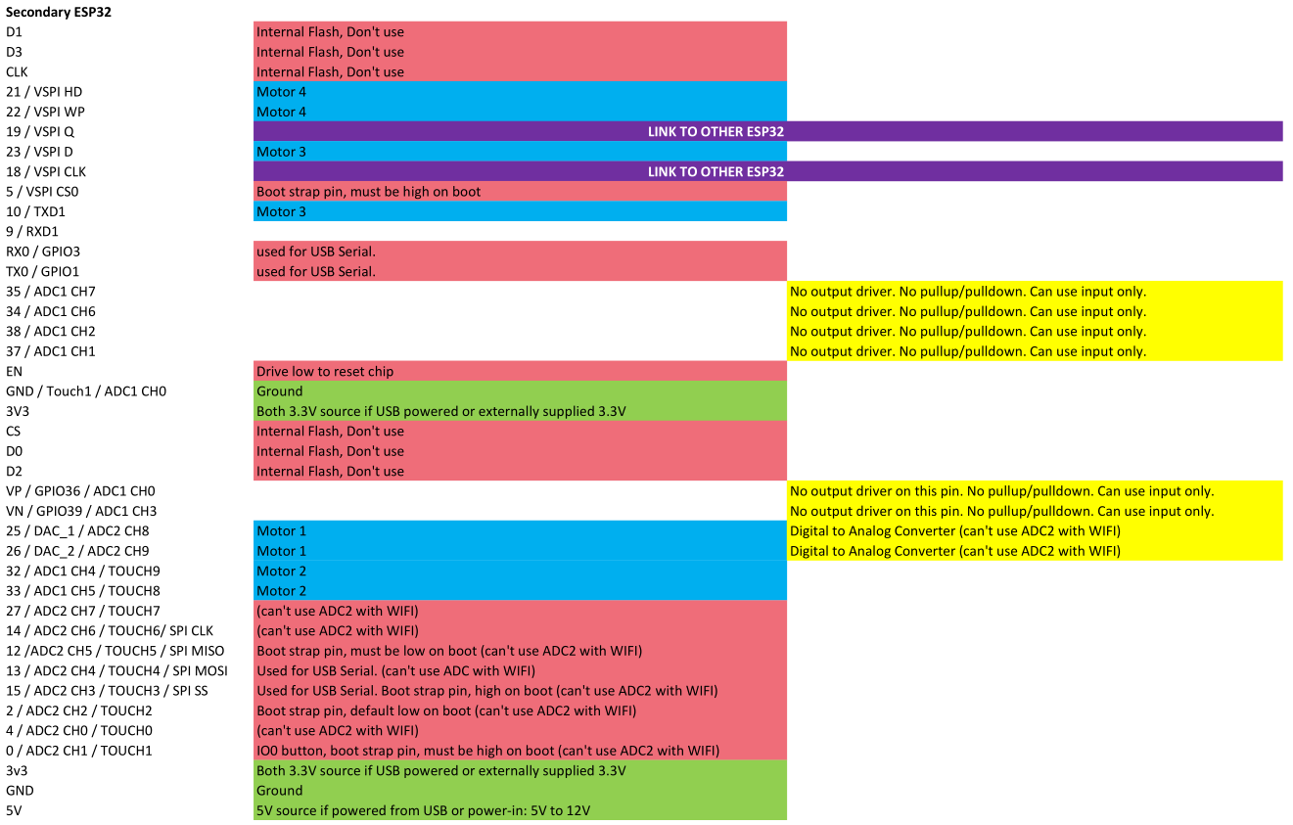
ESP32 Pinouts : Secondary ESP32

Slide 8
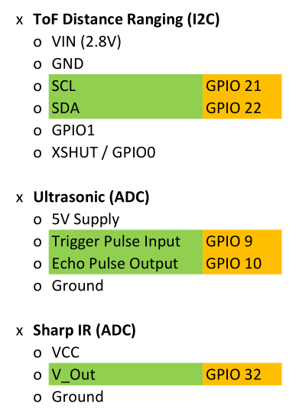
ESP32 Pinouts : Sensors

