Slide 1
MEAM 510 Final Project
Design Review 2
- Sahachar Reddy Tippana

Slide 2
Earlier Design Layout
Limit Switch or Touch Sensor
PSD
Motor1
IR retro reflective
Motor2
Slots for standoffs for another plate of similar shape if needed for more space
Beston or Lipo
Limit Switch or Touch Sensor
Limit Switch or Touch Sensor
Servo with IR photo diodes
Right and Left Mecanum Wheels
Motor3
Motor4
Two floors of Perf-boards with ESP, Teensy circuits
IR retro reflective
Limit Switch or Touch Sensor

Slide 3
Current Design Layout
Ultrasound
Motor1
TOF
Motor2
IR retro reflective
IR retro reflective
Servo
Servo
Beston or Lipo
Slots for standoffs for another plate of similar shape if needed for more space
Ultrasound
Right and Left Mecanum Wheels
Motor3
Motor4
Two floors of Perf-boards with two ESP, circuits
Servo
Two floors of Perf-boards with ESP, Teensy circuits

Slide 4
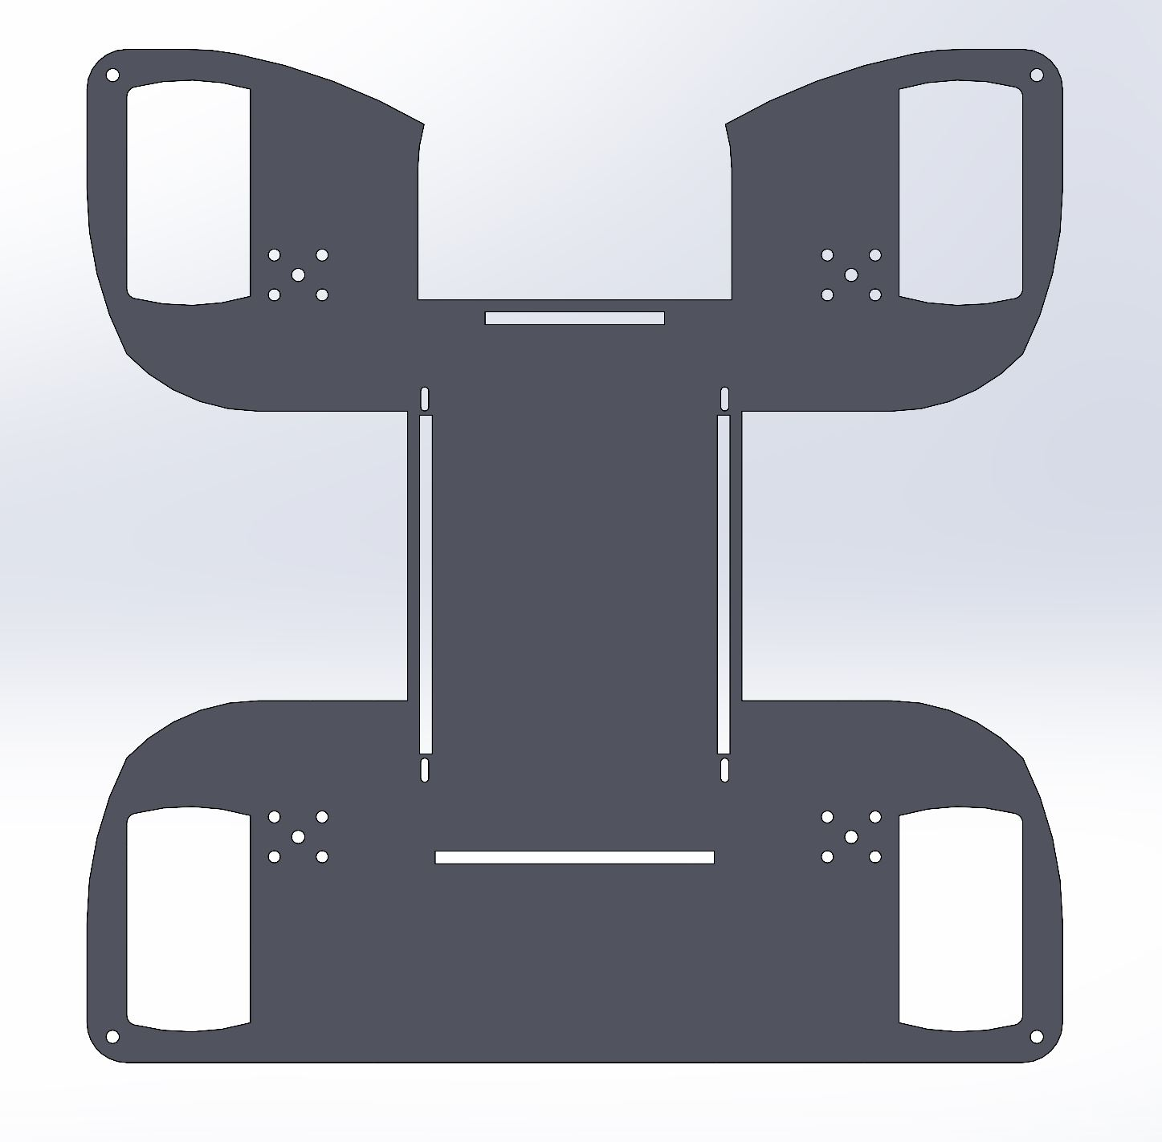
Current Design Base
Battery Housing

Slide 5
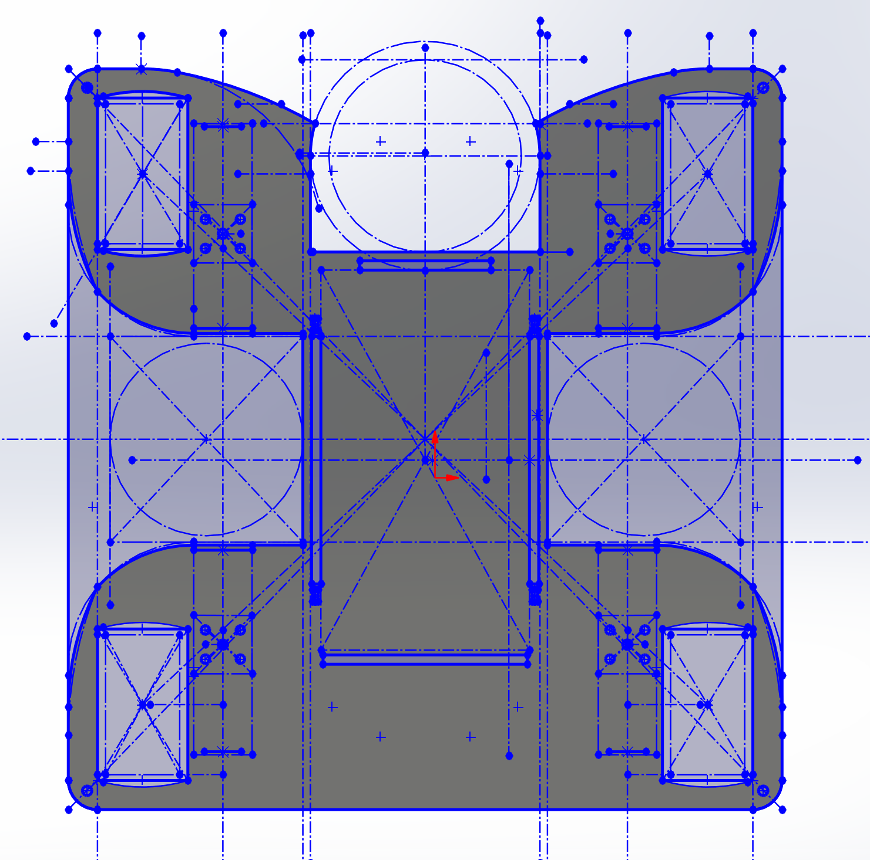
Soda Cans
Motor Mounts

Slide 6
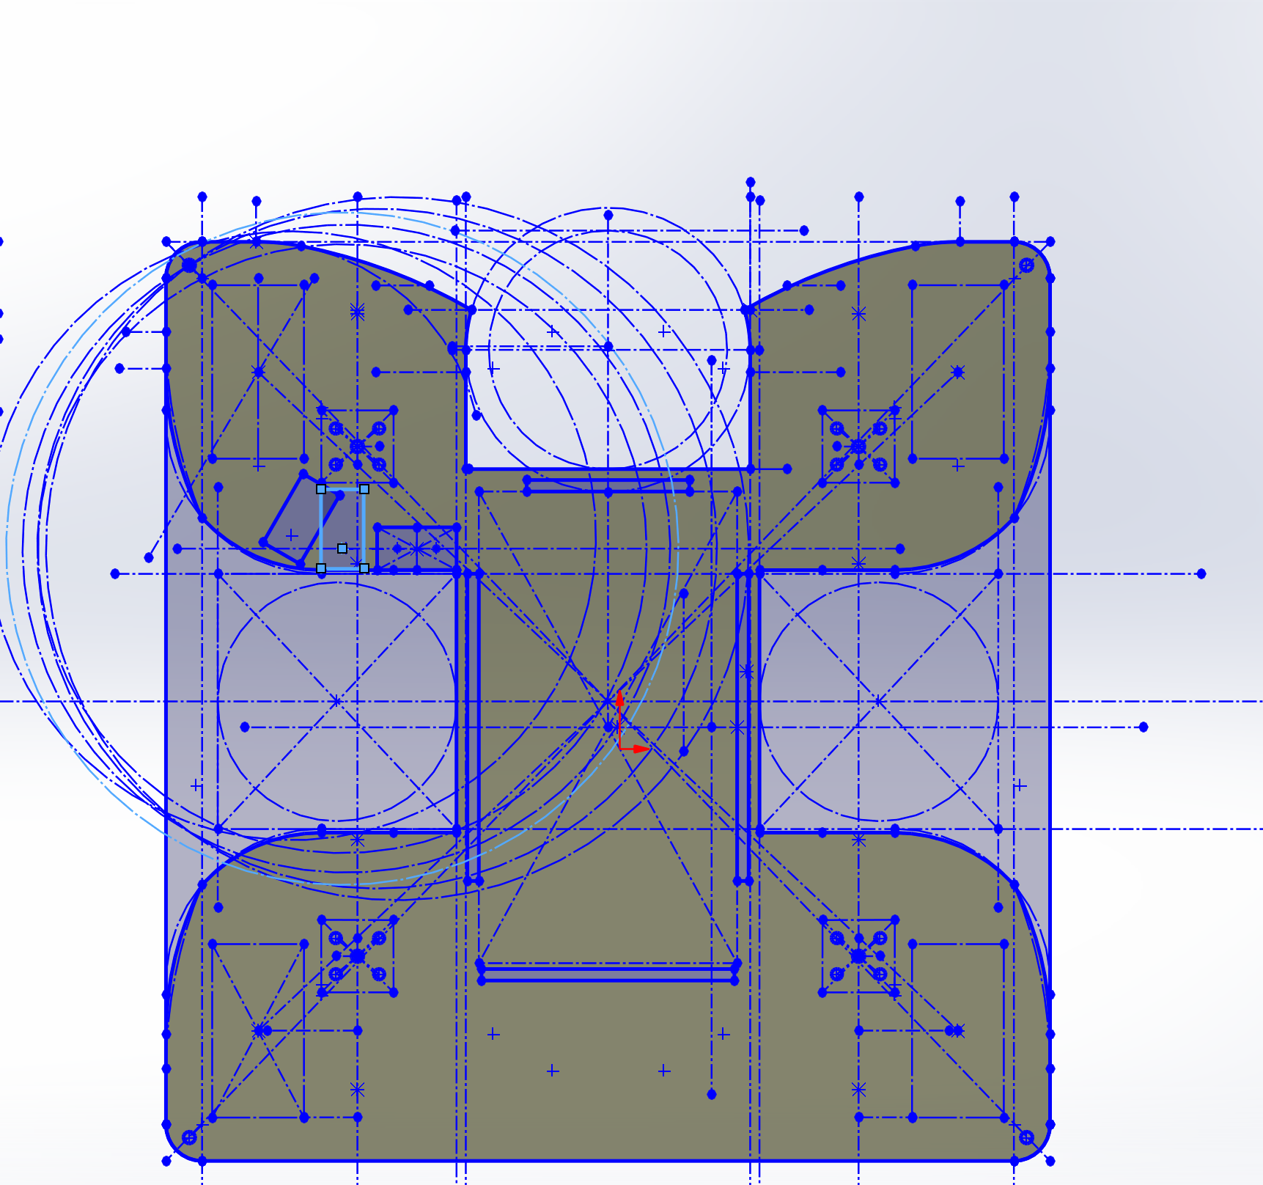
Current Design Base (2nd Floor) hosting circuits , sensors, and grippers
Gripper path: Experimenting with possible gripper paths
Servo hosting Gripper: Experimenting with possible servo positions for various gripper paths

Slide 7
Parts Purachased/used
S.No. | Part | Website | Status
1 | 4xTT DC 6V Motors | Adafruit | Already there
2 | 4x Mecanum Wheels | Adafruit | Arrived
3 | 4x T-slot Photo Interrupter and Encoder wheels | Adafruit | Arrived
4 | TOF ranging Sensor | Adafruit | In Transit
5 | 2 x ESP32 Pico | Kit | Already there
6 | 2 x Ultrasonic Distance Sensors (RCWL -1601) | Kit | Already there
7 | 2 x (SN754410, 74HC00), 10x 1” standoffs, IR retro-reflective | Kit/GM lab | Obtained

Slide 8
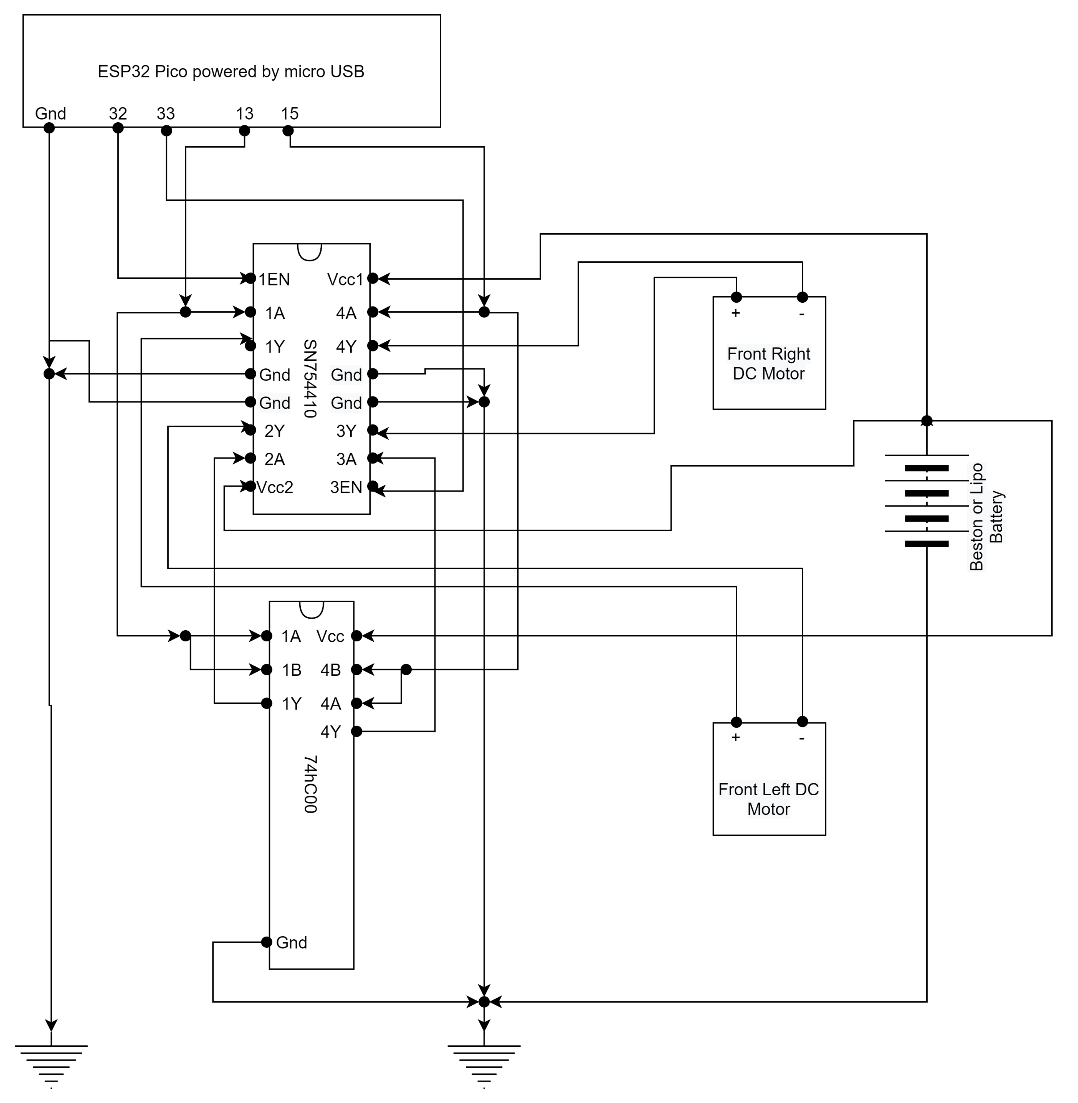
Complete Front Motors Control Circuit

Slide 9

Complete Rear Motors Control Circuit with the same ESP32

Slide 10
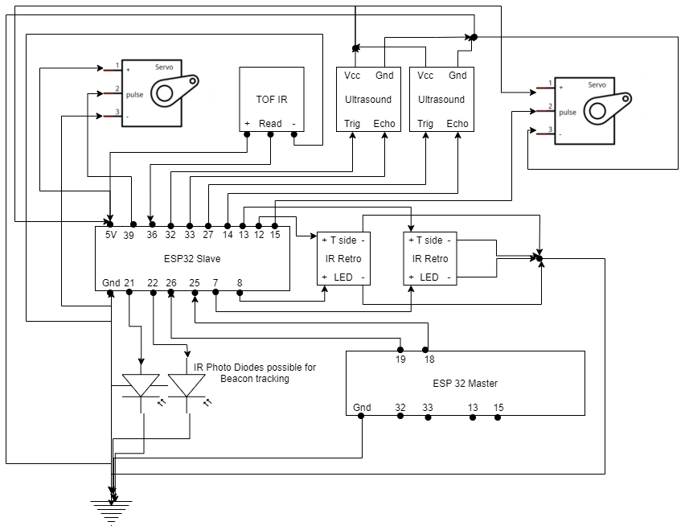
Completed Sensor Circuits with ESP32 Master and ESP32 Slave using I2C with the correct

Slide 11
Vcc
CocaCola
IN CONTACT
Gnd

Slide 12
Thank You

