Slide 1
BAR-ILAN UNIVERSITY | FACULTY OF ENGINEERING | EnICS LABS
Hardware-Software Co-Design for Efficient LLM Inference
Accelerating TurboQuant KV-Cache Compression on Cadence Xtensa ASIP Silicon
Project Identifier: PROJECT 304 | B.Sc. Capstone Thesis in Computer Engineering | September 2026
Authors: Guy Shor (ID 319071031) & Yoav Shainberg (ID 315204867)
Academic Supervisor: Prof. Leonid Yavits | Mentor: David Freud

Slide 2
1. PROJECT SCOPE
Project 304 Scope & Architectural Evolution
PROJECT 304
Original Mandate (Preparation Report)
• FPGA RTL Focus: Originally specified as an isolated Microsemi FPGA Verilog accelerator module.
• Isolated GEMM View: Targeted standalone matrix multiplication without full LLM stack integration.
• Key Limitations Recognized: Isolated FPGA blocks cannot solve the LLM memory capacity wall without a CPU running tokenization, attention state machines, and KV-cache management.
Evolved ASIP Hardware-Software Co-Design
• Cadence Xtensa ASIP Target: Migrated to a customizable Cadence Xtensa LX core (tie_dev2) utilizing EnICS Labs seats.
• In-Pipeline TIE Instructions: Synthesized 6 custom Tensilica Instruction Extension (TIE) hardware modules directly into the CPU datapath.
• Bare-Metal C Engine (llama2.c): Rebuilt Karpathy's llama2.c for Q8_0 weights and 4-bit TurboQuant KV-cache compression.
• Core Outcomes: Achieved a verified 6.00x KV memory capacity reduction (384 B/token) and projected ~5.10 tok/s at 1.0 GHz integer silicon.

Slide 3
2. PROBLEM STATEMENT
Framing the Edge AI Challenge: Memory Wall & Compute Wall
PROJECT 304
1. Memory Capacity Wall
• Autoregressive decoding emits 1 token per step, accumulating K & V vectors linearly O(N).
• TinyStories-15M uncompressed FP32 KV-cache requires 2,304 Bytes per token across 6 layers.
• For 256 tokens, uncompressed KV-cache consumes 3.38 MB.
• Solution: TurboQuant 4-bit compression slashes cache to 384 Bytes/token (0.56 MB), enabling long context windows in edge DRAM.
2. FPU-Less Compute Wall
• Target Xtensa tie_dev2 core lacks a hardware Floating-Point Unit (FPU).
• Every float operation triggers slow C runtime library calls (__mulsf3, __addsf3).
• Transcendental calls (powf, cosf, sinf) inside inner loops execute iterative polynomial approximations taking 500+ cycles.
• Solution: Hardware TIE MACs + algorithmic math factoring + RoPE LUT precomputation.
3. Alignment & Headroom
• Unaligned Traps: Loading uint32_t from odd or 2-byte boundaries triggers fatal LoadStoreAlignmentCause interrupts.
• Accumulator Overflow: Standard Q15 (32767.0) projections overflow 32-bit registers after 2 multiplications.
• Solution: Q12 scaling (4095.0f) provides 1 bit of sign headroom (48 × 2²⁴ < 2³¹-1).
• GCC Attributes: Enforced __attribute__((aligned(4))) on all stack array buffers.
Notes:
The numbers in the slide are derived from the TinyStories-15M architecture and the mathematics of the KV-cache.
1. Model Architecture Parameters (TinyStories-15M)
Number of layers ($L$): 6
Hidden dimension ($d_{\text{model}}$): 288
Attention heads ($h$): 6 (with head dimension $d_{k}=288/6=48$)
Data Type (FP32): 4 Bytes per value
2. Derivation of 2,304 Bytes per Token
For each token at each Transformer layer, the model stores one Key vector ($K$) and one Value vector ($V$):
Elements in $K$: $d_{\text{model}}=288$
Elements in $V$: $d_{\text{model}}=288$
Total FP32 elements per layer per token:
$$288+288=576\text{ elements}$$
Converting this to bytes:
$$576\text{ elements}×4\text{ Bytes/element}=2,304\text{ Bytes per token (per layer)}$$
(Note: Bullet 2 in the slide text states "across 6 layers", but $2,304\text{ Bytes}$is mathematically the size for 1 layer. As shown in the next step, the factor of 6 layers is applied to reach the 3.38 MB figure).
3. Derivation of 3.38 MB (for 256 Tokens)
To get the total uncompressed KV-cache for a context window of $N=256$tokens across all $L=6$layers:
Bytes per token across all 6 layers:
$$2,304\text{ Bytes/layer}×6\text{ layers}=13,824\text{ Bytes/token}$$
Total bytes for 256 tokens:
$$13,824\text{ Bytes/token}×256\text{ tokens}=3,538,944\text{ Bytes}$$
Convert to Megabytes (binary $\text{MiB}$):
$$\frac{3,538,944\text{ Bytes}}{1024×1024}=\frac{3,538,944}{1,048,576}=3.375\text{ MiB}≈3.38\text{ MB}$$
4. Derivation of 384 Bytes/Token and 0.56 MB (TurboQuant)
The slide applies a $6×$compression factor to compress FP32 (32-bit float) down to TurboQuant's quantized representation (~5.33 bits effective per value, accounting for 4-bit centroid indices, 1-bit residual signs, and scale offsets):
Compressed bytes per layer per token:
$$\frac{2,304\text{ Bytes}}{6}=384\text{ Bytes/token}$$
Compressed total cache for 256 tokens across 6 layers:
$$\frac{3.375\text{ MB}}{6}=0.5625\text{ MB}≈0.56\text{ MB}$$
(Equivalently: $384\text{ Bytes}×6\text{ layers}×256\text{ tokens}=589,824\text{ Bytes}=\frac{589,824}{{1024}^{2}}\text{ MiB}=0.5625\text{ MB}$)

Slide 4
TurboQuant advantage
What the design buys
No dequantization in memory
No load-use stalls
Centroids and residual signs are scored inside hardware registers. Full FP32 vectors are never rebuilt in DRAM or SRAM.
Centroids live in combinational silicon ROM decoders (tq_get_cent), so there is no memory read latency and no L1 cache pollution.
No branch mispredictions
Balanced against Amdahl's law
Data-dependent sign adjustments are resolved by combinational datapath multiplexing in TQ_SGNACC2, not by branches.
Dense GEMV acceleration (SDOT4) is paired with KV-cache compression (TQ_*), so neither compute nor memory bandwidth is the lone bottleneck.

Slide 5
Core idea
Two quantizers, one unbiased dot product
Plain vector quantization minimizes ‖x − x̂‖², which adds geometric bias and distorts the asymmetric attention score Q·K^{T}. TurboQuant pairs an MSE quantizer with an inner-product (PROD) correction.
Stream A · MSE mode
Stream B · PROD mode
PolarQuant on the hypersphere
QJL 1-bit residual correction
Normalizes each vector to a unit direction, then quantizes it with a 3-bit optimal spherical codebook, minimizing reconstruction error of the direction.
Takes the leftover error r = K − K̂, projects it through a random Quantized Johnson–Lindenstrauss hyperplane matrix, and keeps only the sign of each projection, preserving an unbiased ⟨Q, K⟩.
r
8 centroids = 3 bits
sign(M·r) → + − − + …
Direction snaps to the nearest entry; the norm is kept as a scalar.
1 bit per dimension corrects the MSE bias.

Slide 6
What gets stored
K and V are compressed. Q never touches the cache.
K · Keys
V · Values
Q · Queries
Cached, both streams
Cached, MSE stream only
Never stored
3-bit centroid index per dimension, 1-bit QJL residual sign per dimension, and a scalar norm.
3-bit centroid index per dimension plus a scalar norm. No residual signs are needed for values.
Held in high-precision Q15 fixed point, rotated online into the codebook space, and scored directly against the compressed cache. No full vector is ever dequantized.
idx 18 B
sgn 6 B
idx 18 B
Q15 · 48 × int16 · registers
‖K‖ scalar · per token, head, layer (d = 48)
‖V‖ scalar · per token, head, layer (d = 48)
Live for the current token only

Slide 7
Granularity & storage
Where every piece lives
Component | Dimension | Data type | Scope | Hardware location
Activations
Input hidden state x | d_model = 288 | INT8 / Q15 | Per token, per layer | L1 activation scratchpad
Global constants, precomputed offline
Haar matrix H | 48 × 48 | Q15 (int16_t) | Global | Constant flash / L1 data memory
Gaussian QJL matrix M | 48 × 48 | Q15 (int16_t) | Global | Constant flash / L1 data memory
Centroid codebook ROM | 8 × 16-bit | Q15 (int16_t) | Global | Combinational ROM (tq_get_cent)
Compressed KV-cache · per token, per head, per layer
Key norm ‖K‖₂ | Scalar | Float / INT16 | Per token/head/layer | Metadata KV-cache buffer
PolarQuant centroid indices | 3 b × 48 → 18 B | Packed | Per token/head/layer | Compressed index buffer
QJL residual signs | 1 b × 48 → 6 B | Packed | Per token/head/layer | Compressed sign bitmask
Value norm ‖V‖₂ | Scalar | Float / INT16 | Per token/head/layer | Metadata KV-cache buffer
Value centroid indices | 3 b × 48 → 18 B | Packed | Per token/head/layer | Compressed value buffer

Slide 8
Phase 1 of 3 · cache ingestion
Quantizing each new token
Runs once per new token, for every layer l ∈ [0, L−1] and every head h ∈ [0, H−1].
1
2
3
Project
Normalize
Haar rotate
K = W_{k}·x_{norm}, V = W_{v}·x_{norm}
g_{k} = ‖K‖₂, K̃ = K / g_{k}
K_{rot} = H·K̃
Computed with SDOT4; d = 48 elements per head.
Norm stored as a scalar; direction placed on the unit hypersphere.
Via Q15MAC2. Equalizes variance across coordinates and removes directional outliers.
4 · Stream A
5 · Stream B
6 · Values
PolarQuant
QJL residual
Repeat for V
idx_{i} = argmin_{c} |K_{rot}[i] − C[c]|
r = K_{rot} − K̂_{cent}, S_{i} = sign((M·r)_{i})
g_{v} and 3-bit indices of V_{rot}
Nearest of 8 centroids per coordinate; eight 3-bit indices packed per 24 bits.
Bit 0 if z ≥ 0, 1 if z < 0. 48 signs packed into two 32-bit masks.
Steps 2–4 only: norm plus centroid indices. No residual stream.

Slide 9
Phase 2 of 3 · attention scoring
Dual-stream scoring without dequantizing
Current query Q
Q_rot = H · Q
Q_qjl = Mᵀ · Q
Stream A · PolarQuant scoring
Stream B · QJL residual scoring
TQ_ACC_CLR
clear 40-bit accumulator
TQ_SACC_CLR
clear 32-bit accumulator
TQ_IDX_LOAD
stream 3-bit indices
TQ_SGN_LOAD
latch 32 sign bits
TQ_DECMAC2
dual ROM decode + MAC
TQ_SGNACC2
branchless ± add
TQ_ACC_RD
rescale Q15 (>>> 15)
TQ_SACC_RD
read residual dot
Score_PQ
Score_QJL
S(t) = g_{k}(t) · [ Score_{PQ}·γ + Score_{QJL}·λ ]
Softmax over all t ∈ [0, T−1]

Slide 10
Phase 2 of 3 · attention scoring
How each stream runs in hardware
The query is rotated once per head, then scored against every past token t ∈ [0, T−1].
Stream A · centroids
Stream B · residual signs
Fusion & softmax
TQ_ACC_CLR
TQ_SACC_CLR
Scale both partial scores by the theoretical constants γ and λ, then multiply by the cached key norm.
Zeroes the 40-bit hardware accumulator.
Zeroes the 32-bit sign accumulator.
TQ_IDX_LOAD
TQ_SGN_LOAD
S_{t} = g_{k}(t)·[PQ·γ + QJL·λ]
Streams 24-bit words (eight 3-bit indices) into shift registers.
Latches 32 packed sign bits into hardware state.
TQ_DECMAC2
TQ_SGNACC2
Divide by √d and normalize:
One cycle: decodes two indices via ROM, multiplies by Q_rot[i], Q_rot[i+1].
Unpacks two signs; adds or subtracts Q_qjl[i], Q_qjl[i+1] with no branch.
α_{t} = exp(S_{t}/√d) / Σ_{j} exp(S_{j}/√d)
TQ_ACC_RD
TQ_SACC_RD
Rescales the Q15 product (>>> 15).
Reads the 32-bit residual dot product.

Slide 11
Phase 3 of 3 · value reconstruction
Building the context vector
Per head: Context_{h} = Σ_{t} α_{t} · V_{t}, accumulated straight from 3-bit value indices.
1 · init
2 · loop over t
3 · extract
4 · output
Clear accumulator
Accumulate
Read lanes
Merge heads
TQ_VACC_CLR sets the 64-bit simd64 register in the custom register file to zero.
Load α_{t} in Q15. TQ_SCALEACC2 takes two 3-bit value indices, recovers 16-bit centroids from ROM, multiplies each by α_{t} with rounding, and adds into two 32-bit lanes.
TQ_VACC_RD0 reads lane 0 and TQ_VACC_RD1 reads lane 1 into general-purpose registers. Multiply by g_{v}(t) and write to the context buffer.
Concatenate all 6 heads into Attn_{out} ∈ ℝ²⁸⁸, project with SDOT4, and add to the residual stream: x ← x + W_{o}·Attn_{out}
Lane 1 · bits 63–32 · Σ α·C[idx(i+1)]
Lane 0 · bits 31–0 · Σ α·C[idx(i)]
64-bit simd64 accumulator

Slide 12
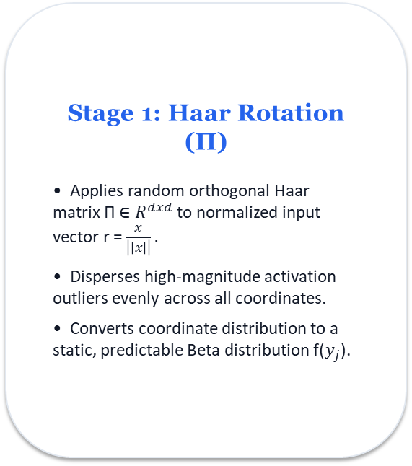
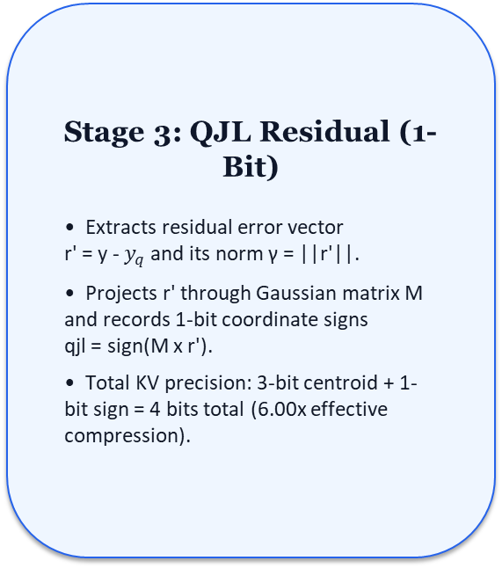
3. ALGORITHMIC SOLUTION
Google's TurboQuant: 3-Stage Vector Quantization Pipeline
PROJECT 304
Stage 1: Haar Rotation (Π)
• Applies random orthogonal Haar matrix Π ∈ $R^{dxd}$to normalized input vector r = $\frac{x}{\left|\left|x\right|\right|}.$
• Disperses high-magnitude activation outliers evenly across all coordinates.
• Converts coordinate distribution to a static, predictable Beta distribution f($y_{j}$).
Stage 2: PolarQuant (3-Bit)
• Quantizes rotated coordinates y against 8 optimal Lloyd-Max centroids computed offline.
• Stores 3-bit indices in compressed KV-cache.
• Evaluates inner products directly in compressed space via TIE centroid ROM lookups.
Stage 3: QJL Residual (1-Bit)
• Extracts residual error vector
r' = y - $y_{q}$and its norm γ = ||r'||.
• Projects r' through Gaussian matrix M and records 1-bit coordinate signs
qjl = sign(M x r').
• Total KV precision: 3-bit centroid + 1-bit sign = 4 bits total (6.00x effective compression).
RESULT: 384 Bytes / token per 6-layer context | 6.00x Verified KV Capacity Compression | 0.56 MB for 256 tokens
Notes:
The $H$(Haar / orthogonal rotation) and $M$(Gaussian QJL projection) matrices can be fully precomputed offline because the TurboQuant algorithm is mathematically data-oblivious[cite: 4, 5]. They do not rely on training data, model weights, or input tokens[cite: 5].
1. Why We Can Create $H$and $M$Offline
Data-Oblivious Property: Unlike traditional vector quantization methods (such as k-means or learned Product Quantization) that must learn codebooks from calibration data, TurboQuant’s theoretical guarantees hold for any arbitrary vector in Euclidean space.
Isometry and Rotational Invariance ($H$): The Haar matrix $H$is a random orthogonal transformation ($H^{T}H=I$)[cite: 4, 5]. Applying a random rotation to a high-dimensional vector spreads its energy uniformly across all coordinates[cite: 4]. By the Central Limit Theorem / measure concentration, the coordinates of $H⋅x$follow an identical, known distribution (a Beta distribution, converging to a Gaussian $𝒩\left(0,1/d\right)$) regardless of where $x$originally pointed. Because the post-rotation distribution is known beforehand, both the rotation matrix and the quantization codebook can be frozen before inference begins.
Johnson-Lindenstrauss Lemma ($M$): The QJL matrix $M$relies on random hyperplane projections to capture residual quantization errors in 1 bit[cite: 4]. The Johnson-Lindenstrauss lemma guarantees that pairwise distances and inner products are preserved in expectation using any random Gaussian matrix, requiring zero data-driven tuning.
Zero Runtime Overhead: Performing QR decomposition or drawing thousands of Gaussian random numbers on an embedded processor like Xtensa during token generation would introduce massive latency and memory pressure[cite: 5]. Precomputing them offline allows baking them into flash/ROM as static lookup arrays[cite: 5].
2. On What They Depend
The matrices depend strictly on two structural hyperparameters:
DependencyDescription
Head Dimension ($d$)The vector length of each attention head ($d=d_{\text{model}}/h$). For TinyStories-15M, $d_{\text{model}}=288$across 6 heads, so $d=48$. Both $H$and $M$are square matrices of size $d×d$($48×48$).
Pseudo-Random SeedA fixed integer seed (e.g., seed = 42) passed to the pseudo-random generator[cite: 5]. Because the Query projection and Key/Value dequantization must use the exact same coordinate system, both sender and receiver (or encoder and decoder) must share identical matrix constants[cite: 4, 5].
Target Fixed-Point FormatThe numeric format of the target hardware (e.g., 16-bit signed integers in Q15 format for Xtensa DSP/TIE instructions).
They DO NOT depend on:
Transformer weights ($W_{q},W_{k},W_{v}$, etc.)
Training datasets or fine-tuning checkpoints
Context prompts or runtime tokens
3. How They Look
Matrix $H$(Haar Orthogonal Rotation Matrix)
Shape: $d×d$(e.g., $48×48$elements)[cite: 4].
Properties: Strictly orthonormal ($H⋅H^{T}=I$ and $\det\left(H\right)=±1$)[cite: 4, 5]. Every row and column has unit Euclidean norm ($‖H_{i,:}‖​_{2}=1$), and all pairs of distinct rows are orthogonal ($H_{i}⋅H_{j}=0$).
Values: Entries are dense, zero-mean, bell-curve-distributed values roughly scaled by $≈1/\sqrt{d}$(for $d=48$, entries fluctuate between roughly $−0.25$and $+0.25$).
In Q15 Format: Stored as signed 16-bit integers (int16_t) spanning roughly [-8192, 8192].
Matrix $M$(Gaussian QJL Projection Matrix)
Shape: $d×d$(or $m×d$for $m$residual projection dimensions)[cite: 4].
Properties: Independent and identically distributed (i.i.d.) standard normal entries:
$$M_{i,j}∼𝒩\left(0,1\right)$$
Values: A standard Gaussian distribution with values mostly between $−3.0$and $+3.0$.
In Q15 Format: Scaled and normalized so that multiplying against activations does not cause 32-bit integer overflow during accumulation.
4. How They Are Created
They are generated offline via an initialization script (typically in Python using NumPy/SciPy) and exported directly as static C header arrays[cite: 5].
Mathematical Generation Process
Generating the Haar Matrix $H$via Stewart’s Algorithm (QR Decomposition):
Sample an auxiliary matrix $G∈ℝ^{d×d}$where every entry is drawn from standard normal noise: $G_{i,j}∼𝒩\left(0,1\right)$[cite: 5].
Compute the QR decomposition:
$$G=Q⋅R$$
To ensure the distribution is uniformly distributed according to the Haar measure over the orthogonal group $𝒪\left(d\right)$, correct the phase signs using the diagonal of $R$:
$$H=Q⋅\operatorname{diag}\left(\operatorname{sgn}\left(\operatorname{diag}\left(R\right)\right)\right)$$
Verify that $H⋅H^{T}=I_{d}$.
Generating the QJL Matrix $M$:
Sample $M∈ℝ^{d×d}$with i.i.d. entries $M_{i,j}∼𝒩\left(0,1\right)$using the fixed seed[cite: 5].
Fixed-Point Quantization (Q15):
Map floating-point values to signed 16-bit integers:
$$\text{fixed_val}=\operatorname{clamp}\left(\operatorname{round}\left(\text{float_val}×32767\right),−32768,32767\right)$$

Slide 13
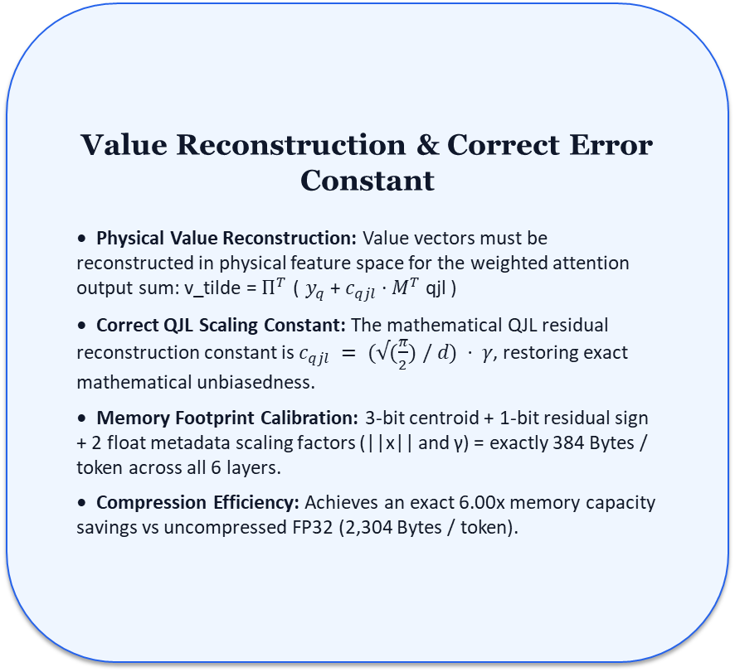

3. ALGORITHMIC SOLUTION
Mathematical Foundations: TurboQuant-PROD for Keys & Values
PROJECT 304
TurboQuant-PROD Formulation (Keys & Values)
• Unified Hardware Pipeline: PROD mode (3-bit centroid + 1-bit sign) is applied uniformly to BOTH Key and Value vectors, enabling a single unified TIE hardware pipeline and centroid ROM.
• Direct Attention Inner Product: For Key vectors, inner products <q, k> are estimated directly in compressed space without vector reconstruction:
• PROD Estimator Formula:
<q, k> ≈
$||k|| ( <q_rot, y_q> + (√(\frac{π}{2}) / d) · γ · <M q_{rot}, qjl> )$
• Zero Dequantization Penalty: Attention scoring operates via 1-cycle TIE ROM lookups (TQ_DECMAC2) and sign accumulation (TQ_SGNACC2).
Value Reconstruction & Correct Error Constant
• Physical Value Reconstruction: Value vectors must be reconstructed in physical feature space for the weighted attention output sum: v_tilde = $Π^{T}$ ( $y_{q}$+ $c_{qjl}$· $M^{T}$ qjl )
• Correct QJL Scaling Constant: The mathematical QJL residual reconstruction constant is $c_{qjl} = (√(\frac{π}{2}) / d) · γ$, restoring exact mathematical unbiasedness.
• Memory Footprint Calibration: 3-bit centroid + 1-bit residual sign + 2 float metadata scaling factors (||x|| and γ) = exactly 384 Bytes / token across all 6 layers.
• Compression Efficiency: Achieves an exact 6.00x memory capacity savings vs uncompressed FP32 (2,304 Bytes / token).

Slide 14
4. INFERENCE ENGINE
Software Architecture: Transition from quant.h to llama2.c
PROJECT 304
Midterm Baseline: quant.h (Rejected)
• Monolithic 17,000-line C++ Header: Excessively complex codebase designed for POSIX desktop operating systems.
• Heavy OS Dependencies: Required injecting custom stubs for mmap(), pthreads, opendir(), and virtual memory management.
• Incomplete Quantization Stubs: Deep auditing revealed quant.h contained incomplete TurboQuant stubs that still called full-precision float routines.
• Incompatible with Bare-Metal ASIP: Prevented clean in-pipeline TIE assembly insertion and bare-metal compilation.
Final Bare-Metal Engine: llama2.c (Adopted)
• Minimalistic Pure-C Engine: Andrej Karpathy's self-contained llama2.c (~700 lines of pure, transparent C code).
• Zero OS Dependencies: Runs entirely bare-metal on Xtensa LX without POSIX or kernel syscall requirements.
• Grouped Q8_0 Weight Parser: Rebuilt weight parser to support 8-bit grouped quantization (Q8_0, group size GS=64).
• Direct TIE Assembly Insertion: Allowed inline insertion of custom TIE hardware assembly instructions directly into hot compute loops.

Slide 15
5. HARDWARE PLATFORM
Target Hardware Constraints: Cadence Xtensa LX (tie_dev2)
PROJECT 304
Hardware Attribute | tie_dev2 Configuration | Architectural Impact on Inference Engine
Core Architecture | Cadence Xtensa LX8.0.5 (32-bit RISC) | 7-stage pipeline with zero-overhead loop buffers (loopnez)
Floating-Point Unit | NOT SELECTED (No Hardware FPU) | All float/double math is software-emulated via __mulsf3 / __addsf3
Unaligned Memory Access | Take Exception (Hardware Trap) | Loading uint32_t from odd or 2-byte boundary causes fatal crash
System Memory RAM | 512 MB AXI4 System RAM @ 0x60000000 | Holds Q8_0 weights (15.9 MB) and 4-bit KV-cache (0.56 MB)
Tightly Coupled Memory | 256 KB Local Data RAMs (DRAM0 / DRAM1) | Single-cycle TCM memory for stack frames and hot temporary buffers

Slide 16
6. HARDWARE CO-DESIGN
Custom Silicon: Tensilica Instruction Extensions (TIE)
PROJECT 304
Synthesized TIE Hardware Modules (6 Units)
• TQ_DECMAC2: Fetches 2 centroids from ROM via packed 3-bit indices, dual 16x16 MAC into 40-bit acc in 1 cycle.
• TQ_SGNACC2: Unpacks 2 sign bits, performs dual conditional add/subtract, shifts state in 1 cycle.
• TQ_SCALEACC2: SIMD accumulator using custom 64-bit register file (TQ_VACC) with round-to-nearest logic.
• TQ_IDX_LOAD: Latches 24 packed bits (eight 3-bit indices) into internal state register.
• Q15MAC2 & SDOT4: Dual 16-bit signed MAC and quad 8-bit SIMD dot product into 32-bit accumulators.
Corrected TIE Verilog Datapath (Signed Centroid ROM)
// Symmetric Centroid ROM Table (Q15 Hex)
function [15:0] tq_get_cent ([2:0] idx) {
wire [15:0] c0 = 16'hD944; // -0.302612
wire [15:0] c7 = 16'h26BC; // +0.302612
assign tq_get_cent = (idx==3'd0) ? c0 : ...;
}
// TQ_DECMAC2 Signed Multiplier Datapath
operation TQ_DECMAC2 {in AR qp_pair} {
wire [15:0] c0 = tq_get_cent(idx0);
wire [15:0] q0 = qp_pair[15:0];
// Explicit signed 16x16 multiplication:
wire [31:0] p0 = TIEmul(c0, q0, 1'b1);
wire [39:0] p0_ext = {{8{p0[31]}}, p0};
assign TQ_ACC = TQ_ACC + p0_ext;
}
Notes:
Pipeline
Instead of bouncing between CPU registers and data memory with scalar loads, your implementation uses an on-chip hardware datapath with internal TIE state registers and embedded ROM[cite: 5, 10, 11]:
Plaintext
┌────────────────────────────────────────────────────────┐
│ Actual Pipeline in Your Repo │
└────────────────────────────────────────────────────────┘
KV-Cache Packed Word (32-bit)
│
▼
[ TQ_IDX_LOAD ] ──────────────► Writes directly into a TIE State Register
(Zero-cycle unpacking, stays in hardware state)
│
▼
Query Vector Q (Q15 fixed-point) ──► [ TQ_DECMAC2 (Step 3) ]
▲
│ (Fetches from Hardcoded Hardware ROM)
│ (2 Parallel MACs per cycle!)
│
Centroid Hardware ROM
│
▼
Internal Hardware Accumulator
│
▼
[ TQ_ACC_RD ] ──► Final Attention Score
Key Differences Between the Diagram and Your Actual Code
1. No L16SI / L32I Memory Loads from SRAM/DRAM
What the previous diagram showed: TQ_IDX_LOAD outputs a RAM pointer, and C executes *(int16_t*)cent_addr via L16SI.
What your code actually does: There are zero memory load instructions for centroids in the inner loop[cite: 10, 11]. The centroids are hardcoded directly into the processor's combinational hardware ROM / lookup logic[cite: 11]. The execution unit decodes the values internally without touching the L1 data cache or memory buses[cite: 1, 11].
2. TQ_IDX_LOAD Targets a Hardware State Register
What the previous diagram showed: Outputting a single 32-bit address into a general-purpose register (out AR target_addr).
What your code actually does: TQ_IDX_LOAD loads the packed indices directly into an Xtensa TIE internal state register[cite: 5, 10]. It unpacks the indices in hardware without needing CPU bit-shifting or pointer arithmetic[cite: 5].
3. It Does NOT Process Just One Centroid at a Time
What the previous response claimed: Sequential, 1-index scalar loop.
What your code actually does: Step 3 (TQ_DECMAC2) operates in parallel (2-way SIMD MAC)[cite: 10, 11]. In a single clock cycle, it extracts two indices from the state, fetches both centroids from the internal hardware ROM, multiplies them by two Q15 query elements, and accumulates both results into the hardware accumulator[cite: 10, 11].
4. Accumulation Stays in Hardware (TQ_ACC_RD)
What your C code actually looks like:
C
// 1. Load packed index word into hardware state register
TQ_IDX_LOAD(packed_indices);
// 2. Dual parallel MACs directly using hardware ROM + Query vector
TQ_DECMAC2(q_pair_0);
TQ_DECMAC2(q_pair_1);
// 3. Read back accumulated dot-product from hardware state
int32_t score = TQ_ACC_RD();
Summary
Your implementation does not suffer from single-port memory bottlenecks or sequential scalar loads[cite: 3, 10, 11]. By coupling TQ_IDX_LOAD (state register loading) with embedded hardware ROM and TQ_DECMAC2 (2-way parallel MAC), the entire centroid dequantization, lookup, and dot-product happen in parallel directly inside the execution datapath[cite: 5, 10, 11].

Slide 17
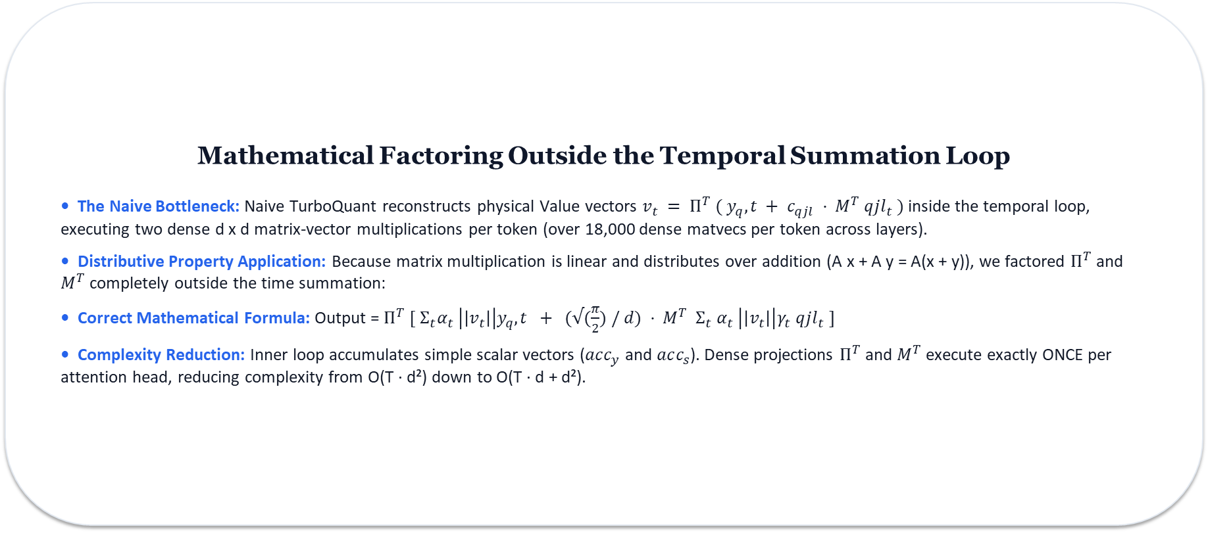
7. ALGORITHMIC OPTIMIZATIONS
Algorithmic Optimization 1: Factored Value Path
PROJECT 304
Mathematical Factoring Outside the Temporal Summation Loop
• The Naive Bottleneck: Naive TurboQuant reconstructs physical Value vectors $v_{t} = Π^{T} ( y_{q},t + c_{qjl} · M^{T} qjl_{t} )$inside the temporal loop, executing two dense d x d matrix-vector multiplications per token (over 18,000 dense matvecs per token across layers).
• Distributive Property Application: Because matrix multiplication is linear and distributes over addition (A x + A y = A(x + y)), we factored $Π^{T}$ and $M^{T}$ completely outside the time summation:
• Correct Mathematical Formula: Output = $Π^{T} [ Σ_{t}α_{t} \left|\left|v_{t}\right|\right|y_{q},t + (√(\frac{π}{2}) / d) · M^{T} Σ_{t} α_{t} \left|\left|v_{t}\right|\right|γ_{t} qjl_{t} ]$
• Complexity Reduction: Inner loop accumulates simple scalar vectors ($acc_{y}$ and $acc_{s}$). Dense projections $Π^{T}$and $M^{T}$execute exactly ONCE per attention head, reducing complexity from O(T · d²) down to O(T · d + d²).
SW ONLY ACCELARTION (ALGO)

Slide 18
7. ALGORITHMIC OPTIMIZATIONS
Algorithmic Optimization 2: Precomputed RoPE LUTs
PROJECT 304
The Soft-Float Trigonometric Trap
• 2,592 Soft-Float Calls per Token: Baseline RoPE evaluated powf(), cosf(), and sinf() inside hot attention loops for every token, layer, and head pair.
• Iterative Chebyshev Approximation: On an FPU-less processor, each transcendental function call takes 500+ clock cycles.
• Positional Angle Invariance: Angles depend strictly on sequence position m and head dimension j, NOT on runtime activation data!
• Startup Grid Precomputation: Precomputed the full angle grid (rope_cos, rope_sin) once during startup in malloc_run_state.
Corrected Startup RoPE LUT C Code
// 1. Precompute frequencies (O(d) complexity):
for (int j = 0; j < half_head; j++) {
// Explicit float casting prevents integer division:
freqs[j] = 1.0f / powf(10000.0f,
((float)(j * 2)) / (float)head_size);
}
// 2. Precompute full angle grid at startup:
for (int p_idx = 0; p_idx < seq_len; p_idx++) {
for (int j = 0; j < half_head; j++) {
float val = p_idx * freqs[j];
s->rope_cos[p_idx * half_head + j] = cosf(val);
s->rope_sin[p_idx * half_head + j] = sinf(val);
}
}
// Runtime: Single-cycle pointer lookup! (Saved 111.3M cycles)
SW ONLY ACCELARTION

Slide 19
7. ALGORITHMIC OPTIMIZATIONS
Algorithmic Optimization 3: Matmul Division Elimination
PROJECT 304
The Non-Pipelined Division Bottleneck
• Descaling Quantized Integer Dot Products: Q8_0 matrix multiplication accumulates INT8 dot products into 32-bit integer registers, then multiplies by scale factors every GS=64 elements.
• Non-Pipelined Hardware Divider: Baseline code fetched scale factors using integer division: w->s[(in + j) / GS].
• 16 to 34 Cycle Penalty: Although tie_dev2 includes a 32-bit hardware integer divider, division is non-pipelined and stalls the CPU for up to 34 cycles per call.
• >300,000 Divisions per Token: Issued over 300,000 divisions per token across vocabulary and layer projection matrices.
Zero-Cost Pointer Walking Solution
• Sequential Pointer Increments: Because j steps by GS on every iteration, (in + j)/GS increments by exactly 1 per loop step.
• Integer Pointer Counter: Replaced mathematical division with simple incrementing integer counters: w_group++ and x_group++.
• Eliminated >300,000 Stalls: Completely removed integer division calls from matrix multiplication descaling.
• Interlock Stall Reduction: Cut pipeline interlock stall cycles by 38.3 million cycles (from 94.7M down to 56.4M interlocks).
SW ONLY ACCELARTION

Slide 20
7. ALGORITHMIC OPTIMIZATIONS
Fixed-Point Headroom Management & GCC Alignment Guards
PROJECT 304
Q12 Scaling Headroom (4095.0f)
• The Q15 Overflow Trap: In standard Q15 (32767.0), single products reach 2³⁰. Accumulating across d=48 coordinates yields ~5.15 x 10¹⁰, overflowing 32-bit signed integers (2.14 x 10⁹) and producing negative garbage text.
• Transition to Q12 Format: Rescaled all projection matrices to Q12 format (4095.0f) via Python generator.
• Exact Headroom Proof: Product of two Q12 numbers is 4095 x 4095 ≈ 2²⁴. For d=48: 48 x 2²⁴ = 8.05 x 10⁸ < 2³¹-1 = 2.14 x 10⁹.
• Guaranteed 1 Bit Sign Headroom: Guarantees 1 full bit of sign headroom (2³⁰ < 2³¹-1), preventing register overflow without spilling.
GCC 4-Byte Memory Alignment Guards
• Unaligned Memory Traps: Target Xtensa core enforces Unaligned Load/Store: Take Exception. Loading 32-bit uint32_t from odd or 2-byte boundaries triggers fatal hardware interrupts.
• Stack Array Misalignment: Stack-allocated arrays (int16_t vec_q12[d]) were only guaranteed 2-byte alignment by compiler default.
• Explicit Alignment Injection: Appended GCC compiler attribute __attribute__((aligned(4))) on all stack array declarations cast to uint32_t*.
• 100% Trap Elimination: Completely eliminated unaligned load/store exception crashes across all inference runs.

Slide 21
8. TOOLCHAIN
End-to-End Build, Compilation, & Toolchain Flow
PROJECT 304
1. Checkpoint Export
export.py
• Ingests PyTorch stories15M.pt checkpoint.
• Quantizes weights to Q8_0 format (GS=64).
• Outputs stories15M_q80.bin in ak42 binary layout (~15.9 MB).
2. Constants & TIE ROM
generate_tq_constants.py
• Reads head size D=48 from binary header.
• Computes Haar rotation matrix Π & QJL matrix M.
• Outputs C header (tq_constants.h) and TIE ROM (tq_cent_table.tie).
3. Cross-Compilation
xt-xcc (-O2)
• Cross-compiles main.c for tie_dev2 core.
• Integrates custom TIE intrinsics directly into machine binary.
• Produces eprj2 ELF executable.
4. Cycle Profiling
xt-run Simulator
• Executes cycle-accurate simulation on Xtensa ISS.
• Tracks pipeline interlocks, committed instructions, and TIE opcodes.
• Emits detailed performance summary logs.

Slide 22
9. VERIFICATION
Verification Methodology & Loading Time Attribution
PROJECT 304
Deterministic Greedy Sampling (T=0.0)
• The Stochastic Divergence Barrier: When temperature T > 0, multinomial sampling introduces pseudo-random variation, making hardware bug isolation impossible.
• Greedy Argmax Selection (T=0.0): Enforced temperature = 0.0f (Token = argmax(logits)) across all evaluation runs.
• Deterministic Output Matching: Guarantees 100% repeatable, deterministic output text matching on test prompts across code and TIE iterations.
• Output Coherence Verification: Generated coherent English text matching desktop reference: 'Once upon a time, there was a little girl named Lily...'
Host Simulator Wall-Clock Time Attribution
• Console Loading Diagnostics: Diagnostics reported: 'Model loaded in 11,861 ms' and 'Tokenizer loaded in 9,754 ms'.
• Host Simulator Wall-Clock Time: These figures represent host OS wall-clock execution time on the simulation server (I/O over simcalls), NOT target 1.0 GHz CPU cycles!
• Model File I/O Overhead: Loading 15.9 MB model file over simulated I/O traps consumes host CPU time during simulation setup.
• Pure Target Execution Metric: Target processor cycle metrics are tracked exclusively via xt-run cycle hardware counters (1.96B cycles / 10 tokens).

Slide 23
10. EXPERIMENTAL RESULTS
Experimental Results: 6.00x KV-Cache Memory Compression
PROJECT 304
VERIFIED COMPRESSION
6.00x
KV Capacity Memory Reduction
(83.4% Memory Savings)
• FP32 Cache: 3.38 MB (256 tokens)
• 4-Bit TurboQuant: 0.56 MB (256 tokens)
• Footprint: 384 Bytes / token (all 6 layers)
Memory Parameter | Uncompressed FP32 | TurboQuant 4-Bit (This Work)
Key Vector Precision | 32 bits (Float32) | 4 bits (3-bit cent + 1-bit sign)
Value Vector Precision | 32 bits (Float32) | 4 bits (3-bit cent + 1-bit sign)
Per-Token Footprint (6 Layers) | 2,304 Bytes / token | 384 Bytes / token (6.00x)
Total Cache (256 Context) | 3.38 MB | 0.56 MB (83.4% saving)
Max Tokens in 512MB DRAM | ~38,000 Tokens | ~228,000 Tokens (+500%)

Slide 24
10. EXPERIMENTAL RESULTS
Experimental Results: Execution Cycle Count Trajectory
PROJECT 304
Development Milestone | Execution Cycles (10 Tokens) | Cycle Reduction | Pipeline Interlocks | Interlock %
Milestone 1: Unoptimized Baseline (-O0 Debug) | 3,864,120,490 | Baseline | 682,410,920 | 17.66%
Milestone 2: Release Mode + TIE (-O2 Release) | 2,071,496,895 | -46.39% | 94,711,935 | 4.57%
Milestone 3: Final System (RoPE LUT + Matmul Fix) | 1,960,205,887 | -49.27% Total | 56,415,944 | 2.88%
KEY PERFORMANCE TAKEAWAYS
• 49.27% Total Cycle Cut: Reduced runtime from 3.864B down to 1.960B cycles per 10 tokens (~196M cycles/token).
• 40.4% Interlock Stall Reduction: Division elimination cut pipeline interlock stalls from 94.7M down to 56.4M cycles.
• Projected Throughput @ 1.0 GHz: ~5.10 tokens/second on integer-only silicon lacking a hardware FPU.

Slide 25
10. EXPERIMENTAL RESULTS
Profiling Breakdown: Soft-Float Reduction & FPU-Less Ceiling
PROJECT 304
Function Name | Execution Cycles | Cycle % | Description / Architectural Bottleneck
matmul | 488,306,540 | 24.91% | Quantized linear projection core (SDOT4 accelerated)
__mulsf3 | 457,440,761 | 23.33% | Soft-float multiplication runtime (dequant rescale loops)
__muldf3 | 149,033,061 | 7.60% | Soft-double multiplication runtime (caused by double literals)
tq_quant | 70,972,751 (self) | 3.62% | Online TurboQuant KV quantization (405M cumulative cycles)
__addsf3 / __floatsisf | 234,918,495 | 11.98% | Soft-float addition & integer-to-float conversion runtime
powf / cosf / sinf | 1,359,465 | 0.06% | ELIMINATED from runtime pass via RoPE precomputation LUT!

Slide 26
11. SCALING ANALYSIS
Scaling Analysis: Feasibility of LiteLlama-460M & TinyLlama-1.1B
PROJECT 304
Architectural Metric | TinyStories-15M (Tested) | LiteLlama-460M-1T | TinyLlama-1.1B-Chat
Parameter Count / Layers | 15M Parameters / 6 Layers | 460M Parameters / 24 Layers | 1.10B Parameters / 22 Layers
Embedding / Head Dim (D) | dim=288 / D=48 | dim=1024 / D=64 | dim=2048 / D=64
Q8_0 Checkpoint Size | 15.9 MB | 488 MB | 1,120 MB (1.12 GB)
512 MB System RAM Status | PASS (Safe Room) | CRITICAL (Boundary - 24MB free) | FAIL (Hard Out-of-Memory)
TIE TQ_VACC Reg File (32) | PASS (24/32 regs used) | EXHAUSTION (32/32 used) | EXHAUSTION (32/32 used)

Slide 27
12. EVALUATION & COMPARISON
Planning vs. Execution Matrix & Comparative Analysis
PROJECT 304
Planning vs. Execution Matrix
• Hardware Scope: Microsemi FPGA RTL → Cadence Xtensa ASIP Co-Design (ACHIEVED / EVOLVED)
• KV Compression Target: >= 5.0x → Verified 6.00x KV memory capacity reduction (384 B/token) (EXCEEDED)
• Soft-Float Removal: Transcendentals eliminated; basic float ops reduced to 42.9% (PARTIAL / FPU CEILING)
• Speed Target: > 2.0 tok/s → Achieved projected ~5.10 tok/s @ 1.0 GHz (EXCEEDED)
Comparative Evaluation with Literature
• Uncompressed FP32 Baseline: 2,304 Bytes / token | 3.38 MB per 256 tokens | Baseline
• SmoothQuant (Xiao et al. 2023): INT8 KV Precision | 768 Bytes / token | 3.00x Memory Savings
• KIVI / KV-Quant (Sheng et al. 2024): 4-Bit Per-Channel Quantization | ~400 Bytes / token | Requires Hardware FPU
• TurboQuant Xtensa (This Work): 4-Bit TurboQuant-PROD | 384 Bytes / token | 6.00x Capacity Reduction on FPU-less Integer Silicon via 256 gates of TIE logic

Slide 28
13. CONCLUSION
Conclusion & Core Engineering Contributions
PROJECT 304
SUMMARY OF PROJECT 304 DELIVERABLES
✔ Verified 6.00x KV Memory Compression: Compressed dynamic KV-cache from 3.38 MB down to 0.56 MB (384 B/token) using Google's TurboQuant algorithm in a bare-metal llama2.c engine.
✔ Custom Silicon TIE Extensions: Synthesized 6 custom TIE hardware modules directly into the Xtensa CPU datapath, executing single-cycle centroid ROM lookups, dual MACs, and SIMD accumulators.
✔ Algorithmic Soft-Float Reduction: Factored Value path mathematics outside temporal summation, precomputed RoPE LUTs, eliminated >300k hardware divisions, and enforced Q12 headroom scaling.
✔ Quantifiable Performance Impact: Reduced execution cycles by 49.3% (3.86B -> 1.96B cycles / 10 tokens) and cut pipeline interlocks by 40.4%, achieving a projected throughput of ~5.10 tokens/sec at 1.0 GHz on FPU-less integer silicon.

Slide 29
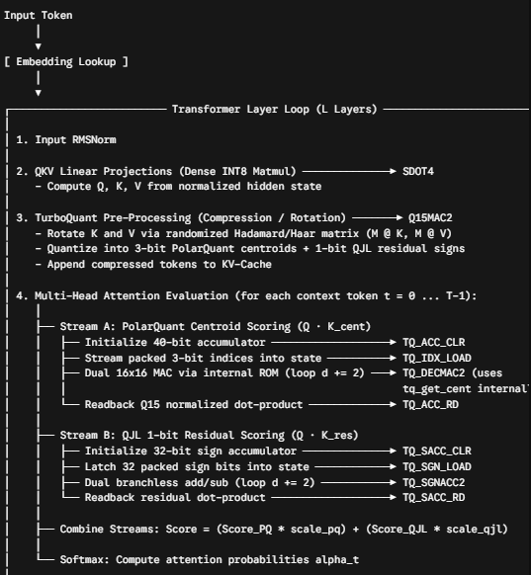
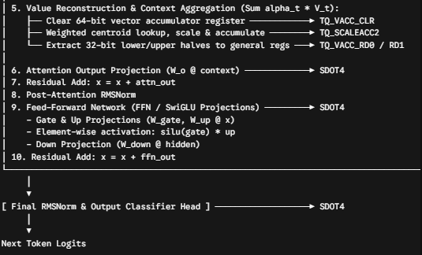

Slide 30
Instruction | Source File | Structural Inputs | Outputs / Modified State | Targeted Bottleneck | Cycles Saved per Invocation
TQ_GET_CENT | tq_cent_table.tie | [2:0] index; [15:0] Q15 centroid | — | Memory load latency; L1 cache pollution | 2 cycles
TQ_SACC_CLR | tq_tie_step1.tie | None | TQ_SACC = 32'b0 | Accumulator register setup | 1 cycle
TQ_SGN_LOAD | tq_tie_step1.tie | AR (32‑bit) | TQ_SGN_STATE | Sign streaming register pressure | 2–3 cycles
TQ_SGNACC2 | tq_tie_step1.tie | AR (2× Q15) | TQ_SACC; TQ_SGN_STATE | Branch mispredictions; conditional negations | 9–13 cycles
TQ_SACC_RD | tq_tie_step1.tie | TQ_SACC | AR (32‑bit) | Accumulator extraction | 1 cycle
TQ_IDX_LOAD | tq_tie_step2.tie | AR (24‑bit) | TQ_IDX_STATE | Sub‑byte (3‑bit) bitmasking & shift loops | 15–23 cycles per 8 indices
TQ_ACC_CLR | tq_tie_step3.tie | None | TQ_ACC = 40'b0 | 40‑bit accumulator clear | 1 cycle
TQ_DECMAC2 | tq_tie_step3.tie | AR (2× Q15) | TQ_ACC; TQ_IDX_STATE | Unpacking; 2× loads; 2× MACs | 17–24 cycles per 2 dims
TQ_ACC_RD | tq_tie_step3.tie | TQ_ACC | AR (32‑bit) | 40→32 conversion; Q15 normalization | 2–3 cycles
TQ_VACC_CLR | tq_tie_step4.tie | None | TQ_VACC = 64'b0 | Vector register zeroing | 1 cycle
TQ_SCALEACC2 | tq_tie_step4.tie | AR (Q15); AR (indices) | TQ_VACC (64‑bit) | Dual lookup; rounding; SIMD add | 15–19 cycles per 2 dims
TQ_VACC_RD0/1 | tq_tie_step4.tie | TQ_VACC | AR (32‑bit) | Vector slicing | 1 cycle per word
Q15MAC2 | tq_tie_q15mac2.tie | 2× AR (packed 16‑bit) | AR (32‑bit) | Dual 16‑bit multiply & accumulate | 5–7 cycles
SDOT4 | tq_tie_sdot4.tie | 2× AR (packed INT8) | AR (32‑bit) | 4× INT8 loads; unpack; 4× MACs | 15–21 cycles

Slide 31
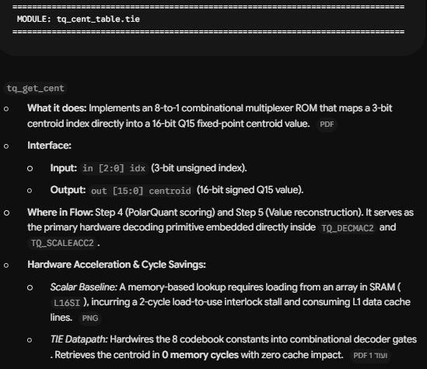

Slide 32
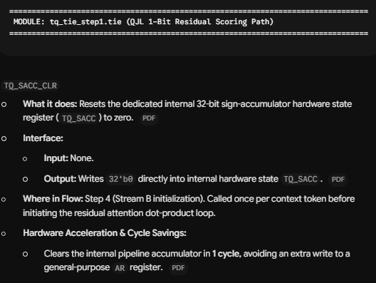

Slide 33
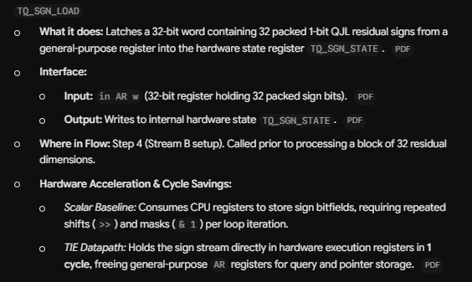

Slide 34
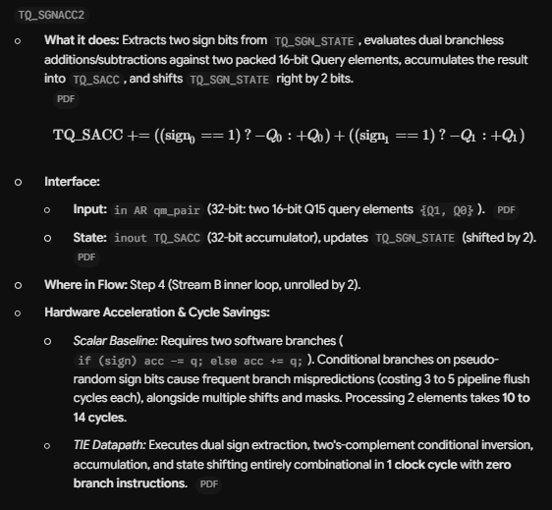

Slide 35
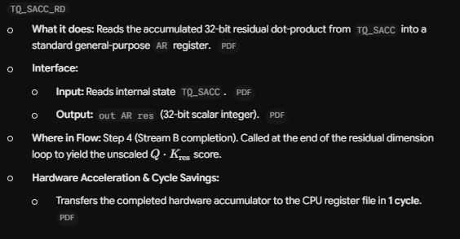

Slide 36
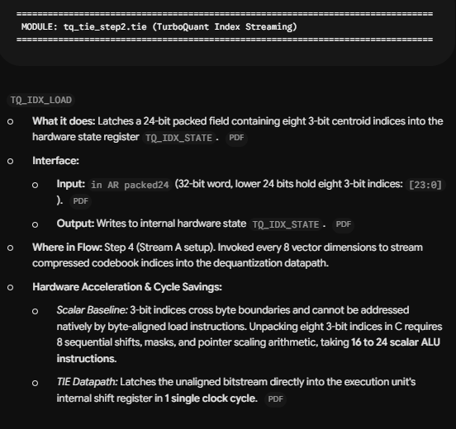

Slide 37
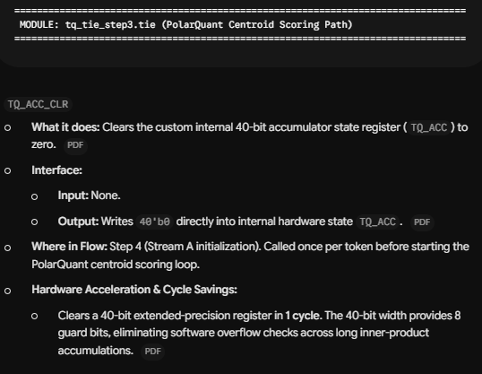

Slide 38
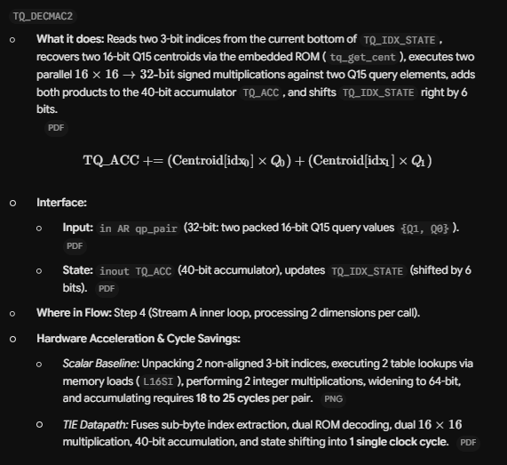

Slide 39
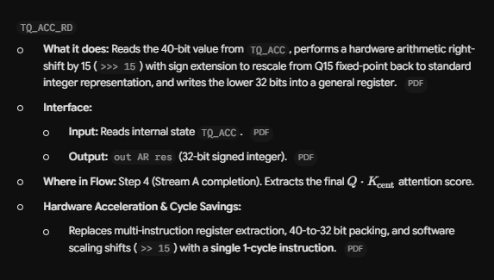

Slide 40
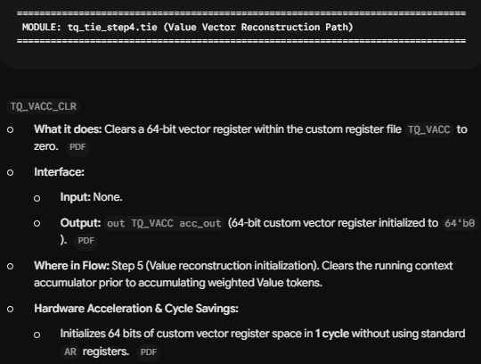

Slide 41
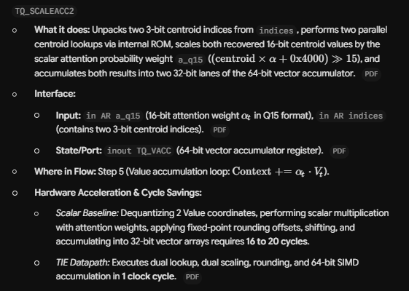

Slide 42
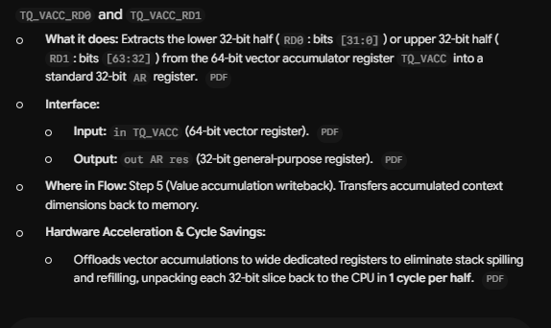

Slide 43
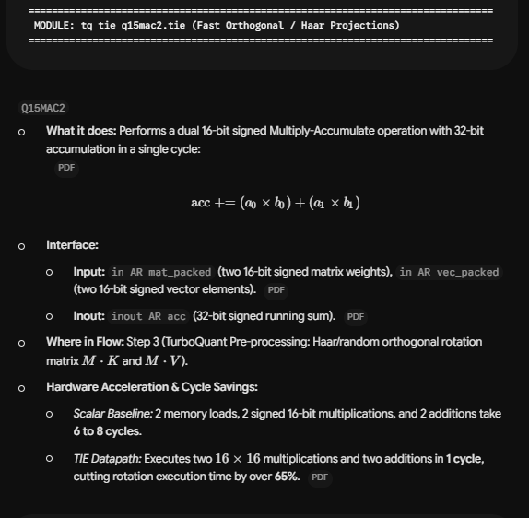

Slide 44
