Slide 1
CDK2 Structure-Based Virtual Screening
Docking → MD → MM-GBSA → FEP · an end-to-end, reproducible CADD pipeline
CDK2 基于结构的虚拟筛选 —— 对接→分子动力学→MM-GBSA→自由能微扰 全流程
自主实践项目 / Self-initiated project · 李仕成 Shicheng Li
github.com/sheinlee/cadd-cdk2-pipeline

Slide 2
Motivation
项目动机
• 跨领域迁移:把已有的 OpenMM/MD 与生成式 ML 长板瞄准药物结合问题
Transfer existing MD + generative-ML strengths to a drug-binding problem
• 目标:独立搭建并跑通工业标准的 CADD 全流程,并对结果有批判性解读
Build & run a full, reproducible, industry-standard CADD workflow end-to-end
• 诚实定位:能力展示,而非新药发现的主张
Honest framing: a capability demonstration, NOT a drug-discovery claim
• 一切开源、脚本化、可一键复现
Everything open-source, scripted, and reproducible from the repo

Slide 3
Target — CDK2
靶点 —— 细胞周期蛋白依赖性激酶 2
• CDK2:经典抗肿瘤激酶靶点;晶体结构 PDB 2R3I(1.28 Å,单体)
Classic oncology kinase; crystal structure 2R3I (1.28 Å, monomeric)
• 选它的理由:ATP 口袋深而规整(docking 友好)、抑制剂非共价(匹配方法)、公开数据多、体系小(单卡可跑)
Deep well-defined ATP pocket, non-covalent inhibitors, rich public data, small system
• 受体准备:还原氧化半胱氨酸 CSD177→CYS、重建无序 β3/αC loop、依共晶配体定义对接盒子
Receptor prep: CSD177→CYS, rebuilt β3/αC loop, ATP-site box from the co-crystal ligand

Slide 4
Pipeline overview
总体流程
• 0 受体准备 (PDBFixer) → 1 配体库:DUD-E 60 actives + 240 属性匹配 decoys
Receptor prep → ligand library (DUD-E actives + matched decoys)
• 2 对接 AutoDock Vina → 富集 / ROC 验证
Docking (AutoDock Vina) → enrichment / ROC validation
• 3 短 MD (OpenMM, 4 ns, 显式溶剂) → pose 稳定性过滤
Short explicit-solvent MD (OpenMM) → pose-stability filter
• 4 MM-GBSA 端点重排 (AmberTools) + 每残基分解
MM-GBSA endpoint rescoring (AmberTools) + per-residue decomposition
• 验证track:相对结合 FEP (OpenFE) 对照实验
Validation track: relative binding FEP (OpenFE) vs experiment

Slide 5
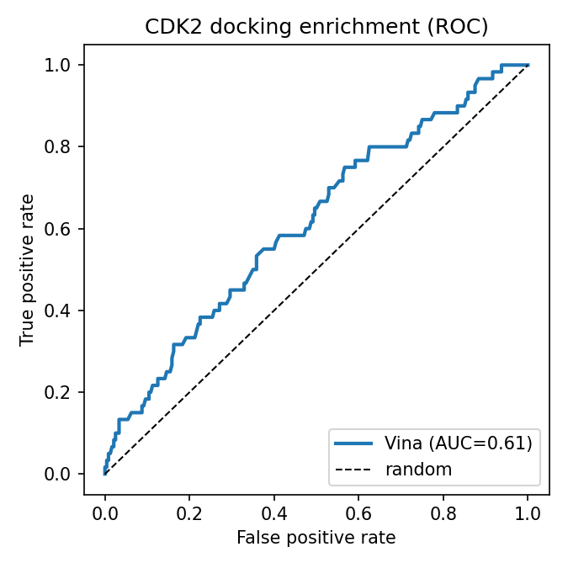
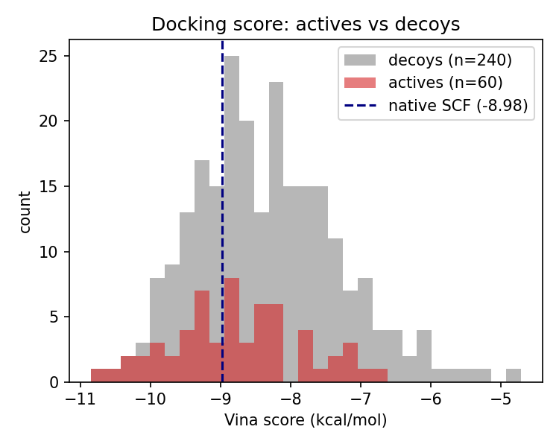
Stage 1 — Docking enrichment
第一步:对接富集验证
• 300 配体(60 actives + 240 匹配 decoys) — 300 ligands, 60 actives / 240 matched decoys
• ROC-AUC 0.61,EF1% 3.3;原生 SCF 回docking −8.98(阳性对照) — ROC-AUC 0.61, EF1% 3.3; native SCF redock −8.98 (control)
• 结论:单构象刚性对接富集温和但真实 → top hits 需物理打分重排 — Modest-but-real enrichment → top hits motivate physics-based rescoring

Slide 6
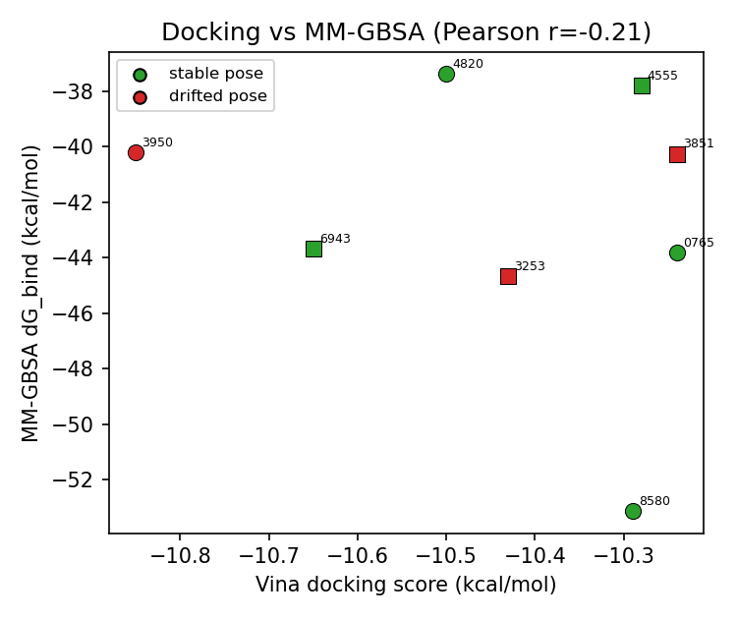
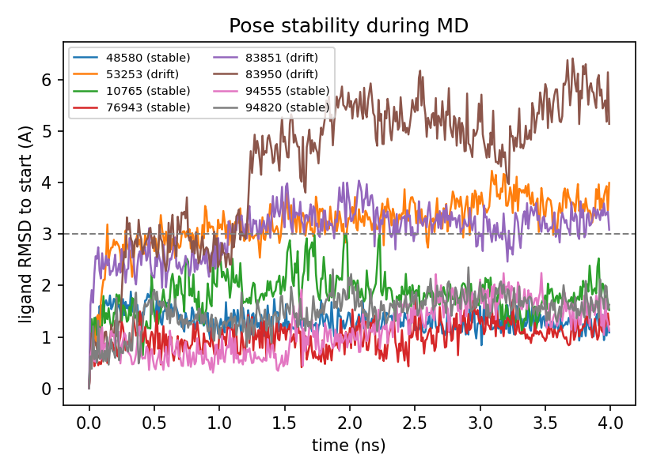
Stage 2 — MD pose filter + MM-GBSA rescoring
第二步:MD 稳定性过滤 + MM-GBSA 重排
• top 8 hits 各 4 ns 显式溶剂 MD:5/8 稳定,3 个漂移 — 8 hits × 4 ns MD: 5/8 poses stable, 3 drift out
• MM-GBSA 把 Vina 的窄分数拉开 ~16 kcal/mol;best = 真实 active CHEMBL148580 (−53 kcal/mol) — MM-GBSA spreads the scores; best hit is a true active (−53 kcal/mol)
• 关键:MM-GBSA 排第2的 decoy 在 MD 中漂出口袋 → 被动力学揪出的假阳性 — A high-MM-GBSA decoy drifts out of the pocket — a false positive caught by dynamics

Slide 7
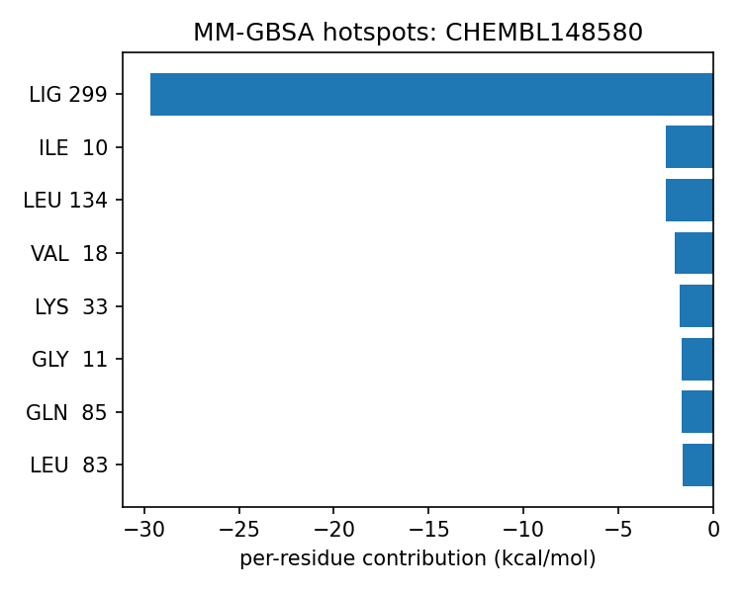
Binding hotspots — per-residue MM-GBSA
结合热点 —— 每残基能量分解
• 自动识别配体周围口袋残基并做能量分解 — Pocket residues auto-detected; per-residue MM-GBSA decomposition
• 定位到 hinge(Gln131/Asn132/Leu134)、催化 Lys33、Gly-rich 区 → 与已知 CDK2 药效团一致 — Localises to the hinge, catalytic Lys33 and Gly-rich loop — consistent with known CDK2 pharmacophores

Slide 8
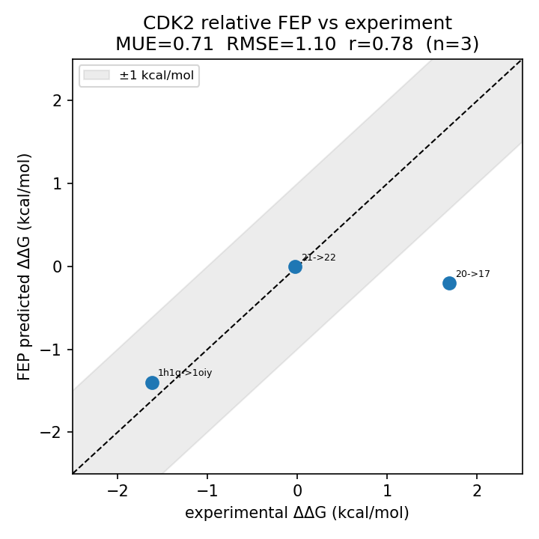
Stage 3 — Relative binding FEP (the differentiator)
第三步:相对结合 FEP(差异化王牌)
• OpenFE:OpenMM hybrid-topology RBFE + Hamiltonian replica exchange + MBAR — OpenFE: OpenMM hybrid-topology RBFE + HREX + MBAR — the community-standard protocol
• JACS/Wang-2015 CDK2 基准,3 条 edge:MUE 0.71 / RMSE 1.1 / r 0.78;2/3 与实验差 ~0.2 kcal/mol — JACS CDK2 benchmark, 3 edges: MUE 0.71 / RMSE 1.1 / r 0.78
• 诚实:3 edge、repeats=1 为演示;lig_20→17 跑偏,如实报告、不挑结果 — Honest: 3-edge single-repeat demo; one edge misses — reported, not cherry-picked

Slide 9
Engineering — real problems solved
工程能力 —— 真实踩坑与解决
• ChEMBL API 宕机/脆弱查询 → 改用稳定的 DUD-E 基准(保留 ChEMBL 备选)
ChEMBL outage → switched to the static DUD-E benchmark (ChEMBL kept as fallback)
• OpenMM CUDA PTX 版本不匹配 → 把 cuda-version 钉到 12.6 对齐驱动
OpenMM CUDA UNSUPPORTED_PTX_VERSION → pinned cuda-version=12.6 to the driver
• OpenBabel 从 pdbqt 错误感知键级(五价 N)→ 用 Meeko 直接重建分子
OpenBabel mis-perceived bonds → reconstruct the ligand with Meeko
• MMPBSA print_res 语法不兼容 → 自动计算口袋残基 + 失败回退
MMPBSA print_res incompatibility → auto-compute pocket residues with graceful fallback
• bash ( set -e ) || 陷阱(静默失效)→ 改用 && 链
set -e silently disabled in a || context → replaced with explicit && chaining

Slide 10
Honest assessment & limitations
诚实评估与局限
• 方法演示,非统计基准:库 300、FEP 3 edges、repeats=1、每 hit 单条 MD
A methods demo, not a benchmark: small library, 3 FEP edges, single repeats
• MM-GBSA 绝对值未校准,仅相对排序有意义;FEP 那段已对照基准实验值
MM-GBSA absolutes uncalibrated (relative only); FEP is validated against experiment
• 生产级下一步:扩库、全 edge 网络 + ≥3 repeats、增强采样、刚性受体→柔性
Production next steps: larger library, full edge network with ≥3 repeats, receptor flexibility

Slide 11
Summary — skills demonstrated
总结 —— 展示的能力
• 全流程能力:结构准备 · 虚拟筛选 · 分子动力学 · 自由能(端点 MM-GBSA + 炼金术 FEP) · HPC/SLURM · Python 工程 · 可复现开源
End-to-end: structure prep · virtual screening · MD · free energy (MM-GBSA + alchemical FEP) · HPC/SLURM · reproducible open source
• 工具链 Toolchain:RDKit · AutoDock Vina · Meeko · OpenMM · AmberTools · OpenFE
• 关键结果 Key results:docking AUC 0.61 / EF1% 3.3 · MM-GBSA 命中真实 active −53 kcal/mol · FEP MUE 0.71 kcal/mol
github.com/sheinlee/cadd-cdk2-pipeline
李仕成 Shicheng Li · shichengli97@gmail.com

