Slide 1
Abnormal Event Detection: Human Activity Recognition
Opportunity uci dataset
Jin Wei
13/6/2018

Slide 2
Agenda
Introduction
Baseline Approach
Proposed Approach
Demo in jupyter
Conclusion & Future Work

Slide 3
Introduction
Dataset: A subset of Opportunity UCI dataset
Body-worn sensors: 7 inertial measurement units, 12 3D acceleration sensors, 4 3D localization information. We use on-body sensors without quaternion data.
Recordings: 4 users, 6 runs per users. Of these, 5 are Activity of Daily Living runs characterized by a natural execution of daily activities. The 6th run is a "drill" run, where users execute a scripted sequence of activities Measures
Annotations/classes: 17 mid-level gesture classes
Data format: synchronized sensor readings and annotations in text matrix format (one line per sample, one column per sensor channel, last columns for annotations
Data characteristics: missing data due to data loss are indicated by "NaN" (not-a-number)

Slide 4
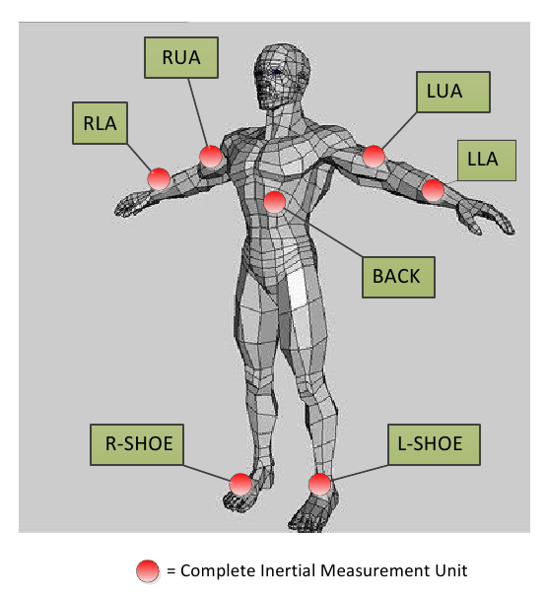
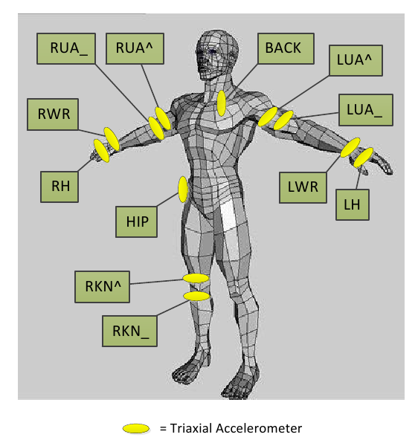
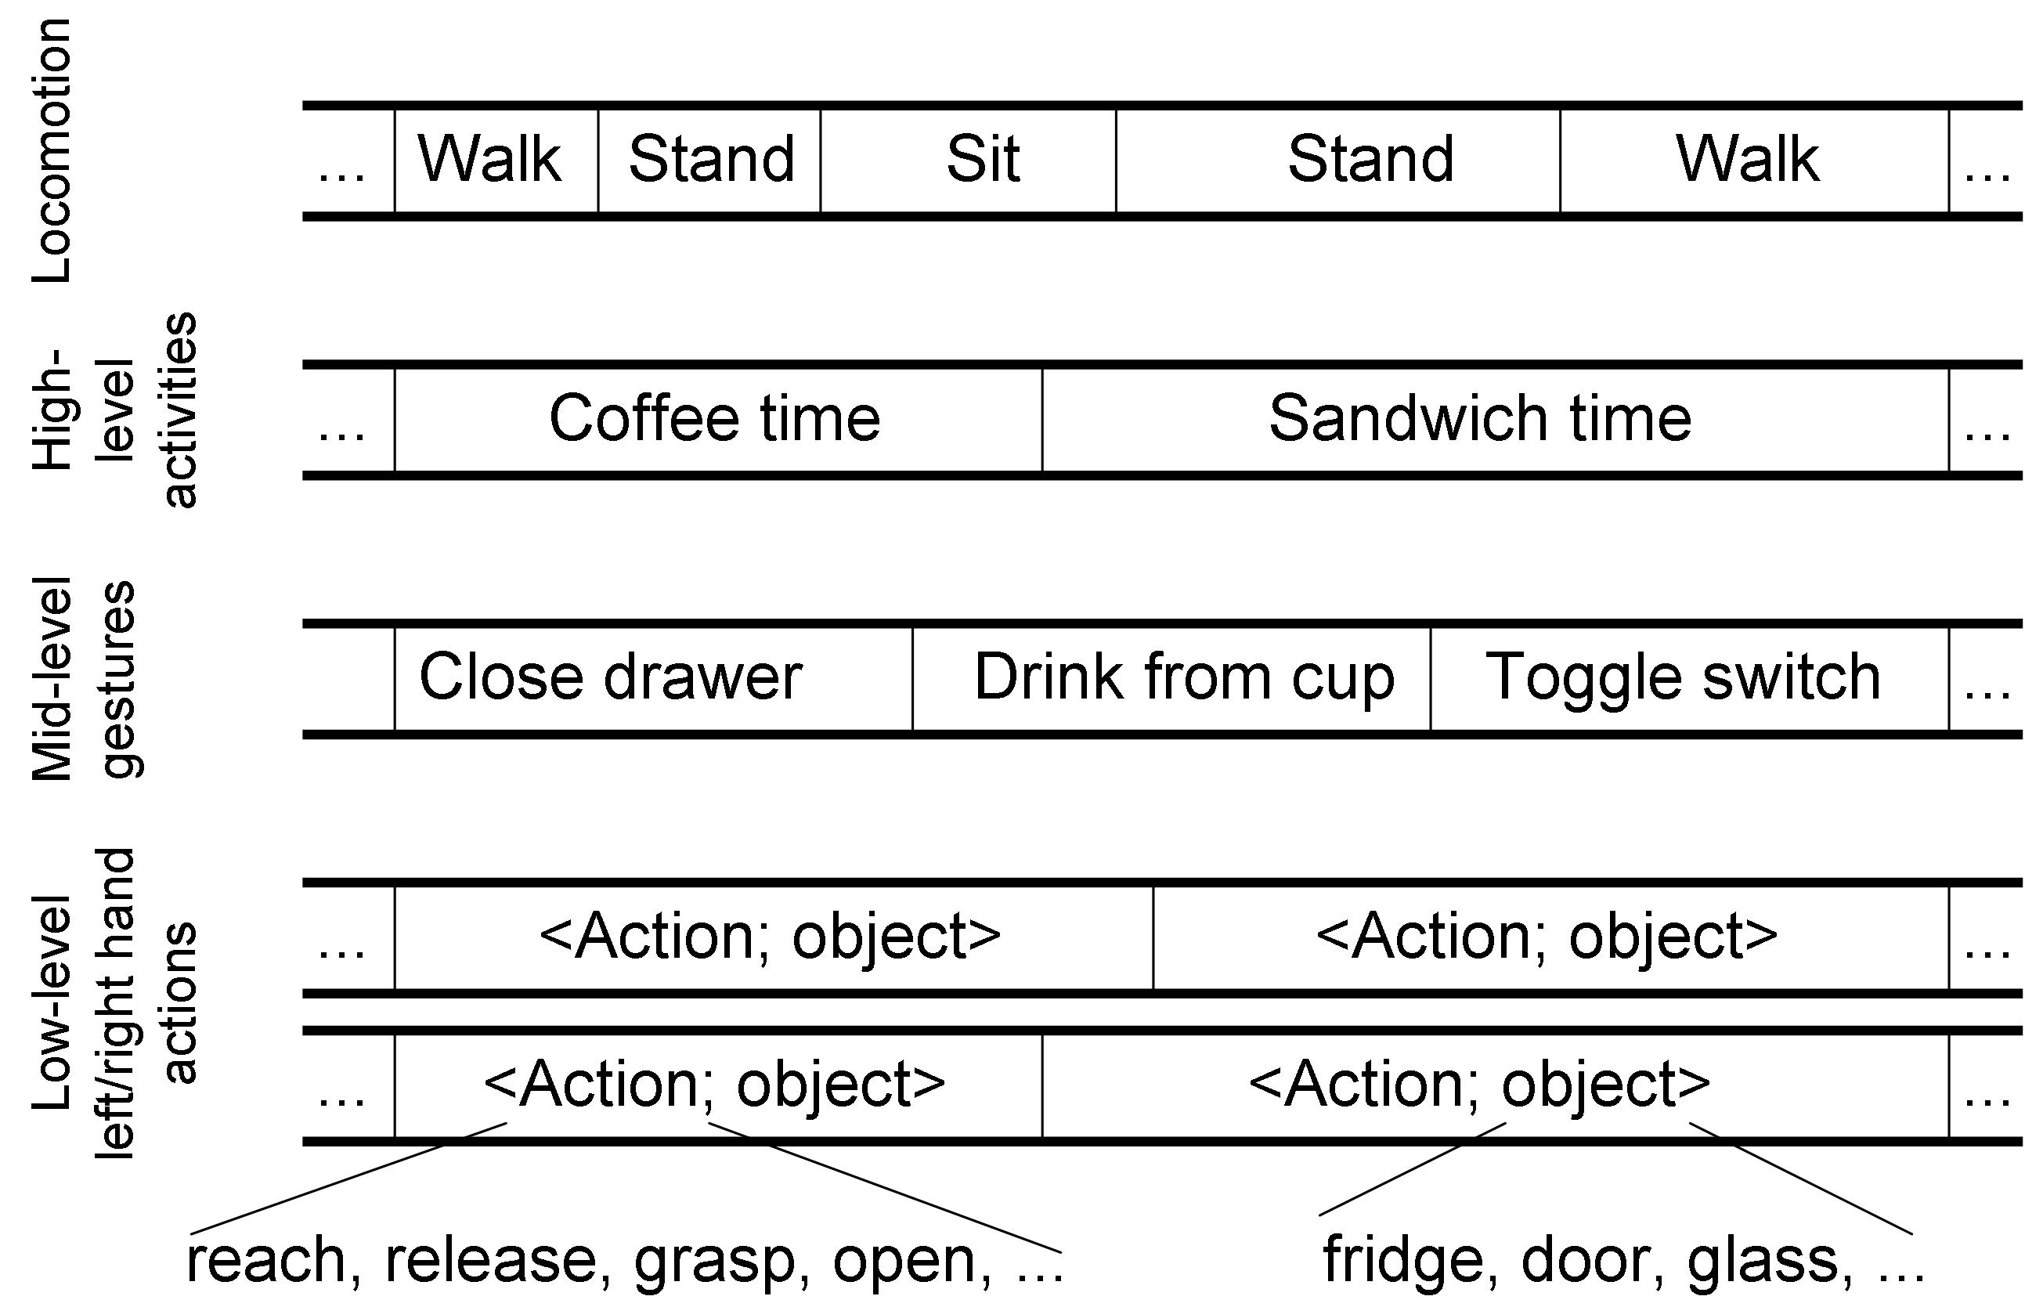
Introduction
Notes:
. It comprises coarser characterization of the user's activities. For instance the low-level annotations "reach door" and "open door" are combined into a single "open door" mid-level annotation.

Slide 5
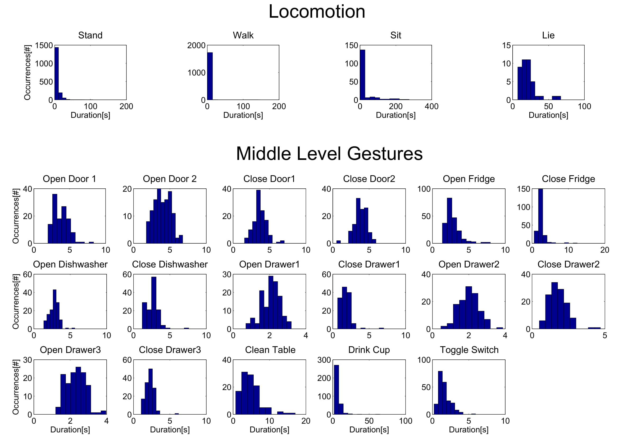
Data Explorer Using MATLAB

Slide 6
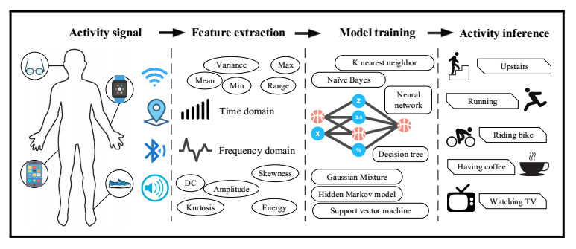
Baseline Approach
Script in MATLAB
Feature Engineering:
Feature reduction: PCA
Feature extraction: mean, mean + variance
Missing value handle: remove, remove + replace
Classifiers:
Guassian Classifier: LDA, QDA
kNN: 1-NN, 3-NN
Nearest Centroid Classifier
Measures
Accuracy, Weighted F-measure, weighted F-measure
Area Under ROC Curve
Notes:
NCC: Euclidean distance between the test sample and the centroid for each class samples is used for the classification
Weighted F-measure: classes can be weighted according to their sample proportion,
Receiver operating characteristic

Slide 7
Proposed Approach
Works done so far:
Feature Engineering in Python:
Missing value handle
Algorithms:
RNN: Feed-forward Long Short Term Memory
RNN: Bidirectional Long Short Term Memory
CNN: 1D
TensorBoard
Google Cloud Platform
To do:
Use Case
Simulate Data to detect the activity change timestamp
Sensor fusion
NULL Class: threshold-based mechanism to detect samples?

Slide 8
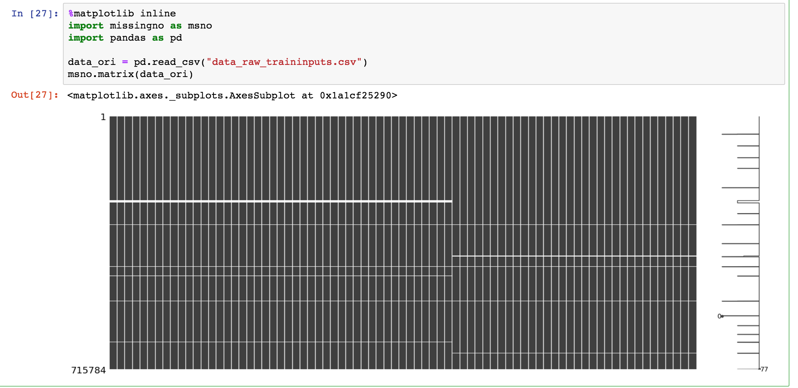
Missing Values Analysis:

Slide 9
Proposed Approach: Feature Engineering
Missing value handler:
Method 1: Omit samples (rows) which contain ’NaN’
Method 2: Replace ‘NaN’ with previous row’s value
Method 3: Omit samples (rows) which have NaN more than threshold (15 columns) + Replace NaN with previous row’s value
To do:
Omit sensor (columns) which have NaN more than threshold (30% of total columns)
Feature PCA
Notes:
imbalance of the dataset and the lack of enough training data. In the first case, I usually apply SMOTE oversampling technique and naturally adapt it as a data augmentation solution for the second case.

Slide 10
Proposed Approach: Algorithms
RNN
Why RNN:
Sequence data
Time series data : extracts temporal dependencies
Capture long-range dependencies in variable-length input sequences
Types of RNN:
Feed-forward LSTM: how a number of input variables affect the output variable.
Bi-directional LSTM: output layer can get information from past and future states, more computational intense
CNN:
Require minimal preprocessing
Automatically extracts local features within each sensor modality and merges the local features of different sensor modalities into global features hierarchically.
Use convolutions across a one-dimensional temporal sequence to capture dependencies among input data.
Use 1-direction (time-axis) to calculate conv
Notes:
he shape of that file is [n_sample,128,9], that is, every windows has 9 channels with each channel has length 128. When feeding it to Tensorflow, it has to be reshaped to [n_sample,128,1,9] as we expect there is 128 X 1 signals for every channel.
Convolution + pooling + convolution + pooling + dense + dense + dense + output
That is: 2 convolutions, 2 poolings, and 3 fully connected layers. Please check the following image.

Slide 11
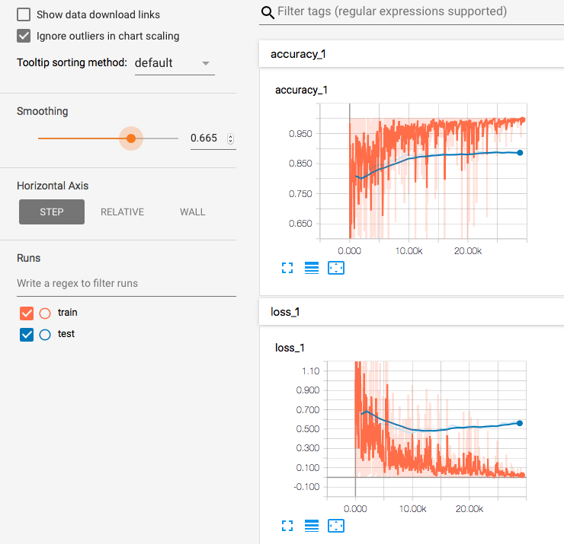
Proposed Approach: TensorBoard
Why TensorBoard :
A suite of visualization tools
Easier to understand, debug, and optimize TensorFlow programs

Slide 12
Proposed Approach: Google Cloud Platform
Why Google Cloud Platform (GCP):
Building a deep learning model from scratch requires high performing computers and GPUs
Deep Neural Network library (cuDNN)
Tensorflow
Jupyter

Slide 13
Demo

Slide 14
Conclusion & Future Work

