Slide 1

Cost Analysis Dashboard
- Created By Saurav Shejwal
Powered By

Slide 2
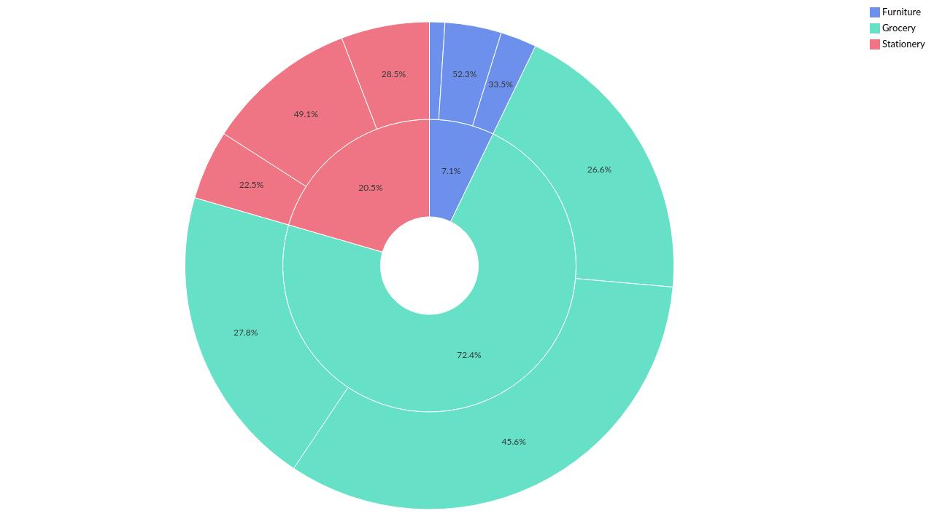
Product Category-wise Cost by Region
Powered By

Slide 3
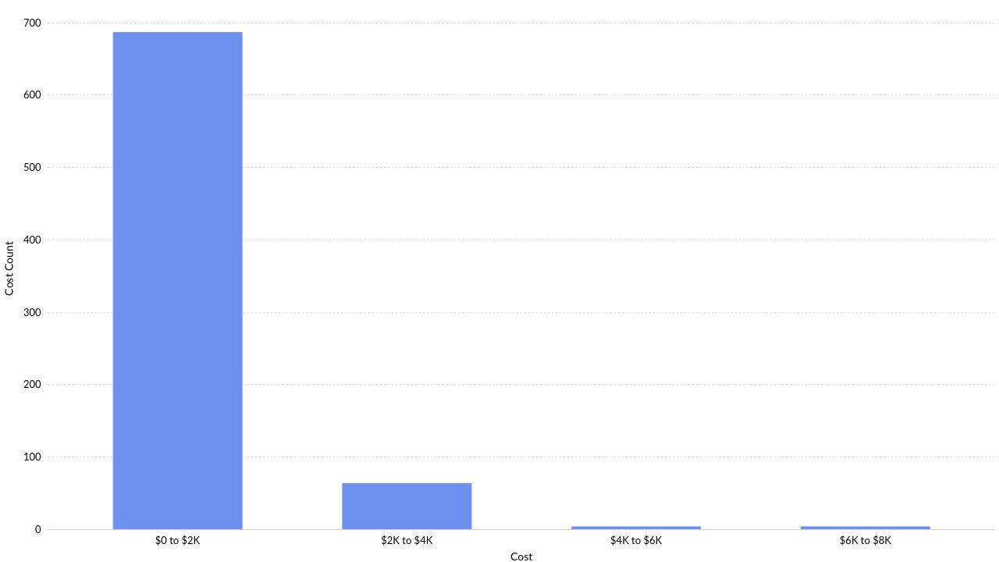
Distribution of Cost over different ranges
Powered By

Slide 4
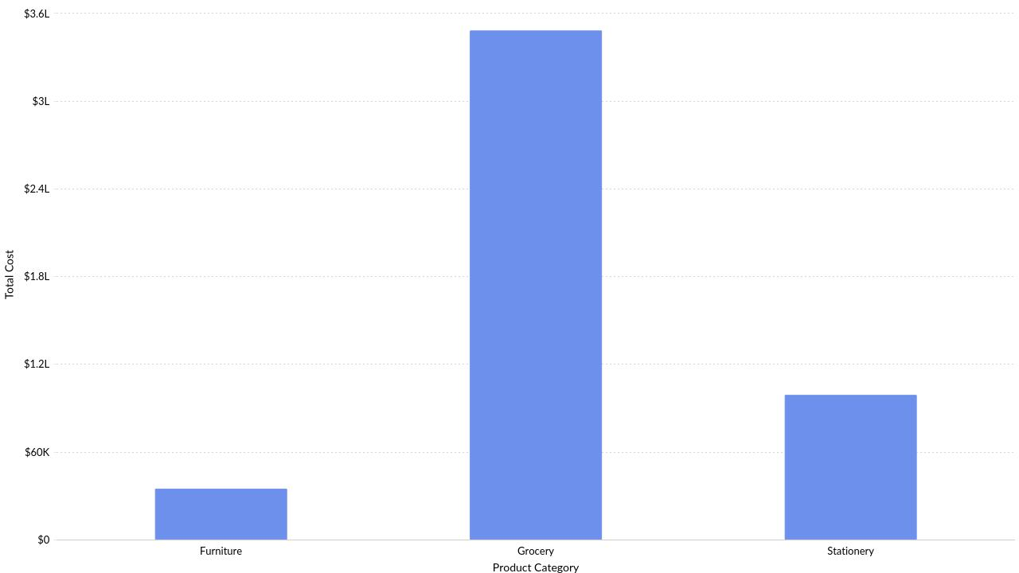
Product Category-wise Cost
Powered By

Slide 5
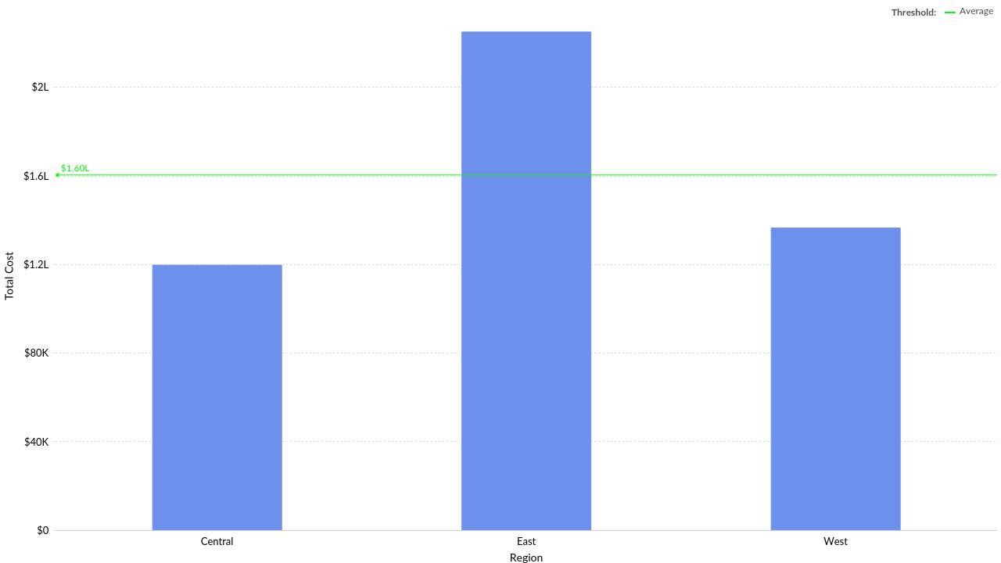
Region-wise Cost
Powered By

Slide 6
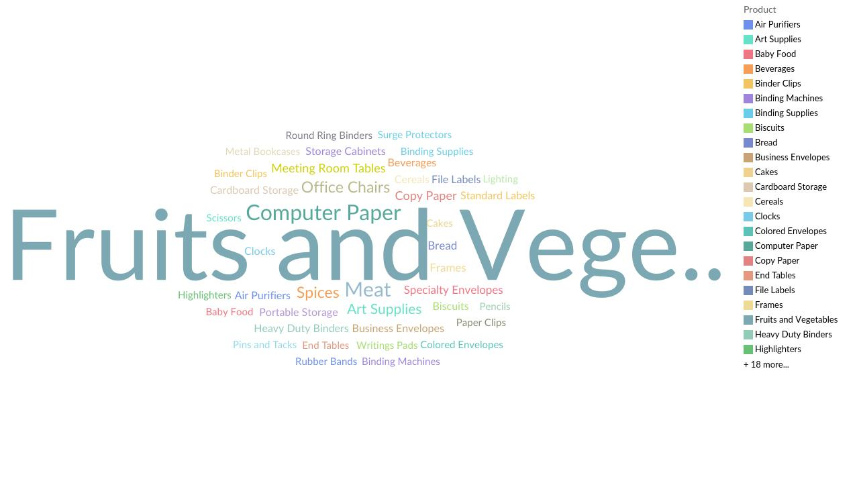
Product-wise Cost
Powered By

Slide 7
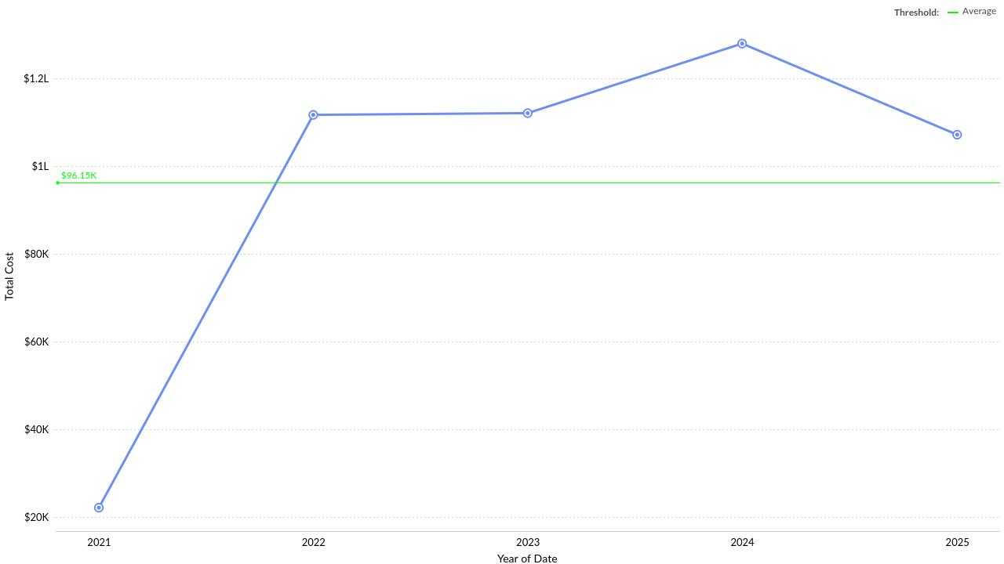
Cost Across Years(Date)
Powered By

Slide 8
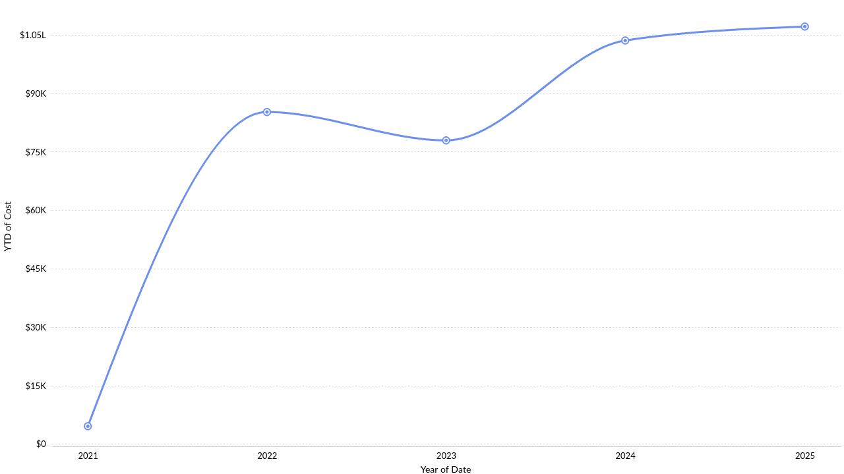
Year to Date(YTD) Cost by each Year(Date)
Powered By

Slide 9
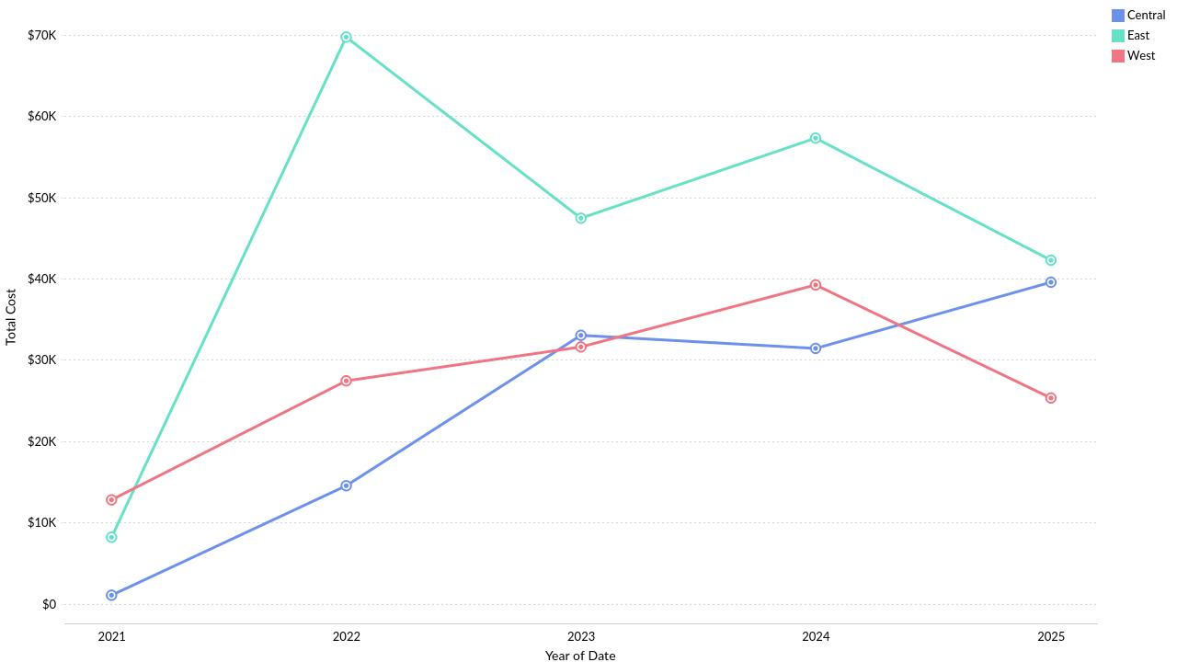
Cost Across Years(Date) by Region
Powered By

Slide 10
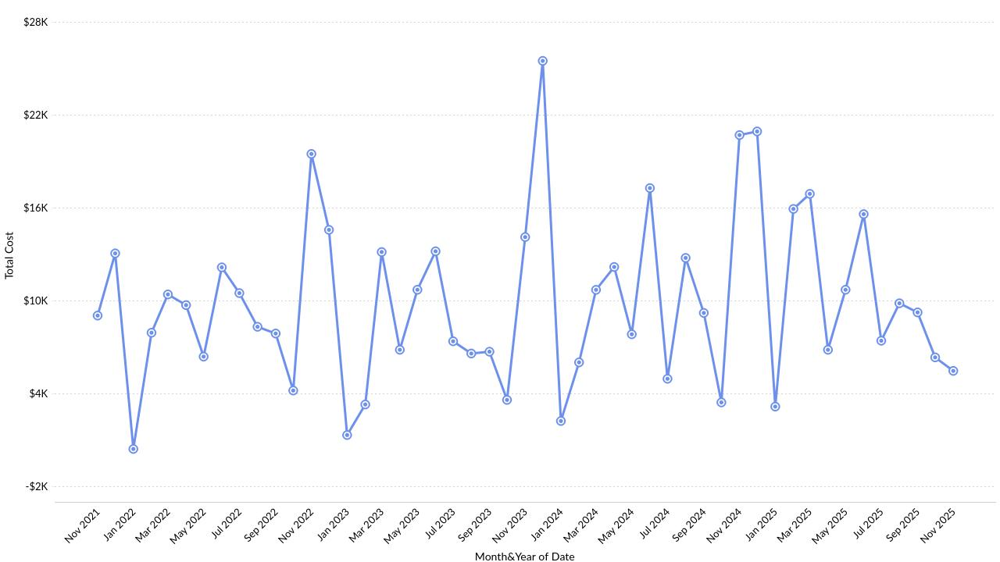
Cost showing Anomaly across Months
Powered By

Slide 11
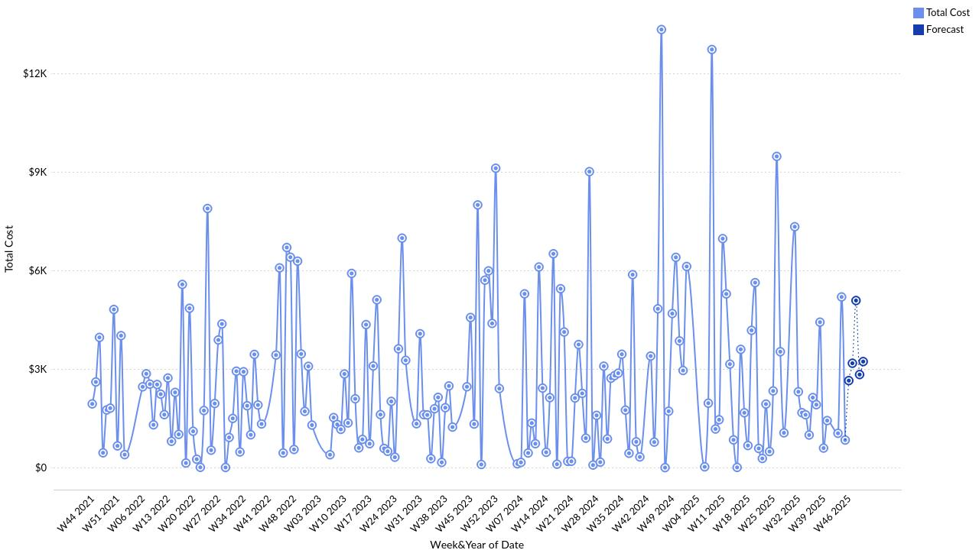
Cost across Weeks with Forecast
Powered By

Slide 12
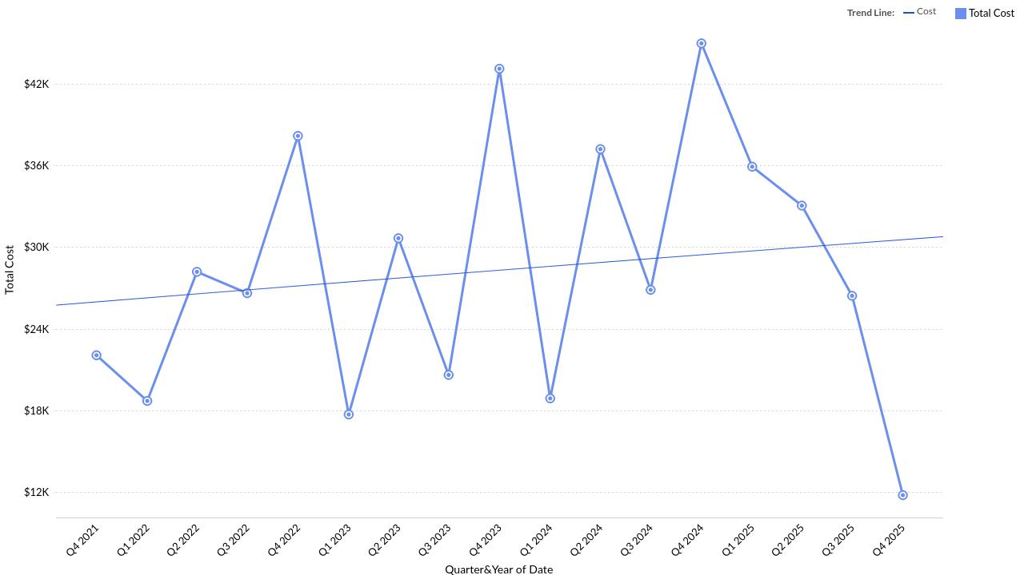
Cost Trend (based on Date)
Powered By

Slide 13
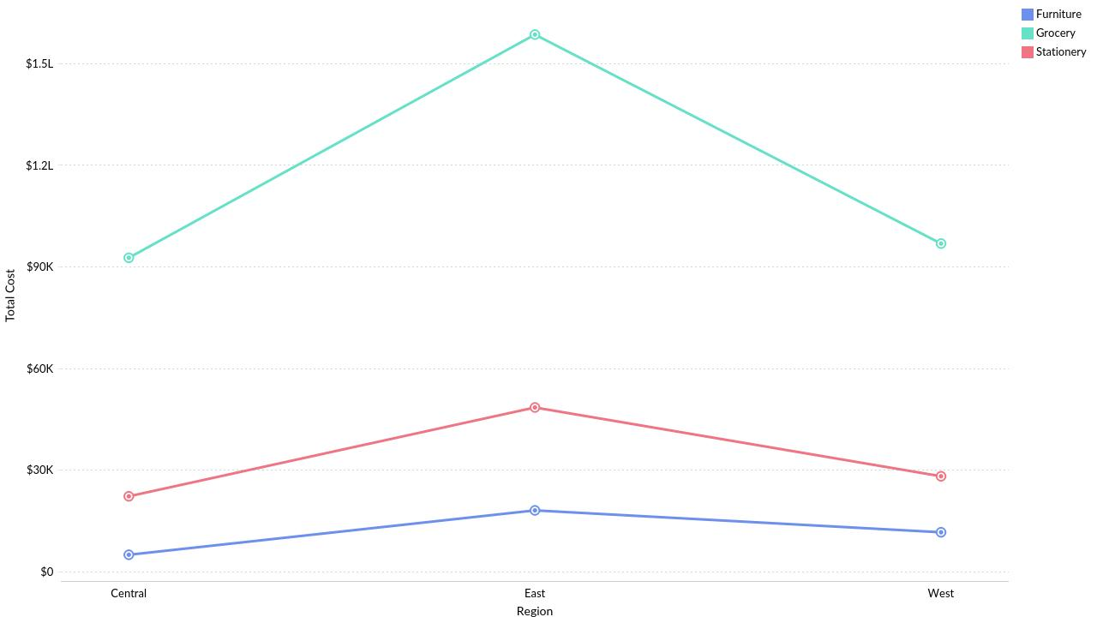
Region-wise Cost by Product Category
Powered By

Slide 14
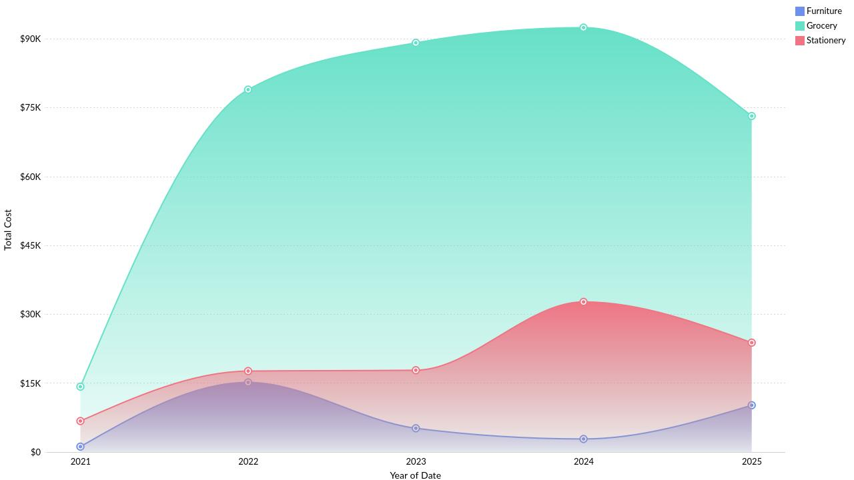
Cost Across Years(Date) by Product Category
Powered By

Slide 15
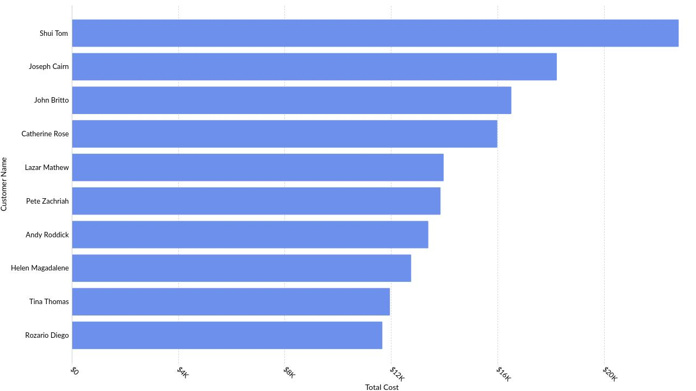
Top 10 Customer Name by Cost
Powered By

Slide 16
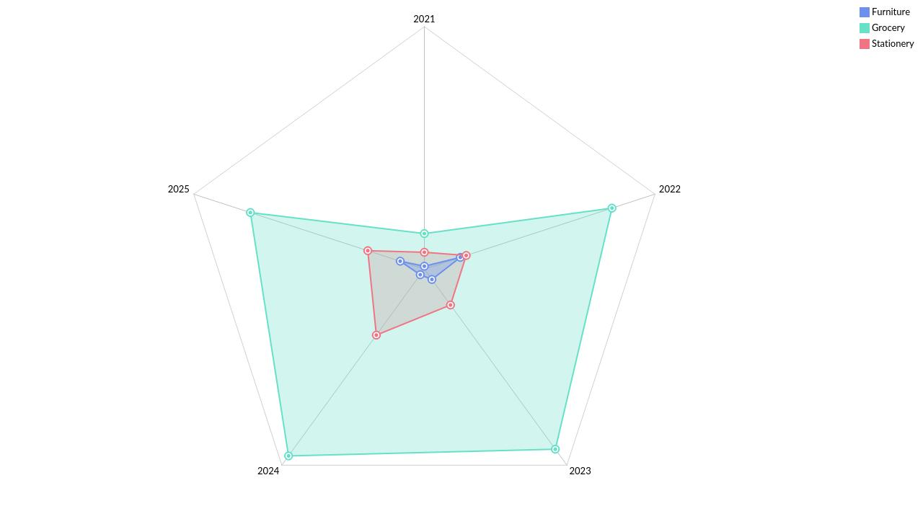
Date-wise Cost by Product Category
Powered By

Slide 17
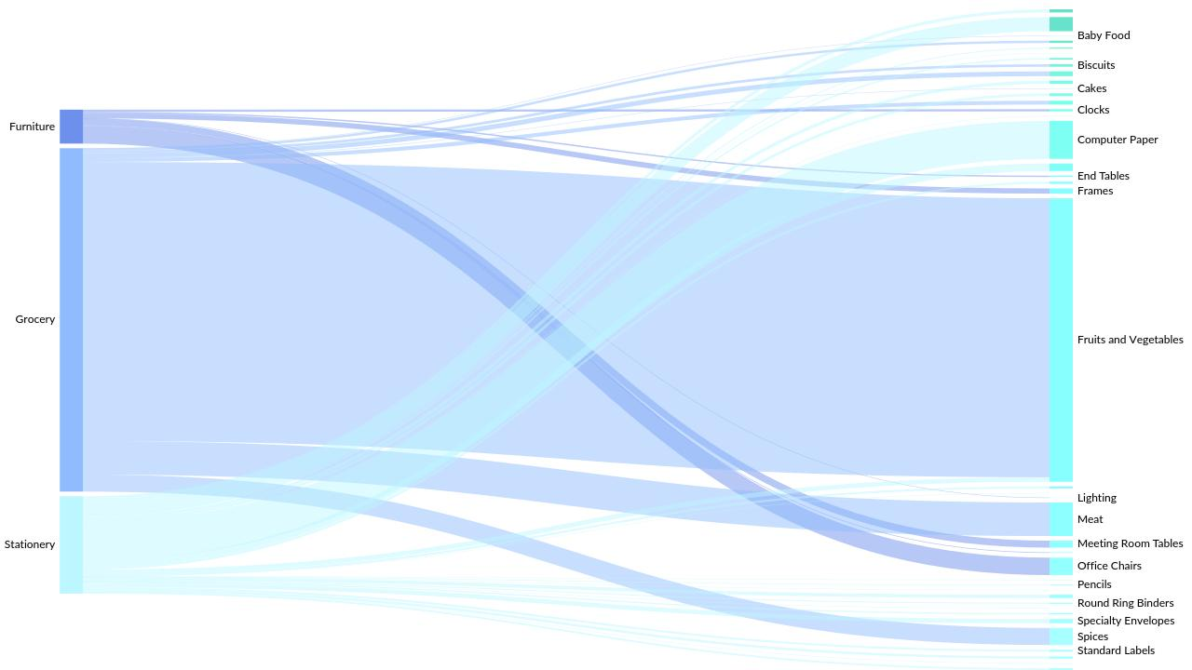
Product & Product Category Contribution to Cost
Powered By

Slide 18
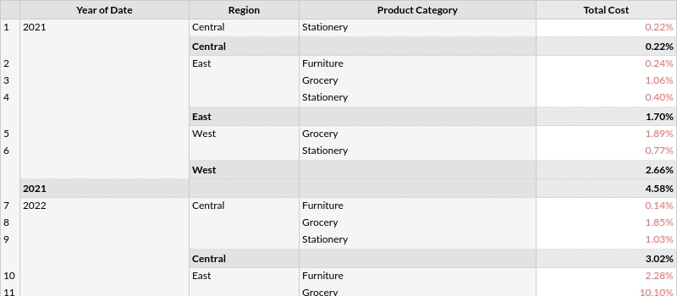
Cost distribution across Years and Region by Product Category
Powered By

Slide 19
Thank you
Powered By

