Slide 1
Rajashekar
Introduction to Design Patterns
Complete Traversal
Chandra Shekar

Slide 2
Agenda
Introduction to Design Patterns.
Why Design patterns?.
3 Different categories of Design Patterns.
Understanding different Design Patterns under each category.
Case Study.

Slide 3
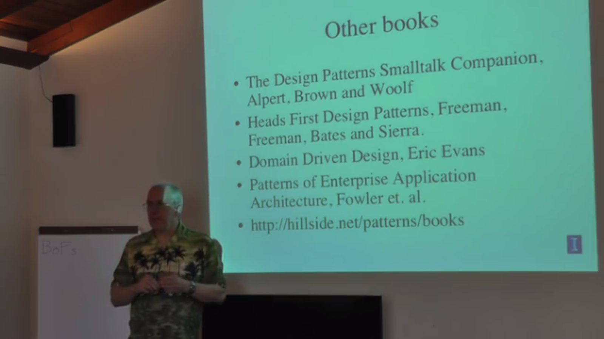
Design Pattern Bibles……..

Slide 4
What is Design Pattern?
Design patterns are generic solutions to common problems encountered during the Object Oriented Software Design.
“An idea that has been useful in one practical context and will probably be useful in others.”
[ MARTIN FOWLER “Analysis Patterns” – 1997]

Slide 5
Design Patterns
Concept of patterns can be applied in various levels of Software Projects.
Design / Code Patterns.
Analysis / Model Patterns.
Architecture Patterns / Architecture styles.
Notes:
Three levels
Design Level - Stage– Code Levels : DESIGN PATTERNS
Analysis Level – Stage – Modelling : UML Modelling /Flow Charts / DFDs
Architecture Level – Stage – Architecture Styles (Resource Oriented/Object Oriented/Service Oriented)

Slide 6
Design / Code Patterns
Lowest level of Patterns in software.
Based around a reusable chunk of code to solve a particular problem.
Typically implemented through source code templates and/or code generation.
Provides a “template” for implementing a system function but requiring elaboration to complete.

Slide 7
Analysis / Model Patterns.
Reusable Object models (for eg. UML).
Typically implemented through UML model templates or perhaps meta – models.
Usually used to represent the systems.
Provides a template for a group of related system functions but usually within a specific domain (For eg. Finance).

Slide 8
Architecture Patterns / Architecture Styles
Reusable system structures , inter - connections and their Interactions.
Typically implemented through Architecture standard and policies.
Provides a “template” for subsystem structure and communication between subsystems.

Slide 9
Design Pattern Categories
Design patterns are broadly classified under the following 3 categories.
Creational
Structural
Behavioral

Slide 10
Design Pattern Categories
Creational : All design patterns under this category focus on Object creation in different ways.
Structural :The design patterns under this category mainly focus on the structure of the subsystems.
Behavioral: The patterns under this category focus on the interactions among the modules or the components .

Slide 11
Design Pattern Categories
Creational : Creational design patterns are very useful in situations where one needs to create objects that are very efficient .
They enable one to create objects in a manner that the memory can be utilized in an efficient way.
Objects thus created are utilized by the modules effectively and efficiently.

Slide 12
Creational Patterns
Following are the patterns which fall under the category of the Creational Design Patterns.
Singleton
Factory
Factory Method
Abstract Factory
Builder
Prototype
Object Pool

Slide 13
Creational Design Patterns – Factory
This pattern enables one to create the objects without exposing the instantiation logic to the client.
Also enables one to refer the newly created object through a common interface.

Slide 14
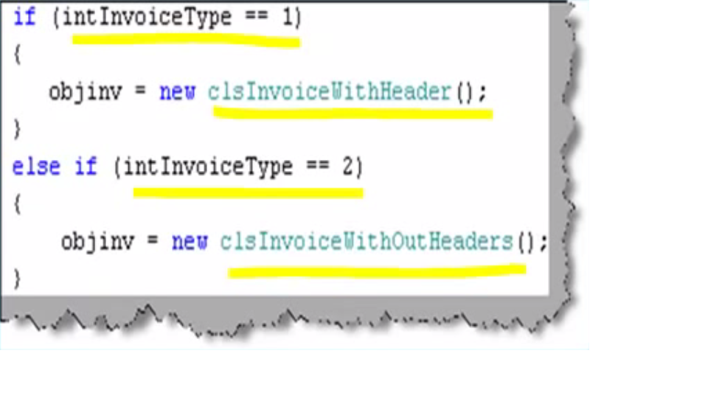
Traditional way……..

Slide 15
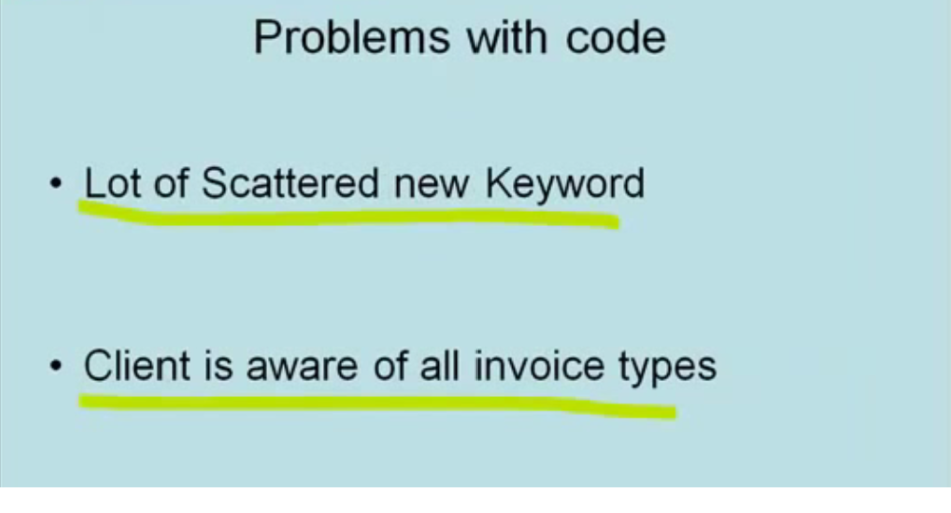
Traditional way….

Slide 16
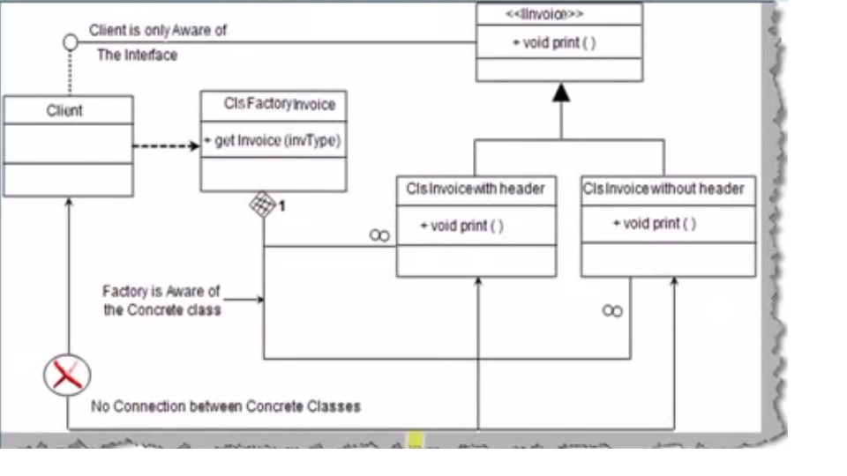
Clean rather Decent way……..

Slide 17
Creational Design Patterns – Factory
Implementation of this pattern is real simple.
Client asks the factory object when it needs an object informing about the type it needs.
Factory instantiates a new concrete product and then returns the newly created product (casted to abstract product class).
Client uses the abstract product without getting into the details of the concrete implementation.
Notes:
The Factory Design Pattern is probably the most used design pattern in modern programming languages like Java and C#. It comes in different variants and implementations. If you are searching for it, most likely, you'll find references about the GoF patterns: Factory Method and Abstract Factory.
In this article we'll describe a flavor of factory pattern commonly used nowadays. You can also check the original Factory Method pattern which is very similar.

Slide 18
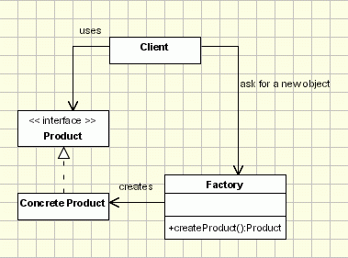
Creational Design Patterns – Factory
Notes:
The Factory Design Pattern is probably the most used design pattern in modern programming languages like Java and C#. It comes in different variants and implementations. If you are searching for it, most likely, you'll find references about the GoF patterns: Factory Method and Abstract Factory.
In this article we'll describe a flavor of factory pattern commonly used nowadays. You can also check the original Factory Method pattern which is very similar.

Slide 19
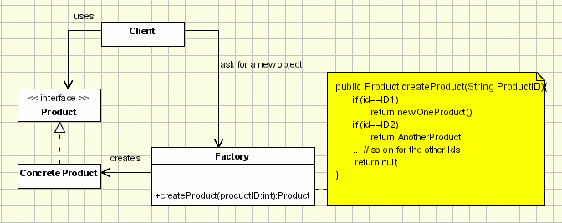
Creational Design Patterns – Factory - Applicability
Procedural Solution – noob instantiation
Notes:
Those are also known as parameterized Factories. The generating method can be written so that it can generate more types of Product objects, using a condition (entered as a method parameter or read from some global configuration parameters - see abstract factory pattern) to identify the type of the object that should be created, as below: public class ProductFactory{ public Product createProduct(String ProductID){ if (id==ID1) return new OneProduct(); if (id==ID2) return return new AnotherProduct(); ... // so on for the other Ids return null; //if the id doesn't have any of the expected values } ... } This implementation is the most simple and intuitive (Let's call it noob implementation). The problem here is that once we add a new concrete product call we should modify the Factory class. It is not very flexible and it violates open close principle. Of course we can subclass the factory class, but let's not forget that the factory class is usually used as a singleton. Subclassing it means replacing all the factory class references everywhere through the code.

Slide 20
Creational Design Patterns – Factory - Applicability
Class registration – using Reflection.
Class registration – avoiding Reflection.
Notes:
Ref this link http://www.oodesign.com/factory-pattern.html for more info.

Slide 21
DEMO

Slide 22
Creational Design Patterns – Abstract Factory
“Abstract Factory” is a super factory , which helps in creating other factories.
It provides an interface for creating a family of related objects without explicitly specifying their classes.

Slide 23
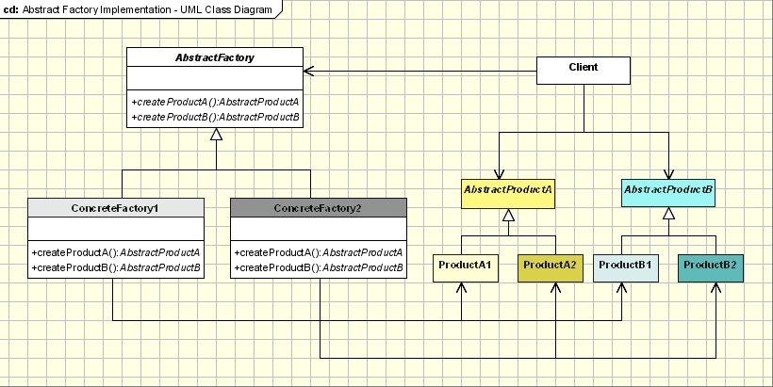
Creational Design Patterns – Abstract Factory
Implementation:

Slide 24
Creational Design Patterns – Abstract Factory
The system needs to be independent from the way the products it works with are created.
The system is or should be configured to work with multiple families of products.
A family of products is designed to work only all together.
The creation of a library of products is needed, for which only the interface is relevant , not the implementation, too.
When to use?.

Slide 25
Creational Design Patterns – Abstract Factory
Applicability & examples:
Phone Number example.
Pizza Factory example.
Look & Feel example.
Notes:
Phone Number Example
The example at the beginning of the article can be extended to addresses, too. The AbstractFactory class will contain methods for creating a new entry in the information manager for a phone number and for an address, methods that produce the abstract products Address and PhoneNumber, which belong to AbstractProduct classes. The AbstractProduct classes will define methods that these products support: for the address get and set methods for the street, city, region and postal code members and for the phone number get and set methods for the number.
The ConcreteFactory and ConcreteProduct classes will implement the interfaces defined above and will appear in our example in the form of the USAddressFactory class and the USAddress and USPhoneNumber classes. For each new country that needs to be added to the application, a new set of concrete-type classes will be added. This way we can have the EnglandAddressFactory and the EnglandAddress and EnglandPhoneNumber that are files for English address information.
Pizza Factory Example
Another example, this time more simple and easier to understand, is the one of a pizza factory, which defines method names and returns types to make different kinds of pizza. The abstract factory can be named AbstractPizzaFactory, RomeConcretePizzaFactory and MilanConcretePizzaFactory being two extensions of the abstract class. The abstract factory will define types of toppings for pizza, like pepperoni, sausage or anchovy, and the concrete factories will implement only a set of the toppings, which are specific for the area and even if one topping is implemented in both concrete factories, the resulting pizzas will be different subclasses, each for the area it was implemented in.
Look & Feel Example
Look & Feel Abstract Factory is the most common example. For example, a GUI framework should support several look and feel themes, such as Motif and Windows look. Each style defines different looks and behaviors for each type of controls: Buttons and Edit Boxes. In order to avoid the hardociding it for each type of control we define an abstract class LookAndFeel. This calls will instantiate, depending on a configuration parameter in the application one of the concrete factories: WindowsLookAndFeel or MotifLookAndFeel. Each request for a new object will be delegated to the instatiated concrete factory which will return the controls with the specific flavor

Slide 26
Creational Design Patterns – Abstract Factory
Issues faced in this pattern and How they can be handled: ( wrt the Example)
Factories as singletons
Creating Products
Extending the factories.
Notes:
Factories as singletons
An application usually needs only one instance of the ConcreteFactory class per family product. This means that it is best to implement it as a Singleton.
Creating the products
The AbstractFactory class only declares the interface for creating the products. It is the task of the ConcreteProduct class to actually create the products. For each family the best idea is applying the Factory Method design pattern. A concrete factory will specify its products by overriding the factory method for each of them. Even if the implementation might seem simple, using this idea will mean defining a new concrete factory subclass for each product family, even if the classes are similar in most aspects.
For simplifying the code and increase the performance the Prototype design pattern can be used instead of Factory Method, especially when there are many product families. In this case the concrete factory is initiated with a prototypical instance of each product in the family and when a new one is needed instead of creating it, the existing prototype is cloned. This approach eliminates the need for a new concrete factory for each new family of products.
Extending the factories
The operation of changing a factory in order for it to support the creation of new products is not easy. What can be done to solve this problem is, instead of a CreateProduct method for each product, to use a single Create method that takes a parameter that identifies the type of product needed. This approach is more flexible, but less secure. The problem is that all the objects returned by the Create method will have the same interface, that is the one corresponding to the type returned by the Create method and the client will not always be able to correctly detect to which class the instance actually belongs.
Hot Points:
AbstractFactory class declares only an interface for creating the products. The actual creation is the task of the ConcreteProduct classes, where a good approach is applying the Factory Method design pattern for each product of the family.
Extending factories can be done by using one Create method for all products and attaching information about the type of product needed.

Slide 27
DEMO

Slide 28
Creational Design Patterns – Builder Pattern
This pattern enables one to construct a complex object by specifying only its type and content being shielded from the details related to the object’s representation.

Slide 29
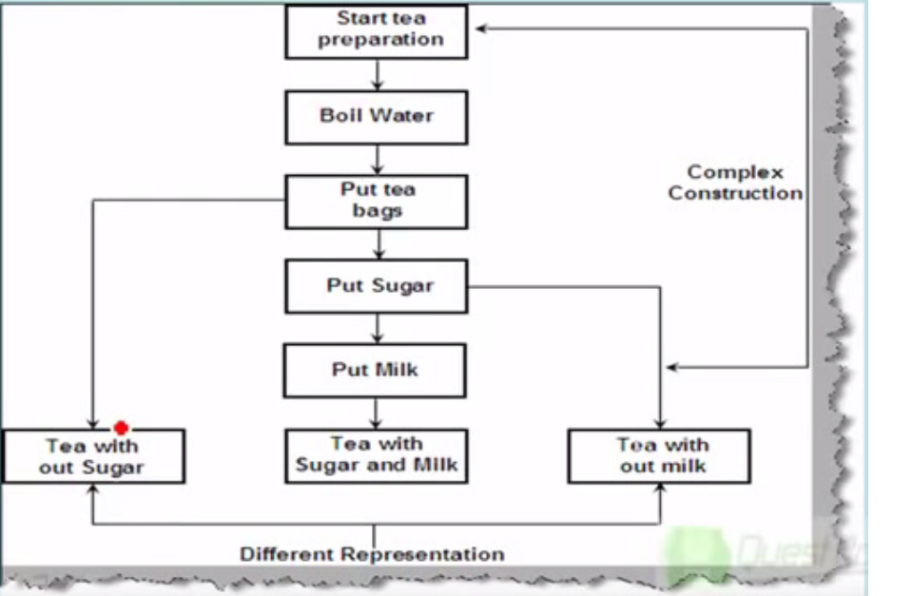
Scenario 1……

Slide 30
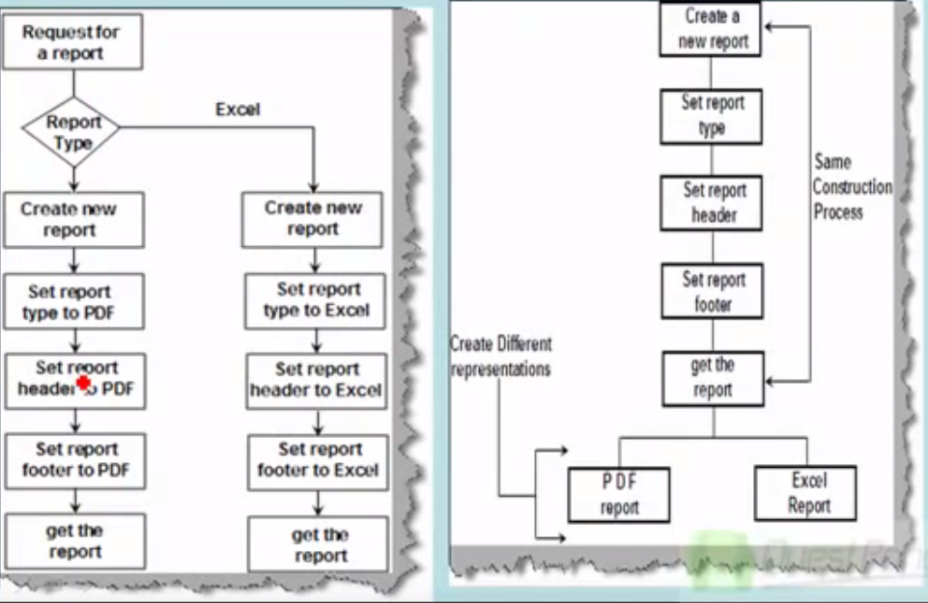
Scenario 2

Slide 31
Creational Design Patterns – Builder Pattern
This pattern helps in creating an object but letting the subclasses decide which class to instantiate.
Refers to the newly created object through a common interface.

Slide 32
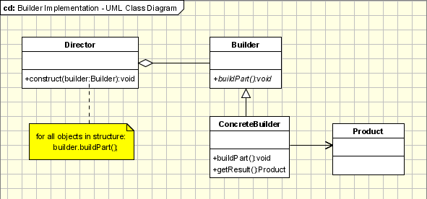
Creational Design Patterns – Builder Pattern
Implementation:

Slide 33
Creational Design Patterns – Builder Pattern
The participants classes in this pattern are:
The Builder class specifies an abstract interface for creating parts of a Product object.
The Concrete Builder constructs and puts together parts of the product by implementing the Builder interface. It defines and keeps track of the representation it creates and provides an interface for saving the product.
The Director class constructs the complex object using the Builder interface.
The Product represents the complex object that is being built.
Notes:
The client, that may be either another object or the actual client that calls the main() method of the application, initiates the Builder and Director class. The Builder represents the complex object that needs to be built in terms of simpler objects and types. The constructor in the Director class receives a Builder object as a parameter from the Client and is responsible for calling the appropriate methods of the Builder class. In order to provide the Client with an interface for all concrete Builders, the Builder class should be an abstract one. This way you can add new types of complex objects by only defining the structure and reusing the logic for the actual construction process. The Client is the only one that needs to know about the new types, the Director needing to know which methods of the Builder to call.

Slide 34
Creational Design Patterns – Builder Pattern
Applicability & Examples:
Vehicles Manufacturer
Student Exams
Notes:
Example 1 - Vehicle Manufacturer.
Let us take the case of a vehicle manufacturer that, from a set of parts, can build a car, a bicycle, a motorcycle or a scooter. In this case the Builder will become the VehicleBuilder. It specifies the interface for building any of the vehicles in the list above, using the same set of parts and a different set of rules for every type of type of vehicle. The ConcreteBuilders will be the builders attached to each of the objects that are being under construction. The Product is of course the vehicle that is being constructed and the Director is the manufacturer and its shop.
Example 1 - Students Exams.
If we have an application that can be used by the students of a University to provide them with the list of their grades for their exams, this application needs to run in different ways depending on the user that is using it, user that has to log in. This means that, for example, the admin needs to have some buttons enabled, buttons that needs to be disabled for the student, the common user. The Builder provides the interface for building form depending on the login information. The ConcreteBuilders are the specific forms for each type of user. The Product is the final form that the application will use in the given case and the Director is the application that, based on the login information, needs a specific form.

Slide 35
Creational Design Patterns – Builder Pattern
Builder and Abstract Factory
The Builder design pattern is very similar, at some extent, to the Abstract Factory pattern.
In the case of the Abstract Factory, the client uses the factory’s methods to create its own objects.
In the Builder’s case, the Builder class is instructed on how to create the object and then it is asked for it.
But the way that the class is put together is up to the Builder class, this detail makes the difference between the two patterns.

Slide 36
DEMO

Slide 37
Creational Design Patterns – Prototype Pattern
Prototype allows an object to create customized objects without knowing the class or any details of how to create them.
It sounds to be very much like a “Factory Method” pattern, but the difference being for “Factory” the palette of prototypical objects never contains more than one object.

Slide 38
Creational Design Patterns – Prototype Pattern
Implementation:
Specifying the kind of objects to create using a prototypical instance.
Creating new objects by copying this prototype

Slide 39
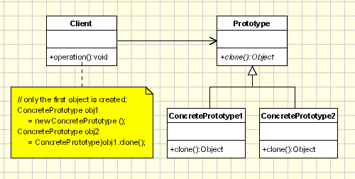
Creational Design Patterns – Prototype Pattern
Implementation:

Slide 40
Creational Design Patterns – Prototype Pattern
Implementation:
The classes participating to the Prototype Pattern are:
Client - creates a new object by asking a prototype to clone itself.
Prototype - declares an interface for cloning itself.
Concrete Prototype - implements the operation for cloning itself.

Slide 41
Creational Design Patterns – Prototype Pattern
Applicability & Examples:
Use Prototype Pattern when a system should be independent of how its products are created, composed, and represented, and:
Classes to be instantiated are specified at run-time
Avoiding the creation of a factory hierarchy is needed
It is more convenient to copy an existing instance than to create a new one.

Slide 42
Creational Design Patterns – Prototype Pattern
Examples:
1) CreateMaze.
2) Sales Analysis.
Notes:
Example 1
In building stages for a game that uses a maze and different visual objects that the character encounters it is needed a quick method of generating the haze map using the same objects: wall, door, passage, room... The Prototype pattern is useful in this case because instead of hard coding (using new operation) the room, door, passage and wall objects that get instantiated, CreateMaze method will be parameterized by various prototypical room, door, wall and passage objects, so the composition of the map can be easily changed by replacing the prototypical objects with different ones.
The Client is the CreateMaze method and the ConcretePrototype classes will be the ones creating copies for different objects.
Example 2:
Suppose we are doing a sales analysis on a set of data from a database. Normally, we would copy the information from the database, encapsulate it into an object and do the analysis. But if another analysis is needed on the same set of data, reading the database again and creating a new object is not the best idea. If we are using the Prototype pattern then the object used in the first analysis will be cloned and used for the other analysis.
The Client is here one of the methods that process an object that encapsulates information from the database. The ConcretePrototype classes will be classes that, from the object created after extracting data from the database, will copy it into objects used for analysis.

Slide 43
Creational Design Patterns – Prototype Pattern
Points to remember:
Prototype Manager – implemented usually as a hashtable keeping the object to clone. When using it, prototype become a factory method which uses cloning instead of instantiation.
Deep Clones vs. Shallow Clones – when we clone complex objects which contains other objects, we should take care how they are cloned. We can clone contained objects also (deep cloning) or we can the same reference for them, and to share them between cloned container objects.
Initializing Internal States – there are certain situations when objects need to be initialized after they are created.
Notes:
Using a prototype manager
When the application uses a lot of prototypes that can be created and destroyed dynamically, a registry of available prototypes should be kept. This registry is called the prototype manager and it should implement operations for managing registered prototypes like registering a prototype under a certain key, searching for a prototype with a given key, removing one from the register, etc. The clients will use the interface of the prototype manager to handle prototypes at run-time and will ask for permission before using the Clone() method.
There is not much difference between an implementation of a prototype which uses a prototype manager and a factory method implemented using class registration mechanism. Maybe the only difference consists in the performance.
Implementing the Clone operation
A small discussion appears when talking about how deep or shallow a clone should be: a deep clone clones the instance variables in the cloning object while a shallow clone shares the instance variables between the clone and the original. Usually, a shallow clone is enough and very simple, but cloning complex prototypes should use deep clones so the clone and the original are independent, a deep clone needing its components to be the clones of the complex object’s components.
Initializing clones
There are cases when the internal states of a clone should be initialized after it is created. This happens because these values cannot be passed to the Clone() method, that uses an interface which would be destroyed if such parameters were used. In this case the initialization should be done by using setting and resetting operations of the prototype class or by using an initializing method that takes as parameters the values at which the clone’s internal states should be set.

Slide 44
DEMO

Slide 45
CASE STUDY 01
Customer Management System.
Project Management System.
Library Management System.

Slide 46
Notes:
We’re going to start by talking about the code quality attributes that are clients experience.

