Slide 1
Rajashekar
Introduction to Design Patterns
Complete Traversal
Chandra Shekar

Slide 2
Agenda
Behavioral Design Patterns.

Slide 3
Behavioral Patterns
Following are the patterns which fall under the category of the Behavioral Design Patterns.
Chain Of Responsibility.
Command
Interpreter
Iterator
Mediator
Memento
Observer
Strategy
Template
Visitor
Null Object

Slide 4
Behavioral Design Pattern – Chain Of Responsibility
The Chain of Responsibility design pattern allows an object to send a command without knowing what object will receive and handle it.
The request is sent from one object to another making them parts of a chain and each object in this chain can handle the command, pass it on or do both.
Notes:
The Chain of Responsibility design pattern allows an object to send a command without knowing what object will receive and handle it. The request is sent from one object to another making them parts of a chain and each object in this chain can handle the command, pass it on or do both. The most usual example of a machine using the Chain of Responsibility is the vending machine coin slot: rather than having a slot for each type of coin, the machine has only one slot for all of them. The dropped coin is routed to the appropriate storage place that is determined by the receiver of the command.

Slide 5
Behavioral Design Pattern – Chain Of Responsibility
It avoids attaching the sender of a request to its receiver, giving this way other objects the possibility of handling the request too.
The objects become parts of a chain and the request is sent from one object to another across the chain until one of the objects will handle it.

Slide 6
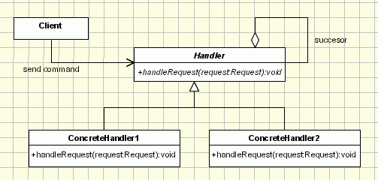
Behavioral Design Pattern – Chain Of Responsibility
Implementation:

Slide 7
Behavioral Design Pattern – Chain Of Responsibility
Implementation:
Handler - defines an interface for handling requests RequestHandler - handles the requests it is responsible for If it can handle the request it does so, otherwise it sends the request to its successor
Client - sends commands to the first object in the chain that may handle the command

Slide 8
Behavioral Design Pattern – Chain Of Responsibility
When to use “Chain of Responsibility”
More than one object can handle a command
The handler is not known in advance.
The handler should be determined automatically

Slide 9
Behavioral Design Pattern – Chain Of Responsibility
When to use “Chain of Responsibility”
It’s wished that the request is addressed to a group of objects without explicitly specifying its receiver
The group of objects that may handle the command must be specified in a dynamic way

Slide 10
Behavioral Design Pattern – Chain Of Responsibility
Applicability & Examples:
Purchase Request System.
GUI System.
Shipping System.
Notes:
Example 1
In designing the software for a system that approves the purchasing requests.
In this case, the values of purchase are divided into categories, each having its own approval authority. The approval authority for a given value could change at any time and the system should be flexible enough to handle the situation.
The Client in the example above is the system in need of the answer to the approval. It sends a request about it to an purchase approval authority. Depending on the value of the purchase, this authority may approve the request or forward it to the next authority in the chain.
For example let’s say a request is placed for the purchase of a new keyboard for an office. The value of the purchase is not that big, so the request is sent from the head of the office to the head of the department and then to the materials department where it stops, being handled locally. But if equipment for the whole department is needed then the request goes form the head of the department, to materials department, to the purchase office and even to the manager if the value is too big.
Example 2
In designing the software that uses a set of GUI classes where it is needed to propagate GUI events from one object to another.
When an event, such as the pressing of a key or the click of the mouse, the event is needed to be sent to the object that has generated it and also to the object or objects that will handle it.
The Client is, of course, the object that has generated the event, the request is the event and the handlers are the objects that can handle it. So, if we have a handler for the click of the mouse, a handler for the pressing of the ‘Enter’ key and a handler for the pressing of the ‘Delete’ key, that is the chain of handlers that take care of the events that are generated.
Example 3
In designing a shipping system for electronic orders.
The steps to complete and handle the order differs form one order to another based on the customer, the size of the order, the way of shipment, destination and more other reasons. The business logic changes also as special cases appear, needing the system to be able to handle all cases.
The Client, the electronic order in process, requests shipping based on a set of pieces of information. Its request is turned by the system into a specific form, combining the steps to completing and the details of handling, based on the input information. The system will send this type of request through a chain of order-handlers until the input information that it comes with matches the input the order-handles takes. When special cases appear, all that is needed is a new handler to be added in the chain.

Slide 11
Behavioral Design Pattern – Chain Of Responsibility
Problems and Resolutions:
Representing Requests.
Unhandled Requests.
Broken Chain.
.
Notes:
Representing requests
In real life each handler represents a system. And each system can handle specific requests or requests common to more handlers. We should take this issue in consideration when we implement this pattern. In the classical samples of the CoR found on the net you can see that the request is generally represented by an integer. Of course in real life we can not use primary data types as a request.
A clever design should be a flexible one. The best solution here is to create an interface a super class Request (or and interface) where to the default behavior. Then if we need to add a new handler and a specific request all we need is to extend the Request base class.
Of course this is not the only approach. Let’s consider the shipping system example. Each request will have to contain a large amount of data. Creating request examples for this might be difficult. We can take some xml objects containing the data, generated during the application flow (let’s assume we already have the code implemented for that) and pass them to each handler.
Or since the data was already saved in the database (let’s assume that also) we can pass only the id’s of the involved objects and then each handler will take the data required from db.
Unhandled requests Unfortunately, the Chain doesn't guarantee that every command is handled, which makes the problem worse, since unhandled commands propagate through the full length of the chain, slowing down the application. One way to solve this is by checking if, at the end of the chain, the request has been handled at least once, otherwise we will have to implement handlers for all the possible requests that may appear.
Broken Chain
Sometimes we could forget to include in the implementation of the handleRequest method the call to the successor, causing a break in the chain. The request isn’t sent forward from the broken link and so it ends up unhandled. A variation of the pattern can be made to send the request to all the handlers by removing the condition from the handler and always calling the successor.
The following implementation eliminates the Broken Chain problem. The implementation moves the code to traverse the chain into the base class keeping the request handling in a different method in the subclasses. The handleRequest method is declared as final in the base class and is responsible to traverse the chain. Each Handler have to implement the handleRequestImpl method, declared as abstract in the super class.

Slide 12
Behavioral Design Pattern – Chain Of Responsibility
Points to remember:
The fundamental flaw of the pattern is the fact that it gets easily broken:
When implementing the CoR pattern a special care should be taken for the request representation.
Unhandled Requests
Notes:
The fundamental flaw of the pattern is the fact that it gets easily broken: if the programmer forgets to call the next handler in the concreteHandler the request gets lost on the way. This problem comes from the fact that the execution is not handled entirely by the superclass and the call is triggered in the superclass. When implementing the CoR pattern a special care should be taken for the request representation. The request is not considered a distinctive part of the CoR pattern, but it is still used in all the components of the pattern. Another flaw of the Chain of Responsibility is the fact that some requests may end up unhandled due to the wrong implementation of concrete handler, their propagation slowing down the rest of the application. This means that extra care is needed when taking into account the requests that may appear in the process.

Slide 13
Demo

Slide 14
Behavioral Design Pattern – Command Pattern
Command design pattern encapsulates commands (method calls) in objects allowing us to issue requests without knowing the requested operation or the requesting object.
Command design pattern provides the options to queue commands, undo/redo actions and other manipulations.
Notes:
“An object that contains a symbol, name or key that represents a list of commands, actions or keystrokes”. This is the definition of a macro, one that should be familiar to any computer user. From this idea the Command design pattern was given birth. The Macro represents, at some extent, a command that is built from the reunion of a set of other commands, in a given order. Just as a macro, the Command design pattern encapsulates commands (method calls) in objects allowing us to issue requests without knowing the requested operation or the requesting object. Command design pattern provides the options to queue commands, undo/redo actions and other manipulations.

Slide 15
Behavioral Design Pattern – Command Pattern
Objective:
- encapsulate a request in an object - allows the parameterization of clients with different requests - allows saving the requests in a queue

Slide 16
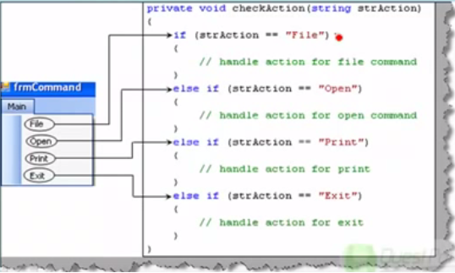
Traditional way……

Slide 17
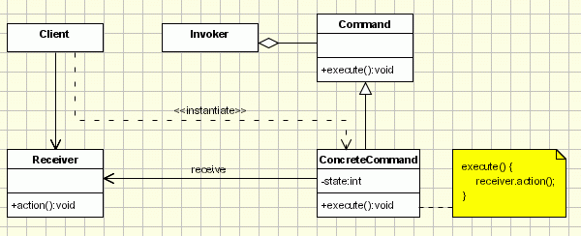
Behavioral Design Pattern – Command Pattern
Implementation:

Slide 18
Behavioral Design Pattern – Command Pattern
Implementation:
Command - declares an interface for executing an operation;
- ConcreteCommand - extends the Command interface, implementing the Execute method by invoking the corresponding operations on Receiver
Client - creates a ConcreteCommand object and sets its receiver;
Invoker - asks the command to carry out the request;
Receiver - knows how to perform the operations;
Notes:
The classes participating in the pattern are: - Command - declares an interface for executing an operation; - Concrete Command - extends the Command interface, implementing the Execute method by invoking the corresponding operations on Receiver. It defines a link between the Receiver and the action. - Client - creates a Concrete Command object and sets its receiver; - Invoker - asks the command to carry out the request; - Receiver - knows how to perform the operations;

Slide 19
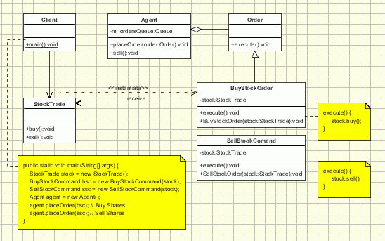
Behavioral Design Pattern – Command Pattern
Applicability & Examples:
Stock Order Management System.
Notes:
The Client asks for a command to be executed. The Invoker takes the command, encapsulates it and places it in a queue, in case there is something else to do first, and the ConcreteCommand that is in charge of the requested command, sending its result to the Receiver. Here is a sample code of a classic implementation of this pattern for placing orders for buying and selling stocks:
The client creates some orders for buying and selling stocks (Concrete Commands). Then the orders are sent to the agent (Invoker).The agent takes the orders and place them to the Stock Trade system (Receiver). The agent keeps an internal queue with the order to be placed. Let's assume that the Stock Trade system is closed each Monday, but the agent accepts orders, and queue them to be processed later on

Slide 20
Behavioral Design Pattern – Command Pattern
Applicability & Examples:
Calculator Application.
Notes:
Let's consider a calculator application. The application represents the Client. The calculator (Receiver) class is the main class used in the application to perform the commands. This might be as well the document class if we have a text editor application and we want to implement operations like copy/paste/etc.... When the application has to perform a command it creates the command and sent it to the invoker. The invoker calls the execute method of the command and adds it to a list containing all the commands. The execute method of the command delegate the call to the Calculator object. When undo operations are performed the invoker uses the list with all executed commands and calls for each one the unexecuted method. The redo operation works in the same manner.

Slide 21
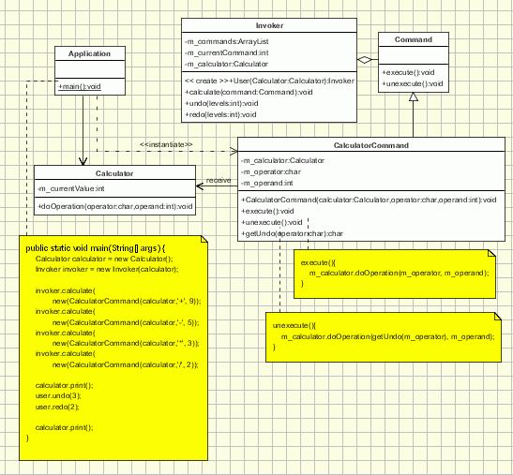

Slide 22
Behavioral Design Pattern – Command Pattern
Applicability & Examples:
Meal Order management System.
Notes:
The example of the meal order at a restaurant is a very good one when trying to explain better how the pattern works: The waiter (Invoker) takes the order from the customer on his pad. The order is then queued for the order cook and gets to the cook (Receiver) where it is processed.
In this case the actors in the scenario are the following: The Client is the customer. He sends his request to the receiver through the waiter, who is the Invoker. The waiter encapsulates the command (the order in this case) by writing it on the check and then places it, creating the ConcreteCommand object which is the command itself. The Receiver will be the cook that, after completing work on all the orders that were sent to him before the command in question, starts work on it. Another noticeable aspect of the example is the fact that the pad for the orders does not support only orders from the menu, so it can support commands to cook many different items.

Slide 23
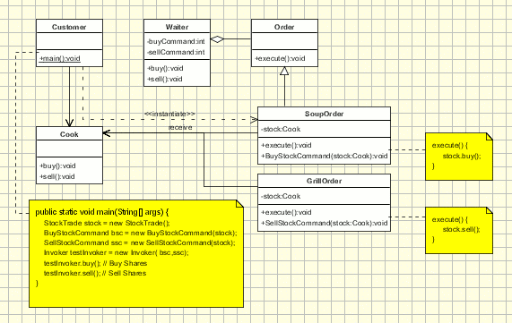

Slide 24
Behavioral Design Pattern – Command Pattern
Points to Remember.
The main advantage of the “ Command “ design pattern is that it decouples the object that invokes the operation from the one that know how to perform it.
Notes:
The main advantage of the command design pattern is that it decouples the object that invokes the operation from the one that know how to perform it. And this advantage must be kept. There are implementations of this design pattern in which the invoker is aware of the concrete commands classes. This is wrong making the implementation more tightly coupled. The invoker should be aware only about the abstract command class.

Slide 25
Demo

Slide 26
Behavioral Design Pattern – Observer Pattern
Defines a one-to-many dependency between objects so that when one object changes state, all its dependents are notified and updated automatically.
Notes:
We can not talk about Object Oriented Programming without considering the state of the objects. After all object oriented programming is about objects and their interaction. The cases when certain objects need to be informed about the changes occured in other objects are frequent. To have a good design means to decouple as much as possible and to reduce the dependencies. The Observer Design Pattern can be used whenever a subject has to be observed by one or more observers.
Let's assume we have a stock system which provides data for several types of client. We want to have a client implemented as a web based application but in near future we need to add clients for mobile devices, Palm or Pocket PC, or to have a system to notify the users with sms alerts. Now it's simple to see what we need from the observer pattern: we need to separate the subject(stocks server) from it's observers(client applications) in such a way that adding new observer will be transparent for the server.

Slide 27
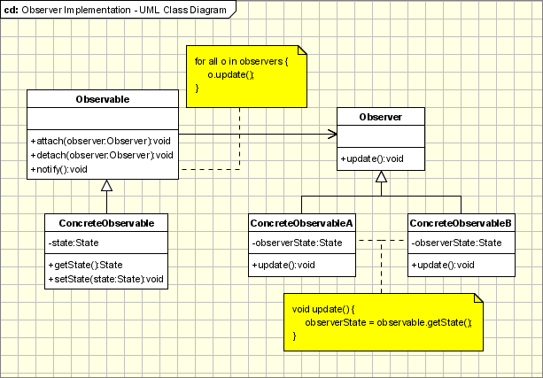
Behavioral Design Pattern – Observer Pattern
Implementation:

Slide 28
Behavioral Design Pattern – Observer Pattern
Implementation:
Observable - interface or abstract class defining the operations for attaching and de-attaching observers to the client. In the GOF book this class/interface is known as Subject.
ConcreteObservable - concrete Observable class. It maintain the state of the object and when a change in the state occurs it notifies the attached Observers.
Observer - interface or abstract class defining the operations to be used to notify this object.
ConcreteObserverA, ConcreteObserver2 - concrete Observer implementations.
Notes:
The participants classes in this pattern are: Observable - interface or abstract class defining the operations for attaching and de-attaching observers to the client. In the GOF book this class/interface is known as Subject.
ConcreteObservable - concrete Observable class. It maintain the state of the object and when a change in the state occurs it notifies the attached Observers.
Observer - interface or abstract class defining the operations to be used to notify this object.
ConcreteObserverA, ConcreteObserver2 - concrete Observer implementations.
The flow is simple: the main framework instantiate the ConcreteObservable object. Then it instantiate and attaches the concrete observers to it using the methods defined in the Observable interface. Each time the state of the subject it's changing it notifies all the attached Observers using the methods defined in the Observer interface. When a new Observer is added to the application, all we need to do is to instantiate it in the main framework and to add attach it to the Observable object. The classes already created will remain unchanged.

Slide 29
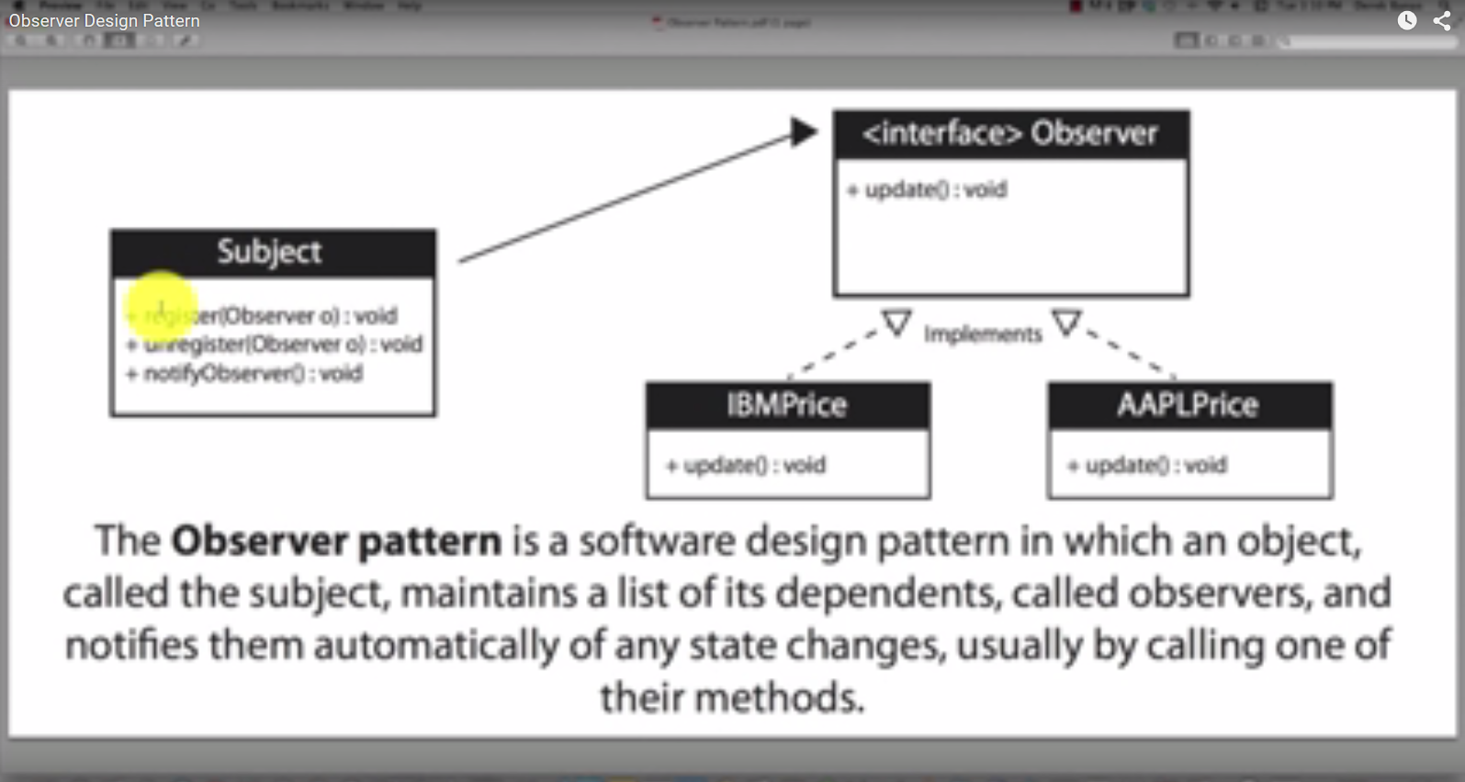
Demo…

Slide 30
Behavioral Design Pattern – Observer Pattern
Applicability & Examples:
The observer pattern is used when: the change of a state in one object must be reflected in another object without keeping the objects tight coupled.
The framework we are writing needs to be enhanced in future with new observers with minimal changes.

Slide 31
Behavioral Design Pattern – Observer Pattern
Applicability & Examples:
Model View Controller.
Event management.
News Agency
Notes:
Some Classical Examples: Model View Controller Pattern - The observer pattern is used in the model view controller (MVC) architectural pattern. In MVC the this pattern is used to decouple the model from the view. View represents the Observer and the model is the Observable object.
Event management - This is one of the domains where the Observer patterns is extensively used. Swing and .Net are extensively using the Observer pattern for implementing the events mechanism.
Obviously, the agency is represented by an Observable(Subject) class named NewsPublisher. This one is created as an abstract class because the agency want to create several types of Observable objects: in the beginning only for business news, but after some time sport and political new will be published. The concrete class is BusinessNewsPublisher.
The observer logic is implemented in NewsPublisher. It keeps a list of all it subscribers and it informs them about the latest news. The subscribers are represented by some observers (SMSSubscriber, EmailSubscriber). Both the observers mentioned above are inherited from the Subscriber. The subscriber is the abstract class which is known to the publisher. The publisher doesn't know about concrete observers, it knows only about their abstraction.
In the main class a publisher(Observable) is built and a few subscribers(Observers). The subscribers are subscribed to the publisher and they can be unsubscribed. In this architecture new types of subscribers can be easily added(instant messaging, ...) and new types of publishers(Weather News, Sport News, ...).

Slide 32
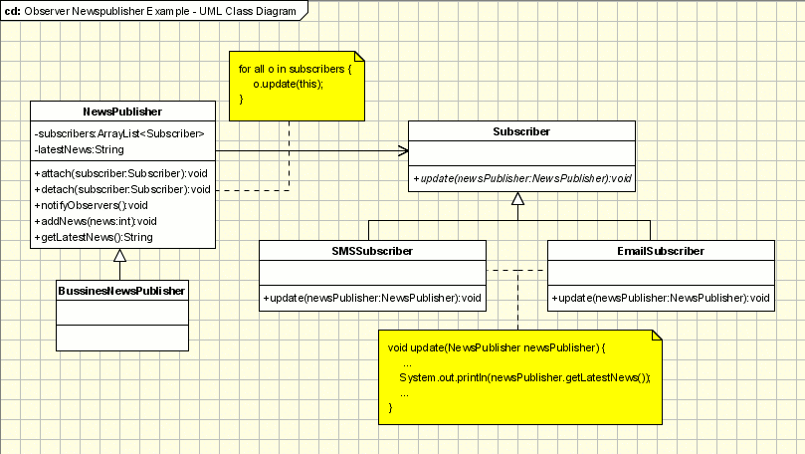
Notes:
Some Classical Examples: Model View Controller Pattern - The observer pattern is used in the model view controller (MVC) architectural pattern. In MVC the this pattern is used to decouple the model from the view. View represents the Observer and the model is the Observable object.
Event management - This is one of the domains where the Observer patterns is extensively used. Swing and .Net are extensively using the Observer pattern for implementing the events mechanism.
Obviously, the agency is represented by an Observable(Subject) class named NewsPublisher. This one is created as an abstract class because the agency want to create several types of Observable objects: in the beginning only for business news, but after some time sport and political new will be published. The concrete class is BusinessNewsPublisher.
The observer logic is implemented in NewsPublisher. It keeps a list of all it subscribers and it informs them about the latest news. The subscribers are represented by some observers (SMSSubscriber, EmailSubscriber). Both the observers mentioned above are inherited from the Subscriber. The subscriber is the abstract class which is known to the publisher. The publisher doesn't know about concrete observers, it knows only about their abstraction.
In the main class a publisher(Observable) is built and a few subscribers(Observers). The subscribers are subscribed to the publisher and they can be unsubscribed. In this architecture new types of subscribers can be easily added(instant messaging, ...) and new types of publishers(Weather News, Sport News, ...).

Slide 33
Behavioral Design Pattern – Observer Pattern
Problems and Resolutions:
Many subjects to Many observers
Who triggers the update?
Making sure Subject state is self-consistent before notification.
.
Notes:
Many subjects to Many observers
It's not a common situation but there are cases when a there are many observers that need to observe more than one subject. In this case the observer need to be notified not only about the change, but also which is the subject with the state changed. This can be realized very simple by adding to the subjects reference in the update notification method. The subject will pass a reference to itself(this) to the when notify the observer.
Who triggers the update?
The communication between the subject and its observers is done through the notify method declared in observer interface. But who it cat be triggered from either subject or observer object. Usually the notify method is triggered by the subject when it's state is changed. But sometimes when the updates are frequent the consecutive changes in the subject will determine many unnecessary refresh operations in the observer. In order to make this process more efficient the observer can be made responsible for starting the notify operation when it consider necessary.
Making sure Subject state is self-consistent before notification
The subject state should be consistent when the notify operation is triggered. If changes are made in the subject state after the observer is notified, it will will be refreshed with an old state. This seems hard to achieve but in practice this can be easily done when Subject subclass operations call inherited operations.

Slide 34
Behavioral Design Pattern – Observer Pattern
Problems and Resolutions:
Many subjects to Many observers
Who triggers the update?
Making sure Subject state is self-consistent before notification.
.
Notes:
Many subjects to Many observers
It's not a common situation but there are cases when a there are many observers that need to observe more than one subject. In this case the observer need to be notified not only about the change, but also which is the subject with the state changed. This can be realized very simple by adding to the subjects reference in the update notification method. The subject will pass a reference to itself(this) to the when notify the observer.
Who triggers the update?
The communication between the subject and its observers is done through the notify method declared in observer interface. But who it cat be triggered from either subject or observer object. Usually the notify method is triggered by the subject when it's state is changed. But sometimes when the updates are frequent the consecutive changes in the subject will determine many unnecessary refresh operations in the observer. In order to make this process more efficient the observer can be made responsible for starting the notify operation when it consider necessary.
Making sure Subject state is self-consistent before notification
The subject state should be consistent when the notify operation is triggered. If changes are made in the subject state after the observer is notified, it will will be refreshed with an old state. This seems hard to achieve but in practice this can be easily done when Subject subclass operations call inherited operations.

Slide 35
Demo

Slide 36
Behavioral Design Pattern – Strategy Pattern
Define a family of algorithms, encapsulate each one, and make them interchangeable. Strategy lets the algorithm vary independently from clients that use it.
Notes:
There are common situations when classes differ only in their behavior. For this cases is a good idea to isolate the algorithms in separate classes in order to have the ability to select different algorithms at runtime.

Slide 37
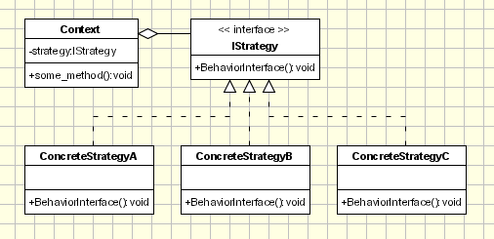
Behavioral Design Pattern – Strategy Pattern
Implementation:

Slide 38
Behavioral Design Pattern – Strategy Pattern
Implementation: Strategy - defines an interface common to all supported algorithms. Context uses this interface to call the algorithm defined by a Concrete Strategy. Concrete Strategy - each concrete strategy implements an algorithm.
Context contains a reference to a strategy object.
may define an interface that lets strategy accessing its data.
The Context objects contains a reference to the Concrete Strategy that should be used.
Notes:
Context contains a reference to a strategy object.
may define an interface that lets strategy accessing its data.
The Context objects contains a reference to the ConcreteStrategy that should be used. When an operation is required then the algorithm is run from the strategy object. The Context is not aware of the strategy implementation. If necessary, addition objects can be defined to pass data from context object to strategy. The context object receives requests from the client and delegates them to the strategy object. Usually the ConcreteStrategy is created by the client and passed to the context. From this point the clients interacts only with the context.

Slide 39
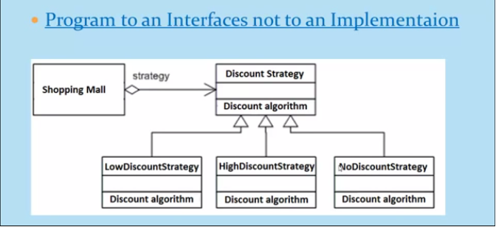
Demo…

Slide 40
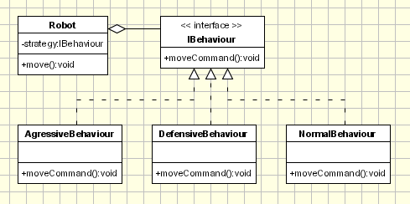
Behavioral Design Pattern – Strategy Pattern
Applicability & Examples:
Robots Application.
Notes:
Let's consider an application used to simulate and study robots interaction. For the beginning a simple application is created to simulate an arena where robots are interacting. We have the following classes: IBehaviour (Strategy) - an interface that defines the behavior of a robot Concrete Strategies: Aggressive Behaviour, Defensive Behaviour, Normal Behaviour; each of them defines a specific behavior. In order to decide the action this class needs information that is passed from robot sensors like position, close obstacles, etc. Robot - The robot is the context class. It keeps or gets context information such as position, close obstacles, etc, and passes necessary information to the Strategy class. In the main section of the application the several robots are created and several different behaviors are created. Each robot has a different behavior assigned: 'Big Robot' is an aggressive one and attacks any other robot found, 'George v.2.1' is really scared and run away in the opposite direction when it encounter another robot and 'R2' is pretty calm and ignore any other robot. At some point the behaviors are changed for each robot.

Slide 41
Behavioral Design Pattern – Strategy Pattern
Problems and Resolutions:
Passing data to/from Strategy object.
Families of related algorithms.
Optionally concrete strategy objects.
Strategy & Creational patterns.
Strategy & Bridge.
.
Notes:
Passing data to/from Strategy object
Usually each strategy need data from the context have to return some processed data to the context. This can be achieved in 2 ways. creating some additional classes to encapsulate the specific data.
passing the context object itself to the strategy objects. The strategy object can set returning data directly in the context.
When data should be passed the drawbacks of each method should be analyzed. For example, if some classes are created to encapsulate additional data, a special care should be paid to what fields are included in the classes. Maybe in the current implementation all required fields are added, but maybe in the future some new strategy concrete classes require data from context which are not include in additional classes. Another fact should be specified at this point: it's very likely that some of the strategy concrete classes will not use field passed to the in the additional classes. On the other side, if the context object is passed to the strategy then we have a tighter coupling between strategy and context. Families of related algorithms.
The strategies can be defined as a hierarchy of classes offering the ability to extend and customize the existing algorithms from an application. At this point the composite design pattern can be used with a special care. Optionally Concrete Strategy Objects
It's possible to implement a context object that carries an implementation for default or a basic algorithm. While running it, it checks if it contains a strategy object. If not it will run the default code and that's it. If a strategy object is found, it is called instead (or in addition) of the default code. This is an elegant solution to exposing some customization points to be used only when they are required. Otherwise the clients don't have to deal with Strategy objects. Strategy and Creational Patterns
In the classic implementation of the pattern the client should be aware of the strategy concrete classes. In order to decouple the client class from strategy classes is possible to use a factory class inside the context object to create the strategy object to be used. By doing so the client has only to send a parameter (like a string) to the context asking to use a specific algorithm, being totally decoupled of strategy classes. Strategy and Bridge
Both of the patterns have the same UML diagram. But they differ in their intent since the strategy is related with the behavior and bridge is for structure. Further more, the coupling between the context and strategies is tighter than the coupling between the abstraction and implementation in the bridge pattern.

Slide 42
Demo

Slide 43
Notes:
We’re going to start by talking about the code quality attributes that are clients experience.

