Slide 1
Rajashekar
Introduction to Design Patterns
Complete Traversal
Chandra Shekar

Slide 2
Agenda
Structural Design Patterns.

Slide 3
Structural Design Patterns.
Patterns categorized under “Structural Design Patterns”.
Adapter.
Bridge.
Composite.
Decorator.
Flyweight.
Proxy.

Slide 4
Structural Design Pattern – Adapter
Convert the interface of a class into another interface clients expect.
Adapter lets classes work together, that could not otherwise because of incompatible interfaces.

Slide 5
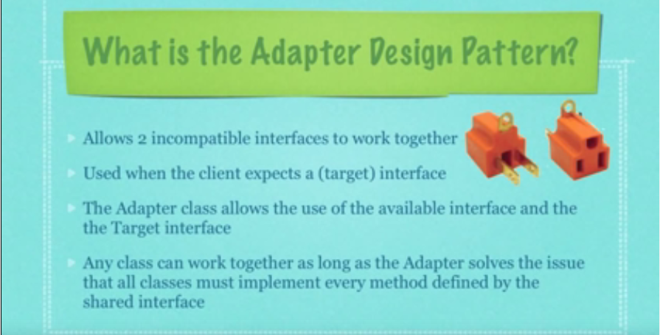

Slide 6
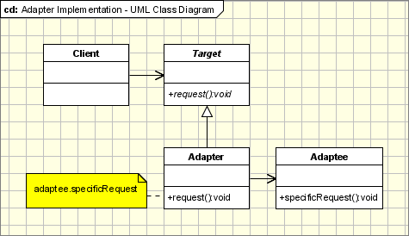
Structural Design Pattern – Adapter
Implementation:UML

Slide 7
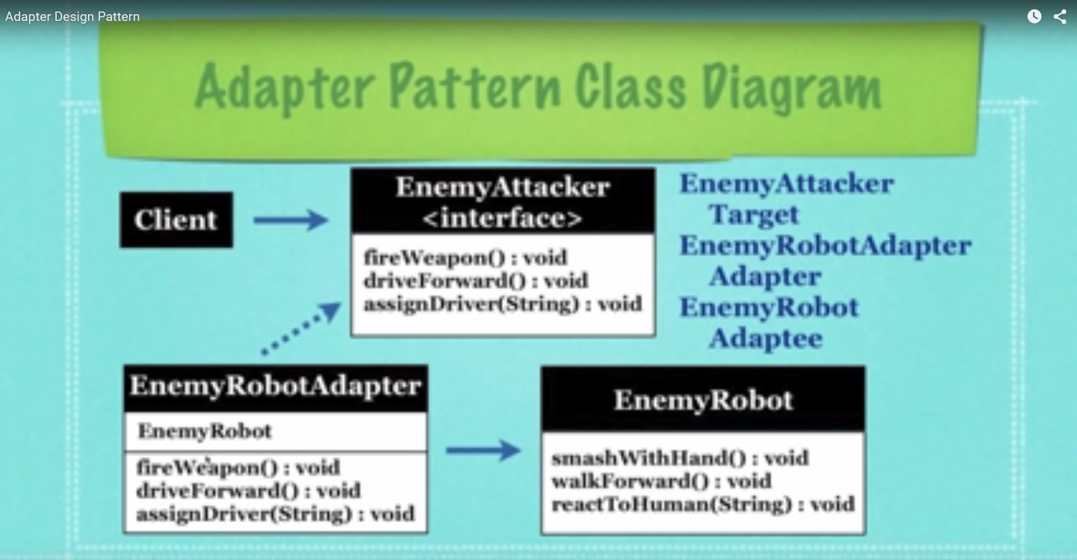
Demo Example

Slide 8
Structural Design Pattern – Adapter
Implementation:
The classes/objects participating in adapter pattern: Target - defines the domain-specific interface that Client uses.
Adapter - adapts the interface Adaptee to the Target interface.
Adaptee - defines an existing interface that needs adapting.
Client - collaborates with objects conforming to the Target interface.

Slide 9
Structural Design Pattern – Adapter
Applicability & Examples:
When: When you have a class(Target) that invokes methods defined in an interface and you have a another class(Adapter) that doesn't implement the interface but implements the operations that should be invoked from the first class through the interface.
Notes:
The visitor pattern is used when: When you have a class(Target) that invokes methods defined in an interface and you have a another class(Adapter) that doesn't implement the interface but implements the operations that should be invoked from the first class through the interface. You can change none of the existing code. The adapter will implement the interface and will be the bridge between the 2 classes.
When you write a class (Target) for a generic use relying on some general interfaces and you have some implemented classes, not implementing the interface, that needs to be invoked by the Target class.
Adapters are encountered everywhere. From real world adapters to software adapters
Non Software Examples of Adapter Patterns : Power Supply Adapters, card readers and adapters, ...
Software Examples of Adapter Patterns: Wrappers used to adopt 3rd parties libraries and frameworks - most of the applications using third party libraries use adapters as a middle layer between the application and the 3rd party library to decouple the application from the library. If another library has to be used only an adapter for the new library is required without having to change the application code.

Slide 10
Structural Design Pattern – Adapter
Problems and Resolutions:
Objects Adapters - Based on Delegation.
Class Adapters - Based on (Multiple) Inheritance
Two way Adapters.
.
Notes:
Objects Adapters - Based on Delegation
Objects Adapters are the classical example of the adapter pattern. It uses composition, the Adaptee delegates the calls to Adaptee (opossed to class adapters which extends the Adaptee). This behaviour gives us a few advantages over the class adapters(however the class adapters can be implemented in languages allowing multiple inheritance). The main advantage is that the Adapter adapts not only the Adpatee but all its subclasses. All it's subclasses with one "small" restriction: all the subclasses which don't add new methods, because the used mechanism is delegation. So for any new method the Adapter must be changed or extended to expose the new methods as well. The main disadvantage is that it requires to write all the code for delegating all the necessary requests tot the Adaptee.
Class Adapters - Based on (Multiple) Inheritance
Class adapters can be implemented in languages supporting multiple inheritance(Java, C# or PHP does not support multiple inheritance). Thus, such adapters can not be easy implemented in Java, C# or VB.NET. Class adapter uses inheritance instead of composition. It means that instead of delegating the calls to the Adaptee, it subclasses it. In conclusion it must subclass both the Target and the Adaptee. There are advantages and disadvantages:
It adapts the specific Adaptee class. The class it extends. If that one is subclassed it can not be adapted by the existing adapter.
It doesn't require all the code required for delegation, which must be written for an Object Adapter.
If the Target is represented by an interface instead of a class then we can talk about "class" adapters, because we can implement as many interfaces as we want.
Two-Ways Adapters
The Two-Ways Adapters are adapters that implements both interfaces of Target and Adaptee. The adapted object can be used as Target in new systems dealing with Target classes or as Adaptee in other systems dealing with Adaptee classes. Going further on this line of thinking, we can have adapters implementing n interfaces, adapting to n systems. Two-way adapters and n-way adapters are hard to implement in systems not supporting multiple inheritance. If adapter has to extend the Target class it can not extent another class like Adaptee, so the Adaptee should be an interface and all the calls should be delegated from the adapter to the Adaptee object.

Slide 11
DEMO

Slide 12
Structural Design Pattern – Composite
The intent of this pattern is to compose objects into tree structures to represent part-whole hierarchies.
Composite lets clients treat individual objects and compositions of objects uniformly.
Notes:
There are times when a program needs to manipulate a tree data structure and it is necessary to treat both Branches as well as Leaf Nodes uniformly. Consider for example a program that manipulates a file system. A file system is a tree structure that contains Branches which are Folders as well as Leaf nodes which are Files. Note that a folder object usually contains one or more file or folder objects and thus is a complex object where a file is a simple object. Note also that since files and folders have many operations and attributes in common, such as moving and copying a file or a folder, listing file or folder attributes such as file name and size, it would be easier and more convenient to treat both file and folder objects uniformly by defining a File System Resource Interface.

Slide 13
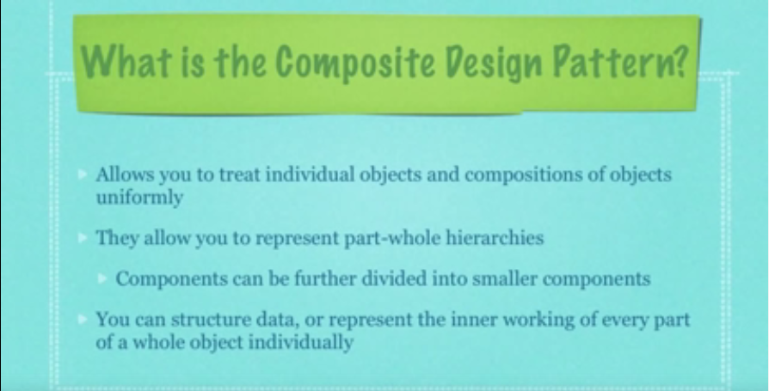

Slide 14
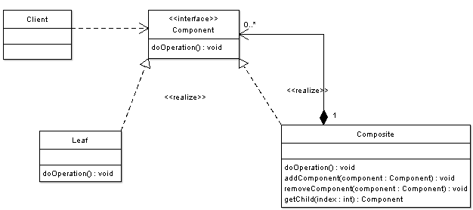
Structural Design Pattern – Composite
Implementation:
Notes:
Component - Component is the abstraction for leafs and composites. It defines the interface that must be implemented by the objects in the composition. For example a file system resource defines move, copy, rename, and getSize methods for files and folders.
Leaf - Leafs are objects that have no children. They implement services described by the Component interface. For example a file object implements move, copy, rename, as well as getSize methods which are related to the Component interface.
Composite - A Composite stores child components in addition to implementing methods defined by the component interface. Composites implement methods defined in the Component interface by delegating to child components. In addition composites provide additional methods for adding, removing, as well as getting components.
Client - The client manipulates objects in the hierarchy using the component interface.
A client has a reference to a tree data structure and needs to perform operations on all nodes independent of the fact that a node might be a branch or a leaf. The client simply obtains reference to the required node using the component interface, and deals with the node using this interface; it doesn�t matter if the node is a composite or a leaf.

Slide 15
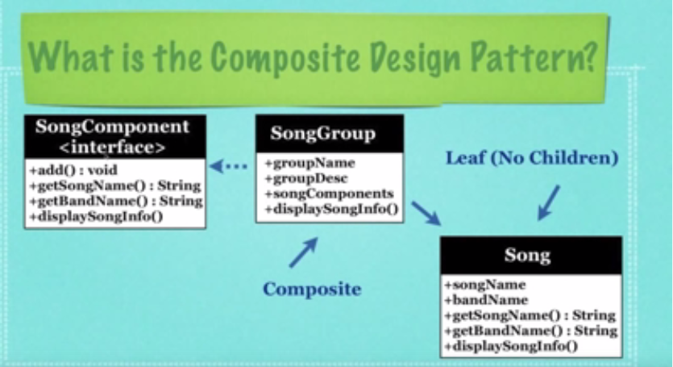
Example…Demo

Slide 16
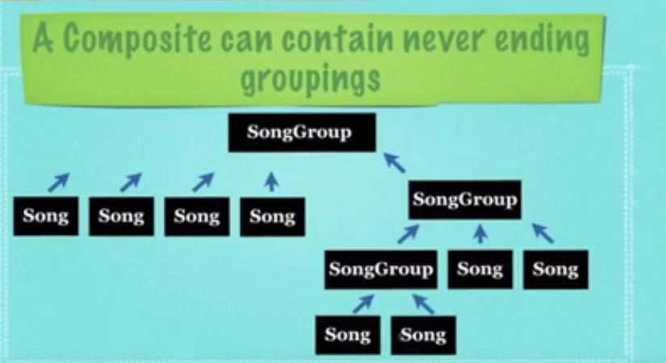
Demo –Example…

Slide 17
Structural Design Pattern – Composite
Applicability & Examples:
The composite pattern applies when there is a part-whole hierarchy of objects and a client needs to deal with objects uniformly regardless of the fact that an object might be a leaf or a branch.

Slide 18
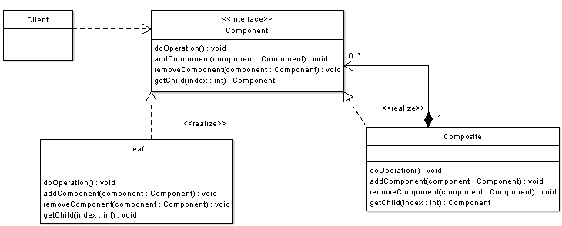
Structural Design Pattern – Composite
Applicability & Examples:
Example - Graphics Drawing Editor , File System.
Notes:
In graphics editors a shape can be basic or complex. An example of a simple shape is a line, where a complex shape is a rectangle which is made of four line objects. Since shapes have many operations in common such as rendering the shape to screen, and since shapes follow a part-whole hierarchy, composite pattern can be used to enable the program to deal with all shapes uniformly.
In the example we can see the following actors: Shape (Component) - Shape is the abstraction for Lines, Rectangles (leafs) and and Complex Shapes (composites).
Line, Rectangle (Leafs) - objects that have no children. They implement services described by the Shape interface.
ComplexShape (Composite) - A Composite stores child Shapes in addition to implementing methods defined by the Shape interface.
GraphicsEditor (Client) - The GraphicsEditor manipulates Shapes in the hierarchy.
Alternative Implementation: Note that in the previous example there were times when we have avoided dealing with composite objects through the Shape interface and we have specifically dealt with them as composites (when using the method addToShape()). To avoid such situations and to further increase uniformity one can add methods to add, remove, as well as get child components to the Shape interface. The UML diagram below shows it:

Slide 19
Structural Design Pattern – Composite
Problems and Resolutions:
Graphics User Interface.
File System.
.
The composite pattern defines class hierarchies consisting of primitive objects and composite objects.
Notes:
Extending an objects functionality can be done statically (at compile time) by using inheritance however it might be necessary to extend an objects functionality dynamically (at runtime) as an object is used.
Consider the typical example of a graphical window. To extend the functionality of the graphical window for example by adding a frame to the window, would require extending the window class to create a FramedWindow class. To create a framed window it is necessary to create an object of the FramedWindow class. However it would be impossible to start with a plain window and to extend its functionality at runtime to become a framed window.

Slide 20
DEMO

Slide 21
Structural Design Pattern – Proxy
The intent of this pattern is to provide a “Placeholder” for an object to control references to it.
Notes:
Motivation
Sometimes we need the ability to control the access to an object. For example if we need to use only a few methods of some costly objects we'll initialize those objects when we need them entirely. Until that point we can use some light objects exposing the same interface as the heavy objects. These light objects are called proxies and they will instantiate those heavy objects when they are really need and by then we'll use some light objects instead.
This ability to control the access to an object can be required for a variety of reasons: controlling when a costly object needs to be instantiated and initialized, giving different access rights to an object, as well as providing a sophisticated means of accessing and referencing objects running in other processes, on other machines.
Consider for example an image viewer program. An image viewer program must be able to list and display high resolution photo objects that are in a folder, but how often do someone open a folder and view all the images inside. Sometimes you will be looking for a particular photo, sometimes you will only want to see an image name. The image viewer must be able to list all photo objects, but the photo objects must not be loaded into memory until they are required to be rendered.

Slide 22
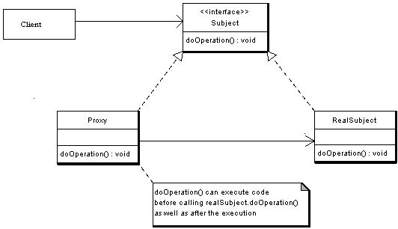
Structural Design Pattern – Proxy
Implementation:
Notes:
The participants classes in the proxy pattern are: Subject - Interface implemented by the RealSubject and representing its services. The interface must be implemented by the proxy as well so that the proxy can be used in any location where the RealSubject can be used.
Proxy
Maintains a reference that allows the Proxy to access the RealSubject.
Implements the same interface implemented by the RealSubject so that the Proxy can be substituted for the RealSubject.
Controls access to the RealSubject and may be responsible for its creation and deletion.
Other responsibilities depend on the kind of proxy.
RealSubject - the real object that the proxy represents.
Description
A client obtains a reference to a Proxy, the client then handles the proxy in the same way it handles RealSubject and thus invoking the method doSomething(). At that point the proxy can do different things prior to invoking RealSubject�s doSomething() method. The client might create a RealSubject object at that point, perform initialization, check permissions of the client to invoke the method, and then invoke the method on the object. The client can also do additional tasks after invoking the doSomething() method, such as incrementing the number of references to the object.

Slide 23
Structural Design Pattern – Proxy
Applicability & Examples:
The Virtual Proxies.
Remote Proxies.
Protection Proxies.
Smart References.
Notes:
The Proxy design pattern is applicable when there is a need to control access to an Object, as well as when there is a need for a sophisticated reference to an Object. Common Situations where the proxy pattern is applicable are: Virtual Proxies: delaying the creation and initialization of expensive objects until needed, where the objects are created on demand (For example creating the RealSubject object only when the doSomething method is invoked).
Remote Proxies: providing a local representation for an object that is in a different address space. A common example is Java RMI stub objects. The stub object acts as a proxy where invoking methods on the stub would cause the stub to communicate and invoke methods on a remote object (called skeleton) found on a different machine.
Protection Proxies: where a proxy controls access to RealSubject methods, by giving access to some objects while denying access to others.
Smart References: providing a sophisticated access to certain objects such as tracking the number of references to an object and denying access if a certain number is reached, as well as loading an object from database into memory on demand.

Slide 24
Structural Design Pattern – Proxy
Problems and Resolutions:
Java Remote Method Invocation (RMI)
Consequences:
JRMI.
Security Proxies.
Notes:
In java RMI an object on one machine (executing in one JVM) called a client can invoke methods on an object in another machine (another JVM) the second object is called a remote object. The proxy (also called a stub) resides on the client machine and the client invokes the proxy in as if it is invoking the object itself (remember that the proxy implements the same interface that RealSubject implements). The proxy itself will handle communication to the remote object, invoke the method on that remote object, and would return the result if any to the client. The proxy in this case is a Remote proxy.

Slide 25
Pattern Oriented Software
Architecture(POSA I)

Slide 26
POSA - I
Pattern Oriented Software Architecture
Involves designing a software system by incorporating a collection of “Design Patterns” in an appropriate way.
It also involves structuring and designing a system by placing the apt design pattern in a suitable position in order to achieve the common objective of the system by leveraging the individual benefits of the respective design pattern.

Slide 27
Pattern Oriented Software
Architecture(POSA II)
Notes:
We’re going to start by talking about the code quality attributes that are clients experience.

Slide 28
DESIGN PATTERNS FOR DISTRIBUTED COMPUTING.
Notes:
We’re going to start by talking about the code quality attributes that are clients experience.

Slide 29
POSA - II.
Following are the patterns which widely cater the distributed systems.
Forward - Receiver.
Client – Dispatcher - Server.
Model – View - Client

