Slide 1
Rajashekar
Introduction to Design Patterns – Level II
Complete Traversal
Chandra Shekar

Slide 2
Agenda
Introduction to Design Patterns.

Slide 3
What is Design Pattern?
Design patterns are generic solutions to common problems encountered during the Object Oriented Software Design.
“An idea that has been useful in one practical context and will probably be useful in others.”
[ MARTIN FOWLER “Analysis Patterns” – 1997]

Slide 4
Design Pattern Categories
Design patterns are broadly classified under the following 3 categories.
Creational
Structural
Behavioral

Slide 5
Design Pattern Categories
Different Dimensional Classification:
Broader Classification:
Creational:
Abstract Factory
Builder
Factory Method
Prototype
Singleton
Lazy Instantiation
Utility Pattern
Creational
Structural
Behavioral
Security
Concurrency
Sql
User Interface
Notes:
Gives our profession a shared language
Helps avoiding re-inventing the wheels constantly
Provides a starting point for a solution
Can speed production in a team
Improves System and application design.

Slide 6
FOCUS: GOF PATTERNS

Slide 7
Design Pattern Categories
Creational : All design patterns under this category focus on Object creation in different ways.
Structural :The design patterns under this category mainly focus on the structure of the subsystems.
Behavioral: The patterns under this category focus on the interactions among the modules or the components .

Slide 8
Design Pattern Categories
Creational : Creational design patterns are very useful in situations where one needs to create objects that are very efficient .
They enable one to create objects in a manner that the memory can be utilized in an efficient way.
Objects thus created are utilized by the modules effectively and efficiently.

Slide 9
Creational Patterns
Following are the patterns which fall under the category of the Creational Design Patterns.
Singleton
Factory
Factory Method
Abstract Factory
Builder
Prototype
Object Pool

Slide 10
Creational Design Patterns - Singleton
Singleton : This pattern ensures that there is only one instance of a class is created for the entire application.
Singletons are used for centralized management of internal or external resources and they provide a global point of access to themselves.
For eg. Only one Window Manager, Only 1 File system, Only 1 Print spooler are required for a system.

Slide 11
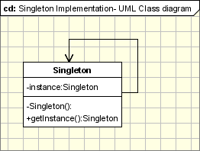
Creational Design Patterns - Singleton
Implementation involves a static member in a singleton class, a private constructor and a static public method that returns a reference to the static member:

Slide 12
Creational Design Patterns – Singleton- Applicability
Examples:
Logger classes
Configuration classes
Accessing resources in shared mode
Factories implemented as singletons.
Notes:
According to the definition the singleton pattern should be used when there must be exactly one instance of a class, and when it must be accessible to clients from a global access point. Here are some real situations where the singleton is used: Example 1 - Logger Classes
The Singleton pattern is used in the design of logger classes. These classes are usually implemented as a singletons, and provides a global logging access point in all the application components without being necessary to create an object each time a logging operations is performed.
Example 2 - Configuration Classes
The Singleton pattern is used to design the classes which provides the configuration settings for an application. By implementing configuration classes as Singleton not only that we provide a global access point, but we also keep the instance we use as a cache object. When the class is instantiated( or when a value is read ) the singleton will keep the values in its internal structure. If the values are read from the database or from files this avoids the reloading the values each time the configuration parameters are used.
Example 3 - Accessing resources in shared mode
It can be used in the design of an application that needs to work with the serial port. Let's say that there are many classes in the application, working in an multi-threading environment, which needs to operate actions on the serial port. In this case a singleton with synchronized methods could be used to be used to manage all the operations on the serial port.
Example 4 - Factories implemented as Singletons
Let's assume that we design an application with a factory to generate new objects(Acount, Customer, Site, Address objects) with their ids, in an multithreading environment. If the factory is instantiated twice in 2 different threads then is possible to have 2 overlapping ids for 2 different objects. If we implement the Factory as a singleton we avoid this problem. Combining Abstract Factory or Factory Method and Singleton design patterns is a common practice.

Slide 13
DEMO

Slide 14
Creational Design Patterns – Factory Method
Also known as virtual Constructor.
It defines an Interface for creating an Object.
Leaving the choice of its type to the subclasses.
Refers to the newly created object thru an Interface.
Thus enabling the creation at the run-time.
Notes:
A simple real life example of the Factory Method is the hotel. When staying in a hotel you first have to check in. The person working at the front desk will give you a key to your room after you've paid for the room you want and this way he can be looked at as a �room� factory. While staying at the hotel, you might need to make a phone call, so you call the front desk and the person there will connect you with the number you need, becoming a �phone-call� factory, because he controls the access to calls, too.

Slide 15
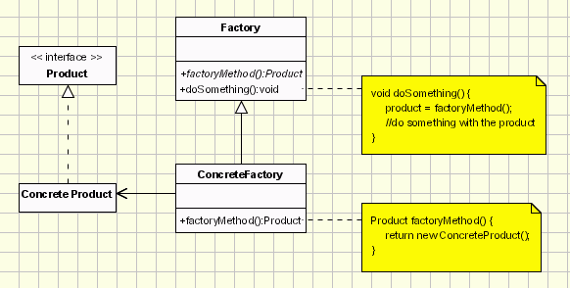
Creational Design Patterns – Factory Method
Implementation:
Notes:
The participants classes in this pattern are: Product defines the interface for objects the factory method creates.
ConcreteProduct implements the Product interface.
Creator(also refered as Factory because it creates the Product objects) declares the method FactoryMethod, which returns a Product object. May call the generating method for creating Product objects
ConcreteCreator overrides the generating method for creating ConcreteProduct objects
All concrete products are subclasses of the Product class, so all of them have the same basic implementation, at some extent. The Creator class specifies all standard and generic behavior of the products and when a new product is needed, it sends the creation details that are supplied by the client to the ConcreteCreator. Having this diagram in mind, it is easy for us now to produce the code related to it.
public interface Product { � } public abstract class Creator { public void anOperation() { Product product = factoryMethod(); } protected abstract Product factoryMethod(); } public class ConcreteProduct implements Product { � } public class ConcreteCreator extends Creator { protected Product factoryMethod() { return new ConcreteProduct(); } } public class Client { public static void main( String arg[] ) { Creator creator = new ConcreteCreator(); creator.anOperation(); } }

Slide 16
Creational Design Patterns – Factory Method
Implementation - This is how a factory method implementation looks like:
public interface Product { � }
public abstract class Creator
{
public void anOperation()
{
Product product = factoryMethod();
}
protected abstract Product factoryMethod();
}
Notes:
The participants classes in this pattern are: Product defines the interface for objects the factory method creates.
ConcreteProduct implements the Product interface.
Creator(also refered as Factory because it creates the Product objects) declares the method FactoryMethod, which returns a Product object. May call the generating method for creating Product objects
ConcreteCreator overrides the generating method for creating ConcreteProduct objects
All concrete products are subclasses of the Product class, so all of them have the same basic implementation, at some extent. The Creator class specifies all standard and generic behavior of the products and when a new product is needed, it sends the creation details that are supplied by the client to the ConcreteCreator. Having this diagram in mind, it is easy for us now to produce the code related to it.
public interface Product { � } public abstract class Creator { public void anOperation() { Product product = factoryMethod(); } protected abstract Product factoryMethod(); } public class ConcreteProduct implements Product { � } public class ConcreteCreator extends Creator { protected Product factoryMethod() { return new ConcreteProduct(); } } public class Client { public static void main( String arg[] ) { Creator creator = new ConcreteCreator(); creator.anOperation(); } }

Slide 17
Creational Design Patterns – Factory Method
public class ConcreteProduct implements Product { � }
public class ConcreteCreator extends Creator
{
protected Product factoryMethod()
{
return new ConcreteProduct();
}
}
public class Client
{
public static void main( String arg[] )
{
Creator creator = new ConcreteCreator();
creator.anOperation();
}
}
Notes:
The participants classes in this pattern are: Product defines the interface for objects the factory method creates.
ConcreteProduct implements the Product interface.
Creator(also refered as Factory because it creates the Product objects) declares the method FactoryMethod, which returns a Product object. May call the generating method for creating Product objects
ConcreteCreator overrides the generating method for creating ConcreteProduct objects
All concrete products are subclasses of the Product class, so all of them have the same basic implementation, at some extent. The Creator class specifies all standard and generic behavior of the products and when a new product is needed, it sends the creation details that are supplied by the client to the ConcreteCreator. Having this diagram in mind, it is easy for us now to produce the code related to it.
public interface Product { � } public abstract class Creator { public void anOperation() { Product product = factoryMethod(); } protected abstract Product factoryMethod(); } public class ConcreteProduct implements Product { � } public class ConcreteCreator extends Creator { protected Product factoryMethod() { return new ConcreteProduct(); } } public class Client { public static void main( String arg[] ) { Creator creator = new ConcreteCreator(); creator.anOperation(); } }

Slide 18
Creational Design Patterns – Factory Method
Applicability & Examples: Situations when factory method is required.
When a class can’t anticipate the kind of object it is supposed to create.
When a class wants its subclasses to specify the type of the newly created object.
Notes:
The participants classes in this pattern are: Product defines the interface for objects the factory method creates.
ConcreteProduct implements the Product interface.
Creator(also refered as Factory because it creates the Product objects) declares the method FactoryMethod, which returns a Product object. May call the generating method for creating Product objects
ConcreteCreator overrides the generating method for creating ConcreteProduct objects
All concrete products are subclasses of the Product class, so all of them have the same basic implementation, at some extent. The Creator class specifies all standard and generic behavior of the products and when a new product is needed, it sends the creation details that are supplied by the client to the ConcreteCreator. Having this diagram in mind, it is easy for us now to produce the code related to it.
public interface Product { � } public abstract class Creator { public void anOperation() { Product product = factoryMethod(); } protected abstract Product factoryMethod(); } public class ConcreteProduct implements Product { � } public class ConcreteCreator extends Creator { protected Product factoryMethod() { return new ConcreteProduct(); } } public class Client { public static void main( String arg[] ) { Creator creator = new ConcreteCreator(); creator.anOperation(); } }

Slide 19
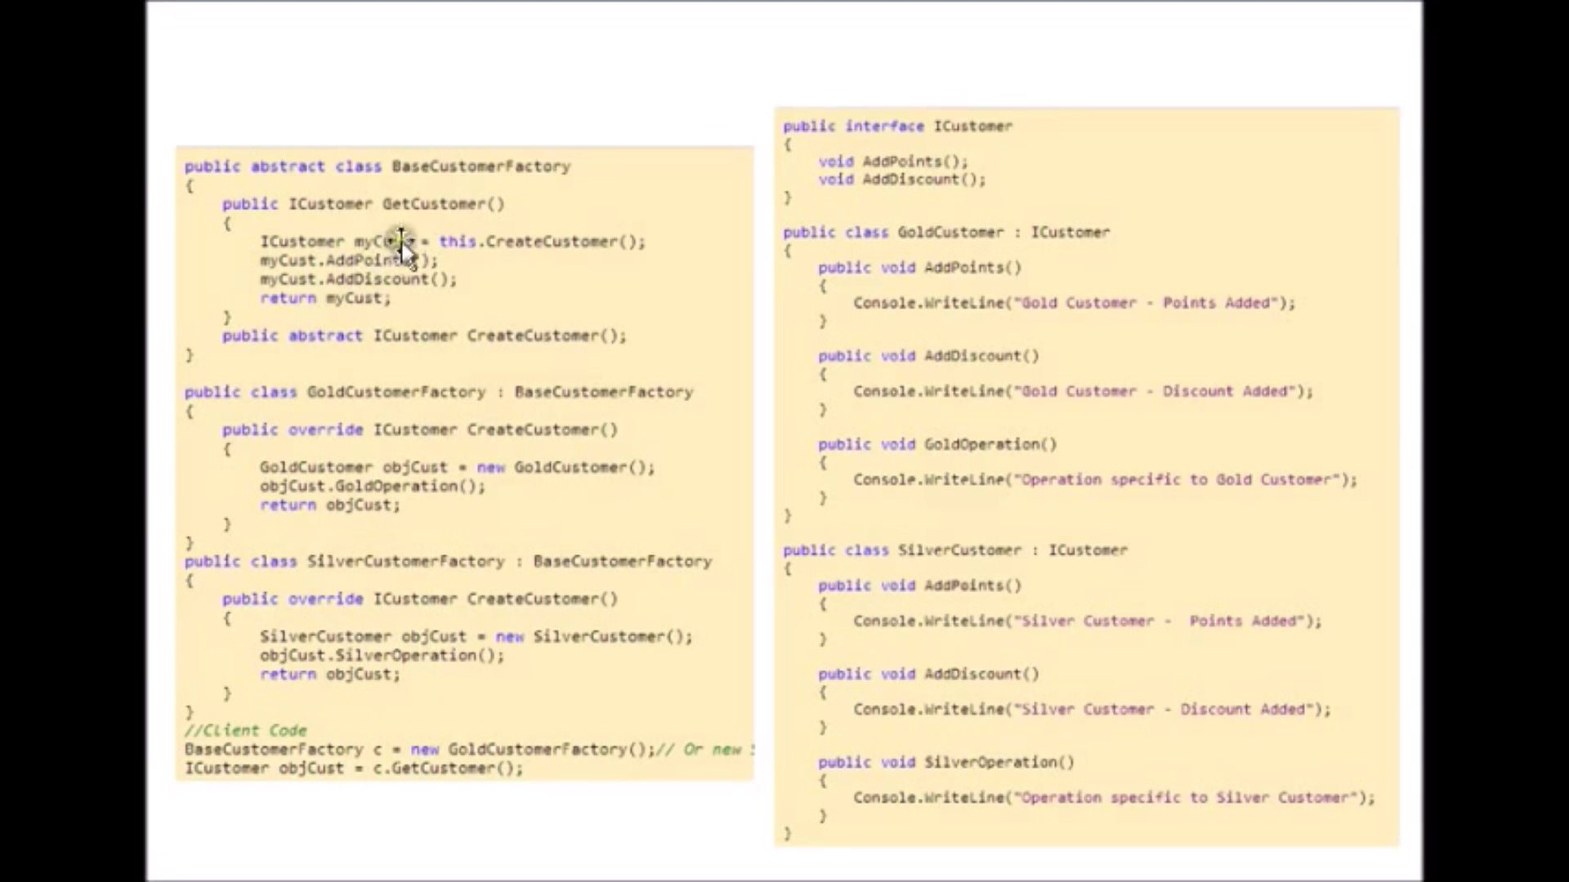
Factory Method

Slide 20
Creational Design Patterns – Factory Method
“factory method” is the most robust and most used pattern.
Issues that arise during the usage of “factory method”.
When this pattern is applied to an already existing code the problems with respect to the creator class are:
Creator class is abstract and generating method does nt have any implementation.
Creator class is a concrete class and generating method has default implementation.
Notes:
Case 1: In this case the ConcreteCreator classes must define their own generation method and this situation usually appears in the cases where the Creator class can't foresee what ConcreteProduct it will instantiate.
Case 2:If this happens, the ConcreteCreator classes will use the generating method for flexibility rather than for generation. The programmer will always be able to modify the class of the objects that the Creator class implicitly creates, redefining the generation method.

Slide 21
Creational Design Patterns – Factory Method
Benefits and drawbacks of the pattern:
+ This pattern helps in introducing “loose coupling” among the entities.
+ It provides customization hooks.
- The factory has to be used for a family of objects.
Notes:
The main reason for which the factory pattern is used is that it introduces a separation between the application and a family of classes (it introduces weak coupling instead of tight coupling hiding concrete classes from the application). It provides a simple way of extending the family of products with minor changes in application code. + It provides customization hooks. When the objects are created directly inside the class it's hard to replace them by objects which extend their functionality. If a factory is used instead to create a family of objects the customized objects can easily replace the original objects, configuring the factory to create them. - The factory has to be used for a family of objects. If the classes doesn't extend common base class or interface they can not be used in a factory design template

Slide 22
Video
https://www.youtube.com/watch?v=hwSEYlj4NEk

Slide 23
DEMO

Slide 24
Creational Design Patterns – Object Pool
While the Prototype pattern helps in improving the performance by cloning the objects, the Object Pool pattern offer a mechanism to reuse objects that are expensive to create.
Objective is to create and share the objects that are expensive to create.
Used when Rate of Instantiation is High and amount of time used by clients is low.
Helps in minimizing the Memory Fragmentation due to repeated instantiation & destruction.
Notes:
Clients of an object pull "feel" like they are owners of a service although the service is shared among many other clients.
3 Players:
Reusable Object
Client 1
Reusable Pool

Slide 25
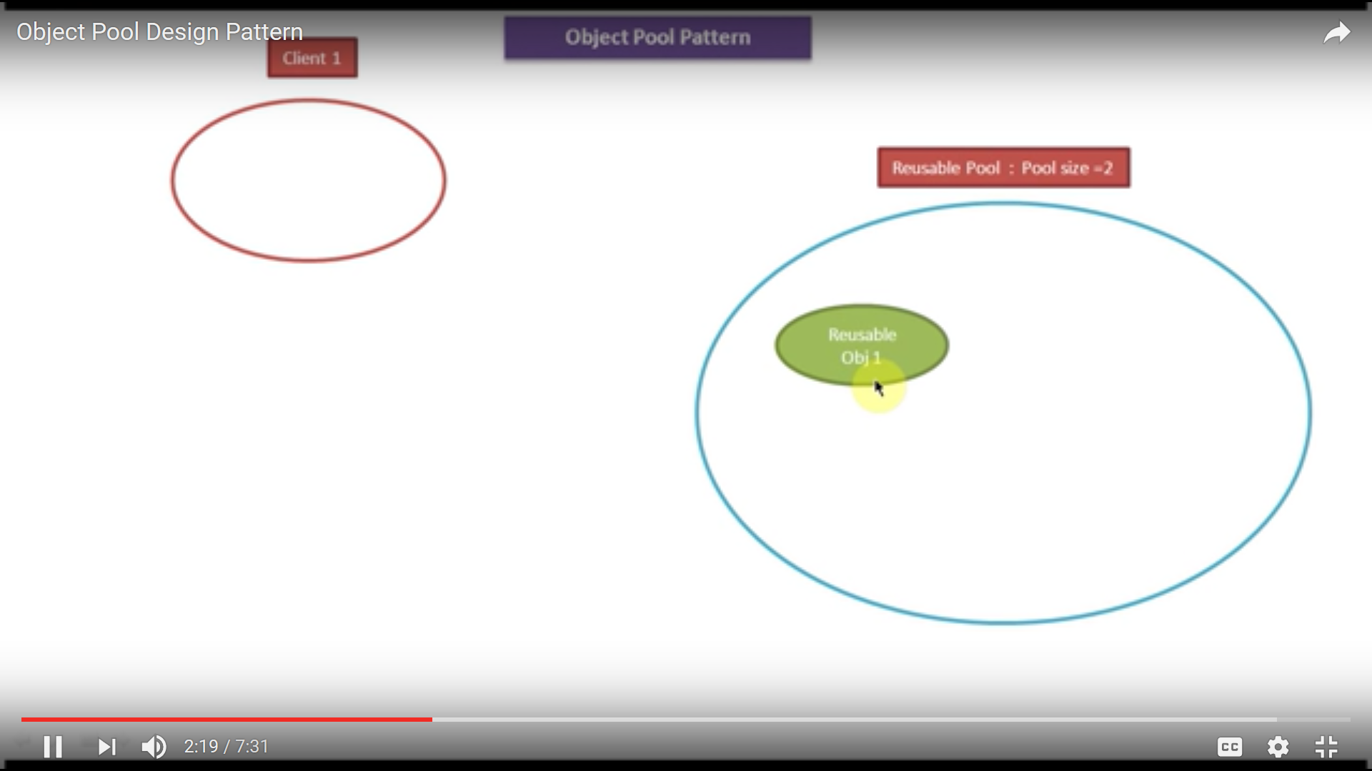
Object Pool ……
Notes:
Object Pool – Reusable Pool – Create and to Manage the Reusable Objects (Attributes : MaxPoolSize , MinPoolSize)
Reusable Pool Class → Singleton Class
Reusable Object : Shared by the Multiple Clients
Client : Share the Reusable Object.
Client1 requests reusable Object., Pool generates and provides the stateless objects
Client2 requests reusable Object. Pool checks for Object, if not available checks size for eg. 2, hence creates and gives it to Client2
Client3 requests, max size is 2 Pool waits until Client 1 / 2 releases the Object, once it releases , the object is shared to Client 3
Clients’ Multiple requests are served by the objects generated by the Pool and shared among the clients.
Physically Objects are lesser than the number of Clients by a particular percentage.

Slide 26
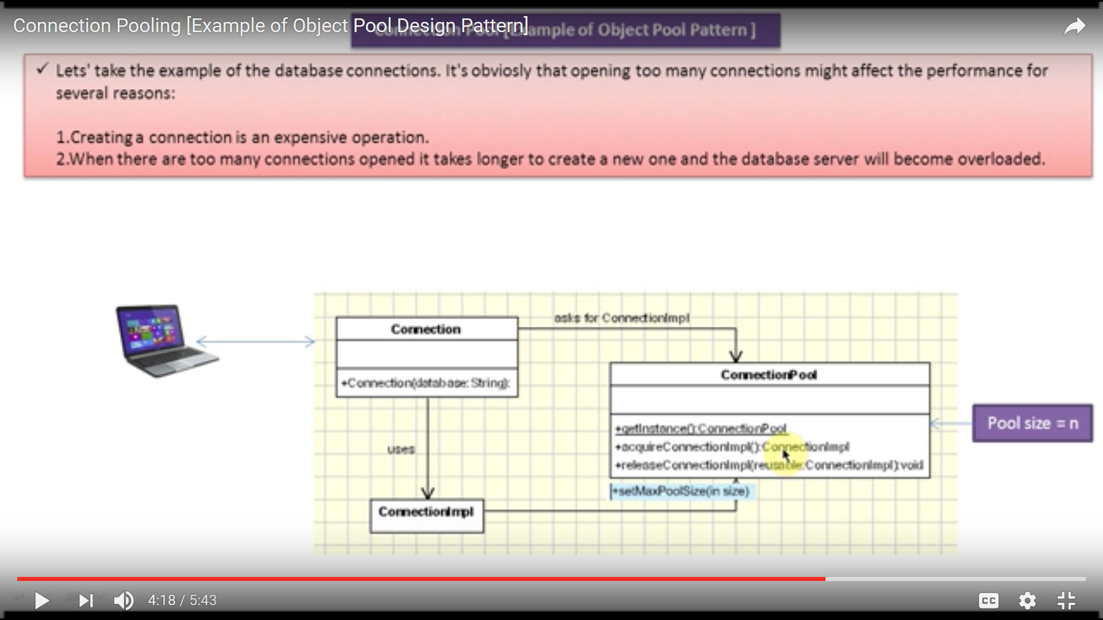
Object Pool – Connection Pool

Slide 27
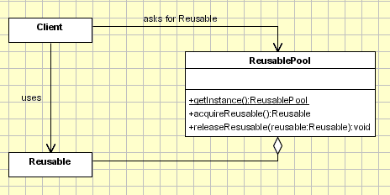
Creational Design Patterns – Object Pool
Implementation:

Slide 28
Creational Design Patterns – Object Pool
Implementation: involves the following objects:
Reusable - Wraps the limited resource, will be shared by several clients for a limited amount of time.
Client - uses an instance of type Reusable.
Reusable Pool - manage the reusable objects for use by Clients, creating and managing a pool of objects.
Notes:
For Example: Connection Pool,
The ConnectionPool , Connection , ConnectionImpl are the entities that would be used.
ConnectionPool may consist of the methods like:
getInstance() (return type would be of ConnectionPool type)
acquireConnectionImpl() : ConnectionImpl
releaseConnectionImpl(reusable : ConnectionImpl
setMaxPoolSize(int size)
Connection –------------ uses------- > ConnectionImpl (with above mentioned methods)
(Interface)
|
|
| uses
V
ConnectionImpl

Slide 29
Creational Design Patterns – Object Pool
Objective is to create and share the objects that are expensive to create.
When a client asks for a Reusable object, the pool performs the following actions:
- Search for an available Reusable object and if it was found it will be returned to the client.
- If no Reusable object was found then it tries to create a new one. If this actions succeeds the new Reusable object will be returned to the client.
- If the pool was unable to create a new Reusable, the pool will wait until a reusable object will be released.
Notes:
Clients of an object pool "feel" like they are owners of a service although the service is shared among many other clients.
The Client is responsible to request the Reusable object as well to release it to the pool. If this action will not be performed the Reusable object will be lost, being considered unavailable by the Resource Pool. The clients are not aware that they are sharing the Reusable object. From the client poinf of view they are the owners of a new object which comes from the Resource pool in the same way that it comes from a factory or another creational design pattern. The only difference is that the Client should mark the Reusable object as available, after it finishes to use it. It's not about releasing the objects; for example if we work with databases, when a connection is closed it's not necessarily destroyed, it means that it can be reused by another client.

Slide 30
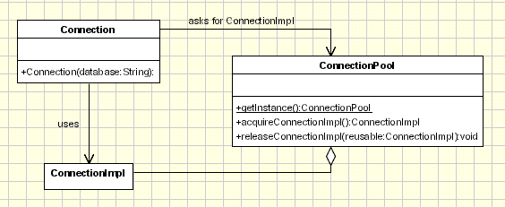
Creational Design Patterns – Object Pool
Applicability & Examples:
Connection Pool - Database Connectivity
Thread Pool

Slide 31
Creational Design Patterns – Object Pool
Connection - represents the object which is instantiated by the client.
Connection Impl is the object which implements the database operations which are exposed by Connection for the client.
Connection Pool is the main actor to manage the connections to the database.
Notes:
Connection - represent the object which is instantiated by the client. From the client perspective this object is instantiated and it handles the database operations and it is the only object visible to the client. The client is not aware that it uses some shared connections. Internally this class does not contain any code for connecting to the database and calls ConnectionPool.aquireImpl to get a ConnectionImpl object and then delegates the request to ConnectionImpl. ConnectionImpl is the object which implements the database operations which are exposed by Connection for the client. ConnectionPool is the main actor to manage the connections to the database. It keeps a list of ConnectionImpl objects and instantiates new objects if this is required. When the client needs to query the database it instantiate a new Connection object specifying the database name and the call the query method which returns a set of records. From the client point of view this is all. When the Connection.Query methd is called it asks for a ConnectionImpl object from the ConnectionPool. The ConnectionPool tries to find and return an unused object and if it doesn't find it creates one. At this point the maximum number of connections can be limited and if it was reached the pool cand wait until one will be available or return null. In the query method the request is delegated to the ConnectionImpl object returned by the object pool. Since the request is just delegated it's recomended to have the same method signature in Connection and ConnectionImpl.

Slide 32
Creational Design Patterns – Object Pool
Problems and Resolutions:
Limited number of resources in the pool .
Handling situations when creating a new resource fails.
Synchronization.
Expired resources(unused but still reserved).
.
Notes:
1. Limited number of resources in the pool The connection pool is responsable for sharing and reusing the resources. Sometimes the resources have to be well managed only because they affects the performace, but there are situations when the number of resources can not exceed a specific limit. In this case the Resource pool check the number of instantiated resources and of the limit is reach it will wait for a resource to be released, it will throw an exception or it will return a null value. In any of the last 2 situations the Client should be notified that the action failed because there are no available resources. 2. Handling situations when creating a new resource fails There are many reasons when the ResourcePool.acquireConnectionImpl method fails to return a resource. It might happens because there are not available resources or some exception occured. Either way the client should be notified about his. 3. Syncronization In order to work in a multithreading environment the methods that are used by differnt threads should be synchronized. There are only three methonds in the ResourcePool object that have to be synchronized: - getInstance should be synchronized or should contain a synchronized block. For details check the singleton multithreading implementation. - acquireConnectionImpl - this menthod returns a resource and should be synchronized not to return the same resource to two different clients running tin different threads. - releaseConnectionImpl - this method release a resource. Ussually it doesn't have to be synchronized a resource is allocated only by one client. Internally some blocks might need to be synchronized(depending on the method implementation and the internal structures used to keep the pool.). 4. Expired resources(unused but still reserved) The main problem for the Object Pool Pattern is that the objects should be released by the client when it finishes using them. There are plenty of examples when the client ”forget” to release the resources. Let's take the example the the database connections when connection are not closed/released after they are used. This seems a minor problem but there are many applications crashing for this reason. In object pool can be implemented a mechanism to check when a specific resource was used last time and if the time expired, to return it to the available resource pool.

Slide 33
Creational Design Patterns – Object Pool
Points to remember:
When the Object Pool pattern is used the objects should be marked as available(released) by the client after they are used, so the pool will be aware about this. –
Creating the resources might fail and this case should be treated carefully
.
Notes:
When the Object Pool pattern is used the objects should be marked as available(released) by the client after they are used, so the pool will be aware about this. This is the main drawback because the client should do this and it's a common situation when database connection are not released afer they are used. To overcome this a mechanism can be implemented to release resources if they are not used for a period of time. - Creating the resources might fail and this case should be treated carefully. When there is no available resource(beacause the number is limited or creating a new one failed) the client should be notified about it.

Slide 34
DEMO

Slide 35
CASE STUDY 01
Customer Management System

Slide 36
Notes:
We’re going to start by talking about the code quality attributes that are clients experience.

