Slide 1
EXECUTIVE PROTOTYPE REVIEW
ASK
FloorGuide AI
Route to the right operational knowledge
Grounded, verifiable guidance for plant-floor decisions
ANSWER
Return one actionable response with evidence
Agentic Forward-Deployed Engineer prototype · Scenario 1
Notes:
[Sources]
- Internal FloorGuide prototype and Scenario 1 requirements.
[/Sources]

Slide 2
EXECUTIVE OUTCOME
Fragmented guidance becomes a defensible decision
Today’s friction
FloorGuide response
A supervisor must interpret safety procedures, maintenance manuals, and quality standards—often under time pressure.
→
One recommended action by default
Grounded in the relevant documents, scored for evidence support, and linked to the exact source sections.
Human approval remains the final control point.
02
Notes:
[Sources]
- Internal product and workflow design decisions.
[/Sources]

Slide 3
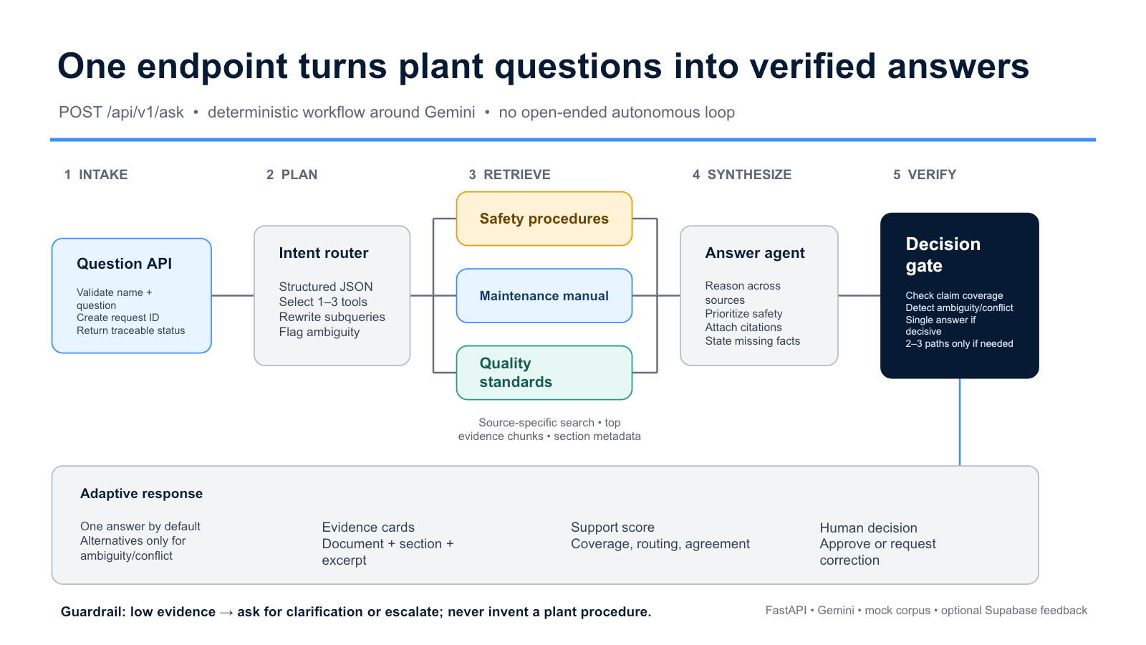
Notes:
[Sources]
- User-supplied architecture visual: docs/floorguide-endpoint-architecture-v2/slide-1.png.
[/Sources]

Slide 4
CONTEXT DESIGN
Compact context makes answers grounded and auditable
SAFETY
MAINTENANCE
QUALITY
SAFE-PKG07-001
MAINT-PKG07-001
QC-PKG07-001
Guarding, LOTO, jams, emergency response
Troubleshooting, inspection, controlled return to service
Checks, holds, traceability, product release
Built for evidence, not volume
Fictional plant-specific content was organized into numbered sections, chunked for retrieval, and exposed as browsable citation links.
04
Notes:
[Sources]
- endpoints/data/safety_procedures.md; endpoints/data/maintenance_manual.md; endpoints/data/quality_control_standards.md.
[/Sources]

Slide 5
OUTPUT EXPERIENCE
Adaptive responses reduce cognitive burden
DEFAULT
ONLY WHEN NEEDED
One decisive answer
Alternatives or escalation
Recommended actions
Safety warnings
Escalation criteria
Evidence-support score
IF
Show 2–3 interpretations for material ambiguity or conflicting guidance. Abstain when the requested fact is not supported.
Every citation opens the exact supporting section.
05
Notes:
[Sources]
- Internal response-mode and citation policy.
[/Sources]

Slide 6
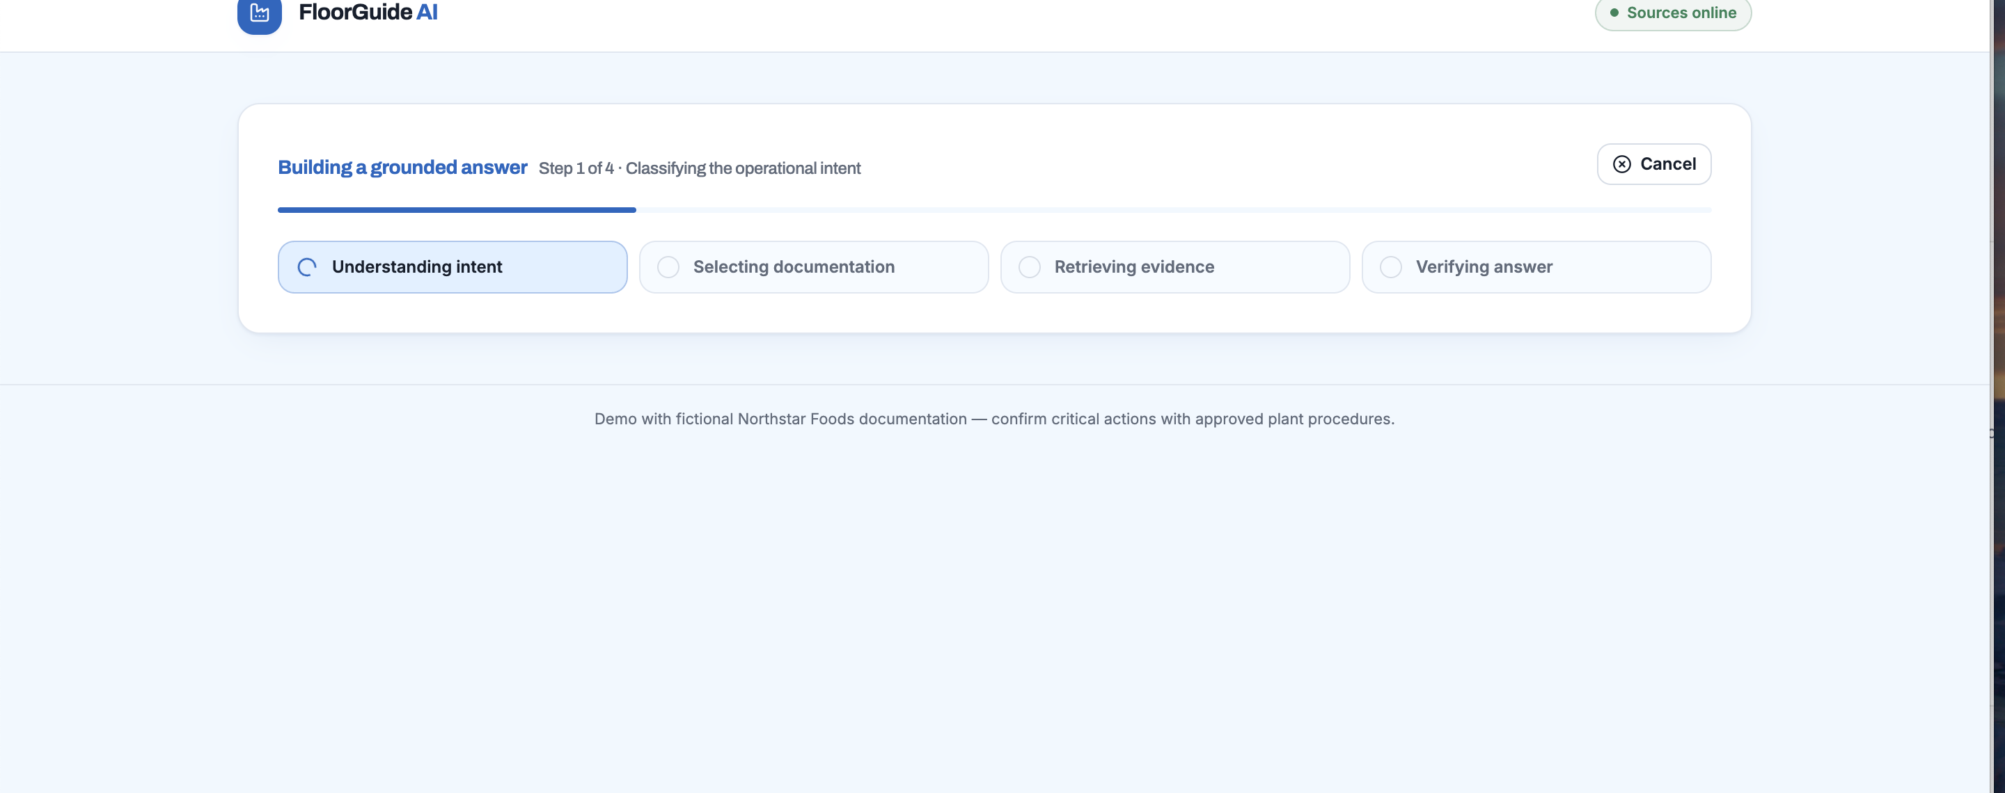
LIVE WORKFLOW · 1 OF 3
The interface makes agent progress visible
06
Notes:
[Sources]
- User-supplied screenshot of the deployed FloorGuide processing state.
[/Sources]

Slide 7
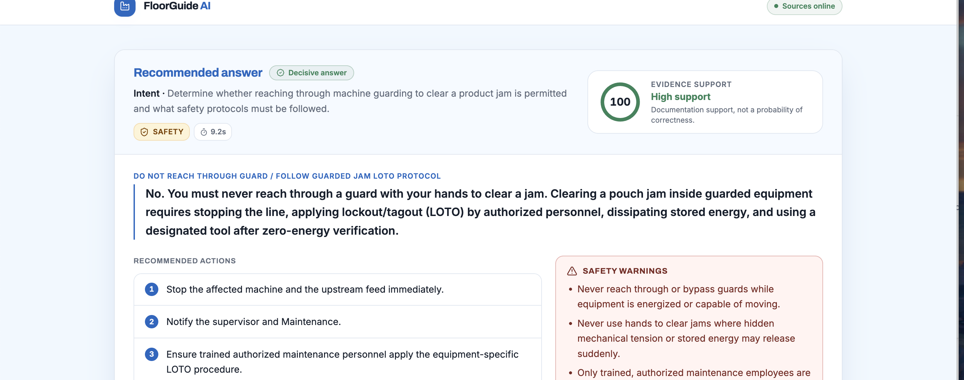
LIVE WORKFLOW · 2 OF 3
A decisive answer combines action, safety, and escalation
07
Notes:
[Sources]
- User-supplied screenshot of the deployed decisive-answer state.
[/Sources]

Slide 8
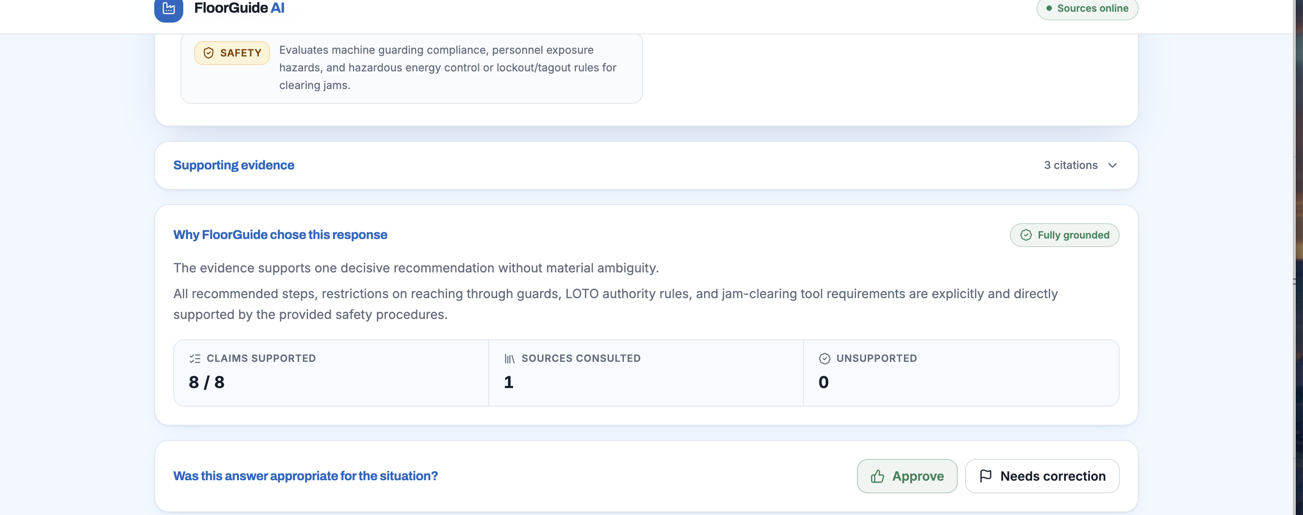
LIVE WORKFLOW · 3 OF 3
Explainability and human feedback close the loop
08
Notes:
[Sources]
- User-supplied screenshot of grounding explanation and human feedback controls.
[/Sources]

Slide 9
EVIDENCE & NEXT STEP
Benchmarking validates the core and reveals the next control
3/5
86.6%
full passes
average check score
What we learned
• Restart guidance must preserve exact quantities.
• “Supported abstention” is not the same as “answerable.”
• Next: add an explicit answerability gate.
No unsafe or invented instructions were detected across the five live cases.
09
Notes:
[Sources]
- endpoints/evals/latest_report.md; endpoints/evals/latest_results.json.
[/Sources]

Slide 10
QUERY-LEVEL RESULTS
The benchmark pinpoints where governance must improve
Case | Operational question | Sources | Score | Support | Latency | Result
B01 | Overheating motor + guarded inspection | Safety + Maint. | 100% | 100 | 35.7 s | PASS
B02 | Guarded jam + affected-product hold | Safety + Maint. + Quality | 100% | 100 | 69.7 s | PASS
B03 | Release after heat-sealer adjustment | Maint. + Quality | 83% | 98 | 17.9 s | FAIL · quantity
B04 | Unreadable lot-code nonconformance | Maint. + Quality | 100% | 100 | 34.4 s | PASS
B05 | Missing motor-bolt torque specification | Maintenance | 50% | 100 | 26.4 s | FAIL · mode
Pass = all six checks: concepts, safety, routing, response mode, citation integrity, and support threshold.
10
Notes:
[Sources]
- endpoints/evals/latest_report.md; endpoints/evals/latest_results.json; endpoints/evals/benchmark.json.
[/Sources]

Slide 11
BENCHMARK DETAIL
Five live cases make strengths and gaps explicit
5/5
3/5
safe responses
full passes
Two actionable failures
• B03: correct direction, but omitted the exact five-package restart check.
• B05: safely said torque was absent, but confidence semantics still marked the question answerable.
• Fix: preserve quantities and gate on requested-fact availability.
Average check score: 86.6% · Transparent six-check rubric · 184.7 seconds across five live calls
11
Notes:
[Sources]
- endpoints/evals/latest_report.md; endpoints/evals/latest_results.json.
[/Sources]

Slide 12
RECOMMENDATION
Move from prototype to a controlled line-level pilot
Prototype proved
Production hardening
Cross-source routing, cited retrieval, adaptive answers, explicit support scoring, browsable evidence, live deployment, and a repeatable benchmark.
→
Three focused controls
1. Add a requested-fact answerability gate
2. Run semantic + deterministic evals in CI
3. Add real ingestion, identity, permissions, and audit logs
Pilot one line with one accountable owner; measure response usefulness, safe escalation, and time-to-decision.
12
Notes:
[Sources]
- Internal prototype findings and benchmark recommendations.
[/Sources]

