Slide 1
EXECUTIVE PROTOTYPE REVIEW
ASK
FloorGuide AI
Route to the right operational knowledge
Grounded, verifiable guidance for plant-floor decisions
ANSWER
Return one actionable response with evidence
Agentic Forward-Deployed Engineer prototype · Scenario 1
Notes:
[Sources]
- Internal project architecture and deployed prototype.

Slide 2
EXECUTIVE OUTCOME
Fragmented guidance becomes a defensible decision
Today’s friction
FloorGuide response
A supervisor must interpret safety procedures, maintenance manuals, and quality standards—often under time pressure.
→
One recommended action by default
Grounded in the relevant documents, scored for evidence support, and linked to the exact source sections.
Human approval remains the final control point.
02
Notes:
[Sources]
- Internal project requirements and product design decisions.

Slide 3
ARCHITECTURE
The workflow separates retrieval from judgment
Supervisor question
1
2
3
4
5
Interpret
Route
Retrieve
Synthesize
Verify
Recognize intent
Select 1–3 sources
Find cited sections
Build grounded answer
Check support & conflict
Adaptive response
Python controls tool execution and the final decision thresholds; Gemini handles structured reasoning.
03
Notes:
[Sources]
- endpoints/app/agents/workflow.py; endpoints/app/agents/router.py; endpoints/app/agents/synthesizer.py; endpoints/app/agents/verifier.py.

Slide 4
CONTEXT DESIGN
Compact context makes answers grounded and auditable
SAFETY
MAINTENANCE
QUALITY
SAFE-PKG07-001
MAINT-PKG07-001
QC-PKG07-001
Guarding, LOTO, jams, emergency response
Troubleshooting, inspection, controlled return to service
Checks, holds, traceability, product release
Built for evidence, not volume
Fictional plant-specific content was organized into numbered sections, chunked for retrieval, and exposed as browsable citation links.
04
Notes:
[Sources]
- endpoints/data/safety_procedures.md; endpoints/data/maintenance_manual.md; endpoints/data/quality_control_standards.md.

Slide 5
OUTPUT EXPERIENCE
Adaptive responses reduce cognitive burden
DEFAULT
ONLY WHEN NEEDED
One decisive answer
Alternatives or escalation
Recommended actions
Safety warnings
Escalation criteria
Evidence-support score
IF
Show 2–3 interpretations for material ambiguity or conflicting guidance. Abstain when the requested fact is not supported.
Every citation opens the exact supporting section.
05
Notes:
[Sources]
- Internal decision policy and API response schema.

Slide 6
EVIDENCE & NEXT STEP
Benchmarking validates the core and reveals the next control
3/5
86.6%
full passes
average check score
What we learned
• Restart guidance must preserve exact quantities.
• “Supported abstention” is not the same as “answerable.”
• Next: add an explicit answerability gate.
No unsafe or invented instructions were detected across the five live cases.
06
Notes:
[Sources]
- endpoints/evals/latest_report.md; endpoints/evals/latest_results.json.

Slide 7
CONTROL ARCHITECTURE
Typed stages make the agent inspectable and governable
Question + user context
1
2
3
4
5
Router
Retriever
Compose
Verifier
Decide
Intent + source plan
Ranked cited chunks
Actions + citations
Support + conflict score
Answer / options / abstain
Response contract
Python owns sequencing, thresholds, and failure handling. Gemini reasons inside bounded prompts; every stage returns structured JSON that can be logged and evaluated.
07
Notes:
[Sources]
- Internal endpoint implementation and prompt contracts.

Slide 8
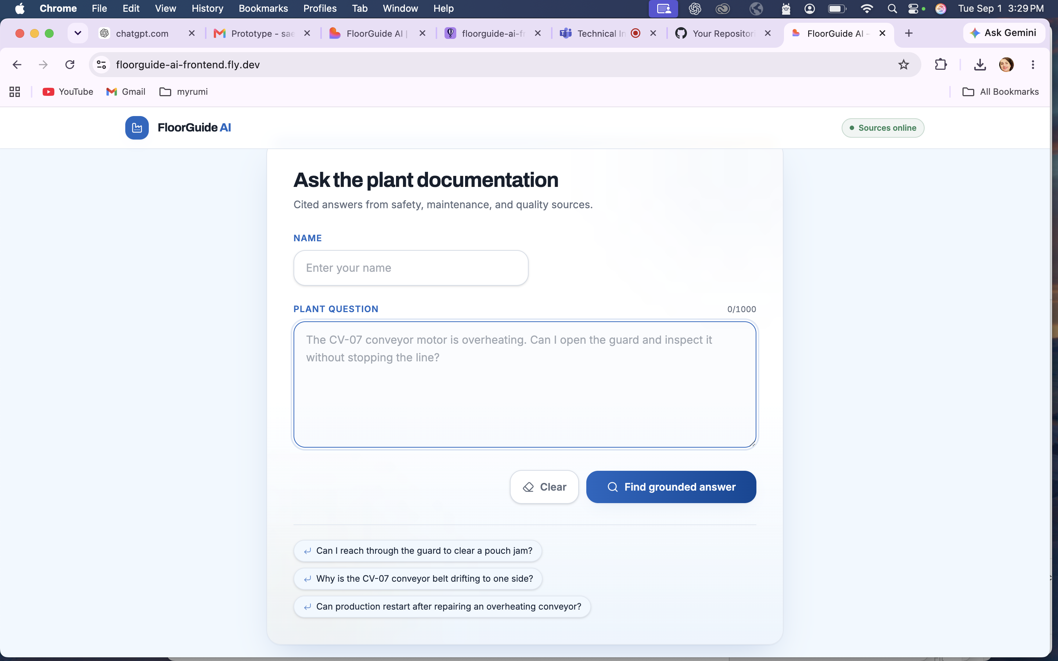
LIVE PRODUCT
The prototype is deployed and usable end to end
Production-like proof
React UI on Fly.io calls the FastAPI agent, waits for the grounded response, and renders its decision, support score, and citations.
Browser-tested: question → agent workflow → answer → browsable source section.
08
Notes:
[Sources]
- User-provided screenshot of https://floorguide-ai-frontend.fly.dev, captured 2026-09-01.

Slide 9
BENCHMARK DETAIL
Five live cases make strengths and gaps explicit
5/5
3/5
safe responses
full passes
Two actionable failures
• B03: correct direction, but omitted the exact five-package restart check.
• B05: safely said torque was absent, but confidence semantics still marked the question answerable.
• Fix: preserve quantities and gate on requested-fact availability.
Average check score: 86.6% · Transparent six-check rubric · 184.7 seconds across five live calls
09
Notes:
[Sources]
- endpoints/evals/latest_report.md; endpoints/evals/latest_results.json.

Slide 10
RECOMMENDATION
Move from prototype to a controlled line-level pilot
Prototype proved
Production hardening
Cross-source routing, cited retrieval, adaptive answers, explicit support scoring, browsable evidence, live deployment, and a repeatable benchmark.
→
Three focused controls
1. Add a requested-fact answerability gate
2. Run semantic + deterministic evals in CI
3. Add real ingestion, identity, permissions, and audit logs
Pilot one line with one accountable owner; measure response usefulness, safe escalation, and time-to-decision.
10
Notes:
[Sources]
- Internal prototype findings and benchmark recommendations.

