Slide 1
TwitterFluence – Finding the centers of influence of Twitter
Prasanth Iyer
Saurabh Jaluka
Himanshu Gupta

Slide 2

TwitterFluence – Finding the centers of influence of Twitter
Kevin Bacons
Prasanth Iyer
Saurabh Jaluka
Himanshu Gupta

Slide 3
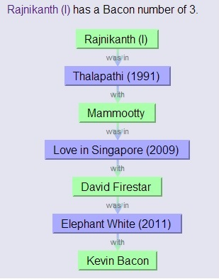
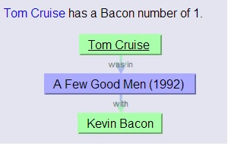
Why Kevin Bacon?
The Oracle of Bacon - http://oracleofbacon.org/

Slide 4
Why centers of influence?
Finding how influential a person is in a social network
Directed Advertising
Finding the bottlenecks in a transport network
Traffic Management
Finding the most relevant sites in a search engine
Search engine ranking

Slide 5
Why Twitter?
Because it is a directed social network
Follower
Followed
directed
Twitter Statistics | Data (1.1.2014)
Number of users | 645 million!!!
Number of new users per day | 100,000
Average followers per user | 200
Number of follower-followed relationships | 129 billion!!!
According to
http://www.statisticbrain.com/twitter-statistics/

Slide 6
Why is this problem interesting?
Is A’s influence more than B’s?
A
… (A billion relationships later)
B

Slide 7
Why is this problem interesting?
Does A’s influence affect B’s influence?
A
follows
B

Slide 8
Why is this problem interesting?
Does A’s influence affect B’s influence?
A
follows
B
What if A was a Kevin Bacon?!!!
And, what if B is following C?

Slide 9
Our Approach

Slide 10

Defining Influence
A user’s influence is defined by the number of his followers and to a lesser extent the number of his followers’ followers and to an even lesser extent the number of …
So, mathematically,
I(A) = n(followers(A))
+ α n(followers(followers(A))
+ α² n(followers(followers(followers(A))) …
In other words, I(A) = α^{k} I(follower_{i}(A))
Katz Centrality

Slide 11
Defining Influence
Problem:
A
B
…(1000 followers)
If B tweets, how likely is it that A will retweet it?
So, I(B) = α^{k} I(A_{i}) n(followers(A_{i}))

Slide 12
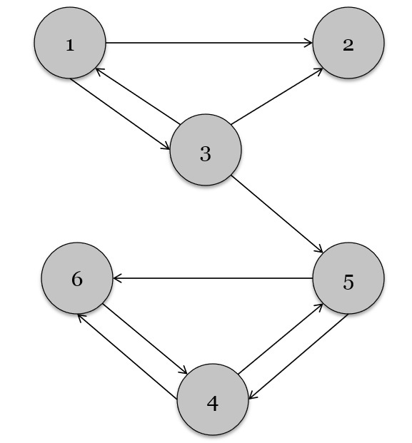
The distributed algorithm
Initial graph

Slide 13
The distributed algorithm
Initial influence
1.0
1.0

Slide 14
The distributed algorithm
Every node sends its influence to its neighbors
1.0
1.0/3
1.0/2
1.0

Slide 15
The distributed algorithm
Iteration 1 (k = 1)
0.5(0.33 + 0.5)=0.42

Slide 16
Our Implementation

Slide 17
What technology to use?
Pregel?
Not open-source!!
Giraph?
Node-by-node processing
Overhead of graph processing
Hadoop?
Not good for dependent data as it has a huge communication overhead.

Slide 18
Is our data really dependent?
Influence of each user is only dependent on the influence values of its direct followers.
So, the only communication required is that each user needs to communicate his influence to all the users that he directly follows.
Hadoop!!!

Slide 19
Hadoop Implementation
User | Follows
A | B
C | A
C | B
A
A
B | 1.0/1
C
A | 1.0/2
B | 1.0/2
C
B
Data
Join
Mapper/
Reducer
Count Mapper/Reducer
Aggregate
Influence
Mapper/
Reducer
Input
Initialize
Influence
Mapper/Reducer
User | Influence
A | 0.75
B | 0.5
C | 0
Output

Slide 20
Experiments and Results

Slide 21
Experimental Setup
Node Configuration on hpc-login2.usc.edu
Processor | Dual Octocore Intel Xeon 2.4 GHz
Memory | 64GB Memory
Temporary disk size | 1TB
Shared Hardisk size | 200GB
Maximum Number of Node requested | 64
Processes per node | 2

Slide 22
Our Data Set
We used the entire Twitter data set as of July 2009 from http://an.kaist.ac.kr/traces/WWW2010.html.
Size: 24.5 GB
No. of Users: 41.7 million
No. of Social Relations: 1.47 billion
Format:
Follower \t Followed\n
Eg: 12 1
User 12 is a follower of 1.

Slide 23
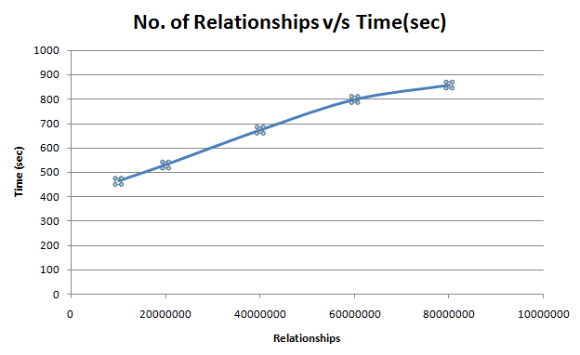
How scalable is it?
How does it perform with increase in data?
User | Relationships | Time(sec) | Factor
4767 | 10 M | 463 | 1.00
21377 | 20 M | 530 | 1.14
53982 | 40 M | 673 | 1.45
120212 | 60 M | 799 | 1.73
194830 | 80 M | 858 | 1.85

Slide 24
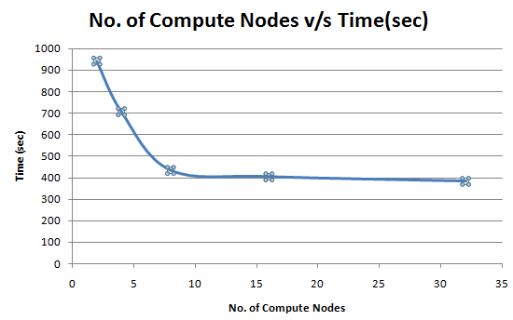
How scalable is it?
How does it perform with increase in number of compute nodes?
Nodes | Time(sec) | Speedup
2 | 942 | 1.00
4 | 707 | 1.33
8 | 434 | 2.17
16 | 404 | 2.33
32 | 383 | 2.46

Slide 25
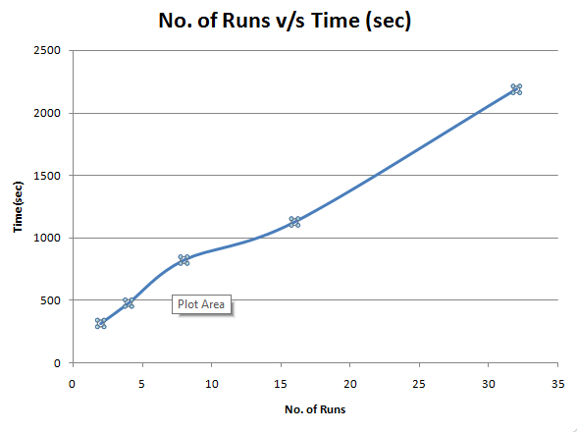
How scalable is it?
How does it perform with increase in number of iterations?
No. of Runs | Time(sec) | Factor
2 | 315 | 1.00
4 | 478 | 1.52
8 | 822 | 2.61
16 | 1127 | 3.58
32 | 2187 | 6.94

Slide 26


Does it even really work with bigger data?
What are the results with 4GB of data?
Number of Users = 1.7 Million
Number of edges = 0.28 Billion
428333
783214
813286

Slide 27



Does it even really work with bigger data?
What are the results with 4GB of data?
Number of Users = 1.7 Million
Number of edges = 0.28 Billion
2,142,902
1,854,051
1,788,362

Slide 28
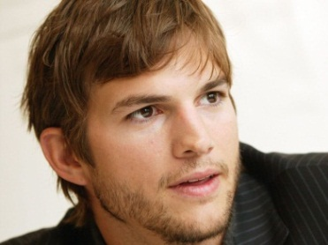

Does it even really work with bigger data?
What are the results with 10GB of data?
Number of Users = 4.4 Million
Number of edges = 0.6 Billion
2,615,432
2,142,902
1,788,362

Slide 29
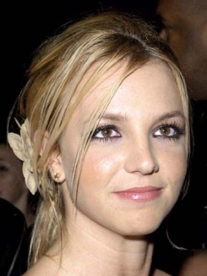
Does it even really work with bigger data?
What are the results with 24GB of data?
Number of Users = 41.7 Million!!!
Number of edges = 1.47 billion!!!
2,142,902
2,553,668
1,788,362

Slide 30
Conclusion
Our implementation works, and scales pretty well with increase in data, number of nodes and iterations.

Slide 31
References
Using MapReduce to compute PageRank
http://michaelnielsen.org/blog/using-mapreduce-to-compute-pagerank/
Incremental PageRank for Twitter Data Using Hadoop
http://homepages.inf.ed.ac.uk/miles/msc-projects/abdullah.pdf
The Anatomy of a Large-Scale Hypertextual Web Search Engine
http://infolab.stanford.edu/~backrub/google.html
Justification and Application of Eigenvector Centrality
https://www.math.washington.edu/~morrow/336_11/papers/leo.pdf
R. Ghosh and K. Lerman. Rethinking centrality: The role of dynamical processes in social network analysis. arXiv:1209.4616, 2012.
http://arxiv.org/pdf/1209.4616.pdf
R. Ghosh and K. Lerman, Predicting Inuential Users in Online Social Networks, in Proc.KDD workshop on Social Network Analysis (SNAKDD), 2010

Slide 32
The End…
Any questions???

