Slide 1
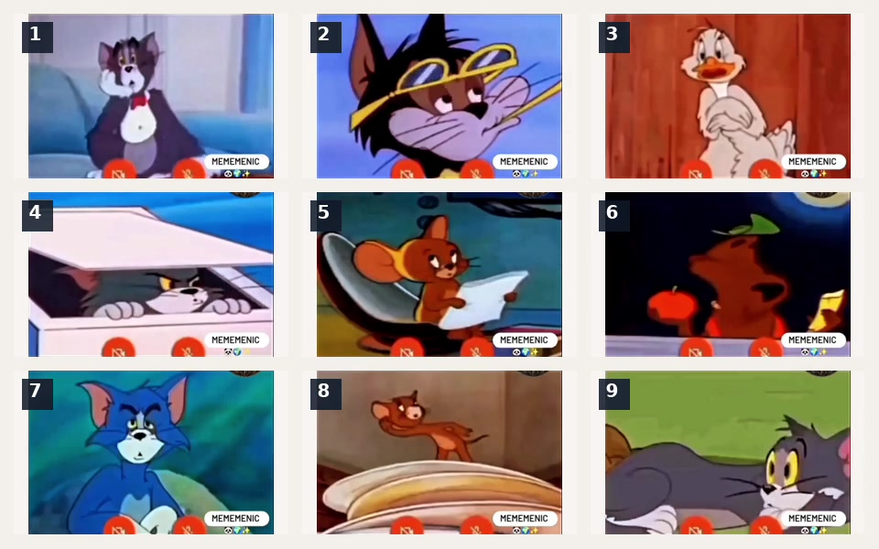
How are you feeling today?
Pick a number. No explanation required 😄
▶ plays with original audio

