Slide 1
Development and Deployment of a Simple Ecommerce Website
Barta, Zoltán Kevin

Slide 2





Introduction
Types:
B2B
B2C
C2C
Predecessors:
EDI
EFT

Slide 3


Literature Review UI Best Practices
Don't Make Me Think, Revisited – Steve Krug
Refactoring UI - Adam Wathan, Steve Schoger

Slide 4






Literature Review Cloud Deployment and Security
Security concerns
Common security threats and their mitigation
Cloud storage
Data security and privacy

Slide 5




Literature Review Analyzing Existing Ecommerce Platforms

Slide 6












Evaluation Criteria
Nonfunctional requirements
Functional requirements

Slide 7
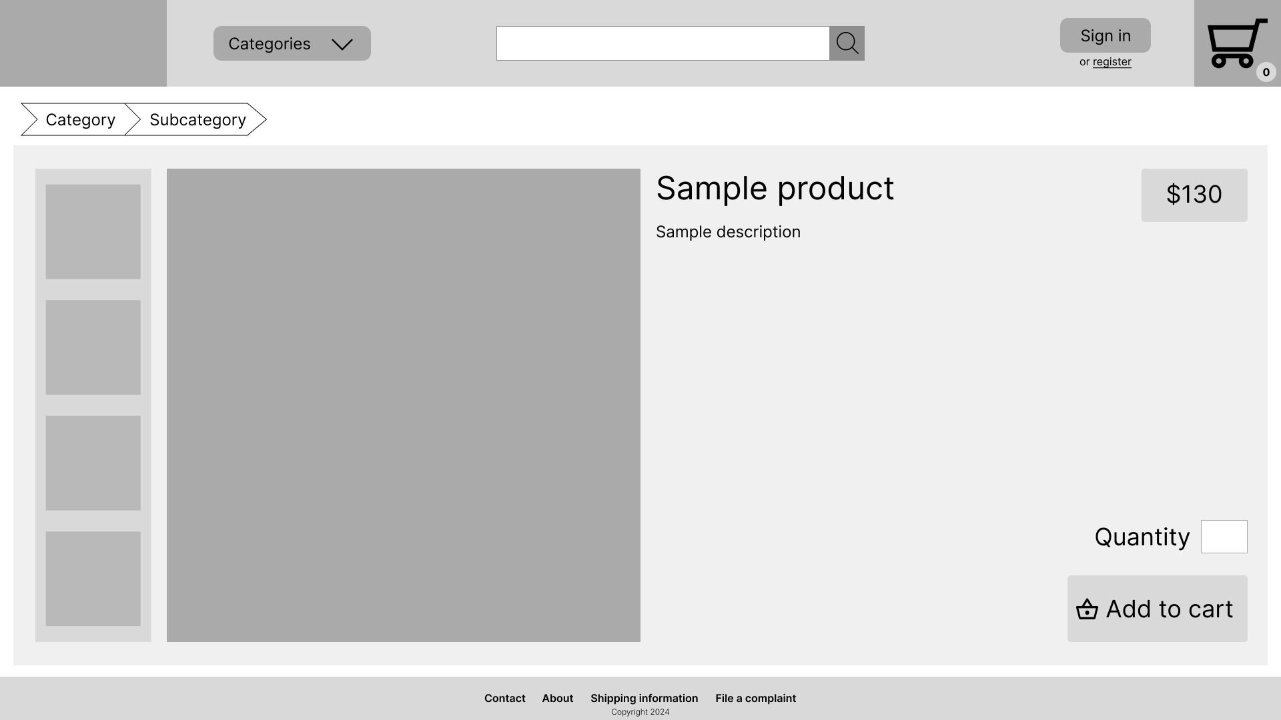

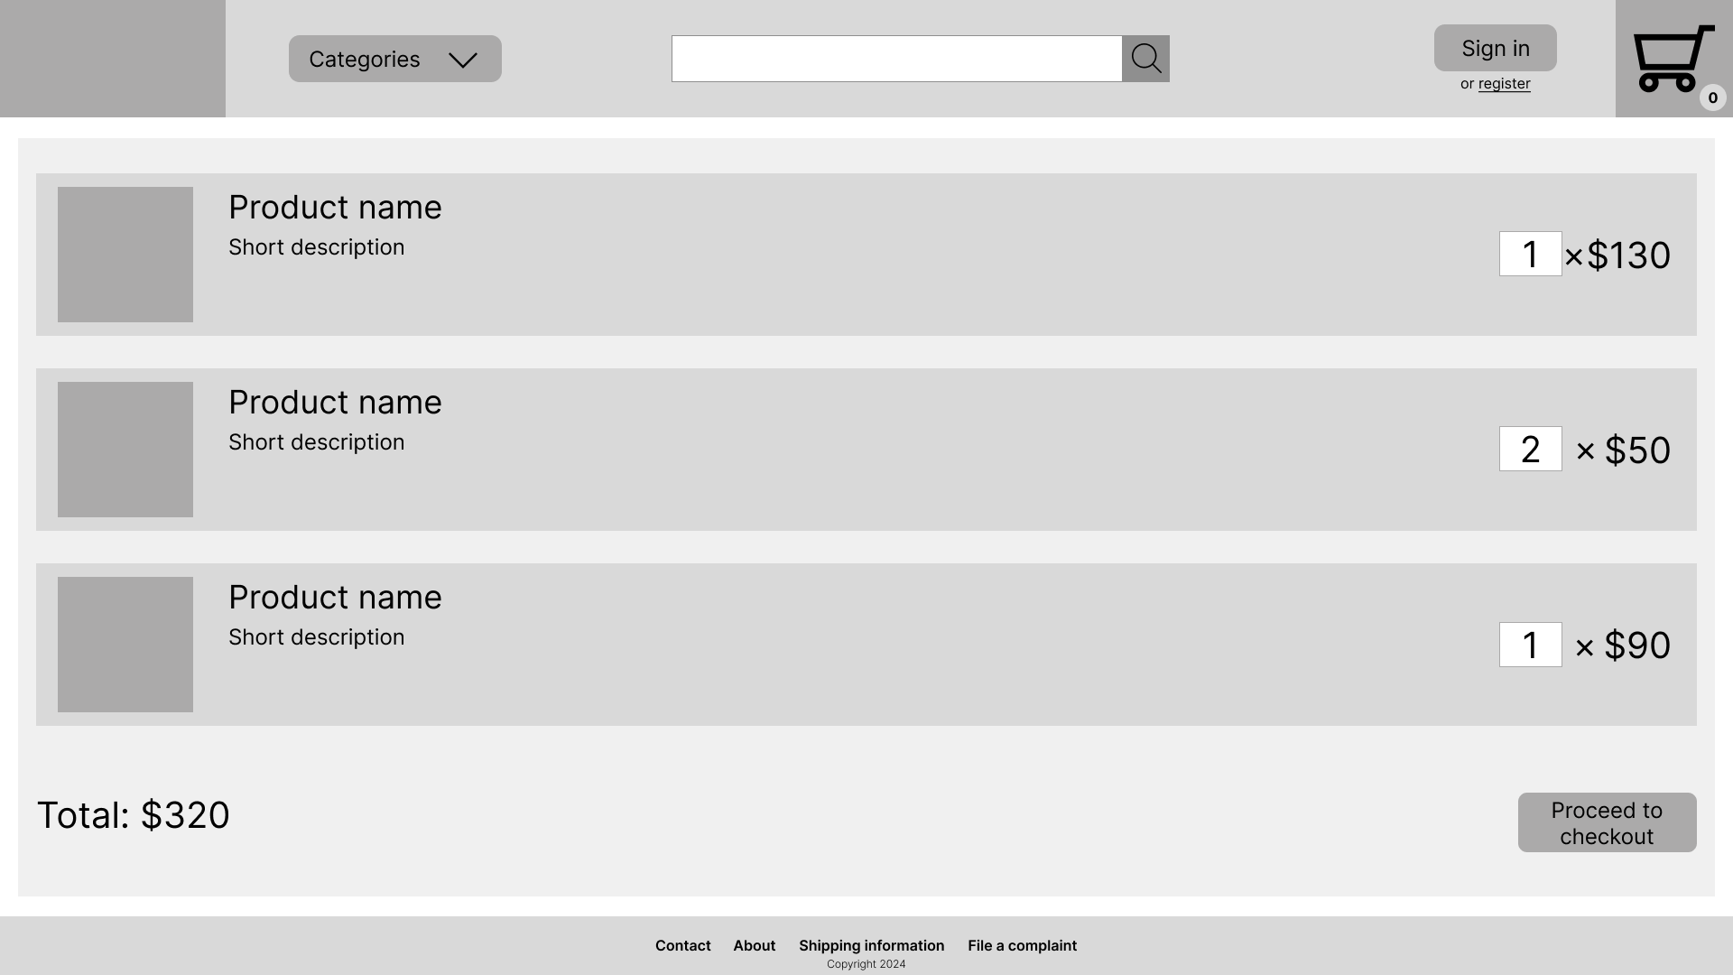

System design Frontend

Slide 8
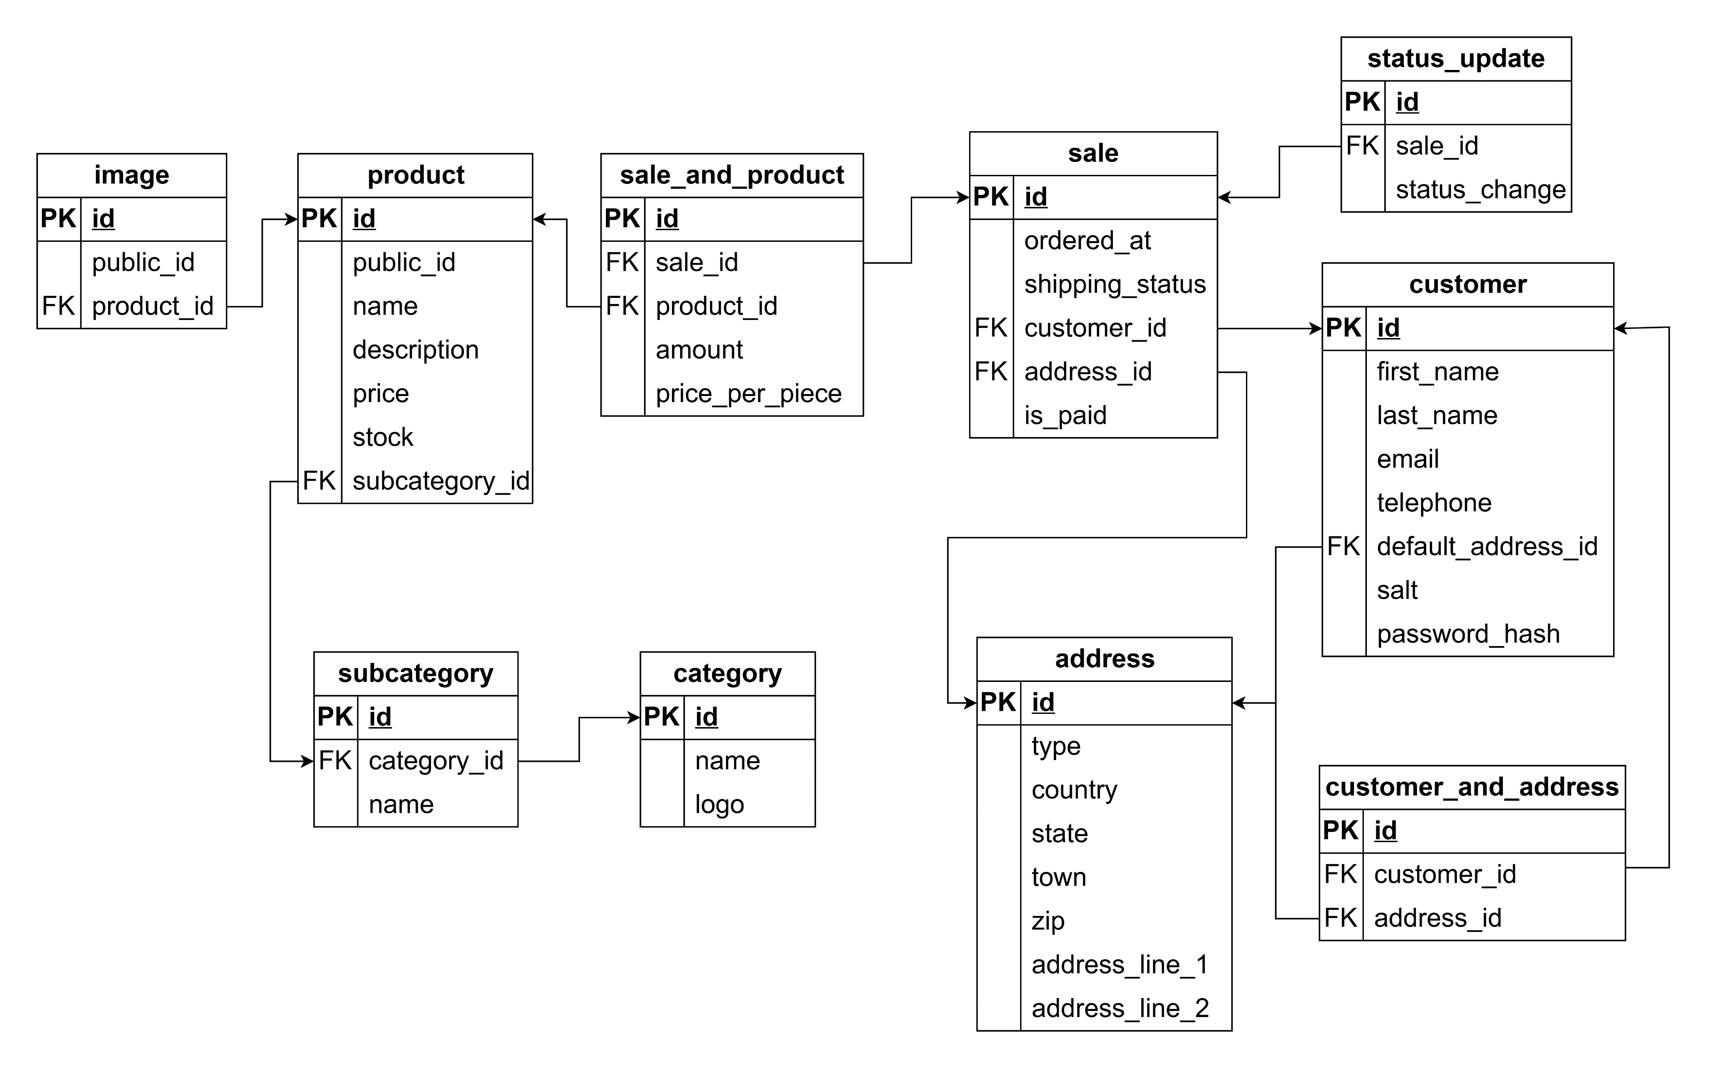

System design Database

Slide 9


System design Backend API
Public Endpoints
Customer Endpoints
Admin endpoints

Slide 10
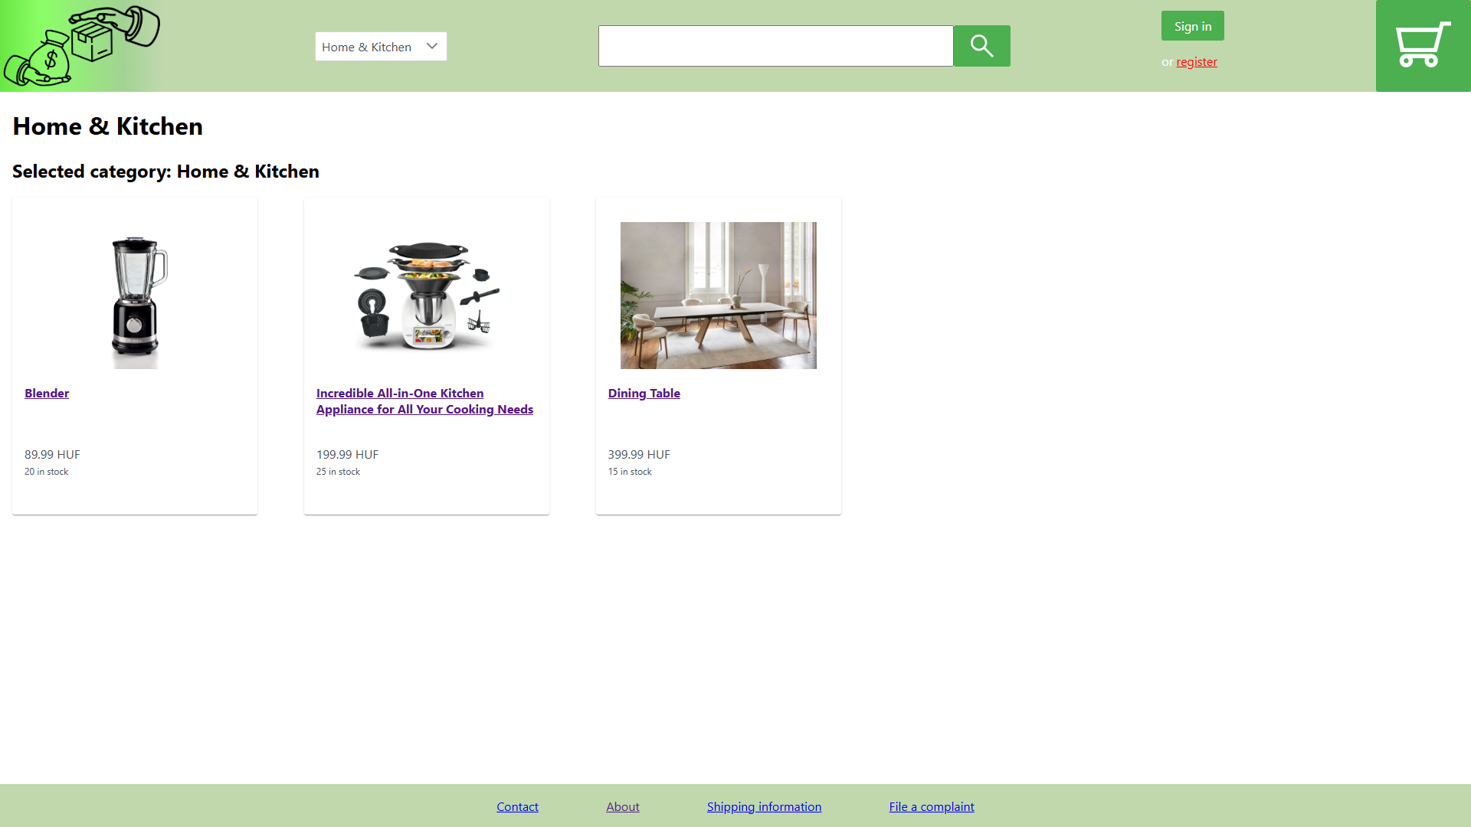
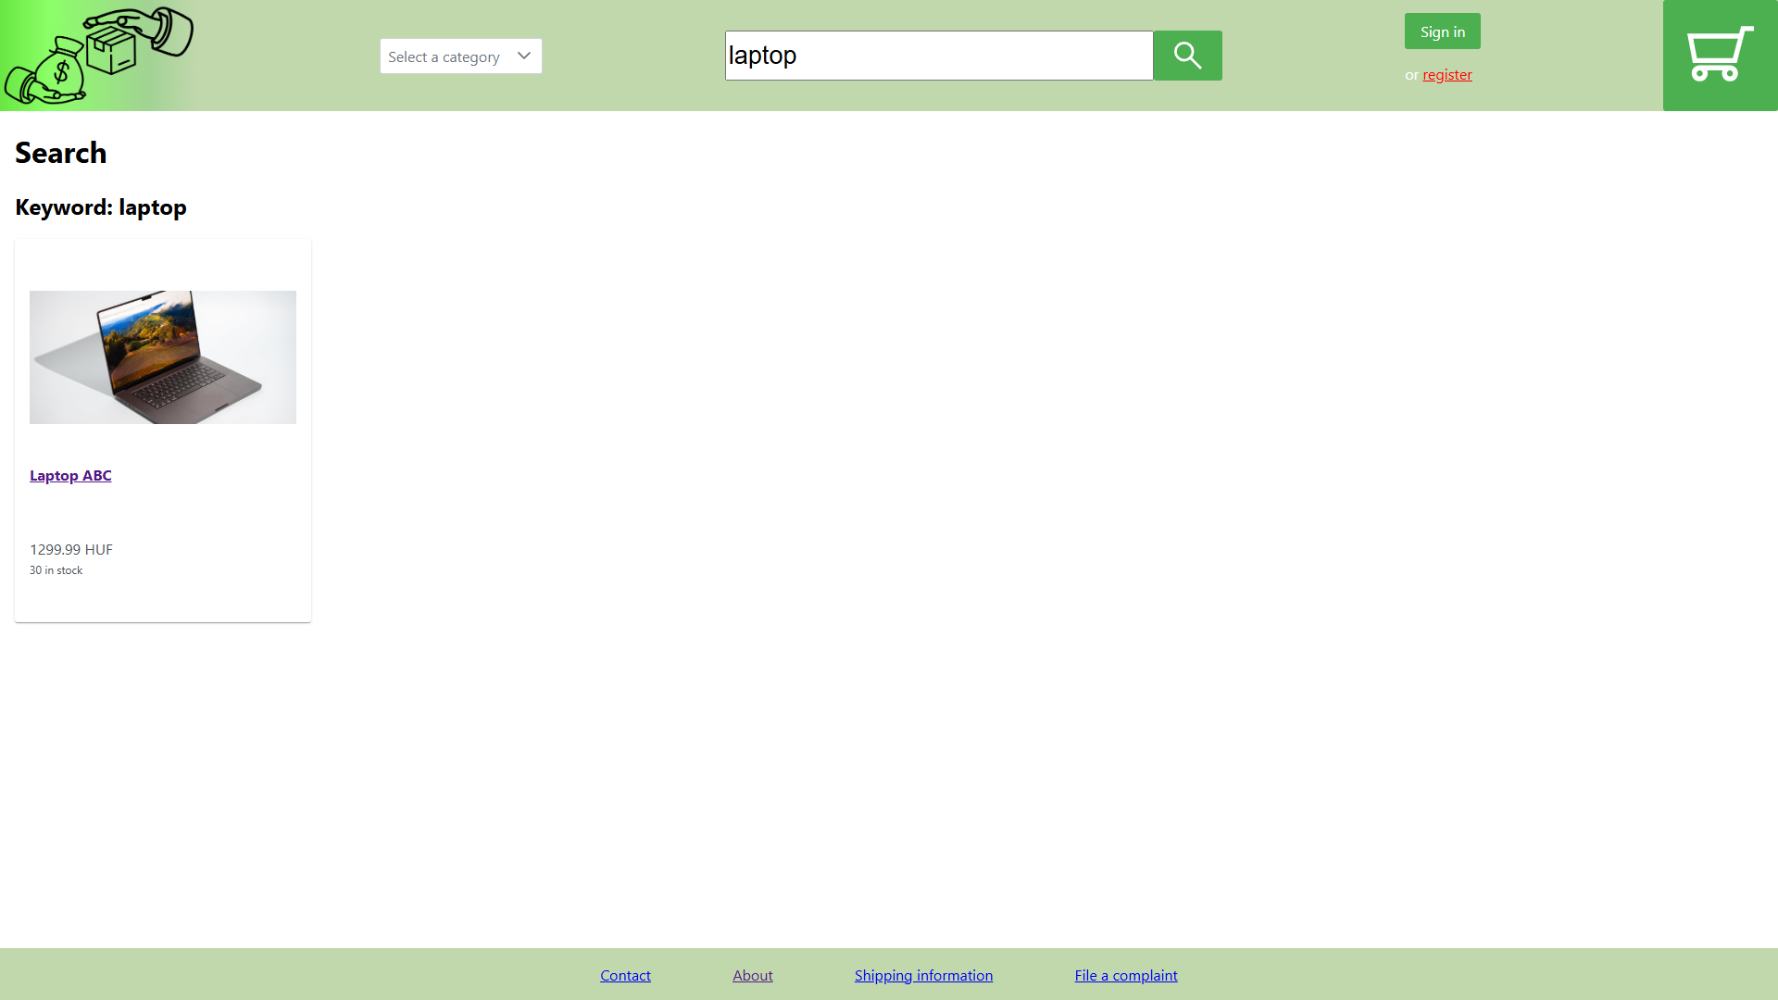
Implementation Frontend Website

Slide 11



Implementation Database
Password hashing
Image management
password
salt
simplepass
275c8c471205ad8abe0df6cec53d2bf7
e23e3e6bd2158d5e7e8a86d859341d8a3f3c3c1bfc60e1e4150e5d77ab2dcdf6
public_id
SHA-256 digest

Slide 12




Implementation Backend API
JWT
my orders?
8 books
2 laptops
username
password
JWT
Client
Server

Slide 13










Deployment

Slide 14


Evaluation
Nonfunctional requirements
Functional requirements

Slide 15
Thank you for listening!

