Slide 1
ACCENTURE
The $70B Reinvention Machine
AI-first transformation partner · FY2025 results
$69.7B
nearly doubled
7%
77,000
FY2025 Revenue
GenAI Bookings YoY
GenAI Market Share
AI & Data Staff
+7% YoY
$5.9B in FY2025
IoT Analytics, Jan 2025
from 40,000 two years prior
June 2026 · Sources: 12 months ended Aug 31, 2025 earnings, Everest Group, IoT Analytics

Slide 2
At a Glance
Accenture · FY2025 Key Metrics
$69.7B
$80.6B
Total Revenue
New Bookings
+7% in both USD & local currency
Book-to-bill 1.2x · -1% YoY
$5.9B
$2.7B
GenAI Bookings
GenAI Revenue
nearly doubled year-over-year
tripled year-over-year
77,000
15.6%
AI & Data Professionals
Adjusted Operating Margin
up from 40,000 two years ago
60–80bps expansion over FY24
Accenture Market Intelligence Brief · June 2026 · Sources: Earnings, Everest Group, IoT Analytics, Exa
2 / 10

Slide 3
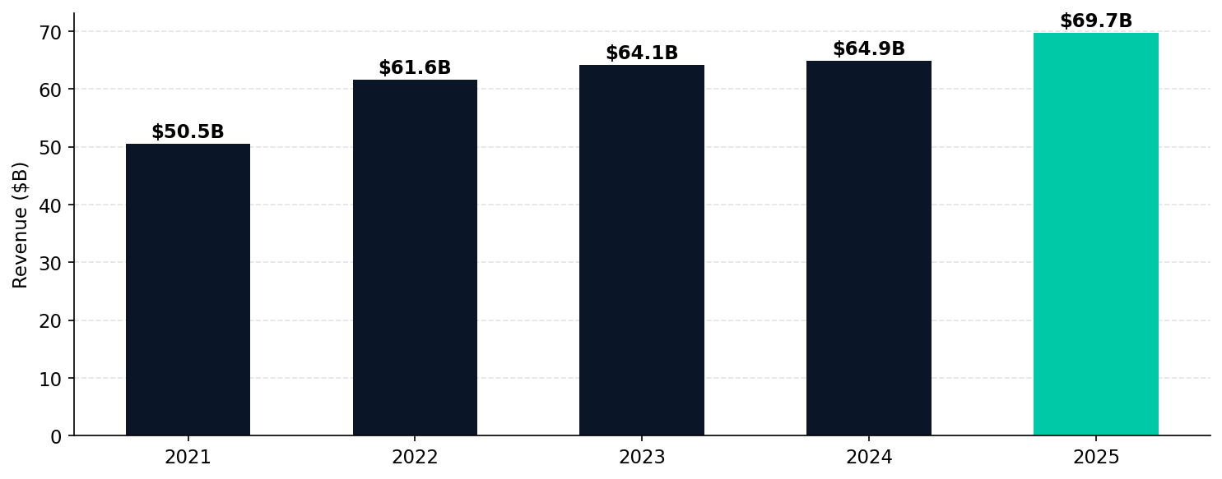
Revenue Trend
5-year trajectory from SEC EDGAR XBRL
Accenture added ~$20B in revenue since 2021 (+38%). FY2025 inflection driven by GenAI bookings ramp.
Accenture Market Intelligence Brief · June 2026 · Sources: Earnings, Everest Group, IoT Analytics, Exa
3 / 10

Slide 4
Revenue Breakdown
Segment & industry mix driving growth
BY TYPE OF WORK
BY INDUSTRY GROUP
Consulting
Products
$35.1B · +6% YoY
$21.2B (30) · +8%
Health & Public Svc
Strategy, Technology, Song, Industry X
$14.8B (21) · +6%
Financial Services
Managed Services
$34.6B · +9% YoY
$12.8B (18) · +10%
Comms, Media & Tech
Operations, BPO, application management
$11.5B (16) · +6%
Resources
$9.5B (14) · +5%
Accenture Market Intelligence Brief · June 2026 · Sources: Earnings, Everest Group, IoT Analytics, Exa
4 / 10

Slide 5
AI PLATFORM & STRATEGY
How Accenture is monetizing the AI wave
$2.7B
$5.9B
77,000
6,000+
GenAI Revenue
GenAI Bookings
AI Staff
AI Projects
tripled YoY
nearly doubled YoY
from 40K 2 years ago
delivered in FY2025
The $3B Bet Is Paying Off
Accenture's FY2023 decision to commit $3B to GenAI is the clearest first-mover bet in consulting. FY2025 results validate the thesis: $2.7B revenue (tripled), $5.9B bookings (nearly doubled), 7% GenAI market share. No competitor has matched this scale of AI revenue to date. The model: train talent first, ship client solutions second, monetize at scale third. CEO Julie Sweet: 'We are reinventing what we sell, how we deliver, how we partner.'
Accenture Market Intelligence Brief · June 2026 · Sources: Earnings, Everest Group, IoT Analytics, Exa
5 / 10

Slide 6
Strategic Moves
What's changed and why it matters
①
Reinvention Services Launch
②
$3B GenAI First-Mover Bet
Sep 1 2025: Collapsed 5 BUs (Strategy, Technology, Operations, Song, Industry X) into one integrated 'Reinvention Services' unit — simpler sell, faster cross-service deals.
Committed $3B to GenAI in FY2023. Result: $2.7B GenAI revenue in FY2025 (tripled YoY), $5.9B bookings. Fastest ramp of any new technology category in Accenture history.
③
Talent at Scale
④
Ecosystem #1 Position
Grew AI & data staff from 40K to 77K in 2 years. 550,000+ employees trained in GenAI fundamentals. $1B invested in client upskilling platform + Udacity acquisition.
No. 1 partner for all top 10 ecosystem partners (AWS, Azure, Google, SAP, Salesforce, etc.). 60% of FY25 revenue from ecosystem work, growing 9% — outpacing total revenue growth.
Accenture Market Intelligence Brief · June 2026 · Sources: Earnings, Everest Group, IoT Analytics, Exa
6 / 10

Slide 7
Competitive Landscape
AI consulting & enterprise technology market
AI Consulting Market Context: Valued at $14B in 2024, projected to reach $630B+ by 2028. Tier 1 players (Accenture, IBM, Deloitte, Capgemini) hold 50–55% share. Accenture leads GenAI services with 7% share — first-mover advantage from $3B investment.
Company
Revenue
GenAI Mkt Share
AI Platform
Analyst Tier
Accenture ◀
$69.7B
7%
Reinvention Services + AI Refinery
Leader
IBM
$62.8B
2%
watsonx + Hybrid Cloud
Leader
Deloitte
~$65B
3%
Deloitte AI
Leader
PwC
~$55B
<1%
PwC AI
Major Contender
Capgemini
~$23B
<1%
AI Lab + partnerships
Leader
McKinsey
~$16B
<1%
QuantumBlack
Major Contender
Accenture Market Intelligence Brief · June 2026 · Sources: Earnings, Everest Group, IoT Analytics, Exa
7 / 10

Slide 8
Key Risks & Headwinds
What could derail the thesis
Premium Pricing Pressure
US Federal Headwind
Client feedback: Accenture priced at premium vs peers. Cost-conscious mid-market enterprises may route to Deloitte, Capgemini, or offshore players.
FY2026 guidance excludes 1–1.5% drag from US federal business contraction. Government consulting spend uncertainty is a notable near-term risk.
Execution at Scale
Consulting vs Services Mix Shift
6,000+ AI projects = massive delivery risk. Referenced clients flag project management gaps and timeline misalignment in some engagements.
Managed Services growing faster (+9%) than Consulting (+6%). Higher managed services mix may compress margins over time.
Accenture Market Intelligence Brief · June 2026 · Sources: Earnings, Everest Group, IoT Analytics, Exa
8 / 10

Slide 9
Strategic Themes
Signal synthesis from market intelligence
AI Revenue Is Real, Not Narrative
Reinvention Services = Simpler Cross-Sell
$2.7B GenAI revenue (tripled) + $5.9B bookings (nearly doubled) in FY2025. This is not PoC pipeline — it's delivered revenue. The $3B multi-year investment made in FY2023 is the highest-conviction AI bet by any consulting firm to date.
Collapsing 5 BUs into one 'Reinvention Services' unit (Sep 2025) reduces internal friction and speeds multi-service deal closure. 80% of large deals already multi-service. This org move is a revenue acceleration lever, not just a restructure.
$2.7B revenue · tripled YoY
80% of large deals are multi-service
Talent Scale Is The Moat
Ecosystem Partnerships Drive Scale
77,000 AI & data professionals + 550,000 GenAI-trained employees = Accenture can staff enterprise AI rollouts that no competitor can match at scale. The talent gap is the #1 barrier enterprises face — Accenture's core competency addresses it directly.
No. 1 partner for all top 10 tech ecosystem companies. 60% of revenue from ecosystem work (+9% YoY, outpacing total growth). This makes Accenture the implementation layer for every major tech platform — a structural advantage competitors can't easily replicate.
77K AI staff · 550K trained
60% ecosystem revenue · +9% YoY
Accenture Market Intelligence Brief · June 2026 · Sources: Earnings, Everest Group, IoT Analytics, Exa
9 / 10

Slide 10
RECOMMENDATIONS
Strategic actions for teams tracking Accenture
Monitor Reinvention Services deal velocity
WATCH
Q1 FY2026 earnings (Dec 2025): first full quarter under the new integrated BU. Watch whether large deal close rates accelerate. A rise in average deal size signals the org change is working.
Target their mid-market gap
COMPETE
Everest Group specifically flags Accenture's limited mid-market presence as a limitation. Competitors can take mid-market AI transformation mandates that Accenture is structurally less suited to serve cost-effectively.
Engage the ecosystem partnership model
PARTNER
60% of Accenture revenue flows through its top 10 ecosystem partners. For tech vendors wanting enterprise AI adoption, Accenture is the most efficient implementation channel — but partnership terms favor Accenture's scale.
Watch GenAI bookings trajectory vs revenue
TRACK
$5.9B GenAI bookings vs $2.7B GenAI revenue = 2.2x book-to-bill on AI alone. This implies a large revenue ramp still ahead in FY2026/27 as bookings convert to revenue. Watch for deceleration signals.
Accenture Market Intelligence Brief · June 2026 · Sources: Earnings, Everest Group, IoT Analytics, Exa
10 / 10

