Slide 1
IBM
The $12.5B AI Book of Business
Hybrid cloud + enterprise AI platform · FY2024/2025 results
$62.8B
$12.5B+
~45%
$6.4B
FY2024 Revenue
GenAI Book (Q4 2025)
Software Revenue
HashiCorp Acquired
+1% (+3% CC) YoY
from $5B a year ago
highest-margin segment
February 27, 2025
June 2026 · Sources: 12 months ended Dec 31, 2024 earnings, Everest Group, IoT Analytics

Slide 2
At a Glance
IBM · FY2024 Key Metrics
$62.8B
$12.5B+
FY2024 Revenue
GenAI Book (Q4 2025)
+1% (+3% CC)
inception-to-date since Q3 2023
~45%
$12.7B
Software Mix
Free Cash Flow (FY2024)
highest-margin segment · 32% gross margin
+$1.5B vs prior year
~80%
$1.4B
Revenue: Multi-Segment
OpenShift ARR
clients buying Software + Consulting + Infra
up 13x since Red Hat acquisition
IBM Market Intelligence Brief · June 2026 · Sources: Earnings, Everest Group, IoT Analytics, Exa
2 / 10

Slide 3
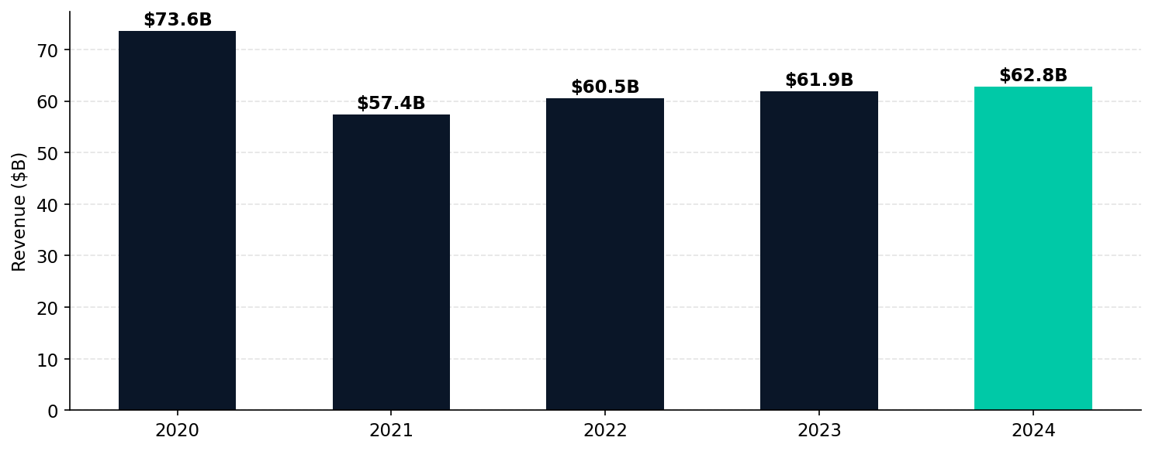
Revenue Trend
5-year trajectory from SEC EDGAR XBRL
IBM revenue stabilized after Kyndryl (2021) and Watson Health (2022) divestitures. Software-led growth resuming.
IBM Market Intelligence Brief · June 2026 · Sources: Earnings, Everest Group, IoT Analytics, Exa
3 / 10

Slide 4
Revenue Breakdown
Segment & industry mix driving growth
Segment
FY2024 Revenue
% of Total
Growth (CC)
Gross Margin
Software
$27.1B
43%
+8.3% (+9% CC)
32.1%
Consulting
$20.7B
33%
-0.9% (+0.6% CC)
9.9%
Infrastructure
$14.0B
22%
-3.9% (-2.7% CC)
17.5%
Financing/Other
$1.0B
2%
—
—
KEY INSIGHT: IBM's transformation thesis — Software (45% of revenue, 32% margin) carries growth while Consulting recovers. Infrastructure declining ~3% is "in line with product cycle" expectations. Red Hat (Software) is the acquisition that changed IBM's trajectory.
IBM Market Intelligence Brief · June 2026 · Sources: Earnings, Everest Group, IoT Analytics, Exa
4 / 10

Slide 5
AI PLATFORM & STRATEGY
How IBM is monetizing the AI wave
$12.5B+
+22%
$1.4B
93%
GenAI Book (Q4'25)
Automation Growth
OpenShift ARR
Fortune 500 on IBM HC
from $5B a year ago
Q3 2025 incl. HashiCorp
13x since Red Hat acqn
hybrid cloud penetration
The 'AI for Regulated Enterprise' Niche
IBM is not competing with OpenAI or Google on frontier models. Its thesis: regulated enterprises (banking, healthcare, government, defense) cannot send data to public cloud AI. IBM's Granite models are 90% more cost-efficient than frontier alternatives and can run on-premise. watsonx GenAI book grew from $5B to $12.5B in 12 months — 150% growth. The IBM 'Client Zero' story (490 workflows, $3.5B savings, -3% to +5% revenue) is the proof point for 500+ consulting deals.
IBM Market Intelligence Brief · June 2026 · Sources: Earnings, Everest Group, IoT Analytics, Exa
5 / 10

Slide 6
Strategic Moves
What's changed and why it matters
①
Software-Led Portfolio Transformation
②
HashiCorp: Infrastructure IaC at Scale
Software is now 45% of IBM revenue (vs ~35% in 2020). Gross margin expanded 130bps to 58% in FY2024. The shift from services-heavy to software-led is the core Arvind Krishna thesis — now executing.
$6.4B acquisition closed Feb 2025. Terraform (+Ansible) = end-to-end infrastructure-as-code. Vault + OpenShift = secrets management for hybrid cloud. Automation segment hit +22% in Q3 2025 partly driven by HashiCorp.
③
watsonx: AI for Regulated Enterprise
④
Client Zero Credibility
watsonx GenAI book grew $5B → $12.5B in 18 months. Granite models 90% more cost-efficient than frontier alternatives. Key differentiator: on-premise deployment for banking, healthcare, government — sectors where cloud-only AI (OpenAI, Google) cannot serve.
IBM 'ate its own cooking': decomposed 490 internal workflows, instrumented ~70 with digital workers, claims $3.5B internal productivity gains. Revenue inflection: –3% to +5% CAGR. Used as proof point in 500+ IBM Consulting Advantage deals.
IBM Market Intelligence Brief · June 2026 · Sources: Earnings, Everest Group, IoT Analytics, Exa
6 / 10

Slide 7
Competitive Landscape
AI consulting & enterprise technology market
IBM's Competitive Niche: Not competing on market share in GenAI services (2% vs Accenture 7%). Competing on infrastructure + platform: 93% of Fortune 500 on IBM hybrid cloud. Regulated industries (banking, healthcare, government) = IBM's defensible moat.
Company
Revenue
GenAI Mkt Share
AI Platform
Analyst Tier
IBM ◀
$62.8B
2%
watsonx + Red Hat + HashiCorp
Leader
Accenture
$69.7B
7%
Reinvention Services + AI Refinery
Leader
Microsoft
$245B
N/A
Azure OpenAI / M365 Copilot
Platform
Deloitte
~$65B
3%
Deloitte AI
Leader
Capgemini
~$23B
<1%
AI Lab
Leader
Red Hat
Internal
—
OpenShift / RHEL AI / Ansible
Acquired
IBM Market Intelligence Brief · June 2026 · Sources: Earnings, Everest Group, IoT Analytics, Exa
7 / 10

Slide 8
Key Risks & Headwinds
What could derail the thesis
Consulting Growth Lag
Microsoft Copilot + Azure OpenAI Scale
Consulting -0.9% FY2024 vs Accenture +6%. IBM Consulting (~38% of revenue) trails Accenture, Deloitte, McKinsey on GenAI services market share (2% vs 7%). Needs reacceleration or Software must carry more weight.
Microsoft has demonstrably larger enterprise AI distribution. IBM's $12.5B GenAI book vs OpenAI ~$20B 2025 revenue. Microsoft's enterprise reach via M365 seat base gives structural advantage.
Granite vs Frontier Model Gap
HashiCorp Product Overlap
IBM Granite models are cost-efficient but capability-trailing vs GPT-5, Claude 4.x, Gemini 3.0. If enterprises shift production workloads to frontier models, IBM's 'AI for business' niche narrows.
Terraform vs Ansible, OpenShift vs Waypoint: significant product overlap unresolved. Partner ecosystem confused about when to use IBM Z + Terraform vs Ansible. Long-term roadmap still unclear as of June 2025.
IBM Market Intelligence Brief · June 2026 · Sources: Earnings, Everest Group, IoT Analytics, Exa
8 / 10

Slide 9
Strategic Themes
Signal synthesis from market intelligence
Software Is Now The Growth Engine
watsonx GenAI Book: $5B → $12.5B in 12 Months
Software at 45% of revenue with 32% gross margin — the highest-margin segment and the fastest growing (+9% CC). Red Hat is the acquisition thesis validated: OpenShift ARR at $1.4B (13x since acquisition). IBM's 'software-led, integrated enterprise' model is now reality, not aspiration.
$12.5B GenAI book of business (Q4 2025) from $5B a year prior = 150% growth. 25% of the $32B revenue backlog is GenAI. Annualized GenAI consulting run rate: $3.6B. IBM is not winning on market share vs Accenture — but it's winning in regulated enterprise where cloud-only AI cannot go.
45% software mix · +9% CC growth
$12.5B book · +150% YoY
HashiCorp Makes IBM The Infrastructure IaC Platform
Consulting Must Reaccelerate Or Thesis Breaks
$6.4B HashiCorp (closed Feb 2025) adds Terraform + Vault to IBM's stack. Terraform + Ansible + Red Hat = end-to-end infrastructure-as-code. Automation segment hit +22% in Q3 2025. Deployment time cuts from 45 min to 3 min = CFO-level ROI story.
IBM Consulting was -0.9% in FY2024 (vs Accenture +6%). Returned to growth in H2 2025 (+2%). If Consulting cannot sustain mid-single-digit growth, total revenue caps at +5%. The 'Client Zero' story and Consulting Advantage platform are IBM's mechanisms for reacceleration.
$6.4B acquisition · +22% Automation
Consulting -0.9% FY24 → needs +5%+
IBM Market Intelligence Brief · June 2026 · Sources: Earnings, Everest Group, IoT Analytics, Exa
9 / 10

Slide 10
RECOMMENDATIONS
Strategic actions for teams tracking IBM
Track Consulting return to growth
WATCH
IBM Consulting was -0.9% in FY2024, returned to +2% in H2 2025. If it cannot sustain +5%+ in FY2026, the software-led thesis faces a 38%-of-revenue deadweight problem. Watch Q1 2026 earnings.
Counter watsonx in regulated industries
COMPETE
IBM's on-premise AI moat is in banking, healthcare, government. Competitors must choose: match IBM's hybrid capability (expensive) or concede regulated industries and focus on cloud-native enterprises.
Evaluate HashiCorp Terraform integration opportunities
PARTNER
HashiCorp just shifted strategy from SaaS-first to hybrid cloud. Partners can build practices around Terraform + Ansible + OpenShift. The IBM channel stamp adds credibility for GSI partnerships.
Watch Granite model adoption vs frontier AI
TRACK
If enterprises choose GPT-5 / Claude 4 over Granite for production AI workloads, IBM's 'AI for business' niche shrinks. Q2/Q3 2026 will show whether the GenAI book converts to revenue at the claimed scale.
IBM Market Intelligence Brief · June 2026 · Sources: Earnings, Everest Group, IoT Analytics, Exa
10 / 10

