Slide 1
ACCENTURE
COMPETITIVE INTELLIGENCE BRIEF
Technology Strategy · Financial Performance · Open-Source Footprint
$69.7B
+7.4%
223
10,027
FY2025 Revenue
YoY Growth
GitHub Repos
Total Stars
June 2026 · Data from SEC EDGAR, GitHub API, Exa

Slide 2
At a Glance
ACCENTURE · Live Data — June 2026
$69.7B
$7.7B
FY2025 Revenue
Net Income
+7.4% vs prior year
Annual from EDGAR 10-K
223
10,027
GitHub Repos
Total Stars
Org: Accenture
Community engagement index
Accenture Competitive Intelligence · June 2026 · Built from live pipeline data
2 / 10

Slide 3
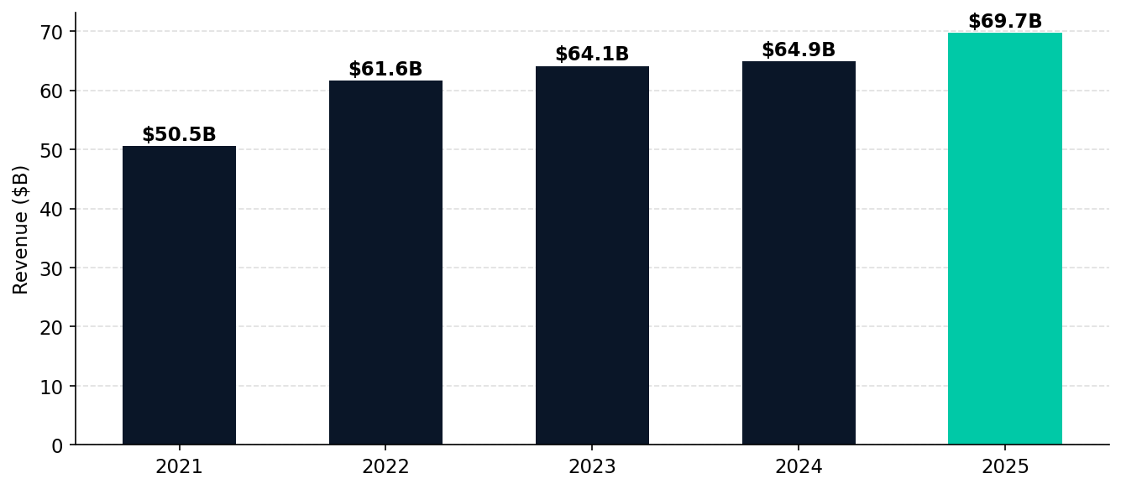
Financial Performance
Revenue trajectory (SEC EDGAR XBRL)
Accenture Competitive Intelligence · June 2026 · Built from live pipeline data
3 / 10

Slide 4
GitHub Technical Footprint
Open-source presence & community engagement
TOP REPOSITORIES BY STARS
LANGUAGE BREAKDOWN
★ 2,237
AmpliGraph
2024-11-22
JavaScript
32
Python library for Representation Learning on Knowledge…
★ 1,083
Spartacus
2024-02-01
Python
31
Spartacus DLL/COM Hijacking Toolkit
Other
30
★ 766
adop-docker-compose
2020-12-04
Talk to us on Gitter: https://gitter.im/Accenture/ADOP
Java
20
★ 664
VulFi
2025-05-13
Shell
19
IDA Pro plugin for query based searching within the bin…
★ 601
reactive-interaction-gateway
2026-04-16
Groovy
17
Create low-latency, interactive user experiences for st…
TypeScript
12
★ 576
jenkins-attack-framework
2025-07-12
HTML
9
★ 524
Codecepticon
2024-02-01
C#
7
.NET/PowerShell/VBA Offensive Security Obfuscator
★ 486
mcp-bench
2025-10-07
C++
6
MCP-Bench: Benchmarking Tool-Using LLM Agents with Comp…
Accenture Competitive Intelligence · June 2026 · Built from live pipeline data
4 / 10

Slide 5
Key AI & Technology Repositories
Deep-dive: strategic open-source bets
airefinery-sdk
mcp-bench
AmpliGraph
MCP-Bench: Benchmarking Tool-Using LLM Agents with Complex Real-World Tasks via …
Python library for Representation Learning on Knowledge Graphs https://docs.ampl…
★ 54 | 2026-06-09
★ 486 | 2025-10-07
★ 2,237 | 2024-11-22
Latest: 1.31.4 · 30 releases / 12mo
Language: Python
Latest: 2.1.0 · 14 releases / 60mo
VulFi
Spartacus
reactive-interaction-gateway
IDA Pro plugin for query based searching within the binary useful mainly for vul…
Spartacus DLL/COM Hijacking Toolkit
Create low-latency, interactive user experiences for stateless microservices.
★ 664 | 2025-05-13
★ 1,083 | 2024-02-01
★ 601 | 2026-04-16
Latest: 8.4-compatibility · 1 releases / 0mo
Latest: v2.2.1 · 11 releases / 13mo
Latest: 3.0.0 · 25 releases / 45mo
Accenture Competitive Intelligence · June 2026 · Built from live pipeline data
5 / 10

Slide 6
Market Intelligence
Web research highlights via Exa (June 2026)
Accenture Reports Fourth-Quarter and Full-Year Fiscal 2025 Results
2025 Annual Report
Accenture Reports Fourth-Quarter and Full-Year Fiscal 2025 Results Sep 25, 2025 6:39 AM Eastern Daylight Time # Accenture Reports Fourth-Quarter and Full-Year Fiscal 2025 Results Share --- Accent…
i accenture Nr 2025 Annual Report Reinventing Reinventing what’s possible what's possible 2025 Annual Report Copyright© 2025 Accenture.All rights reserved. Accenture and its logo are registered t…
2025-09-25
Reinventing what’s possible | FY2025 Annual Report | Accenture
Everest Group Artificial Intelligence (AI) and Generative AI Services PEAK …
## 2025 Annual Report In fiscal year 2025, Accenture further advanced our strategy to be the reinvention partner of choice for our clients, reflected in strong revenue growth, adjusted EPS growth and…
Copyright © 2025 Everest Global, Inc. | this document has been licensed to Accenture #### Everest Group Artificial Intelligence (AI) and Generative AI Services PEAK Matrix® Assessment 2025 November …
Artificial Intelligence (AI) Consulting Services Market | 2035
AI Consulting Market Growth Analysis - Size and Forecast 2025-2029 | Techna…
Artificial Intelligence (AI) Consulting Services Market | 2035 # Artificial Intelligence (AI) Consulting Services Market Artificial Intelligence (AI) Consulting Services Market Research Report: Size…
AI Consulting Market Growth Analysis - Size and Forecast 2025-2029 | Technavio | Technavio Skip to main content # AI Consulting Market Analysis, Size, and Forecast 2025-2029:North America (US, Canad…
Accenture Competitive Intelligence · June 2026 · Built from live pipeline data
6 / 10
2026-01-02
2025-07-22

Slide 7
AI PLATFORM STRATEGY
What ACCENTURE's open-source bets reveal about their AI direction
AI Refinery Platform
MCP Benchmark Investment
Open Source as Business Dev
AI Refinery SDK v1.31.4 — 30 releases in 12 months — signals a production-grade enterprise AI orchestration platform. Bridges pre-built AI models with enterprise system integration.
mcp-bench positions Accenture as a neutral evaluator of AI tool protocols. Strategic value: credibility with enterprise clients evaluating AI infrastructure.
223 repos with focused AI investment (AmpliGraph knowledge graphs, VulFi security scanning) create consulting lead-gen through technical community presence.
30 releases / 12 months
Industry credibility play
223 repos · 10K stars
Accenture Competitive Intelligence · June 2026 · Built from live pipeline data
7 / 10

Slide 8
Competitive Position
AI consulting & technology market landscape
Company
FY Revenue
AI Posture
Key AI Platform
Open Source Signal
Accenture ◀
$69.7B
AI-first integrator
AI Refinery SDK
223 repos / 10K★
IBM
$67.5B
Platform + consulting
watsonx
3,905 repos / 119K★
Microsoft
$245B
Platform & infra
Azure OpenAI / Copilot
High — GitHub + VS Code
Google
$350B
Model + cloud
Gemini / Vertex AI
High — TensorFlow etc
BCG
~$12B
Pure consulting
Fabriq
Low
McKinsey
~$16B
Pure consulting
Lilli
Low
Accenture Competitive Intelligence · June 2026 · Built from live pipeline data
8 / 10

Slide 9
Strategic Themes
Key signals from pipeline intelligence
AI-Native Delivery at Scale
Protocol-Level AI Positioning
1
AI Refinery v1.31.4 + 30 releases in 12 months = Accenture is shipping a real product, not a demo. This SDK is likely the core of their $3B+ AI revenue book. Watch for enterprise licensing announcements.
2
mcp-bench signals Accenture positioning as a neutral AI protocol evaluator — a classic consulting land-and-expand: help clients choose AI tool standards, then implement them.
+7.4% revenue growth
MCP standard bet
Open Source as Client Pipeline
Revenue Acceleration vs Peers
3
AmpliGraph (knowledge graphs) and VulFi (security scanning) are consulting-adjacent tools that attract enterprise developers into Accenture's orbit — a low-CAC lead generation strategy.
4
+7.4% YoY on a $69.7B base is materially stronger than the IT services sector average. GenAI bookings of $3B+ are pulling ahead of IBM consulting segment growth.
223 repos · 10K stars
$69.7B FY2025
Accenture Competitive Intelligence · June 2026 · Built from live pipeline data
9 / 10

Slide 10
STRATEGIC RECOMMENDATIONS
Actions for teams tracking ACCENTURE
Track AI Refinery SDK releases monthly
WATCH
Next major version (v2.x) will signal whether Accenture is productizing for third-party licensing or keeping it consulting-internal.
Benchmark mcp-bench against your MCP evaluation needs
ENGAGE
Accenture's neutral positioning creates an opportunity to co-develop benchmarks — a foot in the door for their consulting pipeline.
Match their AI-first messaging with proof points
COMPETE
Accenture's +7.4% growth is being driven by AI bookings narrative. Competitors need concrete case studies and published ROI numbers to match.
Explore AI Refinery SDK as an integration target
PARTNER
If building enterprise AI agents, integrating with AI Refinery SDK creates market reach via Accenture's enterprise client base.
Accenture Competitive Intelligence · June 2026 · Built from live pipeline data
10 / 10

