Slide 1
IBM
COMPETITIVE INTELLIGENCE BRIEF
Technology Strategy · Financial Performance · Open-Source Footprint
$67.5B
+7.6%
3,905
119,098
FY2025 Revenue
YoY Growth
GitHub Repos
Total Stars
June 2026 · Data from SEC EDGAR, GitHub API, Exa

Slide 2
At a Glance
IBM · Live Data — June 2026
$67.5B
$10.6B
FY2025 Revenue
Net Income
+7.6% vs prior year
Annual from EDGAR 10-K
3,905
119,098
GitHub Repos
Total Stars
Org: IBM
Community engagement index
IBM Competitive Intelligence · June 2026 · Built from live pipeline data
2 / 10

Slide 3
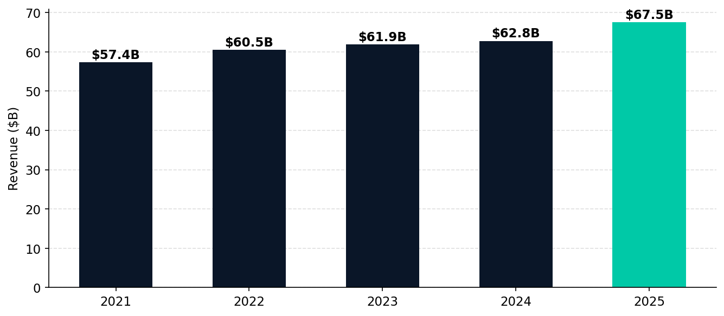
Financial Performance
Revenue trajectory (SEC EDGAR XBRL)
IBM Competitive Intelligence · June 2026 · Built from live pipeline data
3 / 10

Slide 4
GitHub Technical Footprint
Open-source presence & community engagement
TOP REPOSITORIES BY STARS
LANGUAGE BREAKDOWN
★ 12,492
sarama
2026-06-12
Python
956
Sarama is a Go library for Apache Kafka.
★ 11,426
plex
2026-06-12
Other
714
The package of IBM’s typeface, IBM Plex.
JavaScript
430
★ 3,885
mcp-context-forge
2026-06-14
An AI Gateway, registry, and proxy that sits in front o…
Jupyter Notebook
295
★ 2,225
css-gridish
2019-04-18
Java
282
Automatically build your grid design’s CSS Grid code, C…
★ 1,994
fp-go
2026-06-15
Go
255
Functional programming library for Go 1.24+, inspired b…
Shell
213
★ 1,986
mcp-cli
2026-06-12
HTML
145
★ 1,786
AssetOpsBench
2026-06-14
TypeScript
127
AssetOpsBench - Industry 4.0: A unified benchmark and f…
★ 1,683
Project_CodeNet
2025-12-21
HCL
65
This repository is to support contributions for tools f…
IBM Competitive Intelligence · June 2026 · Built from live pipeline data
4 / 10

Slide 5
Key AI & Technology Repositories
Deep-dive: strategic open-source bets
mcp-context-forge
mcp-cli
AssetOpsBench
An AI Gateway, registry, and proxy that sits in front of any MCP, A2A, or REST/g…
AssetOpsBench - Industry 4.0: A unified benchmark and framework for building, or…
★ 3,885 | 2026-06-14
★ 1,986 | 2026-06-12
★ 1,786 | 2026-06-14
Latest: v1.0.3 · 20 releases / 12mo
Language: Python
Language: Python
sarama
Project_CodeNet
fp-go
Sarama is a Go library for Apache Kafka.
This repository is to support contributions for tools for the Project CodeNet da…
Functional programming library for Go 1.24+, inspired by fp-ts. Uses generic typ…
★ 12,492 | 2026-06-12
★ 1,683 | 2025-12-21
★ 1,994 | 2026-06-15
Latest: v1.50.2 · 90 releases / 136mo
Latest: initial · 1 releases / 0mo
Latest: v2.3.40 · 100 releases / 3mo
IBM Competitive Intelligence · June 2026 · Built from live pipeline data
5 / 10

Slide 6
Market Intelligence
Web research highlights via Exa (June 2026)
IBM-4Q24 Earnings Press Release
IBM RELEASES FOURTH-QUARTER RESULTS
### IBM RELEASES FOURTH-QUARTER RESULTS Double-digit Software revenue growth; Free cash flow well-exceeds full-year expectation ARMONK, N.Y., January 29, 2025 . . . IBM (NYSE: IBM) today announced fo…
IBM RELEASES FOURTH-QUARTER RESULTS # All press releases # IBM RELEASES FOURTH-QUARTER RESULTS Double-digit Software revenue growth; Free cash flow well-exceeds full-year expectation Jan 29, 2025 …
2025-01-29
IBM: $9.5-Billion AI Book Of Business Drives Q3 Growth Across Software, Har…
Let’s Create Smarter Business
IBM: $9.5-Billion AI Book Of Business Drives Q3 Growth Across Software, Hardware And Consulting # IBM: $9.5-Billion AI Book Of Business Drives Q3 Growth Across Software, Hardware And Consulting IBM …
IBM 2025 Annual Report I 2025 Annual Report Let’s Create Smarter Business II IBM 2025 Annual Report 1 Dear IBM Investor: IBM’s strategy is built on two technology foundations: hybrid cloud and AI…
Artificial Intelligence (AI) Consulting Services Market | 2035
AI Consulting Services Market Research Report 2034
Artificial Intelligence (AI) Consulting Services Market | 2035 # Artificial Intelligence (AI) Consulting Services Market Artificial Intelligence (AI) Consulting Services Market Research Report: Size…
AI Consulting Services Market Research Report 2034 - Report Description - Table Of Content - Methodology # AI Consulting Services Market Segments - by Service Type (Strategy Development, Implementa…
IBM Competitive Intelligence · June 2026 · Built from live pipeline data
6 / 10
2026-01-02
2024-10-05

Slide 7
AI PLATFORM STRATEGY
What IBM's open-source bets reveal about their AI direction
MCP Context Forge
watsonx AI Book of Business
Infrastructure Heritage
mcp-context-forge v1.0.3 — 3,885 stars, 20 releases in 12mo — IBM's MCP gateway product. Launched in response to Anthropic's MCP standard. Active weekly commits as of June 14.
IBM reports $9.5B AI book-of-business as of Q3 2024. watsonx platform anchors enterprise AI sales — differentiated by on-premise/private cloud deployment for regulated industries.
sarama (12,492★ Kafka Go client) and fp-go (100 releases in 3mo, June 15) reveal IBM's enterprise infrastructure DNA — battle-tested Go tooling underpinning hybrid cloud offerings.
3,885 stars · 20 releases/12mo
$9.5B AI book of business
12,492★ Kafka client
IBM Competitive Intelligence · June 2026 · Built from live pipeline data
7 / 10

Slide 8
Competitive Position
AI consulting & technology market landscape
Company
FY Revenue
AI Posture
Key AI Platform
Open Source Signal
IBM ◀
$67.5B
Platform + consulting
watsonx
3,905 repos / 119K★
Accenture
$69.7B
AI-first integrator
AI Refinery SDK
223 repos / 10K★
Microsoft
$245B
Platform & infra
Azure OpenAI / Copilot
High — GitHub + VS Code
Google
$350B
Model + cloud
Gemini / Vertex AI
High
HPE
$29B
Infra & consulting
Private Cloud AI
Medium
Salesforce
$36B
CRM + AI agents
Agentforce
Medium
IBM Competitive Intelligence · June 2026 · Built from live pipeline data
8 / 10

Slide 9
Strategic Themes
Key signals from pipeline intelligence
MCP as Enterprise Gateway Play
watsonx AI Book of Business
1
mcp-context-forge (3,885★, v1.0.3, weekly commits) is IBM's bet on MCP becoming the de-facto enterprise AI integration standard. IBM is positioning watsonx as the MCP orchestration layer for regulated enterprise AI.
2
$9.5B AI book of business (Q3 2024) is the strongest signal IBM has turned around. Regulated industries (banking, healthcare, government) are the TAM — on-premise matters here.
3,885★ · 20 releases/12mo
$9.5B AI pipeline
Infrastructure Heritage = Moat
HashiCorp Acquisition Multiplier
3
sarama's 12,492 stars (Kafka Go client) and fp-go's 100 releases in 3 months reveal IBM's enterprise infrastructure depth. These libraries underpin hybrid cloud decisions at scale.
4
HashiCorp acquisition (closed 2024) gives IBM infrastructure automation at scale. Terraform + watsonx + MCP = a plausible enterprise AI infrastructure stack.
12,492★ · 90 releases
HashiCorp + watsonx
IBM Competitive Intelligence · June 2026 · Built from live pipeline data
9 / 10

Slide 10
STRATEGIC RECOMMENDATIONS
Actions for teams tracking IBM
Monitor mcp-context-forge adoption velocity
WATCH
Weekly commits + 3,885★ in <12 months = this is IBM's fastest-growing strategic asset. Adoption by enterprise AI teams determines whether watsonx wins the MCP gateway race.
Counter watsonx with cloud-native vs. on-premise narrative
COMPETE
IBM's moat is regulated industries needing on-premise. Cloud-native competitors should compete on speed, ecosystem richness, and price — not infrastructure control.
Leverage sarama in Kafka integration stories
ENGAGE
12,492★ Kafka Go client is the entry point for IBM's hybrid cloud narrative. Enterprise teams using sarama are a proven IBM customer profile.
HashiCorp + watsonx is the enterprise AI infra stack to beat
PARTNER
Terraform-managed infrastructure + watsonx AI = IBM's pitch to regulated enterprises. Evaluate whether to build interoperability or competing integration.
IBM Competitive Intelligence · June 2026 · Built from live pipeline data
10 / 10

