Slide 1
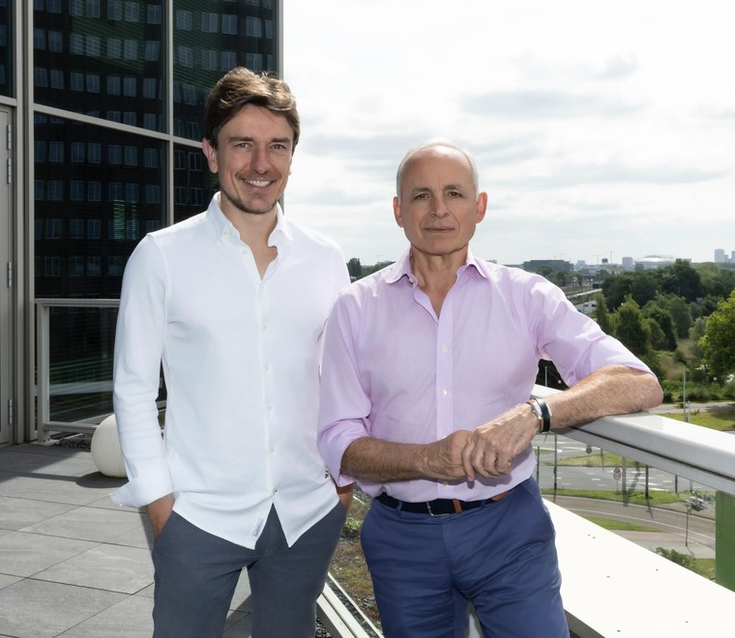
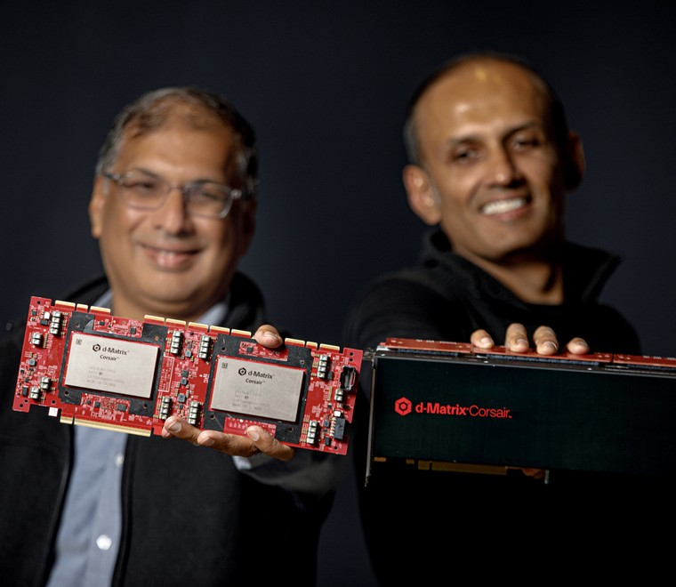
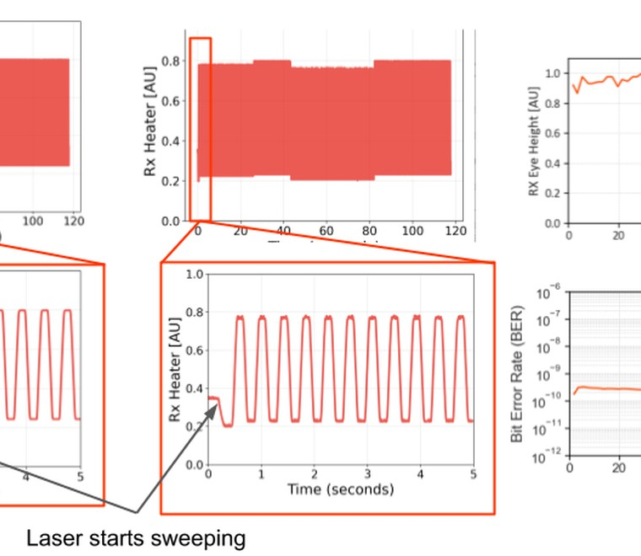

SEMICONDUCTOR STARTUP LANDSCAPE · JULY 2026
Semiconductor Startups 2026
Where partner value can compound across compute, inference, and interconnect
AXELERA AI
D-MATRIX
10 companies · 4 infrastructure wedges · 3 partner roles
LIGHTMATTER
CORNELIS NETWORKS
Based on CRN’s July 15, 2026 cohort; research updated through July 29, 2026.
Semiconductor Startups 2026 · Evidence-Led Strategy
1 / 36
Notes:
Speaker implication: Where partner value can compound across compute, inference, and interconnect
Visible citation: Based on CRN’s July 15, 2026 cohort; research updated through July 29, 2026.
Evidence URLs:
- https://www.crn.com/news/computing/2026/the-10-coolest-semiconductor-startups-of-2026-so-far

Slide 2
EXECUTIVE SUMMARY
Three moves emerge: activate deployable offers, validate complex wedges, monitor pre-scale bets
The decision is a portfolio of bounded actions—not a universal winner ranking.
ACTIVATE
VALIDATE
MONITOR
Axelera AI · d-Matrix · Cornelis
Tenstorrent · NextSilicon · Lightmatter · Xsight
Fractile · Etched · MatX
Package a bounded offer
Buy missing workload and partner proof
Track silicon and commercialization triggers
CRN; Gartner; company announcements.
Semiconductor Startups 2026 · Evidence-Led Strategy
2 / 36
Notes:
Speaker implication: Public evidence can prioritize validation questions by partner archetype without claiming organization-specific right-to-win.
Visible citation: CRN; Gartner; company announcements.
Evidence URLs:
- https://www.crn.com/news/computing/2026/the-10-coolest-semiconductor-startups-of-2026-so-far
- https://www.gartner.com/en/newsroom/press-releases/2026-04-08-gartner-forecasts-worldwide-semiconductor-revenue-to-exceed-us-dollars-one-point-3-trillion-in-2026

Slide 3
PORTFOLIO ANSWER
Deployment evidence—not architectural novelty—drives the action posture
Commercial stage and partner boundaries determine what can be tested now.
POSTURE
CANDIDATES
WHY NOW
PROOF BEFORE CHANGE
Axelera AI · d-Matrix · Cornelis
Deployable offer + visible ecosystem
Partner economics and repeatability
ACT NOW
Tenstorrent · NextSilicon · Lightmatter · Xsight
Strong wedge; motion-specific gaps
Software, design-in, and operating proof
VALIDATE NEXT
Fractile · Etched · MatX
High potential; earlier commercialization
Tape-out, availability, references
MONITOR
Candidate public-evidence posture; requires Phase 0 calibration.
Semiconductor Startups 2026 · Evidence-Led Strategy
3 / 36
Notes:
Speaker implication: A staged portfolio prevents early technical promise from being mistaken for execution-ready partnership.
Visible citation: Candidate public-evidence posture; requires Phase 0 calibration.
Evidence URLs:
- https://www.crn.com/news/computing/2026/the-10-coolest-semiconductor-startups-of-2026-so-far
- https://www.gartner.com/en/newsroom/press-releases/2026-04-08-gartner-forecasts-worldwide-semiconductor-revenue-to-exceed-us-dollars-one-point-3-trillion-in-2026
- https://axelera.ai/news/axelera-ai-secures-more-than-250-million-funding-on-global-commercial-growth
- https://tenstorrent.com/newsroom/tenstorrent-sets-new-performance-records-launches-tt--ascalon-s
- https://www.nextsilicon.com/insights/nextsilicon-breakthrough/
- https://www.fractile.ai/news/fractile-raises-220m-to-build-the-next-generation-of-inference-hardware
- https://www.etched.com/progress
- https://www.d-matrix.ai/announcements/d-matrix-corsair-ai-inference-platform-enters-full-production-to-meet-customer-demand/
- https://www.d-matrix.ai/announcements/d-matrix-raises-275-million-to-power-the-age-of-ai-inference/
- https://www.cornelis.com/
- https://www.cornelis.com/stories/cornelis-networks-announces-29m-series-b-funding-round
- https://lightmatter.co/press-release/lightmatter-unveils-passage-m1000-photonic-superchip-worlds-fastest-ai-interconnect/
- https://lightmatter.co/press-release/lightmatter-raises-400m-series-d-quadruples-valuation-to-4-4b-as-photonics-leader-for-next-gen-ai-data-centers/
- https://matx.com/research/series_b
- https://xsightlabs.com/newsroom/announcements/xsight-labs-announces-x2-programmable-sdn-ethernet-switches-for-hyperscale-and-edge-data-centers-optimized-for-the-ai-factory-era

Slide 4
WHY NOW
Market expansion creates room for new architectures—but fragmentation creates the channel wedge
The opportunity is to make heterogeneous infrastructure adoptable, supportable, and repeatable.
LAND
INTEGRATE
EXPAND
Solve one painful workload or link bottleneck
→
Coexist with GPUs, CPUs, fabrics, and cloud workflows
→
Broaden the system footprint after software and supply prove out
This favors partners that can provide integration, validation, deployment, and customer access—not just component resale.
Tenstorrent; d-Matrix; Cornelis; Lightmatter; Xsight Labs.
Semiconductor Startups 2026 · Evidence-Led Strategy
4 / 36
Notes:
Speaker implication: The cohort’s most plausible adoption paths complement existing infrastructure before displacing it.
Visible citation: Tenstorrent; d-Matrix; Cornelis; Lightmatter; Xsight Labs.
Evidence URLs:
- https://tenstorrent.com/newsroom/tenstorrent-sets-new-performance-records-launches-tt--ascalon-s
- https://www.d-matrix.ai/announcements/d-matrix-corsair-ai-inference-platform-enters-full-production-to-meet-customer-demand/
- https://lightmatter.co/press-release/lightmatter-unveils-passage-m1000-photonic-superchip-worlds-fastest-ai-interconnect/
- https://www.cornelis.com/
- https://xsightlabs.com/newsroom/announcements/xsight-labs-announces-x2-programmable-sdn-ethernet-switches-for-hyperscale-and-edge-data-centers-optimized-for-the-ai-factory-era

Slide 5
MARKET + BUSINESS MODEL
Four bottlenecks—and four commercialization models—shape the cohort
Insertion point determines the buyer, sales clock, and partner value pool.
BOTTLENECK
BUSINESS MODEL
PRIMARY ICP
GTM MOTION
EDGE DEPLOYMENT
Chip + platform
Edge OEM / solution builder
Partner-led deployment
ADAPTABLE COMPUTE
Systems + IP / accelerator
Sovereign AI / HPC
Direct + design-in
INFERENCE SPECIALISTS
Chips + rack systems
Frontier labs / neoclouds
Lighthouse + co-design
INTERCONNECT
Components + systems
Hyperscalers / clusters
Long-cycle ecosystem design-in
CRN; company product pages.
Semiconductor Startups 2026 · Evidence-Led Strategy
5 / 36
Notes:
Speaker implication: The ten companies address edge deployment, compute architecture, inference economics, or scale-out connectivity.
Visible citation: CRN; company product pages.
Evidence URLs:
- https://www.crn.com/news/computing/2026/the-10-coolest-semiconductor-startups-of-2026-so-far

Slide 6
ICP + BUYING TRIGGERS
Buyer pain—not firmographics—determines the ideal customer profile
Each workload has a distinct proof threshold and route to production.
BUYER
TRIGGER PAIN
PROOF TO BUY
PRIMARY MOTION
HYPERSCALERS + LABS
Token economics, density, custom scale
Rack-scale proof + capacity
Co-design / design-in
HPC + RESEARCH
Irregular workloads, fabric behavior
Real applications + migration
Early access / integration
SOVEREIGN + ENTERPRISE
Control, programmability, SLAs
Named-model TCO + operations
Reference platform / SI
EDGE OEMs
Power, thermals, form factor
Time-to-production + SDK
Module / distributor / ISV
ICP synthesis from company-stated target workloads and deployment models.
Semiconductor Startups 2026 · Evidence-Led Strategy
6 / 36
Notes:
Speaker implication: The cohort’s primary ICPs are hyperscalers/frontier labs, HPC institutions, sovereign and enterprise AI operators, and edge OEMs.
Visible citation: ICP synthesis from company-stated target workloads and deployment models.
Evidence URLs:
- https://axelera.ai/news/axelera-ai-secures-more-than-250-million-funding-on-global-commercial-growth
- https://tenstorrent.com/newsroom/tenstorrent-sets-new-performance-records-launches-tt--ascalon-s
- https://www.nextsilicon.com/insights/nextsilicon-breakthrough/
- https://www.d-matrix.ai/announcements/d-matrix-corsair-ai-inference-platform-enters-full-production-to-meet-customer-demand/
- https://www.cornelis.com/
- https://lightmatter.co/press-release/lightmatter-unveils-passage-m1000-photonic-superchip-worlds-fastest-ai-interconnect/
- https://xsightlabs.com/newsroom/announcements/xsight-labs-announces-x2-programmable-sdn-ethernet-switches-for-hyperscale-and-edge-data-centers-optimized-for-the-ai-factory-era

Slide 7
GO-TO-MARKET
The winning GTM motion converts lighthouse proof into an ecosystem repeat
Benchmark credibility must become a reference offer, operating model, and replication channel.
01
02
03
04
→
→
→
LIGHTHOUSE
DESIGN-IN
REFERENCE
REPLICATE
Prove one painful workload
Integrate software, system, and supply
Publish repeatable architecture and support
Scale through OEM, cloud, SI, and ISV
The flywheel only compounds when proof, support, and commercial ownership survive each handoff.
GTM synthesis from company availability, partner, and deployment evidence.
Semiconductor Startups 2026 · Evidence-Led Strategy
7 / 36
Notes:
Speaker implication: The most credible GTM sequence is lighthouse validation, design-in, reference deployment, and ecosystem replication.
Visible citation: GTM synthesis from company availability, partner, and deployment evidence.
Evidence URLs:
- https://axelera.ai/news/axelera-ai-secures-more-than-250-million-funding-on-global-commercial-growth
- https://tenstorrent.com/newsroom/tenstorrent-sets-new-performance-records-launches-tt--ascalon-s
- https://www.nextsilicon.com/insights/nextsilicon-breakthrough/
- https://www.d-matrix.ai/announcements/d-matrix-corsair-ai-inference-platform-enters-full-production-to-meet-customer-demand/
- https://lightmatter.co/press-release/lightmatter-unveils-passage-m1000-photonic-superchip-worlds-fastest-ai-interconnect/
- https://xsightlabs.com/newsroom/announcements/xsight-labs-announces-x2-programmable-sdn-ethernet-switches-for-hyperscale-and-edge-data-centers-optimized-for-the-ai-factory-era

Slide 8
PARTNER VALUE
Partner value compounds where integration risk is highest
The partner earns control by reducing risk across proof, packaging, deployment, and operations.
PROVE
PACKAGE
DEPLOY
OPERATE
Workload benchmark
System + software offer
Reference architecture
Support + lifecycle
REDUCES TECHNICAL RISK
REDUCES INTEGRATION RISK
REDUCES EXECUTION RISK
REDUCES ADOPTION RISK
The highest-leverage partner converts technical advantage into a repeatable production outcome.
Implications derived from company go-to-market and product evidence.
Semiconductor Startups 2026 · Evidence-Led Strategy
8 / 36
Notes:
Speaker implication: Partners can create value through workload validation, system integration, deployment, and managed operations.
Visible citation: Implications derived from company go-to-market and product evidence.
Evidence URLs:
- https://axelera.ai/news/axelera-ai-secures-more-than-250-million-funding-on-global-commercial-growth
- https://tenstorrent.com/newsroom/tenstorrent-sets-new-performance-records-launches-tt--ascalon-s
- https://www.d-matrix.ai/announcements/d-matrix-corsair-ai-inference-platform-enters-full-production-to-meet-customer-demand/
- https://www.cornelis.com/
- https://lightmatter.co/press-release/lightmatter-unveils-passage-m1000-photonic-superchip-worlds-fastest-ai-interconnect/
- https://xsightlabs.com/newsroom/announcements/xsight-labs-announces-x2-programmable-sdn-ethernet-switches-for-hyperscale-and-edge-data-centers-optimized-for-the-ai-factory-era

Slide 9
EVIDENCE QUALITY
The evidence is broad enough to screen—and too vendor-led to declare winners
Coverage supports directional portfolio choices; independent customer, benchmark, and economics proof remains sparse.
83
SOURCED CLAIMS
16
NUMERIC ROWS
30
HIGH CONFIDENCE
53
MEDIUM CONFIDENCE
Complete closed-cohort ledger
Funding, stage, and specifications
Specific attributable disclosures
Directional or vendor-led evidence
Axelera AI
13
Etched
5
Tenstorrent
8
d-Matrix
5
Cornelis
7
MatX
5
NextSilicon
5
Lightmatter
5
Fractile
5
Xsight Labs
5
Evidence ledger and data-quality report; retrieved through Jul. 29, 2026.
Semiconductor Startups 2026 · Evidence-Led Strategy
9 / 36
Notes:
Speaker implication: The evidence ledger contains 83 sourced claims, with uneven company coverage and limited independent proof.
Visible citation: Evidence ledger and data-quality report; retrieved through Jul. 29, 2026.
Evidence URLs:
- https://www.crn.com/news/computing/2026/the-10-coolest-semiconductor-startups-of-2026-so-far

Slide 10
COMMERCIAL MATURITY
Commercial maturity separates actionable platforms from architectural options
The cohort spans shipping systems, design-in components, samples, and pre-scale architectures.
COMPANY | WEDGE | PUBLIC STAGE SIGNAL | LIKELY ENTRY MOTION
Axelera AI | Edge deployment | Shipping platform | Partner-led ecosystem
Tenstorrent | Open compute | Products + IP | Direct + licensing
NextSilicon | Adaptive dataflow | Product-volume claim | HPC design-in
Fractile | Frontier inference | Pre-scale | Lighthouse co-development
Etched | Transformer ASIC | Pre-scale | Hyperscale design-in
d-Matrix | In-memory inference | Full production | System validation
MatX | LLM accelerator | Pre-tape-out | Frontier-lab co-design
Cornelis | Cluster fabric | Commercial portfolio | HPC integration
Lightmatter | Photonic I/O | Reference platform | Packaging ecosystem
Xsight Labs | Ethernet silicon | Customer sampling | NOS/OEM design-in
CRN; official company product and financing announcements.
Semiconductor Startups 2026 · Evidence-Led Strategy
10 / 36
Notes:
Speaker implication: The ten companies differ more by insertion point and readiness evidence than by a single accelerator-versus-GPU frame.
Visible citation: CRN; official company product and financing announcements.
Evidence URLs:
- https://www.crn.com/news/computing/2026/the-10-coolest-semiconductor-startups-of-2026-so-far
- https://www.gartner.com/en/newsroom/press-releases/2026-04-08-gartner-forecasts-worldwide-semiconductor-revenue-to-exceed-us-dollars-one-point-3-trillion-in-2026
- https://axelera.ai/news/axelera-ai-secures-more-than-250-million-funding-on-global-commercial-growth
- https://tenstorrent.com/newsroom/tenstorrent-sets-new-performance-records-launches-tt--ascalon-s
- https://www.nextsilicon.com/insights/nextsilicon-breakthrough/
- https://www.fractile.ai/news/fractile-raises-220m-to-build-the-next-generation-of-inference-hardware
- https://www.etched.com/progress
- https://www.d-matrix.ai/announcements/d-matrix-corsair-ai-inference-platform-enters-full-production-to-meet-customer-demand/
- https://www.d-matrix.ai/announcements/d-matrix-raises-275-million-to-power-the-age-of-ai-inference/
- https://www.cornelis.com/
- https://www.cornelis.com/stories/cornelis-networks-announces-29m-series-b-funding-round
- https://lightmatter.co/press-release/lightmatter-unveils-passage-m1000-photonic-superchip-worlds-fastest-ai-interconnect/
- https://lightmatter.co/press-release/lightmatter-raises-400m-series-d-quadruples-valuation-to-4-4b-as-photonics-leader-for-next-gen-ai-data-centers/
- https://matx.com/research/series_b
- https://xsightlabs.com/newsroom/announcements/xsight-labs-announces-x2-programmable-sdn-ethernet-switches-for-hyperscale-and-edge-data-centers-optimized-for-the-ai-factory-era

Slide 11
SECTION 01 · COMPUTE
Compute challengers split between programmable breadth and workload-specific conviction
The partner question is whether software and supply can make the architecture deployable.
CRN cohort taxonomy.
Semiconductor Startups 2026 · Evidence-Led Strategy
11 / 36
Notes:
Speaker implication: The compute cohort spans broad programmable platforms and highly specialized inference systems.
Visible citation: CRN cohort taxonomy.
Evidence URLs:
- https://www.crn.com/news/computing/2026/the-10-coolest-semiconductor-startups-of-2026-so-far

Slide 12
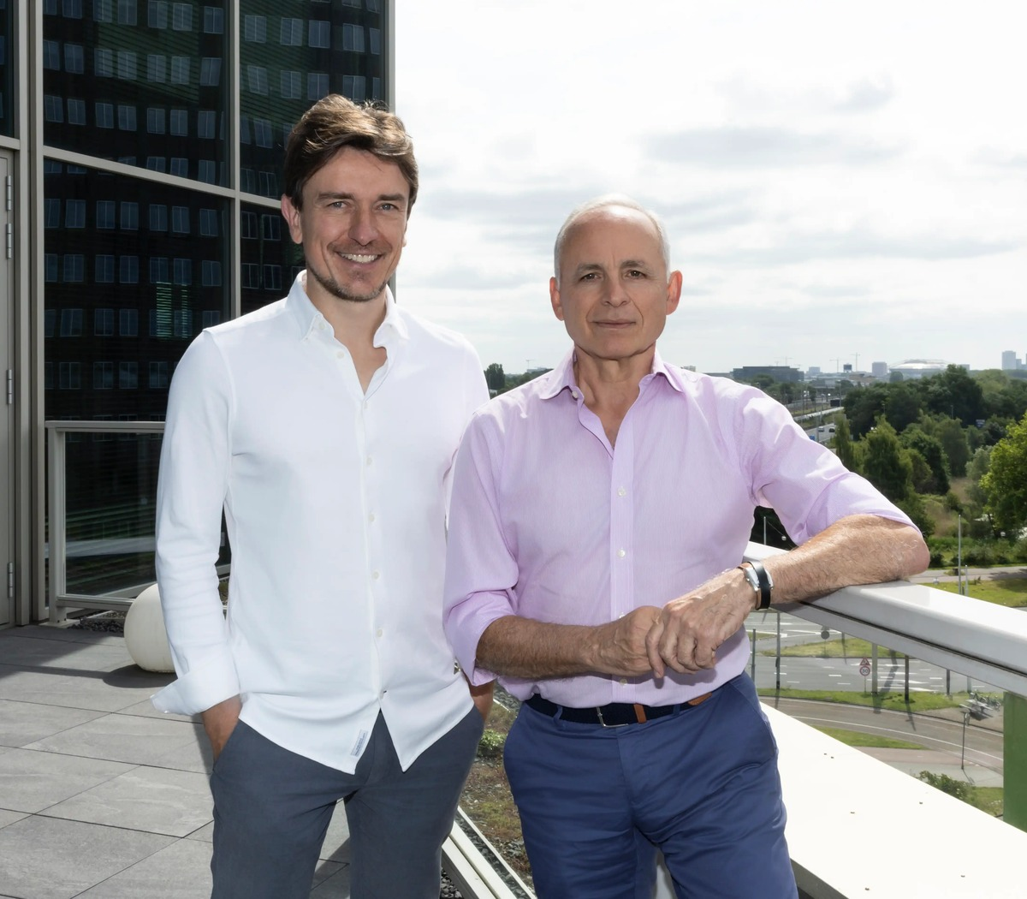
AXELERA AI
EDGE + ECOSYSTEM
Axelera turns edge acceleration into a deployment ecosystem
Efficient AI hardware is paired with software, systems, and a partner-led route to production.
STRATEGIC WEDGE
Purpose-built inference for computer vision and generative AI from edge systems toward data centers.
BUSINESS MODEL
PRIMARY ICP
Chip + edge platform
Edge OEMs and solution builders
GTM MOTION
PARTNER MOVE
Partner-led deployment
Build a vertical reference offer
OFFICIAL SITE VISUAL · AXELERA AI
EVIDENCE / PARTNER
HIGH / MEDIUM
RISK GATE
Repeat deployments + supply scale
Axelera AI, Feb. 24, 2026.
Semiconductor Startups 2026 · Evidence-Led Strategy
12 / 36
Notes:
Speaker implication: Axelera’s differentiator combines edge-focused acceleration with an explicit partner network and more than $250 million of new funding.
Visible citation: Axelera AI, Feb. 24, 2026.
Evidence URLs:
- https://axelera.ai/news/axelera-ai-secures-more-than-250-million-funding-on-global-commercial-growth
- https://axelera.ai/news/axelera-ai-secures-more-than-250-million-funding-on-global-ai-demand

Slide 13

TENSTORRENT
OPEN COMPUTE
Tenstorrent attacks lock-in with a programmable system and licensable IP
Its portfolio spans AI processors, Galaxy systems, Tensix cores, and high-performance RISC-V.
STRATEGIC WEDGE
Open, programmable AI compute plus RISC-V CPU IP rather than a closed accelerator-only product.
BUSINESS MODEL
PRIMARY ICP
Systems + licensable IP
Sovereign AI, enterprise, developers
GTM MOTION
PARTNER MOVE
Direct systems + licensing
Choose the system or IP motion
OFFICIAL SITE VISUAL · TENSTORRENT
EVIDENCE / PARTNER
HIGH / MEDIUM
RISK GATE
Software adoption + support ownership
Tenstorrent, Jun. 30, 2026; CRN.
Semiconductor Startups 2026 · Evidence-Led Strategy
13 / 36
Notes:
Speaker implication: Tenstorrent’s TT-Ascalon S expands its open compute strategy into branch-heavy agentic workloads.
Visible citation: Tenstorrent, Jun. 30, 2026; CRN.
Evidence URLs:
- https://tenstorrent.com/newsroom/tenstorrent-sets-new-performance-records-launches-tt--ascalon-s
- https://www.crn.com/news/computing/2026/the-10-coolest-semiconductor-startups-of-2026-so-far
- https://tenstorrent.com/vision/tenstorrent-announces-availability-of-tt-ascalon

Slide 14
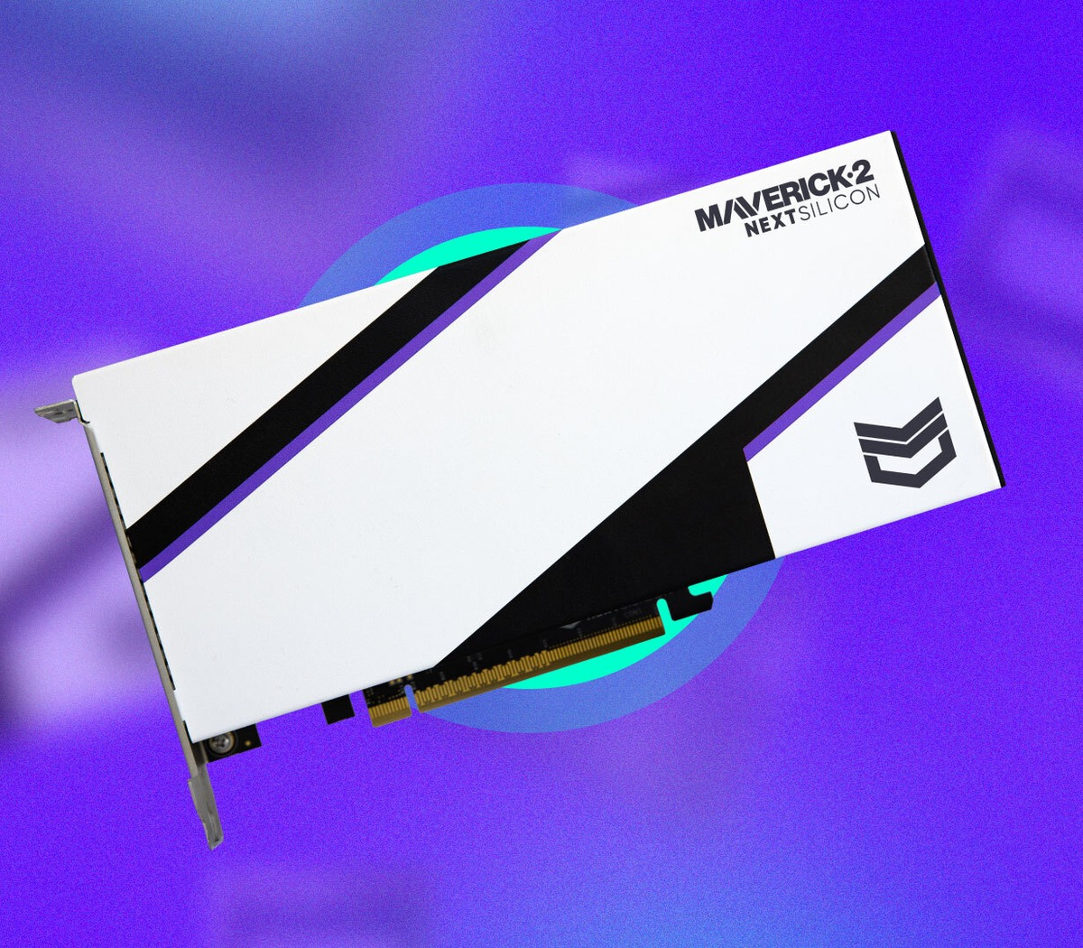
NEXTSILICON
ADAPTIVE DATAFLOW
NextSilicon makes the accelerator adapt to code at runtime
Maverick-2 targets irregular HPC and AI workloads without forcing application rewrites.
STRATEGIC WEDGE
A software-learning Intelligent Compute Architecture dynamically configures dataflow hardware.
BUSINESS MODEL
PRIMARY ICP
Accelerator + design-in
HPC and research institutions
GTM MOTION
PARTNER MOVE
Application-led design-in
Prove porting effort and supply
OFFICIAL SITE VISUAL · NEXTSILICON
EVIDENCE / PARTNER
HIGH / MEDIUM
RISK GATE
Independent workload validation
NextSilicon, Oct. 22, 2025. Performance figures are vendor claims.
Semiconductor Startups 2026 · Evidence-Led Strategy
14 / 36
Notes:
Speaker implication: NextSilicon says Maverick-2 uses runtime-reconfigurable dataflow and was available in product volumes in Q4 2025.
Visible citation: NextSilicon, Oct. 22, 2025. Performance figures are vendor claims.
Evidence URLs:
- https://www.nextsilicon.com/insights/nextsilicon-breakthrough/
- https://www.nextsilicon.com/press-releases/maverick-2-powers-hpc-ai-breakthroughs

Slide 15
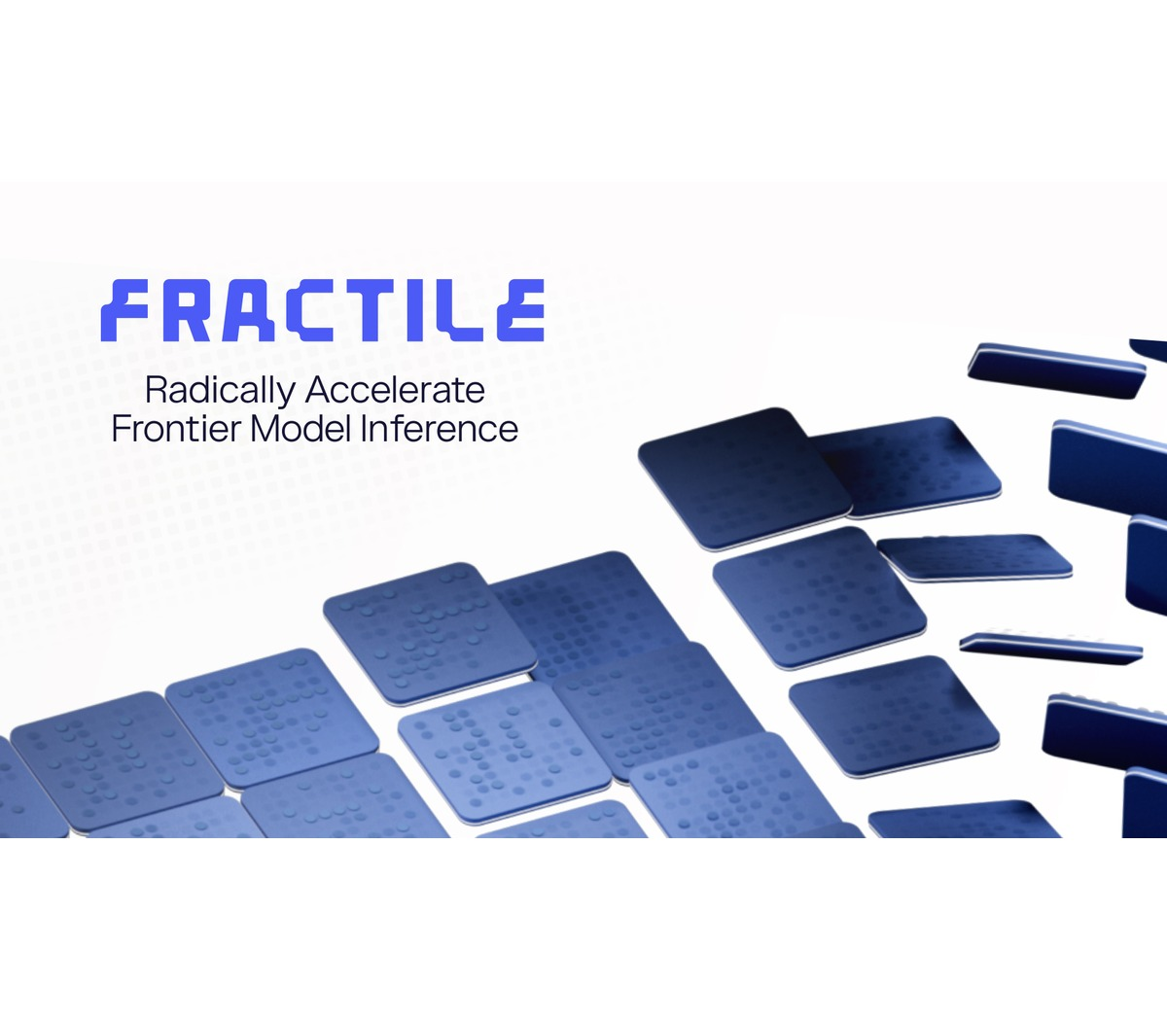
FRACTILE
FRONTIER INFERENCE
Fractile is designing the full stack around exploding inference token demand
The UK startup argues that reasoning workloads require a new cost-versus-latency curve.
STRATEGIC WEDGE
Co-design from AI research and compiler behavior through microarchitecture and foundry process.
BUSINESS MODEL
PRIMARY ICP
Chip + full-stack systems
Frontier labs and high-token inference
GTM MOTION
PARTNER MOVE
Lighthouse co-development
Secure a benchmarkable workload
OFFICIAL SITE VISUAL · FRACTILE
EVIDENCE / PARTNER
HIGH / LOW
RISK GATE
Tape-out + software readiness
Fractile, 2026.
Semiconductor Startups 2026 · Evidence-Led Strategy
15 / 36
Notes:
Speaker implication: Fractile raised $220 million to accelerate its path toward first chips and systems for frontier-model inference.
Visible citation: Fractile, 2026.
Evidence URLs:
- https://www.fractile.ai/news/fractile-raises-220m-to-build-the-next-generation-of-inference-hardware
- https://www.fractile.ai/

Slide 16
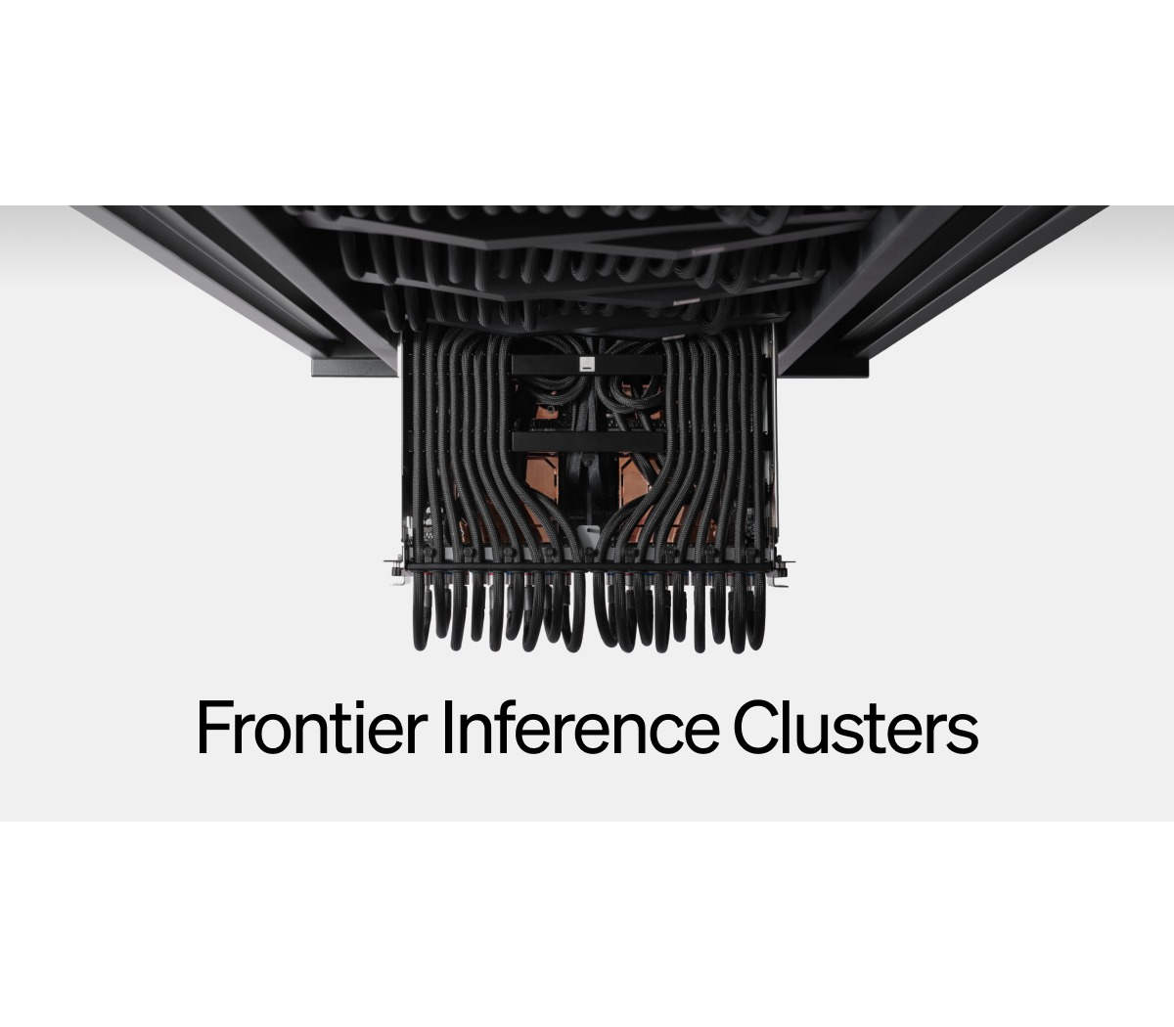
ETCHED
TRANSFORMER ASIC
Etched trades generality for a transformer-only performance ceiling
Sohu hardwires the dominant model architecture into chips, racks, and software.
STRATEGIC WEDGE
A transformer ASIC designed for throughput and interactivity rather than broad model coverage.
BUSINESS MODEL
PRIMARY ICP
Transformer ASIC + racks
Hyperscalers and frontier labs
GTM MOTION
PARTNER MOVE
Strategic design-in
Test workload durability
OFFICIAL SITE VISUAL · ETCHED
EVIDENCE / PARTNER
MEDIUM / LOW
RISK GATE
Model-architecture durability
Etched product and progress pages, accessed Jul. 29, 2026.
Semiconductor Startups 2026 · Evidence-Led Strategy
16 / 36
Notes:
Speaker implication: Etched’s Sohu strategy is an extreme specialization bet on transformers remaining the dominant AI architecture.
Visible citation: Etched product and progress pages, accessed Jul. 29, 2026.
Evidence URLs:
- https://www.etched.com/progress
- https://www.etched.com/

Slide 17
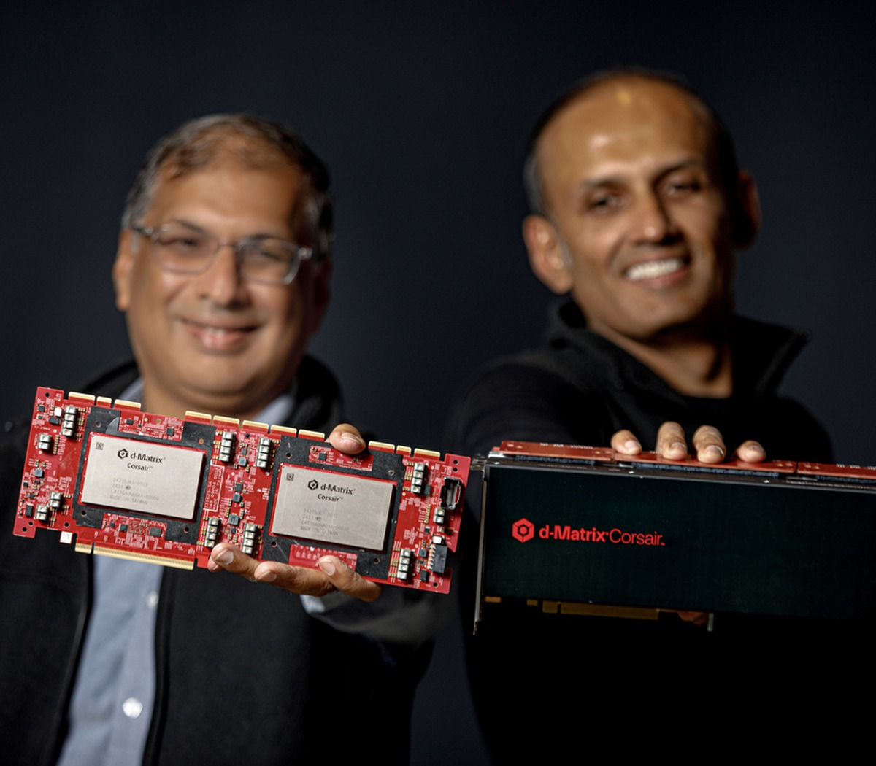
D-MATRIX
IN-MEMORY INFERENCE
d-Matrix moves inference compute closer to memory—and into production
Corsair integrates accelerators, networking, and software for latency-sensitive data-center inference.
STRATEGIC WEDGE
Digital in-memory compute reduces data movement for high-throughput, low-latency inference.
BUSINESS MODEL
PRIMARY ICP
Inference platform + software
Hyperscalers, neoclouds, enterprise AI
GTM MOTION
PARTNER MOVE
System validation + replication
Validate TCO and support boundary
OFFICIAL SITE VISUAL · D-MATRIX
EVIDENCE / PARTNER
HIGH / MEDIUM
RISK GATE
Volume ramp + customer economics
d-Matrix, Nov. 12, 2025 and Jun. 9, 2026.
Semiconductor Startups 2026 · Evidence-Led Strategy
17 / 36
Notes:
Speaker implication: d-Matrix announced Corsair full production in June 2026 after raising a $275 million Series C in late 2025.
Visible citation: d-Matrix, Nov. 12, 2025 and Jun. 9, 2026.
Evidence URLs:
- https://www.d-matrix.ai/announcements/d-matrix-corsair-ai-inference-platform-enters-full-production-to-meet-customer-demand/
- https://www.d-matrix.ai/announcements/d-matrix-raises-275-million-to-power-the-age-of-ai-inference/
- https://www.d-matrix.ai/d-matrix-corsair-ai-inference-platform-enters-full-production/

Slide 18

MATX
LLM-SPECIFIC
MatX designs the chip around LLM throughput and latency from first principles
MatX One combines SRAM-first latency with HBM support for long contexts.
STRATEGIC WEDGE
An LLM-specific architecture balancing high throughput, low latency, and long-context memory.
BUSINESS MODEL
PRIMARY ICP
LLM accelerator + systems
Frontier labs and model builders
GTM MOTION
PARTNER MOVE
Co-design before scale
Wait for accessible silicon
OFFICIAL SITE VISUAL · MATX
EVIDENCE / PARTNER
HIGH / LOW
RISK GATE
Tape-out + real-system benchmarks
MatX, Feb. 24, 2026. Performance statements are vendor claims.
Semiconductor Startups 2026 · Evidence-Led Strategy
18 / 36
Notes:
Speaker implication: MatX raised a $500 million Series B to finish development and scale manufacturing, with tape-out planned in under a year.
Visible citation: MatX, Feb. 24, 2026. Performance statements are vendor claims.
Evidence URLs:
- https://matx.com/research/series_b
- https://matx.com/

Slide 19
COMPUTE COMPARISON
Specialization narrows the ICP while increasing the proof burden
Broad platforms carry software complexity; narrow platforms carry workload-durability risk.
COMPANY | WORKLOAD SCOPE | DESIGN PHILOSOPHY | 2026 STAGE
Axelera | Edge + inference | Platform + partners | Shipping / scaling
Tenstorrent | Broad AI + CPU IP | Programmable + licensable | Commercial portfolio
NextSilicon | HPC + irregular AI | Runtime-adaptive | Product volumes
Fractile | Frontier inference | Full-stack specialist | Pre-scale
Etched | Transformers | Fixed-function ASIC | Early systems
d-Matrix | Data-center inference | In-memory + full stack | Full production
MatX | LLM workloads | Purpose-built | Pre-tape-out
Company announcements; maturity is an analytical assessment.
Semiconductor Startups 2026 · Evidence-Led Strategy
19 / 36
Notes:
Speaker implication: Compute startups occupy different positions on workload breadth, programmability, and commercialization maturity.
Visible citation: Company announcements; maturity is an analytical assessment.
Evidence URLs:
- https://axelera.ai/news/axelera-ai-secures-more-than-250-million-funding-on-global-commercial-growth
- https://tenstorrent.com/newsroom/tenstorrent-sets-new-performance-records-launches-tt--ascalon-s
- https://www.nextsilicon.com/insights/nextsilicon-breakthrough/
- https://www.fractile.ai/news/fractile-raises-220m-to-build-the-next-generation-of-inference-hardware
- https://www.etched.com/progress
- https://www.d-matrix.ai/announcements/d-matrix-corsair-ai-inference-platform-enters-full-production-to-meet-customer-demand/
- https://matx.com/research/series_b

Slide 20
SECTION 02 · CONNECT
Interconnect challengers create partner control points without replacing compute
Fabric, photonics, and programmable Ethernet enter at different layers of the AI system.
Cornelis; Lightmatter; Xsight Labs.
Semiconductor Startups 2026 · Evidence-Led Strategy
20 / 36
Notes:
Speaker implication: The interconnect cohort competes on congestion, bandwidth density, power, and programmability.
Visible citation: Cornelis; Lightmatter; Xsight Labs.
Evidence URLs:
- https://www.cornelis.com/
- https://lightmatter.co/press-release/lightmatter-unveils-passage-m1000-photonic-superchip-worlds-fastest-ai-interconnect/
- https://xsightlabs.com/newsroom/announcements/xsight-labs-announces-x2-programmable-sdn-ethernet-switches-for-hyperscale-and-edge-data-centers-optimized-for-the-ai-factory-era

Slide 21

CORNELIS NETWORKS
SCALE-OUT FABRIC
Cornelis reopens a scale-out fabric alternative for AI and HPC
CN5000 extends Omni-Path into modern training, inference, and technical-computing clusters.
STRATEGIC WEDGE
Purpose-built scale-out networking focused on predictable throughput and congestion control.
BUSINESS MODEL
PRIMARY ICP
Fabric silicon + systems
HPC and AI-cluster operators
GTM MOTION
PARTNER MOVE
Cluster integration
Package migration services
OFFICIAL SITE VISUAL · CORNELIS NETWORKS
EVIDENCE / PARTNER
HIGH / MEDIUM
RISK GATE
Channel coverage + migration proof
Cornelis Networks product page and Series B announcement.
Semiconductor Startups 2026 · Evidence-Led Strategy
21 / 36
Notes:
Speaker implication: Cornelis positions CN5000 Omni-Path as a lossless, interoperable fabric for AI and HPC workloads.
Visible citation: Cornelis Networks product page and Series B announcement.
Evidence URLs:
- https://www.cornelis.com/
- https://www.cornelis.com/stories/cornelis-networks-announces-29m-series-b-funding-round
- https://www.cornelisnetworks.com/stories/cornelis-cn5000-launches-rewiring-ai-and-hpc-networking-at-scale

Slide 22
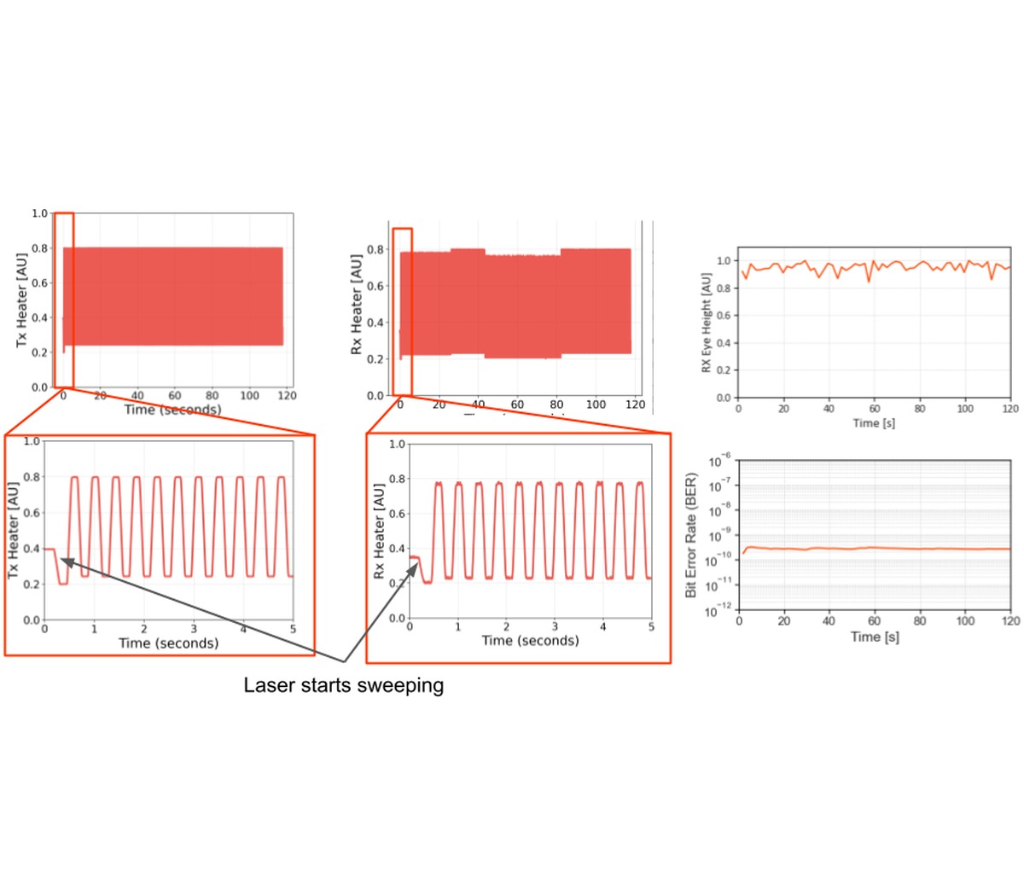
LIGHTMATTER
PHOTONIC I/O
Lightmatter uses photonics to break the electrical I/O bottleneck
Passage integrates optical connectivity across large AI packages and rack-scale systems.
STRATEGIC WEDGE
3D-stacked photonic interposers move data where electrical chip-edge I/O becomes limiting.
BUSINESS MODEL
PRIMARY ICP
Photonic component + design-in
Hyperscalers, packaging ecosystems
GTM MOTION
PARTNER MOVE
Long-cycle ecosystem design-in
Map the orchestrator control point
OFFICIAL SITE VISUAL · LIGHTMATTER
EVIDENCE / PARTNER
HIGH / MEDIUM
RISK GATE
Qualification + design wins
Lightmatter product and funding announcements. Bandwidth is a vendor specification.
Semiconductor Startups 2026 · Evidence-Led Strategy
22 / 36
Notes:
Speaker implication: Lightmatter says the Passage M1000 reference platform provides 114 Tbps of total optical bandwidth.
Visible citation: Lightmatter product and funding announcements. Bandwidth is a vendor specification.
Evidence URLs:
- https://lightmatter.co/press-release/lightmatter-unveils-passage-m1000-photonic-superchip-worlds-fastest-ai-interconnect/
- https://lightmatter.co/press-release/lightmatter-raises-400m-series-d-quadruples-valuation-to-4-4b-as-photonics-leader-for-next-gen-ai-data-centers/
- https://lightmatter.co/blog/seeing-is-believing-a-technical-deep-dive-into-lightmatters-hardware/

Slide 23

XSIGHT LABS
PROGRAMMABLE ETHERNET
Xsight makes programmable Ethernet silicon an AI-factory control point
X2 targets hyperscale, edge, and private data centers with 100G SerDes and 800G fabric links.
STRATEGIC WEDGE
Programmable switching silicon with a documented hardware/software interface.
BUSINESS MODEL
PRIMARY ICP
Ethernet silicon + software
Hyperscalers, OEMs, network teams
GTM MOTION
PARTNER MOVE
NOS/OEM design-in
Validate tooling and support
OFFICIAL SITE VISUAL · XSIGHT LABS
EVIDENCE / PARTNER
HIGH / MEDIUM
RISK GATE
NOS/OEM support maturity
Xsight Labs X2 announcement.
Semiconductor Startups 2026 · Evidence-Led Strategy
23 / 36
Notes:
Speaker implication: Xsight announced X2 sampling as a fully programmable, low-power data-center switch for AI-factory networks.
Visible citation: Xsight Labs X2 announcement.
Evidence URLs:
- https://xsightlabs.com/newsroom/announcements/xsight-labs-announces-x2-programmable-sdn-ethernet-switches-for-hyperscale-and-edge-data-centers-optimized-for-the-ai-factory-era
- https://xsightlabs.com/switches/x2

Slide 24
INTERCONNECT COMPARISON
The three interconnect plays solve different layers of the same scaling problem
Control shifts from cluster fabric to package-level I/O to programmable Ethernet.
COMPANY | PRIMARY LAYER | CORE PROMISE | ADOPTION DEPENDENCY
Cornelis | Cluster fabric | Predictable lossless scale-out | Fabric ecosystem + operations
Lightmatter | Package / scale-up I/O | Bandwidth density + energy efficiency | Packaging + design partners
Xsight | Switch silicon | Programmability + lower-power Ethernet | NOS/tooling + hyperscaler adoption
Company product announcements.
Semiconductor Startups 2026 · Evidence-Led Strategy
24 / 36
Notes:
Speaker implication: Cornelis focuses on cluster fabric, Lightmatter on optical chip/package links, and Xsight on programmable switching silicon.
Visible citation: Company product announcements.
Evidence URLs:
- https://www.cornelis.com/
- https://lightmatter.co/press-release/lightmatter-unveils-passage-m1000-photonic-superchip-worlds-fastest-ai-interconnect/
- https://xsightlabs.com/newsroom/announcements/xsight-labs-announces-x2-programmable-sdn-ethernet-switches-for-hyperscale-and-edge-data-centers-optimized-for-the-ai-factory-era

Slide 25
PARTNER ENTRY GATES
Six hard gates determine whether a partner motion is credible
A strong architecture cannot compensate for missing product, support, or operating boundaries.
01
DISTRIBUTE
02
INTEGRATE
Packaged offer, supply visibility, support model
APIs, software maturity, reference architecture
03
CO-SELL
04
DESIGN-IN
Named ICP, repeatable proof, commercial ownership
Roadmap alignment, qualification, capacity path
05
VALIDATE
06
OPERATE
Transparent benchmark method and workload access
Telemetry, lifecycle support, SLA accountability
Research-team diligence framework.
Semiconductor Startups 2026 · Evidence-Led Strategy
25 / 36
Notes:
Speaker implication: Commercial readiness requires evidence across workload proof, software, supply, reference customers, partners, and economics.
Visible citation: Research-team diligence framework.
Evidence URLs:
- https://www.crn.com/news/computing/2026/the-10-coolest-semiconductor-startups-of-2026-so-far
- https://axelera.ai/news/axelera-ai-secures-more-than-250-million-funding-on-global-commercial-growth
- https://www.nextsilicon.com/insights/nextsilicon-breakthrough/
- https://www.d-matrix.ai/announcements/d-matrix-corsair-ai-inference-platform-enters-full-production-to-meet-customer-demand/
- https://lightmatter.co/press-release/lightmatter-unveils-passage-m1000-photonic-superchip-worlds-fastest-ai-interconnect/
- https://xsightlabs.com/newsroom/announcements/xsight-labs-announces-x2-programmable-sdn-ethernet-switches-for-hyperscale-and-edge-data-centers-optimized-for-the-ai-factory-era

Slide 26
DISTRIBUTOR LENS
Distributor fit favors packageable offers with bounded support
Qualitative labels are provisional public-evidence judgments; validate locally before partner selection.
COMPANY | CANDIDATE FIT | PUBLIC SIGNAL | NEXT VALIDATION
Axelera AI | STRONG | Partner network + edge systems | Validate channel economics
Tenstorrent | EMERGING | Systems and developer products | Clarify support ownership
NextSilicon | VALIDATE | Product-volume claim | Confirm SKU + supply path
Fractile | MONITOR | Pre-scale platform | Wait for product availability
Etched | MONITOR | System ambition | Wait for production offer
d-Matrix | EMERGING | Full-production platform | Test repeatable packaging
MatX | MONITOR | Pre-tape-out | Track launch milestones
Cornelis | STRONG | Commercial fabric portfolio | Validate geographic coverage
Lightmatter | VALIDATE | Design-in component | Distributor role may be limited
Xsight Labs | VALIDATE | Sampling switch silicon | Confirm OEM/NOS support
Directional research judgment from public product, availability, and partner evidence.
Semiconductor Startups 2026 · Evidence-Led Strategy
26 / 36
Notes:
Speaker implication: Distribution fit rises with product packaging, supply visibility, enablement, and support clarity.
Visible citation: Directional research judgment from public product, availability, and partner evidence.
Evidence URLs:
- https://www.crn.com/news/computing/2026/the-10-coolest-semiconductor-startups-of-2026-so-far
- https://www.gartner.com/en/newsroom/press-releases/2026-04-08-gartner-forecasts-worldwide-semiconductor-revenue-to-exceed-us-dollars-one-point-3-trillion-in-2026
- https://axelera.ai/news/axelera-ai-secures-more-than-250-million-funding-on-global-commercial-growth
- https://tenstorrent.com/newsroom/tenstorrent-sets-new-performance-records-launches-tt--ascalon-s
- https://www.nextsilicon.com/insights/nextsilicon-breakthrough/
- https://www.fractile.ai/news/fractile-raises-220m-to-build-the-next-generation-of-inference-hardware
- https://www.etched.com/progress
- https://www.d-matrix.ai/announcements/d-matrix-corsair-ai-inference-platform-enters-full-production-to-meet-customer-demand/
- https://www.d-matrix.ai/announcements/d-matrix-raises-275-million-to-power-the-age-of-ai-inference/
- https://www.cornelis.com/
- https://www.cornelis.com/stories/cornelis-networks-announces-29m-series-b-funding-round
- https://lightmatter.co/press-release/lightmatter-unveils-passage-m1000-photonic-superchip-worlds-fastest-ai-interconnect/
- https://lightmatter.co/press-release/lightmatter-raises-400m-series-d-quadruples-valuation-to-4-4b-as-photonics-leader-for-next-gen-ai-data-centers/
- https://matx.com/research/series_b
- https://xsightlabs.com/newsroom/announcements/xsight-labs-announces-x2-programmable-sdn-ethernet-switches-for-hyperscale-and-edge-data-centers-optimized-for-the-ai-factory-era

Slide 27
SYSTEMS-INTEGRATOR LENS
SI fit favors deployable systems with reusable integration
Systems integrators create value when reference architecture and operating accountability are both real.
COMPANY | CANDIDATE FIT | PUBLIC SIGNAL | NEXT VALIDATION
Axelera AI | STRONG | Edge solution ecosystem | Build vertical reference offer
Tenstorrent | EMERGING | Broad programmable stack | Validate software operations
NextSilicon | EMERGING | HPC application compatibility | Prove porting effort
Fractile | VALIDATE | Full-stack thesis | Secure lighthouse workload
Etched | VALIDATE | Rack-scale specialization | Test workload durability
d-Matrix | STRONG | Production inference platform | Validate TCO + SLA
MatX | MONITOR | Pre-scale architecture | Wait for accessible system
Cornelis | STRONG | Cluster fabric integration | Package migration services
Lightmatter | VALIDATE | Packaging-level insertion | Clarify SI control point
Xsight Labs | EMERGING | Programmable Ethernet | Validate NOS/tooling
Directional research judgment from public product and deployment evidence.
Semiconductor Startups 2026 · Evidence-Led Strategy
27 / 36
Notes:
Speaker implication: SI fit rises when the startup exposes a deployable integration boundary and a repeatable customer outcome.
Visible citation: Directional research judgment from public product and deployment evidence.
Evidence URLs:
- https://www.crn.com/news/computing/2026/the-10-coolest-semiconductor-startups-of-2026-so-far
- https://www.gartner.com/en/newsroom/press-releases/2026-04-08-gartner-forecasts-worldwide-semiconductor-revenue-to-exceed-us-dollars-one-point-3-trillion-in-2026
- https://axelera.ai/news/axelera-ai-secures-more-than-250-million-funding-on-global-commercial-growth
- https://tenstorrent.com/newsroom/tenstorrent-sets-new-performance-records-launches-tt--ascalon-s
- https://www.nextsilicon.com/insights/nextsilicon-breakthrough/
- https://www.fractile.ai/news/fractile-raises-220m-to-build-the-next-generation-of-inference-hardware
- https://www.etched.com/progress
- https://www.d-matrix.ai/announcements/d-matrix-corsair-ai-inference-platform-enters-full-production-to-meet-customer-demand/
- https://www.d-matrix.ai/announcements/d-matrix-raises-275-million-to-power-the-age-of-ai-inference/
- https://www.cornelis.com/
- https://www.cornelis.com/stories/cornelis-networks-announces-29m-series-b-funding-round
- https://lightmatter.co/press-release/lightmatter-unveils-passage-m1000-photonic-superchip-worlds-fastest-ai-interconnect/
- https://lightmatter.co/press-release/lightmatter-raises-400m-series-d-quadruples-valuation-to-4-4b-as-photonics-leader-for-next-gen-ai-data-centers/
- https://matx.com/research/series_b
- https://xsightlabs.com/newsroom/announcements/xsight-labs-announces-x2-programmable-sdn-ethernet-switches-for-hyperscale-and-edge-data-centers-optimized-for-the-ai-factory-era

Slide 28
ECOSYSTEM LENS
Ecosystem fit favors platforms that coordinate scarce complements
The strongest orchestration candidates can align OEMs, software, cloud, packaging, or network partners.
COMPANY | CANDIDATE FIT | PUBLIC SIGNAL | NEXT VALIDATION
Axelera AI | STRONG | Explicit partner network | Measure partner-sourced pipeline
Tenstorrent | STRONG | IP + systems + open stack | Test governance and overlap
NextSilicon | EMERGING | Code compatibility | Expand software proof
Fractile | VALIDATE | Full-stack co-design | Map foundry + system partners
Etched | VALIDATE | Transformer-specific stack | Test model ecosystem risk
d-Matrix | EMERGING | Heterogeneous inference | Map cloud/OEM replication
MatX | VALIDATE | LLM-specific platform | Validate launch ecosystem
Cornelis | EMERGING | Interoperable fabric | Test ecosystem breadth
Lightmatter | STRONG | Packaging + foundry dependency | Coordinate design partners
Xsight Labs | EMERGING | Programmable switch interface | Align NOS + OEM roadmap
Directional research judgment from public platform and partner evidence.
Semiconductor Startups 2026 · Evidence-Led Strategy
28 / 36
Notes:
Speaker implication: Orchestrator fit rises when partner coordination is essential to the product’s adoption and scale.
Visible citation: Directional research judgment from public platform and partner evidence.
Evidence URLs:
- https://www.crn.com/news/computing/2026/the-10-coolest-semiconductor-startups-of-2026-so-far
- https://www.gartner.com/en/newsroom/press-releases/2026-04-08-gartner-forecasts-worldwide-semiconductor-revenue-to-exceed-us-dollars-one-point-3-trillion-in-2026
- https://axelera.ai/news/axelera-ai-secures-more-than-250-million-funding-on-global-commercial-growth
- https://tenstorrent.com/newsroom/tenstorrent-sets-new-performance-records-launches-tt--ascalon-s
- https://www.nextsilicon.com/insights/nextsilicon-breakthrough/
- https://www.fractile.ai/news/fractile-raises-220m-to-build-the-next-generation-of-inference-hardware
- https://www.etched.com/progress
- https://www.d-matrix.ai/announcements/d-matrix-corsair-ai-inference-platform-enters-full-production-to-meet-customer-demand/
- https://www.d-matrix.ai/announcements/d-matrix-raises-275-million-to-power-the-age-of-ai-inference/
- https://www.cornelis.com/
- https://www.cornelis.com/stories/cornelis-networks-announces-29m-series-b-funding-round
- https://lightmatter.co/press-release/lightmatter-unveils-passage-m1000-photonic-superchip-worlds-fastest-ai-interconnect/
- https://lightmatter.co/press-release/lightmatter-raises-400m-series-d-quadruples-valuation-to-4-4b-as-photonics-leader-for-next-gen-ai-data-centers/
- https://matx.com/research/series_b
- https://xsightlabs.com/newsroom/announcements/xsight-labs-announces-x2-programmable-sdn-ethernet-switches-for-hyperscale-and-edge-data-centers-optimized-for-the-ai-factory-era

Slide 29
ROLE-SPECIFIC PORTFOLIO
One heatmap shows the role-specific portfolio—not a universal ranking
The same company can merit a different next move for a distributor, SI, or ecosystem orchestrator.
COMPANY
DISTRIBUTOR
SI
ORCHESTRATOR
NEXT VALIDATION
Axelera AI
STRONG
STRONG
STRONG
Validate economics
Tenstorrent
EMERGING
EMERGING
STRONG
Choose motion
NextSilicon
VALIDATE
EMERGING
EMERGING
Prove porting
Fractile
MONITOR
VALIDATE
VALIDATE
Secure lighthouse
Etched
MONITOR
VALIDATE
VALIDATE
Test workload durability
d-Matrix
EMERGING
STRONG
EMERGING
Validate TCO + SLA
MatX
MONITOR
MONITOR
VALIDATE
Wait for silicon
Cornelis
STRONG
STRONG
EMERGING
Package migration
Lightmatter
VALIDATE
VALIDATE
STRONG
Map control point
Xsight Labs
VALIDATE
EMERGING
EMERGING
Validate NOS/tooling
Public-evidence posture; candidate model, not calibrated organization-specific scoring.
Semiconductor Startups 2026 · Evidence-Led Strategy
29 / 36
Notes:
Speaker implication: Partner readiness varies by role and must be displayed with the next validation question.
Visible citation: Public-evidence posture; candidate model, not calibrated organization-specific scoring.
Evidence URLs:
- https://www.crn.com/news/computing/2026/the-10-coolest-semiconductor-startups-of-2026-so-far
- https://axelera.ai/news/axelera-ai-secures-more-than-250-million-funding-on-global-commercial-growth
- https://www.d-matrix.ai/announcements/d-matrix-corsair-ai-inference-platform-enters-full-production-to-meet-customer-demand/
- https://www.cornelis.com/
- https://lightmatter.co/press-release/lightmatter-unveils-passage-m1000-photonic-superchip-worlds-fastest-ai-interconnect/

Slide 30
DISTRIBUTOR ECONOMICS
Unit economics differ by where the partner controls value
Inventory, design-in, software, and ecosystem motions create distinct margin and support exposure.
SYSTEM SALE
High initial value
Inventory, support, and supply exposure
SILICON DESIGN-IN
Sticky volume revenue
Long qualification and concentration
IP LICENSE
Asset-light leverage
Customer implementation and royalty timing
SOFTWARE + SUPPORT
Recurring control layer
Requires developer adoption and model coverage
PARTNER ECOSYSTEM
Distribution leverage
Enablement cost and channel conflict
Directional business-model assessment; no company financial forecasts implied.
Semiconductor Startups 2026 · Evidence-Led Strategy
30 / 36
Notes:
Speaker implication: Business models with reusable software or IP leverage can scale differently from bespoke system and design-in models.
Visible citation: Directional business-model assessment; no company financial forecasts implied.
Evidence URLs:
- https://tenstorrent.com/newsroom/tenstorrent-sets-new-performance-records-launches-tt--ascalon-s
- https://axelera.ai/news/axelera-ai-secures-more-than-250-million-funding-on-global-commercial-growth
- https://www.d-matrix.ai/announcements/d-matrix-corsair-ai-inference-platform-enters-full-production-to-meet-customer-demand/
- https://lightmatter.co/press-release/lightmatter-unveils-passage-m1000-photonic-superchip-worlds-fastest-ai-interconnect/
- https://xsightlabs.com/newsroom/announcements/xsight-labs-announces-x2-programmable-sdn-ethernet-switches-for-hyperscale-and-edge-data-centers-optimized-for-the-ai-factory-era

Slide 31
PHASE 0 CALIBRATION
Calibrate the model on three deliberately different archetypes
Axelera AI, Etched, and Lightmatter test deployment, specialization, and ecosystem-design-in assumptions.
AXELERA AI
ETCHED
LIGHTMATTER
DEPLOYMENT ECOSYSTEM
SPECIALIZATION BET
DESIGN-IN ECOSYSTEM
Can partners replicate a vertical edge offer with bounded support?
Does transformer-only advantage survive workload and roadmap scrutiny?
Who owns qualification, packaging coordination, and commercial pull?
PRIMARY LENS · Distributor + SI
PRIMARY LENS · SI + lighthouse
PRIMARY LENS · Orchestrator
Phase 0 operating recommendation; public evidence defines hypotheses, not final selections.
Semiconductor Startups 2026 · Evidence-Led Strategy
31 / 36
Notes:
Speaker implication: A three-company pilot with independent raters should precede organization-specific recommendations.
Visible citation: Phase 0 operating recommendation; public evidence defines hypotheses, not final selections.
Evidence URLs:
- https://axelera.ai/news/axelera-ai-secures-more-than-250-million-funding-on-global-commercial-growth
- https://www.etched.com/progress
- https://lightmatter.co/press-release/lightmatter-unveils-passage-m1000-photonic-superchip-worlds-fastest-ai-interconnect/

Slide 32
90-DAY ACTION PLAN
The first 90 days should buy evidence, not commitments
Each stage resolves a specific uncertainty and ends in an explicit advance, redesign, or stop decision.
0–30 DAYS · SCREEN
31–60 DAYS · TEST
61–90 DAYS · DECIDE
Confirm offer, stage, ICP, partner boundary, and evidence owner for six shortlisted motions.
Run workload, integration, support, and commercial discovery with named hypotheses.
Advance, redesign, or stop each motion based on proof-package completion.
One evidence ledger, one archetype decision, and one next-action brief per shortlisted company.
Recommended validation sequence; no named-partner commitment implied.
Semiconductor Startups 2026 · Evidence-Led Strategy
32 / 36
Notes:
Speaker implication: The first 90 days should reduce uncertainty through bounded tests rather than make execution claims.
Visible citation: Recommended validation sequence; no named-partner commitment implied.
Evidence URLs:
- https://www.crn.com/news/computing/2026/the-10-coolest-semiconductor-startups-of-2026-so-far
- https://www.gartner.com/en/newsroom/press-releases/2026-04-08-gartner-forecasts-worldwide-semiconductor-revenue-to-exceed-us-dollars-one-point-3-trillion-in-2026
- https://axelera.ai/news/axelera-ai-secures-more-than-250-million-funding-on-global-commercial-growth
- https://tenstorrent.com/newsroom/tenstorrent-sets-new-performance-records-launches-tt--ascalon-s
- https://www.nextsilicon.com/insights/nextsilicon-breakthrough/
- https://www.fractile.ai/news/fractile-raises-220m-to-build-the-next-generation-of-inference-hardware
- https://www.etched.com/progress
- https://www.d-matrix.ai/announcements/d-matrix-corsair-ai-inference-platform-enters-full-production-to-meet-customer-demand/
- https://www.d-matrix.ai/announcements/d-matrix-raises-275-million-to-power-the-age-of-ai-inference/
- https://www.cornelis.com/
- https://www.cornelis.com/stories/cornelis-networks-announces-29m-series-b-funding-round
- https://lightmatter.co/press-release/lightmatter-unveils-passage-m1000-photonic-superchip-worlds-fastest-ai-interconnect/
- https://lightmatter.co/press-release/lightmatter-raises-400m-series-d-quadruples-valuation-to-4-4b-as-photonics-leader-for-next-gen-ai-data-centers/
- https://matx.com/research/series_b
- https://xsightlabs.com/newsroom/announcements/xsight-labs-announces-x2-programmable-sdn-ethernet-switches-for-hyperscale-and-edge-data-centers-optimized-for-the-ai-factory-era

Slide 33
12-MONTH WATCHLIST
Quarterly triggers—not narrative momentum—should change posture
Commercial milestones are the control system for the portfolio.
Fractile · MatX
Etched · Lightmatter · Xsight
PRE-SILICON / PRE-SCALE
EARLY SYSTEMS / SAMPLES
Tape-out, first silicon, compiler readiness
Customer qualification, production benchmarks, design wins
Axelera · NextSilicon · d-Matrix
Tenstorrent · Cornelis
PRODUCT / VOLUME RAMP
PORTFOLIO / ECOSYSTEM
Shipment growth, repeat deployments, supply execution
Partner replication, software depth, installed-base expansion
Forward watchpoints inferred from publicly stated product stages.
Semiconductor Startups 2026 · Evidence-Led Strategy
33 / 36
Notes:
Speaker implication: The most decision-relevant next events are tape-outs, volume ramps, production benchmarks, design wins, and ecosystem expansion.
Visible citation: Forward watchpoints inferred from publicly stated product stages.
Evidence URLs:
- https://axelera.ai/news/axelera-ai-secures-more-than-250-million-funding-on-global-commercial-growth
- https://www.fractile.ai/news/fractile-raises-220m-to-build-the-next-generation-of-inference-hardware
- https://www.etched.com/progress
- https://www.d-matrix.ai/announcements/d-matrix-corsair-ai-inference-platform-enters-full-production-to-meet-customer-demand/
- https://lightmatter.co/press-release/lightmatter-unveils-passage-m1000-photonic-superchip-worlds-fastest-ai-interconnect/
- https://matx.com/research/series_b
- https://xsightlabs.com/newsroom/announcements/xsight-labs-announces-x2-programmable-sdn-ethernet-switches-for-hyperscale-and-edge-data-centers-optimized-for-the-ai-factory-era

Slide 34
WHAT TO WATCH
Five kill criteria stop technically impressive but non-deployable bets
Software, silicon, proof, customers, and workload durability are non-negotiable gates.
01
SOFTWARE
Compiler maturity, frameworks, model coverage, and developer experience
02
SILICON
Tape-out, yield, packaging, memory availability, and manufacturing scale
03
PROOF
Independent benchmarks, production workloads, and total-cost evidence
04
CUSTOMERS
Design-win conversion, concentration, support burden, and renewal economics
05
DURABILITY
Whether the targeted workload or interconnect standard remains strategically important
Research-team risk synthesis from public company evidence.
Semiconductor Startups 2026 · Evidence-Led Strategy
34 / 36
Notes:
Speaker implication: Software, supply, independent benchmarks, customer concentration, and architecture durability are the central diligence risks.
Visible citation: Research-team risk synthesis from public company evidence.
Evidence URLs:
- https://www.crn.com/news/computing/2026/the-10-coolest-semiconductor-startups-of-2026-so-far
- https://www.nextsilicon.com/insights/nextsilicon-breakthrough/
- https://www.fractile.ai/news/fractile-raises-220m-to-build-the-next-generation-of-inference-hardware
- https://www.etched.com/progress
- https://www.d-matrix.ai/announcements/d-matrix-corsair-ai-inference-platform-enters-full-production-to-meet-customer-demand/
- https://lightmatter.co/press-release/lightmatter-unveils-passage-m1000-photonic-superchip-worlds-fastest-ai-interconnect/

Slide 35
EVIDENCE BUYING PLAN
The evidence ledger exposes exactly what must be learned next
Every priority has a strongest anchor, a decisive gap, and a next question.
COMPANY / GROUP | STRONGEST ANCHOR | DECISIVE GAP | NEXT QUESTION
Axelera AI | Partner ecosystem + funding | Partner-sourced pipeline | Validate distributor/SI economics
d-Matrix | Production platform | Independent TCO + references | Validate repeatable SI offer
Cornelis | Commercial fabric | Channel coverage + migration proof | Package integration motion
Tenstorrent | Broad products + IP | Support ownership + adoption | Choose licensing vs systems motion
Lightmatter | Reference photonic platform | Qualification + design wins | Map orchestrator role
Fractile / Etched / MatX | Capital + architecture thesis | Availability + customer proof | Monitor milestone triggers
Illustrative public-evidence snapshot; not the authoritative scorecard.
Semiconductor Startups 2026 · Evidence-Led Strategy
35 / 36
Notes:
Speaker implication: A useful ledger links each company to its strongest anchor, decisive gap, and next validation action.
Visible citation: Illustrative public-evidence snapshot; not the authoritative scorecard.
Evidence URLs:
- https://www.crn.com/news/computing/2026/the-10-coolest-semiconductor-startups-of-2026-so-far
- https://www.gartner.com/en/newsroom/press-releases/2026-04-08-gartner-forecasts-worldwide-semiconductor-revenue-to-exceed-us-dollars-one-point-3-trillion-in-2026
- https://axelera.ai/news/axelera-ai-secures-more-than-250-million-funding-on-global-commercial-growth
- https://tenstorrent.com/newsroom/tenstorrent-sets-new-performance-records-launches-tt--ascalon-s
- https://www.nextsilicon.com/insights/nextsilicon-breakthrough/
- https://www.fractile.ai/news/fractile-raises-220m-to-build-the-next-generation-of-inference-hardware
- https://www.etched.com/progress
- https://www.d-matrix.ai/announcements/d-matrix-corsair-ai-inference-platform-enters-full-production-to-meet-customer-demand/
- https://www.d-matrix.ai/announcements/d-matrix-raises-275-million-to-power-the-age-of-ai-inference/
- https://www.cornelis.com/
- https://www.cornelis.com/stories/cornelis-networks-announces-29m-series-b-funding-round
- https://lightmatter.co/press-release/lightmatter-unveils-passage-m1000-photonic-superchip-worlds-fastest-ai-interconnect/
- https://lightmatter.co/press-release/lightmatter-raises-400m-series-d-quadruples-valuation-to-4-4b-as-photonics-leader-for-next-gen-ai-data-centers/
- https://matx.com/research/series_b
- https://xsightlabs.com/newsroom/announcements/xsight-labs-announces-x2-programmable-sdn-ethernet-switches-for-hyperscale-and-edge-data-centers-optimized-for-the-ai-factory-era

Slide 36
CONCLUSION
Select validation priorities now—and reserve partnership decisions for calibrated evidence
The portfolio is actionable when posture, confidence, and the next proof purchase travel together.
PUBLIC EVIDENCE
PHASE 0
LOCAL PROFILE
Prioritizes what to test
Calibrates the rubric
Determines who to partner with
Use the cohort to choose what to test next—not to declare a market winner.
Conclusion based on the CRN cohort and primary-source review.
Semiconductor Startups 2026 · Evidence-Led Strategy
36 / 36
Notes:
Speaker implication: A bottleneck-first watchlist is more useful than treating all ten companies as direct accelerator competitors.
Visible citation: Conclusion based on the CRN cohort and primary-source review.
Evidence URLs:
- https://www.crn.com/news/computing/2026/the-10-coolest-semiconductor-startups-of-2026-so-far
- https://www.gartner.com/en/newsroom/press-releases/2026-04-08-gartner-forecasts-worldwide-semiconductor-revenue-to-exceed-us-dollars-one-point-3-trillion-in-2026

