Slide 1

PRE-SERIES A INVESTOR BRIEFING
Commercializing Vertically Integrated
Edge-AI Silicon for Non-Discretionary
Autonomy Mandates
Bypassing Western merchant silicon to deliver compliant commercial
vehicle safety at a 3x to 7x cost reduction.
INCUBATION
T-Hub Phase 2, Hyderabad
STRATEGIC FOCUS
Demystifying the Ideal Customer Profile (ICP) and executing a phased
Go-To-Market strategy with no existing customer base.
₹55 Cr
3–7×
39.3
₹1,387.95 Cr
PRE-SERIES A ASK
COST REDUCTION
TOPS INT8
FY32 REVENUE (MODEL)
Blended · ≈ $4.79M at ₹94/USD
vs. imported ADAS systems
64×512 MAC lattice, 600MHz ×2
Management projection, unaudited
DEEPGRID SEMI · PRE-SERIES A INVESTOR BRIEFING · JULY 2026
01
Notes:
Cover. Ask corrected to canonical ₹55 Cr blended (was ₹25 Cr in source PDF/script) — see slide 2 correction card.

Slide 2
EXECUTIVE SUMMARY
Bridging the Valley of Death — FPGA Prototype to Custom ASIC
The technical reality
The production bottleneck
The silicon destination
DeepGrid has validated its custom 39.3 TOPS INT8 edge-AI processor architecture on FPGAs — algorithmic efficacy proven, not simulated.
FPGA boards are physically too large, run hot, and cost ~₹35,000 (~$420) per unit — uneconomic at any commercial volume.
Custom 28nm ASICs cut die cost to $3.876 at scale (<$4) and total board-level BOM to ~$30.
The GTM mandate
DeepGrid has no existing commercial automotive customers and cannot wait for 4-year OEM validation cycles. The commercial roadmap is sequenced through dual-use defense wedges (Months 0–6) and aftermarket retrofit mandates (Months 6–18) before OEM line-fit (Months 18–36) — see slides 16–18.
⚠ A correction we are making to our own materials
Earlier versions of this briefing cited a ₹25 Crore (~$3M) Pre-Series A ask. The reconciled Use-of-Funds model raises ₹45 Cr equity (CCPS) + ₹10 Cr CGTMSE-backed debt = ₹55 Cr blended (≈ $4.79M at ₹94/USD). We present the reconciled ask because it is the figure the funded plan — tape-out NRE, EDA licenses, MPW shuttle — actually builds to. See slide 22 for the matching NRE correction.
DEEPGRID SEMI · PRE-SERIES A INVESTOR BRIEFING · JULY 2026
02
Notes:
Reference p1-2 (Exec Summary). CORRECTION: ask corrected ₹25 Cr → ₹55 Cr blended per canonical-numbers.md, stated openly.

Slide 3

THE CORE PROBLEM
The Hardware Squeeze Zone Traps Every Pure-Play AI Stack
Pure-Play AI Software
The Squeeze Zone
The Result
Advanced AV/ADAS perception algorithms, no owned silicon
Dependency on third-party merchant silicon (NVIDIA/Ambarella) drives compute BOM past $6,000
High hardware costs restrict sales to high-end logistics networks in developed economies
The power bottleneck
Flat GPU and traditional matrix processors suffer memory-bandwidth bottlenecks, leaving extremely low real-world utilization on edge ADAS workloads.
The local data failure
Global computing platforms run vision algorithms trained on structured Western highways — highly unreliable in unstructured, high-entropy Indian and GCC traffic, at right.
DEEPGRID SEMI · PRE-SERIES A INVESTOR BRIEFING · JULY 2026
03
Notes:
Reference p2 (Squeeze Zone infographic) + p3 (unstructured traffic illustration).

Slide 4

THE SOLUTION
The Custom DGrid Alpha Combo-Die Architecture
3D Systolic Tensor Cube
Batch dispatch firmware
A 64×512 MAC lattice, dual-issue (×2) at 600MHz — verified to deliver 39.3 TOPS INT8.
Decouples host supervision from execution units — up to 200× higher real-world compute efficiency.
Combo-die integration
Unmatched cost advantage
Eliminates multi-chip complexity — AI, sensor interfaces, and telematics on one die.
Board BOM lands ~$30 at scale — absorbed into hardware, monetized via software (slide 24).
Architecture verifies: 64 × 512 × 600MHz × 2 = 39.3 TOPS INT8 (canonical chip-spec reconciliation) — vs. the source script's uncorroborated "8×8×8, 32,768 MACs," which does not arithmetically produce 39.3 TOPS.
DEEPGRID SEMI · PRE-SERIES A INVESTOR BRIEFING · JULY 2026
04
Notes:
Reference p4 (Architecture of Autonomy — 3D Systolic Tensor Cube) — image-conditioned regeneration of the isometric cube + flat-GPU comparison, text-free.

Slide 5
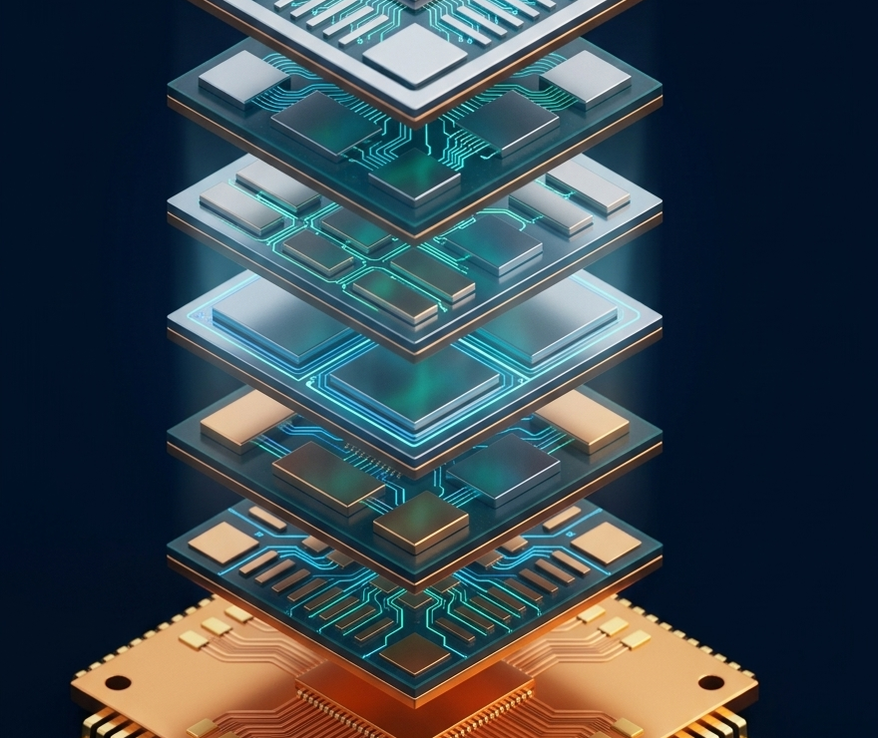
THE ARCHITECTURE
DeepGrid's Six-Chiplet Integration
Consolidating every mandatory ADAS feature onto single-die silicon
A100 — ADAS / AI Processor
R100 — Radar DSP
39.3 TOPS INT8 running perception models (YOLOv11, VLA) at 40 fps.
12-bit native ADC for 77GHz radar — eliminates external radar chips.
T100 — Thermal / LiDAR DSP
D100 — Secure Enclave
Dense multi-sensor thermal and LiDAR point-cloud processing for low light.
Dual-core lockstep RISC-V — hardware-level keys, blocks unauthorized overrides.
S100 — SDV Telematics Gateway
H100 — Health / Bio-ADC
Software-Defined Vehicle gateway, integrated AIS-140 real-time tracking.
Drowsiness detection from steering torque and cabin-camera biometrics.
DEEPGRID SEMI · PRE-SERIES A INVESTOR BRIEFING · JULY 2026
05
Notes:
Reference p5 (DGrid Alpha Combo-Die Deconstruction) — image-conditioned regeneration of the exploded six-layer chip stack, text-free.

Slide 6
ICP FRAMEWORK
The 5-Dimensional Diagnostic for Early-Stage Silicon
A common failure mode: targeting broad segments without scoring buying behavior
1 · Regulatory Compulsion
2 · Integration & Certification Friction
3 · Price Elasticity & BOM Limit
Is the purchase discretionary, or driven by immediate non-discretionary safety mandates?
Engineering hours and homologation cost to design our chip into the customer platform.
Customer's maximum budget tolerance for upfront hardware additions.
4 · Sales Cycle & Time-to-Revenue
5 · ODD Entropy
Why this matters
Timeline from initial technical engagement to commercial volume purchase orders.
Does the target system run in structured spaces, or chaotic, unstructured local roadways?
Segments scoring high across all five dimensions minimize cash-burn during the Pre-Series A runway. See the scored matrix, next.
DEEPGRID SEMI · PRE-SERIES A INVESTOR BRIEFING · JULY 2026
06
Notes:
Reference p6 (5-D framework) + docx methodology section.

Slide 7
ICP FRAMEWORK
Scoring the Three Segments to Minimize Cash-Burn
DIMENSION
A · TACTICAL DEFENSE
B · AFTERMARKET FLEET
C · OEM LINE-FIT
Primary platforms
UGVs, Port AGVs, Campus AMRs
N2/N3 medium & heavy trucks
New M2/M3 buses, N2/N3 trucks
Regulatory compulsion
Moderate — defense upgrades
Extreme — transport safety deadlines
High — type approvals & certificates
Integration friction
Low–moderate — bypasses public-road standards
Moderate — mounting & power mapping
Extreme — multi-year E/E redesign
Price elasticity
Low — sovereignty over cost
High — needs rapid payback
Moderate–high — BOM pressure
Sales cycle
Short (6–12 mo) — military pilots
Moderate (12–18 mo) — direct-to-fleet
Long (24–48 mo) — engineering pipeline
ODD entropy
High — tactical / seaport terrain
Extreme — unstructured mixed traffic
Moderate–high — highways + urban
The read
Option B (aftermarket fleet retrofit) sequences first: extreme regulatory compulsion plus a 12–18 month sales cycle converts fastest into mandate-driven volume, which is why it anchors Phase 2 of the GTM roadmap (slide 17).
DEEPGRID SEMI · PRE-SERIES A INVESTOR BRIEFING · JULY 2026
07
Notes:
Reference p7 (segment matrix table) + sa-media/image8.png radar chart (Aftermarket Retrofit dominant area) as directional confirmation.

Slide 8

ICP OPTION A
Tactical Defense & Constrained Robotics
The low-friction, immediate FPGA validation wedge
Target & pain point
Sovereign UGVs, border surveillance platforms, seaport AGVs. Traditional chips expose these strategic systems to foreign supply-chain threats and remote tracking.
Buying behavior & technical fit
Extremely insensitive to unit chip cost — prioritizes hardware-level cybersecurity and absolute data sovereignty. The D100 lockstep secure RISC-V enclave executes cryptographic tasks in rugged, GPS-denied environments.
The FPGA advantage
Deploys directly on currently validated FPGA boards — bypasses the wait for custom ASICs, securing immediate revenue to cushion engineering burn (₹1 Cr in defense contract revenue already received — slide 16).
DEEPGRID SEMI · PRE-SERIES A INVESTOR BRIEFING · JULY 2026
08
Notes:
Reference p8 + illustration: constrained-zone UGV with scan cone.

Slide 9
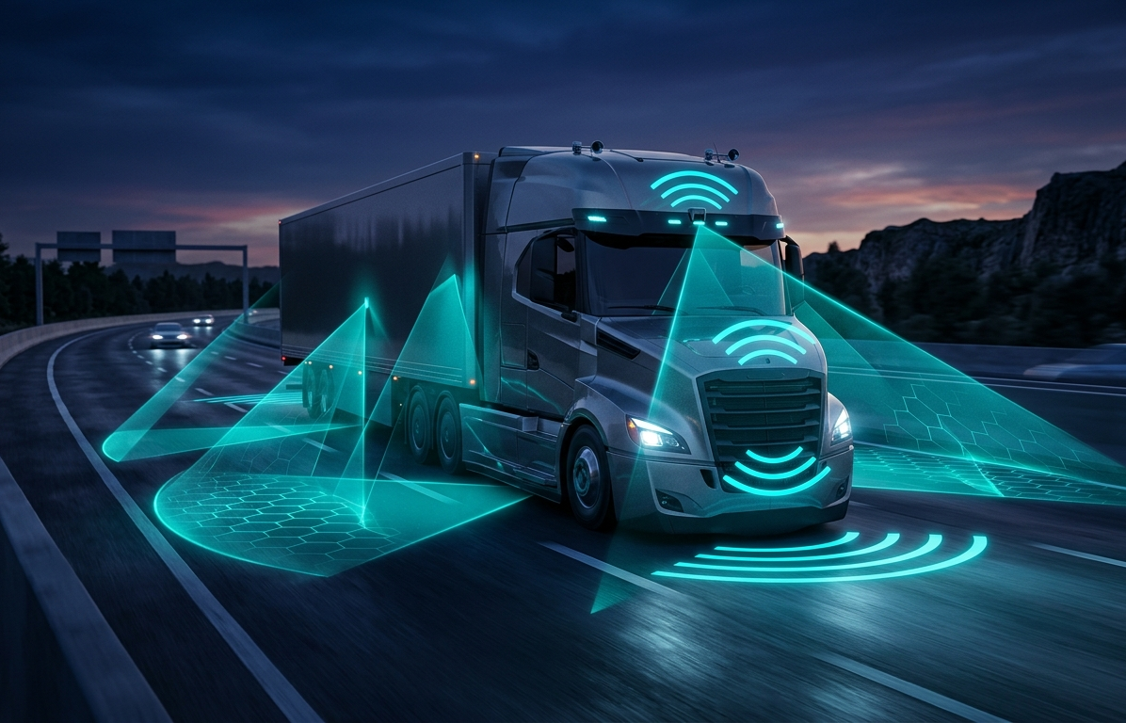
ICP OPTION B
Non-Discretionary Aftermarket Fleet Retrofit
The high-volume, mandate-driven volume engine
Target & pain point
Medium and heavy goods trucks (N2/N3) owned by private transport and logistics operators. Mandates require immediate ADAS integration, but razor-thin margins block new-vehicle purchases.
Buying behavior & technical fit
Highly cost-sensitive — weighs upgrade cost against non-compliance penalties and rising insurance premiums. DeepGrid's combo-die handles perception, blind-spot monitoring, and drowsiness telemetry on one board.
Commercial fit
A low-cost, homologated retrofit kit priced at ₹2–2.5 Lakh — 3–7× below premium imported systems. Full unit-economics build-up on slide 21.
DEEPGRID SEMI · PRE-SERIES A INVESTOR BRIEFING · JULY 2026
09
Notes:
Reference p9 + illustration: truck with sensor-coverage cones.

Slide 10

ICP OPTION C
OEM Factory Line-Fit Embedding
The long-term platform-locking GTM — the future scale engine
Target & pain point
Domestic Indian and emerging GCC heavy truck and passenger bus OEMs. Consolidating safety devices across multiple ECUs inflates platform BOM and creates integration bottlenecks.
Buying behavior & technical fit
Highly conservative and slow-moving — will not deal directly with pre-revenue, unproven startups. Consolidating six chiplets on one die cuts physical ECU footprint and simplifies electronics.
DeepGrid's approach
DeepGrid acts as a "Tier-2" chip designer, partnering with established Tier-1 automotive suppliers (Uno Minda, Spark Minda, Bosch India) who own direct OEM relations and warranties.
DEEPGRID SEMI · PRE-SERIES A INVESTOR BRIEFING · JULY 2026
10
Notes:
Reference p10 + illustration: factory gantry with chassis on the assembly track.

Slide 11

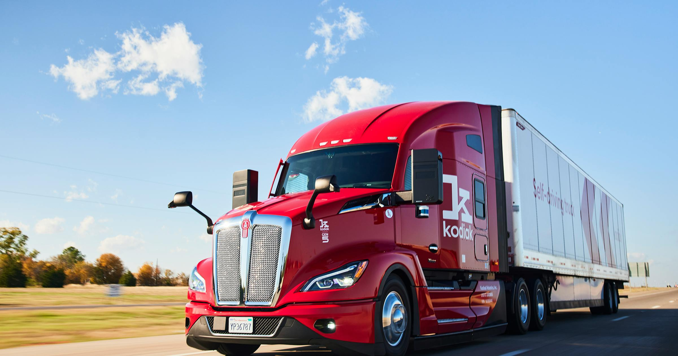
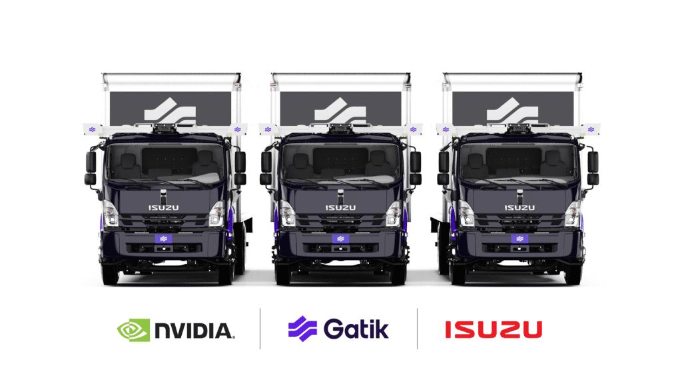
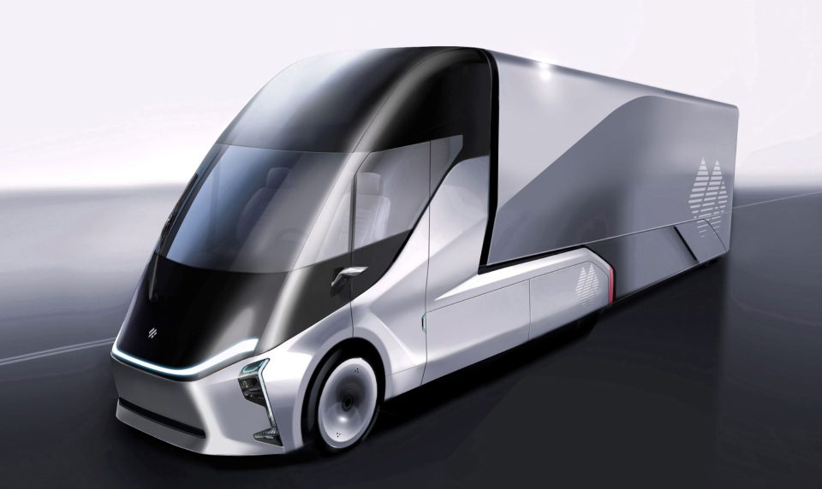
COMPETITIVE LANDSCAPE
Strategic Playbooks of Freight Autonomy Giants
Real fleets, four different bets on where autonomy pays first
Aurora — the heavy-OEM playbook
Kodiak Robotics — the dual-use playbook
Gatik — the constrained-route playbook
DeepWay — the vertical-integration playbook
Long-haul Class-8 on dual NVIDIA DRIVE Thor ($6,000+ BOM). Continental Tier-1 partnership; targeting 2025 pilot scale.
Highway freight + DoD defense contracts on Ambarella CV3-AD685. Active US commercial freight trials.
Fixed middle-mile routes on NVIDIA DRIVE AGX Orin + Isuzu box trucks. Driverless ops live for Walmart, Kroger.
China domestic fleets on high-compute NPU + Baidu Apollo co-design. "Xingtu" L4 electric trucks in commercial ops.
The lesson for DeepGrid
Every credible playbook picks one lane — constrained ODD (Gatik), dual-use defense revenue (Kodiak — DeepGrid's Phase 1), heavy-OEM capital intensity (Aurora — DeepGrid's Phase 3), or full vertical integration (DeepWay). No incumbent runs all three phases at DeepGrid's ~$30 BOM.
DEEPGRID SEMI · PRE-SERIES A INVESTOR BRIEFING · JULY 2026
11
Notes:
Reference p11 + real press photos (Aurora BusinessWire/aurora.tech, Kodiak Gen5 kodiak.ai, Gatik x NVIDIA x Isuzu gatik.ai, DeepWay Xingtu sustainabletruckvan.com) via You.com Level 2 livecrawl — real competitor evidence, not generated.

Slide 12



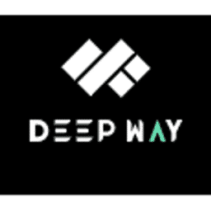
COMPETITIVE LANDSCAPE
Global Semiconductor & Dependency Matrix
METRIC
AURORA
KODIAK
GATIK
DEEPWAY
DEEPGRID SEMI
Primary markets
US Highway
US & Defense
US & Canada B2B
China Freight
India / GCC
Silicon partner
NVIDIA
Ambarella
NVIDIA / Intel
Baidu ecosystem
TSMC (28nm, in-house)
Compute model
Merchant silicon
Specialized merchant
Off-the-shelf (COTS)
Proprietary co-design
Custom in-house ASIC
Core processor
DRIVE Thor
CV3-AD685 (5nm)
Heterogeneous PC
High-compute NPU
DGrid Alpha combo-die
Compute capacity
~2,000 TOPS
5nm vector logic
Varies with GPUs
>500 TOPS
39.3 TOPS INT8
Chip dependency
Extreme
High
High
Moderate–high
Zero third-party dependency
Compute BOM cost
$6,000+ / board
High premium
Moderate–high
High platform cost
~$30 / board
The read
Every other player is dependent on third-party merchant silicon — DeepGrid is the only one with zero chip dependency, at roughly 1/200th the compute BOM of the US highway incumbents.
DEEPGRID SEMI · PRE-SERIES A INVESTOR BRIEFING · JULY 2026
12
Notes:
Reference p12 + real company logos (Aurora, Kodiak, Gatik, DeepWay) via You.com Level 2 livecrawl, sourced from official sites/Crunchbase.

Slide 13



COMPETITIVE LANDSCAPE
Mapping the Domestic Semiconductor Wave
As supplied in DeepGrid research materials — not independently re-verified in this pass
Netrasemi
Mindgrove Technologies
Agnit Semiconductors
A2000 AI SoC on TSMC 12nm. Paid evaluation trials with 3 OEMs (surveillance + automotive). Raised ₹125 Cr (incl. ₹107 Cr Series A from Zoho, Jul 2025). Targeting mid-2027 commercial launch.
700MHz secure, low-power RISC-V MCU on TSMC 28nm. MoU with Bosch (Jun 2025); deal with Pinetics. Raised $10.3M total (incl. $8M Series A led by Peak XV, Dec 2024).
Vertically integrated GaN devices on sapphire/SiC. Live defense radar pilots; targeting 100,000 GaN units in 24 months. $7.47M total funding (incl. $2.6M seed extension, Shastra VC, Mar 2026).
The read
India's semiconductor wave is real but young — the most advanced (Netrasemi) targets mid-2027 launch. DeepGrid's FPGA-validated architecture and live defense revenue put it ahead on commercial proof, not just design.
DEEPGRID SEMI · PRE-SERIES A INVESTOR BRIEFING · JULY 2026
13
Notes:
Reference p13 + real company logos (Netrasemi, Mindgrove, Agnit) via You.com Level 2 livecrawl, sourced from official sites/LinkedIn/Crunchbase. External competitor claims as supplied — not covered by the DeepGrid canonical-numbers contract, which governs DeepGrid's own figures only.

Slide 14



COMPETITIVE LANDSCAPE
Mapping Software-First Autonomy Competitors
As supplied in DeepGrid research materials — not independently re-verified in this pass
Minus Zero
Swaayatt Robots
RoshAI
Vision-first stack (Nature Inspired AI, True Vision Autonomy) — eliminates LiDAR and heavy compute. L4 zPod prototype; Ashok Leyland partnership for port/campus autonomy. $1.7M seed raised.
L5 navigation via unsupervised/RL algorithms mapping unstructured roads without HD maps. Demonstrated map-free, LiDAR-free driving at speed. $4M post-seed (Jun 2024, $151M valuation).
Hardware-agnostic software for control, navigation, localization, fleet tracking. Active in heavy industrial port/mining deployments. $1M seed (Aug 2024) + subsequent seed rounds (Apr 2026).
Why none of these compete on DeepGrid's axis
All three are hardware-agnostic by design — they run on third-party merchant silicon (typically NVIDIA-class) and inherit its BOM. DeepGrid competes on owned silicon economics, not perception-algorithm quality.
DEEPGRID SEMI · PRE-SERIES A INVESTOR BRIEFING · JULY 2026
14
Notes:
Reference p14 + real company logos (Minus Zero, Swaayatt Robots, RoshAI) via You.com Level 2 livecrawl, sourced from Crunchbase.

Slide 15
COMPETITIVE POSITIONING
How Vertical Integration Beats Software-Only and Microcontroller Rivals
Software-first competitors are squeezed
Microcontroller players lack compute
Minus Zero, Swaayatt, RoshAI write excellent algorithms but run on expensive merchant silicon (NVIDIA-class) — hardware cost stays high for the end customer.
Mindgrove designs low-power MCUs for IoT but has no path to the 39.3 TOPS deep-learning acceleration real-time camera-radar fusion needs.
Surveillance/server players lack integration
DeepGrid's edge
Netrasemi targets surveillance and edge servers — no 77GHz radar (R100) or driver-biometrics (H100) path for vehicle safety.
The only Indian startup designing a vertically integrated, single-die ADAS combo-die purpose-built for upcoming commercial-vehicle mandates at a disruptive price point.
DEEPGRID SEMI · PRE-SERIES A INVESTOR BRIEFING · JULY 2026
15
Notes:
Reference p15 + real competitor logo accents (Minus Zero, Swaayatt, RoshAI, Mindgrove, Netrasemi) via You.com Level 2 livecrawl.

Slide 16

GTM ROADMAP · PHASE 1
The Tactical & Off-Highway Wedge
Months 0–6 — FPGA deployments and immediate cash flow
PHASE 1
PHASE 2
PHASE 3
Tactical Wedge
Aftermarket Retrofit
OEM & Tier-1
Months 0–6
Months 6–18
Months 18–36
Direct FPGA field deployments
Tactical defense positioning
Deploy fully functional FPGA boards into enclosed port facilities and industrial campuses — bypasses slow public-road regulation to refine radar-vision fusion in real time.
Bid on sovereign military research contracts, highlighting the D100 RISC-V lockstep secure enclave that isolates critical software execution.
Non-dilutive cash flow
De-risking the pitch
The dual-use tactical defense strategy has already generated ₹1 Cr in contract revenue — extending runway through the Pre-Series A phase.
Real-world performance data from port and tactical deployments is the proof-of-concept evidence that closes the Pre-Series A round.
DEEPGRID SEMI · PRE-SERIES A INVESTOR BRIEFING · JULY 2026
16
Notes:
Reference p16. "₹1 Cr defense revenue" retained — consistent with prior reviewed DeepGrid IM rebuild (2026-07-16), not a canonical-numbers.md conflict.

Slide 17
GTM ROADMAP · PHASE 2
Regulatory Aftermarket Volume
Months 6–18 — launching the custom 28nm ASIC in the aftermarket sector
PHASE 1
PHASE 2
PHASE 3
Tactical Wedge
Aftermarket Retrofit
OEM & Tier-1
Months 0–6
Months 6–18
Months 18–36
Close the Pre-Series A
Leverage government subsidies
MPW tape-out
Secure ₹55 Cr blended (₹45 Cr equity CCPS + ₹10 Cr CGTMSE) to fund the transition to custom silicon.
Apply to MeitY's Design Linked Incentive scheme to offset chip design cost and secure sales-linked incentives (slide 25).
Execute a cost-efficient tape-out via TSMC's 28nm HPC+ MPW program, bypassing a dedicated mask set.
High-volume aftermarket launch
The disruptive price wedge
Package the ASIC into a complete retrofit kit; sell direct-to-fleet to commercial trucks facing upcoming safety mandates.
Price the kit at ₹2–2.5 Lakh — undercutting imported systems (company-stated ₹5–18L import bands) by 3–7×.
DEEPGRID SEMI · PRE-SERIES A INVESTOR BRIEFING · JULY 2026
17
Notes:
Reference p17. CORRECTION: ask corrected ₹25 Cr -> ₹55 Cr blended, consistent with slide 2 disclosure.

Slide 18
GTM ROADMAP · PHASE 3
OEM & Tier-1 Integration
Months 18–36 — scalable Tier-1 partnerships and factory line-fit
PHASE 1
PHASE 2
PHASE 3
Tactical Wedge
Aftermarket Retrofit
OEM & Tier-1
Months 0–6
Months 6–18
Months 18–36
Tier-1 strategic alliances
Sovereign OEM line-fit wins
Partner with domestic Tier-1 suppliers (Uno Minda, Spark Minda, Bosch India) — DeepGrid licenses the ASIC and software; the Tier-1 manages manufacturing and warranty liability.
Direct-to-fleet retrofit data becomes the pitch for a cost-saving, factory-installed standard component on new vehicle models.
High-margin SaaS activation
The sovereign data moat
Shift from hardware-only sales to recurring subscriptions for fleet tracking, collision alerts, and driver monitoring (slide 24).
Every kilometer driven by fleet retrofits generates localized training data — reinforcing accuracy and raising switching costs for operators.
DEEPGRID SEMI · PRE-SERIES A INVESTOR BRIEFING · JULY 2026
18
Notes:
Reference p18.

Slide 19
REGULATORY MANDATE
The Non-Discretionary Compliance Engine in India
Mapping mandatory MoRTH and AIS deadlines to DeepGrid chiplets
MANDATE
CORE ADAS APPLICATION
CHIPLET MAPPING
AIS-184
Driver Attention Warning
H100 Bio-ADC fatigue core
AIS-186
Blind Spot Detection
R100 Radar DSP core
AIS-187
Moving-Off Detection
R100 Radar + T100 Vision DSP
AIS-188
Lane Departure Warning
A100 Edge AI vision core
AIS-162
Advanced Emergency Brake
A100 & R100 real-time logic
AIS-189/190
Secure software & hardware update mgmt.
D100 RISC-V lockstep secure enclave
⚠ A correction we are making to our own materials
Earlier DeepGrid materials cited GSR 184(E) as live from 1 April 2026 (new vehicles) / 1 October 2026 (existing fleet) — that date comes from a March-2025 draft notification. The operative dates, per the ministerial reply, are 1 October 2027 (AEBS + ESC) and 1 January 2028 (all four functions). We present the operative dates because the tape-out clock still fits inside them, and because an investor will check MoRTH's gazette directly.
DEEPGRID SEMI · PRE-SERIES A INVESTOR BRIEFING · JULY 2026
19
Notes:
Reference p19. CORRECTION: mandate dates corrected April/Oct 2026 draft -> Oct 2027/Jan 2028 operative, consistent with the DeepGrid IM rebuild precedent (2026-07-16) and canonical-numbers.md Flag #1.

Slide 20

REGULATORY MANDATE
GCC Regional Compliance Engine — Saudi TGA & WASL
Natively meeting SASO and WASL fleet-tracking requirements
The Saudi WASL mandate & penalties
Saudi Arabia's Transport General Authority requires all commercial heavy-goods trucks, buses, and delivery vehicles to sync live location and weight metrics to the WASL platform. Unlinked vehicles face operational suspension and heavy municipal fines.
Integrated tracking & the S100 solution
Heavy trucks must run a GPS tracker paired with on-board weight sensors (>90% accuracy). Integrated WASL protocols and raw sensor interfaces on-chip let fleets run this sync directly on DeepGrid hardware — no secondary tracker unit.
DEEPGRID SEMI · PRE-SERIES A INVESTOR BRIEFING · JULY 2026
20
Notes:
Reference p20 + illustration: truck-to-satellite/cloud tracking uplink.

Slide 21

FINANCIAL MODEL
Hardware Unit Economics
High production yields and low manufacturing cost on TSMC 28nm
$3.876
~$30
12.9×
96.7%
DIE COST AT 1M CHIPS
COMPLETE BOARD BOM
COST ADVANTAGE
PREDICTED YIELD
<$4 · Muse/GSME quote, 28nm HPC+
ASIC + sensors + enclosure
vs. Mobileye $50 ASP (sourced)
IM figure — see workbook flag below
RETROFIT KIT VARIABLE COST BUILD-UP ($200 TOTAL)
ASIC Board ~$30
Radar Sensor ~$100
Visual Cameras ~$50
Enclosure ~$20
At a ₹2–2.5L (~$2,400–$3,000) retail ASP, this $200 variable cost implies a computed unit gross margin of roughly 92–93% at scale. We show it as a range because it is not yet reconciled to the company-level P&L model (slide 23).
⚠ A correction we are making to our own materials
Earlier materials stated die cost as "~$3 at scale." The canonical reconciliation (Muse/GSME quote) puts it at $3.876 — under $4, not under $3. We also do not repeat the source deck's "84% gross margin" figure; it is not derivable from the $200 kit-cost build-up above at the stated ASP, so we show the math instead of asserting a number.
Source: DeepGrid Business Plan v2 workbook + reviewed Pre-Series A Analysis (canonical reconciliation, 2026-07-19). Yield discrepancy flag: workbook models 94.5% (Murphy 0.1/cm²) vs. 96.7% in the IM — immaterial to die cost, both figures should not be printed together.
DEEPGRID SEMI · PRE-SERIES A INVESTOR BRIEFING · JULY 2026
21
Notes:
Reference p21. CORRECTIONS: die cost ~$3 -> $3.876 (<$4, banned figure corrected); 84% margin claim replaced with shown math per canonical-numbers.md banned list.

Slide 22
FINANCIAL MODEL
Cost Curves & Tape-Out Break-Even
Surgical application of NRE capital
$3.17M
~174,908
FY2032
TAPE-OUT NRE
BREAK-EVEN VOLUME
BREAK-EVEN CROSSES
MPW phasing: A100+R100 MPW, full-die MPW, backend→GDSII, mask, IP, PHY
Chips, at $18.12 blended margin
Per reviewed analysis recomputation
⚠ A correction we are making to our own materials
Earlier materials showed an $8M NRE break-even of "just 3,636 retrofitted trucks" — using Break-Even = $8,000,000 ÷ ($2,400 ASP − $200 unit cost). That $8M NRE figure and the resulting 3,636-unit break-even were already investigated and superseded once, in our internal financial reconciliation (2026-07-19): the actual tape-out NRE build is $3.17M (at-risk pre-validation exposure: $370K, 11.7%), and the correctly recomputed break-even — at $18.12 blended per-unit margin, not the retail-vs-kit-cost spread alone — is ~174,908 chips, crossing profitability in FY2032. We are not repeating the earlier, smaller number.
NRE PHASING (CANONICAL)
$69K A100 MPW + $69K R100 MPW + $232K full-die MPW → $1.0M backend→GDSII (post-MPW) + $1.0M mask + $300K PrimeSoC IP + $500K Terminus PHY = $3.17M
Source: Tapeout Expenses sheet, DeepGrid Business Plan v2 workbook (added 2026-07-19). This volume is a fraction of a percent of active commercial vehicles in India — the mandate-driven TAM is not the constraint; capital-efficient NRE phasing is.
DEEPGRID SEMI · PRE-SERIES A INVESTOR BRIEFING · JULY 2026
22
Notes:
Reference p16 (Break-Even Fulcrum). MARQUEE CORRECTION: $8M NRE / 3,636-unit break-even is the exact figure already retracted in canonical-numbers.md — replaced with $3.17M NRE / ~174,908 chips / FY2032, disclosed openly per storyboard-method.md precedent.

Slide 23
FINANCIAL MODEL
6-Year Revenue & Margin Trajectory
Management projection, unaudited — model output, not observed data
₹1,388.0 Cr
88%
FY32 GM
₹731.5 Cr
from 53%
₹351.4 Cr
39%
₹144.7 Cr
FY32 EBITDA
₹6 Cr
₹41.2 Cr
₹536.6 Cr
FY27
FY28
FY29
FY30
FY31
FY32
Net income turns positive FY2029; FY32 net income ₹381.37 Cr.
Source: DeepGrid Business Plan v2 P&L (canonical, 7 independent confirmations). Replaces the source script's unreconciled Year-1/2/3 USD ARR table, which does not tie to this P&L model. All projections are management, unaudited.
DEEPGRID SEMI · PRE-SERIES A INVESTOR BRIEFING · JULY 2026
23
Notes:
Reference p23. REPLACED: the source script's Year1-3 $ARR/units/CAC table is not in canonical-numbers.md and does not reconcile to the six-year Rs Cr P&L; substituted the canonical six-year revenue+margin trajectory, labeled management/unaudited per Flag #2.

Slide 24
MONETIZATION
Recurring Software Monetization — SaaS & the Sovereign Data Moat
Turning low-cost hardware into long-term subscription revenue
Base Compliance Tier
Advanced Autonomy Tier
Premium Autonomy Tier
₹10,000 / year per vehicle. Basic safety metrics, automated drowsiness warning logs, automated compliance sync with Indian MoRTH and Saudi WASL portals.
₹15,000 / year per vehicle. Advanced driver-fatigue tracking via the H100 bio-ADC and edge-based Vision-Language-Action video analytics.
₹25,000 / year per vehicle. Active Level 2+ collision avoidance, lane-keeping assist, adaptive speed compliance via secure OTA updates.
The data moat
Every kilometer driven acts as a Trojan Horse — generating localized training data that creates switching costs no general-purpose competitor can replicate without the same fleet footprint.
DEEPGRID SEMI · PRE-SERIES A INVESTOR BRIEFING · JULY 2026
24
Notes:
Reference p15/24 + sa-media/image inspiration (data moat framing). Tier pricing standardized to annual figures (matches docx and script; source PDF showed a mixed monthly/annual table for the same tiers).

Slide 25

CAPITAL EFFICIENCY
Leveraging Sovereign Subsidies
Maximizing India Semiconductor Mission outlays to reduce capital burn
Product Design Linked Incentive (P-DLI)
Deployment Linked Incentive
Up to 50% reimbursement of eligible chip design expenditure, capped at ₹15 Cr per application.
Financial incentives of 4–6% of net sales turnover over five years, capped at ₹30 Cr.
Shared EDA grid support
The VC multiplier
Access to the ChipIN Centre's centralized EDA platform — saves hundreds of thousands in licensing.
The ₹55 Cr blended round + these incentives fund a well-capitalized path to first-silicon.
⚠ A correction we are making to our own materials
Consistent with slide 2 and slide 17: the raise this subsidy stack is sized against is the reconciled ₹55 Cr blended figure, not the ₹25 Cr cited in earlier materials.
DEEPGRID SEMI · PRE-SERIES A INVESTOR BRIEFING · JULY 2026
25
Notes:
Reference p18 (Leveraging Sovereign Capital Subsidies — diamond hub + 3 shields) — image-conditioned regeneration, text-free.

Slide 26

THE CLOSE
The Defensible Pre-Series A Investment Thesis
Pillar 1 — eliminating the hardware squeeze zone
Pillar 2 — de-risked technical validation
Owning the chip, sensor interfaces, and software secures high hardware margins plus high-margin recurring SaaS revenue.
Not a concept-stage bet: the tensor-cube architecture is validated on FPGAs, generating ₹1 Cr in tactical defense contract revenue already.
Pillar 3 — non-discretionary mandate capture
Pillar 4 — capital-efficient engineering
MoRTH GSR 184(E) (operative Oct 2027 / Jan 2028) and GCC WASL mandates provide a guaranteed, price-sensitive TAM.
TSMC's mature 28nm node plus India's DLI subsidies mean the ₹55 Cr blended ask funds the journey to first-silicon and market launch.
₹55 Cr
₹2.48 Cr
18.07%
FY2029
THE ASK
CAPITAL TO DATE
OFFERED STAKE
PROFITABLE FROM
Blended equity + CGTMSE debt
≈ $264k · angel + ARAI + HDFC
⇒ implied ~₹249 Cr post (derivation)
Net income positive, model output
Join us in delivering sovereign edge-autonomy to the next billion vehicles.
DEEPGRID SEMI · PRE-SERIES A INVESTOR BRIEFING · JULY 2026
26
Notes:
Reference p26 (Thesis close) + sa-media/image15.png diamond-chip motif inspiration. KPI strip uses corrected ₹55 Cr ask, canonical capital-to-date and offered-stake derivation.

