Slide 1
Designing AI Workflows
That Can Be Trusted
The graph engineering pattern: jobs, arrows, and shared state — and when it earns its place
Designing AI Workflows That Can Be Trusted
1 / 14

Slide 2
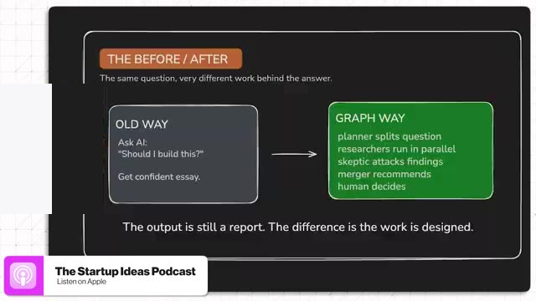
One model, one pass — no way to check the work
BUSINESS IMPLICATION
A single confident pass leaves no seam to check what evidence was used. Jobs, arrows, and shared state make the same work checkable at every step, not just at the end.
Decision: run the six-condition test (slide 8) before scaling risky AI work — then start with a manual first rep, not a tooling purchase.
Designing AI Workflows That Can Be Trusted
2 / 14

Slide 3
The vocabulary is having a very contested moment
48 hrs
3
1
from first post to three competing definitions
incompatible meanings of “graph” in circulation at once
widely shared founding study — confirmed fabricated
The term is new and contested. The mechanics underneath it are not — treat the label with more skepticism than the pattern.
Source: independent industry reporting, July 2026 (see run sources)
Designing AI Workflows That Can Be Trusted
3 / 14

Slide 4
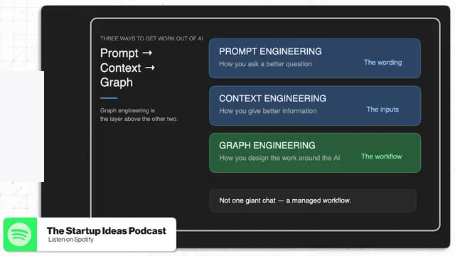
One active framing — not a settled progression
BUSINESS IMPLICATION
Prompt engineering is about wording, context engineering about information, graph engineering about how the work is designed — three levers, not an agreed sequence.
Take the mechanics (design the work, not just the prompt) without adopting the trend-cycle framing wholesale.
Designing AI Workflows That Can Be Trusted
4 / 14

Slide 5
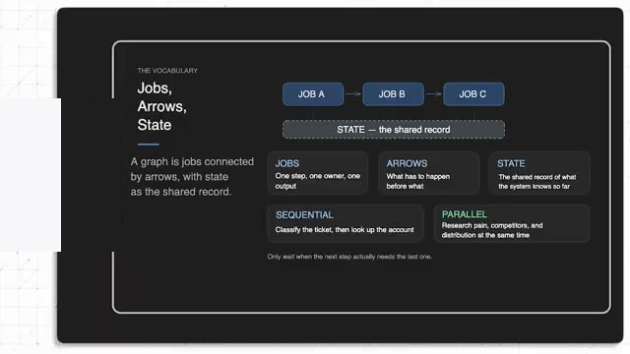
The vocabulary: jobs, arrows, and one shared record
BUSINESS IMPLICATION
A job is one step with one owner and one output. An arrow says what has to happen before what. State is the shared record every job reads and writes. That's the entire vocabulary — nothing more exotic is required to start.
This is the whole mental model. Everything else in this deck is this vocabulary applied to a real decision.
Designing AI Workflows That Can Be Trusted
5 / 14

Slide 6
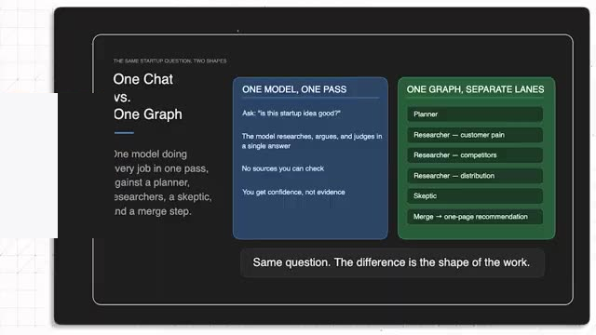
Same report format — different shape of work behind it
BUSINESS IMPLICATION
A single chat and a structured graph can both hand back a report. Only one of them lets you see which claims were checked, by whom, before you trust the answer.
Ask of any AI-produced recommendation: can I see the work behind it, or only the output?
Designing AI Workflows That Can Be Trusted
6 / 14

Slide 7
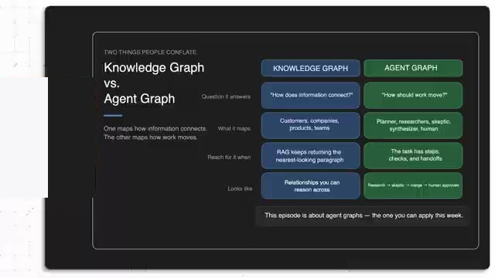
Don't confuse a knowledge graph with an agent graph
BUSINESS IMPLICATION
A knowledge graph maps what your data means — customers, products, relationships. An agent graph maps how work should move, get checked, and get approved. This deck is about the second one.
Buying or building a knowledge graph does not give you a checkable AI workflow — they solve different problems.
Designing AI Workflows That Can Be Trusted
7 / 14

Slide 8
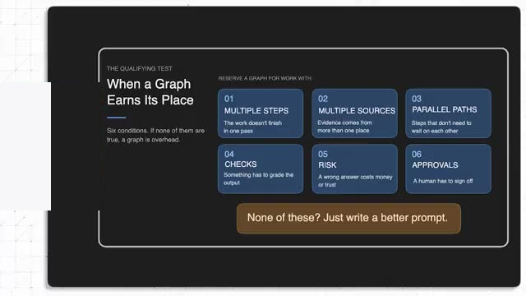
The qualifying test: when a graph earns its place
BUSINESS IMPLICATION
Multiple steps, multiple sources, parallel paths, real checks, real risk, required approvals — if none of these are true for a workflow, a graph is overhead, not sophistication.
Run every candidate workflow through this test before reaching for any framework. Most AI work still doesn't need one.
Designing AI Workflows That Can Be Trusted
8 / 14

Slide 9
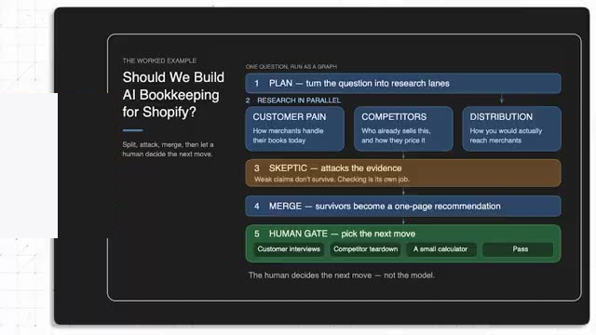
Worked example: AI bookkeeping for Shopify?
BUSINESS IMPLICATION
Three parallel researchers cover customer pain, competitors, and distribution. A skeptic attacks the findings. A merge step turns survivors into a one-page recommendation. A human picks the next move.
The messy one-shot chat becomes a workflow you can actually inspect, challenge, and reuse on the next decision.
Designing AI Workflows That Can Be Trusted
9 / 14

Slide 10
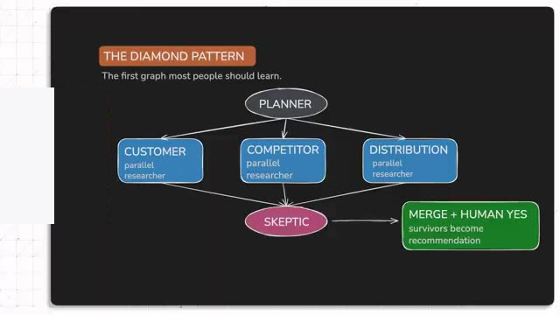
The pattern underneath: the Diamond
BUSINESS IMPLICATION
Planner fans out to parallel researchers, a skeptic checks their findings, then merge and human approval close the loop. This is the one shape worth learning first — every other pattern is a variation on it.
Learn this one diagram before anything else. It generalizes to support, content, and code work (next slide).
Designing AI Workflows That Can Be Trusted
10 / 14

Slide 11
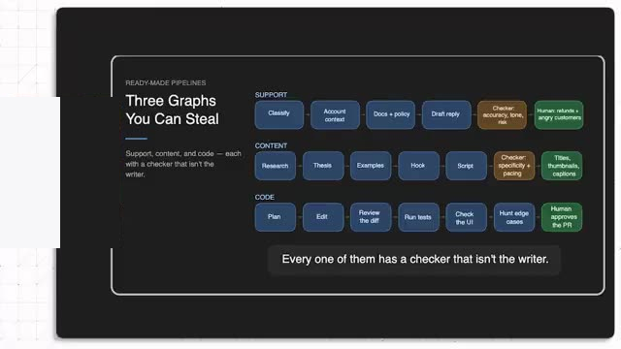
Three ready-made pipelines you can steal
BUSINESS IMPLICATION
Support, content, and code workflows all follow the same rule: the checker is never the same role as the writer. That one constraint is what makes each pipeline trustworthy enough to run unattended.
Pick the lane closest to your own work and copy the structure — not the specific steps — into your first graph.
Designing AI Workflows That Can Be Trusted
11 / 14

Slide 12
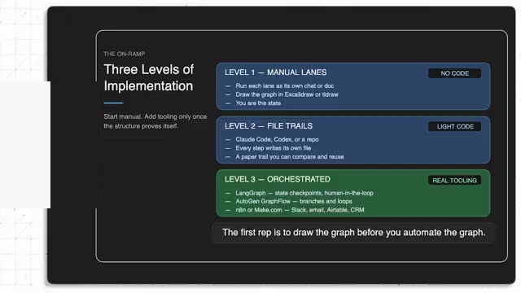
Three levels of implementation — start manual
BUSINESS IMPLICATION
Manual whiteboard lanes prove the shape works with no code at all. File trails make the run reusable. Real orchestration tooling only pays off after that — earn the tooling, don't start with it.
Do not buy or install anything before finishing Level 1 by hand at least once.
Designing AI Workflows That Can Be Trusted
12 / 14

Slide 13
Where the named tools actually fit
Tool
Best for
Watch for
LangGraph
Stateful multi-agent logic, human-approval gates
Needs engineering capacity
AutoGen GraphFlow
Parallel fan-out, conditional/looping flows
Code-first, Python
n8n
Self-hostable, AI-native automation
Needs comfort with JSON/APIs
Make.com
Fully-hosted, non-technical automation
Billing punishes looping agents
Most teams should start below all four — see “Three levels of implementation.” Source: industry reporting, July 2026.
Designing AI Workflows That Can Be Trusted
13 / 14

Slide 14
Next move: draw one graph this week
1
Pick one workflow you already run.
2
Draw the jobs and the arrows between them.
3
Delete the fake sequential waiting — run independent jobs in parallel.
4
Add one skeptic step before anything ships.
5
Run it once, by hand, before automating anything.
Designing AI Workflows That Can Be Trusted
14 / 14

