Slide 1
CAN IMPECCABLE
take the AI slop
out of slides?
A design-direction experiment for client-ready presentations
DECISION BRIEF · AUGUST 2026
Impeccable × Client-ready presentations
1 / 12

Slide 2
Impeccable works—but only as a workflow
YES
Impeccable removes recognizable defaults by expanding the option set and forcing a committed design direction.
01
02
03
Choose a world
Compare alternatives
Review the finish
Commit before composing.
Select visually, not verbally.
Detect patterns, then QA delivery.
It cannot repair weak evidence, a vague narrative, or missing PowerPoint QA.
Impeccable × Client-ready presentations
2 / 12

Slide 3
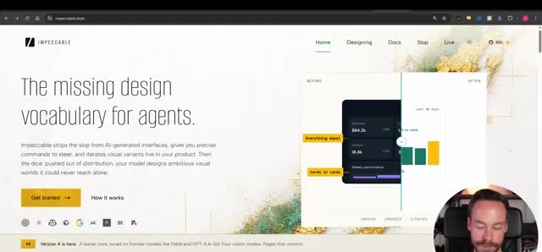
The demonstration attacks sameness
OBSERVATION
The product is framed as a system of commands and review behaviors—not a library of decorative slide skins.
Implication: adapt the method to presentations; do not simply copy a website aesthetic.
Captured from the supplied demonstration
Impeccable × Client-ready presentations
3 / 12

Slide 4
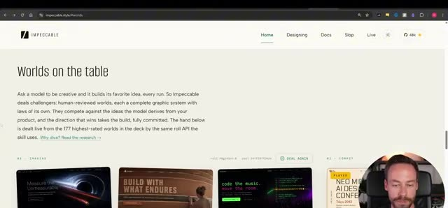
A committed world breaks the default
OBSERVATION
A broad visual-world library gives the model a concrete grammar before it starts composing.
Decision: add visual-world selection after evidence capture and before the slide plan.
Captured from the supplied demonstration
Impeccable × Client-ready presentations
4 / 12

Slide 5
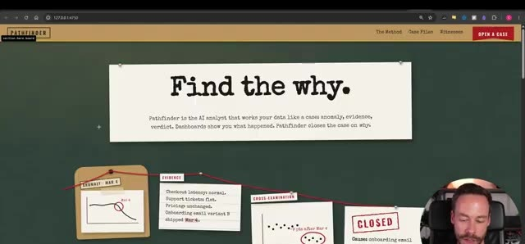
Live comparison changes the task
OBSERVATION
Seeing alternatives side by side changes the task from accepting an answer to choosing a direction.
Decision: require at least two materially different directions for high-stakes decks.
Captured from the supplied demonstration
Impeccable × Client-ready presentations
5 / 12

Slide 6
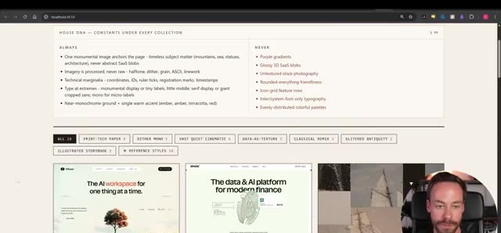
Outside references add specificity
OBSERVATION
A reference library supplies proportion, type, rhythm, and interaction cues that prose alone underspecifies.
Guardrail: borrow visual grammar; never copy gallery layouts, artwork, or brand assets.
Captured from the supplied demonstration
Impeccable × Client-ready presentations
6 / 12

Slide 7
The anti-slop loop has five deliberate gates
1
2
3
4
5
TRUTH
WORLD
RANGE
DETECT
SHIP
Capture evidence
Commit direction
Compare options
Remove patterns
Render + QA
Remove any gate and the workflow can still produce polished-looking slop.
Impeccable × Client-ready presentations
7 / 12

Slide 8
Explicit criteria make slop detectable
01
✓
Committed visual world
02
✓
Non-default hierarchy
03
✓
No gradient cliché
04
✓
No nested-card maze
05
✓
No pill/icon confetti
06
✓
Authentic evidence
07
✓
Varied archetypes
08
✓
Readable density
09
✓
Clear decision
Pass/fail criteria turn taste from a vague preference into a delivery gate.
Impeccable × Client-ready presentations
8 / 12

Slide 9
Four failures remain outside Impeccable’s reach
01
Bad evidence
Beautifully presented uncertainty is still uncertainty.
02
Weak argument
A visual world cannot create a decision narrative.
03
Blind copying
Reference sites are inputs, not reusable templates.
04
Broken delivery
Overflow, collisions, and missing fonts still need QA.
Design discipline complements content discipline; it never substitutes for it.
Impeccable × Client-ready presentations
9 / 12

Slide 10
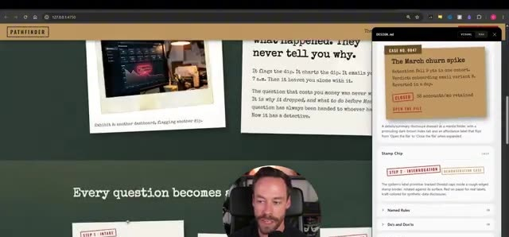
A design record makes the chosen world reusable
OBSERVATION
Capturing design decisions converts a one-off result into a system that can survive the next slide or deck.
Decision: every material deck keeps its brief, design contract, slide plan, visual spec, and QA record.
Captured from the supplied demonstration
Impeccable × Client-ready presentations
10 / 12

Slide 11
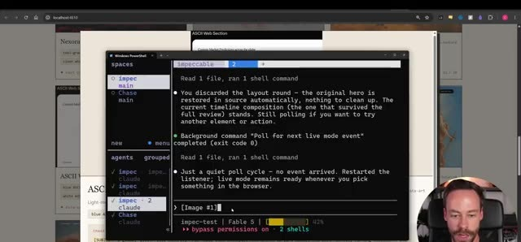
The improvement is range plus control
OBSERVATION
The strongest result comes after reference, iteration, and finish review—not from the first generated composition.
Measure success by fewer recognizable defaults and better decision clarity, not visual novelty.
Captured from the supplied demonstration
Impeccable × Client-ready presentations
11 / 12

Slide 12
RECOMMENDATION
Make visual-world selection a standard deck stage.
WATCH → TRUTH → WORLD → BUILD → REVIEW → QA
Start now
Use the scorecard on every material deck. Reject any direction that cannot name its visual world.
Impeccable × Client-ready presentations
12 / 12

