Slide 1

IMPECCABLE 4.0
Design with range, taste, and control
Reconstructed from the complete visual demonstration
Impeccable 4.0 · Visual reconstruction
1 / 18

Slide 2
Impeccable 4.0 introduction
Impeccable 4.0 is introduced as a design-control system.
Impeccable 4.0 · Visual reconstruction
2 / 18

Slide 3

Avoid generic AI design
The opening problem is sameness: generic visual defaults instead of deliberate taste.
Impeccable 4.0 · Visual reconstruction
3 / 18

Slide 4
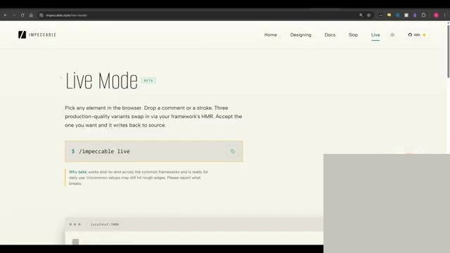
Live mode
Live mode is presented as the release's largest workflow change.
Impeccable 4.0 · Visual reconstruction
4 / 18

Slide 5
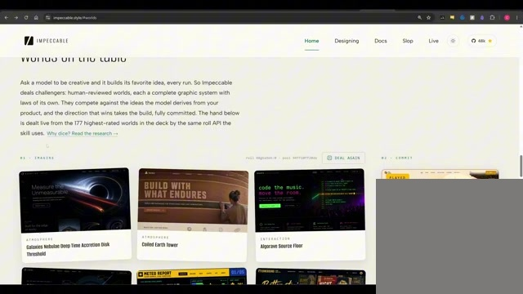
Visual worlds
A world supplies a coherent visual grammar before composition begins.
Impeccable 4.0 · Visual reconstruction
5 / 18

Slide 6
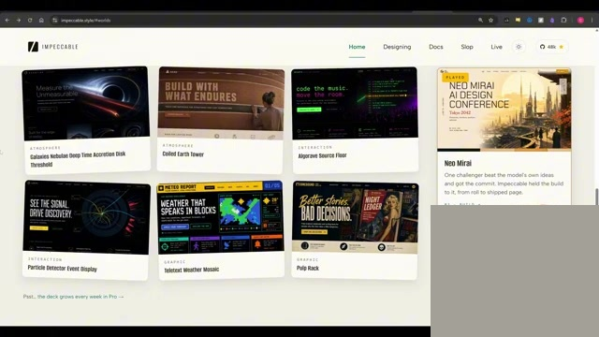
Context-specific options
The interface proposes directions that respond to the current project.
Impeccable 4.0 · Visual reconstruction
6 / 18

Slide 7
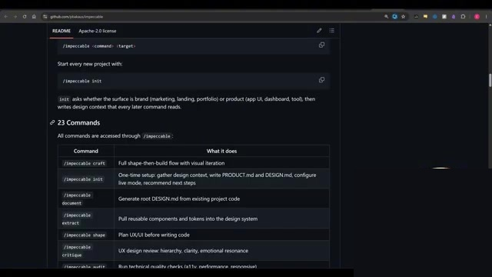
One skill and its commands
A single installed skill exposes a family of design and review commands.
Impeccable 4.0 · Visual reconstruction
7 / 18

Slide 8
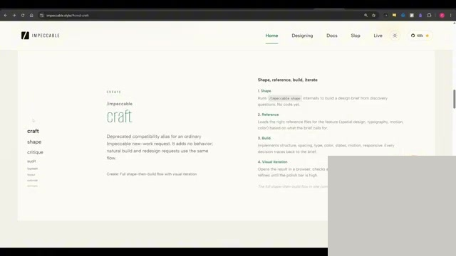
Anti-pattern detection
Detection makes recurring generic patterns visible and actionable.
Impeccable 4.0 · Visual reconstruction
8 / 18

Slide 9
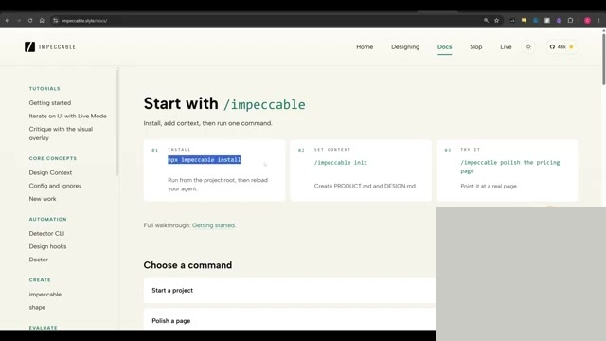
Installation
The demonstrated setup is a single package-install command.
Impeccable 4.0 · Visual reconstruction
9 / 18

Slide 10
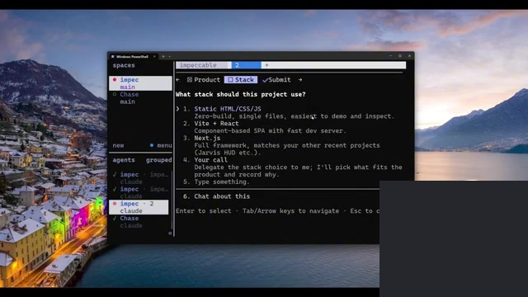
Website brief
The example begins with purpose and content, not decoration.
Impeccable 4.0 · Visual reconstruction
10 / 18

Slide 11
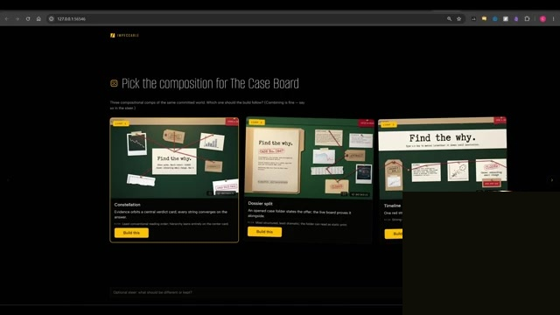
Visual variations
Multiple directions are generated so the user can select visually.
Impeccable 4.0 · Visual reconstruction
11 / 18

Slide 12
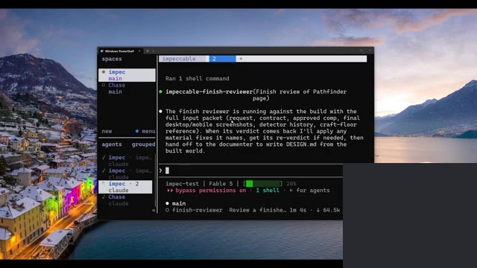
First finished result
The first complete page establishes a usable baseline rather than a final answer.
Impeccable 4.0 · Visual reconstruction
12 / 18

Slide 13
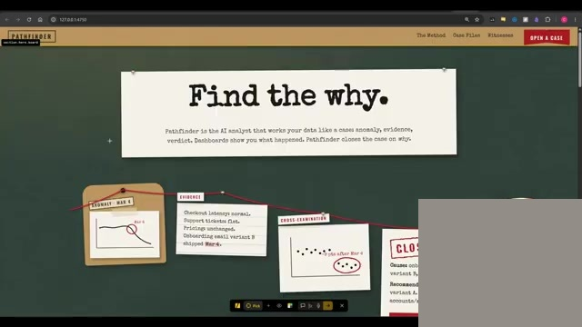
Live comparison
Side-by-side inspection turns iteration into a selection loop.
Impeccable 4.0 · Visual reconstruction
13 / 18

Slide 14
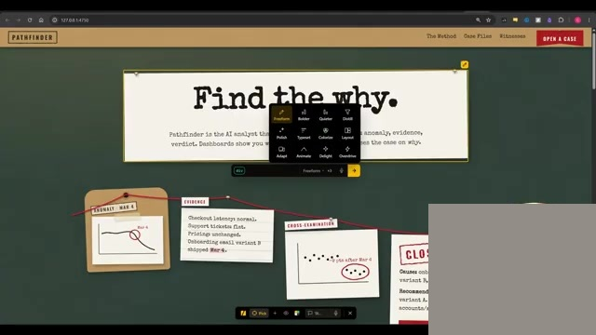
Bolder alternatives
The next pass deliberately pushes range instead of polishing one default.
Impeccable 4.0 · Visual reconstruction
14 / 18

Slide 15
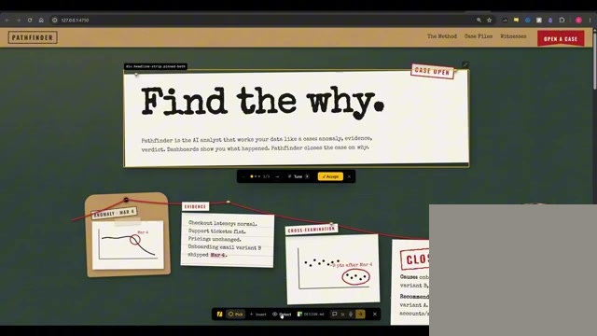
Detector results
The detector identifies concrete anti-patterns in the working design.
Impeccable 4.0 · Visual reconstruction
15 / 18

Slide 16
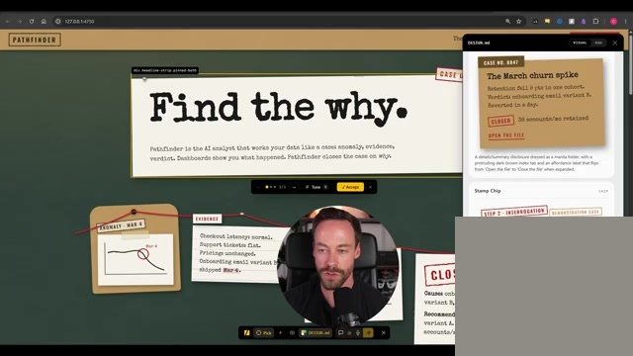
Design system record
Design decisions are captured so the direction remains coherent across iterations.
Impeccable 4.0 · Visual reconstruction
16 / 18

Slide 17
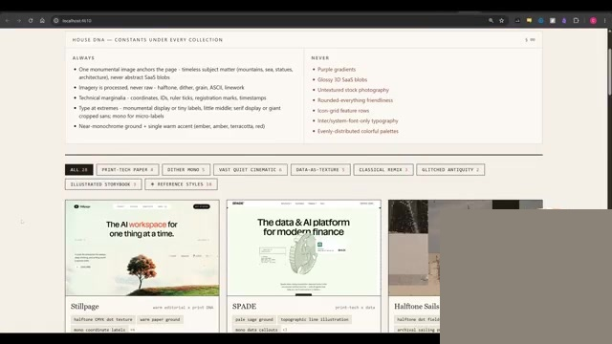
Inspiration library
External references provide visual specificity that prose cannot fully encode.
Impeccable 4.0 · Visual reconstruction
17 / 18

Slide 18
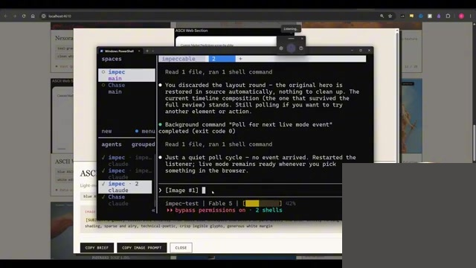
Reference-led result
The reference is translated into a distinct implementation rather than copied literally.
Impeccable 4.0 · Visual reconstruction
18 / 18

