Slide 1
IMPECCABLE 4.0 · EXECUTIVE ANALYSIS
AI design's bottleneck is judgment allocation.
Impeccable matters when it moves human attention to the decisions with the highest leverage—before direction hardens, during local comparison, and before release.
Decision brief
Adopt as a governed accelerator—not an autonomous taste engine.
EVIDENCE · observed demonstration | presenter assertion | analyst assessment
Analyst assessment based on the supplied walkthrough
1 / 18

Slide 2
Plausible defaults push expensive correction downstream
The cost of generic output appears after the first draft, when direction has already accumulated work.
GENERIC BASELINE
→
LATE DIRECTION DEBATE
→
MACRO REWORK
→
SLOWER APPROVAL
Looks plausible
Taste enters too late
Layout and assets reset
More cycles, less coherence
Management implication
Fix the decision architecture before optimizing generation speed.
A faster first draft can still increase total cycle time when it anchors the team to the wrong visual grammar.
Observed workflow · consequences are analyst assessment
2 / 18

Slide 3
More choice improves taste only when it is structured
Too little choice creates default convergence. Too much unmanaged choice creates decision paralysis.
DECISION VALUE
The feature count is incidental.
The commitment gates create the value.
CONCEPTUAL RELATIONSHIP · NOT MEASURED
ONE DEFAULT
UNSTRUCTURED OPTIONS
WORLDS → COMMIT → VARIANTS
ENDLESS REROLLS
Observed workflow + presenter view · value curve is analyst model
3 / 18

Slide 4
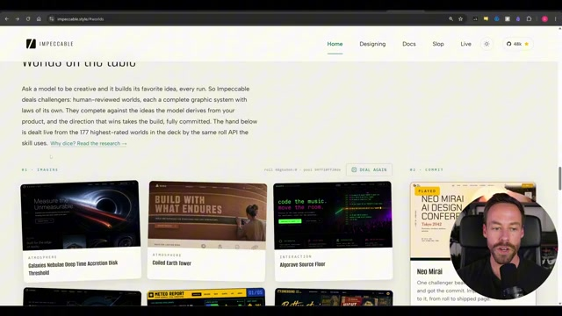
Impeccable externalizes the macro taste decision
Worlds turn an abstract preference into a visible choice.
The workflow separates divergent exploration from commitment. This reduces the burden of encoding taste entirely in a prompt.
Observed demonstration
4 / 18

Slide 5
Four commitment gates prevent exploration from becoming drift
EVIDENCE
WORLD
VARIANT
RELEASE
Is the brief grounded in real content and constraints?
Is the visual grammar appropriate for the audience and task?
Is the baseline strong enough for local refinement?
Has an independent challenge found drift or defects?
OWNER
OWNER
OWNER
OWNER
Design owner
Brand / design lead
Product owner
Reviewer + accountable human
EXIT CRITERION
EXIT CRITERION
EXIT CRITERION
EXIT CRITERION
Explicit yes—or return upstream
Explicit yes—or return upstream
Explicit yes—or return upstream
Explicit yes—or return upstream
Recommended operating model derived from the observed workflow
5 / 18

Slide 6
Generality raises the ceiling—and shifts risk to the operator
ONE-TRICK STYLE SKILL
IMPECCABLE
Higher floor
Higher ceiling
Predictable novelty Narrow aesthetic range Lower judgment burden
Broad differentiation More operator variance Higher governance need
CONVENTIONAL WORKFLOW WINS WHEN
the surface is highly standardized · evidence is weak · review capacity is limited · the team cannot own directional choices
Presenter-stated trade-off · no controlled benchmark
6 / 18

Slide 7
Change altitude determines the correct interface
Route by change radius and confidence in the current direction.
DIRECTION CONFIDENCE
LOW
HIGH
LARGE CHANGE
REFERENCE RESET
TERMINAL
Reopen the visual grammar
Change layout or structure
SMALL CHANGE
STOP POLISHING
LIVE MODE
Clarify the direction first
Compare local variants
Observed macro/micro split · matrix is analyst decision rule
7 / 18

Slide 8
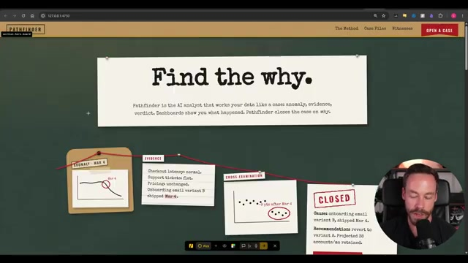
Live Mode compresses the local judgment loop
Select → generate 1–4 variants → compare → tune → accept.
The advantage is not visual editing alone. It reduces the distance between seeing a local problem and comparing concrete alternatives.
Observed demonstration
8 / 18

Slide 9
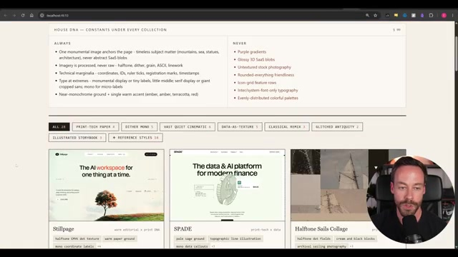
When the direction is wrong, local polish compounds sunk cost
References are an escalation mechanism—not decoration.
Reset the macro direction through references and terminal work. Return to Live Mode only after the visual grammar is sound.
Observed demonstration
9 / 18

Slide 10
Human judgment belongs at four high-leverage moments
FRAME TRUTH
COMMIT DIRECTION
RESOLVE TRADE-OFFS
APPROVE RELEASE
HUMAN DECIDES
HUMAN DECIDES
HUMAN DECIDES
HUMAN DECIDES
Define audience, evidence, constraints
Choose the visual grammar
Judge variants and escalation
Own the release decision
SYSTEM SUPPORTS
SYSTEM SUPPORTS
SYSTEM SUPPORTS
SYSTEM SUPPORTS
Structure the brief
Expand materially different options
Generate and compare alternatives
Detect patterns and run technical QA
Analyst role model derived from the full walkthrough
10 / 18

Slide 11
Taste scales only when decisions become organizational memory
DESIGN.MD
Less reinvention
CHOSEN DECISIONS
→
→
FUTURE CONSTRAINTS
Lower variance
Faster future cycles
↖
↙
DETECTION + OVERRIDES
Risk: stale constraints become a new default. Version the record and permit explicit resets.
Design record and detection observed · flywheel is analyst model
11 / 18

Slide 12
Fresh-context review is a challenge control—not proof of quality
MAKER CONTEXT
CHECKER CONTEXT
Knows the brief Knows every compromise Can rationalize its own choices
→
Challenges known defaults Sees the result without build momentum Still needs human adjudication
Keep separate QA for accessibility, factual accuracy, performance, responsive behavior, and user outcomes.
Presenter-described review control · efficacy is unmeasured
12 / 18

Slide 13
The demo reaches Level 2—and shows pieces of Level 3
There is no supplied evidence for measured productivity or user outcomes.
RUBRIC · decision gates | change routing | design memory | QA control | measurement
0
1
2
3
4
5
AD HOC
GUIDED
STRUCTURED
CONTROLLED
MEASURED
OUTCOME
One-shot prompt Subjective approval
Worlds and steering Named decision owner
Macro commitment Then local convergence
Design record Detect + independent QA
Time, cost, rework Quality metrics
Usability and business impact validated
DEMONSTRATED
UNPROVEN
Maturity assessment based on the observed workflow
13 / 18

Slide 14
Four readiness gates define when adoption may advance
?
INPUT
Real copy, proof, constraints, approved references
?
DECISION
Named owner for World and variant selection
?
WORKFLOW
Macro/micro routing and stop rules understood
?
GOVERNANCE
Versioned design record, QA, provenance controls
ANY RED GATE → RUN A BOUNDED PILOT. DO NOT SCALE THE WORKFLOW.
Recommended governance framework
14 / 18

Slide 15
Success is fewer wrong-direction cycles—without quality regressions
PILOT OUTCOME
Reduce the cost of arriving at an acceptable direction.
EFFICIENCY
REWORK
QUALITY
GOVERNANCE
Time to direction Time to production-ready
Major resets Post-approval changes
Blind brand + usability scores Independent defects
Unsupported claims Reference exceptions
PROPOSED GO / NO-GO · confirm before launch
6+ matched tasks · 2+ operator profiles · ≥20% fewer major resets · quality within 5% of baseline · zero critical accessibility/provenance regressions · cost ≤ baseline +15%
Pilot recommendation · no benchmark data supplied
15 / 18

Slide 16
A fair pilot isolates workflow value from operator enthusiasm
FIXED ACROSS BOTH ARMS
CURRENT PROCESS
IMPECCABLE WORKFLOW
Same landing-page brief
Conventional prompting and review
Worlds → commitment → Live refinement
Same real copy and evidence
Same approved references
Matched task Matched operator profile Blind downstream review
Same task Same operator profile Same blind review
Same model and time budget
Primary endpoint
Major direction resets before acceptance
Controlled evaluation design · thresholds require client confirmation
16 / 18

Slide 17
The operating model needs controls at every failure boundary
INPUT
Invented proof
→
Lock real claims and assets before visual exploration
WORLD
Choice paralysis
→
Name a decision owner and cap rerolls
BUILD
Local polish on a wrong direction
→
Escalate by change altitude
MEMORY
Design-system drift
→
Version accepted decisions and explicit resets
RELEASE
Self-confirming review
→
Use fresh-context challenge plus human adjudication
CONTROL PRINCIPLE · automate detection; never automate accountability
Risk-control ledger derived from the demonstrated workflow
17 / 18

Slide 18
Adopt the decision architecture—then earn the right to scale
RECOMMENDATION
Run one governed, matched-task pilot.
Approve expansion only if the workflow reduces wrong-direction cycles without degrading accessibility, performance, factual integrity, provenance, or cost.
1
NAME THE OWNER
2
SELECT THE TASK
3
LOCK THE SCORECARD
One accountable lead for direction and release
One bounded landing-page workflow with real evidence
Baseline, thresholds, blind reviewers, stop rules
Decision requested
Authorize pilot design—not enterprise rollout.
Recommendation bounded by the supplied walkthrough's evidence limits
18 / 18

