Slide 1
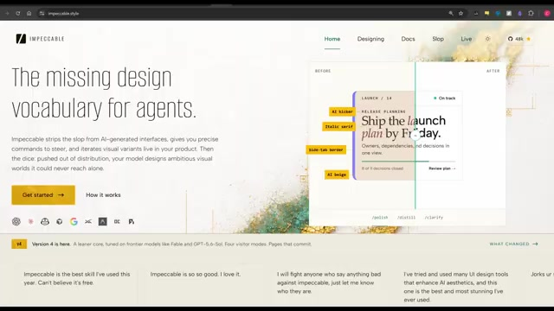
FINAL PROOF
01 / 19
IMPECCABLE 4.0
Design with range, taste, and control
A visual reconstruction of the complete workflow

Slide 2
SEQUENCE MAP
Impeccable is a loop, not a style button
02 / 19
The demonstration moves through five linked decisions.
01
02
03
04
05
GROUND
EXPAND
SELECT
DETECT
RECORD
Start from purpose
Generate real range
Compare visually
Remove defaults
Preserve the world
The visual assets on the following pages remain the evidence; the template improves how they are seen.
Impeccable 4.0
2 / 19

Slide 3
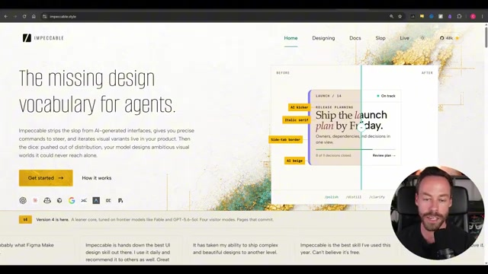
The problem is sameness
WORKING PROOF
03 / 19
Taste has to enter the workflow before the first composition becomes the default.
Impeccable 4.0
3 / 19

Slide 4
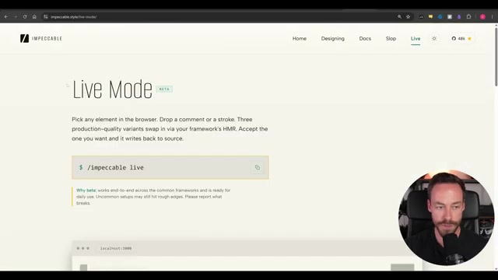
Live Mode changes the interaction
WORKING PROOF
04 / 19
CONTEXT
Visual direction becomes something you inspect and choose—not merely describe.
Same evidence. Stronger focus.
Impeccable 4.0
4 / 19

Slide 5
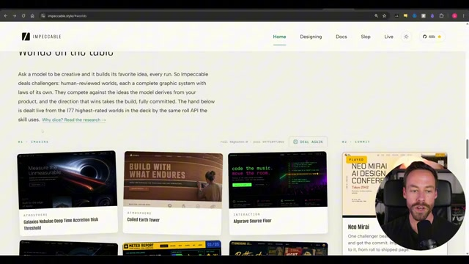
Worlds supply a complete visual grammar
WORKING PROOF
05 / 19
A world constrains composition, typography, material, rhythm, and interaction together.
Impeccable 4.0
5 / 19

Slide 6
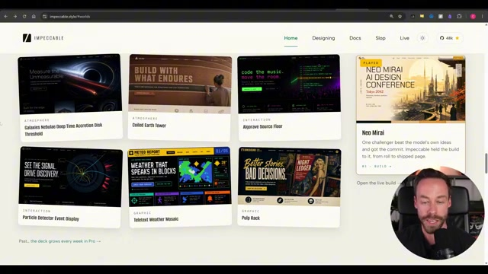
Options respond to the project
WORKING PROOF
06 / 19
The system proposes directions grounded in the current surface instead of a generic style menu.
Impeccable 4.0
6 / 19

Slide 7
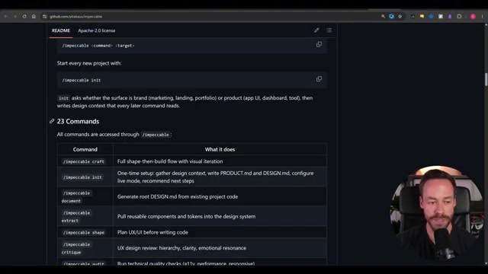
One skill exposes a design workflow
WORKING PROOF
07 / 19
CONTEXT
Commands separate shaping, detection, refinement, documentation, and finish review.
Same evidence. Stronger focus.
Impeccable 4.0
7 / 19

Slide 8
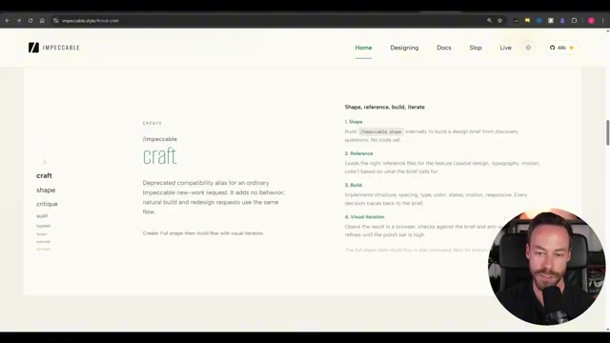
Anti-patterns become detectable
WORKING PROOF
08 / 19
Recurring machine-made defaults can be named, located, and removed deliberately.
Impeccable 4.0
8 / 19

Slide 9
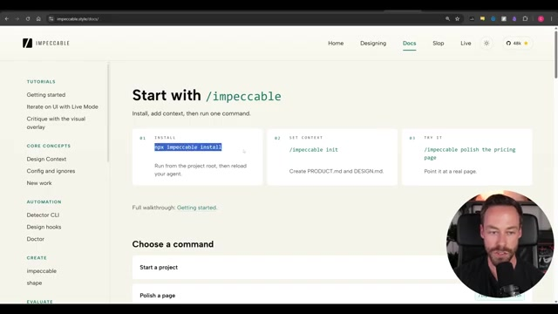
Installation is deliberately lightweight
WORKING PROOF
09 / 19
The design system enters the existing workflow through one package command.
Impeccable 4.0
9 / 19

Slide 10
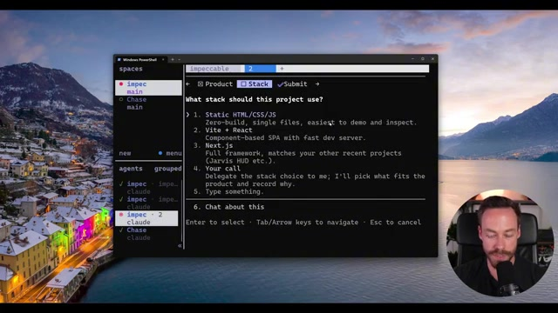
The example begins with purpose
WORKING PROOF
10 / 19
CONTEXT
The demonstration starts from the site's reason to exist before choosing its appearance.
Same evidence. Stronger focus.
Impeccable 4.0
10 / 19

Slide 11
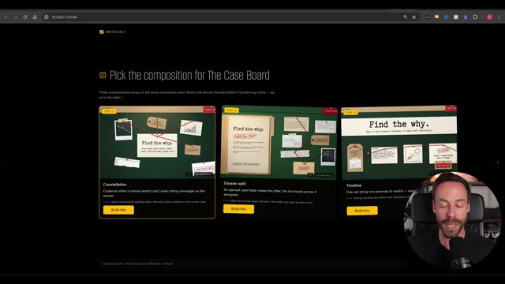
Compare directions before committing
WORKING PROOF
11 / 19
Multiple treatments expose range and make the design decision visual.
Impeccable 4.0
11 / 19

Slide 12
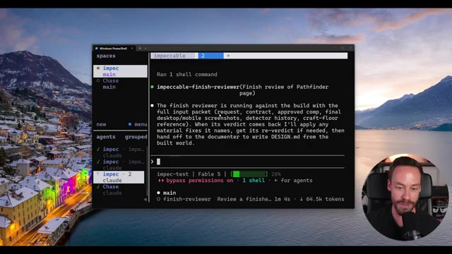
The first result is a baseline
WORKING PROOF
12 / 19
A complete first pass creates something concrete to inspect—not an excuse to stop iterating.
Impeccable 4.0
12 / 19

Slide 13
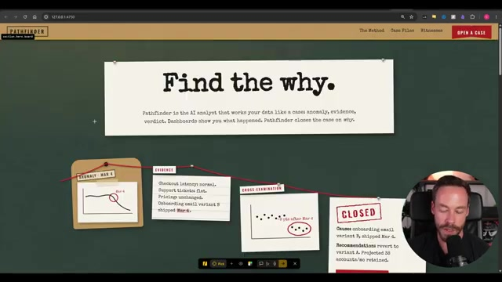
Live comparison creates a selection loop
WORKING PROOF
13 / 19
CONTEXT
Side-by-side alternatives make differences in hierarchy and character immediately visible.
Same evidence. Stronger focus.
Impeccable 4.0
13 / 19

Slide 14
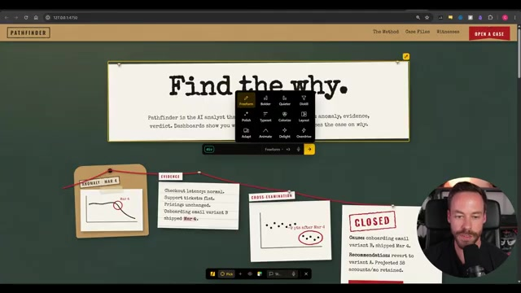
The next pass deliberately increases range
WORKING PROOF
14 / 19
The workflow pushes beyond cautious polish to test a materially stronger direction.
Impeccable 4.0
14 / 19

Slide 15
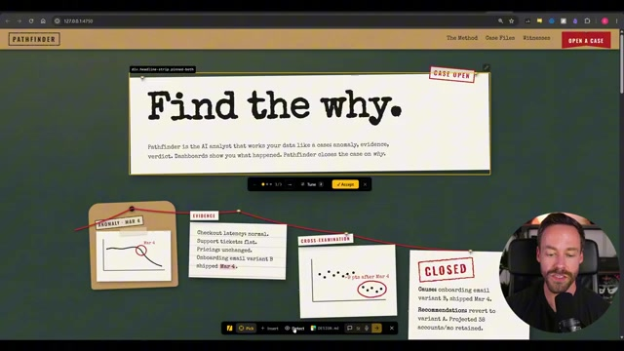
Detection turns taste into action
WORKING PROOF
15 / 19
The working design is checked against explicit visual anti-patterns.
Impeccable 4.0
15 / 19

Slide 16
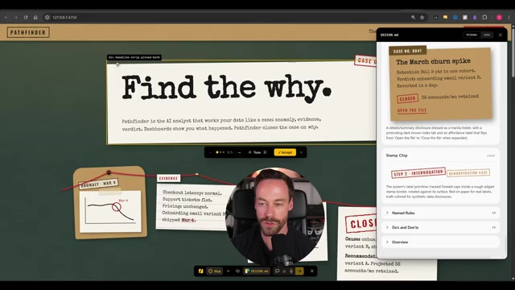
The chosen world becomes a design record
WORKING PROOF
16 / 19
CONTEXT
Documented decisions keep later iterations coherent instead of rediscovering taste each time.
DESIGN RECORD
Palette · typography · composition · interaction
Same evidence. Stronger focus.
Impeccable 4.0
16 / 19

Slide 17
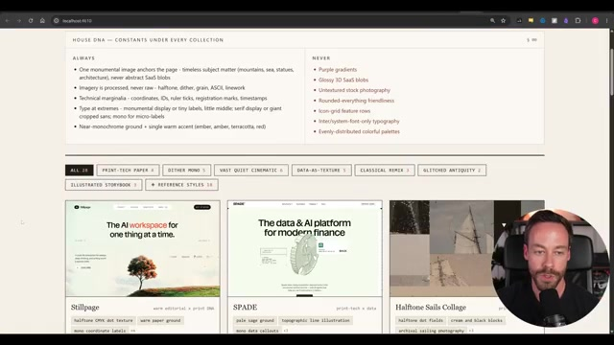
Outside references add specificity
WORKING PROOF
17 / 19
Real visual references communicate proportion and texture that prose cannot fully encode.
Impeccable 4.0
17 / 19

Slide 18
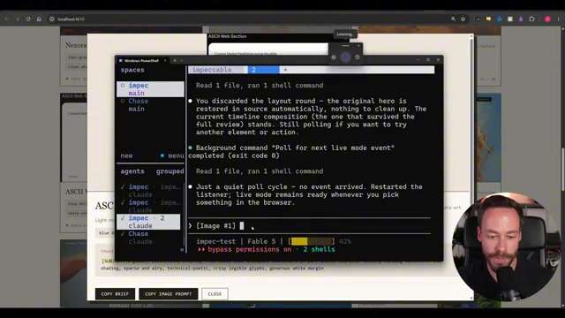
Reference becomes interpretation—not imitation
WORKING PROOF
18 / 19
The final pass translates the reference grammar into a distinct working result.
Impeccable 4.0
18 / 19

Slide 19
CHOSEN PROOF
19 / 19
The template improved how the assets are seen
It did not replace what the video showed.
ASSET PROMINENCE
CONTEXT BINDING
Visuals occupy the field instead of becoming thumbnails.
Annotations sit on the presenter-obscured region they explain.
HIERARCHY
COHERENCE
Each page has one proof, one title, and one attached interpretation.
Three proof archetypes create rhythm without changing the sequence.
Decision: use the Impeccable treatment for client delivery.
Impeccable 4.0
19 / 19

