Slide 1
Pilot the decision architecture— not the promise of autonomous taste.
The walkthrough demonstrates stronger direction selection, local comparison, and escalation. It does not demonstrate productivity, usability, or business impact.
Decision
Authorize one governed, matched-task pilot—not enterprise rollout.
EVIDENCE · observed demonstration | presenter assertion | analyst assessment
Analyst assessment based on the supplied walkthrough
1 / 18

Slide 2
The case for a pilot rests on three demonstrated mechanisms—and three unproven outcomes
DEMONSTRATED
NOT DEMONSTRATED
DECISION
1
Worlds makes macro direction visible
1
Faster production or lower total cost
1
Authorize one matched-task pilot
2
Live compares bounded local alternatives
2
Higher usability or brand effectiveness
2
Keep inputs and budgets constant
3
References reset a wrong visual grammar
3
Conversion, retention, or commercial lift
3
Expand only after blind quality and control review
Executive implication
Evaluate the workflow as a controlled operating-model change—not as a showcase design.
Executive summary · evidence boundary based on the supplied walkthrough
2 / 18

Slide 3
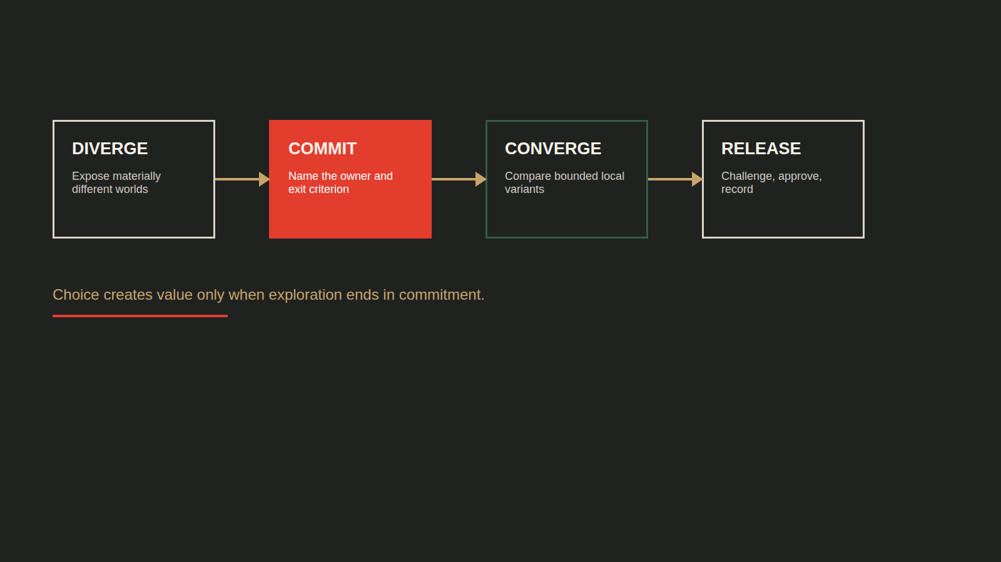
More choice improves taste only when it is structured
Observed workflow + presenter view · value curve is analyst model
3 / 18

Slide 4
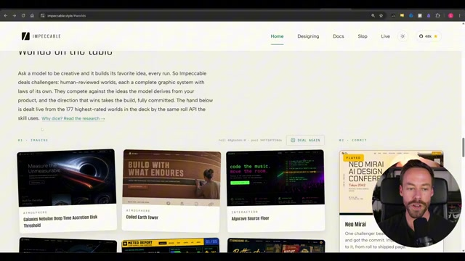
Worlds turns “make it better” into a visible macro decision
Setup: the Pathfinder landing page is shown in materially different visual worlds.
Finding: the user chooses a visual grammar before implementation variants. Action: name the direction owner and record why the world was selected.
Observed demonstration
4 / 18

Slide 5
Four commitment gates prevent exploration from becoming drift
EVIDENCE
WORLD
VARIANT
RELEASE
Is the brief grounded in real content and constraints?
Is the visual grammar appropriate for the audience and task?
Is the baseline strong enough for local refinement?
Has an independent challenge found drift or defects?
OWNER
OWNER
OWNER
OWNER
Design owner
Brand / design lead
Product owner
Reviewer + accountable human
EXIT CRITERION
EXIT CRITERION
EXIT CRITERION
EXIT CRITERION
Explicit yes—or return upstream
Explicit yes—or return upstream
Explicit yes—or return upstream
Explicit yes—or return upstream
Recommended operating model derived from the observed workflow
5 / 18

Slide 6
Generality raises the ceiling—and shifts risk to the operator
ONE-TRICK STYLE SKILL
IMPECCABLE
Higher floor
Higher ceiling
Predictable novelty Narrow aesthetic range Lower judgment burden
Broad differentiation More operator variance Higher governance need
CONVENTIONAL WORKFLOW WINS WHEN
the surface is highly standardized · evidence is weak · review capacity is limited · the team cannot own directional choices
Presenter-stated trade-off · no controlled benchmark
6 / 18

Slide 7
Change altitude determines the correct interface
Route by change radius and confidence in the current direction.
DIRECTION CONFIDENCE
LOW
HIGH
LARGE CHANGE
REFERENCE RESET
TERMINAL
Reopen the visual grammar
Change layout or structure
SMALL CHANGE
STOP POLISHING
LIVE MODE
Clarify the direction first
Compare local variants
Observed macro/micro split · matrix is analyst decision rule
7 / 18

Slide 8
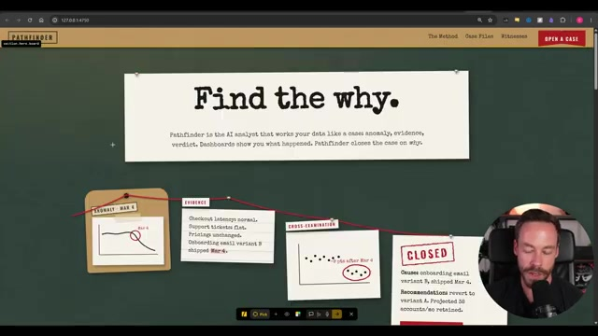
Live Mode shortens local comparison after direction is chosen
Setup: the “Find the why” component is selected and alternatives are generated side by side.
Finding: compare → tune → accept compresses a bounded choice. Action: use Live for detail changes; return structural work to the terminal.
Observed demonstration
8 / 18

Slide 9
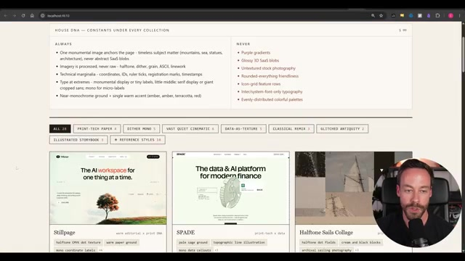
A wrong visual grammar requires a reference reset—not more polish
Setup: an outside reference is introduced after the existing direction remains unsatisfying.
Finding: the reference drives a macro departure through terminal work. Action: log provenance and return to Live only after direction is accepted.
Observed demonstration
9 / 18

Slide 10
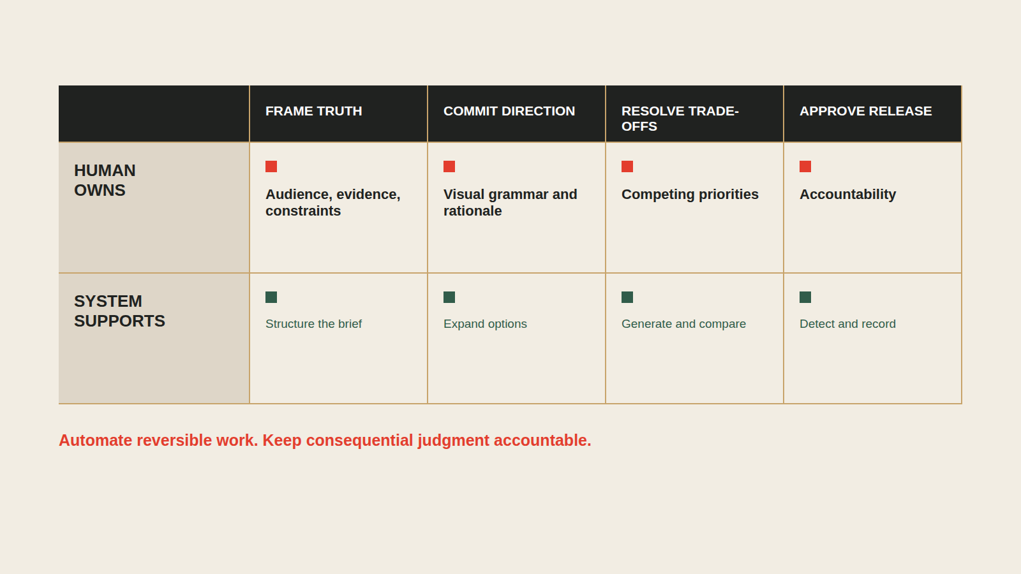
Human judgment belongs at four high-leverage moments
Analyst role model derived from the full walkthrough
10 / 18

Slide 11
Taste scales only when decisions become organizational memory
DESIGN.MD
Less reinvention
CHOSEN DECISIONS
→
→
FUTURE CONSTRAINTS
Lower variance
Faster future cycles
↖
↙
DETECTION + OVERRIDES
Risk: stale constraints become a new default. Version the record and permit explicit resets.
Design record and detection observed · flywheel is analyst model
11 / 18

Slide 12
Fresh-context review is a challenge control—not proof of quality
MAKER CONTEXT
CHECKER CONTEXT
Knows the brief Knows every compromise Can rationalize its own choices
Challenges known defaults Sees the result without build momentum Still needs human adjudication
→
Keep separate QA for accessibility, factual accuracy, performance, responsive behavior, and user outcomes.
Presenter-described review control · efficacy is unmeasured
12 / 18

Slide 13
The demo reaches Level 2—and shows pieces of Level 3
There is no supplied evidence for measured productivity or user outcomes.
RUBRIC · decision gates | change routing | design memory | QA control | measurement
0
1
2
3
4
5
AD HOC
GUIDED
STRUCTURED
CONTROLLED
MEASURED
OUTCOME
One-shot prompt Subjective approval
Worlds and steering Named decision owner
Macro commitment Then local convergence
Design record Detect + independent QA
Time, cost, rework Quality metrics
Usability and business impact validated
DEMONSTRATED
UNPROVEN
Maturity assessment based on the observed workflow
13 / 18

Slide 14
Four readiness gates define when adoption may advance
?
INPUT
Real copy, proof, constraints, approved references
?
DECISION
Named owner for World and variant selection
?
WORKFLOW
Macro/micro routing and stop rules understood
?
GOVERNANCE
Versioned design record, QA, provenance controls
ANY RED GATE → RUN A BOUNDED PILOT. DO NOT SCALE THE WORKFLOW.
Recommended governance framework
14 / 18

Slide 15
Success is fewer wrong-direction cycles—without quality regressions
PILOT OUTCOME
Reduce the cost of arriving at an acceptable direction.
EFFICIENCY
REWORK
QUALITY
GOVERNANCE
Time to direction Time to production-ready
Major resets Post-approval changes
Blind brand + usability scores Independent defects
Unsupported claims Reference exceptions
PROPOSED GO / NO-GO · confirm before launch
6+ matched tasks · 2+ operator profiles · ≥20% fewer major resets · quality within 5% of baseline · zero critical accessibility/provenance regressions · cost ≤ baseline +15%
Pilot recommendation · no benchmark data supplied
15 / 18

Slide 16
A fair pilot isolates workflow value from operator enthusiasm
FIXED ACROSS BOTH ARMS
CURRENT PROCESS
IMPECCABLE WORKFLOW
Same landing-page brief
Conventional prompting and review
Worlds → commitment → Live refinement
Same real copy and evidence
Same approved references
Matched task Matched operator profile Blind downstream review
Same task Same operator profile Same blind review
Same model and time budget
Primary endpoint
Major direction resets before acceptance
Controlled evaluation design · thresholds require client confirmation
16 / 18

Slide 17
The operating model needs controls at every failure boundary
INPUT
Invented proof
→
Lock real claims and assets before visual exploration
WORLD
Choice paralysis
→
Name a decision owner and cap rerolls
BUILD
Local polish on a wrong direction
→
Escalate by change altitude
MEMORY
Design-system drift
→
Version accepted decisions and explicit resets
RELEASE
Self-confirming review
→
Use fresh-context challenge plus human adjudication
CONTROL PRINCIPLE · automate detection; never automate accountability
Risk-control ledger derived from the demonstrated workflow
17 / 18

Slide 18
Adopt the decision architecture—then earn the right to scale
RECOMMENDATION
Run one governed, matched-task pilot.
Approve expansion only if the workflow reduces wrong-direction cycles without degrading accessibility, performance, factual integrity, provenance, or cost.
1
NAME THE OWNER
2
SELECT THE TASK
3
LOCK THE SCORECARD
One accountable lead for direction and release
One bounded landing-page workflow with real evidence
Baseline, thresholds, blind reviewers, stop rules
Decision requested
Authorize pilot design—not enterprise rollout.
Recommendation bounded by the supplied walkthrough's evidence limits
18 / 18

