Slide 1
Pilot the decision architecture— not the promise of autonomous taste.
The walkthrough demonstrates stronger direction selection, local comparison, and escalation. It does not demonstrate productivity, usability, or business impact.
Decision
Authorize one governed, matched-task pilot—not enterprise rollout.
EVIDENCE · observed demonstration | presenter assertion | analyst assessment
Analyst assessment based on the supplied walkthrough
1 / 18
Notes:
Open with the decision. This is not a review of whether the demonstration looks attractive. It is a request to test whether a structured design-decision workflow reduces expensive wrong-direction cycles without creating new control failures.
Transition: Separate what was demonstrated from what still must be proven.

Slide 2
The case for a pilot rests on three demonstrated mechanisms—and three unproven outcomes
DEMONSTRATED
NOT DEMONSTRATED
DECISION
1
Worlds makes macro direction visible
1
Faster production or lower total cost
1
Authorize one matched-task pilot
2
Live compares bounded local alternatives
2
Higher usability or brand effectiveness
2
Keep inputs and budgets constant
3
References reset a wrong visual grammar
3
Conversion, retention, or commercial lift
3
Expand only after blind quality and control review
Executive implication
Evaluate the workflow as a controlled operating-model change—not as a showcase design.
Executive summary · evidence boundary based on the supplied walkthrough
2 / 18
Notes:
This slide is the meeting in miniature. Executives should be able to understand the evidence boundary and approve or reject the pilot without needing a feature tour.
Transition: The business problem begins before visual refinement: generic defaults defer the hardest decision.

Slide 3
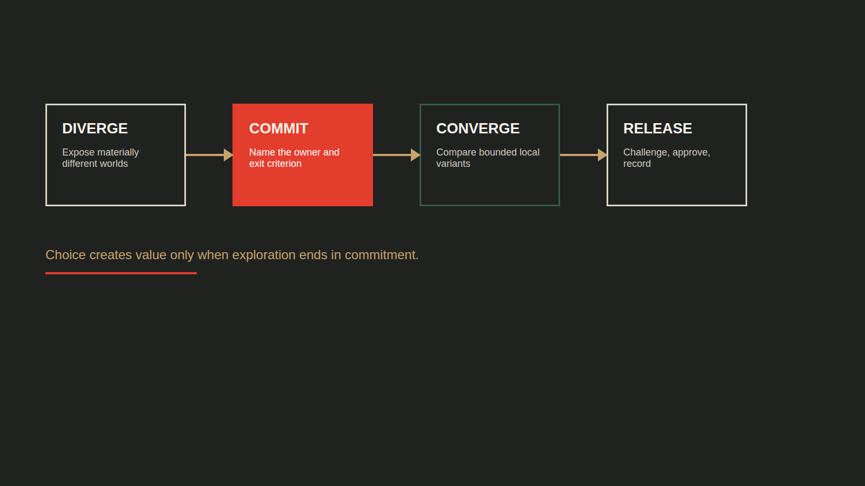
More choice improves taste only when it is structured
Too little choice creates default convergence. Too much unmanaged choice creates decision paralysis.
DECISION VALUE
The feature count is incidental.
The commitment gates create the value.
CONCEPTUAL RELATIONSHIP · NOT MEASURED
ONE DEFAULT
UNSTRUCTURED OPTIONS
WORLDS → COMMIT → VARIANTS
ENDLESS REROLLS
Observed workflow + presenter view · value curve is analyst model
3 / 18
Notes:
The number of available styles is not the value proposition. The value lies in sequencing divergence and convergence so that teams make the large decision before investing in implementation detail.
Transition: The Worlds interface makes that macro decision observable.

Slide 4
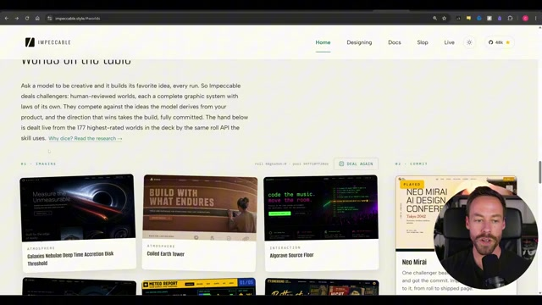
Worlds turns “make it better” into a visible macro decision
Setup: the Pathfinder landing page is shown in materially different visual worlds.
Finding: the user chooses a visual grammar before implementation variants. Action: name the direction owner and record why the world was selected.
Observed demonstration
4 / 18
Notes:
Treat the screenshot as evidence of interaction state, not as the slide’s argument. The management implication is to name a direction owner and record why the selected world fits the audience and task.
Transition: Visible choice still needs gates or it becomes drift.

Slide 5
Four commitment gates prevent exploration from becoming drift
EVIDENCE
WORLD
VARIANT
RELEASE
Is the brief grounded in real content and constraints?
Is the visual grammar appropriate for the audience and task?
Is the baseline strong enough for local refinement?
Has an independent challenge found drift or defects?
OWNER
OWNER
OWNER
OWNER
Design owner
Brand / design lead
Product owner
Reviewer + accountable human
EXIT CRITERION
EXIT CRITERION
EXIT CRITERION
EXIT CRITERION
Explicit yes—or return upstream
Explicit yes—or return upstream
Explicit yes—or return upstream
Explicit yes—or return upstream
Recommended operating model derived from the observed workflow
5 / 18
Notes:
The workflow becomes governable when each exploration stage can explicitly return upstream. A gate without an owner is merely a pause; a gate without an exit criterion is subjective delay.
Transition: This governance burden is the cost of a higher creative ceiling.

Slide 6
Generality raises the ceiling—and shifts risk to the operator
ONE-TRICK STYLE SKILL
IMPECCABLE
Higher floor
Higher ceiling
Predictable novelty Narrow aesthetic range Lower judgment burden
Broad differentiation More operator variance Higher governance need
CONVENTIONAL WORKFLOW WINS WHEN
the surface is highly standardized · evidence is weak · review capacity is limited · the team cannot own directional choices
Presenter-stated trade-off · no controlled benchmark
6 / 18
Notes:
This is the strongest counterargument. A powerful general system should not be the default for every task; its flexibility is valuable only when the organization can govern directional choice.
Transition: Work should therefore be routed by the radius of change, not personal tool preference.

Slide 7
Change altitude determines the correct interface
Route by change radius and confidence in the current direction.
DIRECTION CONFIDENCE
LOW
HIGH
LARGE CHANGE
REFERENCE RESET
TERMINAL
Reopen the visual grammar
Change layout or structure
SMALL CHANGE
STOP POLISHING
LIVE MODE
Clarify the direction first
Compare local variants
Observed macro/micro split · matrix is analyst decision rule
7 / 18
Notes:
This rule prevents a common failure: using faster local iteration to rationalize a fundamentally weak visual grammar.
Transition: Live Mode is valuable precisely because its scope is bounded.

Slide 8
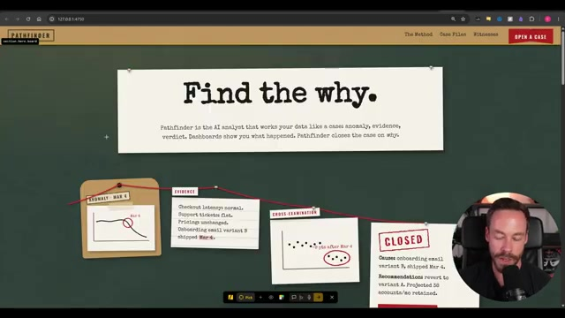
Live Mode shortens local comparison after direction is chosen
Setup: the “Find the why” component is selected and alternatives are generated side by side.
Finding: compare → tune → accept compresses a bounded choice. Action: use Live for detail changes; return structural work to the terminal.
Observed demonstration
8 / 18
Notes:
Use Live when the decision can be stated at component level and the accepted macro direction remains valid. Escalate structural changes instead of accumulating local exceptions.
Transition: When visual grammar itself is wrong, local iteration must give way to a reset.

Slide 9
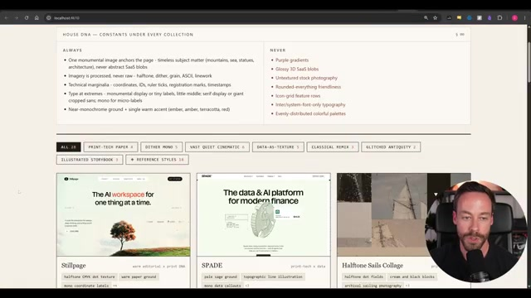
A wrong visual grammar requires a reference reset—not more polish
Setup: an outside reference is introduced after the existing direction remains unsatisfying.
Finding: the reference drives a macro departure through terminal work. Action: log provenance and return to Live only after direction is accepted.
Observed demonstration
9 / 18
Notes:
References are not decoration. They are a controlled reset mechanism and therefore need provenance, usage boundaries, and an explicit statement of what design grammar is being borrowed.
Transition: The workflow now reveals which decisions must remain human-owned.

Slide 10
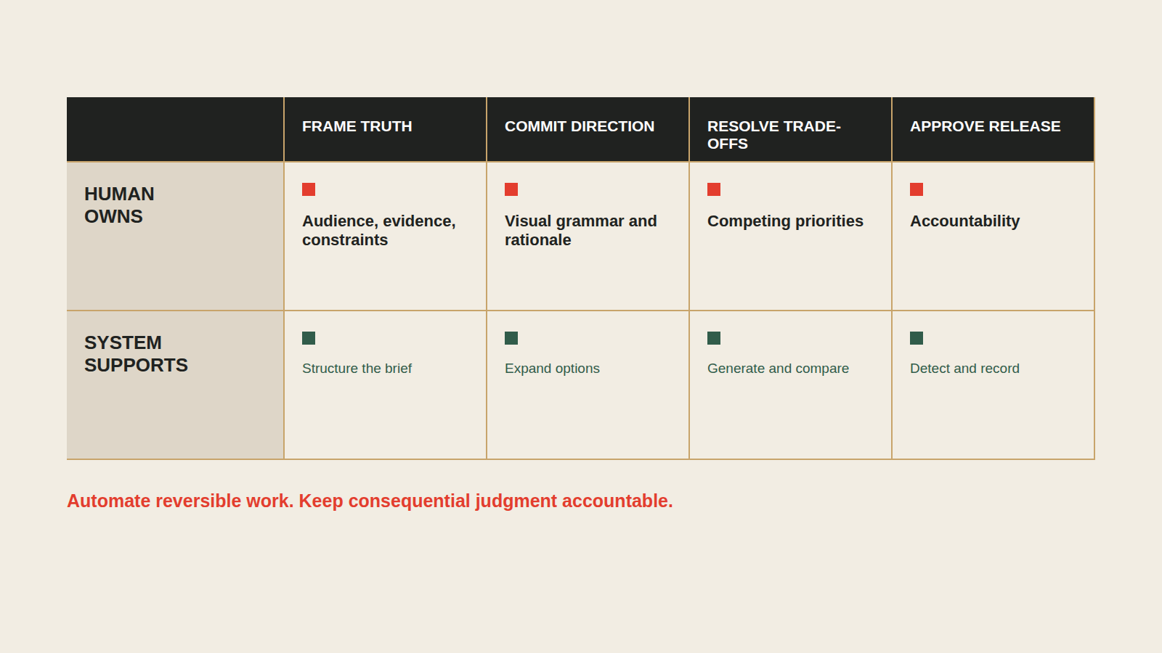
Human judgment belongs at four high-leverage moments
FRAME TRUTH
COMMIT DIRECTION
RESOLVE TRADE-OFFS
APPROVE RELEASE
HUMAN DECIDES
HUMAN DECIDES
HUMAN DECIDES
HUMAN DECIDES
Define audience, evidence, constraints
Choose the visual grammar
Judge variants and escalation
Own the release decision
SYSTEM SUPPORTS
SYSTEM SUPPORTS
SYSTEM SUPPORTS
SYSTEM SUPPORTS
Structure the brief
Expand materially different options
Generate and compare alternatives
Detect patterns and run technical QA
Analyst role model derived from the full walkthrough
10 / 18
Notes:
This allocation is the operating model. It avoids the false choice between manual design and autonomous generation by assigning machines the reversible work and humans the consequential decisions.
Transition: Accepted decisions then become useful only when they constrain future work responsibly.

Slide 11
Taste scales only when decisions become organizational memory
DESIGN.MD
Less reinvention
CHOSEN DECISIONS
→
→
FUTURE CONSTRAINTS
Lower variance
Faster future cycles
↖
↙
DETECTION + OVERRIDES
Risk: stale constraints become a new default. Version the record and permit explicit resets.
Design record and detection observed · flywheel is analyst model
11 / 18
Notes:
Organizational memory is more valuable than any single generated page. Treat the design record as governed policy with authorship, version history, rationale, and expiration—not as permanent truth.
Transition: A fresh-context checker can challenge that memory, but cannot certify the result alone.

Slide 12
Fresh-context review is a challenge control—not proof of quality
MAKER CONTEXT
CHECKER CONTEXT
Knows the brief Knows every compromise Can rationalize its own choices
Challenges known defaults Sees the result without build momentum Still needs human adjudication
→
Keep separate QA for accessibility, factual accuracy, performance, responsive behavior, and user outcomes.
Presenter-described review control · efficacy is unmeasured
12 / 18
Notes:
Position the finish reviewer as a challenge control. Its independence is useful, but the source provides no measured evidence that it catches every defect or predicts user value.
Transition: That boundary places the demonstrated workflow at a specific maturity level.

Slide 13
The demo reaches Level 2—and shows pieces of Level 3
There is no supplied evidence for measured productivity or user outcomes.
RUBRIC · decision gates | change routing | design memory | QA control | measurement
0
1
2
3
4
5
AD HOC
GUIDED
STRUCTURED
CONTROLLED
MEASURED
OUTCOME
One-shot prompt Subjective approval
Worlds and steering Named decision owner
Macro commitment Then local convergence
Design record Detect + independent QA
Time, cost, rework Quality metrics
Usability and business impact validated
DEMONSTRATED
UNPROVEN
Maturity assessment based on the observed workflow
13 / 18
Notes:
This prevents the deck from converting feature sophistication into outcome certainty. Levels four and five are hypotheses to test, not benefits to claim.
Transition: Readiness should therefore be assessed before the pilot is allowed to broaden.

Slide 14
Four readiness gates define when adoption may advance
?
INPUT
Real copy, proof, constraints, approved references
?
DECISION
Named owner for World and variant selection
?
WORKFLOW
Macro/micro routing and stop rules understood
?
GOVERNANCE
Versioned design record, QA, provenance controls
ANY RED GATE → RUN A BOUNDED PILOT. DO NOT SCALE THE WORKFLOW.
Recommended governance framework
14 / 18
Notes:
The gates are intentionally unscored until the client assesses them. Presenting invented green status would defeat the governance standard this deck recommends.
Transition: Once readiness is acceptable, success criteria must be locked before execution.

Slide 15
Success is fewer wrong-direction cycles—without quality regressions
PILOT OUTCOME
Reduce the cost of arriving at an acceptable direction.
EFFICIENCY
REWORK
QUALITY
GOVERNANCE
Time to direction Time to production-ready
Major resets Post-approval changes
Blind brand + usability scores Independent defects
Unsupported claims Reference exceptions
PROPOSED GO / NO-GO · confirm before launch
6+ matched tasks · 2+ operator profiles · ≥20% fewer major resets · quality within 5% of baseline · zero critical accessibility/provenance regressions · cost ≤ baseline +15%
Pilot recommendation · no benchmark data supplied
15 / 18
Notes:
Lock metrics before the first pilot output is seen. Otherwise the demonstration can redefine success around whichever result looks strongest.
Transition: A matched-task design isolates workflow value from novelty and operator enthusiasm.

Slide 16
A fair pilot isolates workflow value from operator enthusiasm
FIXED ACROSS BOTH ARMS
CURRENT PROCESS
IMPECCABLE WORKFLOW
Same landing-page brief
Conventional prompting and review
Worlds → commitment → Live refinement
Same real copy and evidence
Same approved references
Matched task Matched operator profile Blind downstream review
Same task Same operator profile Same blind review
Same model and time budget
Primary endpoint
Major direction resets before acceptance
Controlled evaluation design · thresholds require client confirmation
16 / 18
Notes:
The primary endpoint is major direction resets before acceptance. Secondary measures cover elapsed time, quality, defects, provenance exceptions, and cost.
Transition: The experiment still needs a control for every known failure boundary.

Slide 17
The operating model needs controls at every failure boundary
INPUT
Invented proof
→
Lock real claims and assets before visual exploration
WORLD
Choice paralysis
→
Name a decision owner and cap rerolls
BUILD
Local polish on a wrong direction
→
Escalate by change altitude
MEMORY
Design-system drift
→
Version accepted decisions and explicit resets
RELEASE
Self-confirming review
→
Use fresh-context challenge plus human adjudication
CONTROL PRINCIPLE · automate detection; never automate accountability
Risk-control ledger derived from the demonstrated workflow
17 / 18
Notes:
Governance is part of the product decision, not a compliance appendix. A pilot that omits controls cannot answer whether the workflow is safe to scale.
Transition: The decision can now be reduced to one bounded authorization and three actions.

Slide 18
Adopt the decision architecture—then earn the right to scale
RECOMMENDATION
Run one governed, matched-task pilot.
Approve expansion only if the workflow reduces wrong-direction cycles without degrading accessibility, performance, factual integrity, provenance, or cost.
1
NAME THE OWNER
2
SELECT THE TASK
3
LOCK THE SCORECARD
One accountable lead for direction and release
One bounded landing-page workflow with real evidence
Baseline, thresholds, blind reviewers, stop rules
Decision requested
Authorize pilot design—not enterprise rollout.
Recommendation bounded by the supplied walkthrough's evidence limits
18 / 18
Notes:
Close on the decision requested. The next meeting should review pilot design and readiness, not another showcase output.

